Slide 1
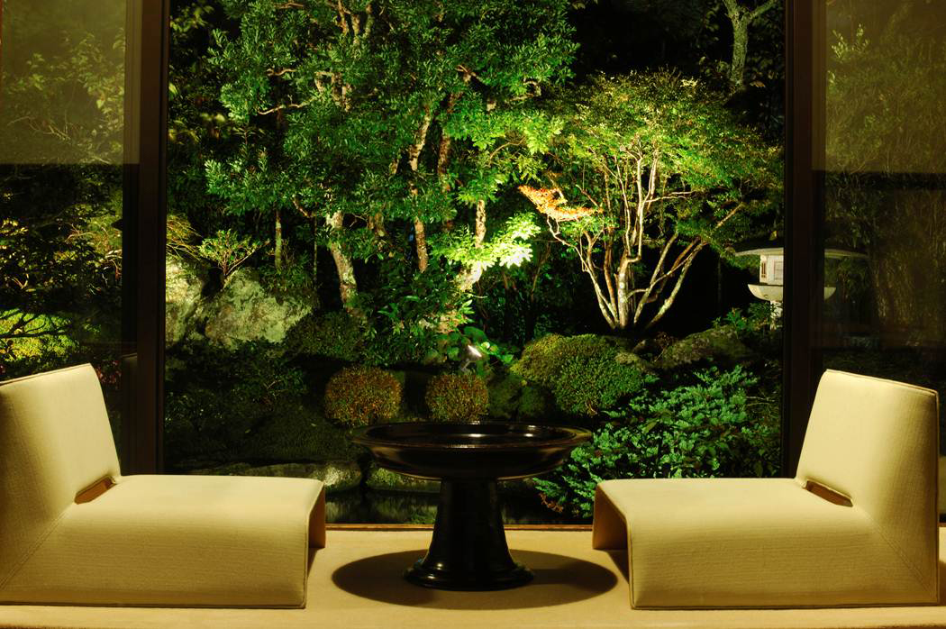

Creating Beautiful Outdoor Spaces
Jason Andrews, Sales Associate

Slide 2
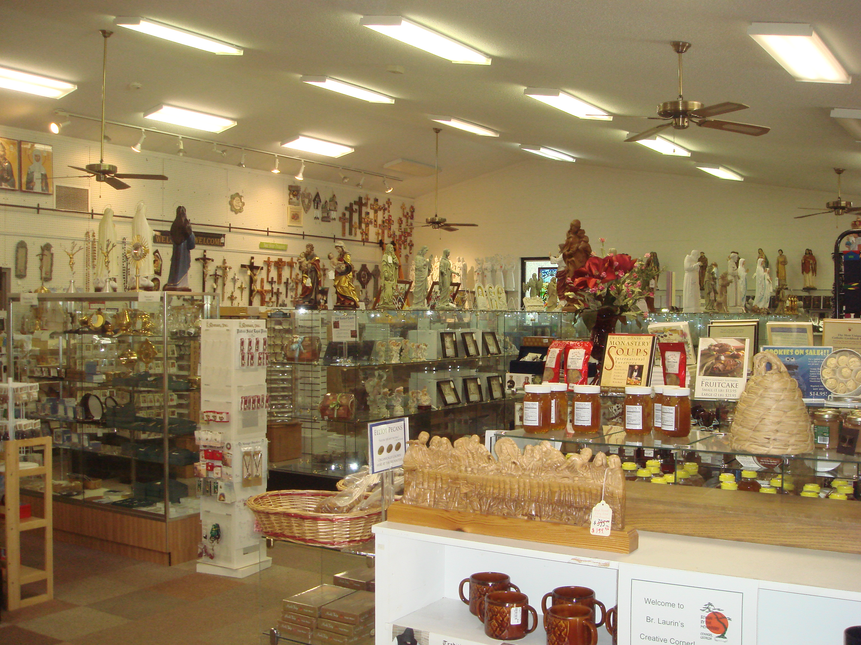
Our Services
Garden center
Tree nursery
Gift Shop
Delivery and installation
Patios and irrigation systems

Slide 3
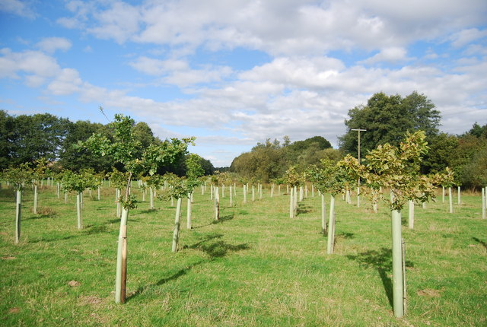
Available Products
Shrub, perennials, annuals
Soils and mulches
Garden décor including fountains
Shade trees and evergreen screening trees
Flowering or ornamental trees
Trees and plants for Christmas

Slide 4
We Make IT Easy
We can do the entire project or we can assist
  You can do as much, or as little, as you like
We Will provide:
  Landscape design planning or just advice
  Soil testing
  Low-cost delivery
  Fountain set up

Slide 5
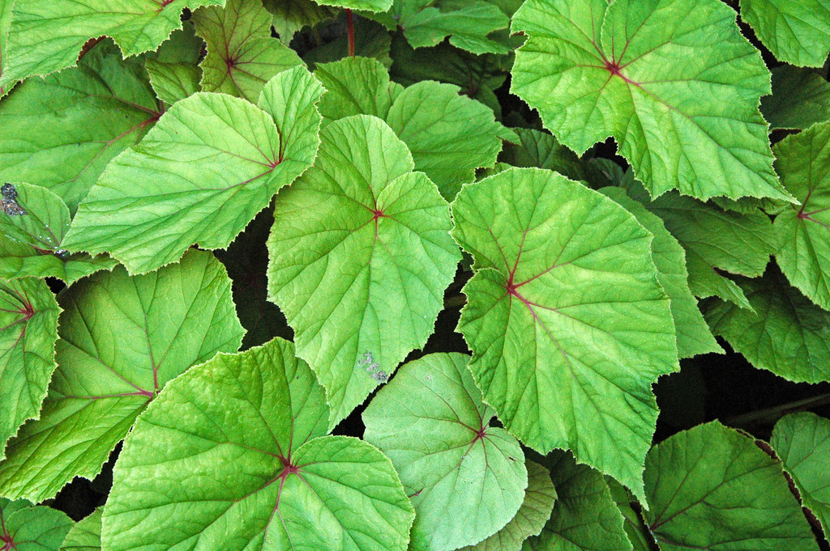
Why Sustainable Design
Energy efficiency increased
Water efficiency increased
Dependency on chemicals decreased
Vigor assured through native and hardy plants

Slide 6
Call for a Consultation
615-792-8833

