Slide 1
HIPAA PRESENTATION
Tanya Hart
HCAS129-Electronic Health Records
14, March 2021

Slide 2
Introduction
Health
Insurance
Portability and
Accountability
Act
Created in 1996
Guards a patients personal health information (PHI)
Promotes the use of medical savings accounts
Combats waste, fraud, and abuse
HIPAA CONCERNS: Privacy and Security Issues Regarding
Health status of an individual
Healthcare provided to an individual
Payment of healthcare provider

Slide 3

Privacy and Security Issues
EHR Electronic Health Records
Accessing patient electronic health records without patient’s consent
ROI Release Of Information
Patient’s private healthcare information was released without proper authorization

Slide 4
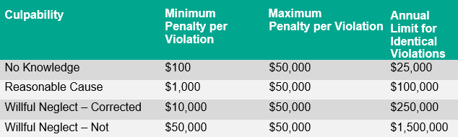
Legal Consequences and Risks

Slide 5

Preventative Measures
Educate-Continuing education on HIPAA regulations and new information that becomes available
Train- Proper personnel training and refresher courses on HIPAA regulations and information
Prevent- Proper handling of patient information , storage and disposal

Slide 6
Scenarios
Proper Way to Release Information
Signature for release of information document
ID showing information is being released to the proper entity
Documentation received in proper format from patient or patient advocate.
Improper Way to Release Information
No signature on release forms
Improper ID shown/ no ID
Documents being handed over based on friendship or word of mouth

Slide 7
References
https://www.hhs.gov/hipaa/for-professionals/compliance-enforcement/examples/index.html
https://www.google.com/search?q=hipaa+violation&client=firefox-b-1-d&source=lnms&tbm=isch&biw=1284&bih=733#imgrc=aUOarRjoOSTTIM&imgdii=WmCc180v-MHyWM

