Slide 1



Nigerian Culture
By: LaWanda Webb
September 17,2021

Slide 2
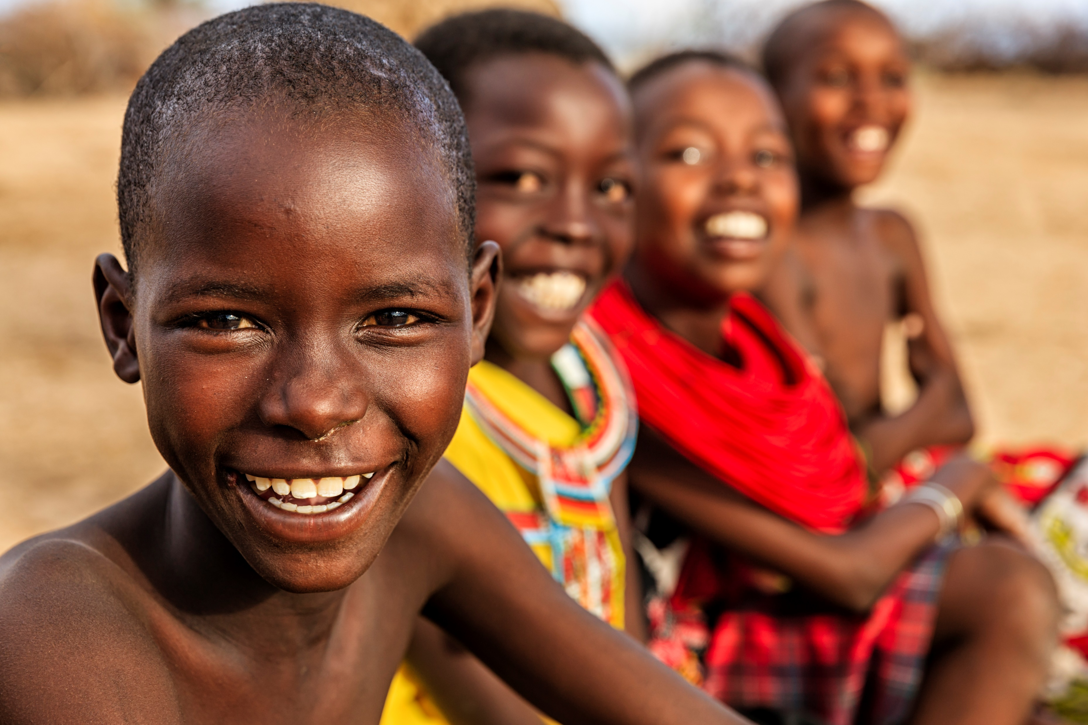


Slide 3
Nigerians are known for many different languages and unique culture. Nigeria makes up 250 different ethnic groups and over 300 hundred tribes. These ethnic groups speak up to 500 different languages and in Nigeria individuals can become part of more than one ethnic group. Food is an essence of the Nigerian culture, but also music and dance play a key role as well.
The Nigerian culture is really important in the daily lives of their people. Culture is what makes a person and helps to bring people together. The Nigerian culture values respect, courage, self reliance, and chastity among women. “The population of Nigeria contributes to 1/8 of the African continent being the most populated black nation in the world” ( Mgbuoba, 2017).

Slide 4

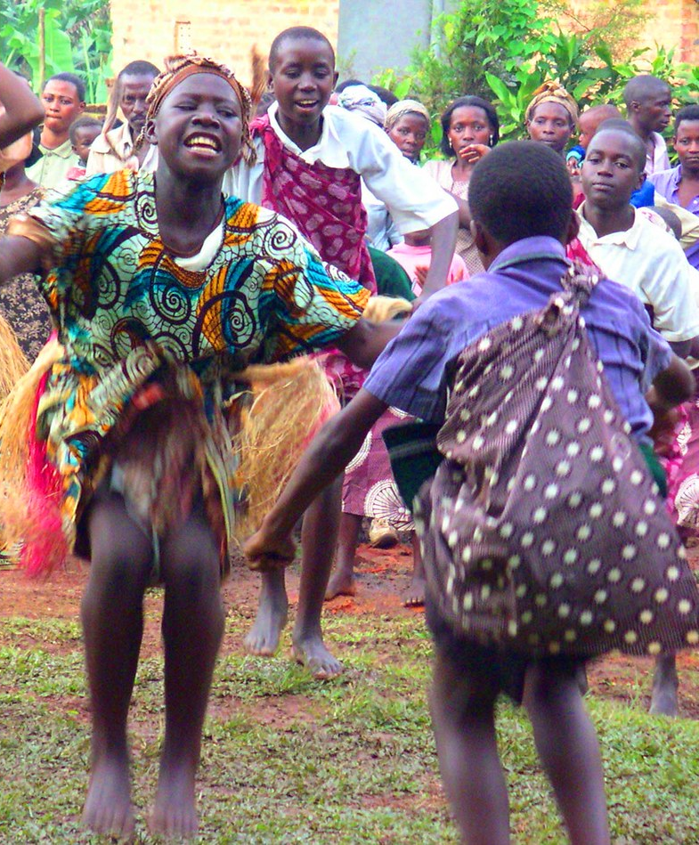
The primary source of my presentation “Importance of Culture in Nigeria” has been informative teaching me the tricks and trades of the Nigerian culture. Nigeria is heavily populated and has a rich cultural heritage.” Nigeria is almost twice the size of California and who knew child marriage is a very common practice in Nigeria, however, the culture of Nigeria is shaped by Hausa-Fulani are the most populated ethnic group in the country’s northern part (Owhonda, 2017).” Even thought the official language of Nigeria is English and it’s used for education purposes, the major native language spoken represents three Nigerian families.
Nigerians are very proud of their country, being well educated and having many natural resources on hand.” Nigeria is a hierarchical society meaning age and position earns respect and they are greeted first” (Davids, 2020). Nigerians are generally friendly and outgoing and use gestures when communicating. Nigeria’s most diverse feature is the people and their many diverse expressions.
This Photo by Unknown Author is licensed under CC BY

Slide 5

Synthesis of Research
The findings from my primary sources supports the findings in my two secondary sources being that they both illustrate the culture of Nigeria. My secondary sources also pursued the facts that Nigeria is so rich in cultural heritage and heavily populated, the largest black nation in the world. Nigerians are proud of their country and it’s a huge part of their culture. Nigerian beliefs, traditions, ethnicity, religion, values, and communication has helped me gained so much knowledge and insight on their characteristics and customs.

Slide 6
Multicultural Awareness
Reflecting on my findings or researching the culture of Nigeria and how it influences my future career or life in general helps me to pursue my interests, learn something new, and challenge myself in new ways. Researching Nigerian culture has taught me to develop certain skills I cannot learn in the classroom; however, it has enhanced my intellectual growth as a person and realize everyone has cultural differences. Personally, I feel this research will aid me in my critical thinking, reality, and knowledge I can apply to everyday life whether in the workplace or personal.
My research has impacted my choices and life decisions because it promotes exercise for the mind and help in making confident decisions. The main point of research is to gather information, develop understanding of that particular topic, and help me succeed in my professional growth. Knowing what I now know and the importance, of research in understanding issues, supporting ideas, and increasing public awareness, it will definitely guide me in future endeavors.

Slide 7
References
Dumbili, E. (2010). Nigeria.Petaluma, California: Worde Trade Press. Society and Culture. https://www.BestCountyReports.com
Davids, C. (2020). The Cultral Uniqueness of Nigeria: What Makes Us Who We Are. Destinali. https://www.destinali.com
Ikande, M. (2017). Importance of Culture in Nigeria. Legit Contribute.
Mgbuoba, P. (2018). Facts about Nigeria. Nigerian People/Lifestyle https://www.total-facts-about-nigeria.com
Okoroafor, C. (2017). 10 Traditions Only Nigerians Can Understand. Culture Trip.
Owhonda, J. (1997). Nigeria: A Nation of Many Peoples ( Discovering Our Hertiage). Dallas,TX: Silver Burdett Press.

