Slide 1

COMPETING HOSPITAL BUSINESS, SET-UP, AND PATIENT POPULATION
JOI FORD
HTHS230

Slide 2


ASCENSION SE WISCONSIN –ST. JOSEPH CAMPUS
Nonprofit Catholic Faith Based | Primary Care Specialty Care Heart And Vascular Orthopedics Women’s Health Maternity Stroke Care Imaging/ Laboratory Emergency Hospital/ Medical Center Pharmacy | Client Focus All People Persons Living In Poverty Vulnerable Community

Slide 3
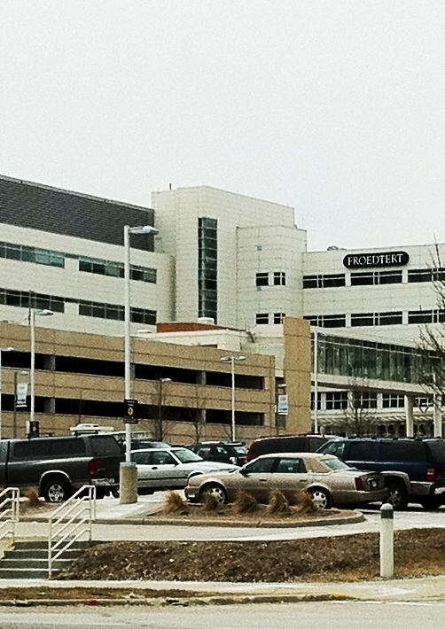
FROEDTERT AND MEDICAL COLLEGE OF WISCONSIN
Nonprofit LUTHERAN FAITH BASED ADULT TEACHING HOSPITAL | • Cancer • Communication Disorders • Ear, Nose, Throat • Emergency • Fertility and Reproductive Medicine • Diabetes and Endocrinology • Digestive and Gastroenterology • Heart and Vascular • Musculoskeletal • Neurosciences and Stroke • Orthopedic, Sports and Spine • Plastic and Reconstructive Surgery • Pregnancy and Birth • Primary Care • Sleep Disorders • Transplant • Urology • Vision Services • Weight Management and Bariatrics | COMMUNITY SOUTH-EAST WISCONSIN 5 HOSPITALS /2 COMMUNITY HOSPITALS COMMITED TO SERVE UNDERPRIVILEDGE COMMUNITIES DRAWS PATIENTS IN MIDWEST
This Photo by Unknown Author is licensed under CC BY-SA

Slide 4
LEGAL AND REGULATIONAL BOUNDARIES THAT THESE TWO HOSPITALS MAY EXPERIENCE DUE TO THE TYPE OF BUSINESS STRUCTURE
(4m) NONPROFIT HOSPITALS. (a) Real property owned and used and personal property used exclusively for the purposes of any hospital of 10 beds or more devoted primarily to the diagnosis, treatment or care of the sick, injured, or disabled.... This exemption does not apply to property used ... as a doctor's office.
  SATELLITE HOSPITALS ARE CONSIDERED AS DOCTOR’S OFFICES
  SPACE UTILIZATION
  OUTPATIENT SERVICES
  FACILITY AND HOSPITAL BILLING STATEMENTS
  HOURS OF OPERATION
  EQUIPMENT OWNERSHIP

Slide 5
Employee Sponsored Plans
Managed Care Plans
Medicare and Medicaid
Private Insurance
Self pay options for uninsured and underinsured patients.
Reimbursement Models

Slide 6


Legal and Regulatory Concern for Reimbursement
Balanced billing can limit a specific reimbursement model.
  Geography
  Sociological
  Funding
This Photo by Unknown Author is licensed under CC BY-NC-ND
This Photo by Unknown Author is licensed under CC BY-SA

Slide 7
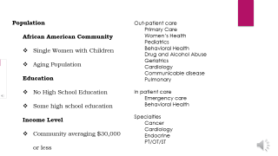
Population
  African American Community
  Single Women with Children
  Aging Population
  Education
  No High School Education
  Some high school education
  Income Level
  Community averaging $30,000
  or less
Out-patient care
Primary Care
Women’s Health
Pediatrics
Behavioral Health
Drug and Alcohol Abuse
Geriatrics
Cardiology
Communicable disease
Pulmonary
In patient care
Emergency care
Behavioral Health
Specialties
Cancer
Cardiology
Endocrine
PT/OT/ST

Slide 8
Regulatory & Financial Perspective
Compliance with federal, state, local government.
Identify departments that are struggling and provide intervention.
Reduce fraud, waste, abuse, and malpractice and subsequent liabilities such as fines and lawsuits.
Receive monetary incentive from government for meaningful use of EHR system.
Curve healthcare spending.
Expands Access to Health care.
Reduce risks that promote healthcare access the community.
Adopting EHR system that promotes compliance through a uniform workflow system.
GAAP program that promotes financial responsibility by reporting income, depreciation of equipment, and reimbursement.

Slide 9

Financial standpoint
Timely collection of payments
Requesting copays and out-of-pocket expenses AT THE TIME OF SERVICE
Repetition of when costs are due.
How much time is needed to pay outstanding balance?
Charity Services
Necessary services that are delivered for uninsured patients undergo thorough procedures finding the patient and or family inability to pay.
Contract with charity programs that fund treatment for specific diseases.
Engaging in department practices to ensure accurate billing and operations that align with company.
Careful utilization of resources.
Staffing, equipment, and supplies.
Following a uniform workflow with minimum deviation.
Proper charting of records, triaging visits and directing care from admission to discharge.
Prevent costly errors and unnecessary procedures and duplication of services.
Promotes access to healthcare so that the hospital can meet bottom line expenses and continue to serve the community effectively with the specialties to target community needs.

Slide 10
Leverage Over the Competition
BEHAVIOR HEALTH
INPATIENT CLINIC
100 BEDS
VOLUNTARY AND INVOLUNTARY MENTAL HEALTH ASSESSMENT
ALCOHOL AND DRUG ABUSE DETOX.
TREATMENT /STABILIZATION
WORKS WITH LAW ENFORCEMENT AGENCIES
SHORT TERM STAYS WITH GOALS TO RETURN INDIVIDUALS TO THE COMMUNITY WITH SUPPORT AND PLAN TO AVOID RECURRENT ADMISSION
OUT-PATIENT CLINIC
CHILDREN/ADULT CLINIC
MULTIDISCIPLINARY THERAPY
*GROUP *INDIVIDUAL
*FAMILY *MEDICATION
Women’s Health
FAMILY PLANNING SERVICES
OB/GYN/LABOR AND DELIVERY/NEONATAL CARE
POSTPARTUM
STI CLINIC
PREVENTION/ TREATMENT
NUTRITIONAL SUPPORT
PSYCOSOCIAL SUPPORT
SOCIAL WORK
FOLLOW UP CALLS AND VISITS TO SUPPORT THE FAMILY IN THE HOME.
DIABETES CLINIC
DIAGNOSING, MONITORING, TREATMENT OPTIONS
GESTATIONAL DIABETES
TREATMENT
GOAL SETTING AND RESOLVING
MEDICATION MANAGEMANT
NUTRIONAL MANAGEMENT
PREVENTION OF COMPLICATION OF DISEASE
PYSCHOSOCIAL
ADAPTATION AND MODIFICATION

Slide 11
Barriers
Reimbursement
Patients on payment plans.
Multiple payment plans.
Patients facing hardships in an under privileged community
Solutions
Collection strategies that consists of constant communication by phone, letters and statements.
Updated monitoring accounts that allow patients access to view and pay accounts online.
Policies that hold physicians and patients accountable for payment of services and writes offs approved at the high-level authority for needed services only with practices that prove a patient’s inability to pay for services.
Working with the individuals to set up feasible payment arrangements for services insurance will not pay for prior to rendering services for wanted services.
GOAL
Expanding access to health care. Targeting the community immediate needs, improve health outcomes, following up on delivery of care, empowering individuals to participate in health care goals. Improving conditions and behaviors that do not promote overall wellness.
Teaching/Training/Preventative and Social Work sets us apart from other hospitals.
Curving health care costs, by practicing procedures that improve healthcare outcomes and keep patients from readmission for the same health occurrence.

Slide 12
Final Thoughts
Milwaukee presents many opportunity for an up-and-coming hospital that the community may benefit from, however there are many strategies that competing hospitals are using that will be difficult to compete with.
Ascension and Froedtert have developed several satellite clinics that provide specialty programs.
Expanding urgent care facilities near the community where emergency care was limited.
City has banded together to target our main approach in attacking behavioral health care.
I recommend that we do not proceed in construction of this hospital, research other geographical location where there is limited healthcare such as the south-east region in the area between Kenosha and Racine area where the demographics and demand align with our organizations approach to health care.

Slide 13
References
Ascension. (2021, 03 22). Retrieved from Ascension: https://healthcare.ascension.org/Locations/Wisconsin/WIWHE/Milwaukee-Ascension-S E-Wisconsin-Hospital-St-Joseph-Campus
Auerbach, M. (2019). Public Health Service Industry. Salem Press Encyclopedia, 11.
David J. Edquist, A. S. (2019, DECEMBER 6). 2020 Vision: Protecting Your Hospital's Tax-Exempt Status. Retrieved from National Law Review: https://www.natlawreview.com/article/2020-vision-protecting-your-hospital-s-tax-exempt-status
Erika L. Crable, D. B.-L. (2020, 03 11). Barriers and facilitators to implementing priority inpatient initiatives in the safety net setting. Retrieved from Implementation Science Communications: https://implementationsciencecomms.biomedcentral.com/articles/10.1186/s43058-020-00024-6
Froedtert & the Medical College of Wisconsin. (2021, 03 22). 2020 Report to the Community. Retrieved from Froedtert & the Medical College of Wisconsin: https://www.froedtert.com/sites/default/files/upload/docs/about/report-to-the-community.pdf
Kevin Lucia, J. H. (2017, June). Balance Billing by Health Care Providers: Assessing Consumer Protections Across States. Retrieved from Commonwealthfund: https://www.commonwealthfund.org/sites/default/files/documents/___media_files_publications_issue_brief_2017_jun_lucia_bala nce_billing_ib.pdf

