Slide 1
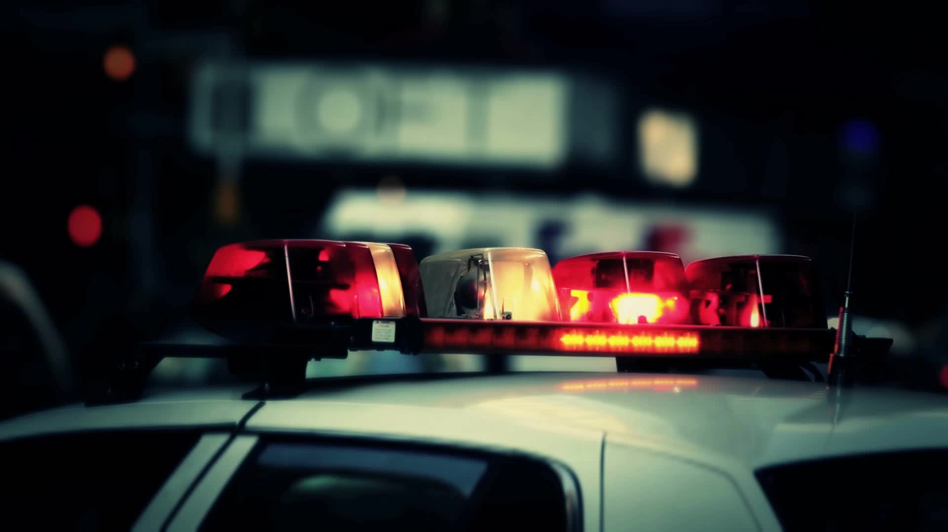
Law Enforcement Body Cams
CRJU145- Justice Information Systems
Heather Elliott

Slide 2
Introduction
Body Cams
Body Cams Continued
Advantages with having body cams
Advantages Continued
Disadvantages with having body cams
Disadvantages Continued
Ethical Issues
Ethical Issues Continued
Conclusion
References

Slide 3



Body Cams
One-third of U.S. police departments started using cams in 2013
Other departments that utilize cams include
  Aircraft Rescue and Firefighting
  Firefighting
  Inmate Transportation
  EMS (ambulance personnel)

Slide 4
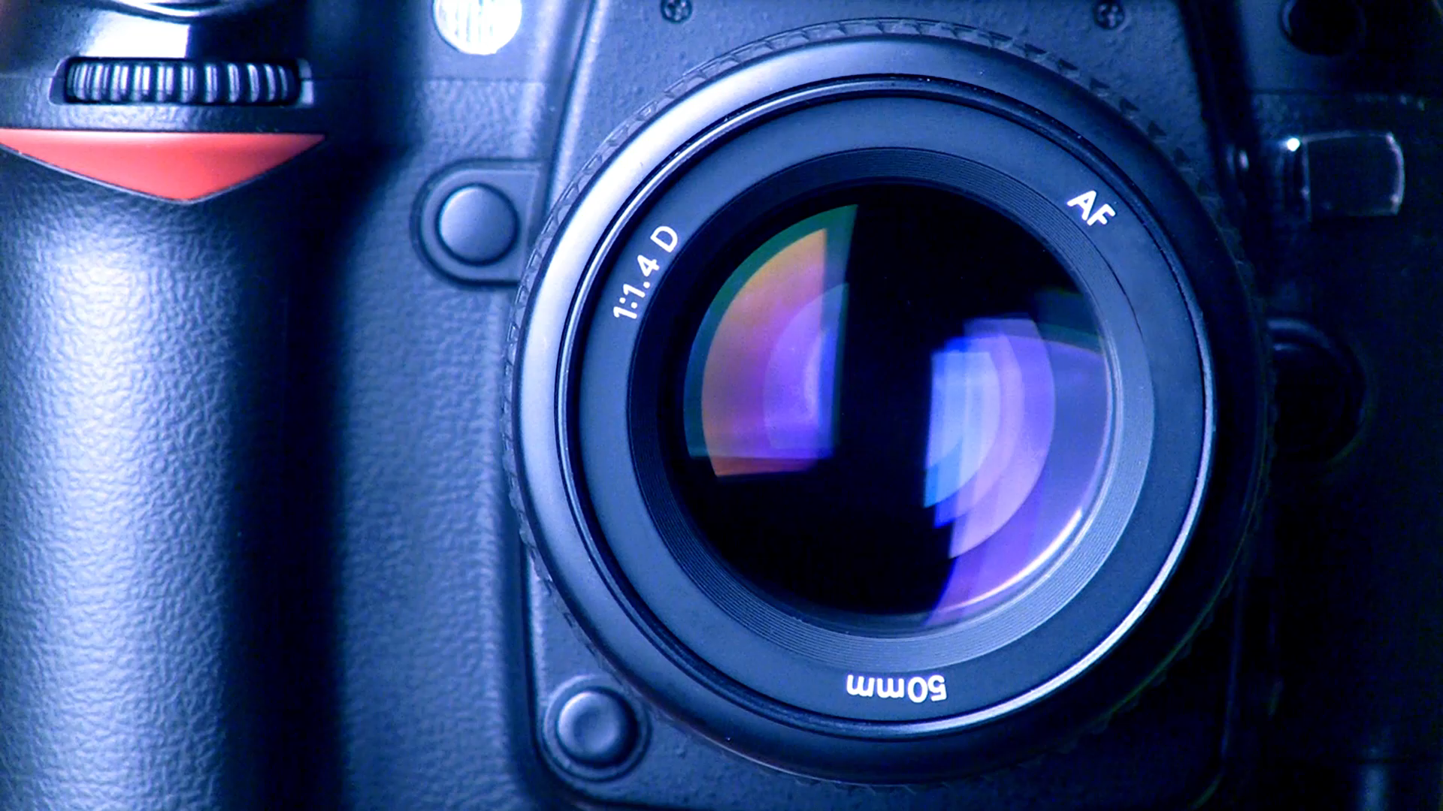
Body Cams Continued…
This can prevent criminals to get away with more due to the addition evidence
Evidence from video footage can help in identifying a suspect as well as maintain an officer’s recollection
Can be used for training exercises

Slide 5

Advantages with having body cams
Can accurately depict encounters/ incidents
Who, what, where, when why can be answered with footage captured
Increase transparency
An abundantly positive change statistically

Slide 6
Advantages Continued…
Lowering complaints against officers
A decrease in the use of force

Slide 7

Disadvantages with having body cams
Officers can turn the cameras off
The cameras can fall off during a struggle with a suspect
The batteries can die
The footage can be tampered with

Slide 8
Disadvantages Continued…
Negative reactions from public awareness of data collection
Data can be used to expose officers or civilians to
  Humiliation
  Blackmail
  Retaliation

Slide 9

Ethical Issues
Withholding video footage
Doctoring and deleting captured images/ footage
Leakage to the press or civilian entities
Privacy issues for both police and citizens can be invaded
An advantage to utilizing this technology can protect from false accusations
Ramification for misuse of cams

Slide 10
Ethical Issues Continued…
When will the recording begin?
What conditions will start or stop the recording?
Where and for how long will the data recorded be stored?

Slide 11

Conclusion
Having video footage of any sort of police activity when it comes to being involved with the public is a good thing but not only is it to protect officers but citizens as well.

Slide 12

References
Pasternack, A. (2017). THE BIG BUSINESS OF BODY CAMS. Fast Company, (217), 58-61.
Pagliarella, C. (2016). Police Body-Worn Camera Footage: A Question of Access. Yale Law & Policy Review, 34(2), 533-543.
https://www.pbs.org/newshour/politics/body-cameras-are-seen-as-key-to-police-reform-but-do-they-increase-accountability

