Slide 1

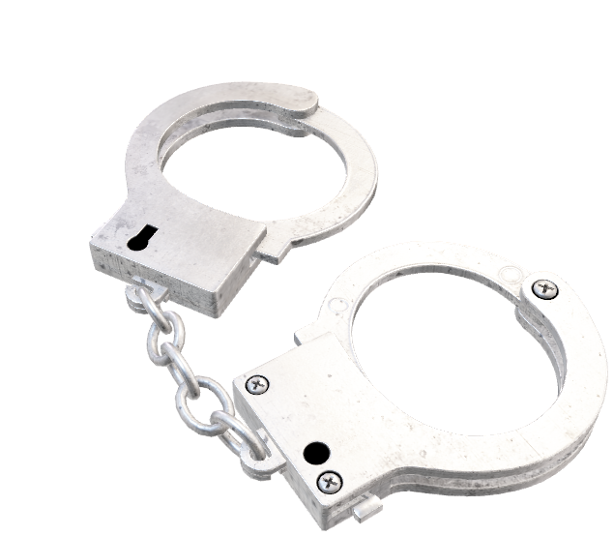
Inter-Con Industries Security Management
CRJU135- Security in the 21st Century

Slide 2

History and Evolution of Private Sector Security
Started with the merchant’s guild paying for men to patrol and guard their warehouses and merchandise they had
Private security has evolved from an untrained rough band to highly trained individuals with specialties in recovering property or doing night watching

Slide 3


History and Evolution of Public Sector Security
In 1214 A.D. English King John approved the Magna Carta, even though it only meant for high class such as barons
In the Middle Ages public policing consisted of clearing the road for bandits on a regular basis and keeping higher class citizens safe
In the 1700’s using tax money to pay for policing
Henry Fielding proposed that policing should be permanent and paid for with tax revenue

Slide 4
Similarities Between Public and Private Sector Security and How They Relate To Crime Control and Administration of Justice In The 21st Century
Both wear uniforms
The hiring process take in both men and women
Duties and goals are to prevent crime and disorder, identify criminals, and ensure the security of people and property
Both carry weapons
Public police have authority to enforce laws and protect and serve society, whereas private sector protect property and personnel

Slide 5




Differences Between Public and Private Sector Security and How They Relate To Crime Control and Administration of Justice In The 21st Century
Public:
Are a government service
Must go through due process to confirm illegal activities
Needs more thorough education
Private:
All for profit
Is not authorized to us force or make arrest
Allowed to detain you for any reason

Slide 6
Managing Risk Conditions and Loss Prevention: Private Sector
Are hired to ensure there is no lost merchandise destruction of property or any accidents that could be costly to their client
Does not focus on criminal law, instead, their objective is to follow the instructions of their clients
Rely on surveillance, due to the fact they are for profit
Has more access to technology than public police
Are hired to prevent business activities being disrupted

Slide 7
Managing Risk Conditions and Loss Prevention: Public Sector
Public police are mainly used as a deterrent to prevent crime from happening
Public police are in the public eye and held to a higher scrutiny
Public officers are sworn in and must follow protocols and uphold the constitution and what it stands for
Public sector is paid with tax revenue and must relay on grants as well as any other available revenue to help them be successful at their job
Public police are to prevent crime, find people who break the law, and enforce the law
Even though they are limited to entrapments and Miranda regulations

Slide 8
Code of Ethics – Private Sector
Requirement for individuals to sign an agreement
Ethics code focus on values and principles
Conduct code focus on behaviors

Slide 9

Code of Ethics – Public Sector
Are sworn to uphold constitution, rights of public, and their safety
Public officers are believed to have similar values and beliefs that are shared amongst them
In public policing, they are under scrutiny of the media and all public eyes
Any issues with ethics are under constant surveillance by the public currently
Public sector share identical sentiments which lead to a profound effect on officers due to professionalism that must be utilized when dealing with the public

Slide 10

Conclusion
Both public and private sector security is needed for multiple reasons. While most are utilized in preventing crime form being committed, they are both needed. With the private sector outnumbering the public sector in almost a 3 to 1 ratio, anytime they can work together they should. Considering that both types of security, weather public or private, are young and need to be nurtured. They are used to help keep the people safe.

Slide 11

References
https://psisecurityservice.com/ethics-professional-conduct-of-security-guards/
https://rise.articulate.com/share/rpucY8U1aiMWCErw4J27ZVrpgxX9HRLZ#/lessons/lOORuPvINa9kWz0VtS8H-ChS20ajHSSv
https://rise.articulate.com/share/rr1JDCDaC5U-jTvk9BMrhDt7O1wo8Jzb#/lessons/3zpu1zNBh-nEt26Xthr08jMdOJeH6ngX

