Slide 1
Portfolio project
Kaitlynn Cross

Slide 2
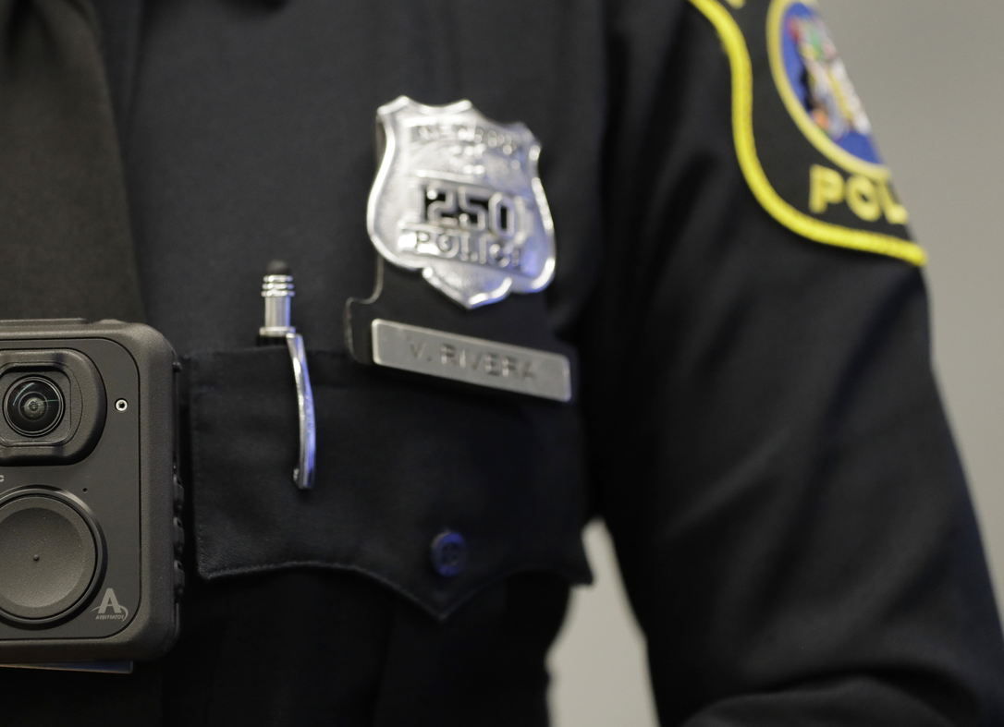
Law enforcement
Body cameras

Slide 3
are body cameras necessary?
Is there a need for them?
Yes, body cameras should be utilized in all police departments.
Body cameras are used as an accountability and transparency tool in law enforcement. Body cameras help law enforcement officers cure the public peoples lack of trust in them by providing proof of necessary force or unnecessary force. It acts as a back up or an electronic partner for officers.

Slide 4
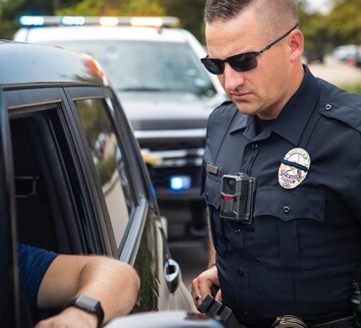
Body camera Advantages
. Increase public trust
. Improves officer safety
. Improves police accountability
. Lowers reports of police misconduct
. Promotes transparency and openness
. Used as an impartial eyewitness
. Aides in evidence collection
. Improve officer training and development
. Helps identify and correct problems

Slide 5
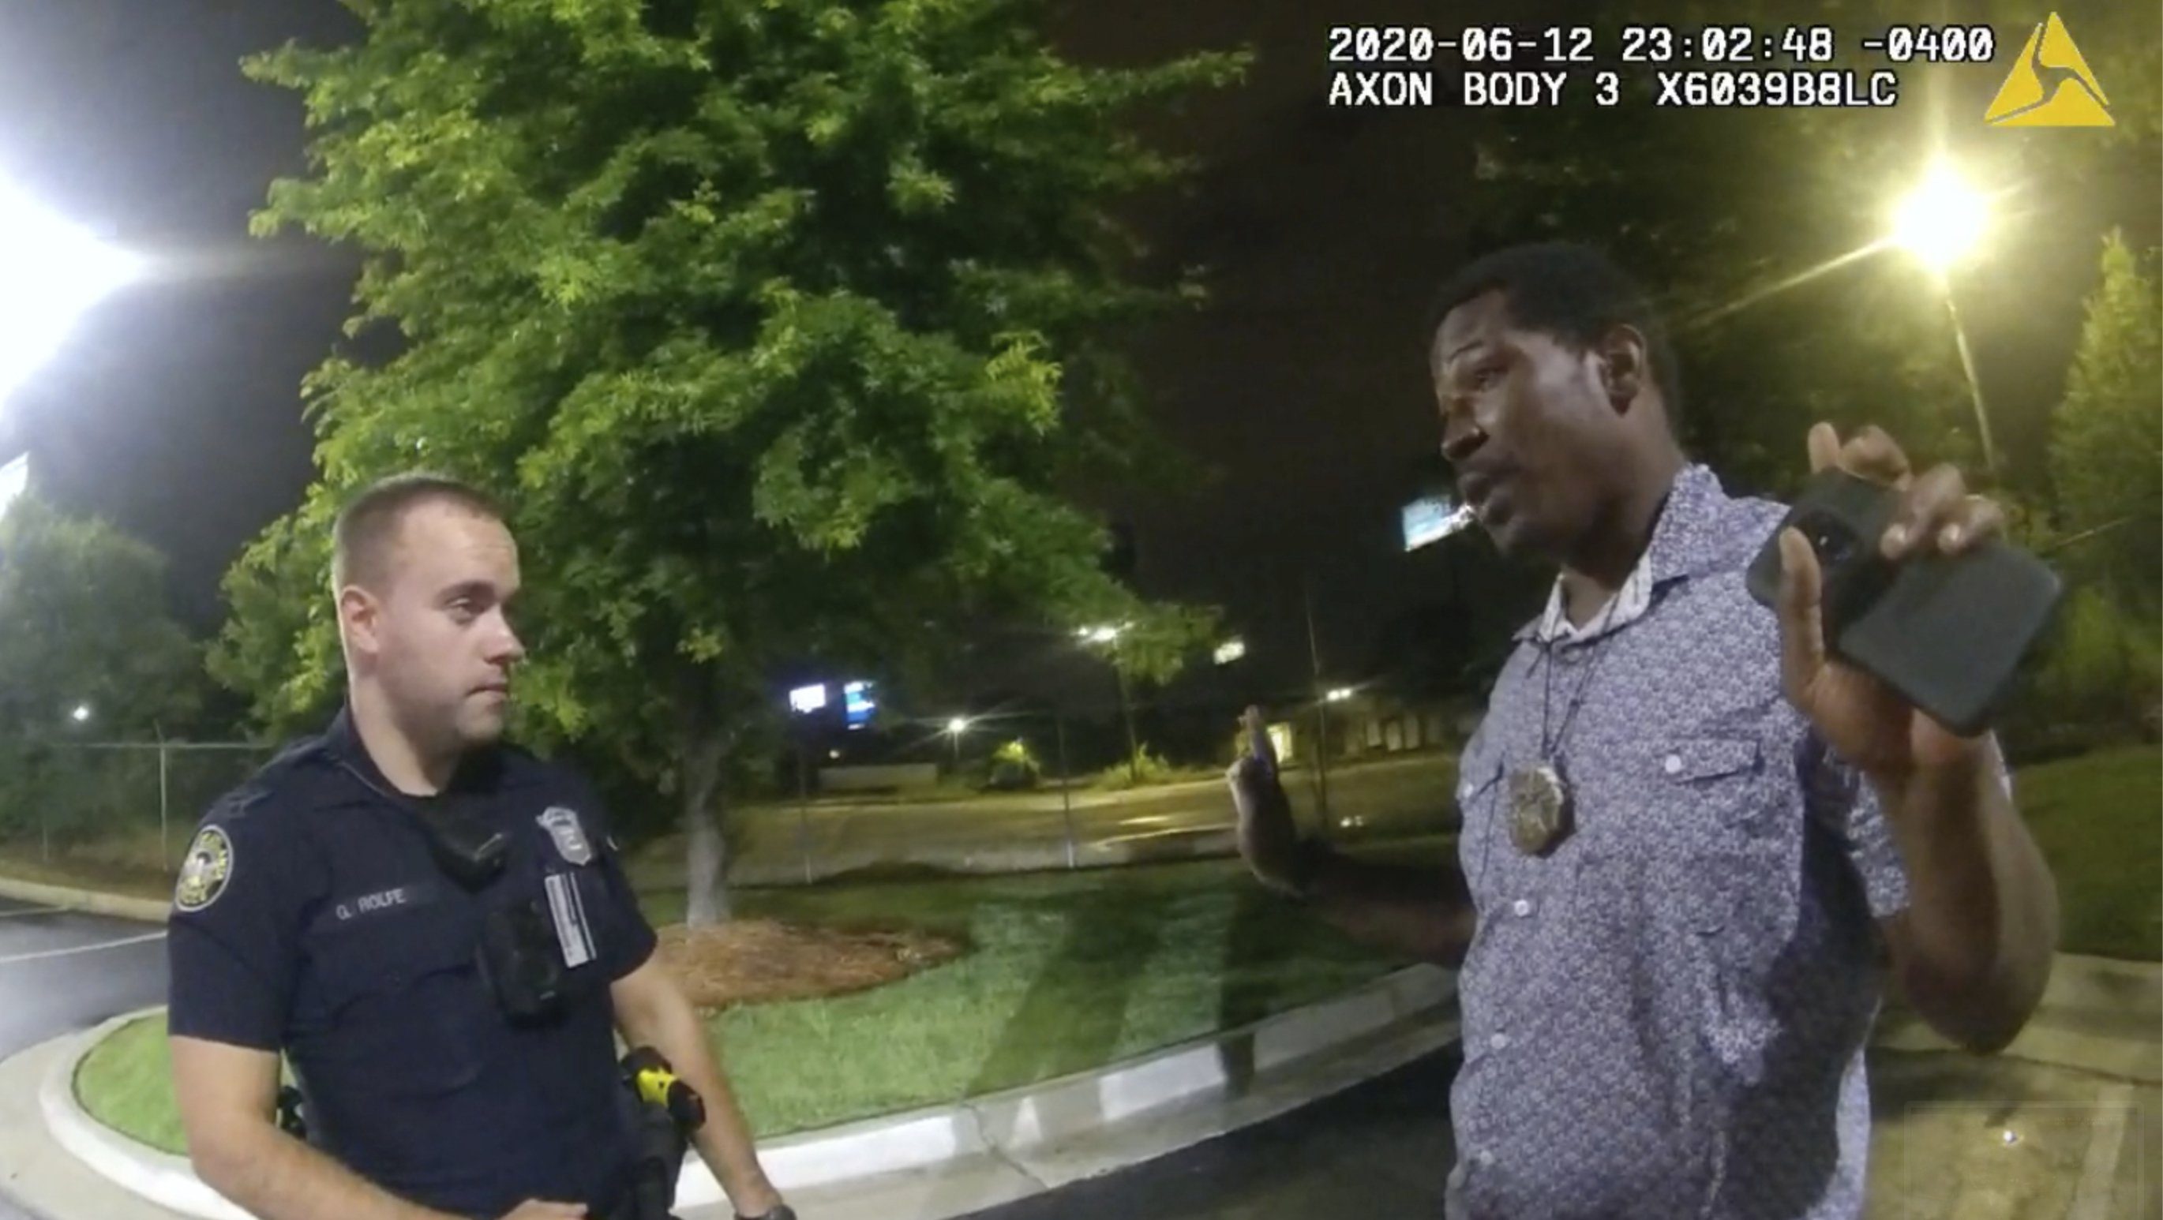
Body camera disadvantages
. Expensive
. Invades citizens privacy
. Invades officers privacy
. Can cause public misconceptions
. Only works when officers use it properly
. Adds a need for additional officer training
. Leads to data storage issues

Slide 6
Ethical issues associated with body cameras
Privacy concerns is one of the biggest ethical issues associated with body cameras.
. If the body camera cannot be turned off it can capture private conversations of anyone who is around the camera
. Captures confidential conversations of civilians telling police where criminals are located
. Captures footage of civilians going about their daily lives as officers move about them without them knowing it
. Captures officers using the bathroom, eating lunch, or their private and personal cell phone conversations

Slide 7
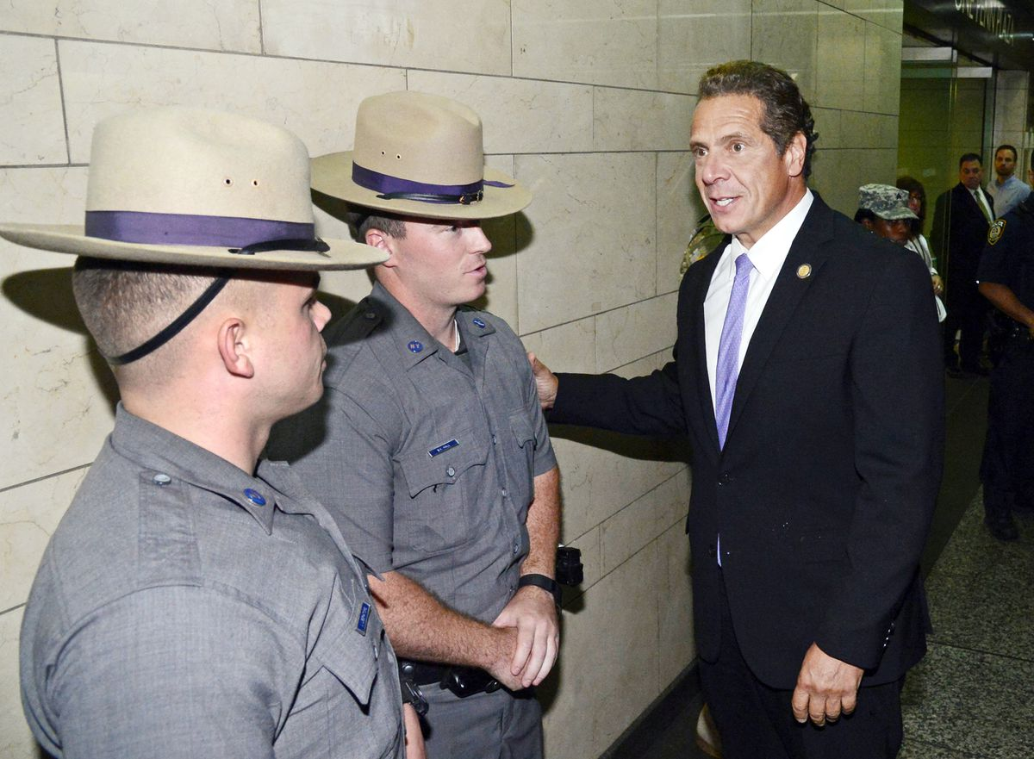
Body camera standards and rules for new York
. Record immediately after exiting a patrol car for any officer to civilian contact
This includes any use of force, all arrests and summonses, and all interactions with individuals suspected of criminal activity as well as all searches of persons and property, any call to a crime in progress, investigative actions involving members of the public, any interactions with an emotionally disturbed person, and any instances where an officer feels any imminent danger or the need to document their time on duty.
. Law enforcement is required to keep video recordings of the above interactions

Slide 8
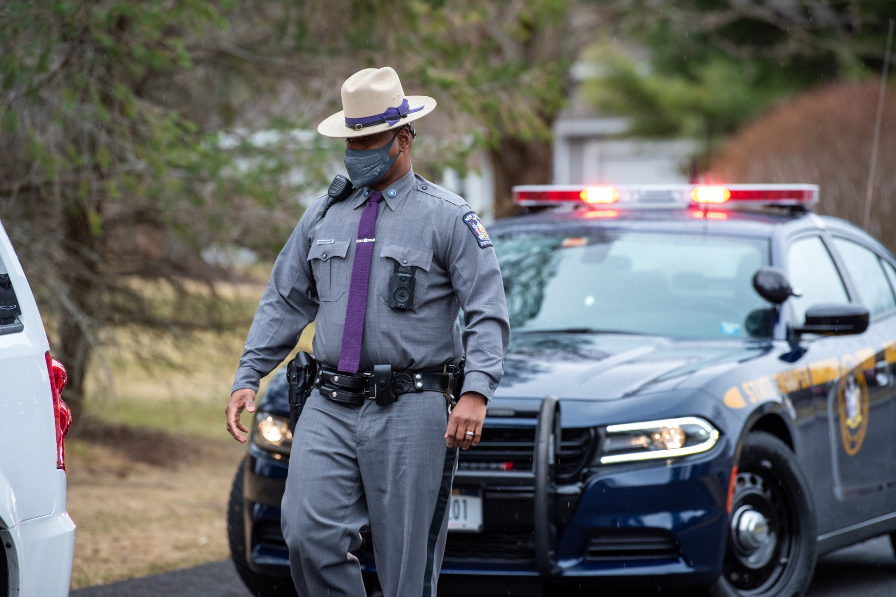
Body camera conclusion
The use of body worn cameras in law enforcement has both its positive and negative affects and will continue to be an important issue facing law enforcement agencies in the United States. There will always be questions about the benefits body worn cameras have and if they weigh out the privacy concerns also associated with body cameras.

Slide 9
Sources
https://www.policefoundation.org/body-cameras-work-just-not-in-the-way-you-think/
https://www.rasmussen.edu/degrees/justice-studies/blog/pros-and-cons-of-police-body-cameras/
https://www.procon.org/headlines/police-body-cameras-top-3-pros-and-cons/
https://connectusfund.org/18-major-pros-and-cons-of-police-body-cameras
https://philarchive.org/archive/STACCA-12v12
https://www.urban.org/research/publication/body-cameras-and-policing
https://www.policefoundation.org/body-cameras-and-privacy-where-do-you-draw-the-line/?gclid=Cj0KCQjwktKFBhCkARIsAJeDT0iwl4566yjDOS0Jn8Xe3qaLtpUI0mCikYSOcuT-MTNKxOuft5UEJpoaAuJ6EALw_wcB
https://www.governor.ny.gov/news/governor-cuomo-signs-legislation-requiring-new-york-state-police-officers-wear-body-cameras-and#:~:text=This%20new%20law%20requires%20all,individuals%20suspected%20of%20criminal%20activity%3B

