Slide 1


Math 201: Student loan project
Kaneisha Dodson
September 22, 2021

Slide 2
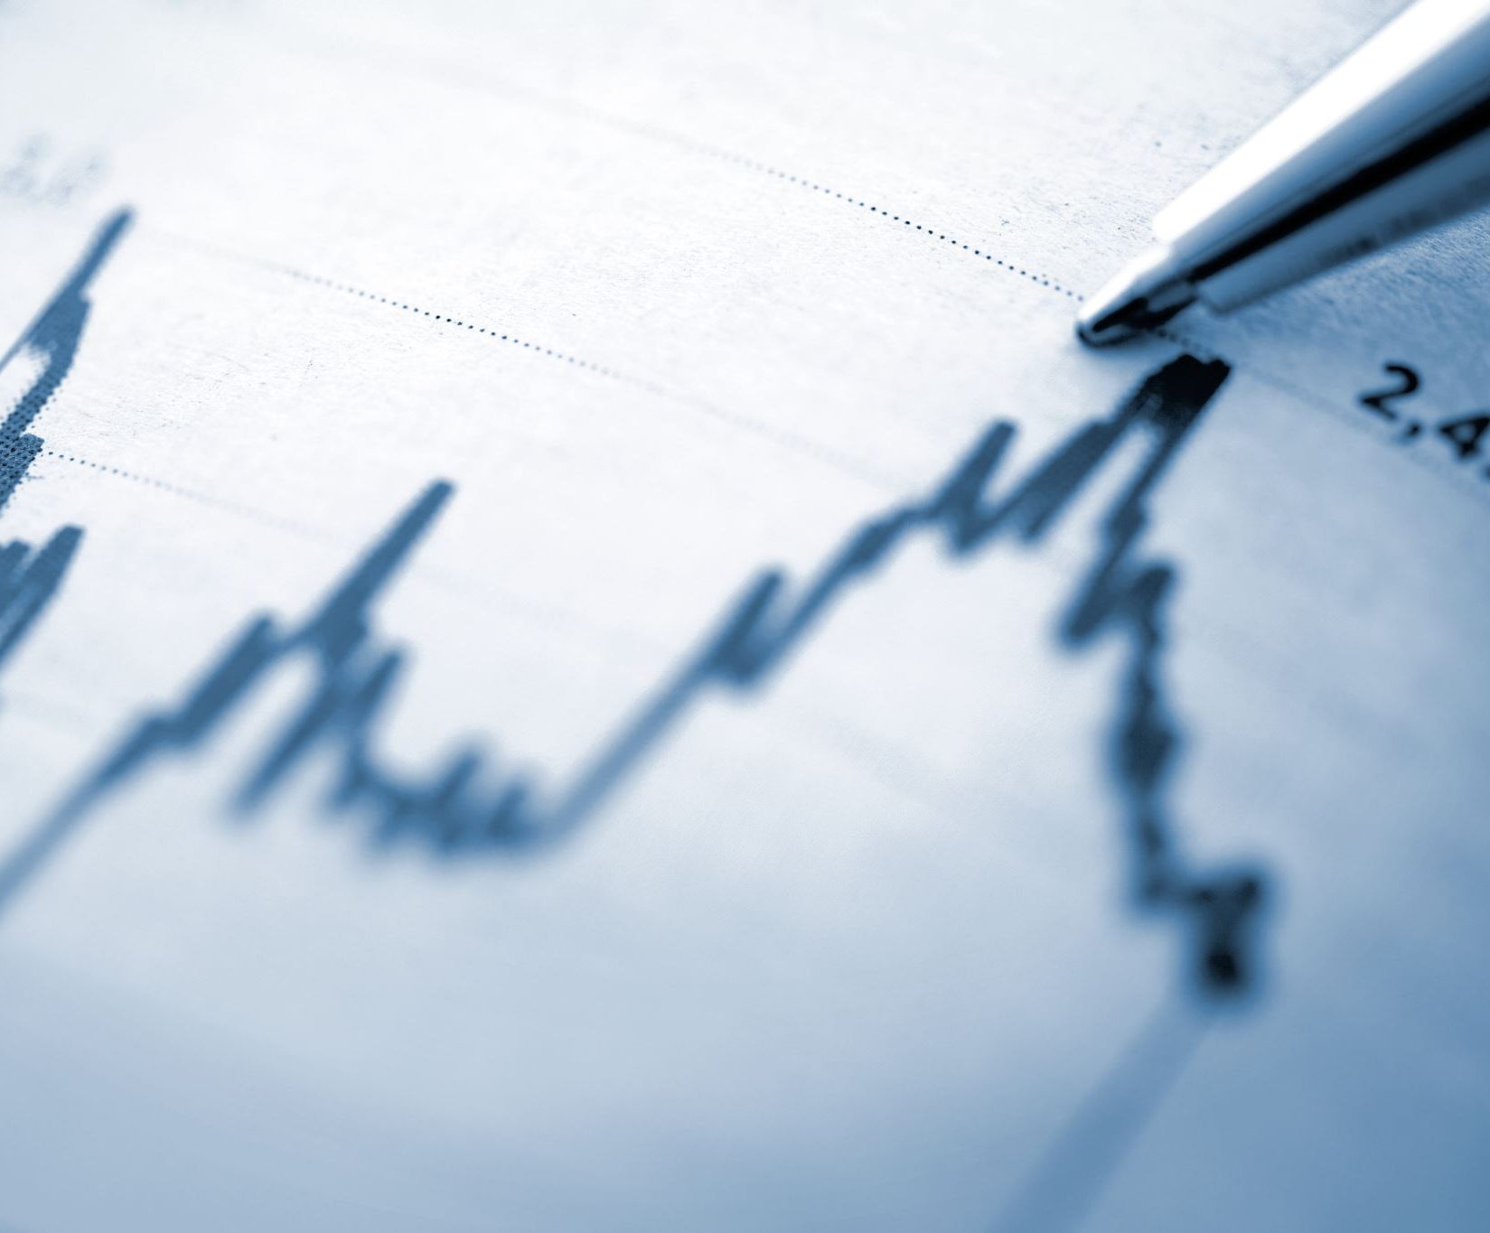
Introduction
This PowerPoint Presentation will be talking about student loans and the problems we may run into while trying to pay them off, whether it's life, finances, sickness, etc.

Slide 3
Will you be able to pay back your student loan in 10 years?
The amount I have set, I do believe I will be able to have my student loans paid off within five years or less.
◦My monthly student loan payment is $350, and my student loans are around $15,000.
◦By the time I finish school, it may go higher or lower depends on me and if I do right and pay my loans on time.

Slide 4
Salary After Graduation
Early Childhood Education- $25k- $37k
Child Psychologist- $54k - $110k
Pediatrician- $150k - $230k
Each salary is for each degree I will complete. Once I graduate in December 2021, I will be going back to school in 2024 to get my degree in Child psychologist, and then I will go back to college once I finish that in 2034. Each goal will put me in a better financial situation, and I will be able to pay off my student loans in my five-year gap.

Slide 5
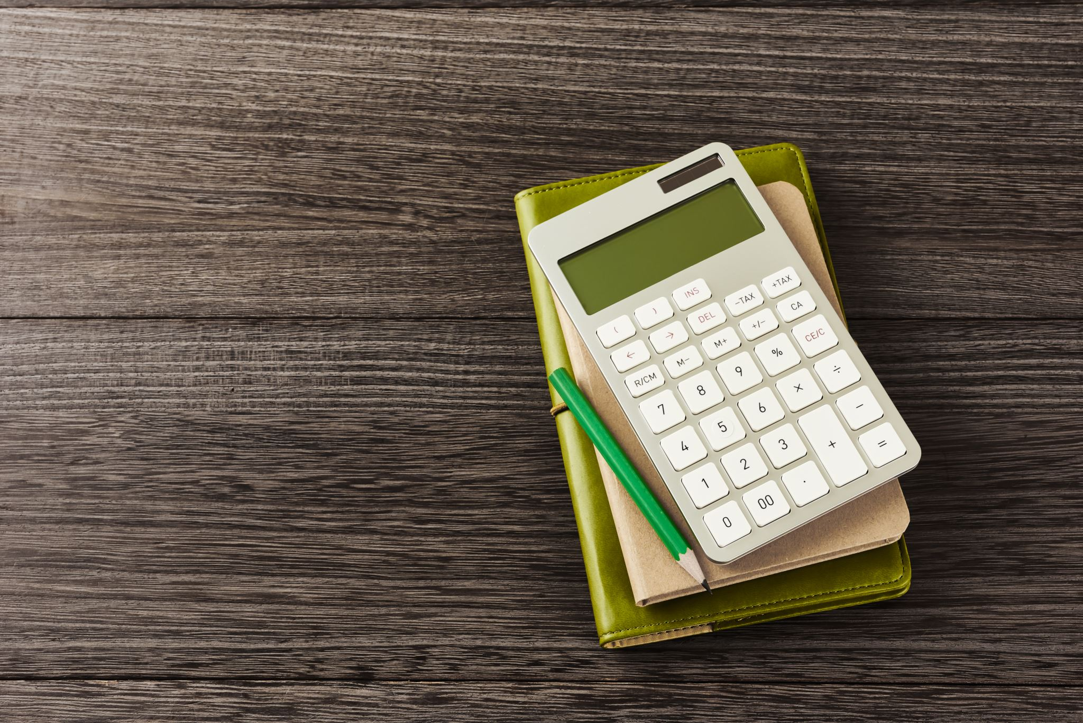
Budget!
•I’ll save $100 each check while paying my monthly payments of $125. This way I can spend the next month beforehand.
Budget
Net Monthly Income |  | $3,500
Expenses:
Rent | $1,569
Light Bill | $175
Internet | $106
Cell Phone #1 | $75
Cell Phone #2 | $82.00
Student Loans | $689
Total expense: |  | $2,661
Disposable income: |  | $839

Slide 6
Student Loans
Current Balance
After graduation
Current Balance: $3,096.78
Monthly Payment: 516.13/Monthly for 6 months
Above is what my current student loan balance is and what I am paying now. After I graduate, I do not know my total compensation, but I estimate what it possibly could be.
After Graduation: $7,819.00
Monthly Payments: $229.97/Month for 34 months.
Above I have broken down my future balance of what I think it will be and how long it will take me to get it paid off.

Slide 7
Monthly Payments & Repayments
Current Monthly Payment
10-year payment
My current monthly payment is $103, and I will have my student loan paid off in the next 4 months.
With this loan on me I will not receive my diploma at graduation, but I will get it once my loan is paid in full.
If I am looking into paying off my future loan of $7,896 over 10 years, I will have to pay $658.
This loan is just a guess I do not have my full balance just yet, but Monday I plan on talking to financial aid.

Slide 8
10 Year Mark!
My loan after graduation will be $7890, in 10 years I will be having this paid off with the monthly payments of $657.50.
This is just a guess, I am not sure that this will be my payment, but from what I am looking at on my student portal, this is the correct amount.

Slide 9
Ways to reduce Student Loans
Income driven repayment.
Sign up for graduation repayment plan
Refinance your student loan
Enroll in automatic payments (this is so you will not miss a payment)
Save money to make payments early

Slide 10
Conclusion
This PowerPoint was based on information I had received at the very beginning of this semester. Some of it may have changed, and some may have not. I did what I could to the best of my knowledge, and I also did not use any reference other than my financial aid team and my advisor.

Slide 11

Reference
Bryant & Stratton College(2021). Week 3 and 4 lecture https://rise.articulate.com/share/4EPWact9ncbz5wWvmWPnYUDy6UIYHrJg#/.

