Slide 1

MATH201 College Mathematics - Quantitative Reasoning Portfolio Project
Victoria Peters
Notes:
Quantitative Reasoning Portfolio Project on our Student Loans by Victoria Peters

Slide 2
Brief Overview
This project is designed to start you thinking about how you will repay your student loans once you have graduated.
Notes:
The goal of his project is to get us thinking about how we intend to pay our student loan debt

Slide 3
Hypothesis
I will be able to pay back my student loans faster than the standard 10 year repayment plan.
Notes:
My hypothesis is that I will be able to pay my loans off quicker than expected by making larger monthly payments.

Slide 4
Expected Salary after Graduation
Medical Practice Manager in the state of Virginia
Sources used to estimate salary: Ziprecruiter and GlassDoor
Estimated starting salary 1: $67,000
Estimated starting salary 2: $63,000
Estimated starting annual salary (avg of salary1/2): $65,000
Estimated starting monthly salary: $5,416.67
Estimated net monthly salary (after taxes): $4,062.50
Notes:
I used two different sources to estimate how much my salary will be in my desired field. After averaging the two figures it look like I will have a starting annual salary of $65,000 and a net monthly salary (after taxes) of $4062.50

Slide 5
Monthly Budget
Estimated net monthly salary (after taxes): $4,062.50
Total Monthly Expenses: $2737.09
Disposable income: $1325.41
Monthly Expenses | Amount
Mortgage | $1209
Car Payment | $279.63
Food | $350.00
Electric | $270
Cell Phone | $196
Insurance | 192.46
Gas | 140
Internet | 100
Notes:
After paying all of my bills I have $1325.41 in disposable income each month

Slide 6
Total Amount of student loans at Graduation
Up until this semester I have not needed student loans as I have been using my Post 9/11 GI BILL.
However, as of this Semester I have accumulated $4095.13 in a direct subsidized loan, for which there is no interest charged while an undergraduate student is in school at least half-time.
I have 5 semesters left of school for which I estimate my costs will be approximately the same for each semester, at a 3.95 % interest rate
Total Amount Due: $24,570.78 at 3.95% interest starting at graduation.
Notes:
I estimate that I will owe a total of $24,570.78 at 3.95% interest after finishing up my degree.

Slide 7
Monthly Payment Required
To satisfy the balance of my student loans I will have to pay at least the minimum required monthly payment of $248.18 per month for 10 years.
Estimated net monthly salary (after taxes): $4,062.50
Total Monthly Expenses with student loan payment: $2985.27
Disposable income after student loan payment: $1077.23
This monthly payment is approx. 6 % of my estimated monthly income. This seems like it is completely reasonable and should not be an issue in repaying this under these terms.
Notes:
The minimum required monthly payment for my loan is $248.18 which is approx. 6 % of my monthly income.

Slide 8
Interest the loan will accrue
By making the minimum monthly payments over the entire 10 year period the loan will accrue $5,211.27 in interest.
In addition to the original balance this will bring the total cost of this loan to $29,782.05.
Notes:
If I take the full 10 year loan term to pay the amount back I will accrue $5211.27 in interest which will mke my full cost $29,82.05

Slide 9
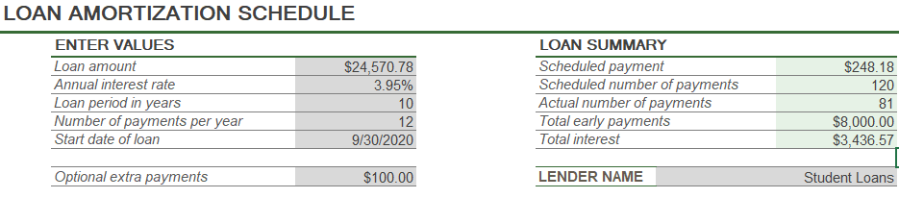
Should I pay my loan off sooner?
Payment Options:
Term | Monthly Payment | Future Value | Interest Paid
5 years | $451.95 | $27,117.25 | $2,546.47
7 years | $335.29 | $28,164.19 | $3,593.41
9 years | $270.71 | $29,236.46 | $4,665.68
What my plan looks like:
Notes:
I estimated three different terms and what the payments would look like to be able to pay it off in those time frames.

Slide 10
Optimal Monthly Payment
Ideally I will be making a $400 a month payment on my student loans.
I can afford this in my current budget and it will allow me to pay a lot less interest on the total amount.
It will also allow me to pay the loan off sooner than the estimated 10 years which holds true to my hypothesis.
Notes:
My goal is to make monthly payments of $400 a month towards my student loans which will allow me to pay the debt off quicker and save on the accrued interest.

