Slide 1

MATH201 - Quantitative Reasoning
Student Loan Project
Karman Beller
6/17/2021

Slide 2

Introduction
The purpose of this project is to get students to start thinking about how they will repay our student loan once they have graduated, while assisting students in meeting both institutional and course outcomes for our degree.

Slide 3
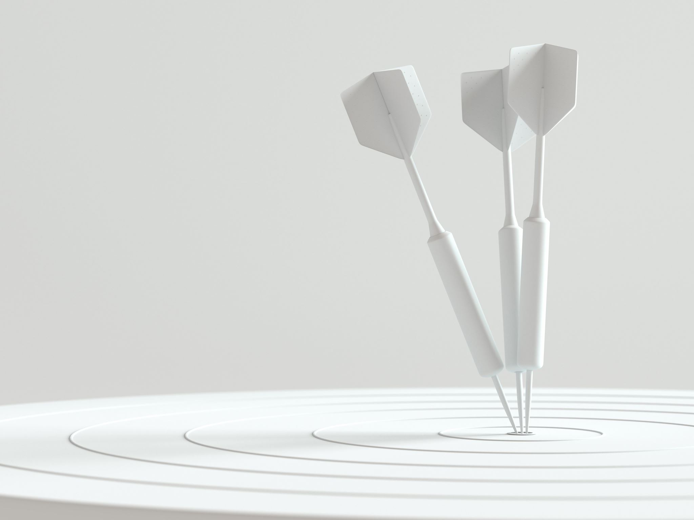
Hypothesis
Will your student loan monthly payment fit into your budget?
My student loan payment will be income driven payments and will fit into my budget.
Will you be able to pay back your loan faster than the standard 10-year repayment plan?
According to my plan I will be able to pay off within my 10 year plan.

Slide 4
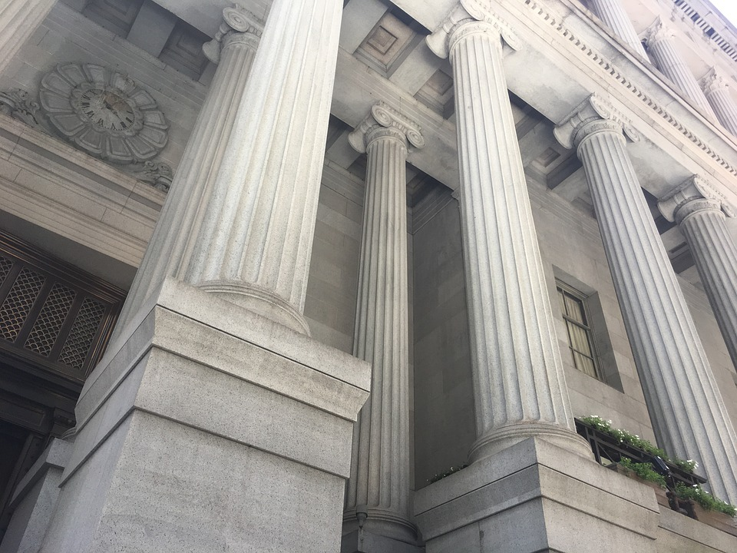
Estimated Net Starting Salary upon Graduation
Student Name: Karman Beller Date: 6/13/2021 Job title: Paralegal State: CA
Sources used to estimate salary:
Source 1: Paralegal I Salary in Sacramento, CA | Salary.com
Estimated starting salary 1: $48,201
Source 2: 2: https://www.indeed.com/career/paralegal/salaries/Sacramento--CA
Estimated starting salary 2: $45,609
Estimated starting annual salary: $57,123
Estimated starting monthly salary: $4,044
Estimated net monthly salary : $3,801

Slide 5

Net Monthly Income $ $3,801.00
Mortgage -$427.87
Electric -$150.00
Water/Trash -$30.00
Cell Phone -$45.00
Internet -49.99
Car/ Home Insurance -$111.00
Amazon Prime Subscription -12.99
Total -$946.85
Expenses
Gas-$120.00
Total left over-$2,860.66

Slide 6

 | Enter Values |  |  |  |  | Loan Summary
 | Loan amount |  |  | $22,696.00 |  | Scheduled payment |  | $190.00
 | Annual interest rate |  |  | 3.40% |  | Scheduled number of payments |  | 24
 | Loan period in years |  |  | 10 |  | Actual number of payments |  | 12
 | Number of payments per year |  |  | 12 |  | Total early payments |  | $0.00
 | Start date of loan |  |  | 4/13/2020 |  | Total interest |  | $3,696.00
 |  |  |  |  |  | Lender name |  | Great Lakes
 | Optional extra payments |  |  | $100.00
 | Payment Number | Payment Date | Beginning Balance | Scheduled Payment | Extra Payment | Total Payment | Principal | Interest | Ending Balance | Cumulative Interest
 | 1 | 10/1/2022 | $22,696.00 | $190.00 | $100.00 | $290.00 | $225.69 | $64.31 | $22,470.31 | $64.31
 | 2 | 11/1/2022 | $22,470.31 | $190.00 | $100.00 | $290.00 | $226.33 | $63.67 | $22,243.97 | $127.97
 | 3 | 12/1/2022 | $22,243.97 | $190.00 | $100.00 | $290.00 | $226.98 | $63.02 | $22,017.00 | $191.00
 | 4 | 1/1/2023 | $22,017.00 | $190.00 | $100.00 | $290.00 | $227.62 | $62.38 | $21,789.38 | $253.38
 | 5 | 2/1/2023 | $21,789.38 | $190.00 | $100.00 | $290.00 | $228.26 | $61.74 | $21,561.11 | $315.11
 | 6 | 3/1/2023 | $21,561.11 | $190.00 | $100.00 | $290.00 | $228.91 | $61.09 | $21,332.20 | $376.20
 | 7 | 4/1/2023 | $21,332.20 | $190.00 | $100.00 | $290.00 | $229.56 | $60.44 | $21,102.64 | $436.64
 | 8 | 5/1/2023 | $21,102.64 | $190.00 | $100.00 | $290.00 | $230.21 | $59.79 | $20,872.44 | $496.44
 | 9 | 6/1/2023 | $20,872.44 | $190.00 | $100.00 | $290.00 | $230.86 | $59.14 | $20,641.57 | $555.57
 | 10 | 7/1/2023 | $20,641.57 | $190.00 | $100.00 | $290.00 | $231.52 | $58.48 | $20,410.06 | $614.06

Slide 7

What percentage of your net monthly salary will go toward repaying your student loans? Does this seem to be a manageable amount?
I will be sticking to my 10year plan because my goal is to open my own law firm and the extra funds during these months will help fund that plan.
Net Monthly Income $ $3,801.00
Mortgage -$427.87
Electric -$150.00
Water/Trash -$30.00
Cell Phone -$45.00
Internet -49.99
Car/ Home Insurance -$111.00
School Loans -$190.00+ $100.00
Amazon Prime Subscription -12.99
Total -$1,236.85
Expenses
Gas-$120.00
Total left over-$2,564.15

Slide 8
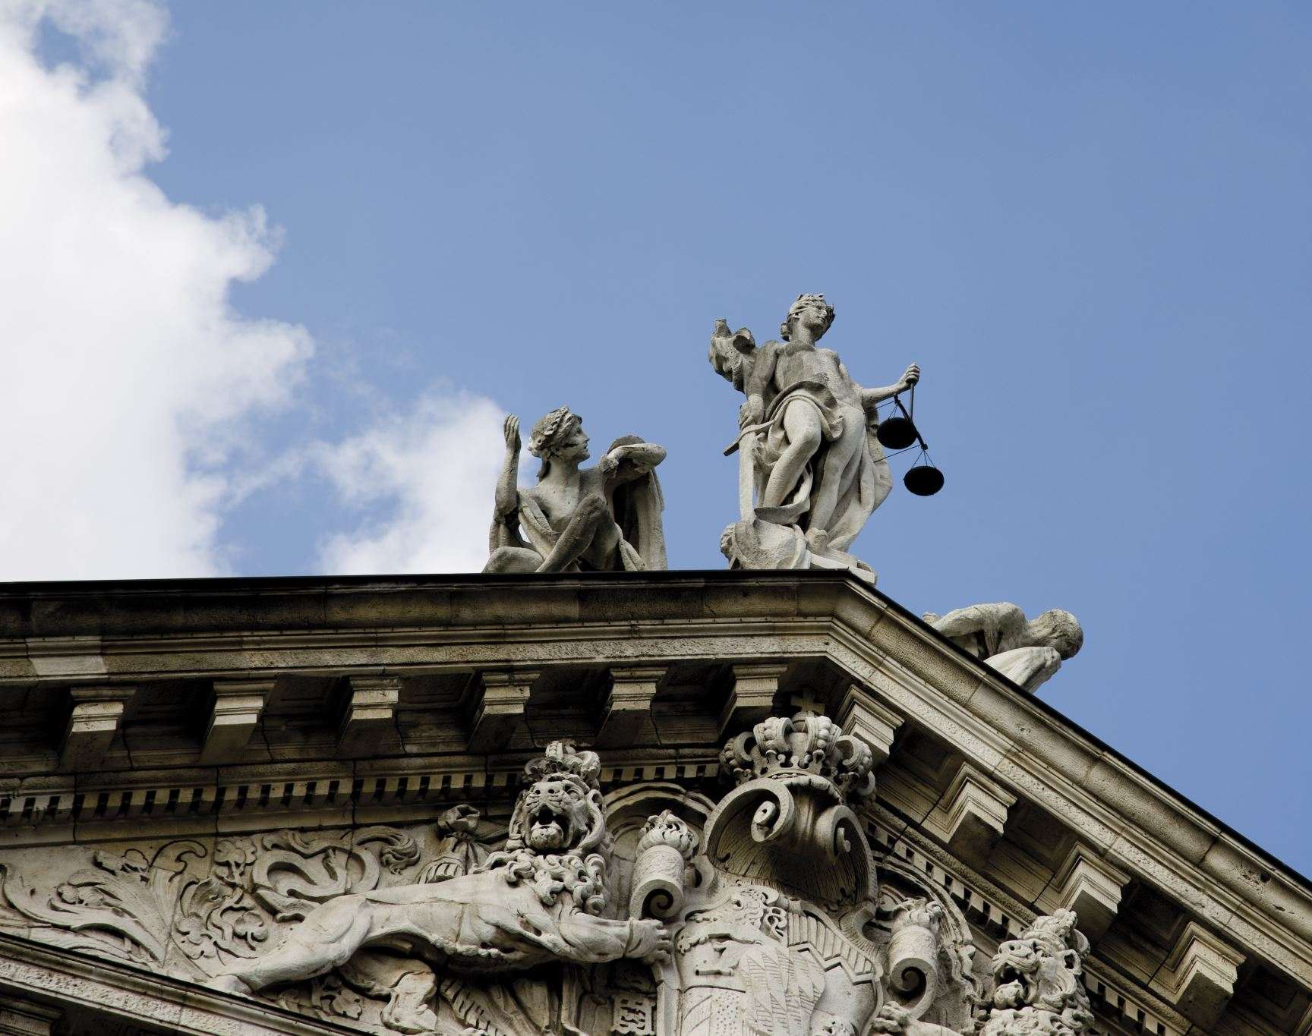
Monthly Payment
◦ Payments over 10 years- $190.00
◦ Future Value- $ 22,696.00
◦ Interest- $3,696.00

Slide 9

 | Simple Loan Calculator
 | Enter values
 | Loan amount |  |  | $ 19,000.00
 | Annual interest rate |  |  | 3.40%
 | Loan period in years |  |  | 10
 | Start date of loan |  |  | 4/15/2020
 | Monthly payment |  |  | $ 190.00
 | Number of payments |  |  | 120
 | Total interest |  |  | $ 3,439.33
 | Total cost of loan |  |  | $ 22,439.33
The loan calculator show a significant decrease in my, over all loan amount payoff from 10 years at $22,439.33 down to 5 years at $20,687.58. I still plan on sticking with my hypothesis.
Enter values
Loan amount |  |  | $ 19,000.00
Annual interest rate |  |  | 3.40%
Loan period in years |  |  | 7
Start date of loan |  |  | 10/1/2022
Monthly payment |  |  | $ 190.00
Number of payments |  |  | 84
Total interest |  |  | $ 2,377.38
Total cost of loan |  |  | $ 21,377.38
Enter values
Loan amount |  |  | $ 19,000.00
Annual interest rate |  |  | 3.40%
Loan period in years |  |  | 5
Start date of loan |  |  | 10/1/2022
Monthly payment |  |  | $ 190.00
Number of payments |  |  | 60
Total interest |  |  | $ 1,687.58
Total cost of loan |  |  | $ 20,687.58

Slide 10
Conclusion
Identify what your optimal monthly payment would be. Explain why this payment would be beneficial and realistic for you. Describe how your findings from this project relate to your hypothesis from step 1.

