Slide 1


Laguna Productions Cyber Attack resolution
Melanie makowski
Notes:
I will be going over how we can resolve the problem for Laguna Productions and the current situation at hand of being hacked from lack of cyber security.

Slide 2

hacking group, known as the NY Rebels, took over the network system of Laguna Productions
Notes:
The problem we have going on at Laguna Productions is that because the company has been a success, they have been targeted by a group of hackers called the NY Rebels. They have taken over personal identifying information (PII) of all the employees, customers, and financial investors. This information has been stolen and posted online. The number of impacted individuals is estimated to be near 10,000.

Slide 3

What's your liability?
Notes:
You are personally held accountable for all the parties that have been affected by this cyber hack.

Slide 4

DATA BREACH
$1,000 per record: The average cost in a medical data breach.
25,000 records per incident: The average number of records stolen.
$1.5 million per breach event: Damages Assuming Liability to the company.
https://brassvalley.com/ramifications-data-breaches-whats-liability/
Notes:
In result, your company has entered a data breach. "The party that was negligent in its duties to protect that data is liable for damages". "The following information gathered is listed above in the slide". "These figures only account for money paid in damages and does not include legal fees, time lost, reputation damage and other factors".
https://brassvalley.com/ramifications-data-breaches-whats-liability/

Slide 5
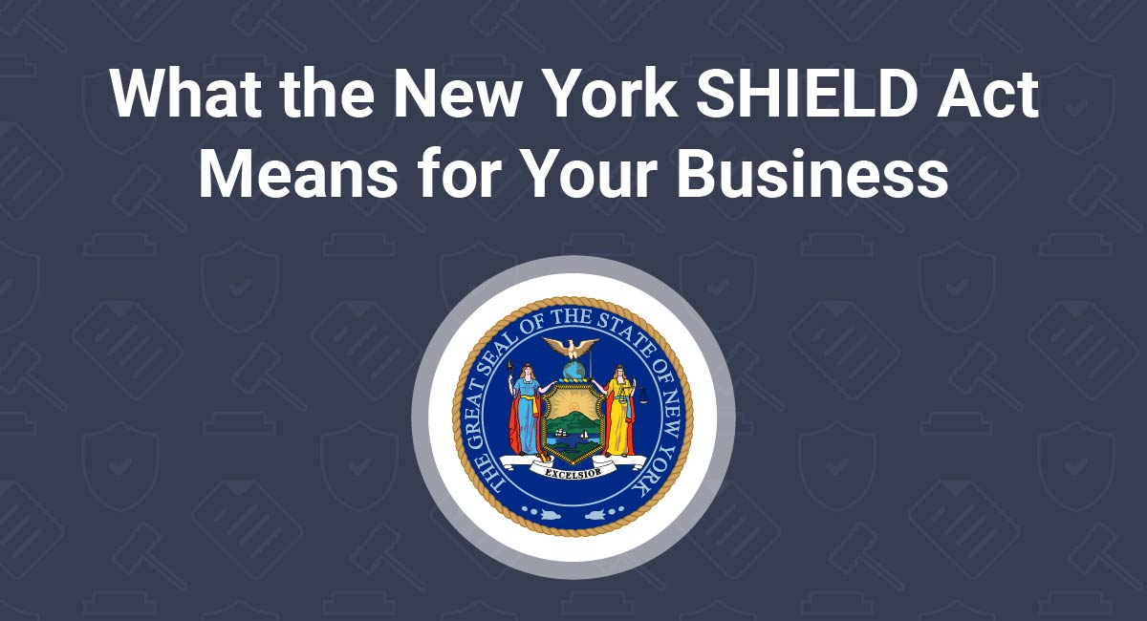
statutory liability under new york law
Stop Hacks and Improve Electronic Data Security (SHIELD) Act:
is designed to address unauthorized access of data.
Notes:
Statutory Liability under New York Law is the New York SHIELD Act. This is designed to address unauthorized access of data.

Slide 6

statutory liability under california law
California Cyber Security Law:
Is designed to safeguard PII (personal identifying information)
Notes:
The statutory liability under California law is the California Cyber Security Law, which protects individuals personal identifying information.

Slide 7
Ethical actions to help victims
Provide comfort and reasurrance to those people affected
1
Provide a place for any updates or information
2
Provide information on how to recover from identity theft
3
Give those effected information on the law enforcement handling the case
4
Notes:
1.) It's important to assure those people affected that steps have been taken to resolve the issue. People need to be reassured and feel at ease so that no one panics.
2.) Give the people affected a place they can visit for any information updates such as a website or a phone number they can call for any updates.
3.) Give those affected information on how to recover from identity theft.
4.) Supply those affected with the law enforcements information handling the case so that they can stay in the loop.

Slide 8
Plan of action
Hire data security expertise to install a cyber security system
Following up with mandatory education programs on cyber security
Understanding the risks involved and creating plans to prevent them
Notes:
The nexts steps should be hiring a data security expert to install a cyber security system to ensure that this doesn’t happen again.
Stay informed on cyber security and ways to protect your assets from being compromised again. Stay educated and mandate employees to participate in security training.
Knowing what your risks are and creating a preventative action will ward off future threats.

Slide 9
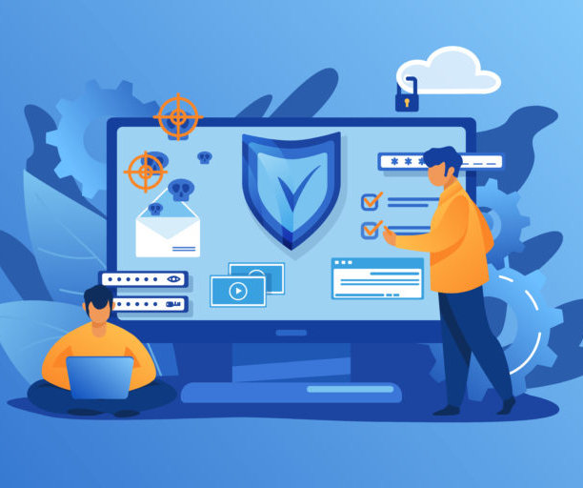
Prepare for future attacks
Have an incident response plan to pinpoint future threats
Invest in additional safeguards such as a cyber insurance policy
Repair and rebuild all computers and systems
Replacing corrupt data, files and applications with a clean backup
Notes:
Preparing for future attacks gives you a manual on how to protect your company if this were to happen again. Better safe than sorry is your best option.

Slide 10
Work cited
https://www.tripwire.com/state-of-security/government/new-york-law-expands-cyber-protection/
New York Passes a Law that Further Expands Cyber Protection
Bob Covello Jul 9, 2019
http://www.scurichinsurance.com/california-cyber-security-law-data-breach-notification/
Copyright © 2019 Insurance Websites by CompleteMarkets.com
https://staysafeonline.org/blog/hacked-5-ways-minimize-damage/
You’ve Been Hacked: 5 Ways to Minimize the Damage
June 28, 2018
| Scott Spiro, SugarShot
https://brassvalley.com/ramifications-data-breaches-whats-liability/
20 Brass Valley. All Rights Reserved | Privacy Policy

