Slide 1



Cheryl Marr
Bryant & Stratton College
J-SOSC102
V. Lambert
Sociology Portfolio.

Slide 2


Intro:
This presentation is about Sociology and how it affects business employees as well as their customers internal and external influences.

Slide 3

Family:
Parents and siblings can affect the way another’s social skills.
Specific individual’s beliefs.

Slide 4

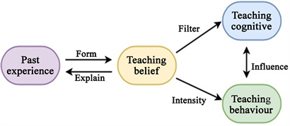
School:
Schooling is a major part of a person's sociology.
What the teachers might teach.
Different student's beliefs about a topic.

Slide 5


Media:
The media can destroy anything in its path if given to the wrong hands.
The media always has their own opinion on everything.

Slide 6

Peer Groups:
Who you associate with is a big part in sociology.
With others' beliefs and different thoughts on things can tend to stick with them; in their heads on that’s the correct way of thinking.

Slide 7


Workplace:
The workplace is where you should believe in what your company is standing for.

Slide 8
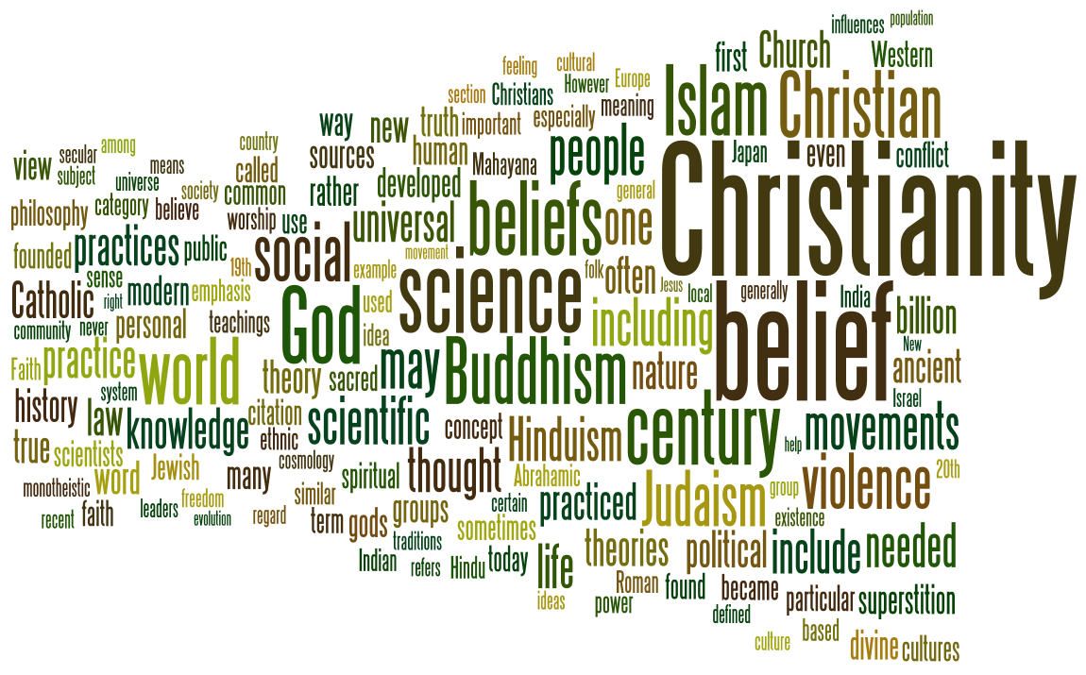
Religion:
Each person has their own religious preferences and there is nothing a company can be reprimanded for.
This Photo by Unknown Author is licensed under CC BY-SA

Slide 9
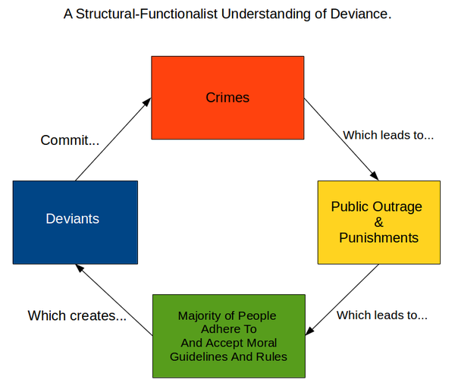
Deviance:
Deviance has both pros and cons.
When in a workplace who has strict rules and regulations.
Personal life.

Slide 10


Social Inequalities:
Income gaps. (poor-rich)
Gender
Racial discrimination
As a community not only as a company we need to show that everyone should be treated as an equal.

Slide 11
Conclusion:
At the end of the day socialization is everywhere, it influences everyone and everything in either a positive or negative way.
With that being said, we all need to learn to respect each others' beliefs and make this company thrive.

Slide 12
References:
Department of sociology. UNC. 2021. https://sociology.unc.edu/undergraduate-program/sociology-major/what-is-sociology/
Crossman, Ashley. "The Sociology of Social Inequality." ThoughtCo, Feb. 16, 2021. https://www.thoughtco.com/sociology-of-social-inequality-3026287
Boundless Sociolgy. Lumen Learning. https://courses.lumenlearning.com/boundless-sociology/chapter/deviance/

