Slide 1


Student Loans
MATH 201
Brittany Tucker

Slide 2
Introduction
Determine loan amount after graduation.
Determine estimated starting salary after graduation.
Determine how much will I be paying each month, and how long it will take to repay the loan.

Slide 3
Hypothesis
Will my student loan monthly payments fit into my budget?
  With a loan of $22,150 I will be able to fit a monthly payment of $300 into my budget after graduation

Slide 4
Salary after Graduation
Job Title | Office Manager
State | Texas
Source 1 | Rosendin Electric
Estimated starting salary | $57,000
Source 2 | H&R Block
Estimated starting salary | $51,000
Estimated starting annual salary (average of the two salaries above) | $54,000
Estimated starting monthly salary | $4,500
Estimated net monthly salary (after taxes) | $4,387.50
https://www.glassdoor.com/Job/dallas-office-manager-jobs-SRCH_IL.0,6_IC1139977_KO7,21.htm
https://www.indeed.com/salaries/Office-Manager-Salaries,-Dallas-TX

Slide 5
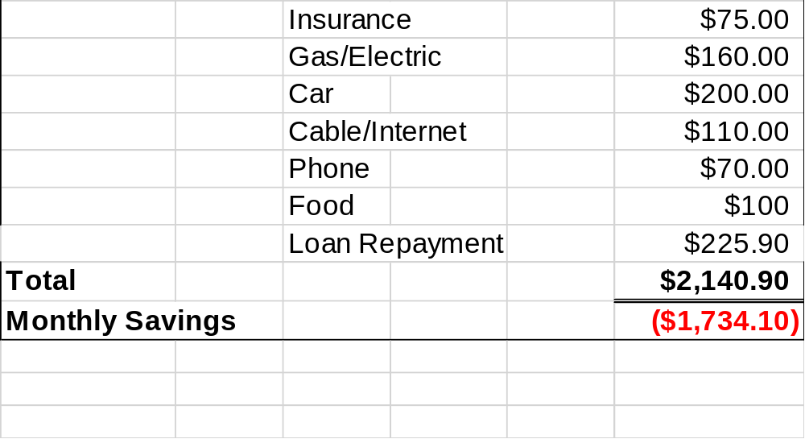
My Budget

Slide 6
Total Student Loans at Graduation
Winter 16/17 Principal Interest Rate
$9,500.00 $514.00 3.76%
Spring 17/18
$9,500.00 $328.00 4.45%
Fall 18/19
$3,150.00 $ 36.00 4.45%
Loan Total $22,150
Estimated monthly payments $293.00

Slide 7
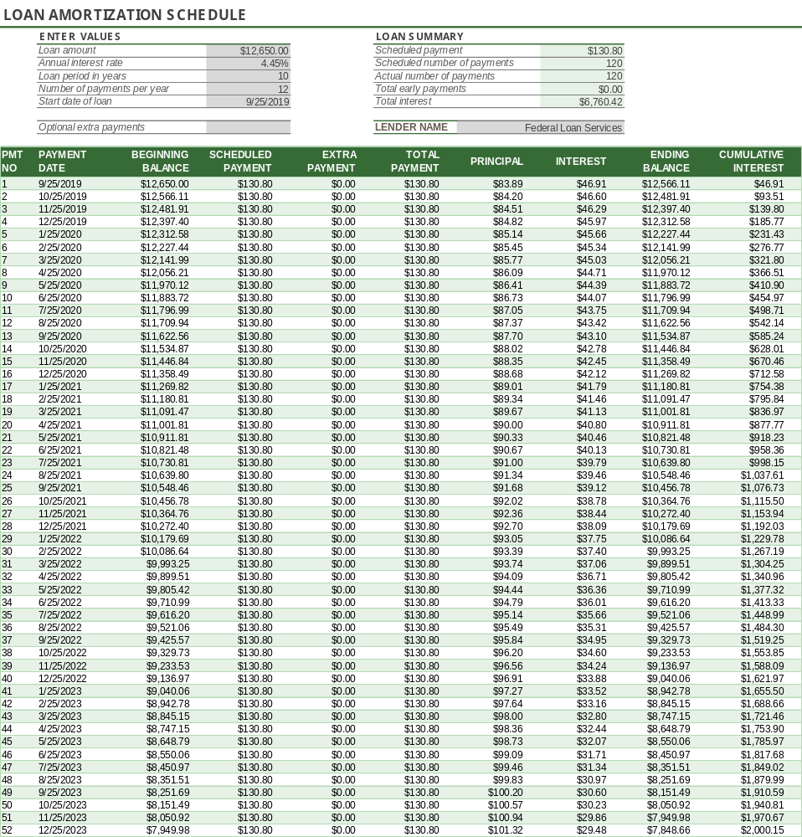
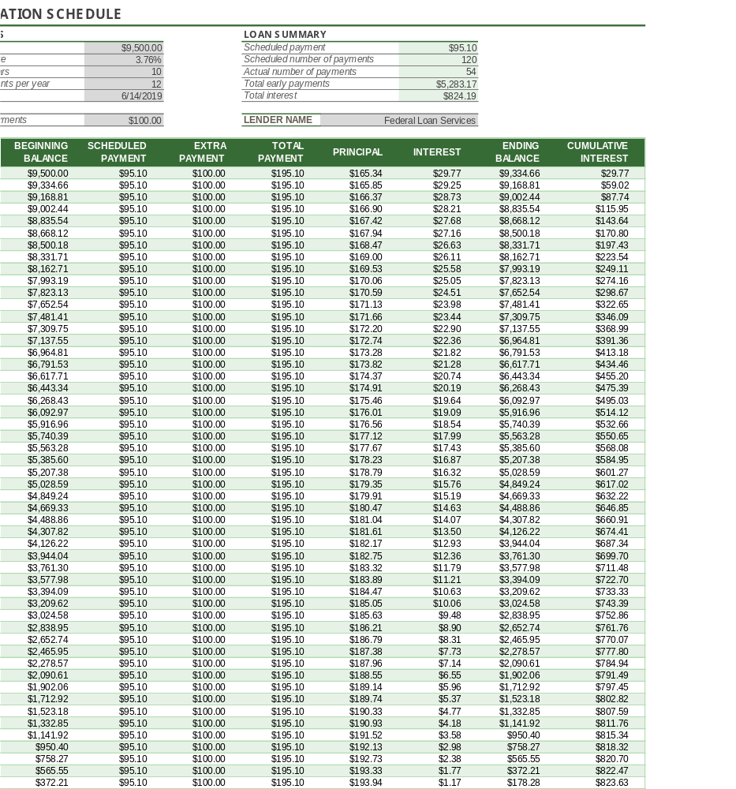
Repayment Plan
FV:$6,760.42+$2,650.00=$19,410.42 FV:$824.19+$9,500=$10,324.19

Slide 8
Future Value
Total loan: $22,150.00
Total interest paid: $7,584.61
Future Value: $29,734.61

Slide 9
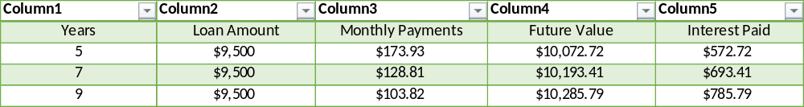
Ways to Reduce Amount of Interest Paid

Slide 10
Conclusion
Optimal monthly payment $275.00-$300.00
  Same as my hypothesis
  I would have extra money for emergencies
  I would have extra money for special purchases

