Slide 1


Elevator Pitch
https://youtu.be/gD0BLVb9Aww
Hello, my name is Margaret Barrios, I am currently pursuing an Associate degree in Criminal Justice. Prior to enrolling in criminal justice, I have already received a diploma in the same field. What makes me unique is that I am passionate about criminal justice reform, and plan to develop the skills I need to improve. I’m creative with non-stop ideas, from brainstorming to research. I’m a team player, skillful and reliable. So, lets get to work because I am ready for it.

Slide 2

Knowledge
The theoretical framework is to support the theory of a research. It plays an important role in the process of the research study. It explains the events, behavior, and relationship. In the theoretical framework, researchers observe and collect data.

Slide 3
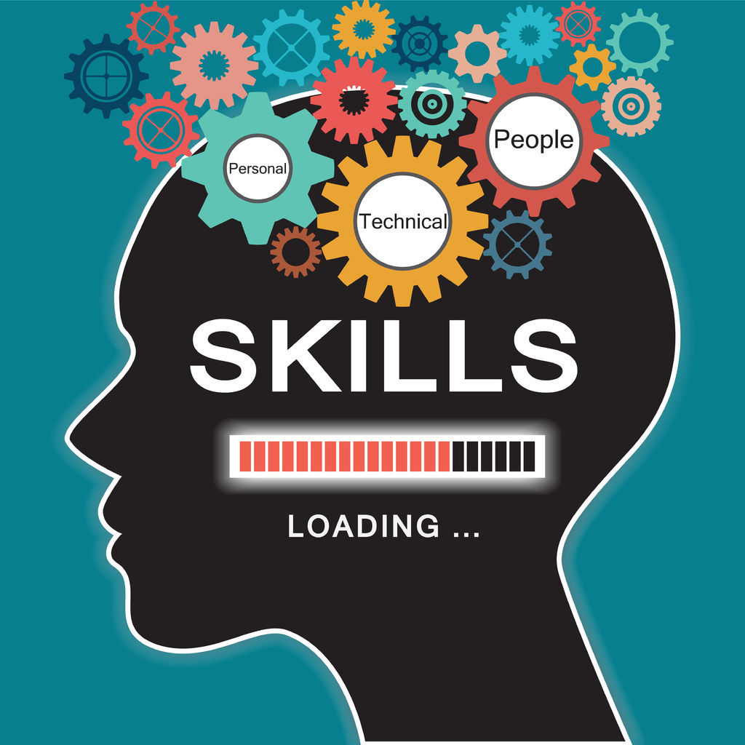
Skills
Skills are your practical, real-world application of knowledge. These are the things you are able to do.

Slide 4
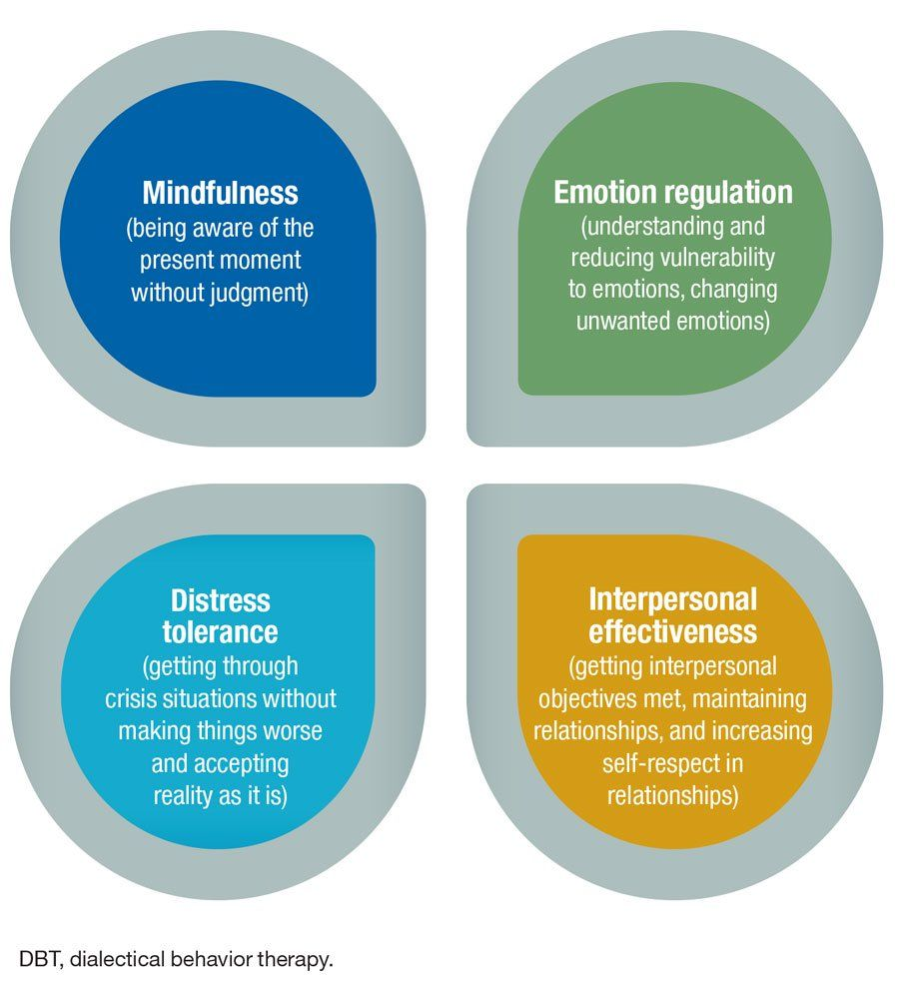
Behavior
A subject of research which consists of people’s attitude & opinions and its relation to the behavior & actions.

