Slide 1

Criminal Investigation
C. Stymus
Bryant & Stratton
4/18/2021
Margaret Barrios

Slide 2
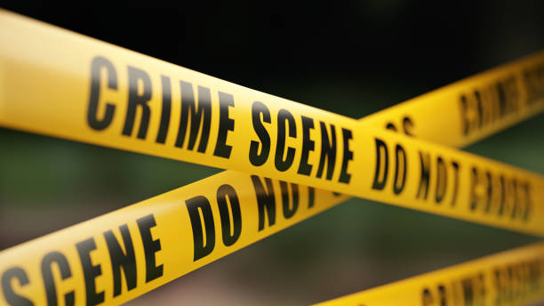
Investigative Plan
Investigative Plan (IP)
Witness interviews
Witness can assist by providing a statement of the incident and to come forward to share the knowledge of the event.
Collection of evidence
Fingerprints, blood samples, surveillance camera, witness, body of victim
Criminal procedures (search warrants)
Profile of victim
Victim was female, appears to be Hispanic early 20s, victim was murdered and raped.
Profile of suspect
White male
Crime Lab reports (evidence that was collected)
Fingerprints, blood samples, surveillance camera, witness statement
Follow-up on evidence
Finding the suspect
Surveillance
Tampered with but still works

Slide 3
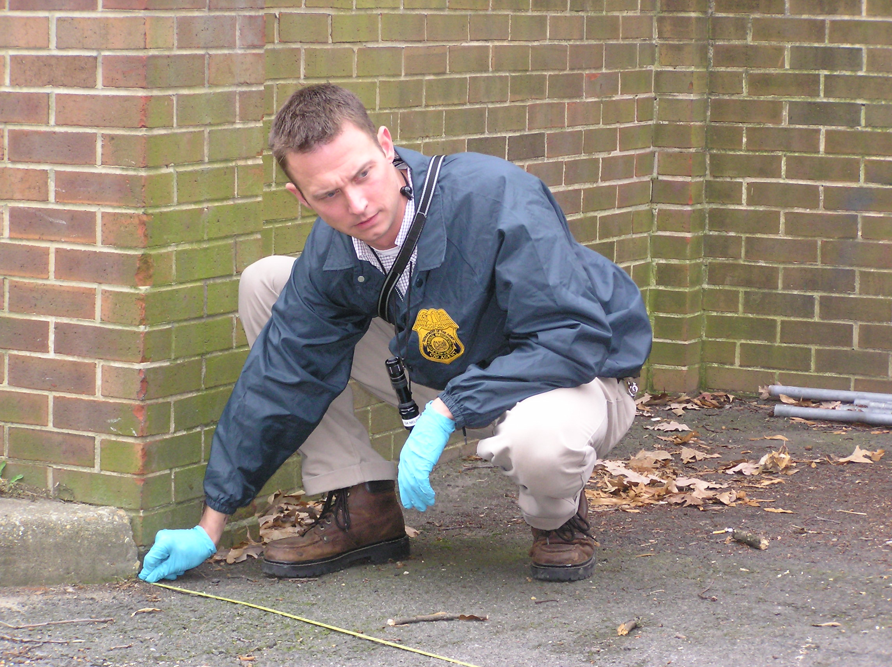
Scene of the Crime
Officers arrive at the scene of the crime, which appears to be a robbery. The officer responding to the scene discovered body of a female lying in a pool of blood. Investigators arrive at the scene of the crime and discover the robbery and murder. Investigators record every step of the crime, including witness statements, forensic reports and crime scene photos. Keeping an open mind about the cause and possible perpetrators of the crime is essential to the investigators. Everything at the crime scene from the victim’s body can dramatically increase the chances of solving the crime. Forensic evidence and fingerprints is important to be collected and useful for DNA to help solve the murder. Time can be a major factor in solving this murder, we know the rule about the first 48 hours being the most important.
When addressing something as complicated as an ethical dilemma, remember to consider things carefully before taking drastic actions. Make sure we are aware of all sides of the story. Make sure everything is in writing, this is a helpful tool to answer questions because someone’s story might change. Don’t jump to conclusions without facts, define ethical issues, identity the crime scene.

Slide 4


5 Questions
How do I know from your work that your analysis
should be accepted?
2. How do we know you are not biased in this case,
choosing to report only what would
help law enforcement?
3. Who committed the alleged behavior?
4. Is a plea bargain possible?
5. What is the case about?

Slide 5
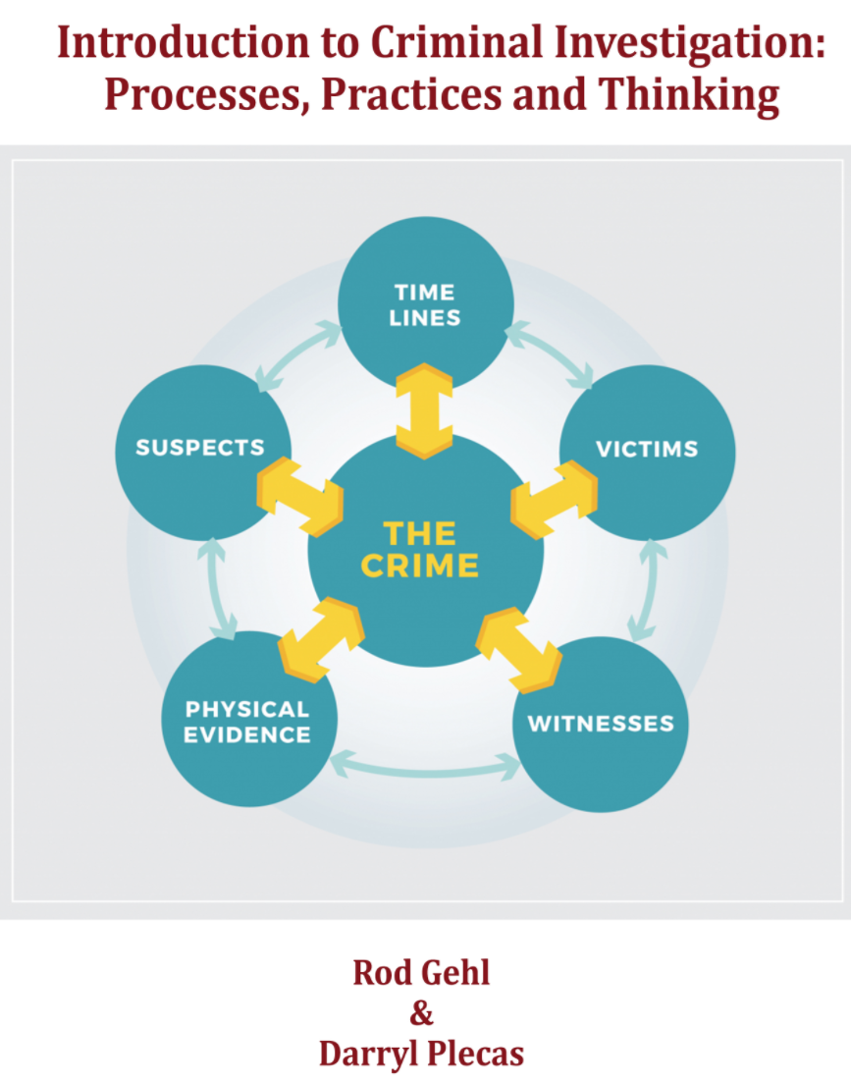
Evidence Log
Item Number | Date | Location Found | Collected/Packaged By: | Description/Notes
1 | 11/6/2014 | On the floor behind the cash register | Investigator Cruz | Empty Cash Drawer
2 | 11/6/2014 | On the front door and handles | Investigator Cruz | Blood samples
3 | 11/6/2014 | Lottery tickets | Investigator Cruz | Fingerprint samples
4 | 11/6/2014 | Cigarettes | Investigator Cruz | Fingerprints samples
5 | 11/6/2014 | Surveillance camera | Investigator Cruz | Tampered with but still works, White male
6 | 11/6/2014 | Witness | Investigator Cruz | Seen a white male run
7 | 11/6/2014 | Car description | Investigator Cruz | Black Ford Mustang leave the scene
8 | 11/6/2014 | Victim | Investigator Cruz | Body found in pool of blood.

Slide 6


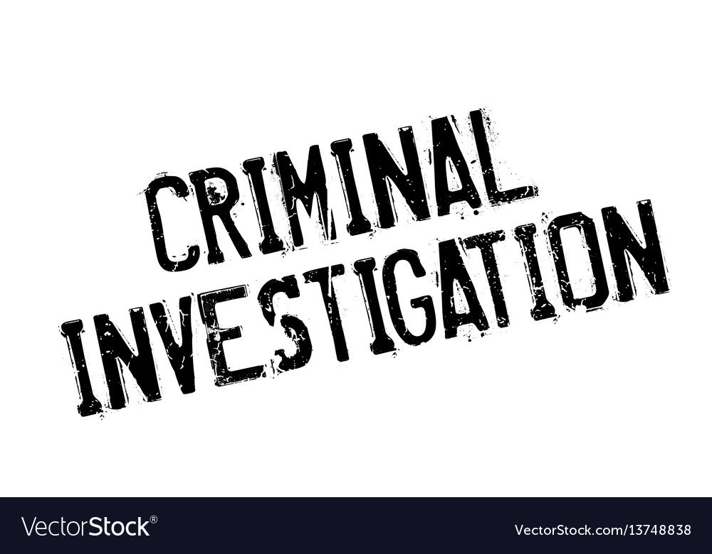
Field Notes
Date: 11/6/2014 Time 11:30pm
Arrived on the scene; Investigator Cruz seconds after the uniform patrol officer Stevens; victim Francelia Pallomares has been found murdered at the Dolex Dollar Express in the 2400 block of Fulton Street.
Date: 11/6/2014 Time 11:40pm
Officer Stevens briefs me on a crime scene; takes me to the storage room in the rear of the store. Where she was found lying in a pool of blood. Victim appeared to have been beaten, sexually assaulted and shot.
Date: 11/6/2014 time 12:00am
Witness statement; called the police when could not find anyone working the store; witness claimed to see a white male run to the parked car next to the dumpster. The witness thinks the car may have been a black Ford Mustang.
Fieldnotes allow the researcher to access the subject and record what they observe in an unobtrusive manner. Fieldnotes are crucial to document a crime scene and should be kept in a safe place.
Field Notes

Slide 7
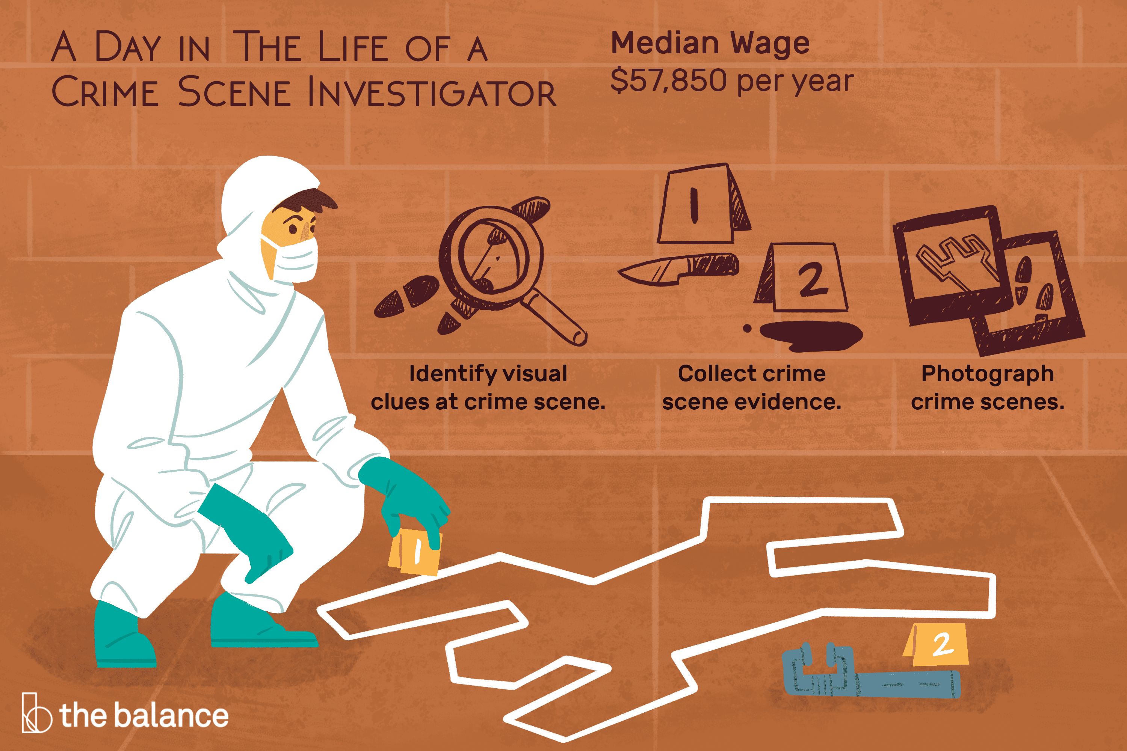
Trial Preparation
Comprehensive evidence
Report creation and delivery
Exhibition labeling and preparation
Testimony in court
Following up on the investigation

Slide 8

Code of Ethics
A legal investigator is dedicated to a search for truth and the furtherance of his or her employer’s or client’s interest consistent therewith. This search for truth makes possible the establishment of the American ideals of fairness and justice for the benefit of the client in every case that the investigator works on. It should be the intention of every investigator to deal honestly, justly and courteously with all whom he or she comes in contact and to practice the profession according to this Code of Ethics.

Slide 9
Reference Page
www.casamo.com ›
www.pinow.com ›
http://www.ojp.usdoj.gov
https://www.cii2.org ›

