Slide 1
SWOT Analysis
HTHS 405 Week 4
Armida Gallegos

Slide 2
Financial Aspects
Strengths
There are many different living situations to fit every ones needs
Medical/Medicaid covers most housing
Nursing beds, personal care studios, and independent living
Weaknesses
Its not for everyone
May have to pay some out of pocket expenses
May not be suitable for family members
Finding the right care that fits their needs

Slide 3
Financial Aspects
Opportunity
Family members can live on their own
Do what they love without feeling like people are hovering over them
Opportunity to do their daily activities on their own
Live in a community with others like them
Threat
This may not be suitable for your family member
Them falling and not being able to get them the help they need
Can be hard to reach them when ever you want

Slide 4
Staffing
Strength
There is enough staff on hand to watch and care for your loved ones
Very helpful and available to family members seeking their care
They know what they are doing
Proper training
Weakness
Not enough staffing
They are rude and not available
They do not have the proper training to handle certain situations
Lack of professional pride
High workload
Disrespect, discrimination, and lack of support

Slide 5

Legal and ethical issues
Strength
Knowing the difference of each of these
Following the rules and regulations
Being trained to handle situation that occur and knowing the ending result
Weakness
Breaking rules
Being fined
Losing medical license
Losing credibility
Losing trust of patients, residents, and community
This Photo by Unknown Author is licensed under CC BY-SA-NC

Slide 6
Management Challenges and opportunities
Strength
Knowing what needs to be changed
Having the ability to work on and address the issues accordingly
Listening to the concerns of others
Highlighting opportunities that arise
Weakness
Not being familiar with the changes that need to happen
Avoiding concerns of others
Not knowing how to run a successful organization

Slide 7




Strengths and weaknesses
This Photo by Unknown Author is licensed under CC BY-SA-NC
This Photo by Unknown Author is licensed under CC BY-SA
Caring for our residents is our main goal. We need to be knowledgeable in many different areas these are our strengths.
We never want our residents to feel frightened of us, this look that the elderly woman has is not a look that we want our residents to have. We want then to feel comfortable and to be happy

Slide 8
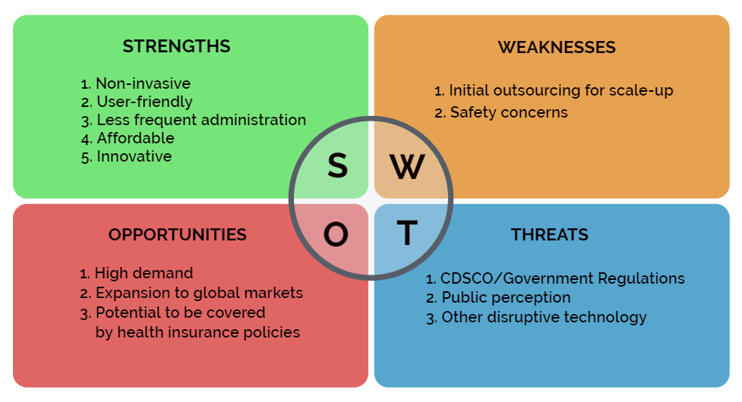
Short-Term plans
To build a routine to stand by daily
Acknowledge what need to change and work towards it
Find what is broken and fix it
Setting goals that are reasonable and are beneficial to the facility
This Photo by Unknown Author is licensed under CC BY

Slide 9
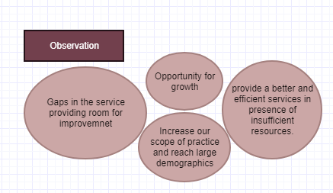
Long-term plans
Develop strategies that are beneficial in the long run
Making changes that will be noticed 5 years from now
keeping the future of the company in mind when setting long-term goals
Never stop building and upgrading facility and technology that matches the time
This Photo by Unknown Author is licensed under CC BY-NC-ND

Slide 10
references
SWOT analysis for goal setting: How to do it. Achieve Goal Setting Success. (n.d.). Retrieved February 25, 2022, from https://www.achieve-goal-setting-success.com/swot-analysis-for-goal-setting.html
Shaw, J., Berry, T., Gerber, S., Landau, C., & Gleeson, A. (2017, May 12). 11 tips for creating a long-term strategic plan. plans Blog. Retrieved February 25, 2022, from https://articles.bplans.com/11-tips-for-creating-a-long-term-strategic-plan/
What is SWOT analysis? (n.d.). Retrieved February 25, 2022, from https://www.visual-paradigm.com/guide/strategic-analysis/what-is-swot-analysis/

