Slide 1



human development through the seven stages of a lifespan
Cheryl Bruce
Bryant & Stratton College
PSYC111
Dr. Shavonne Arthurs

Slide 2
Table of Contents
Introduction
“LOOK WHO’S TALKING”
Physical/Social Development in Infancy
“KINDERGARTEN COP”
Personality Development Early Childhood
“NOW & THEN”
Social/Emotional Development Middle Childhood
“GOOD WILL HUNTING”
Emotional/Conduct Development Adolescence
“GOOD WILL HUNTING”
Intellectual/Social Development Early Adulthood
“STEEL MAGNOLIAS”
Emotional/Social Development Middle Adulthood
“FRIED GREEN TOMATOES”
Cognitive Development Old Age
Conclusion
References

Slide 3

Introduction
Welcome to my PowerPoint presentation. For this presentation, I am presenting the development of psychology through the seven stages of a human’s lifespan. For each slide, I am demonstrating each major stage of the human lifecycle from masterpiece award winning movies. For each movie it focuses on the stages of life experiences through infancy, the toddler years, childhood, middle childhood, adolescence, adulthood, middle adulthood, and the senior years.

Slide 4
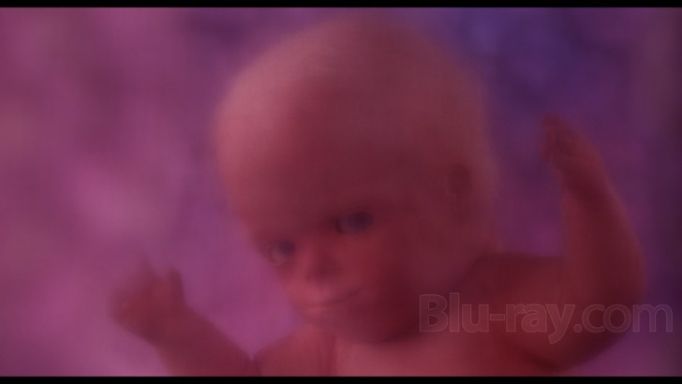
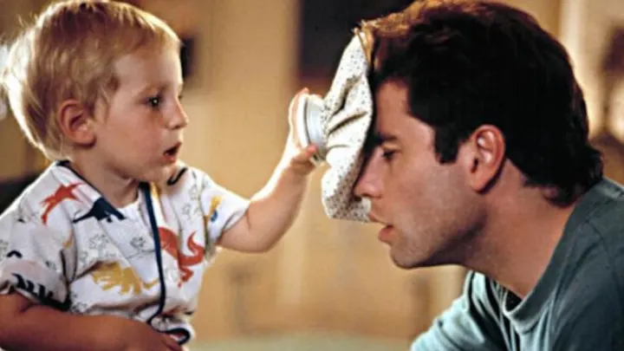
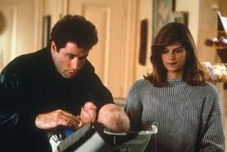
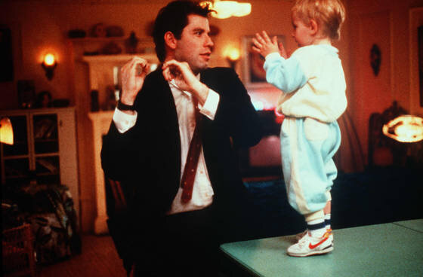
“Look Who’s Talking”
Physical/Social Development in Infancy
Psychical Development starts in the fetus stages
Toddlers start developing & recognizing emotions
Social Development begins at birth.
Building relationships starts at birth.
Motor skills advance at toddler stage.

Slide 5
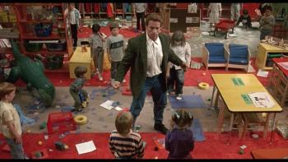
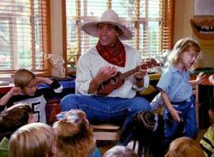
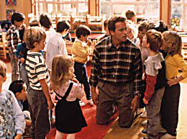
“Kindergarten cop”
Personality/Social Development Early Childhood
They learn skills for managing conflict, turn-taking, compromise, and bargaining.
Developing goals, actions, and understanding.
Their personality develops by their characteristics
Social interaction with another child who is similar in age.

Slide 6
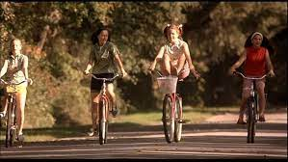
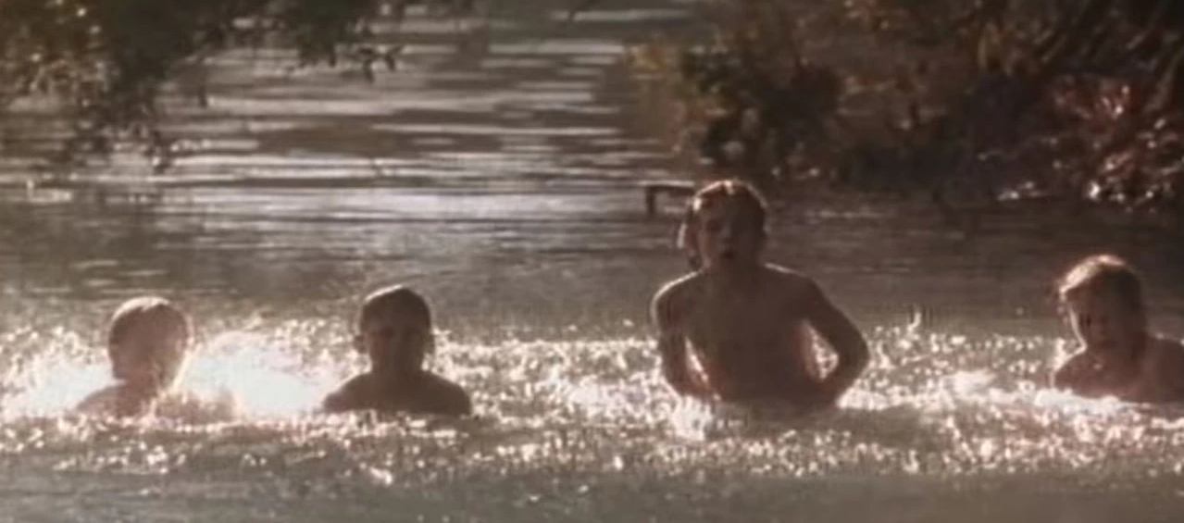
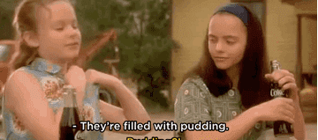
“NOW & THEN”
Social/Emotional Development Middle Childhood
Developing friendships and peer relationships.
Developing close friends for emotional support
Becoming more aware of the opposite sex.

Slide 7
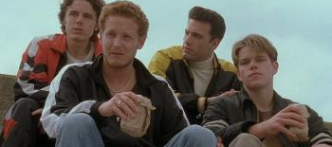
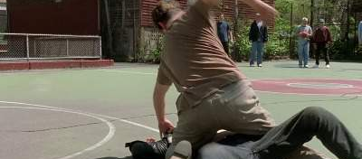
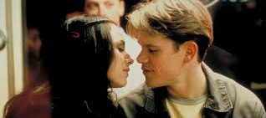
“good will hunting”
Emotional/Conduct Development Adolescence
Show more independence from parents.
Spend less time with parents and more time with friends.
Rebellious stages can lead to, alcohol or drug use, unsafe sex, and other problems.
Have more interest in romantic relationships and sexuality.

Slide 8
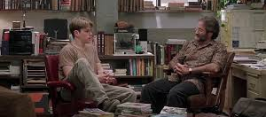
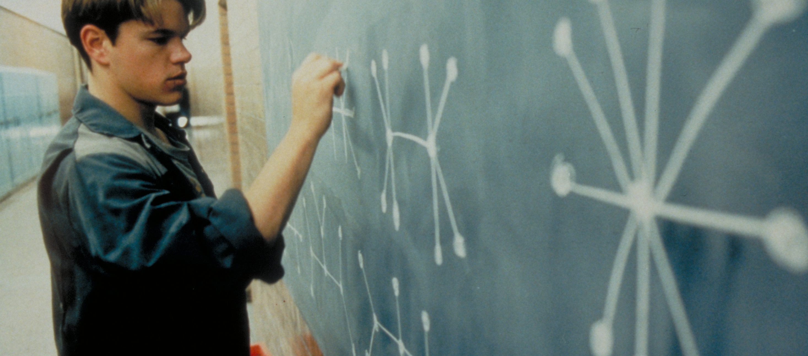
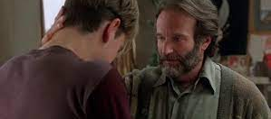
“good will hunting”
Intellectual Development Early Adulthood
Self-awareness of consequences and personal limitations
Recognizing their intelligence, logical, decision making and workplace skills.
Formal operational thought is influenced by past experiences and education.

Slide 9
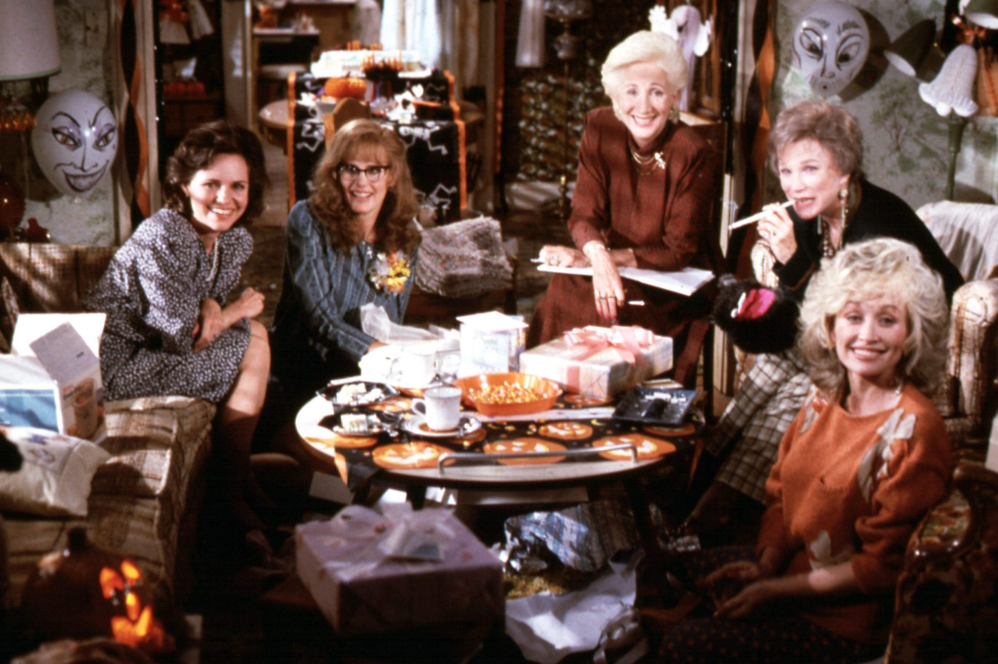
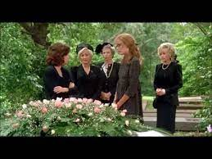
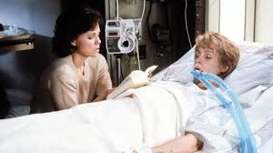
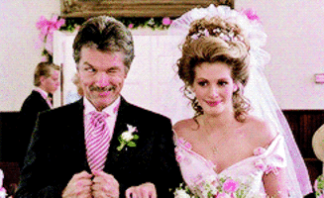
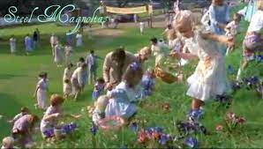
“Steel magnolias”
Emotional Development Middle Adulthood
Generativity to family, society, and future generations.
Bonding with close friends and families during emotional life experiences.
Mid-life crisis a sense of mortality.
Experiences emotional health challenges
Experiences emotional changes to life events
Traditions passing to the next generation.

Slide 10
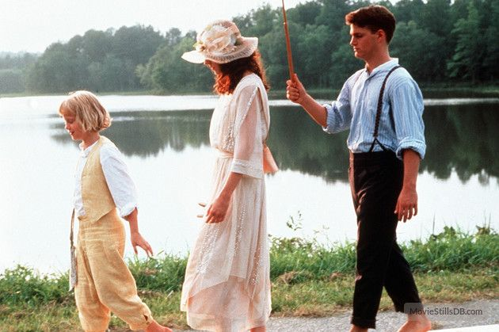
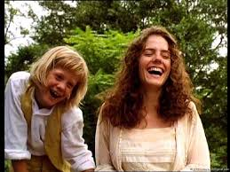
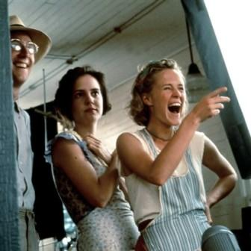
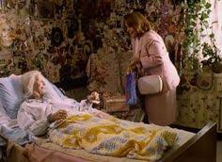
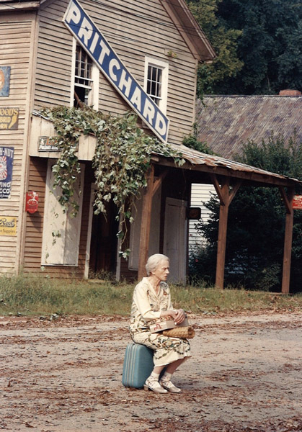
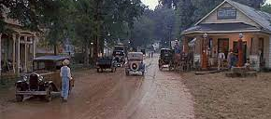
“Fried Green tomatoes”
Cognitive Development Old Age
Age is a major risk factor for most common neurodegenerative diseases, including mild cognitive impairment.
Memory loss occurs during the end-of-life stages
Talking about their life experience to the next generation.

Slide 11

Conclusion
In conclusion, the stages of human life are the seven steps that are experienced throughout the life cycle. During that time, the individual learns from the surrounding environment and experiences all kinds of physical and emotional changes. The psychological aspect in a lifespan intrigues me in how the learning and intellect process of human development. Especially, in how the early stages of life in infancy develops with much more intensity, and then our minds reverses (declines) at the end stage of life. We endure and go through life experiences that shapes us into who we are. It is a part of human nature. Cherish each moment, make memories with family and loved ones throughout each stage in a lifespan to keep the memories until the end.

Slide 12
Picture References
https://www.google.com/search?q=Pictures+of++scenes+look+who%27s+talking+movie&tbm=isch&ved=2ahUKEwi0g6-I7_32AhWLmnIEHfogA54Q2-cCegQIABAA&oq=Pictures+of++scenes+look+who%27s+talking+movie&gs_lcp=CgNpbWcQAzIHCCMQ7wMQJ1CACFisF2CpL2gAcAB4AIABR4gBxASSAQIxMJgBAKABAaoBC2d3cy13aXotaW1nwAEB&sclient=img&ei=wLRMYrSjFIu1ytMP-sGM8Ak&bih=837&biw=1707&rlz=1C1RXQR_enUS967US967
https://www.google.com/search?q=Pictures+of++scenes+kindergarten+cop+movie&tbm=isch&ved=2ahUKEwiqrcbY7_32AhW7rHIEHWXXB_EQ2-cCegQIABAA&oq=Pictures+of++scenes+kindergarten+cop+movie&gs_lcp=CgNpbWcQAzoHCCMQ7wMQJzoGCAAQCBAeUN8JWOJSYKFhaABwAHgAgAHXAYgBthCSAQYzNC4wLjGYAQCgAQGqAQtnd3Mtd2l6LWltZ8ABAQ&sclient=img&ei=aLVMYqrZHbvZytMP5a6fiA8&bih=837&biw=1707&rlz=1C1RXQR_enUS967US967
https://www.google.com/search?q=Pictures+of+now+%26+then++movie+&tbm=isch&ved=2ahUKEwi2qPry9v32AhVoGVkFHd2RBcMQ2-cCegQIABAA&oq=Pictures+of+now+%26+then++movie+&gs_lcp=CgNpbWcQAzoHCCMQ7wMQJ1ClBVjrQGD-SWgBcAB4AIABQogBug2SAQIzMpgBAKABAaoBC2d3cy13aXotaW1nwAEB&sclient=img&ei=9rxMYrbVN-iy5NoP3aOWmAw&bih=837&biw=1707&rlz=1C1RXQR_enUS967US967
https://www.google.com/search?q=Pictures+of+scenes+good+will+hunting++movie+fighting&tbm=isch&ved=2ahUKEwj2ptXw9_32AhW1D1kFHUUNAjAQ2-cCegQIABAA&oq=Pictures+of+scenes+good+will+hunting++movie+fighting&gs_lcp=CgNpbWcQAzoHCCMQ7wMQJ1D4BljEFmDdGmgAcAB4AIABQIgBvQSSAQIxMJgBAKABAaoBC2d3cy13aXotaW1nwAEB&sclient=img&ei=_r1MYvavIbWf5NoPxZqIgAM&bih=837&biw=1707&rlz=1C1RXQR_enUS967US967
https://www.google.com/search?q=Pictures+of+scenes+steel+magnolias+easter&tbm=isch&ved=2ahUKEwj535Ow-v32AhXlF1kFHT5iBi8Q2-cCegQIABAA&oq=Pictures+of+scenes+steel+magnolias+easter&gs_lcp=CgNpbWcQAzoHCCMQ7wMQJ1AAWIEPYKgUaABwAHgAgAGyBIgBixmSAQczLTEuNC4ymAEAoAEBqgELZ3dzLXdpei1pbWfAAQE&sclient=img&ei=nMBMYvmhIuWv5NoPvsSZ-AI&bih=837&biw=1707&rlz=1C1RXQR_enUS967US967
https://www.google.com/search?q=movie+scene+pics+fried+green+tomatoes+&tbm=isch&ved=2ahUKEwiE-aTMjP72AhXQqnIEHb0MCb0Q2-cCegQIABAA&oq=movie+scene+pics+fried+green+tomatoes+&gs_lcp=CgNpbWcQAzIHCCMQ7wMQJzIHCCMQ7wMQJ1DECFiqImDGKWgAcAB4AIABS4gBqgiSAQIxNpgBAKABAaoBC2d3cy13aXotaW1nwAEB&sclient=img&ei=t9NMYsTBGNDVytMPvZmk6As&bih=837&biw=1707&rlz=1C1RXQR_enUS967US967
https://www.google.com/search?rlz=1C1RXQR_enUS967US967&sxsrf=APq-WBtH5I4hSkdU7gF87Y_c4ViymvjiPA:1649218020371&source=univ&tbm=isch&q=pictures+of+movie+action+roll&fir=FCxbEJXdRPyfHM%252ChH0po9AVVUopgM%252C_%253BSSd0hwjcKvceiM%252Cpa4N68J2FUJ-cM%252C_%253BTEiSyY4vgqPTDM%252CPeEMjW1uEttP2M%252C_%253B8M--ilQDN2YsIM%252CiwkaWzUtLqeL2M%252C_%253BDXyKl_IZGC5s3M%252CgpB71JzKz0CrzM%252C_%253Bz1--tvTLgWoFSM%252CPqNrB3ILW6V9CM%252C_%253BS3fMit360ASLAM%252CMfMHKch2eUuG5M%252C_%253BWV0MkRIPgvbENM%252CIDQaQKtAnp4OqM%252C_%253BB_-n-UMg1Kg2jM%252CiwkaWzUtLqeL2M%252C_%253B7FBZz6ils7OviM%252Cpa4N68J2FUJ-cM%252C_&usg=AI4_-kRSk_6LCssZyUCigPXT5CctwI0VDA&sa=X&ved=2ahUKEwjrqovyx_72AhXEhHIEHXyhC9UQ7Al6BAgCEEY&biw=1707&bih=837&dpr=1.13#imgrc=DXyKl_IZGC5s3M
This Photo by Unknown Author is licensed under CC BY-NC

Slide 13
Movie References
Heckerling, A., (Director). (1989) Look Who’s Talking (Film). M.C.E.G. Productions.
https://catalog.afi.com/Catalog/MovieDetails/58179
Reitman, I. (Director). (1990) Kindergarten Cop (Film). Imagine Entertainment Productions.
https://catalog.afi.com/Search?searchField=MovieName&searchText=KINDERGARTEN+COP&sortType=sortByRelevance
Glatter, L. (Director). (1995) Now and Then (Film). Katja Motion Picture Productions.
https://catalog.afi.com/Search?searchField=MovieName&searchText=NOW+AND+THEN&sortType=sortByRelevance
Sant, V. (Director). (1997) Good Will Hunting (Film). Be Gentlemen Production
https://catalog.afi.com/Search?searchField=MovieName&searchText=GOOD+WILL+HUNTING&sortType=sortByRelevance
Ross, H. (Director). (1989) Steel Magnolias (Film). Rastar Productions
https://catalog.afi.com/Search?searchField=MovieName&searchText=STEEL+MAGNOLIAS&sortType=sortByRelevance
Avnet, J. (Director). (1991) Fried Green Tomatoes (Film). Avnet/Kerner., Act111 Communications., Electric Shadow Productions
https://catalog.afi.com/Search?searchField=MovieName&searchText=FRIED+GREEN+TOMATOES&sortType=sortByRelevance

