Slide 1

Family & Marriage
Sociology
Cheryl Bruce
Bryant & Stratton College

Slide 2
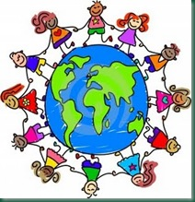
America’s History of Family & Marriage
Sociology
  Demonstrating America’s social history on family and marriage
  Explaining mixed raced families and marriages
  Describing global variations of families and different cultures
  Identifying the diversity of gender roles of the twentieth century
  Managing a dual-income family and marriage
  Presenting the structural changes of same-sex marriages
  Increasing divorce rates and single parents
  Displaying society and economics in the U.S.

Slide 3
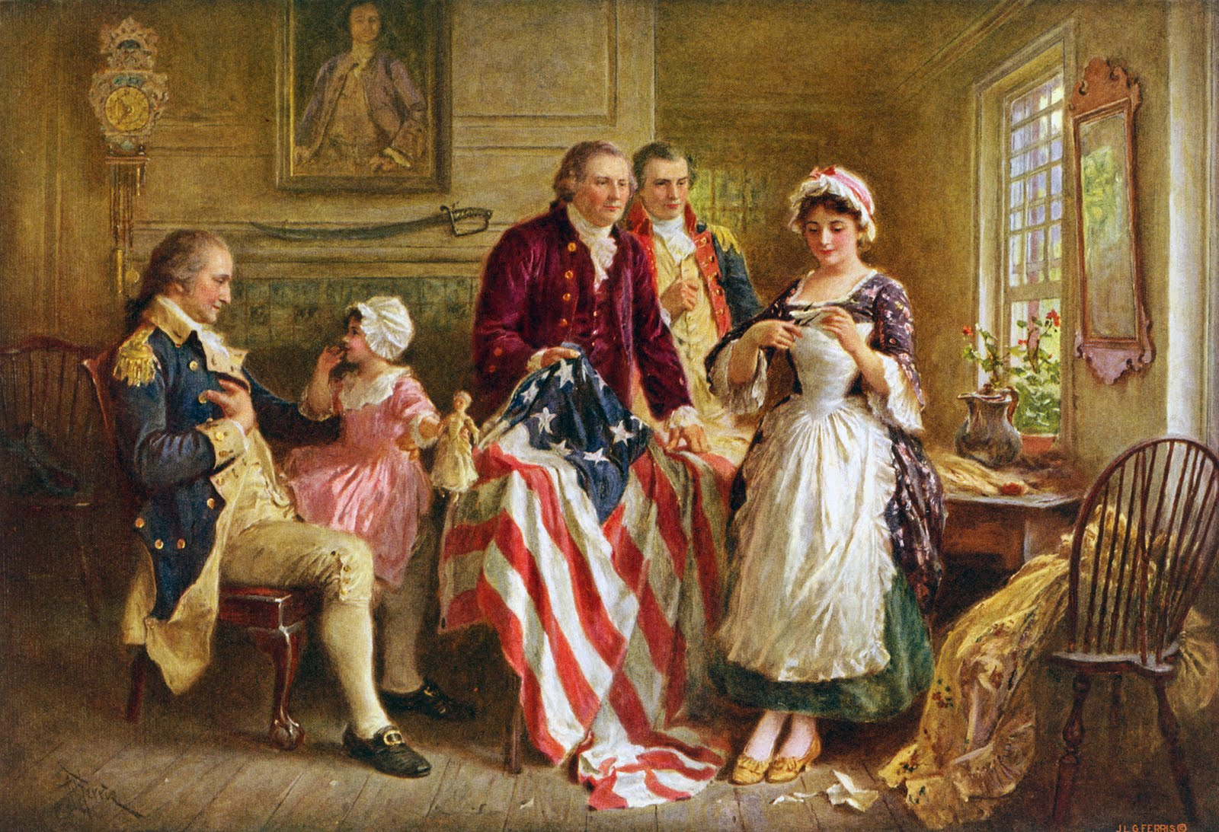
America’s Social History Marriage & Family
Pre-20th Century in an American Nuclear Family
Married until death do you part
Divorce was rare and unheard of
Men were dominate over their wives
Wives assisted their husbands taking care of home and children
Women were not aloud to work
Was a husband’s duty to provide for his wife and children
American Family in History

Slide 4
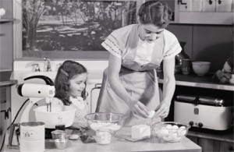


Gender Roles in the Twentieth Century
Not until the mid-19th century did the role of the male as the “good provider” emerge.
American’s lives had such rapid and dramatic change during World War II, as the social and economic roles of women.
Before Pearl Harbor happened, more than 80 percent of American men and women declared that it was wrong for wives to work outside the home if their husbands were employed.
In the 1970s married women began entering the work force in great numbers.
New technology has meant that many tasks that once required heavy physical exertion, and hence were restricted to men, can now be performed simply by pushing buttons.
Today there is 74.6 million women in the civilian labor force.

Slide 5

Interracial Families & Marriages
The Current Population Survey estimates that there are more than 450,000 black-white marriages today, compared with 51,000 in 1960.
In 1967, the Supreme Court ruled that a ban on interracial marriage was unconstitutional.
The law was overturned in Virginia and 15 other states. Still, a dozen states had the ban on interracial marriages on their books into the 1970s, though the laws were legally unenforceable.
Tolerance of intermarriage has been gradually increasing in recent years.
Interracial marriages are increasing because, in an ever more diverse and open society, more and more contact between people of different races is taking place.

Slide 6
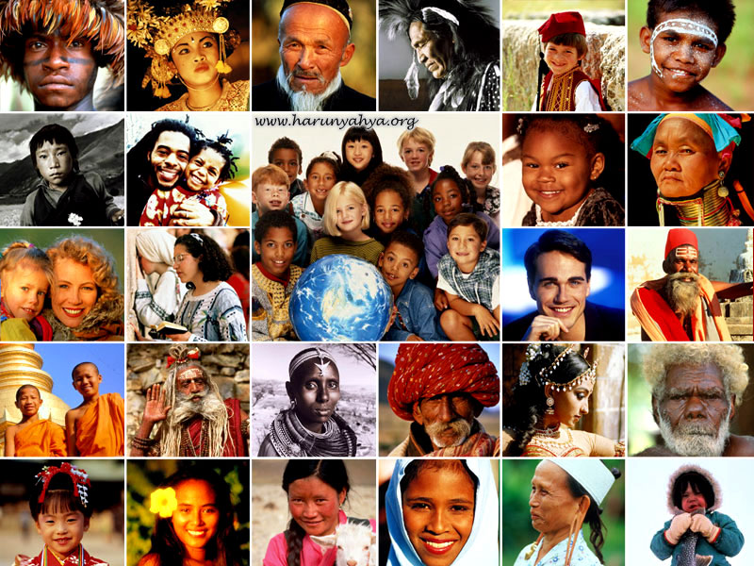
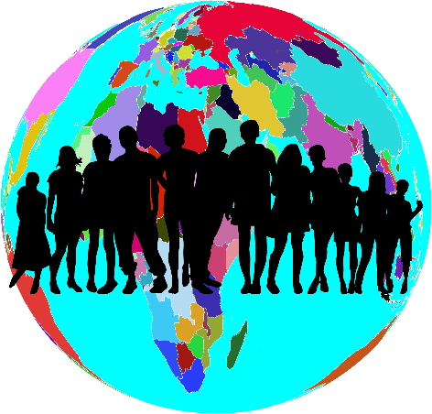
Global Variations of Families & Different Cultures
In nearly all countries across the world, many children under 18 live with both of their parents.
In Middle Eastern and Asian countries, an average of 80-90% of children live with both parents, with India and Jordan at the highest with 93% and 94%, respectively. Among Europe and North America, the United Kingdom and the United States are the only countries with fewer than 75% of children living with both parents.
Overall, living apart from both parents is uncommon for most of the world, except parts of Africa, Central and South America. Children in Africa are least likely to live with both parents, due to high rates of teen marriage, high parental morality, and the common practice of sending children to live with other relatives.
The lowest rates of children born outside of marriage occur in Asia and the Middle East. Many children are born outside of marriage in Eastern Europe.

Slide 7
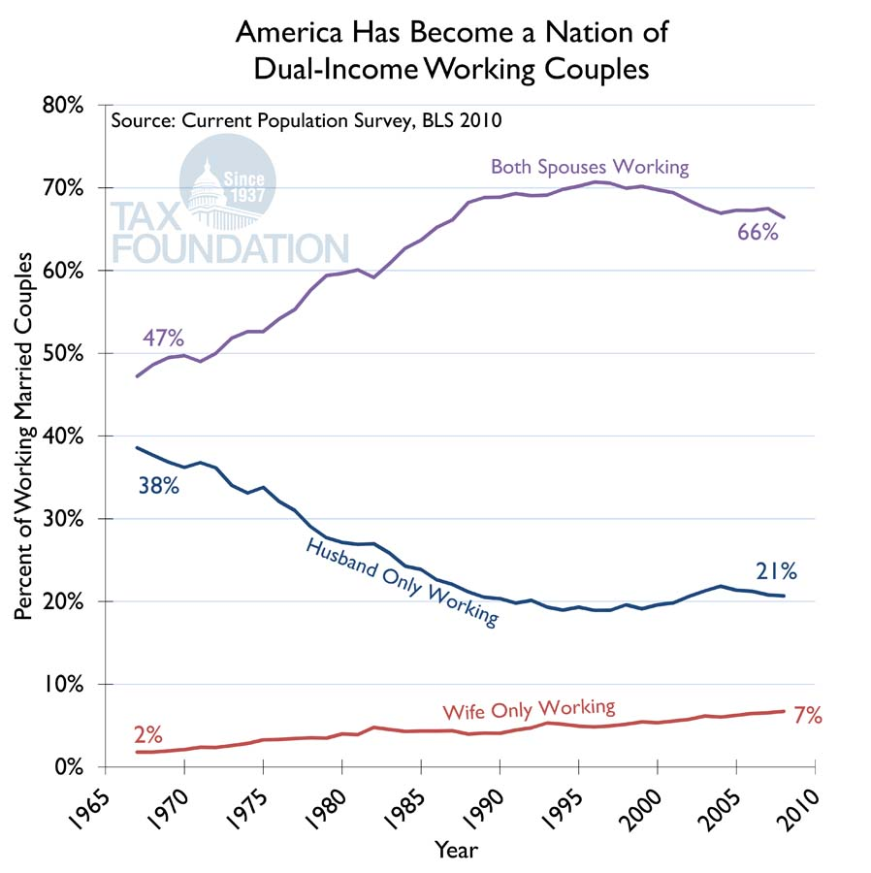


Dual-Income Family and Marriage
In 2002, only 7 percent of all U.S. households consisted of married couples with children in which only the husband worked.
Dual-income families with children made up more than two times as many households.
Between 1990 and 2010 married-couple households, consisted at 66% were dual-income families with children
In families where parents both work full-time, parenting duties are split more
It goes without saying that striking the right balance is a challenge.
It's worth spending some time and energy to figure out strategies that work for you and your partner.

Slide 8
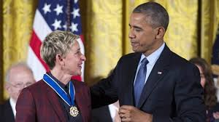
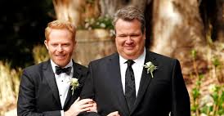
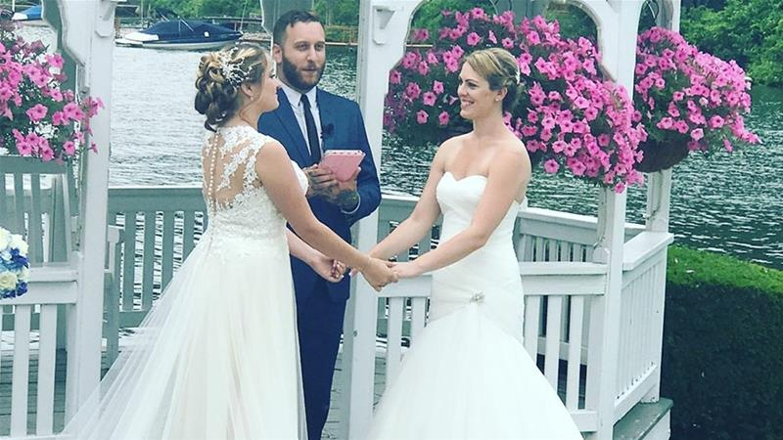
Structural Changes of Same-Sex Marriages
On June 26, 2015, President Obama and his administration have made historic strides to expand opportunities and advance equality.
Justice rights for all Americans, including Lesbian, Gay, Bisexual, and Transsexual Americans.
Ellen DeGeneres helped support gay rights and marriages movement.
President Obama awarded Ellen DeGeneres for The Presidential Medal of Freedom.
It is the Nation’s highest civilian honor, presented to individuals who have made especially meritorious contributions to the security or national interests of the United States, and to world peace.

Slide 9
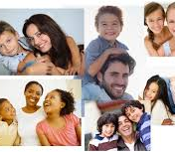
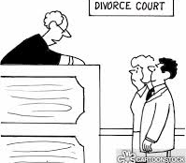
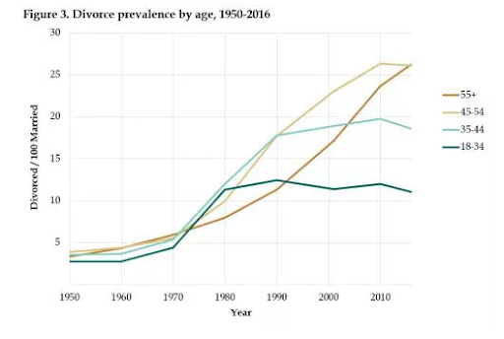
Divorce & Single Parents
In 1960, divorce was generally uncommon, affecting only 9.1 out of every 1,000 married people.
After the 1960s has been associated with the liberalization of divorce laws.
The majority of Americans stayed married, and most children lived in stable, two-parent families
The shift in societal makes up due to women increasingly entering the workforce.
24 million U.S. children younger than 18 are living with an unmarried parent
Divorce rates have skyrocketed in the 20th century, women are now more equal to men.

Slide 10
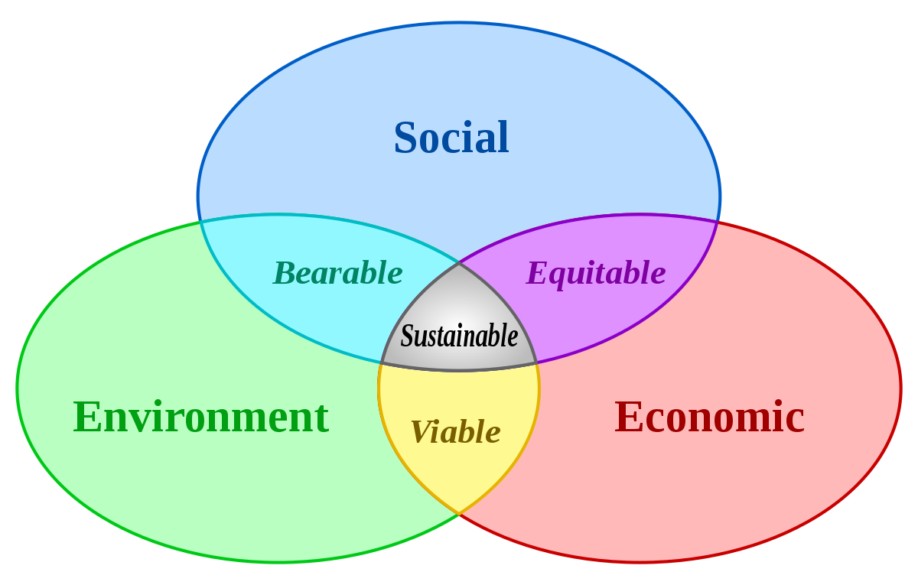
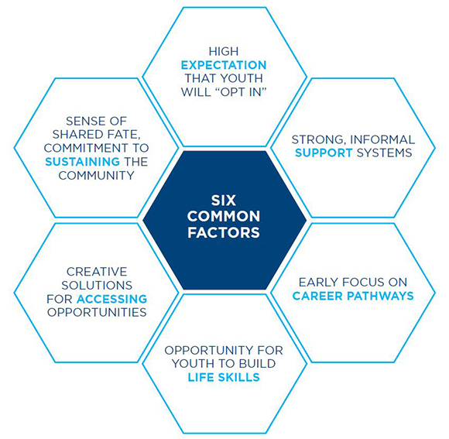
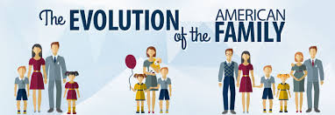
Society & Economics in the U.S.
Family structure in the United States has changed dramatically over the past fifty years.
Fifty years ago, highly-paid men often married women with less education working as secretaries or receptionists.
Changes in marriage patterns widen the income disparities among households.
The United States is one of high-income households made up of two doctors, lawyers, or university professors both with high salaries
Lower-income households made up of cohabiting adults with high-school educations and children related to only one of the adults.
This Photo by Unknown Author is licensed under CC BY

Slide 11
Conclusion
This presentation has concluded different subjects of today’s society in how it came to be in America. I presented slides from how our society use to be 50 years ago with historical events. Throughout the last 50 years, times have surely changed since then with some negative and positive outcomes. Women became more independent; they have equal rights to a man now. There is more divorce and single families now than before. The rights of gay marriages have been legalized by President Obama. America has grown stronger economically with dual-income families of all cultures across the globe.
With putting this PowerPoint presentation together and doing the research, has given me an even better understanding about how marriage and families evolve in our world. I hope presenting this presentation gives you a better understanding of how sociologist’s see the world, and what it means in our society.

Slide 12
References
CELELLO, K. Making Marriage Work : A History of Marriage and Divorce in the Twentieth-Century United States. Chapel Hill: The University of North Carolina Press, 2009. ISBN 9780807832523. Disponível em: http://search.ebscohost.com/login.aspx?direct=true&AuthType=ip,sso&db=nlebk&AN=282900&site=eds-live. Acesso em: 28 maio. 2020.
Croteau R. David, Hoynes William, @ Copyright by Hill Mcgraw 2019. Published in a revised sixth edition, The Business of Media: Corporate Media and the Public Interest, Copyright Act of 1976, Education
Katz MB, Stern MJ. One Nation Divisible : What America Was and What It Is Becoming. New York: Russell Sage Foundation; 2006. http://search.ebscohost.com/login.aspx?direct=true&AuthType=ip,sso&db=nlebk&AN=1069692&site=eds-live. Accessed May 28, 2020.

