Slide 1

Employee Motivation
Ubah Ismael
08/03/2022

Slide 2

Employee motived
Employee motivation is the amount of vigor, dedication, and innovation that employees bring to their work. A management concern is continually finding ways to inspire staff, regardless of how the economy is doing.
This will, in my opinion, be a great system for outlining the causes and implications of stress at work.
Due to the significance of this resource and the subject I'm discussing, a company with highly motivated employees will be an attractive place to work.

Slide 3

Describe chosen Psychological Principal Employee motivation at Workplace
1. Physiological - a person needs to have their physical needs, such as food, water, and shelter, supplied in order to survive.
2. Safety, which includes health and welfare, personal and financial security, and safety.
3. Love/belonging - the requirement for group identity, connections, and families.
4. Esteem is the desire to be respected by others and to feel self-assured.
5. Self-actualization, or the drive to fulfill all of your potential and grow to your fullest potential.
Expectancy - the feeling that your efforts will lead to the achievement of your desired outcome.
This depends on your prior experience, your level of confidence, and how challenging you perceive the objective to be at the workplace
Instrumentality, the conviction that you will be rewarded for exceeding performance standards.
Valence, or how much you appreciate the reward by your managers and the appreciation your hard work.

Slide 4
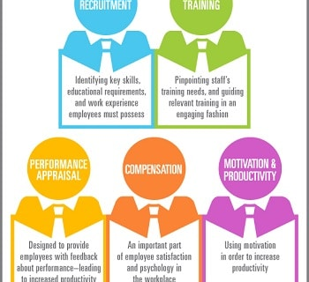
Psychological Principal Employee motivation

Slide 5

The chosen psychological principle/topic relates to collaborative workplace processes.
For this portfolio project, I've decided to focus on employee motivation. The success of a business depends on its capacity to inspire its workforce. It refers to the level of dedication, optimism, and vigor that employees of a company bring to their work each day.
Employees who are motivated are more likely to put in long hours and take an active role in operating the company. They consider themselves to be an essential component of the company.
Without employee motivation, businesses would produce less work and be less productive, and they will probably fail to meet important goals.

Slide 6

Important of employees Motivation
In business and management, it is important to take into account long-debated human behavior motivations.
I'll get the chance to talk about human actions at work and in other contexts thanks to this resource.
The actions of the employees at work will fall under this.
Additionally, this material is crucial since it delves deeper into business education principles that take into account human motivation

Slide 7
Reference slide in APA format
https://www.inc.com/encyclopedia/employee-motivation.html
Joan, P. (2019). Employee Engagement: Creating High Positive Energy at Work. Talent Management Ser. https://discovery.ebsco.com/c/zbkays/details/hqv5ykp6mj?limiters=FT%3AY&q=employee%20motivation%20
Claire, W. (2021). The importance of motivation in the workplace. Employment motivation. https://www.penguins.co.uk/incentive-travel-blog/the-importance-of-motivation-in-the-workplace
William, C. (2014). Motivating Employees Should Be One of a Leader's Top Priorities. Why Is Motivation Important? https://www.forbes.com/sites/williamcraig/2017/06/20/motivating-employees-should-be-one-of-a-leaders-top-priorities/?sh=3375148d1d7d

