Slide 1
Christina Binion
Production Manager
Workplace Capabilities Strengths;
My individual strengths are that I am a very honest, responsible, calm, and practical, proud employee. I like to create and enforce order working to achieve any goal I set my mind on

Slide 2

Occupation Research
What is my job outlook?
What is the pay for my career?
How do I become one?
The projected outlook for production managers show little or no change from 2018 to 2028.
The median annual wage for production managers was $105,480 in May 2019. I would not expect to earn that right out of school.
Production managers typically need a bachelor’s degree and several years of related work experience. In some company’s certificates may be required such as food safety, and internal auditing. Sometimes, production workers with many years of experience take management classes to become production managers.
This Photo by Unknown Author is licensed under CC BY-NC-ND

Slide 3
Career Development Theories
What theorist (Holland, Super, Krumboltz or Savickas) do I believe in and why?
I believe in Savickas and Peavy’s Constructivist Theory the most. I think careers are not always something you choose as a young adult. I struggled trying to figure out what I wanted to be when I grow up, so I got a job where my dad had worked. I have always been adaptable and able to do anything. I have 26 years of experience to look back on and utilize if I want to move up in my career. I think using my experience to move forward is the best path. The constructivist theory is a good way to see my glass half-full and use the experience I have to move forward.

Slide 4
Action Plan; Workplace Documents
My workplace Documents Assessment level was 6.
According to workplace documents, I can make an educated guess about the meaning of an acronym, jargon, or technical term from context. I can apply information/instruction to a situation not directly described in the document or to a completely new situation. I can apply principles inferred in a passage to a situation not directly described in the document or to a new situation.
I can improve my understanding if I slow down and take my time to listen more.
I can use this assessment for job interviews to show that I can make job-related decisions and solve problems. I can understand what someone is trying to say and act on my educated guess. This shows the level or characteristics and skills I am capable of. I hope to be at level 7 before I graduate from Bryant & Stratton.

Slide 5

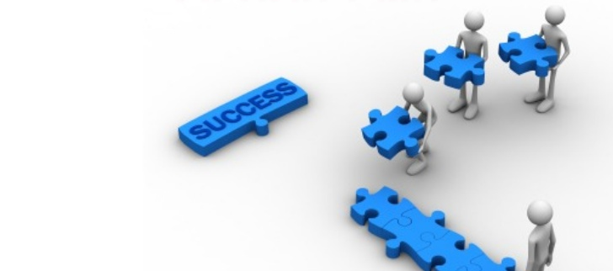
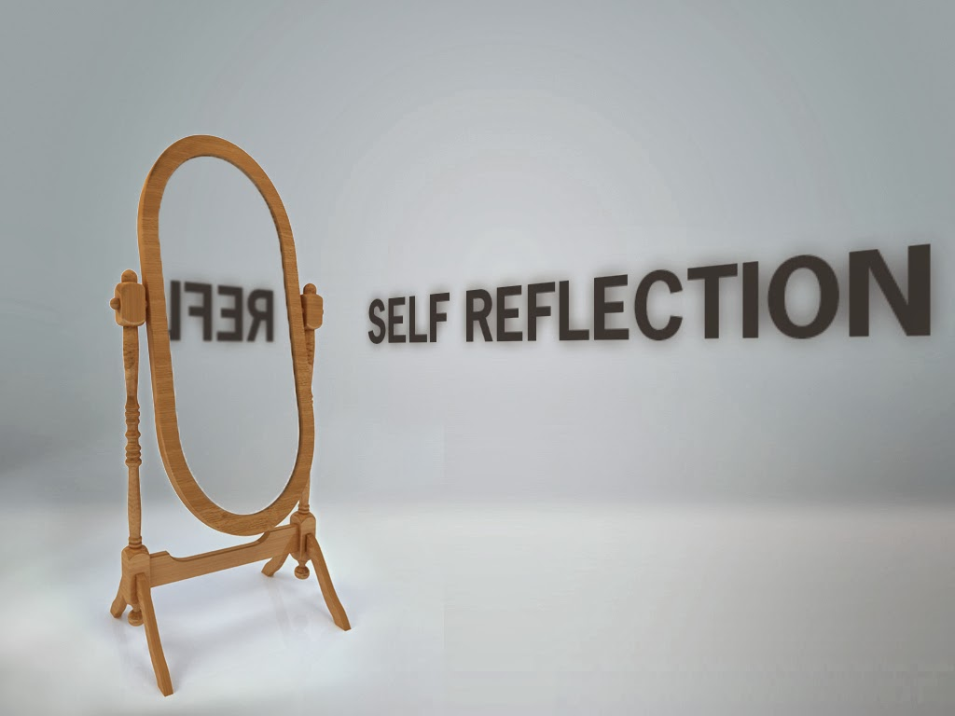
Conclusion
This Photo by Unknown Author is licensed under CC BY-SA-NC
This Photo by Unknown Author is licensed under CC BY-NC
This Photo by Unknown Author is licensed under CC BY-NC
Main point 1
Main point 2
Main point 3
How to write a good resume, cover letter, and always include a thank you letter for an interview.
Having an “Action Plan” can help you focus on self-improvement and work goals.
Reflections can help you understand your own thoughts and ideas by writing them out and thinking through an issue or strategy.

