Slide 1

Marriage and Family
Interracial Marriages
Created By: Sharon Grant
Principles of Sociology- SOC 102
Professor Austin
Bryant and Stratton College

Slide 2
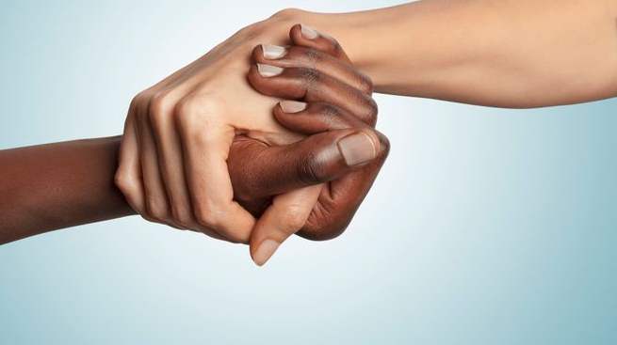
Interracial marriages
BACKGROUND: Over the years there have been many interracial couples across the world, not matter what race the individuals are. It has official been 55 years since interracial marriages became legal in the United States. It became legal when the decision for Loving vs Virginia was passed on June 2, 1967. The number of marriages with interracial couple has increased by 5 times since it became legal. With a 17% increase over the years.

Slide 3
Interracial marriages we frowned upon in the 1940’s.
Interracial marriages are more accepted in today’s society
Younger people and native native-born adults are more likely to marry out of their racial or ethical group than are older people

Slide 4
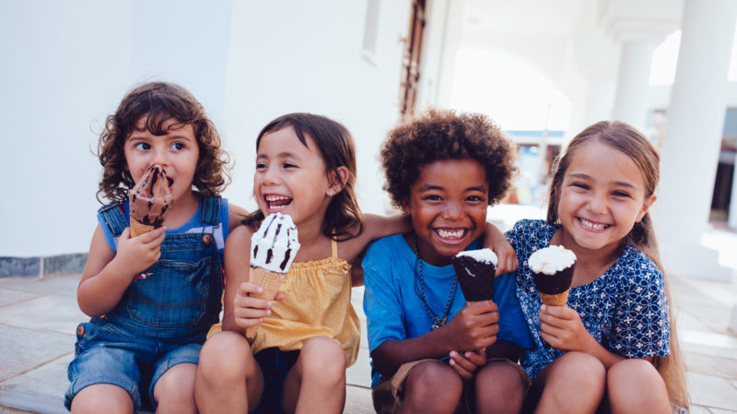
Society will see that multiracial and multiethnic people are becoming popular.
African American family members are perceived to be the most supportive and accepting when involving one of their own.

Slide 5
Research show that mixed-race children can have social and psychological problems from feeling like they are not a member of any race.
Some people perceive that fraternal twins are black and white. However two children born from the same parents that one is black and the other is white are not different races, they are the same race.

Slide 6
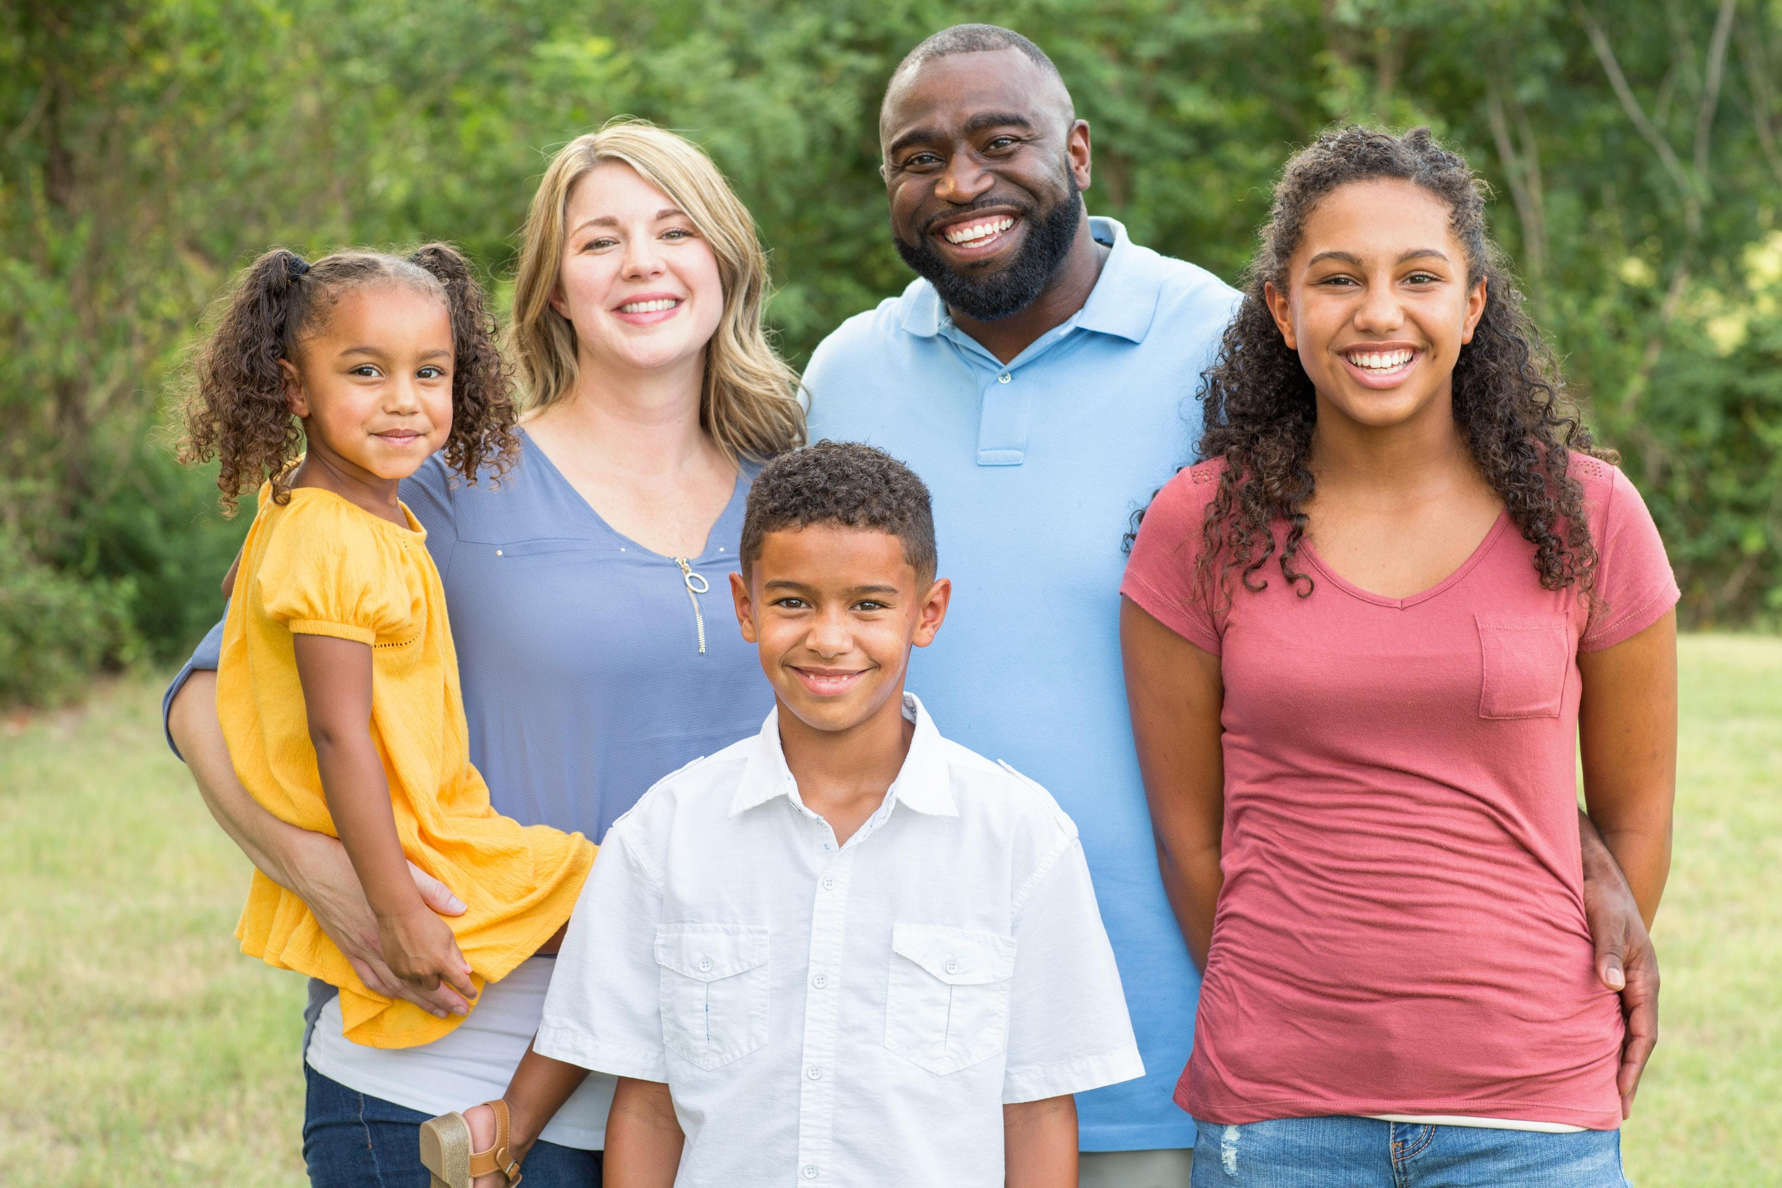
“Children of Interracial Families” is believed to be the first national gathering to address children of interracial marriages. It was a 2-day meeting of 130 experts and members of interracial families.

Slide 7
Mr. Bardwell, a veteran member of the Justice of the Peace refused to marry an interracial couple. He says he is not racist, but his main concern are the children in an interracial marriage.

Slide 8
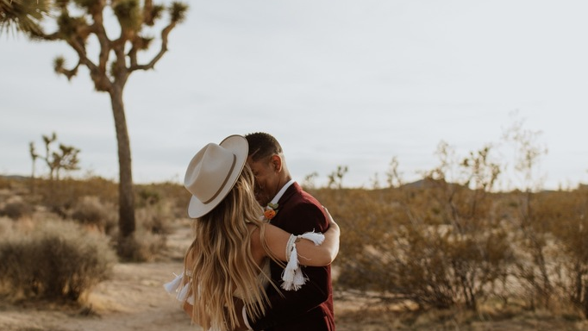
In a 2008 study of 182 mixed-race high school students in California showed that these students were not focused on their features like skin color or hair, but they were more focused on their heritage making them unique.

Slide 9
As recent as 1962 J.D. Teicher, who is a psychologist noted that “Although the burden of the black child is recognized as a heavy one, that one of the black\white child is seen to be heavier.
Statistics show that African American spouses in a biracial marriage get more support than couples in other non-biracial marriages.

Slide 10
Graph that shows Intermarriage Rates of Newlyweds in 2015 (Soci 102- pg. 261.)

Slide 11
CONCLUSION
Up on my conclusion, it is clear that children can be affected by biracial marriages, however it starts at the home. If parents and guardians raise children to treat everyone equally. Show a child that there is no difference because of the color of your skin. Children who come from a biracial relationship should be taught that they too are no different from the other children and again it is the parent’s responsibility to teach the child that they to have a place in this world. I feel it is never too early to teach a child that skin color and a child’s clothing or their religion does not make them different, so children should be taught early in life about equality.

Slide 12
Reference Page
1. SOC 102 (Page 261)- Bryant & Stratton College
2. Richard Lewis Jr. , George Yancy (1980), Biracial Marriages in the United States: Analysis of Variation in Family Member Support
3. "THE FAMILY; CHILDREN OF INTERRACIAL MARRIAGE". Nytimes.Com, 2020,
https://www.nytimes.com/1984/06/20/garden/the-family-children-of-interracial-marriage.html. Accessed 6 June 2020.
4. Jonsson, Patrik. "La. Interracial Marriage: Is Life Tougher For Biracial Kids?". The Christian Science Monitor, 2009, https://www.csmonitor.com/USA/Society/2009/1016/p02s16-ussc.html. Accessed 6 June 2020.

