Slide 1
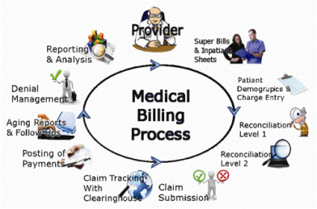

MCCG145 CPT AND HCPCS II
CODING SYSTEMS POWER POINT PRESENTATION

Slide 2

Exactly what is medical coding:
Medical coding is the process of converting diagnosis, procedures and supply information provided by healthcare individuals into ICD-10, CPT and HCPCS codes for billing purposes. Coders need a strong background in medical terminology and anatomy to correctly code procedures and diagnosis identified in the provider documentation. Coders must also understand billing to apply correct guidelines for some procedures and services.
Medical billing is the process of electronically filing claims electronically to the insurance companies using encrypted technology to secure patient information.

Slide 3
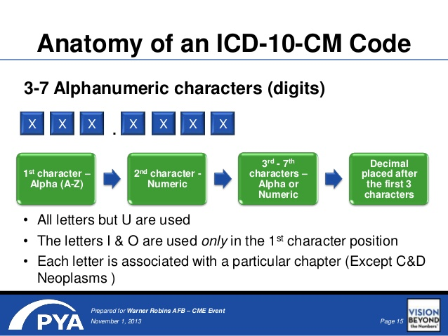
Overview of the different coding sets:
ICD-10-CM: The International Classification of Diseases.
All providers, including physicians, use this code set in healthcare settings.
Medical Coders select the codes based on documentation in a patient’s record.
Centers for Disease Control and Prevention (CDC) developed and maintains this code set.
Payment Information: Physician reports diagnosis codes on claims.
The Medical Administrative Contractor (MAC) uses codes to determine coverage, not the amount the Centers for Medicare and Medicaid Services (CMS) will pay for furnished services.
Inpatient providers report ICD-10-CM diagnosis and ICD-10-PCS procedure codes on claims, MAC uses to assign discharges to appropriate Medicare Severity-Diagnosis Related Group (MS-DRG).

Slide 4

ICD-10-PCS (Procedures)
Code set is used by providers to report procedures performed, only, in the United States hospital inpatient healthcare settings.
Not used by physicians to report services, including ambulatory and inpatient visits.
The CMS developed and maintains this code set.
Payment information
Inpatient providers report ICD-10-PCS procedure codes and ICD-10-CM diagnosis codes on claims, which the MAC will use to assign discharges to the appropriate MS-DRG

Slide 5
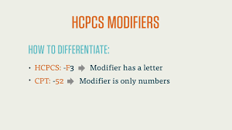
Introduction to HCPCS CODES
HCPCS Codes are classed in different levels.
Level I codes and modifiers are the CPT codes.
Level II codes and modifiers primarily identify products, supplies, and services not included in the CPT codes.
When providers report HCPCS codes on claims, the MAC uses the codes to either determine coverage or the amount CMS will pay for furnished services (less beneficiary and copayments).

Slide 6
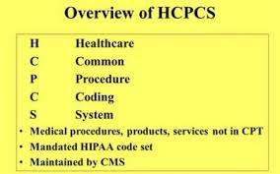
Level I HCPCS: CPT
Code set that providers use to report medical procedures and professional services furnished in ambulatory/outpatient settings, including physician visits to inpatients. The AMA developed, copyrighted, and maintains the code set.
Payment information
Claims are paid when the decision is made that Medicare can reimburse for the services (less beneficiary coinsurance and copayments).
Physicians, suppliers, outpatient facilities, and hospital outpatient department.
Follow CMS guidance when reporting CPT codes, including CPT modifiers for laterality.

Slide 7
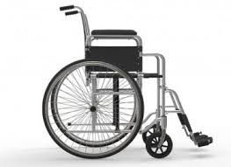
Level II HCPCS: Alphanumeric HCPCS
The code set providers use to report medical items, supplies, procedures, and certain professional services not described by any CPT codes.
CMS maintains the code set, with the exception of the code set for Dental services (D-codes). The American Dental Association (ADA) developed, copyrighted, and maintains the D-codes.
Payment information:
When providers report Level II HCPCS codes on claims, the MAC uses the codes to wither determine coverage or payment for furnished items and services (less beneficiary coinsurance and copayments).
Physicians, suppliers, outpatient facilities, and hospital outpatient departments:
Report and receive payments for furnished services, including physician visits to inpatients, based on HCPCS codes.
Use onlyICD-10-CM (diagnosis) codes, not ICD-10-PCS (procedure) codes on claims.
Follow CMS guidance when reporting HCPCS codes, including HCPCS modifiers for laterality.

Slide 8
The impact of improper coding
Impact on Patient’s
Inaccurate medical coding can lead to frustration and confusion and a potential breakdown of the relationship you have built with valued patients.
CODING ERRORS DELAY OR PREVENT REIMBURSEMENT
Medical coding is the life-blood of a practice. That is how the services you provide are transformed into billable revenue. Failure to provide correct coding can cause these payments to be delayed, denied, or limited. MEREM Healthcare Solutions has found that an alarming majority of claims are rejected or denied upon initial submission. The reimbursement for denied claims depends on a practice’s efforts for correcting and resubmitting claim denials.
A miscoded procedure’s reimbursement has the potential to differ by up to $15,000. Delayed reimbursements are also costly, as they are unexpected. A build-up of delayed reimbursements can cause a backup of paperwork, stress on your staff, overlooked coding errors, and even more incorrect coding to be filed resulting in loss of revenue for your practice.
This back up of denials due to coding errors requires focused efforts to catch up on claim denial and improve your revenue cycle.

Slide 9
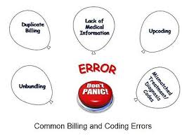
CODING ERRORS DELAY OR PREVENT REIMBURSEMENT
Medical coding is the life-blood of a practice.
A miscoded procedure’s reimbursement has the potential to differ by up to $15,000.
CODING ERRORS MAY LEAD TO FRAUD AND ABUSE FINES
As you can see, incorrect coding causes poor patient care and trouble with reimbursements, but what happens to those responsible?.
The False Claims Act (FCA) is the enforcement tool used for false claims. The consequences could be a monetary penalty or a legal issue if the claim is named fraudulent. To prove fraud occurred rather than abuse, the.

Slide 10

Examples for each provider setting:
R10.13 - Epigastric pain
Scenario 1: Physician’s Office Visit
47 year old male presented in my office today with CC of mid-abdominal epigastric pain. Pain has become “severe” and constant.
Patient reports eating 6 slices of pepperoni and sausage pizza last night and his symptoms got worse. VS: T 99.8°F, otherwise normal.
Problem focused history: Patient was seen on October 12, 2018 for annual physical. No abnormal findings. Family history of pancreatitis, patient’s mother.
Problem focused exam: The abdomen is distended and tender across upper abdomen. Bowel sounds are diminished in all four quadrants.
Assessment and Plan
Diagnosis is acute pancreatitis. Straightforward medical decision making: Admit to hospital immediately. Orders written and sent to the on-call physician. Blood drawn for labs.
Patient’s wife was notified of plan; she will transport to the hospital by private vehicle.
ICD-10-CM code: K85.90 Acute pancreatitis without necrosis or infection, unspecified
CPT code: 99212

Slide 11
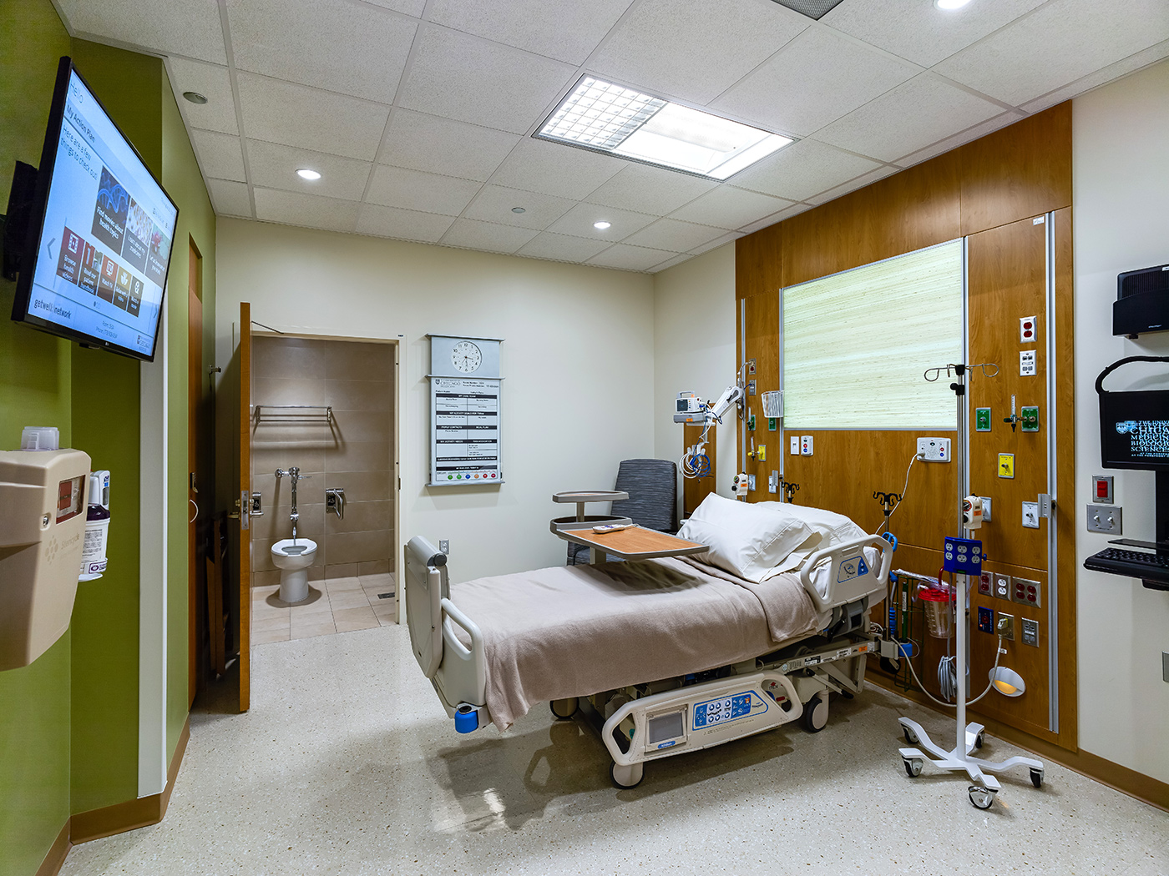
Scenario 2: Hospital Inpatient Visit
85-year old female seen in the ER today complaining of confusion, feeling weak and dizzy. She had mowed her yard in 78 degree heat. Patient did not remember hydrating today.
Problem focused history; Patient has never experienced these symptoms, relatively healthy for her age.
Upon problem focused examination: VS T 101.0 BP 112/65 , sunken eyes, very dry skin.
Blood test performed and revealed low levels of electrolytes -sodium and potassium. Diagnosis is severe dehydration and hyponatremia. Straightforward medical decision making.
Plan of Care: Patient was admitted to hospital and treated for severe dehydration with 90 minutes Intravenous rehydration. She will remain under observation until rehydrated.
ICD-10-CM codes are: E86.0 Dehydration, E87.1 Hypo-osmolality and hyponatremia Sodium [NA] deficiency
CPT: 99281
ICD-10-CPT codes: 96360 Intravenous infusion, hydration; initial, 31 minutes to 1 hour, and
96361 each additional hour

Slide 12

Scenario 3: Hospital Outpatient
45 year old female scheduled for Outpatient cystourethroscopy. Pre-Operation Exam performed and no problems found. Patients vitals and blood work were normal.
Medically necessary for patient’s urgency incontinence when there is no urinary tract infection. Cystourethroscopy performed to examine the bladder and urethral lumen to look for urethral diseases or abnormalities.
ICD-10-CM code: Y92.530 Ambulatory surgery center as the place of occurrence of the external cause.
ICD-10-CM code: N32.9 Bladder disorder, unspecified
CPT code: 52000 Cystourethroscopy (separate procedure)

Slide 13
Sources:
327 Changes to 2018 HCPCS Level II ...
aapc.com
www.medpartners.com › coding-tip-laterality
www.medpartners.com › coding-tip-laterality
www.medpartners.com › coding-tip-laterality
http://www.careercoders.com/
https://www.cms.gov/Outreach-and-Education/Medicare-Learning-Network-MLN/MLNProducts/Downloads/ICD9-10CM-ICD10PCS-CPT-HCPCS-Code-Sets-Educational-Tool-ICN900943.pdf
www.slideshare.net
Let's Code It! ICD-10-CM/PCS mheducation.com
HCPCS Modifiers in Billing and Coding medicalbillingandcoding.org
https://www.aapc.com/blog/41834-skip-prior-authorization-for-these-4-hcpcs-codes/
327 Changes to 2018 HCPCS Level II ... aapc.com
www.meremhealth.com

