Slide 1


What is the purpose of ICD-10-PCS Coding?
This code set is used to identify services and treatments performed to an inpatient (person admitted to the hospital). It was created to accompany the WHO’s icd-10-cm diagnosis classification system. Icd-10-pcs enables each code to have a standard structure, be descriptive, and expand to accommodate future needs. This procedure coding system is used to gather data, collect information, determine payment, support the HER for all inpatient services and procedures in the icd-10-pcs manual.

Slide 2
ICD-10-PCS Code Structure
Codes meet specific objectives, essential characteristics, and follow general guidelines.
This allows for the coder to meet today’s data requirements. It is a major step toward building a health in formation infrastructure that is suited for the current electronic era.
All codes in ICD-10-PCS are 7 characters in length, and each of these characters represents a particular aspect of the procedure. (Barta, DeVault, and Zeisset, 2011)
Codes are constructed from flexible code components using Tables.
Codes are alphanumeric. Each code is made-up of any of the 10 digits 0-9 and any of the 24 letters A-H, J-N, and P-Z. The letters O and I are not used so as not to be confused with the number 0 and 1.

Slide 3
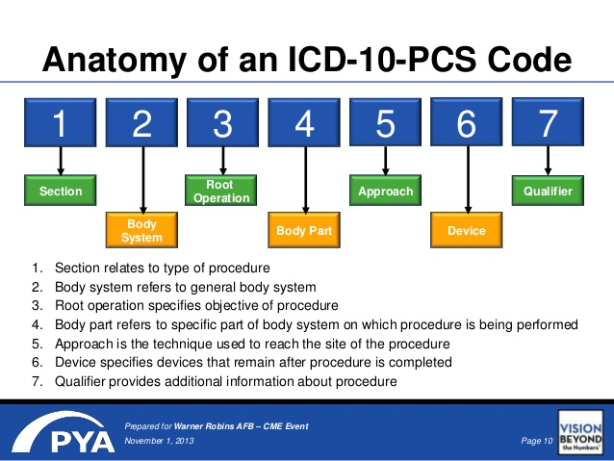

Slide 4
How to create an icd-10-pcs code using the pcs code tables
Step 1: Locate the main term in the Alphabetic Index.
The main terms are often common procedures, such as Appendectomy. They can also be a root operation value, like resection, or they both may be body parts like arm or leg.
Step 2: Find the Applicable Table.
Once the coder finds the first 3 or more code characters in the Alphabetic Index, the next step is to refer to the appropriate Table. When using the ICD-10-PCS code book, the coder must locate the Tables, which are arranged in a series. The coder has to review the section, body system, and root operation definition and then check to see if the first 3 characters referenced by the Alphabetic Index match.
Step 3: Continue Code Building.
The coder can continue building the ICD-10-PCS code by selecting a value from each column for the remaining 4 characters.
To do this, the coder selects the 4th character from the Body Part column, selects the 5th character from the Approach column, and selects the 7th character from the Qualifier column.
(Leon-Chisen, 2011)

Slide 5
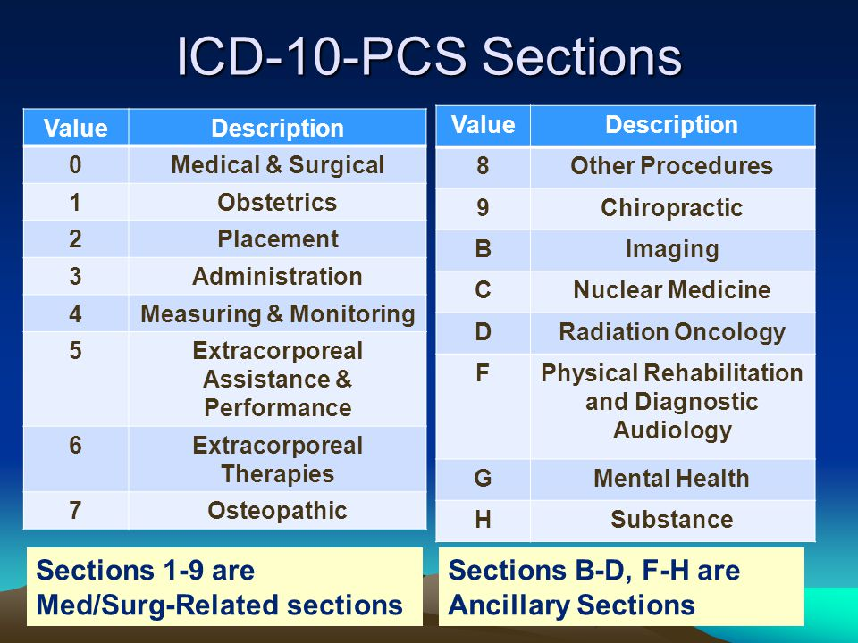
Icd-10-pcs defines the term procedure to mean the complete specification of the seven characters. Each procedure is divided into specific sections that identify the general type of procedure with the first character, either a number or letter, designating the section. The sections and their corresponding section identifier (number or letter) are as follows:

Slide 6
Example of an icd-10- PCS code and the steps to create it.
ICD-10-PCS code for a manually assisted delivery is 10E0XZZ (obstetrics, pregnancy, delivery, products of conception, external approach, no device, no qualifier).
The procedure code 10E0XZZ is in the obstetrics section and is part of the pregnancy body system, classified under the delivery operation. The applicable body part is products of conception.

Slide 7
Sources:
Article: What is ICD-10-PCS? By Universal Class
(Barta, DeVault, and Zeisset, 2011)
ICD-10-PCS: An Introduction for Coders… slideplayer.com
ICD-10 Presentation Takes Coding to…slideshare.net

