Slide 1


Articulation Presentation
Career Development 3
Professor Malloney
By Channell Carmon

Slide 2
Business Law & Ethics
Outcome
Brief description of the course portfolio project, including summary of how outcome was met
Participate in social, academic, and professional communities for individual growth and to function as a citizen of a multicultural world.
BLE has taught me about the judicial system works. As well as what w white collar crime is.

Slide 3


English 102
Explain the role of business in a global environment
I had to learn about how to do memos and we had to do my essays. English 102 taught me how to do a lot of grammar.
This Photo by Unknown Author is licensed under CC BY
This Photo by Unknown Author is licensed under CC BY-SA-NC

Slide 4

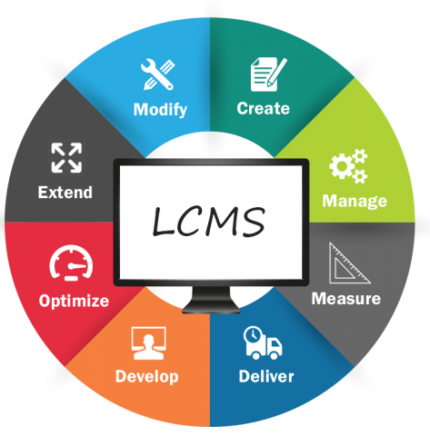
Management Principle
Recognizes management and leadership skills
Learning management principles was very difficult but fun to learn. It teaches you the management process.
This Photo by Unknown Author is licensed under CC BY-SA
This Photo by Unknown Author is licensed under CC BY-SA-NC

Slide 5
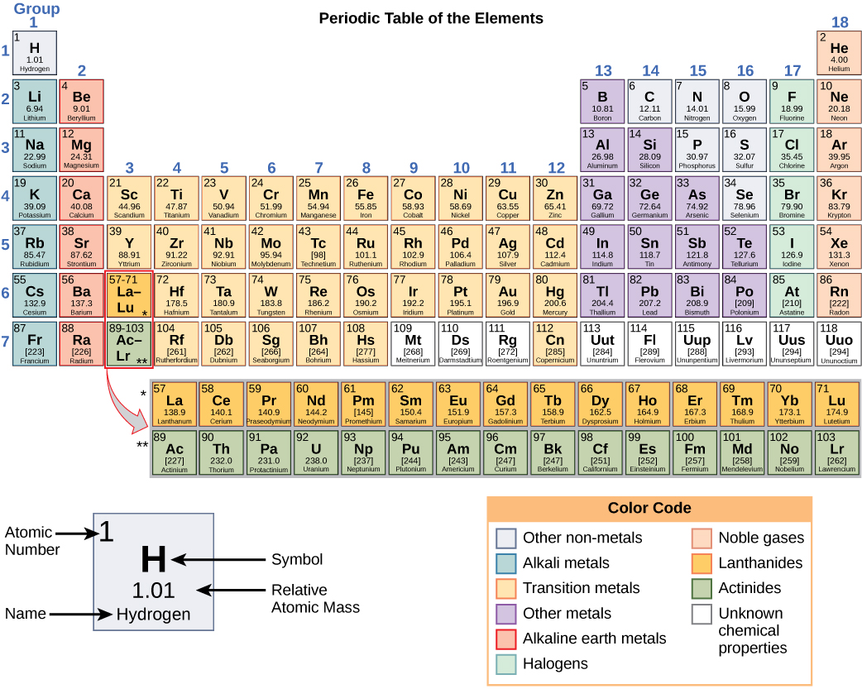
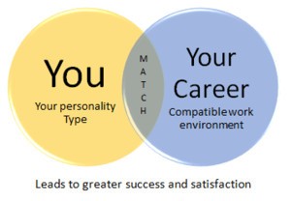
Career Development 1
Demonstrate knowledge of numeric measurements within the business environment to make informed decisions
I learned about career theory’s and we also had to do that act testing to see what level we were on
This Photo by Unknown Author is licensed under CC BY-SA
This Photo by Unknown Author is licensed under CC BY

Slide 6

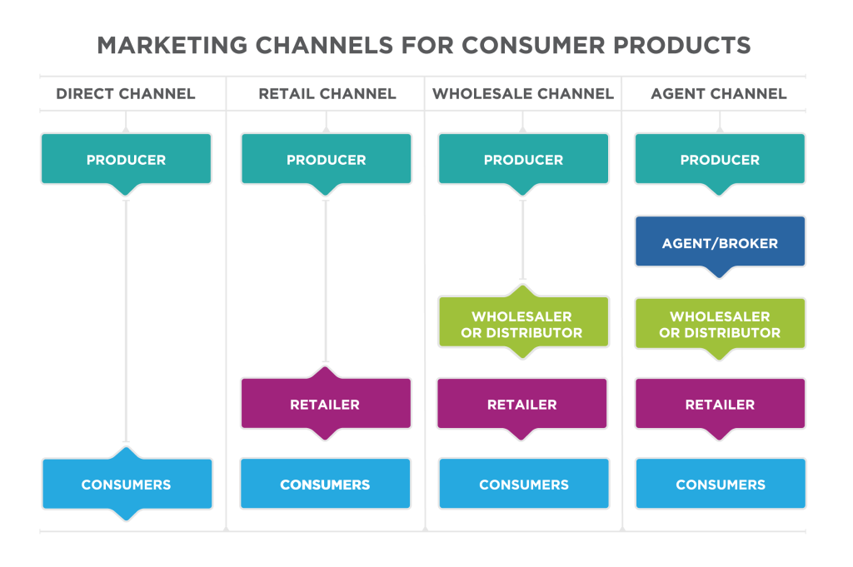
Marketing Principles
Select and apply current technology skills to specific business applications such as social media and cloud technology
Marketing principles has a lot of good qualities of management I learned about the four Ps in marketing
This Photo by Unknown Author is licensed under CC BY
This Photo by Unknown Author is licensed under CC BY-SA-NC

Slide 7
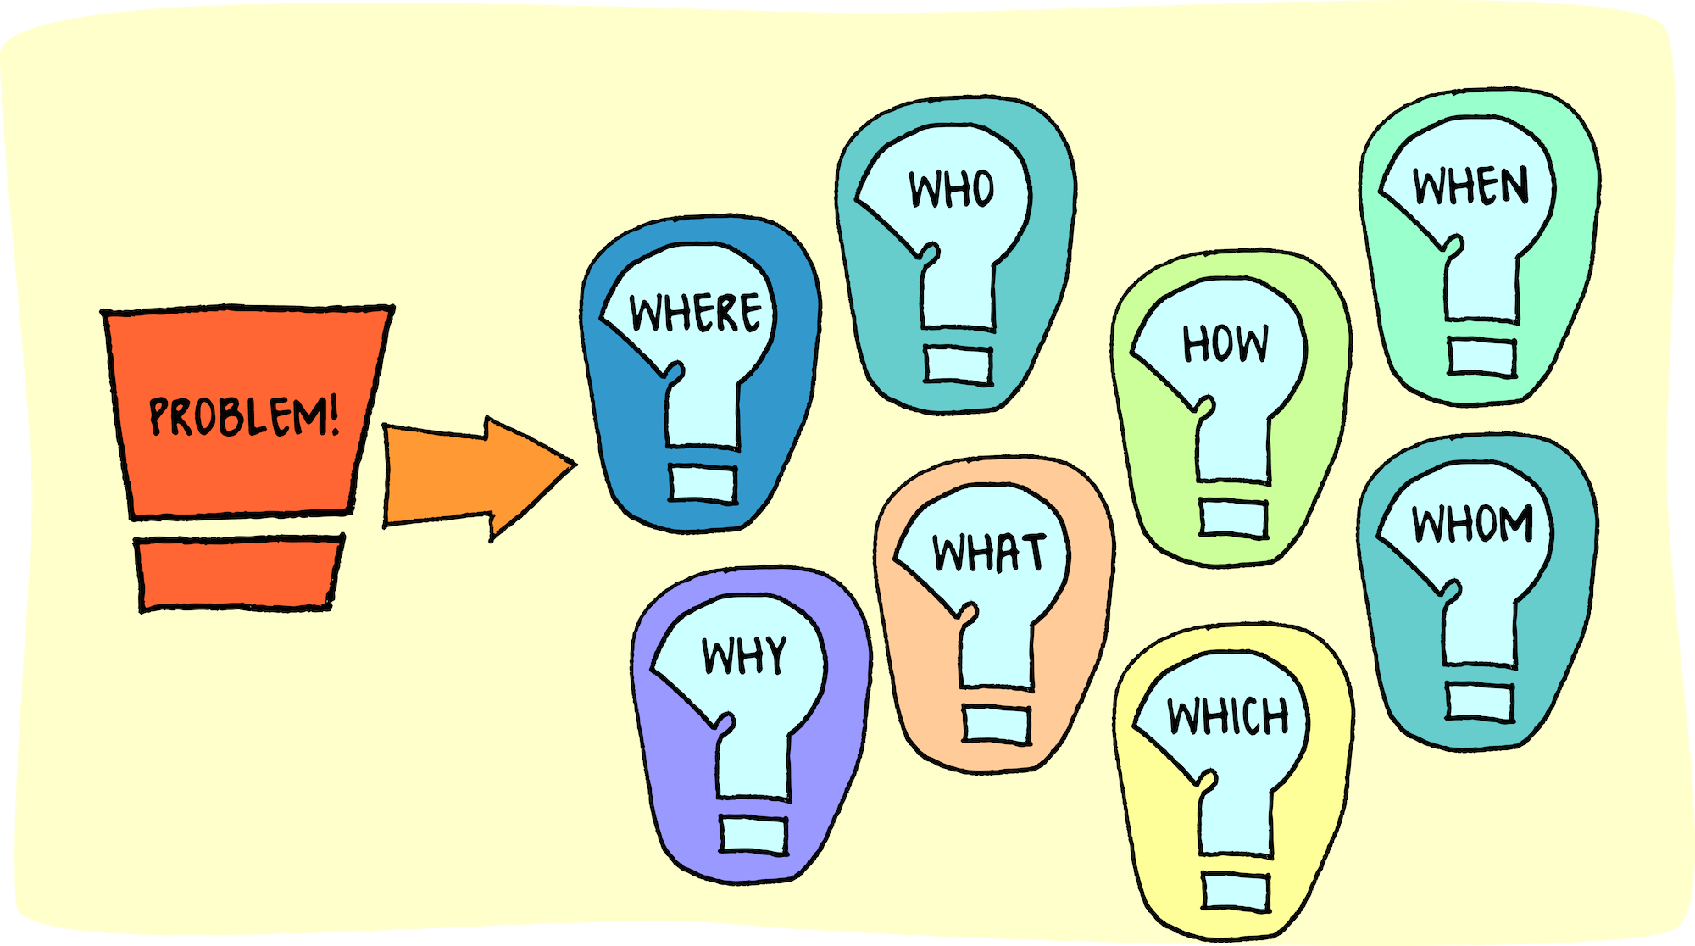
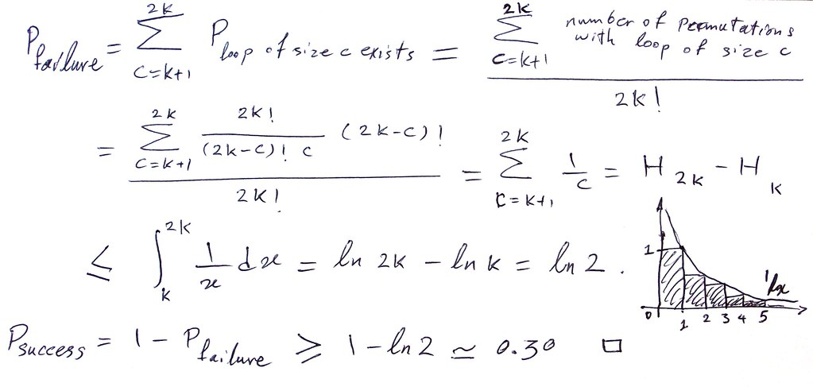
College Math
In College Mathematics I lea about integers and other math that was hard, but at the end I learned a lot.
Identify and apply the basic functions of management such as staffing, planning organizing, controlling and leading to the decision -making process.
This Photo by Unknown Author is licensed under CC BY
This Photo by Unknown Author is licensed under CC BY

Slide 8


Learning Communities
Formulate ethical decision-making skills that can be applied in the workplace
I learned how to get along with my peers and try to communicate with others.
This Photo by Unknown Author is licensed under CC BY-SA
This Photo by Unknown Author is licensed under CC BY-NC

Slide 9
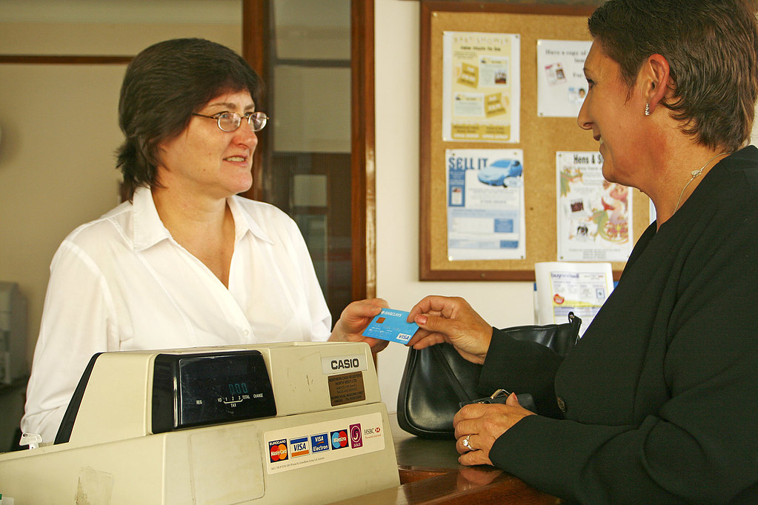

Sales and Service Principles
Utilize appropriate current technology and resources to locate and evaluate information needed to accomplish a goal, and then communicate findings in visual, written and/or oral formats
Sales and Service Principles was very interesting to learn. I learned how to do sales and customer service skills.
This Photo by Unknown Author is licensed under CC BY
This Photo by Unknown Author is licensed under CC BY-NC-ND

Slide 10

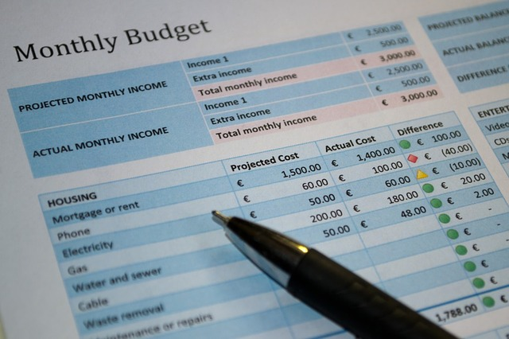
Accounting Principles 2
Follow established methods of inquiry and mathematical reasoning to form conclusions and make decisions.
This was a new process I learned, very different but also taught me how accounts are helpful to businesses
This Photo by Unknown Author is licensed under CC BY-SA
This Photo by Unknown Author is licensed under CC BY-SA

