Slide 1

E-Portfolio Project
Skylar Pero
Bryant & Stratton College
Medical Assisting
2021

Slide 2
Institutional outcomes
Information, Literacy, and Communication - Utilize appropriate current technology and resources to locate and evaluate information needed to accomplish a goal, and then communicate findings in visual, written, and/or oral format.
Relational Learning - Transfer knowledge, skills and behaviors acquired through formal and informal learning and life experiences to new situations.
Thinking Abilities – Employ strategies for reflection on learning and practice, in order to adjust learning processes for continual improvement.
Quantitative and Scientific Reasoning – Follow established methods of inquiry and mathematical reasoning to form conclusions and make decisions.
Community and Career – Participate in social, learning, and professional communities for personal and career growth.

Slide 3
Program outcomes
Communicate effectively, utilizing content knowledge of medical terminology, anatomy, physiology, and pathophysiology.
Demonstrate and practice behavior consistent with the legal and ethical standards of the profession, including working efficiently and collaboratively in a team setting.
Using standard safety and risk-reduction precautions, demonstrate administrative and clinical skills to the AAMA entry-level competency standards.

Slide 4
Information, literacy, and communication
To vaccinate or not to vaccinate
Vaccines are a huge topic of debate today for many reasons. Many parents are hesitant to get their children vaccinated even though many vaccines are mandated for children to be enrolled in school. In this essay, I intend to inform as well as persuade my audience about vaccinating their children with my topic of school-mandated vaccines. By looking at school-mandated vaccines, there are opposing opinions on whether certain vaccines should be mandatory. This essay argues that it is necessary to have school-mandated vaccines to alleviate virus outbreaks that pose a threat to children.
The first artifact I have chosen is my final English essay from English 102
This first artifact complies with the Institutional outcome; information, literacy, and communication, because it required me to find 5 sources and evaluate them
I then had to communicate my findings in written format, to accomplish my goal of educating and persuading my audience to vaccinate their children.

Slide 5
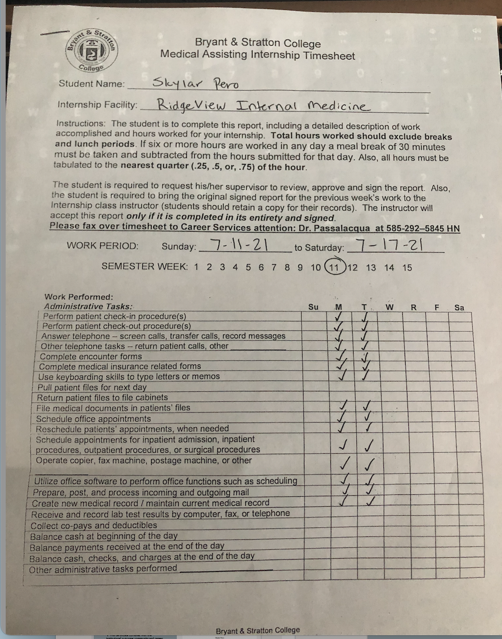
Relational learning
The second artifact I chose was a time sheet from my internship at Ridgeview Internal Medicine Group LLP.
This artifacts complies with relational learning, because it shows that I have used the Knowledge, skills, and behaviors learned in my courses, and applied them to the workplace.
I have even expanded on my knowledge and gained new skills through my internship, such as ear irrigation, and getting preauthorization for procedures and medications.

Slide 6
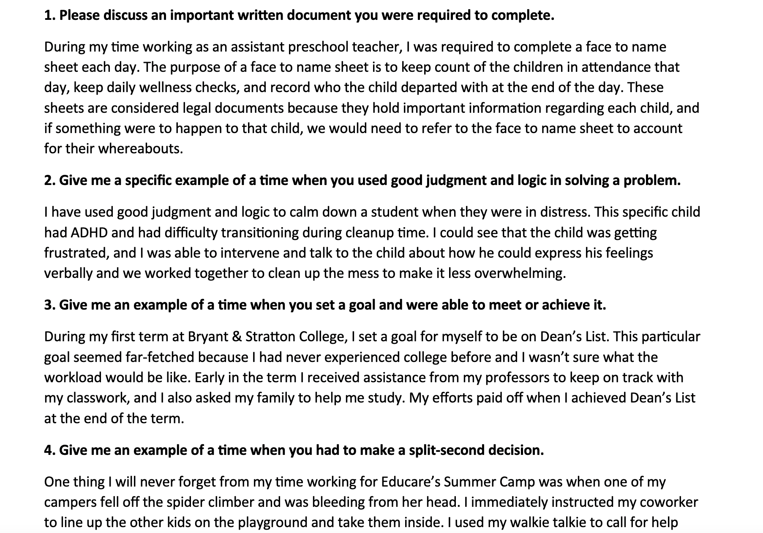
Thinking abilities
My third artifact, are the answers to interview questions for my speed interviews in SOSC225 (career development).
This artifact complies with the institutional outcome; thinking abilities, because writing these answers helped me reflect on my skills as well as improve on my communication.
These answers helped me to recognize my personal qualities and transferable skills.

Slide 7
Quantitative and scientific reasoning
Skylar Pero
Evaluation Report
Introduction:
Infant Mortality rate is significantly higher in the non-Hispanic African American community, compared to the non-Hispanic White community. Two of the leading causes of infant mortality in the African American community are low birth weight and maternal complications. Many people are biased in thinking that African American infant mortality rates are so high due to socioeconomic status as well as health conditions associated with the African American race. Although these factors may contribute, the main contributing factor for infant mortality in the African American community is racism and discrimination because of the extreme stress and anxiety that it creates, according to the Center for American Progress.
The fourth artifact I chose is my Evaluation Report, from HUSS130 (cultural competence).
This artifact complies with the Institutional outcome; quantitative and scientific reasoning because it required me look at statistics and form a conclusion based on the scientific and quantitative findings.

Slide 8
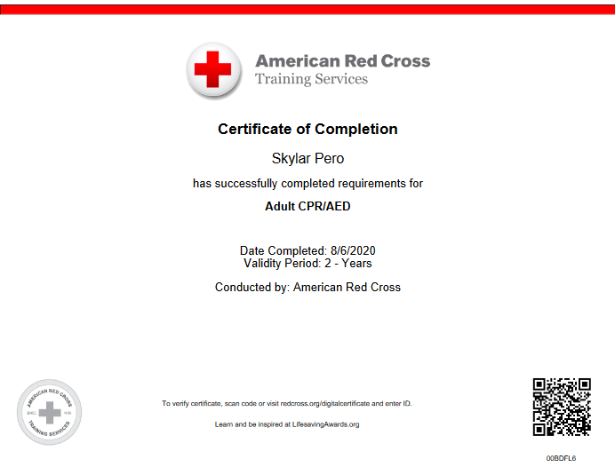
Community and career
My fifth artifact is my CPR certificate from the American Red Cross.
This certificate complies with the institutional outcome; community and career, because it shows that I participated in a learning opportunity for professional growth.

Slide 9
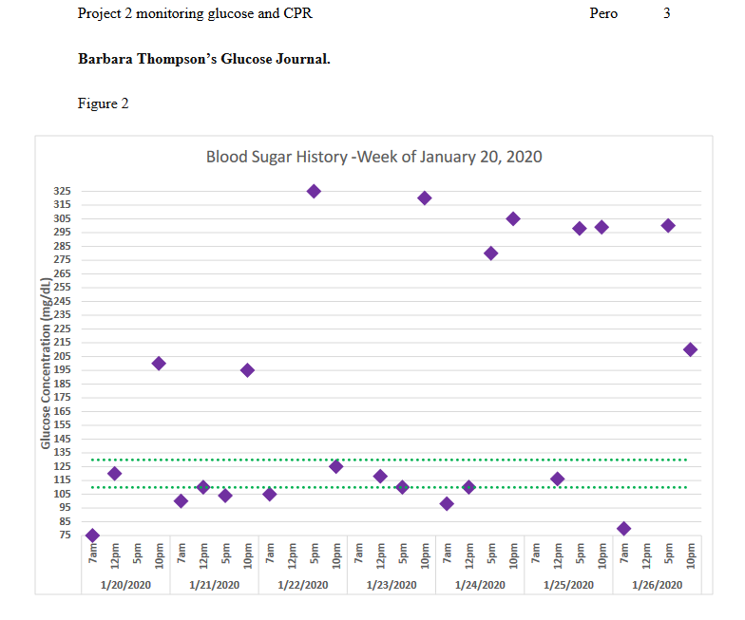
Program outcome 1
Communicate effectively
This sixth artifact is project 2 monitoring glucose and CPR, from medical laboratory
This project complies with the program outcome of communicating effectively, and utilizing my knowledge of medical terminology, as well as anatomy, and physiology.
In this project I demonstrated my knowledge of blood glucose monitoring and the steps of performing CPR.

Slide 10
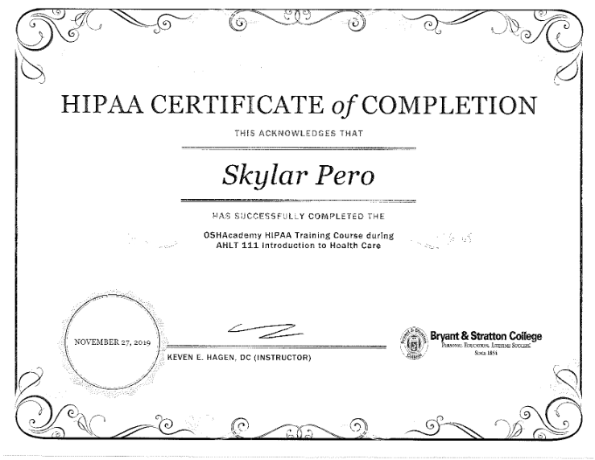
Program outcome 2 legal and ethical behaviors
My seventh artifact is my HIPAA certification AHLT111 (introduction to healthcare).
This artifact complies with the program outcome; demonstrate legal and ethical behaviors consistent with the standards of the profession
I demonstrated compliance with HIPPA regulations that apply to the medical field and patient confidentiality.

Slide 11
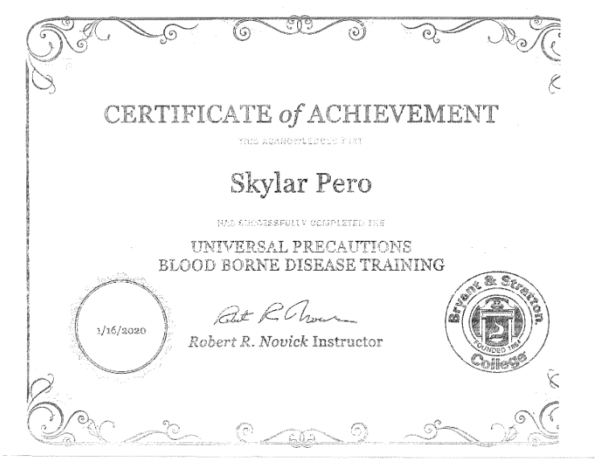
Program outcome 3 standard safety and risk reduction
My eighth artifact is my certificate of achievement in universal precautions and blood borne disease training, from medical laboratory
This certificate complies with the program outcome; using standard safety and risk-reduction precautions.
To gain this certificate I needed to prove my knowledge on universal precautions and blood borne diseases, which I ultimately achieved.

Slide 12
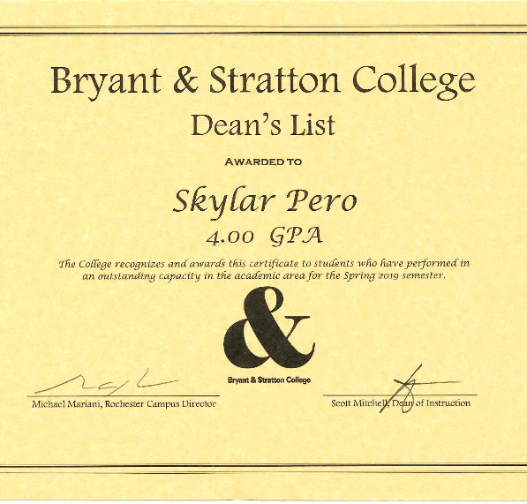
Deans list award
Spring term, 2019

Slide 13
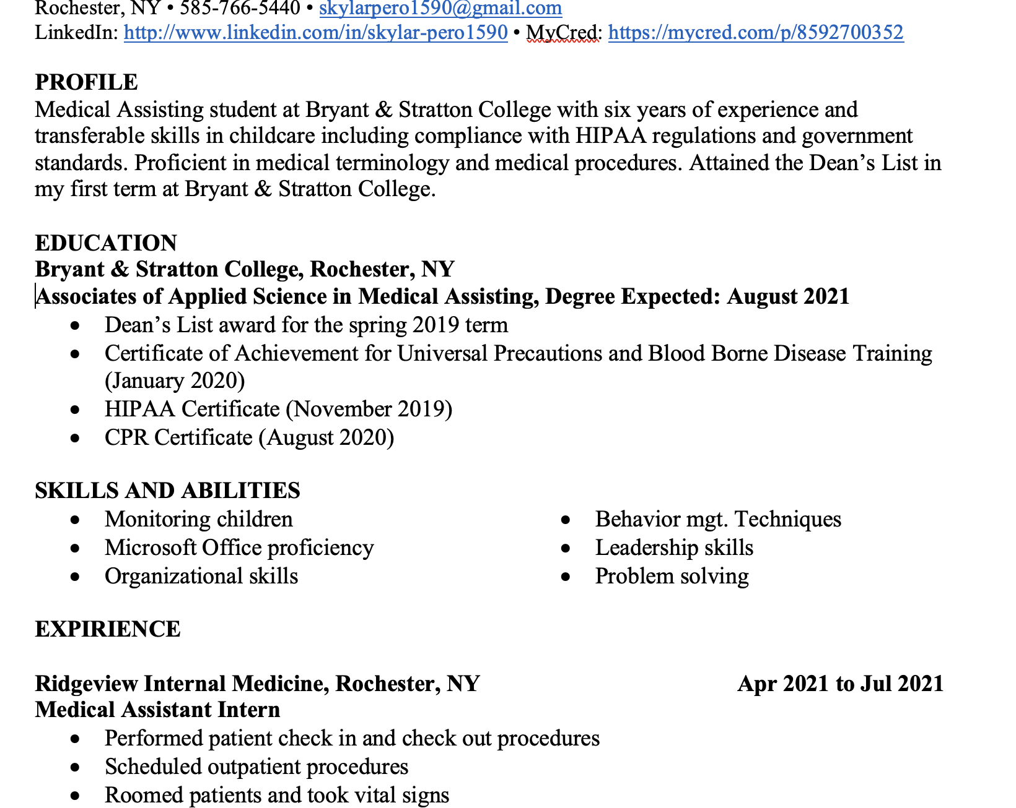
Resume
In my resume I present my previous jobs, the duties that accompanied those jobs, the skills I possess, my internship, and the duties I had at Ridgeview.
My resume gives a future employer a glimpse inside my work history and transferable skills, but most of all I hope it gives them an idea of who I am as a worker.

Slide 14
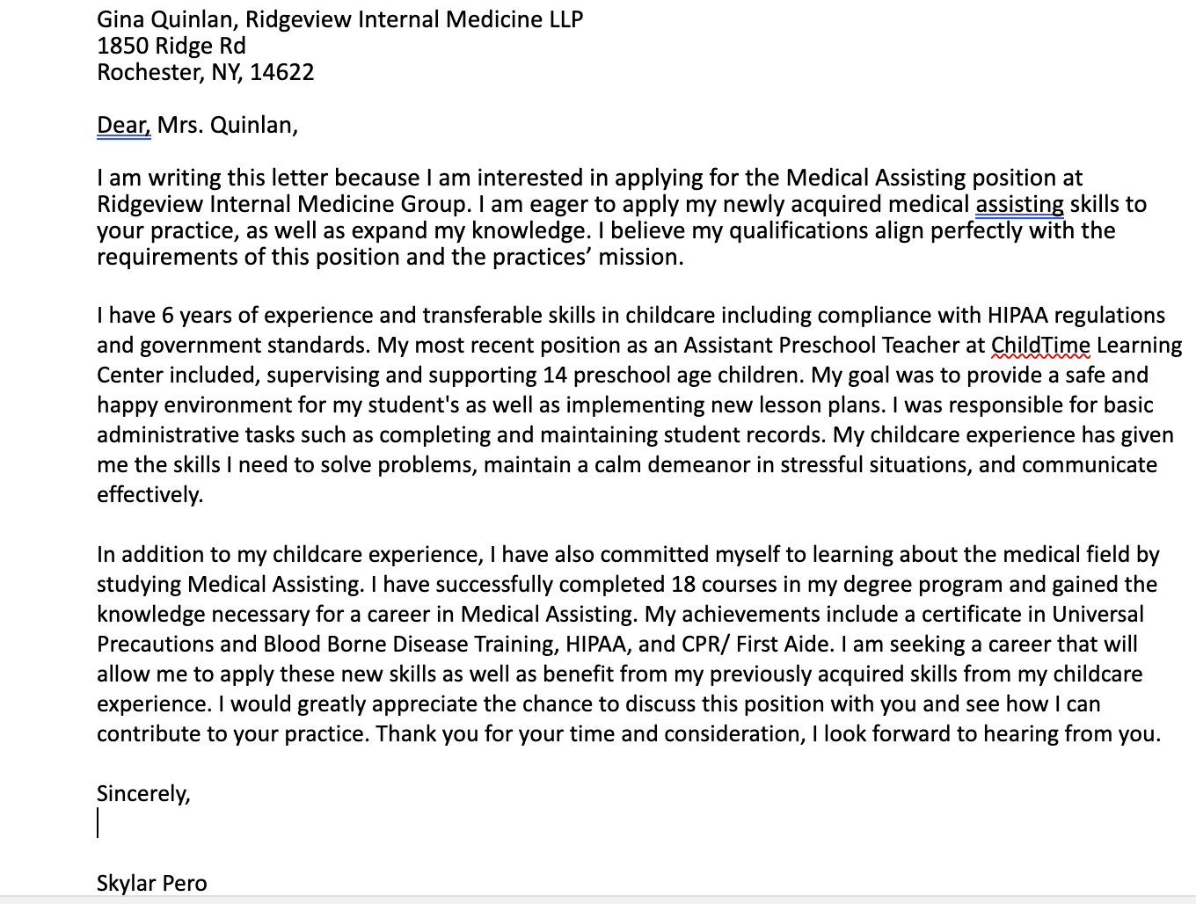
Cover letter
I wrote my cover letter to Gina Quinlan, the practice manager at Ridgeview Internal Medicine. In my cover letter I described my work expirience as well as my college achievments that I stated in my resume.

Slide 15
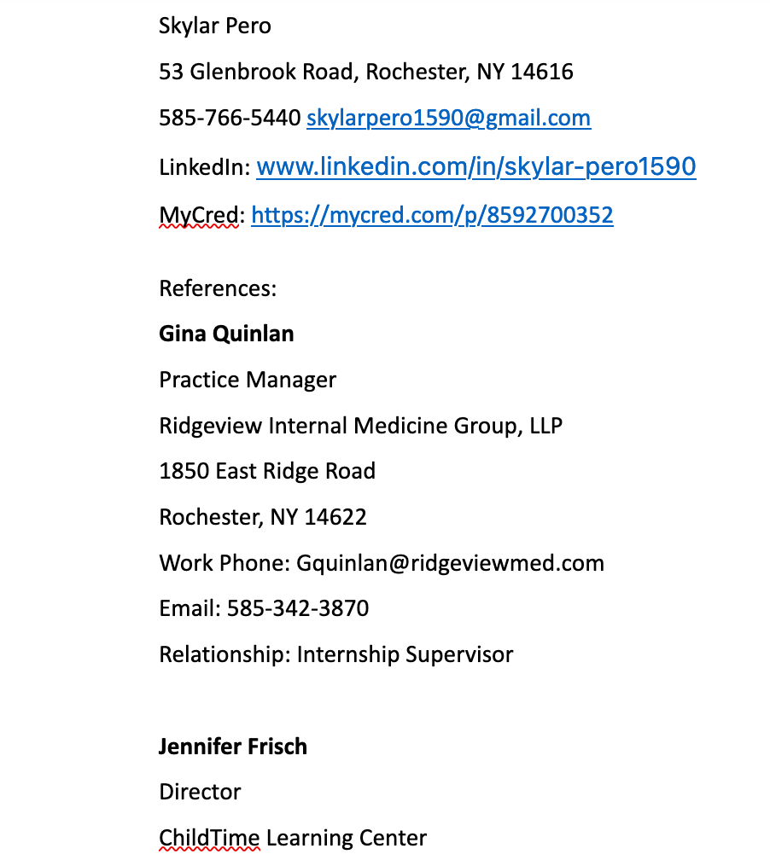
Professional references
My professional references are three people that have seen how I work and can speak to my skills and abilities.

Slide 16
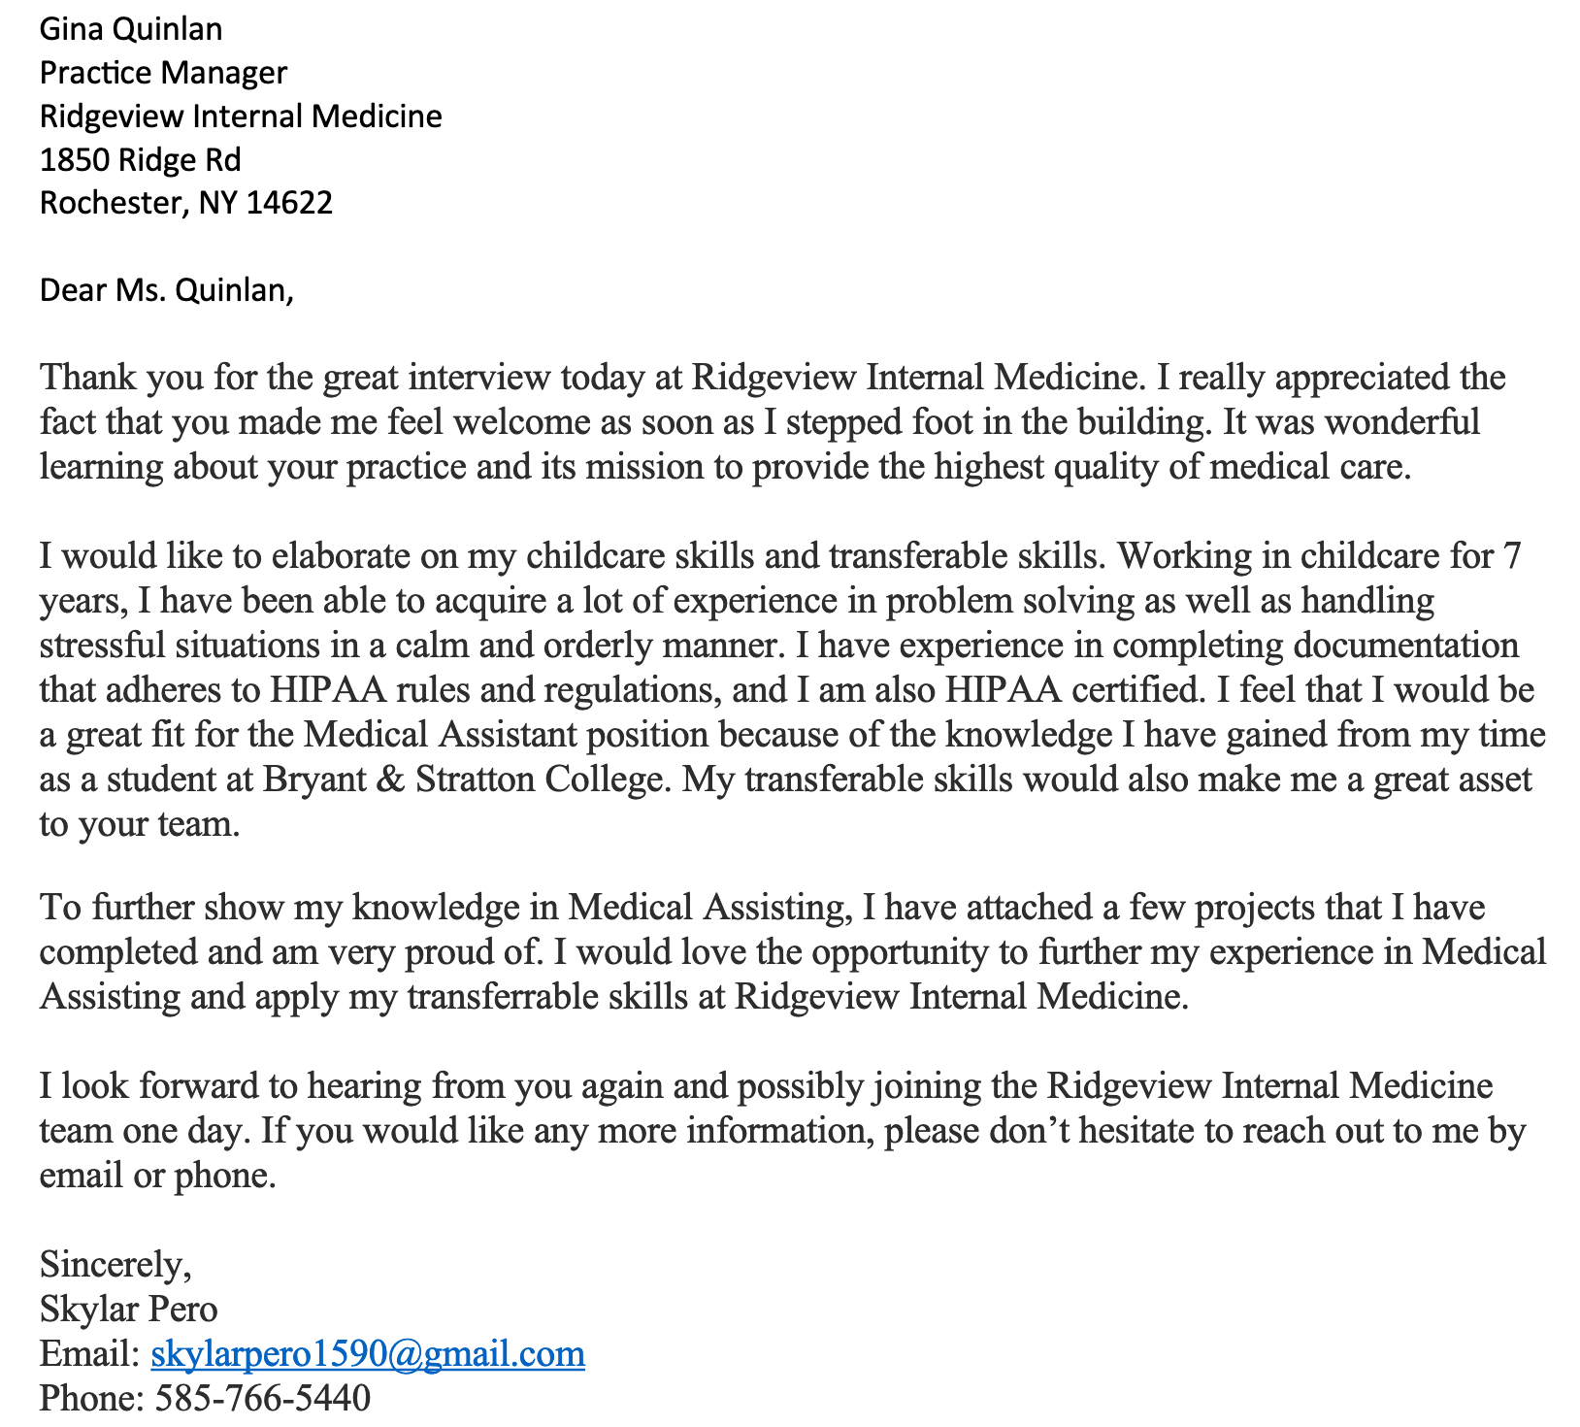
Thank you letter
In my Thank You Letter, I wrote to Gina Quinlan who is the Practice Manager at Ridgeview Internal Medicine.
I did my internship at Ridgeview and will be working there in the near future.

