Slide 1

Portfolio Project
Terri Nichols
10/02/2022

Slide 2


Topics to be discussed
Psychological disorders
How they affect everyday life
How they affect the workplace
How to improve employee performance and employee satisfaction

Slide 3
Introduction
There are many different types of physiological disorders. They have a different effect on your life. The way they affect your day-to-day living and then how they affect your work environment is completely different. We will be going over some of the different disorders and then how they affect everything. Next, we will be going over how to handle them in the workplace and in your day-to-day life. This will lead us to how employers can make sure every employee is treated the same no matter what. There will be some tips to follow and also how to improve employee performance and satisfaction.

Slide 4

Different types of physiological disorders

Slide 5
We will be talking about the top 4 disorders that people struggle with
Disorder | Definition | Signs/Symptoms
Depression | persistent sadness and a lack of interest or pleasure in previously rewarding or enjoyable activities | Not caring about things one used to, Feeling sad, down, or hopeless most of the day, nearly every day. Weight gain or loss, Sleeping too much or too little, Fatigue/lack of energy, Thoughts of death or suicide
Anxiety | a feeling of worry, nervousness, or unease, typically about an imminent event or something with an uncertain outcome. | Worry, Fear, Feeling “on edge", Tiredness, Muscle tension, Stomach aches, Chest tightness or pain
Obsessive compulsive disorder(OCD) | excessive orderliness, perfectionism, attention to details, and a need for control in relating to others | Repetitive and persistent thoughts, images or urges Repetitive behaviors or mental acts that a person feels compelled to perform in relation to an obsession or according to rules that must be applied rigidly or to achieve a sense of “completeness”
Post tramatic stress disorder (PTSD) | a condition of persistent mental and emotional stress occurring as a result of injury or severe psychological shock, typically involving disturbance of sleep and constant vivid recall of the experience, with dulled responses to others and to the outside world. | Reliving the trauma: memories, nightmares, or flashbacks Feeling “numb” Avoiding certain people or places Intense feelings, such as anger, fear, or worry Trouble sleeping

Slide 6

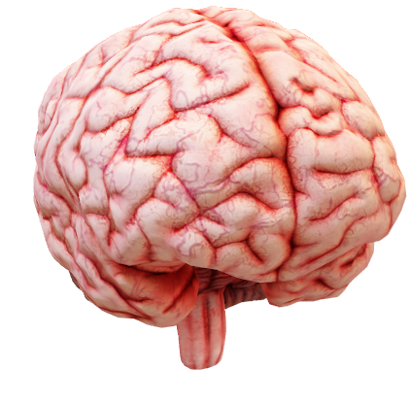
Many different aspects of psychological disorders
Mental health includes our emotional, psychological, and social well-being. It affects how we think, feel, and act. It also helps determine how we handle stress, relate to others, and make healthy choices.

Slide 7


How psychological disorders relate to collaborative workplace processes
Working together is seen as a keyway to focusing on prevention and early intervention which can effectively stop mental health-related issues from escalating and significantly improve individuals' wellbeing and recovery.
20xx

Slide 8

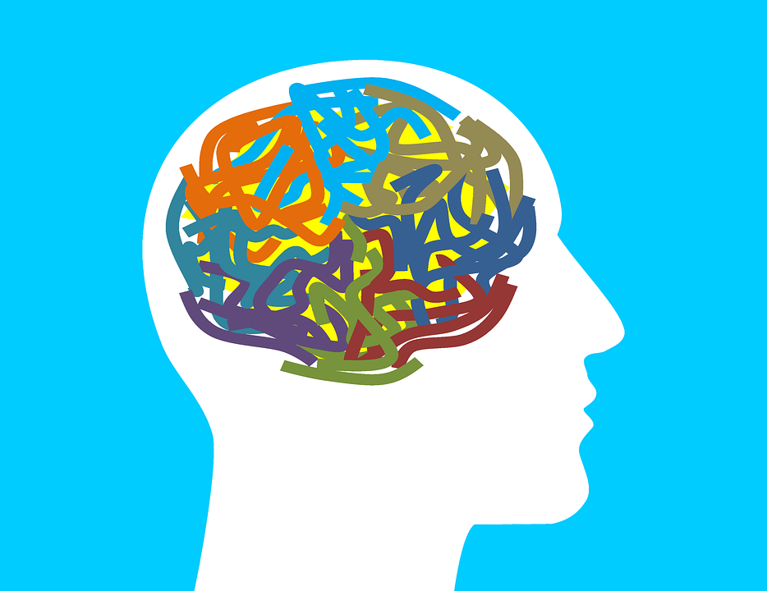
A long literature has shown that individuals with mental illness have less education, are less likely to be employed, and have lower earnings than those without mental illness. We examine the impact of a mental illness diagnosis on the risk of employment termination and length of employment using a variety of estimation techniques. Specifically, we use survival analysis techniques such as Cox proportional-hazards models when assessing the risk of employment termination and quantile regression and instrumental variables estimation when assessing the length of employment. Finally, we also use multinomial logistic regression to investigate the effect of mental illness on the risk of both involuntary and voluntary employment termination relative to remaining employed

Slide 9
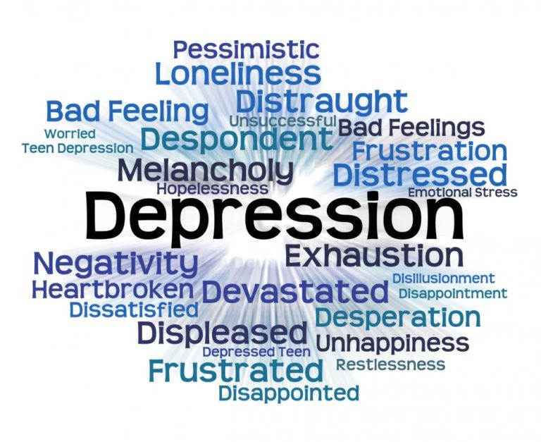
Depression in the workplace
Most people take a mean of 35.9 days off work a year due to depression
This leads to more employee turnover and lower production
Many people do not disclose they have depression
Employeers can make shorter work days
Employeers can work with employees to make sure they feel safe to discuss their depression
Employeers can convert the work place so that it may not be as stressful for the employee
This Photo by Unknown Author is licensed under CC BY-ND

Slide 10

Stress and psychological burnout taking a break from work
workaholics are usually incapable of enjoying a vacation and cutting themselves off psychologically from their work.
Women feel less relaxed on vacation than men because of the heavy burden of home-related chores that is their lot when the whole family is on vacation.
This Photo by Unknown Author is licensed under CC BY-SA-NC

Slide 11

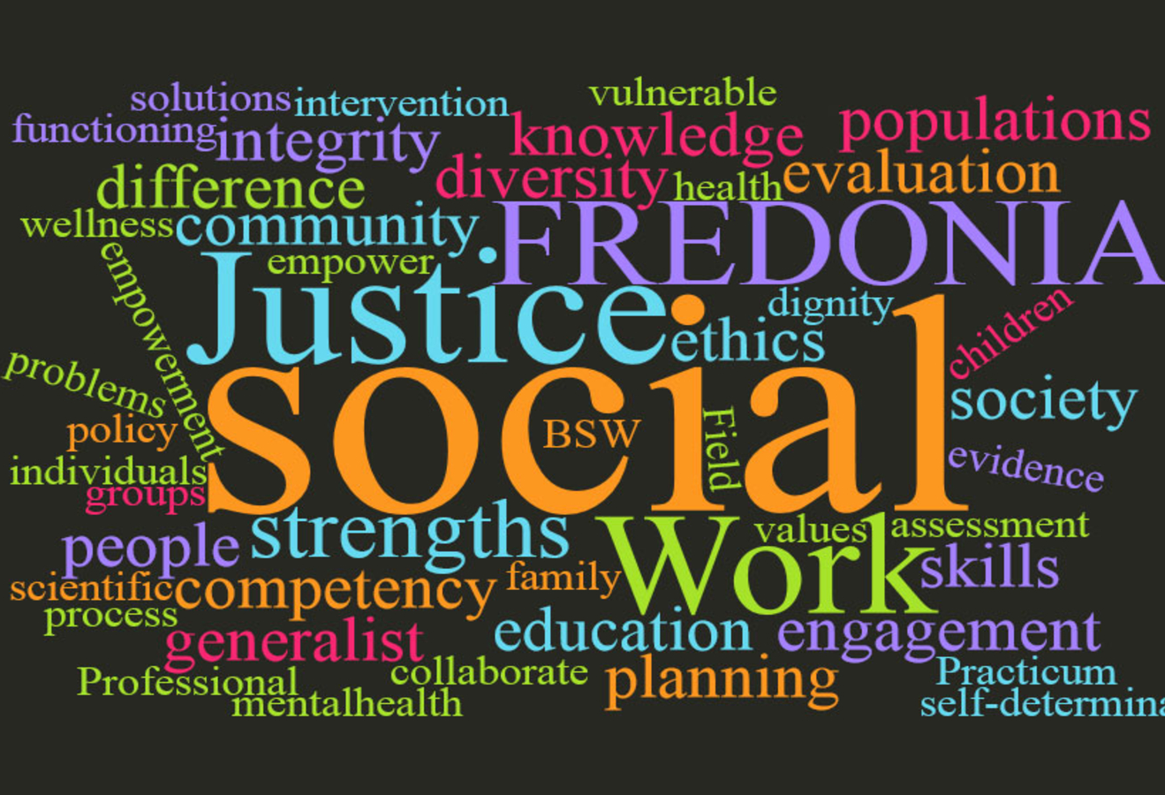

Work stress and social support
social support from supervisors mediates the effects of job control on physical well-being
high support from that source had a negative impact on physical well-being

Slide 12
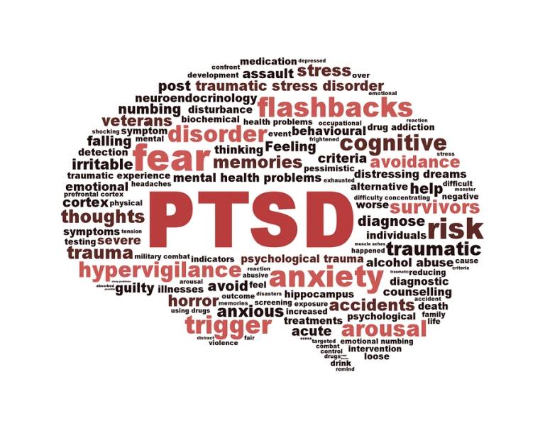
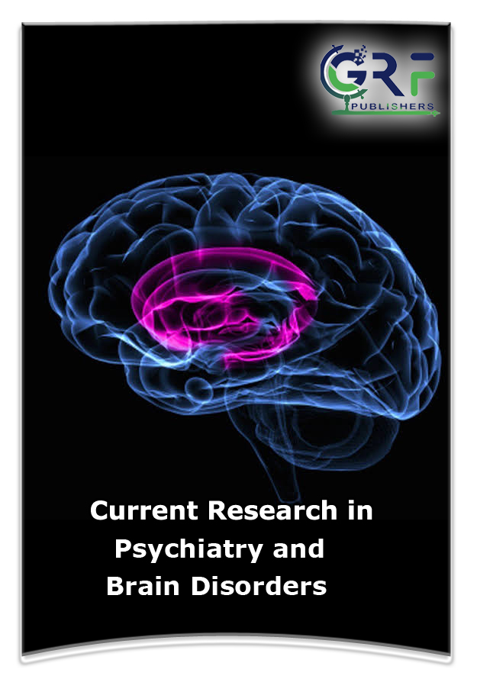
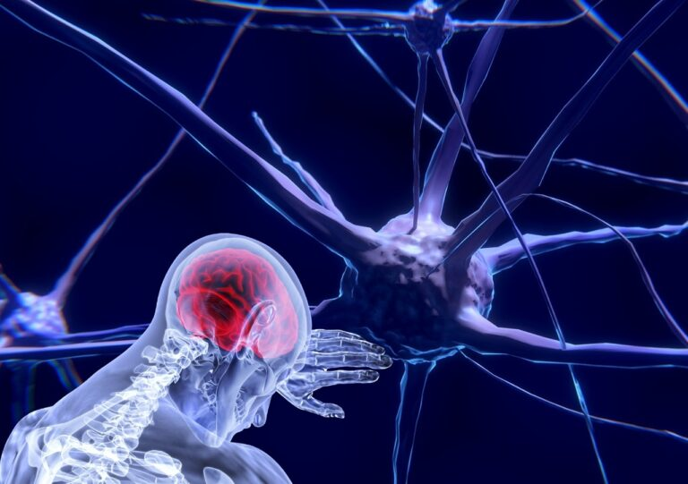
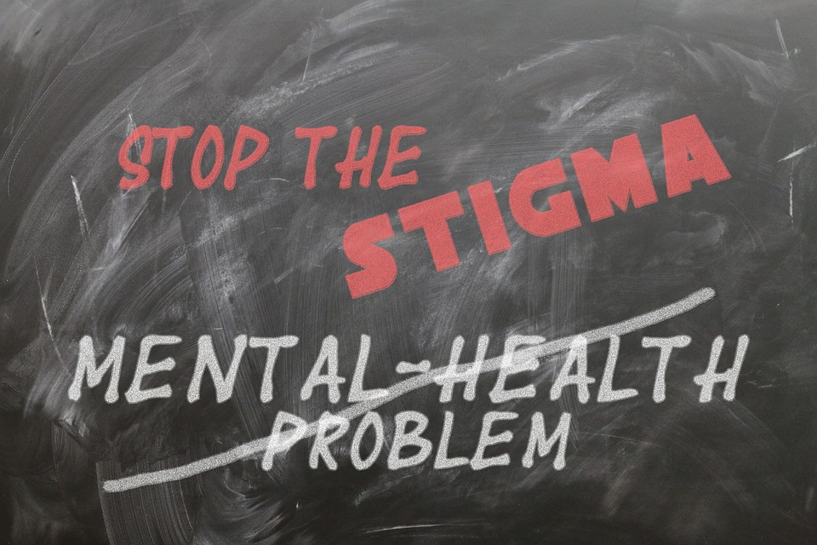
Work and psychiatric disorder
the decision of some individuals to go on sick leave or seek benefits is the result of a complicated set of factors to which individual perceptions, beliefs and other psycho-social influences contribute.
psycho-social determinants of the pathway from healthy working to long-term sickness absence are under-researched
This Photo by Unknown Author is licensed under CC BY
This Photo by Unknown Author is licensed under CC BY-SA-NC
This Photo by Unknown Author is licensed under CC BY
This Photo by Unknown Author is licensed under CC BY

Slide 13
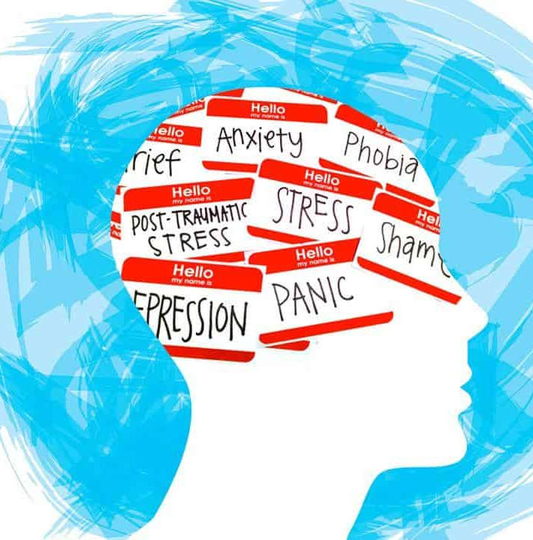
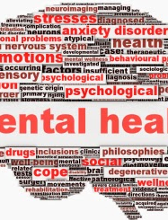
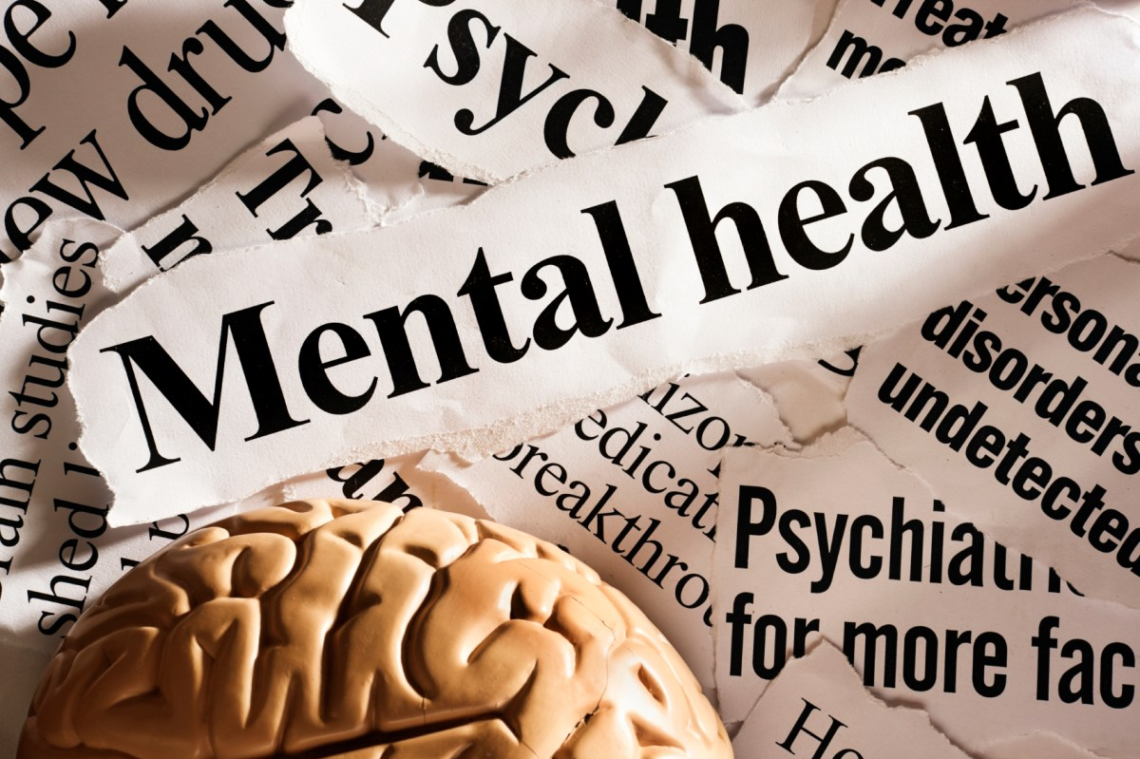
How this all relates to life
I have known a lot about this topic for a very long time. The research that I have done for this has given me a different perspective on this topic. I have always thought that people push this aside to make them feel better. Not anymore. Working in groups has made my life very hard when it comes to this. I have always had a hard time working in groups due to my mental health.
This Photo by Unknown Author is licensed under CC BY-SA
This Photo by Unknown Author is licensed under CC BY-SA-NC
This Photo by Unknown Author is licensed under CC BY-SA-NC

Slide 14
Conclusion
When it comes down to mental health this is not something to mess with. So many people have mental health issues that they just do not talk about. When doing this project, I concluded that more people need to open up about the illnesses that they have so that more employees realize that this is something that is not going away. This is something that is here to stay, and employees need to find a way to work with employees to make sure that they are safe and that they are cared for. Many people think that if they show that they have mental health problems they will get fired because managers most of the time do not understand what it is like. They are mostly out for the company. Employers need to make sure that all employees are taken care of no matter what.

Slide 15
References
Iris Arends, Sander KR van Zon, & Ute Bültmann. (2022). Supporting workers with mental health problems at work: challenges and avenues. Scandinavian Journal of Work, Environment & Health, 48(5), 323–326.
NCBI - WWW Error Blocked Diagnostic. (n.d.-b). Retrieved October 5, 2022, from https://www.ncbi.nlm.nih.gov/pmc/articles/PMC3089873/
Nelson, R. N., & Kim, JW. K. (2008, October). Survival of the Fittest: Impact of Mental Illness on Employment Duration. https://citeseerx.ist.psu.edu/viewdoc/download?doi=10.1.1.534.3589&rep=rep1&type=pdf.
Petra Buchwald, E. (2006). Stress and Anxiety: Application to Health, Work Place, Community, and Education. Cambridge Scholars Publishing
THISTED, C. N. et al. Understanding depression as a workplace issue: Clarifying employers’ attitudes to manage employees with depression. Work, [s. l.], v. 65, n. 4, p. 857–868, 2020. DOI 10.3233/WOR-203137. Disponível em: https://discovery.ebsco.com/linkprocessor/plink?id=bd547319-73aa-322b-9108-35f34e3c511f. Acesso em: 15 set. 2022.

