Slide 1
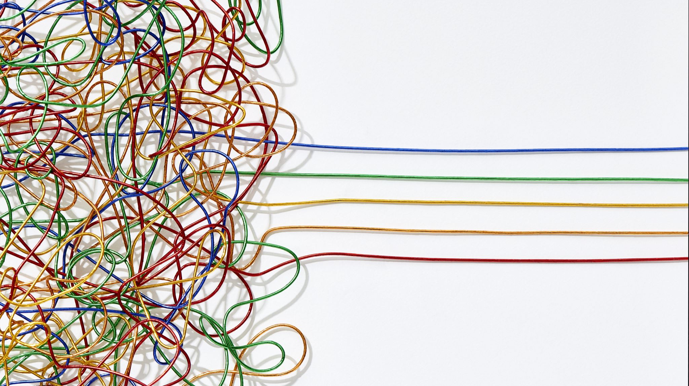

Cultural Diversity
Yolanda Bowman
PSYC 310

Slide 2
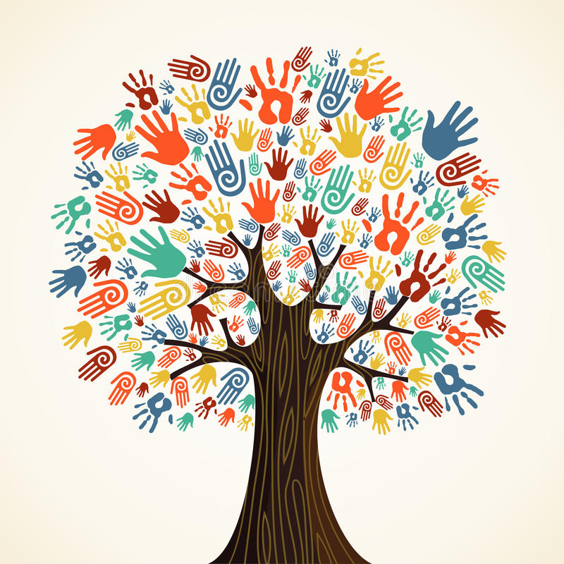
Cultural Diversity
Biological
Functional
Sexual
Cultural
Religious
Ethnic
Notes:
the existence of a variety of cultural or ethnic groups within a society
The world is a colorful canvas of people from all walks of life and backgrounds. Brought together in a variety of cultural or ethnic groups within a society.
There are many types of cultural diversity, some of them are:
Biological diversity, a term that refers to everything that surrounds nature.
Functional diversity, a sociological term that refers to physical limitations.
Sexual diversity, related to human sexuality.
Cultural Diversity, which refers to the cultural richness of a human group.
Religious diversity, which includes all types of religion in the world.
Ethnic diversity, which is formed by a group of people who share the same historical identity, language and religion.

Slide 3

Black Psychology
https://youtu.be/H8he8koHAlw

Slide 4
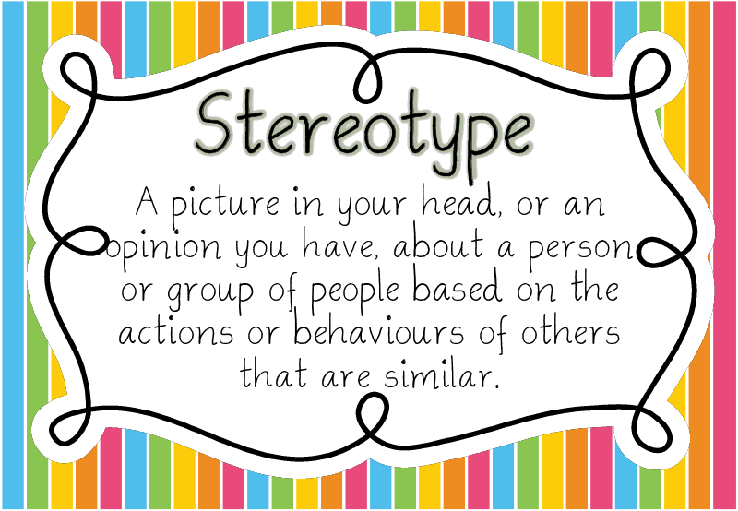
Stereotypes
Race
Religion
Age
Gender
Sexual Orientation
Notes:
Diversity provides labor resources and cultural vitality However, this does not mean that diversity comes without difficulties. Among the most noticeable disadvantages of cultural diversity include language barriers, social tension, and civic disengagement. It should be noted that these are not reasons to avoid diversity, but rather, factors to keep in mind as society heads toward a more diverse future.
Language Barriers
Language barriers are generally temporary in nature but the resultant segregation can endure, as exemplified in segregated neighborhoods and ethnic ghettos.

Slide 5
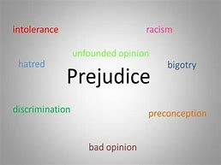
Prejudice
Discrimination
Racism
Sexism
Notes:
Discrimination- Unjustified negative behavior toward a group or its members
Racism- Prejudicial attitudes and discriminatory behavior toward people of a given race
Sexism- Prejudicial attitudes and discriminatory behavior toward people of a given sex
Civic disengagement is not a consequence one would expect from social diversity. when cultural diversity is combined with income inequality, members of all cultural and income groups are less likely to volunteer or become politically involved. This effect is most likely to be observed when an immigrants are systematically placed at an economic disadvantage, whether due to immigration policy or workplace discrimination.

Slide 6
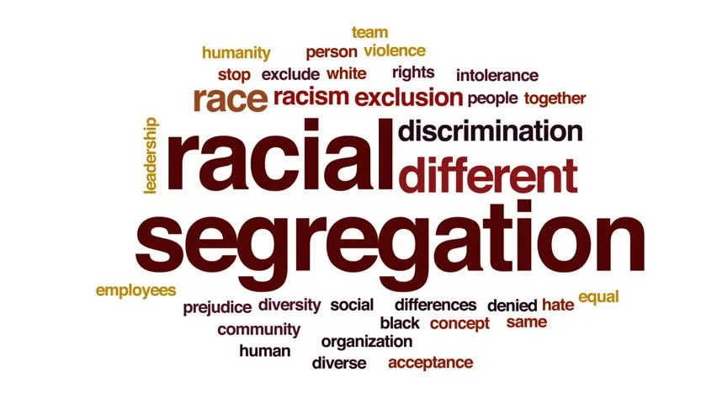
Discrimination
Height
Gender
Weight
Sexual Orientation Race
Notes:
Occasionally, workplace issues can arise from cultural diversity. White employees sometimes feel institutionally discriminated against in diverse workplaces, African-American employees often feel socially discriminated against in diverse workplaces, especially when the workplace has an all-white management team while both perceiving diversity instruments to be a form of reverse discrimination.

Slide 7
Workplace Cultural Diversity
Importance
Impact
Deep Learning
Confidence And Growth
Preparation For the Future
Productivity
Communications
Improve the morale
Encourage positivity
Notes:
Deep learning-have the privilege of gaining more understanding about people and backgrounds from all over.
Confidence and Growth-it provides them with more confidence in dealing with things outside of their comfort zones. It can build strength of character, pride, and confidence.
More Empathy- Interacting with people who have diverse practices, beliefs, life experiences, and culture promotes empathy. While you can never fully understand someone’s life without being them, you can learn, listen, and understand.
A diverse working culture would be beneficial to an organization in numerous ways, especially in terms of its productivity and efficiency. When diversity is properly managed, the result is that all people would feel valued and consider themselves important no matter what their differences are. Giving employees the chance to work with various people who bring different skills and opinions to the table would help them realize that everyone is valued and important for different reasons. Feeling valued would have a positive impact and could improve the morale of each worker, encouraging positivity and productivity in the w
knowing how to build relationships and understanding cultural distinctions and differences workplace.

Slide 8

Overcoming Biases
Soliciting honest feedback about the company’s efforts to foster a diverse and inclusive environment
Assigning diverse groups to work together to help achieve a common goal
Organizing perspective activities to address stereotypes and view situations through a different lens
Encouraging peer-to-peer recognition in a public forum to help foster a sense of connection, shared purpose and belonging among employees

Slide 9
References
No Author. (Feb 2022) Youtube: Affirming the Black Experience: A Challenge to Black Psychology. Retrieved from Affirming the Black Experience: A Challenge to Black Psychology - YouTube April 8, 2022.
No Author. (ND) Euston: Cultural Diversity. Retrieved from Cultural diversity | What it is, characteristics, history, types, advantages, disadvantages (euston96.com) on April 22., 2022.
Sanchez- Friginal, Marge. (Aug 2018) Medium: The Impact of Cultural Diversity in the Workplace. Retrieved from The Impact of Cultural Diversity in the Workplace | by Marge Friginal-Sanchez | John Clements Lookingglass | Medium on April 23. 2022.
Button, Andrew. (June 2018) The classroom: The disadvantages of Cultural Diversity. Retrieved from What Are the Benefits of Immigration in the USA? (theclassroom.com) on April 24, 2022.

