Slide 1
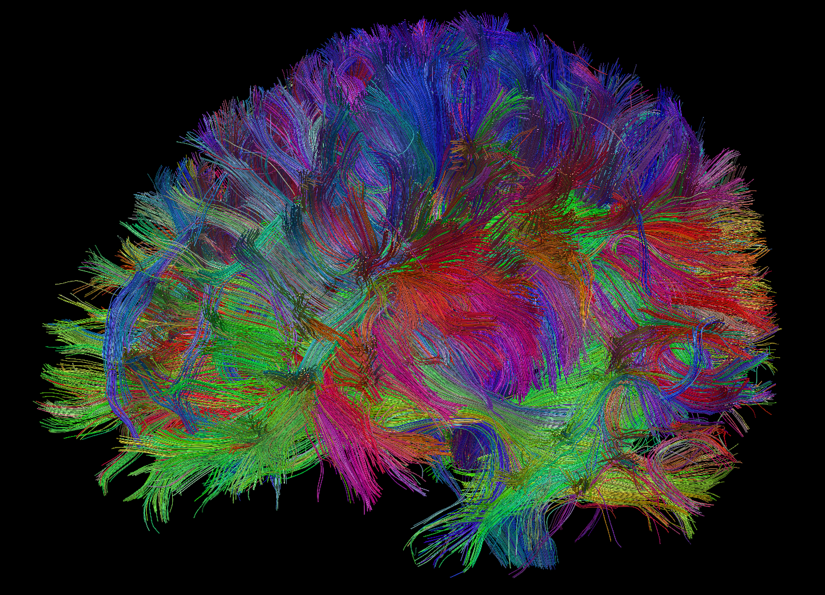
Eportfolio presentation
Yolanda Bowman
Human Resources Specialist
Sosc 225
April 22, 2020

Slide 2



Outcome: Transfer knowledge and skills acquired in formal learning and life experience to new situations
Artifact: Human Resources Essay
Class: English 200
How this artifact demonstrates I’ve met the outcome: For this assignment, I gained a wealth of knowledge of how departments were established for business industries. Positive Attitude
It allowed me to learn new terminology, different perspective and concepts of organizational structures. Communication Skills
I reflected the similarities to workplace situations and experiences for understanding. Enthusiasm
I apply the experience to workplace activities currently and for the future. Persuasion

Slide 3
GAINS
Knowledge: Knowledge: I gained a perspective of organizational behaviors, the importance of laws, and protective strategies of the organization procedures. Customer Service and Literacy
WPC #1: Information Literacy- I had to research multiple sites gathering information of HR interest to create a ladder of accomplishment or aspirations.
WPC #2: : In the work of a Human Resources Specialist I will be interacting with other’s I have to produce a well reason response to establish trust with others. Perseverance

Slide 4

Career connection
Knowledge: Knowledge: I gained experience and skills in training, detailed oriented, creative and the importance of meeting deadlines. Work Discipline
WPC #1: Using technology has been most beneficial in analyzing and evaluating information effectively. Technology Literacy
WPC #2: This capability helps to interpret the financial aspects and the cost effectiveness of business chooses and home responsibilities. Financial Literacy

Slide 5
OUTCOME: Employ strategies for reflection on learning and practice to adjust learning processes for continual improvement.
Artifact: Career Development Action 4
Class: SOSC 115
For this assignment we took a series of assessments to measure our perceptions moving forward into our career. Dependability
It allowed me to learn various divisions of Human Resources branches and the effects on the organization it presents. Information Literacy
The assessments identified my challenges and offered some effective methods of improvement. Perseverance
I apply critical thinking skills more often through solutions and creativity. Problem-solving

Slide 6

GAINS
Knowledge: The knowledge gained from this assessment assignment helps me to be more informed and compassionate professional. Managerial Potential
WPC #1: : I take suggestions and evaluate situations to provide feedback to how to solve an issue. Problem-Solving
WPC #2: : I take suggestions and evaluate situations to provide feedback to how to solve an issue. Problem-Solving

Slide 7

Career connection
Knowledge: I present myself in a professional manner with clear and respectful communication to build positive relationships. Customer Service Orientation
WPC #1: Listening, as well as, body language are signs of effective communication. Ask questions if you do not understand someone perception or view. Communication
WPC #2: Human Resources Specialist must be detailed oriented, creative, focused, organized and able to meet deadlines effectively Productivity

Slide 8
conclusion
The purpose of ePortfolio is a professional presentation of your written, technological, and informational literacy within your studies. A measurement of knowledge, abilities, and skills to understanding conceptual topics of which they employ.
I need to understand the outcomes and related assignments in my ePortfolio because it shows creditability to its topics of important necessary information applications.
My ePortfolio or something similar can be used for my future career by measuring my progress and professional translation of documents and presentations.

