Slide 1


Laguna Productions
This Photo by Unknown Author is licensed under CC BY-NC-ND
Notes:
Laguna Production a multimedia entertainment corporation based in Los Angeles, California.

Slide 2

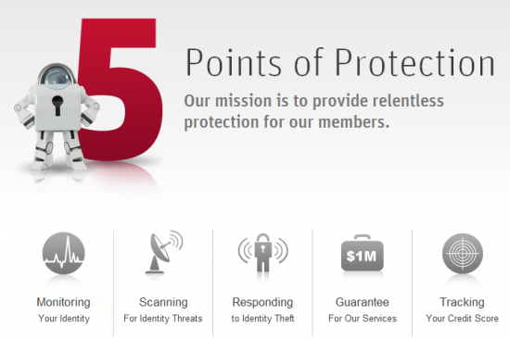
LifeLock Protection
The protection of any data that can contain potentially hackable information to identify a particular person.
•Includes social security numbers, email address, driver's license number, bank account number, and passport numbers.
•The legal conception of information can track the distinguishing or trace of individual identity from jurisdictions and states.
The PHI-a subset of Public Health Information that the medical record can provide the identify an individual, especially if the disease or condition is rare.
This Photo by Unknown Author is licensed under CC BY-NC-ND
Notes:
The company interest in expansion of operations into New York State has brought attention to a software update.

Slide 3
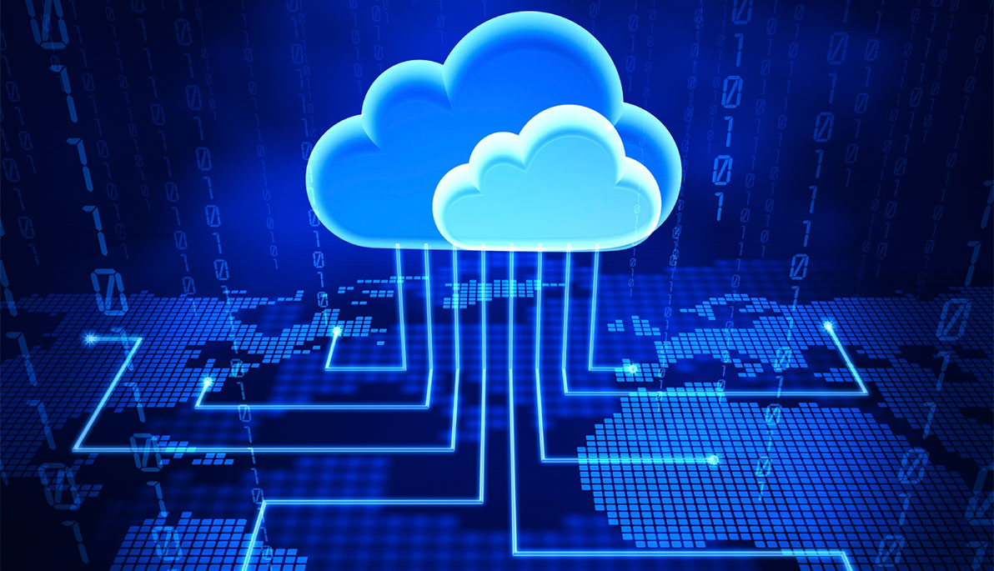
Organizational Goals
Developing our goals and objectives that tend to growth and prosperity.
Designing and implementing plans and strategies to promote the attainment of goals.
Ensuring that the company has the adequate and suitable resources to complete its activities.
Organize and coordinate operations in ways that ensure maximum productivity.
Gather, analyze and interpret external and internal data.
Ensure adherence to legal rules and guidelines.
This Photo by Unknown Author is licensed under CC BY-SA
Notes:
Moving forward the company will continue to abide by the organizational goal format.

Slide 4
Security & Privacy
Critical infrastructure
Cloud security
Network security
Text Material
Photograph and still Images
Video Presentations
GIFs and other types of Animation
Audio Files
This Photo by Unknown Author is licensed under CC BY-SA
Notes:
Some specific areas of multimedia security that could be affected from a cyber attack.

Slide 5
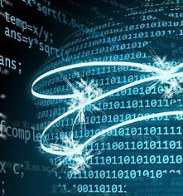
Cyber Attacks Prevention
Train employees in cyber security principles.
Install, use and regularly update antivirus and antispyware software on every computer used in your business.
Use a firewall for your Internet connection.
Download and install software updates for your operating systems and applications as they become available.
Make backup copies of important business data and information.
Control physical access to your computers and network components.
Secure your Wi-Fi networks. If you have a Wi-Fi network for the organization to make sure it is secure and hidden.
Require individual user accounts for each employee.
Limit employee access to data and information and limit authority to install software.
Regularly change passwords.
This Photo by Unknown Author is licensed under CC BY
Notes:
Some training and developing methods for the prevention of attacks at Laguna Productions.

Slide 6
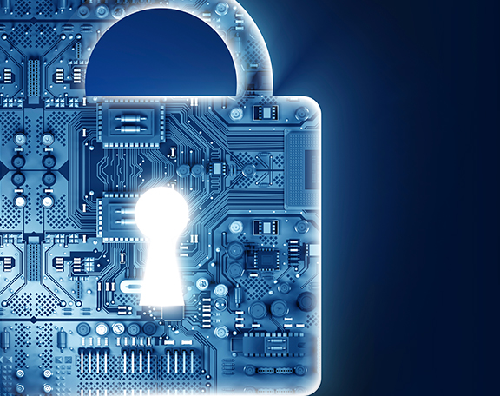
Cybersecurity
Awareness
Cyber security threats
Data Leak Protection
Ransomware Protection
Advanced Social engineer tactics
This Photo by Unknown Author is licensed under CC BY-NC-ND
Notes:
Cyber security is malicious act that seeks to damage data, steal data, or disrupt digital life in general; includes computer viruses, data breaches, and denial of service attacks.

Slide 7
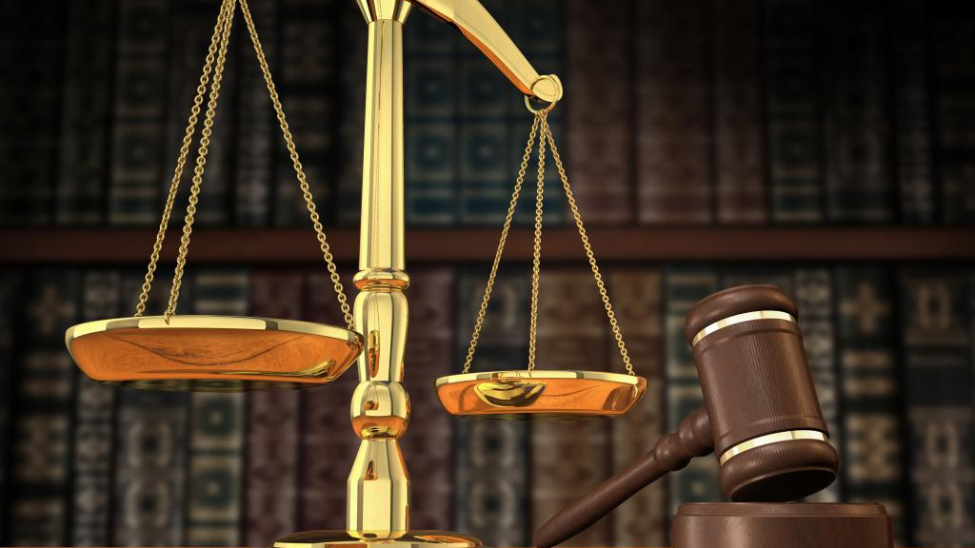
Ethics of Laguna Productions
To encourage social responsibility.
To encourage professional decision-making and responsibility.
To positively influence workplace and recruitment practices.
To inform and educate current and future organizations we serve.
To assist the organizations we serve in achieving their objectives and goals.
This Photo by Unknown Author is licensed under CC BY
Notes:
Corporate culture of the organization and the quality of products and services that is provided to the customer’s and employees.

Slide 8

Cyber Attacks on Businesses
Short Term Effect attacks can temporarily or indefinitely disrupt services of any business connected to the Internet. It can stop customers from reaching your online checkout, browsing/purchasing your merchandise, or from accessing your site altogether.
Long Term Effects that impact businesses are lawsuits and fines. Often, these lawsuits take years to settle and are expensive.
This Photo by Unknown Author is licensed under CC BY
Notes:
The impact of cyber security against business. $600 billion was lost in cyber scams in 2016.

Slide 9
Federal and State Laws
Privacy Act
The Privacy Act of 1974, a United States federal law, establishes a Code of Fair Information Practice that governs the collection, maintenance, uses, and dissemination of personally identifiable information about individuals that is maintained in systems of records by federal agencies.
The Shield Act
The SHIELD Act, which amends the State's current data breach notification law, imposes more expansive data security and data breach notification requirements on companies, in the hope of ensuring better protection for New York residents from data breaches of their private information.
Notes:
New York and California Laws of cyber security.

Slide 10

Legislation & Regulations
Electronic Communications Privacy Act of 1986
Fair Credit Report Act (FCRA)
Federal Privacy Act of 1974
Video Privacy Protection Act of 1988
Computer Fraud and Abuse Act of 1984
If the impacted business deals with health care information and falls under HIPAA compliance or BAA compliance
This Photo by Unknown Author is licensed under CC BY-SA
Notes:
The importance of a negligence state. Theories of liability for a corporation.

Slide 11

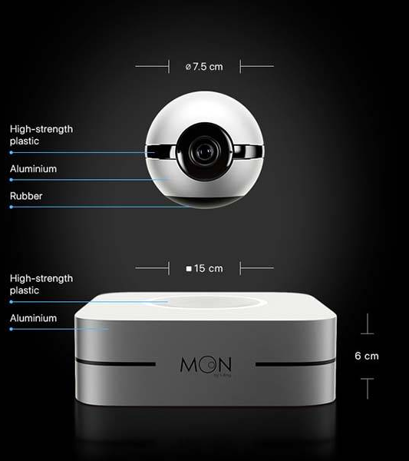
Technology
Trends
This Photo by Unknown Author is licensed under CC BY-SA-NC
Notes:
The latest technology trends are with abilities of camera’s and cloud computing.

Slide 12

Recommendations
A less inexpensive software security system
Projections of company growth potential and precautions
An overall sustainable estimate of all aspects, not only software
This Photo by Unknown Author is licensed under CC BY-SA-NC
Notes:
An overview of the software security system, laws and the company culture are important. But I also think the total amount of entire relocation should be included in that estimate.

Slide 13
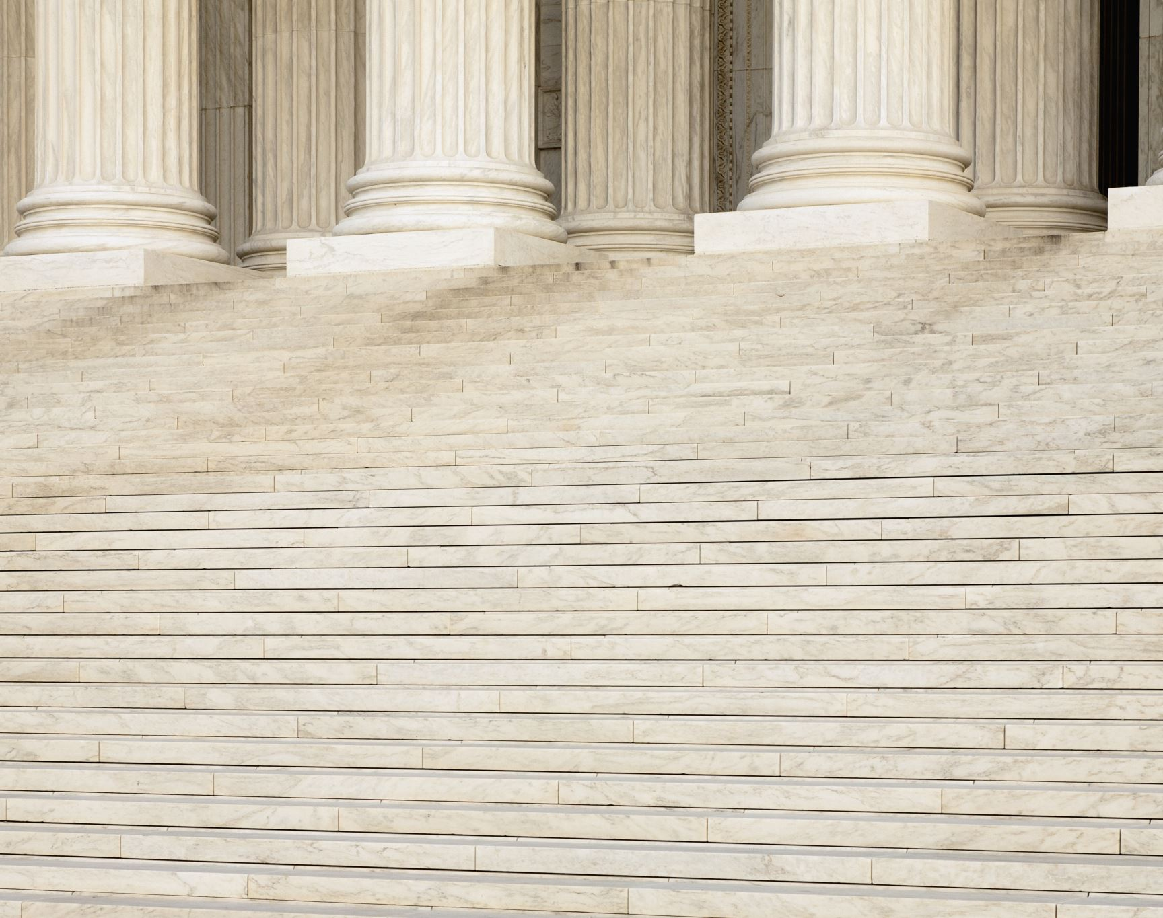
References
Becerra, Xavier (2020). Privacy Laws. Retrieved from https://oag.ca.gov/privacy/privacy-laws on June 4, 2020.
Minahan, Bill. (November 1, 2109). Effects of Cyber Attacks on Business. aNetworks. Retrieved from https://www.anetworks.com/effects-of-cyber-attacks-on-business/ on June 25, 2020.
Skeath, Caleb. Altvater, B.J. (August 7,2019). New York Passes New Data Security and Breach Notification Requirements. Retrieved from https://www.insideprivacy.com/data-security/new-york-passes-new-data-security-and-breach-notification-requirements/ on June 4, 2020.
No Author, (N.D). 10 ways to prevent Cyber Attacks. The Capacity Group. Retrieved from https://capcoverage.com/index.php/10-ways-to-prevent-cyber-attacks/ on June 25, 2020.
Notes:
Sources of information page.

