Slide 1

Human Resources Specialist
Yolanda Bowman

Slide 2

Human Resources Specialist
This is an introduction into my career choice of an Associates of Science in Human Resources Specialist. In this presentation I will include history, an educational ladder of the degree’s this career may require and a comparison of two employment opportunities.
This Photo by Unknown Author is licensed under CC BY

Slide 3
Bryant & Stratton College
AAS Human Resources Specialist
Human Resources Specialist
Human Resources Assistant
Payroll and Timekeeping Clerk
BBA Human Resources
Human Resources Specialist
Benefits Coordinator
Training and
Development Coordinator

Slide 4
Higher Education
Positives
Negatives
Diverse student population
Significant support and resources
Convenient Morning and Evening classes
Internships
Higher potential salary
Very competitive job market

Slide 5
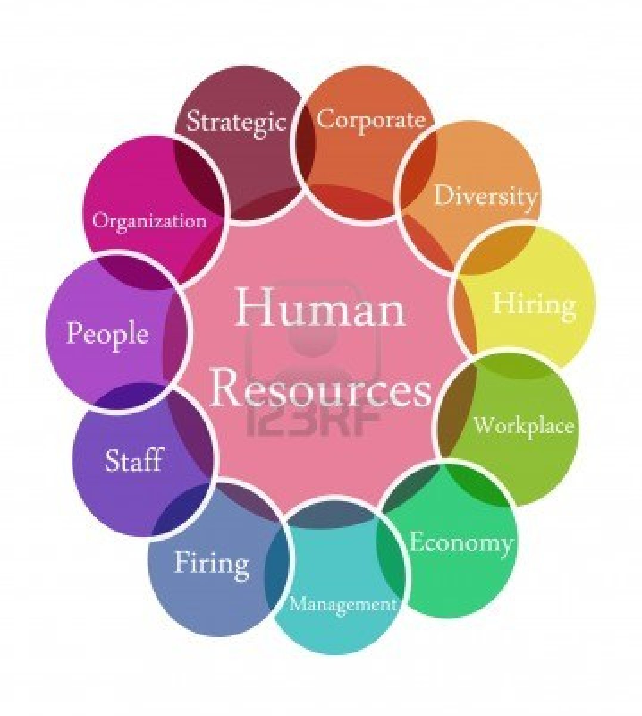
The Main 3
Labor Relations
Compensation and Benefits
Training and Development
This Photo by Unknown Author is licensed under CC BY-SA-NC

Slide 6
Career Comparison
  I am pursuing a degree in an Associates in Applied Sciences as a Human Resources Specialist. Human Resources is one of the most important departments within businesses and organizations. Building industries and corporations morale at a rapid pace. Some of HR responsibilities are recruiting, hiring, training, and compensating for the employees. Abiding by standardize labor relations, health and safety, and fairness regulations for employees or customers. For my internship, I’ve selected The City of Richmond Department and FedEx Corporation for my career comparison research paths. The two comparisons are for entry level positions and both contribute to the same educational processes, promoting the acceleration for education.

