Slide 1

Walt Disney World
Orlando, Florida
Yolanda Bowman

Slide 2
Come join the fun
Walt Disney World is an entertainment complex of theme parks located in Lake Buena Vista, Florida. Near the counties of Orlando and Kissimmee. The park is inclusive of five parks, two water parks, Nightlife for adults, and resorts on site. It’s a great experience for the family and the children. Environmentally rich in culture and diversity, as a part of their human resources strategies. From finger foods to fine dining, I mean they have it all.

Slide 3
Theme Parks
Magic Kingdom Park
Epcot
Disney Hollywood Studios
Animal Kingdom
Star Wars Galaxy Edge
Water Parks
Typhoon Lagoon
Blizzard Beach

Slide 4

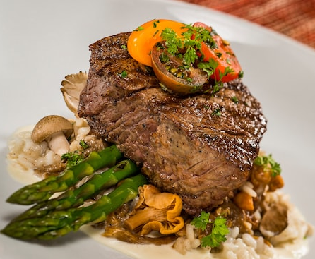
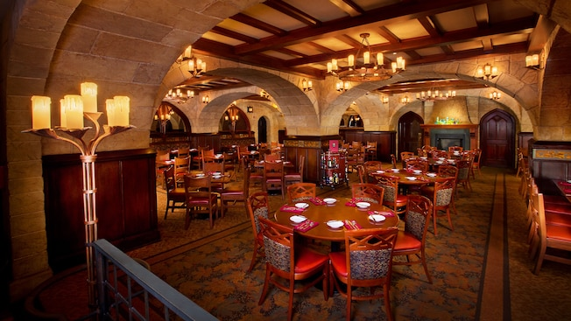
Epcot World Showcase
American Steak Cuisine

Slide 5



Culture and History
Meet Mulan in China
Meet Princess Jasmine in Morocco
Meet Pocahontas on Discovery Island Trails

Slide 6
Reference
Walt Disney World Florida
https://disneyworld.disney.go.com/en_GB/
For tickets: http://www.disneyholidays.co.uk/walt-disney-world/tickets/
For resorts: https://www.disneyworld.co.uk/resorts/
Walt Disneyland California
https://disneyland.disney.go.com

