Slide 1
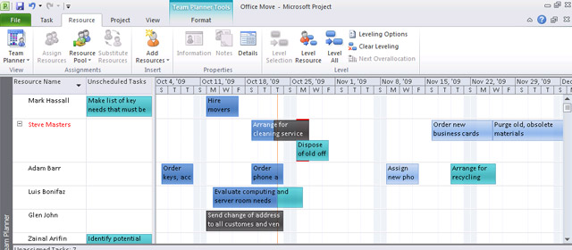
Scheduling Difficulties
By Acacia Vancil
This Photo by Unknown Author is licensed under CC BY-SA

Slide 2


Brainstorming Scheduling Difficulties
Putting an organized system in place.
Not overbooking patients.
Having a calendar handy is helpful.
Keeping a timely schedule
Keeping on the schedule.
Keeping slots of time for possible scheduling conflicts.
Staying calm and being patient with patients is key.
Maintaining good customer service

Slide 3

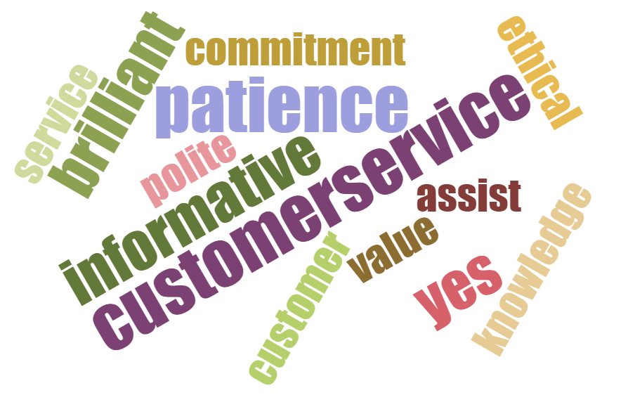


Scheduling & Customer Service
Scheduling
Makes things run smooth in personal and professional life. But, in professional it is essential.
Customer Service
Is key in making patience not only
Happy but insures there needs both mentally and physically are met.
3

Slide 4



Scheduling Vs Customer Service
Customer Service
Is key in making patients not only
Happy but insures there needs both mentally and physically are met.
It is our job working in the medical field to make patients and their families feel safe and happy.
Scheduling
Makes things run smooth in personal and professional life. But, in professional it is essential.
Keeping a smooth operation in a clinic or health care setting is key in making the staff less stressed as well as the patients we see regularly.
4

Slide 5

Scheduling & Customer Service Unite.
Scheduling and Customer Service go hand in hand so to speak. You generally can not have a good scheduling for patients without good Customer Service as well as an attitude that is positive and caring of others.
Customer service sometimes stands alone but, in a clinical or hospital setting it is key to have both as well as a caring attitude. As well as a want to learn and grow from one’s mistakes, we make as human beings.
5

Slide 6
There Are 5 Key Elements To Great Customer Service And Dealing With Patients and there Scheduling Needs.
Scheduling | Customer Service | Willingness to learn | Willingness to grow and change | Rectify mistakes when possible.

Slide 7


Learning & Growing
Learning and growing from mistakes and areas unknown are important steps in being good with others as well as doing a good job and excelling at one does. Keeping compassion and thinking of others is a big help in the medical field.
7

Slide 8


My Growth In Customer Service and My Future Path.
I have found the more I learn and grow the more I am equipped to help others. This helps me provide better Customer Support and helps me to be positive and compassionate to what others are going through.
8

Slide 9
INCONCLUSION
I believe Customer Service and accurate and timely schedules are important for a medical office or facility.
I also believe education and proper training are key in having a good experience and well trained on individuals to help each other and patients makes operations run smoothly and with cohesion.
I personally joined the medical field to help others because I deeply about others rather I know them well or not.

Slide 10




THANK YOU
Acacia Vancil
Bryant Stratton College Online
B00533860@bryantstratton.edu
JMDAA208004-ONOD-IMPROVEMENT TO MED OFFICE

Slide 11
A Note To My Instructor
I was unable to get the narration or voice over to work. I am sorry about this I really tried.
Thank you
Acacia Vancil

