Slide 1
The Forever Loan
Shay Flora
Math-201

Slide 2
Introduction
My forever loan project is to help me figure out how I will repay my students loans after I graduate. I am calling this forever loan because looking at the amount already and knowing I will be going back for another degree once I’m done with my associates degree now. Which will only add more money to the total and it feels like I will never have the loan paid off.

Slide 3

Budgeting for the goal
Most of the time people go to school to better their education to further their career, which makes more income. With furthering your education comes at a price, education is not cheap, but is worth it in the end. As you finish college and prepare for a career you have to remember you still have a loan to repay, so preparing early can save you stress later on. I believe the #1 question when starting or even finishing school is will I be able to pay back this loan. My concern is will the monthly payment fit into my budget, will my new job give me enough income to repay comfortably?

Slide 4
Expected Salary after graduation
Resource | Google | Glassdoor
Yearly | 60,677 | 59,180
Average Yearly $59,928.5
Average Monthly $4,994.04
After Taxes $ 3,745.53

Slide 5
Monthly expenses & Salaries

Slide 6
Loans
Current
3500 @ 3.8%
6205 @ 3.8%
4500 @ 4.4%
6069 @ 4.4%
3176 @ 2.7%
1588 @ 2.7%
Future
6205 @ 3.8%
3500 @ 3.8%

Slide 7

Loan Payments
@ $351.76 Per Month
This Photo by Unknown Author is licensed under CC BY-NC

Slide 8
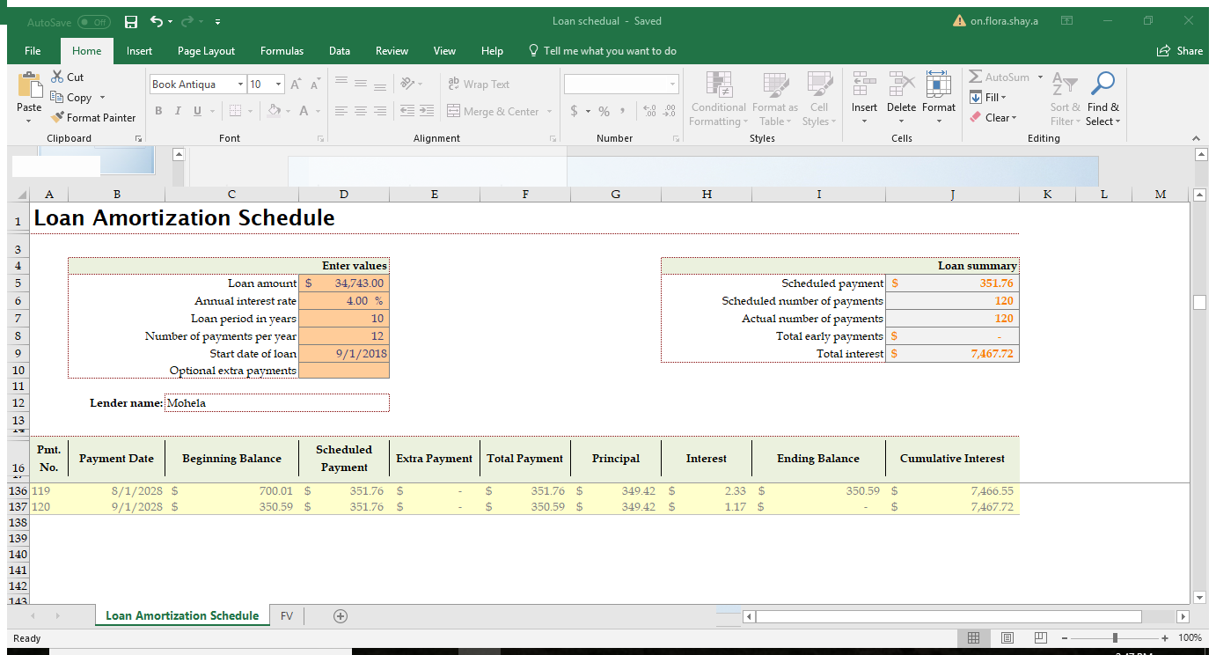
Future loan total: FV: $34,743.00 +$7,467.72 = $42,210.72

Slide 9
Years | Monthly Payments | Interest | Total loan
9 | $67.93 | $1131.44 | $7336.44
7 | $84.24 | $871.57 | $7076.57
5 | $113.72 | $617.92 | $6822.92

Slide 10

Ideal payment
My ideal payment would be, having the state forgive all my loans and wipe my debt clean. Since that is not an option I see in the future I must learn to calculate in this extra large payment to my finances after I finish school. I have already started to calculate what I can afford, as of now if I was not to get a new job and stay at my current position I would only be able to afford $50.00 per month, which would take longer then the 10 years to repay. Now, if I got a new job with in the field I receive my degree in the pay is considerably higher, so in that case I would be able to pay back the loan at the recommended amount of $250.00 per month and still be able to breath and pay all my other bills with ease. Although I have also decided to continue school after this degree and go for my bachelor’s degree, so there will be another set of loans and a higher pay back amount I assume.

