Slide 1


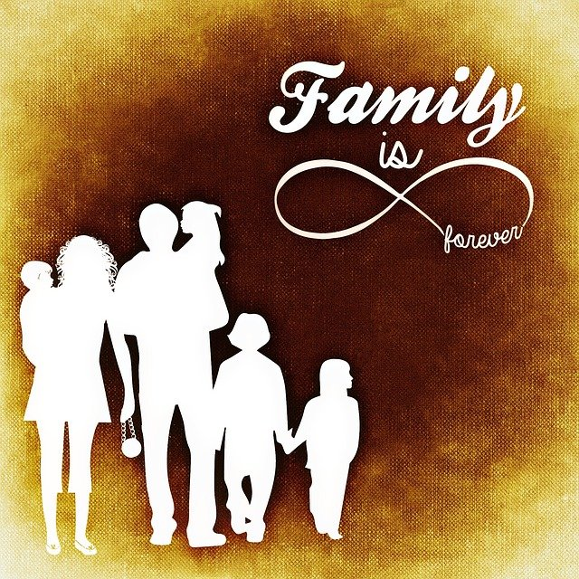
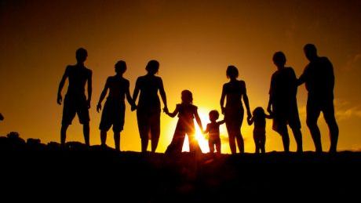
Contemporary Family Patterns, Trends, and Relationships Across Cultures, Class, and Ethnicities
This Photo by Unknown author is licensed under CC BY-NC-ND.
By Savannah Kimble
This Photo by Unknown author is licensed under CC BY-SA.

Slide 2
Definition Of “The Family” A basic social unit consisting of parents and their children, considered as a group.

Slide 3
Trends in Family and Family Structure Family Trends
Increased proportions of children living in single parent families
Increased proportions of adults in nontraditional living arrangements
Increased female labor force
Decreased proportions of children and increased proportions of older people
Family structure
Nuclear family- married partners and their offspring
Extended family- Grandparents, married offspring and grandchildren
Joint family- sets of siblings, their spouses and dependent children
Blended family- when divorced or widowed parents with children marry

Slide 4
Impact of Family Trends on Student Learning and Teacher-Family Relationships
Communication can impact student learning and/or the teacher family relationship.
School-family communication provides an opportunity of inclusiveness and equity.
Communication between families and school staff is important to keep families involved and school staff informed.
Communication between school and family could prevent any misinformation. When teachers are communicating with families, they should be sure to use languages all families could understand.
Parent handouts should include other languages they know the families speak
Teachers should be sure to contact families to find the best times that work for them
Teachers should create a sign-up sheet to have parents sign up at their convenience.

Slide 5
Define “Social Class”
Noun(plural social classes)
(social sciences) A class of
people, based on social power,
wealth or another criteri

Slide 6
Low Class (poverty) Class
Families that work for minimum wage
The family may need help from the community to feed, clothe, or raise the children
The family would not be able to enroll the child in extra curricular activities or enroll the child for tutor services. The family
would need to enroll in free services, services from the community, or services through the public-school system.
High Class (white collar workers)
Well educated
Their children will most likely go to the best schooling/private school or college and earn a degree that will make a lot of
wealth over time

Slide 7
Education Attained
Count
Percentage
Less Than 9th Grade1927.64%9th to 12th Grade30412.10%High
School Graduate1,15245.84%Some
College31512.53%Associates
Degree2309.15%Bachelors
Degree2068.20%Graduate
Degree1144.54%

Slide 8
Scheduling conflicts due to work schedules
No transportation
No childcare
Language barrier
Teacher and parent relationship

Slide 9
Define “Culture” and “Ethnicity” What is culture?
Culture is the various understandings, traditions, and guidance of the groups to which we all belong; the ways of living developed by a social group and transmitted to succeeding generations; (Gestwicki, 2016).

Slide 10
Different Cultures and Ethnicities Present In/Around Your Community White alone, 93.4%, and White alone, not Hispanic or Latino, 90.0%, make up most of this town. Hispanic or Latino, 3.8%, and Asian alone ,2.6%, are the second highest race in this town • Two or More Races ,2.0%, Black or African American alone, 1.4%, and American Indian and Alaska Native alone, 0.4%, make up the lowest race in this town.

Slide 11
Impact of Culture and Ethnicity on Student Learning and Teacher-Family Relationship • Confusion in directions, verbal prompts, written language • Misunderstood emotions, directions, unable to communicate their ideas • Underestimated developmental milestones, IQ, • Low Academic Achievement, Adjustment to a new cultural environment, trust problems with self as well as the new culture. (Alsubaie, 2015)

Slide 12
Reference
Council on Foundations. (2019). The Effects of Family Culture on Foundations. Retrieved from Council on Foundations: https://www.cof.org/content/effects-family-culture-family-foundations
Alsubaie, M. A. (2015, Novemeber 10). Examples of Current Issues in the Multucultural Classroom. Journal of Education Practice, pp. 86-89.
How culture influences children's development . (2018, 7 19). Retrieved from The Conversation: https://theconversation.com/how-culture-influences-childrens-development-99791
Movoto. (n.d.). Movoto. Retrieved from Demographics/Neighborhoos Info East Hampton, CT, 06424: https://www.movoto.com/demographics/ct/06424/
U.S. Department of Commerce. (n.d.). United States Census Bureau. Retrieved from U.S. Census Bureau QuickFacts: United States:
https://www.census.gov/quickfacts/fact/table/easthamptontownmiddlesexcountyconnecticut,US/POP645217#POP645217
Your Dictionary. (2019, June 29). Social Class . Retrieved from Your Dictionary : https://www.yourdictionary.com/social-class
https://health.howstuffworks.com/pregnancy-and-parenting/understanding-family-structures-and-dynamics-ga.htm

