Slide 1




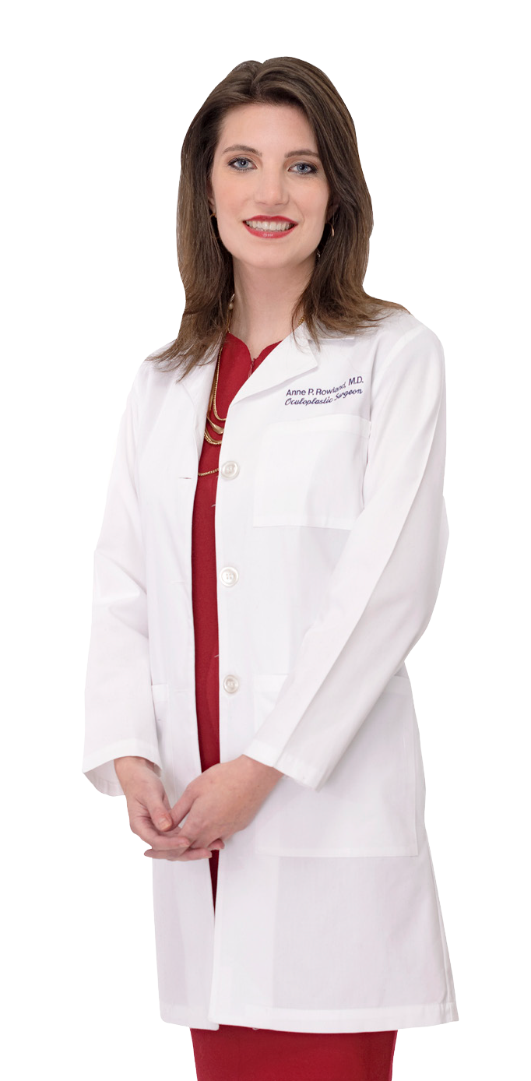

SURGICAL EYE CARE FOUNDATION
AN AFTERNOON OF BEAUTY
12TH ANNUAL
2017 CONTINUING EDUCATION SEMINAR
With Dr. Anne Rowland
Welcome Optometrists Ophthalmologists Technicians & Staff
SATURDAY,
FEBRUARY 18 12PM-2PM
1890 Goodman Rd. E,
Suite 200
Southaven, MS 38671
February 17-19, 2017 At Guest House
at Graceland
Please join us for an afternoon of beauty with Dr. Anne Rowland.
Enjoy refreshments while learning about some of the most advanced cosmetic services. Experience them for yourself, by taking advantage of the exclusive discounts on select services and skin care products!
3
Days of Exceptional
COPE CE Courses
Eye Specialty Group would like to thank you for
attending the Surgical Eye Care Foundation’s 2017 Continuing Education Seminar. Our event continues to be an outstanding success because of you!
We look forward to being your vision
partner---now and in the years to come .
National and Local Eye Care Leaders
Approved CE Training for Technicians
and Staff
Rejuvenating Cosmetic Services
Delicious Hors d’oeuvres & Drinks
Complimentary Transportation Provided from Guest House at Graceland.
Eye Specialty Group
825 Ridge Lake Boulevard Memphis, TN 38120
901-695-2200
EXTRA Classes:
Scott Ensor, O.D., M.S.
“Rational Prescribing and Drug Diversion” A REQUIRED COURSE FOR TENNESSEE OPTOMETRISTS offered by Southern College of Optometry
Angie Printup, M.S.
CPR Course
Please RSVP by sending each guest’s name,
phone, and email address to marketing@esg.md

Slide 2
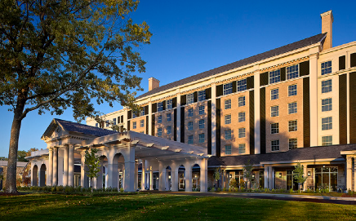
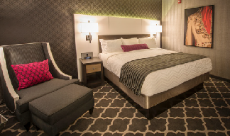
Welcome to the Surgical Eye Care Foundation’s 12th Annual Continuing Education Seminar.
We are excited to offer you the opportunity to earn your CE credits in a convenient and comfortable environment during our exclusive three-day seminar.
Expand your knowledge of cutting-edge optometry procedures
Advance your clinical capabilities
Learn from preeminent eye care leaders
REGISTRATION FORM
We know you will find tremendous value in your continuing education experience with us!
Name Company Mailing Address (❑ Residence ❑ Business)
City State Zip Office Phone Cell Phone Emergency Contact Email Phone
SUNDAY, FEBRUARY 19
8:00 AM
Whitney Hauser, O.D.
Ocular Surface Disease Innovations in Clinical Care
COPE ID: 48951-AS
Credit Hours: 2
––––––––––––––––––
OPHTHALMOLOGISTS / OPTOMETRISTS
2017 CONTINUING EDUCATION ITINERARY
EXTRA CLASSES (Additional Charges)
1:00 PM-3:00PM
Scott Ensor, O.D., M.S. ($75 Payable to SCO)
“Rational Prescribing and Drug Diversion” A REQUIRED COURSE FOR TENNESSEE OPTOMETRISTS offered by Southern College of Optometry
COPE ID: 4402-EJ
Credit Hours: 2
Register at http://www.cvenet.com/d/fvqggw or contact Jeanie Snider @ jsnider@sco.edujsnider@sco.edu
––––––––––––––––
8:00 AM-12:00PM
Angie Printup, M.S. ($55 Payable to SECF)
CPR Course
FRIDAY, FEBRUARY 17
5:30 PM-7:30 PM
Registration & Cocktail Mixer
––––––––––––––––––
11:00 AM
Kirk Mack, COMT, CPC, COE
Introduction to Medicare’s Quality Payment Program – MACRA and MIPS
COPE ID: 52694-PM
Credit Hours: 1
––––––––––––––––––
Will you be bringing a guest? ❑ Yes ❑ No
Guest Name Address Email Phone
10:00 AM
David Mills, M.D.
Don’t Cry Over the Tearing Patient
COPE ID: 52863-AS
Credit Hours: 1
6:30 PM
Andrew Crothers, M.D.
Descemet’s Membrane Endothelial Keratoplasty (DMEK)
COPE ID: 52214-PO
Credit Hours: 1
––––––––––––––––––
7:30 PM
Subba Gollamudi, M.D.
Corneal Collagen Cross-linking: An Update
COPE ID: 52213-AS
Credit Hours: 1
Will you or your guest be attending the Afternoon of Beauty Tea Event with Dr. Anne Rowland, Saturday, February 18 at 12:00 PM? ❑ Yes ❑ No
Attendee(s):
12:10 PM
Lunch & Exhibits
––––––––––––––––––
11:00 AM
Jim Grue, O.D.
Trump Eye Care
COPE ID: 52828-PM
Credit Hours: 1
––––––––––––––––––
Please choose your professional classification:
❑ Optometrist ❑ Ophthalmologist ❑ Optometric Resident ❑ Technician ❑ Staff
1:00 PM
Kirk Mack, COMT, CPC, COE
2017 Reimbursement Updates
COPE ID: 52693-PM
Credit Hours: 1
––––––––––––––––––
Demographic information is collected by SECF to better serve your needs at each of our continuing education events.
TECHNICIAN/STAFF SCHEDULE SATURDAY, FEBRUARY 18
OE Tracker Number Optometry School Attended (Attending) Gender ❑ Male ❑ Female
2:00 PM
Jim Grue, O.D.
Expanded Clinical Role of Eye Care Diabetes Management
COPE ID: 52853-GO
Credit Hours: 1
––––––––––––––––––
SATURDAY, FEBRUARY 18
8:00 AM
David Mills, M.D.
When Droopy Lids Affect Your Patient
COPE ID: 52846-AS
Credit Hours: 1
––––––––––––––––––
9:00 AM
Luke Peterson, M.D.
A Review of Current and Emerging Glaucoma Diagnostic Testing Modalities
COPE ID: 52632-GL
Credit Hours: 1
7:00 AM
Registration & Breakfast
––––––––––––––––––
12:10 PM
Lunch & Exhibits
––––––––––––––––––
Age Group ❑ 21-25 ❑ 26-36 ❑ 37-47 ❑ 48-58 ❑ 59-69 ❑ over 70
Which days do you plan to attend the CE Event? ❑ Friday ❑ Saturday ❑ Sunday
3:00 PM
Dennis Mathews, O.D. Management of Retina Disease with Fluorescein Angiography
COPE ID: 42747-SD
Credit Hours: 1
––––––––––––––––––
8:00 AM
Basic Ocular Anatomy and Physiology with Lynn Lawrence
(1 group A credit pending approval)
––––––––––––––––––
1:10 PM
Shingles, “Ouch!” with Lynn Lawrence
(1 group A credit pending approval)
––––––––––––––––––
❑ Yes! I plan to attend the Friday afternoon mixer.
How many years have you attended the SECF Annual Continuing Education Seminar?
Please select one lunch option below.
❑ Dry Rub Smoked Brisket ❑ Southern Style Fried Chicken ❑ Vegetarian ❑ Kosher
9:00 AM
Break
––––––––––––––––––
2:10 PM
Break
––––––––––––––––––
Please check all that may apply:
❑ I wish to join the SECF E-Newsletter List
❑ I require special assistance in accordance with the Americans with Disabilities Act (ADA)
4:00 PM
Anupa Mandava, M.D.
When a Macular Hole Is Not A Macular Hole
COPE ID: 52847-PS
Credit Hours: 1
––––––––––––––––––
9:10 AM
My Last Nerve
with Lynn Lawrence
(2 group A credit pending approval)
––––––––––––––––––
2:20 PM
100 Questions for the Advancing Review with Lynn Lawrence
(2 group A credit pending approval)
I Am Paying by: ❑ VISA ❑ Mastercard ❑ Check #
Card#
Expiration Date CVV
Name as it Appears on Card
Card Holder’s Billing Address
10:00 AM
Dennis Mathews, O.D. Optic Neuropathy Rounds
COPE ID: 49165-NO
Credit Hours: 1
5:00 PM – 8:00PM
Social Mixer-
Music by: Joyce Cobb
11:10 AM
Ocular Motility and Vision with Lynn Lawrence
(1 group A credit pending approval)
Signature (Signature indicates approval of charges to your account.)
SECF may record or photograph part or all of this event. Registration and attendance at this event constitutes an agreement by the registrant with SECF to use and distribute photographs or audio or video recordings made of the registrant during the event. Additionally, SECF may provide your demographic information to grantors of the 2017 Annual Continuing Education Seminar which is in part supported by grant funding from eye care companies.
Book Your Room At the Beautiful Guest House at Graceland
SURGICAL EYE CARE FOUNDATION
Special Discount Code: 170214EYES www.graceland.com

