Slide 1


In collaboration with
Methods for Including Mitigation Actions and Plant Behavior into Physical Security for Optimization - Initial Outcomes
Steven Prescott
  Steven.Prescott@inl.gov
Presented by
Dan McCorquodale

Slide 2
Background

Slide 3
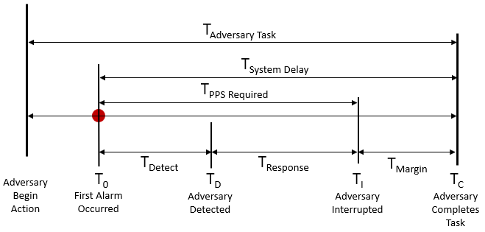
Current Security Assessment
Notes:
Current methods basically just compare time of adversaries vs. time of response.

Slide 4
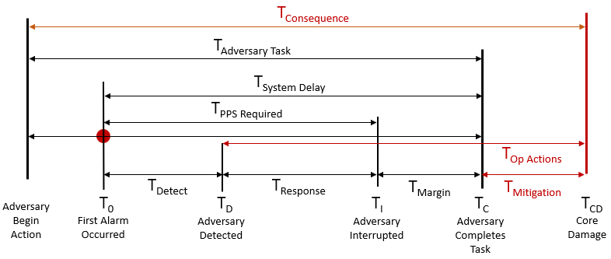
Desired Security Assessment
Notes:
Ideally, we want to easily include operator actions during or after an attack, after attack mitigation options, and use the time of events to determine if there is actual core damage.

Slide 5
Goal
Reduce physical security costs by reducing target set significance, using FLEX-like equipment and operator procedures. Demonstrate equivalent safety level to enable simple regulatory change review. 10 CFR 50.54(p)
Methods – crediting of FLEX and other procedures and accurately model reactor effects over time including:
Operator procedure to fill steam generators (SG)
FLEX-like pump procedure modeling
Thermal hydraulics with operator actions and component loss times
Extend scenarios past RAPT time
FLEX - Diverse and Flexible Mitigation Strategy
RAPT - Reasonable Assurance of Protection Time RG 5.76
Notes:
***This slide could be removed or skipped over in presentation
We want a process that shows a new strategy is as good as an old one so using a process as to not impose a lot of regulatory burden

Slide 6
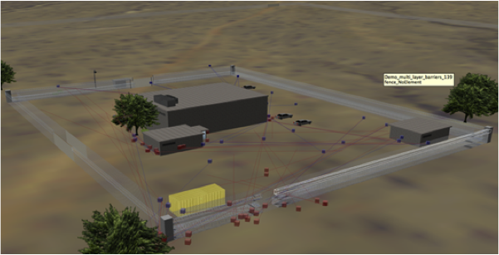
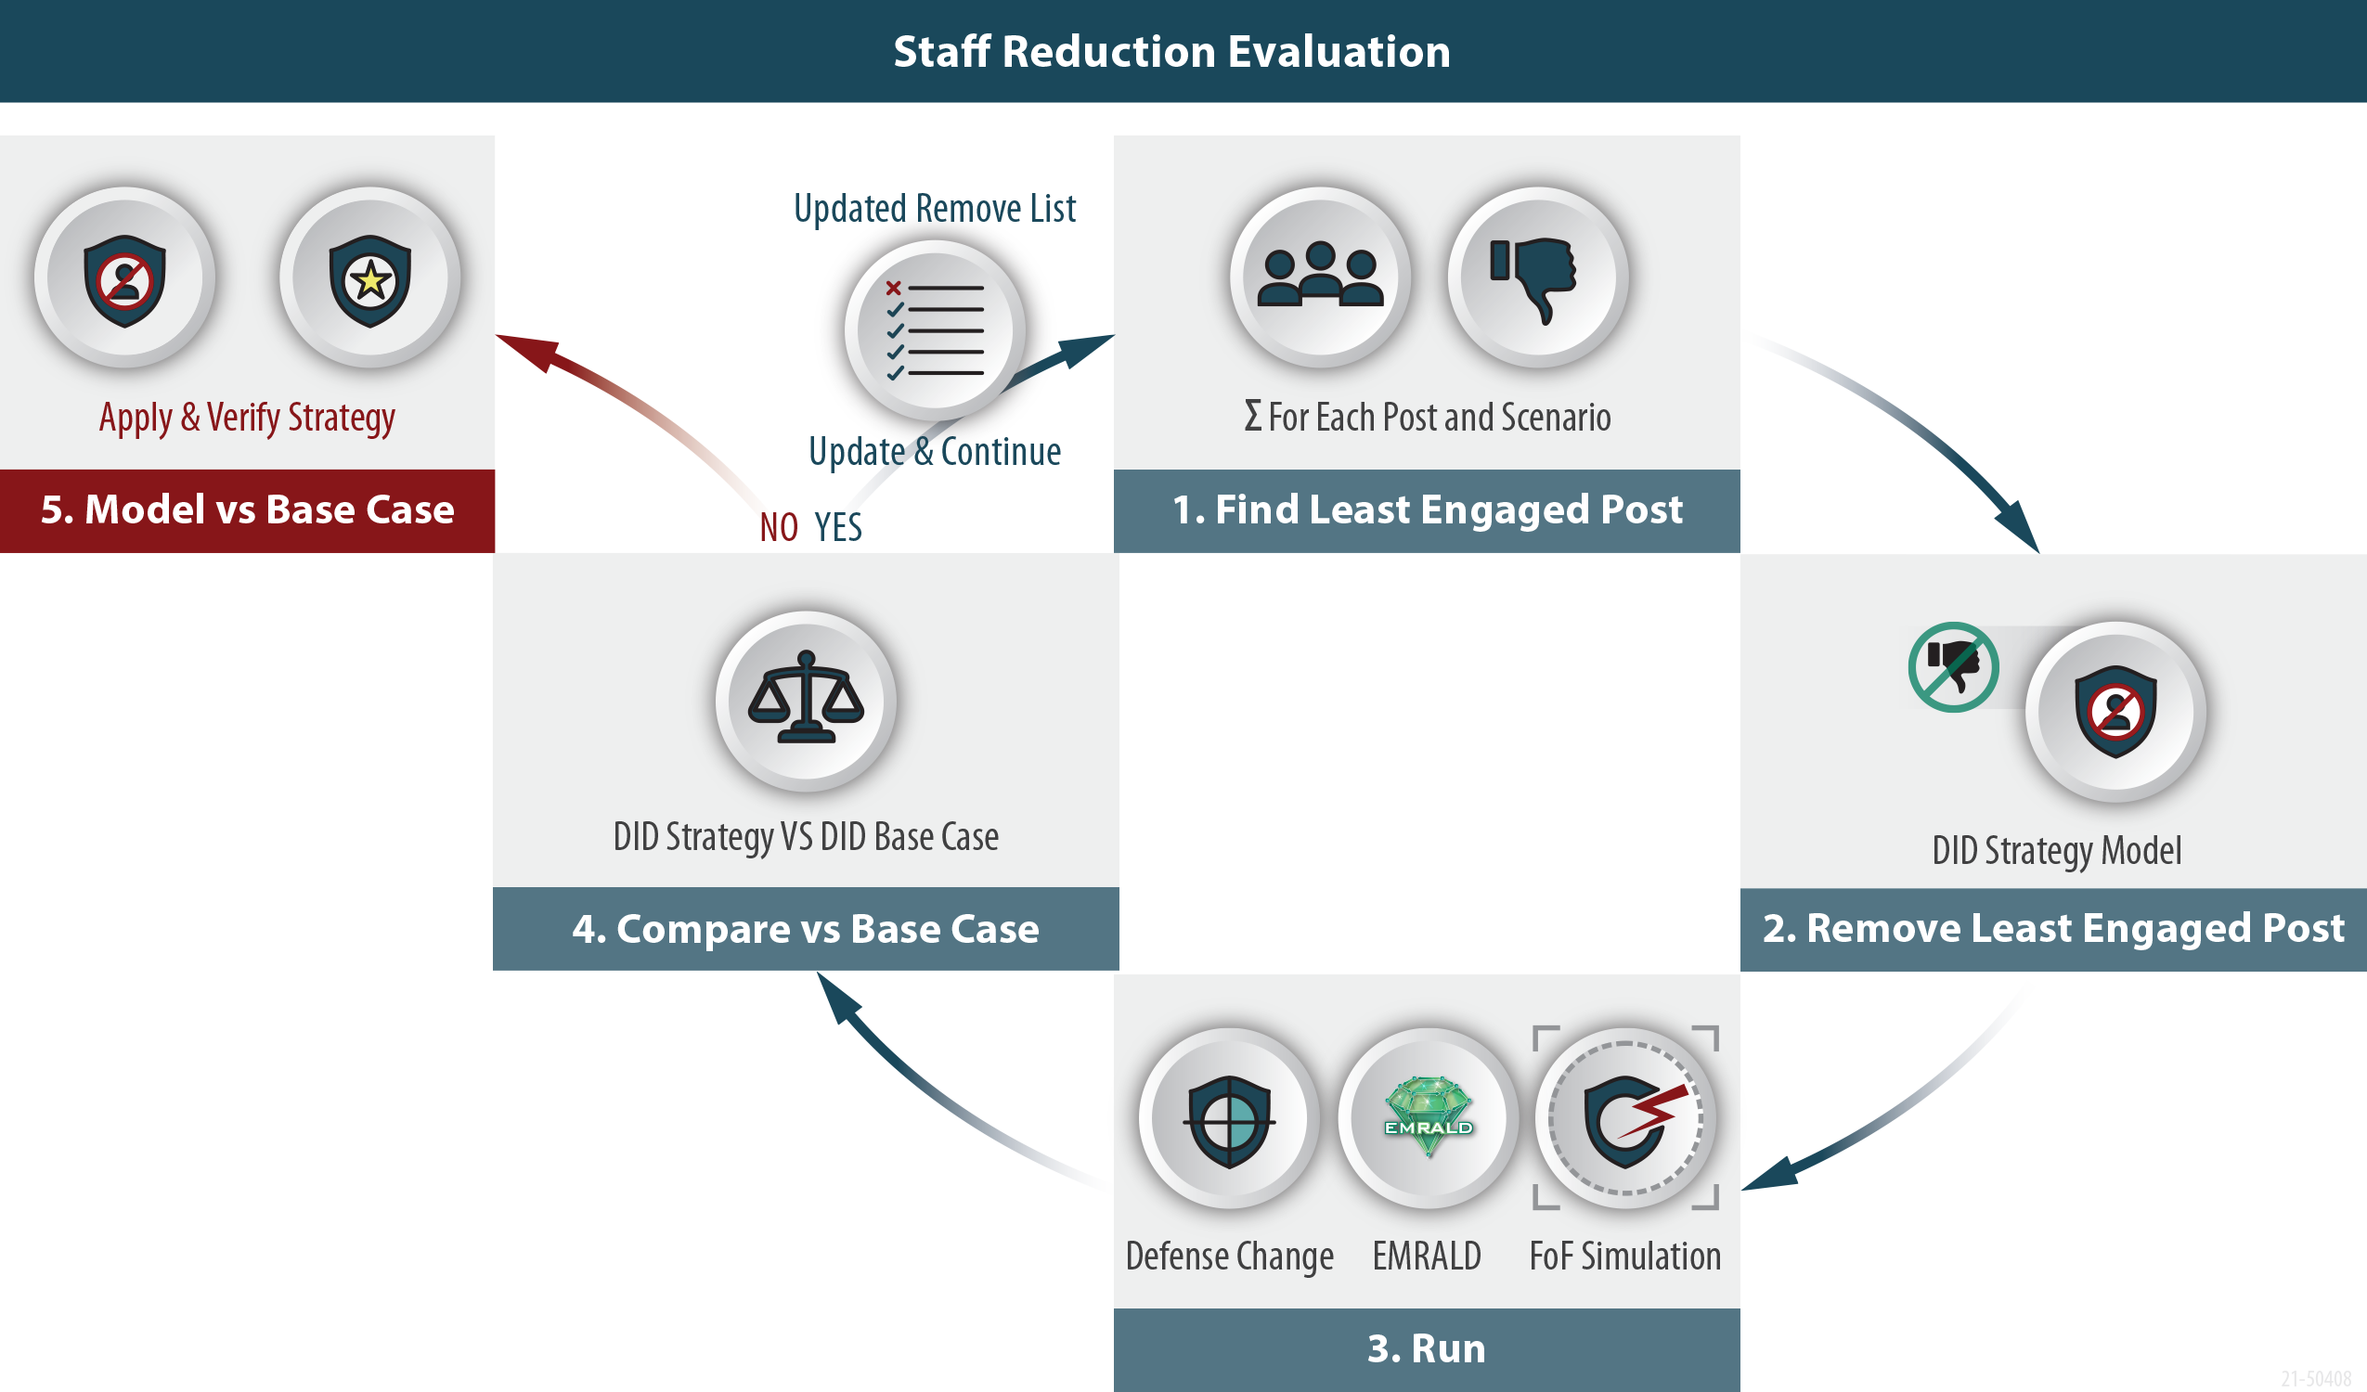
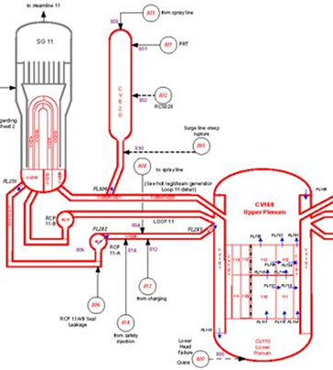

MASS-DEF Two Parts
Modeling and Analysis for Safety and Security using Dynamic EMRALD Framework (MASS-DEF)
Modeling and Simulation
Post-Reduction Process
Notes:
The process is called MASS-DEF, it consists of two parts, simulation and method of reduction to show equivalency with previous protection strategy

Slide 7
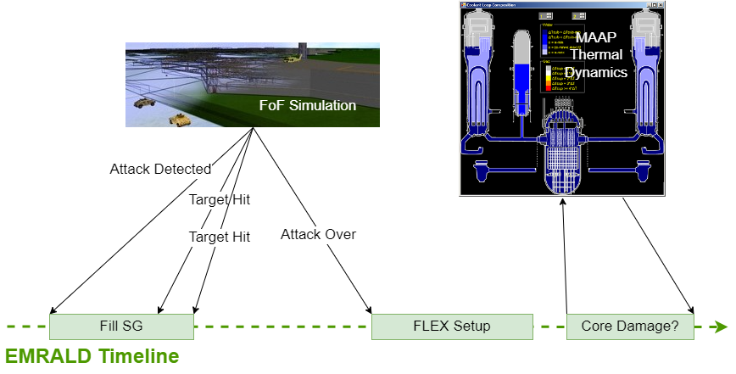

Combining Simulations
Notes:
Big picture capture important times from FOF, perform plant response strategies in EMRALD, run Thermal Hydraulics with specific timings to determining core damage.

Slide 8

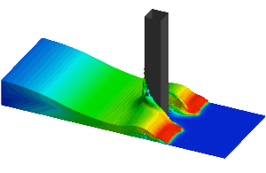



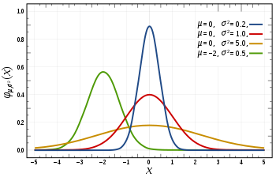
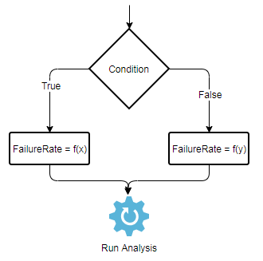
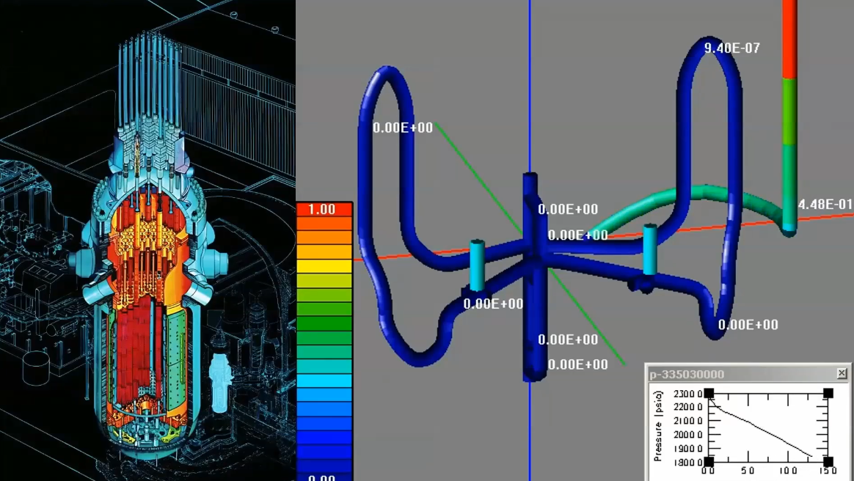
EMRALD Modeling
A time-based or dynamic probabilistic risk assessment (PRA) modeling tool
Couple multiple tools
See events over time
Condition-based events
Drag-and-drop Web UI
www.emrald.inl.gov
Notes:
ERMALD is a dynamic PRA tool from INL that makes it possible to model complex procedures and link with other tools.

Slide 9
Generic PWR Model
Includes major targets (no target sets)
Model not SGI but used in SGI room with SGI input data
Can work with input (data/statistics) from any FOF tool: pilot-pulled target time results from Simajin
Using generic FLEX procedures (update with site-specific times)
FLEX execution determined according to targets
Link to MAAP for thermal hydraulics
Run MAAP for final core damage outcome
Use RAPT time for cut off
Include custom procedures such as filling the SG
FOF – Force on Force
SGI – Safeguards Information
MAAP – Modular Accident Analysis Program
Notes:
A generic model was made that captures possible targets that can be adjusted to match specific facilities. This makes it easy for facilities to use with minimal training.

Slide 10
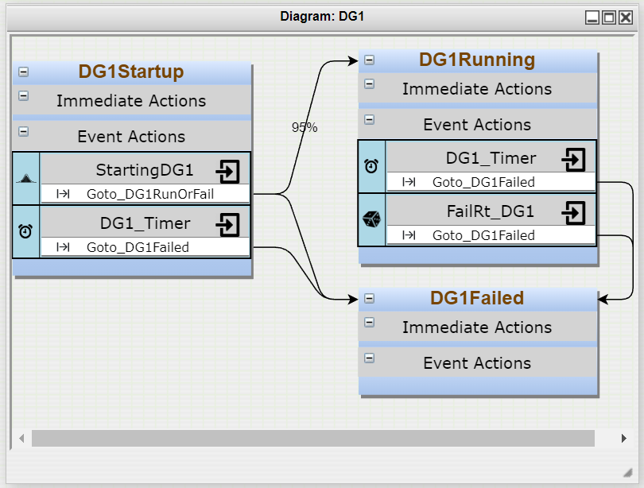
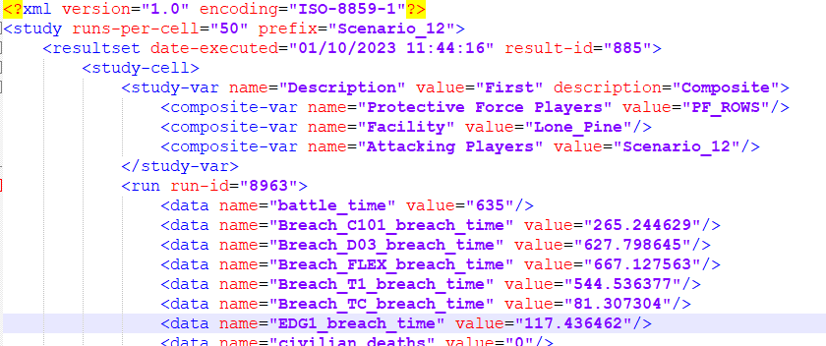
Modeling Equipment and Failure Methods
Fails to Start Random Failure
Random Failures
Fails to Run Random Failures
Simajin Breach Time
Notes:
Show that both random failure events are captures along with the linking to Simajin

Slide 11
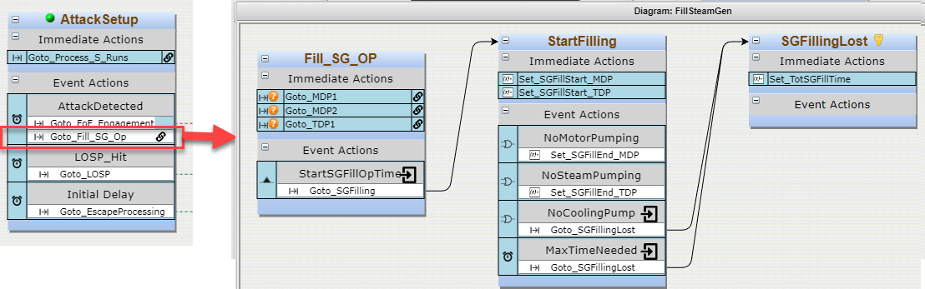
Steam Generator Fill
Fill SGs to allow more time to implement FLEX
Normal operation ~30%
Operators start filling on initial security event
Fill until ~80% or pumps no longer available due to attack
Start procedure time distribution
  Normal dist. 30 sec mean 5 sec std.
  ??? need data
Save calculated fill-time for TH analysis
Notes:
This Steam generator filling is a good example of an operator action a plant could do if an attack occurs. This procedure could give a facility hours of extra time to prevent core damage. Facilities could add other operator procedures as needed. This was procedure was evaluated for the pilot project.

Slide 12
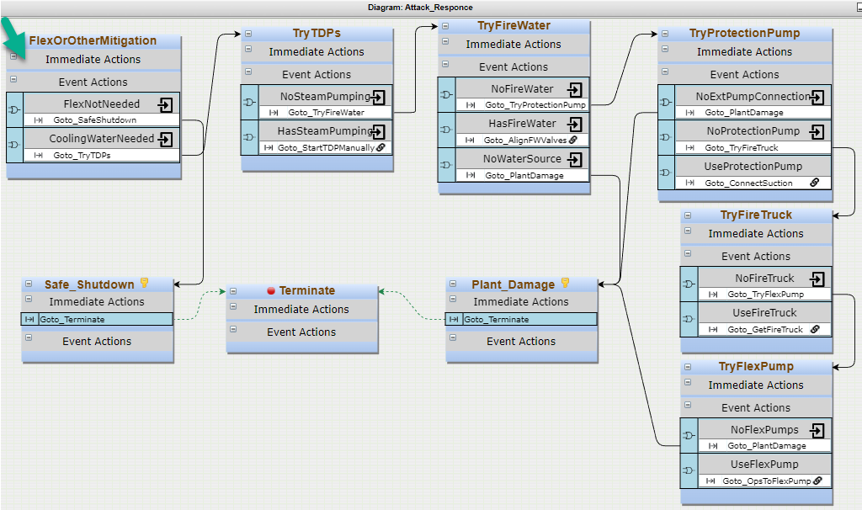
After Attack
Steps through options:
Manual TDP operation
Fire water
Protection pump
Fire truck
FLEX pump
Pilot Mitigation Options
TDP – Turbine-Driven Pump
Notes:
After an attack mitigation options are used to prevent core damage. The generic model provides 5 options. In the most recent pilot strategy, two are used, manual TDP and a protection pump.

Slide 13
Post Reduction

Slide 14
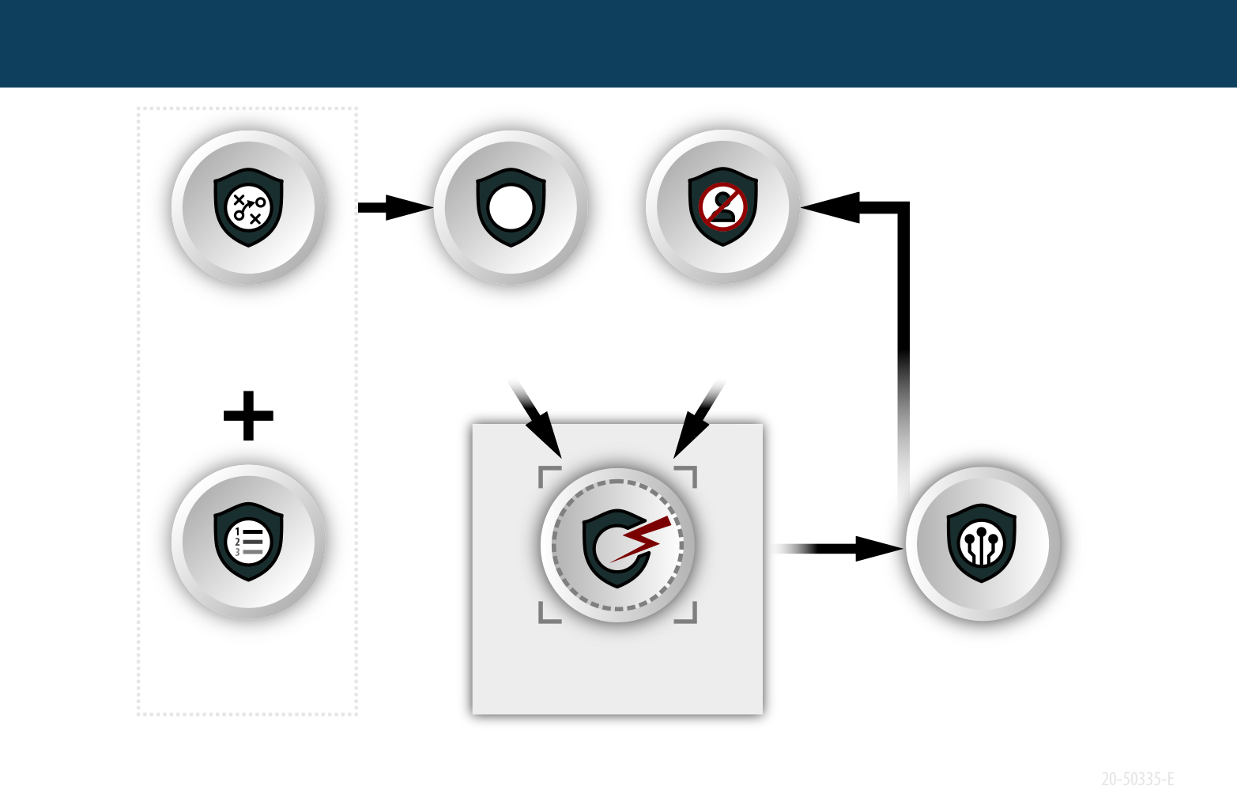
Initial Model - Base Case with Exaggerated Scenarios
Base Case Analysis
Strategy
Model
Original
Scenarios
Exaggerated
Scenarios
Top Attack
Options
FOF Simulation
Base Case Results
Full Scenarios
Exaggerated Scenarios
Notes:
The first step of evaluation is developing a two base case comparison results. Original Exaggerated,
*explain what Exaggerated is and why

Slide 15
Determining Possible Contribution
Evaluate max potential of adding FLEX-like equipment and operator action using “Exaggerated Scenario” model
Desire high percentage of Main Only vs. Main & FLEX
Scenario | Safe | Main Only | Main & FLEX | FLEX Contribution
S1 | 50% | 40% | 10% | Potential high-impact use of FLEX
S2 | 50% | 5% | 45% | FLEX less effective, consider FLEX protection
S3 | 90% | 5% | 5% | Mostly effective scenarios, low-impact from FLEX until post reduction
Safe: target set not fully lost or compromised
Not real results
Notes:
After running initial data, see if the new strategy will have a significant benefit.
*Explain two target sets Main Only and Main & FLEX

Slide 16
Evaluate Potential Post Reductions
Exaggerated Strategy VS Base Case
Exaggerated Strategy Model
Notes:
*Explain looping of post reduction process

Slide 17
Pilot Results

Slide 18
Scenario Evaluation
Reviewed scenarios, in order of significance, and determined which would benefit from FLEX.
Reviewed 24 plant attack scenarios
Five significant scenarios chosen that would likely benefit from FLEX
All scenarios could use FLEX pump; only some could use FLEX DG, so only pump usage was included
Adversary total increased to stress defense in depth (DID) to increase sensitivity in order to evaluate mitigation strategies
EMRALD used to determine recoverable cases where mitigation prevented plant damage
Notes:
Process taken in for the modeling and simulation steps

Slide 19
Pilot Post Reduction Evaluation
Evaluated two options for reductions with exaggerated scenario
  Reduction A is 12% and Reduction B is 20%
  Can continue reduction process.
Scenario | Exaggerated Baseline | Exaggerated Op Act & Pump | Reduction A | Reduction B
1 | 70% | 83% | 83% | 76%
2 | 44% | 71% | 67% | 68%
3 | 28% | 98% | 96% | 92%
4 | 69% | 99% | 85% | 74%
5 | 79% | 99% | 98% | 98%
Notes:
Results show that the operator actions and mitigation with security pump significantly increased exaggerated baseline. After two sets of reductions, the values are still higher than exaggerated baseline.

