Slide 1


Simulated Systems - Real ROI
1 December 2025
Dr. Tim Cooley - DynamX Consulting
Dr. Ivar Oswalt, CMSP - The MIL Corporation
Dr. Oswalt contributed to this effort in his personal capacity and the views expressed are his own and do not necessarily reflect those of The MIL Corporation.

Slide 2
Return on Investment (ROI) Tutorial Learning Objectives
After this tutorial, attendees will be able to:
  Define Return on Investment
  Explain what M&S ROI is and what it is not
  Summarize the differences in calculating M&S ROI where profit is not the motive - e.g., DOW
  Construct metrics for use in the ROI calculation
  Recall real world examples and considerations (level and type of ROI metrics)
  Describe how to apply the ROI concepts provided to your / real world M&S use cases

Slide 3
Outline
The Importance of ROI
Defining ROI, Comparative ROI, ROI Examples and Levels
What is Not Return on Investment
Challenges to Calculating ROI for DoD M&S
Overall Approach, M&S Value Variation, Expected Value ROI
Simple M&S Value Examples
Moving Toward Comprehensive ROI Calculation
Comprehensive ROI Calculation Processes
Case Study and Next Steps

Slide 4
The Importance of ROI
When requirements increase faster than available resources, decisions on how to allocate the resources among various programs and projects are required.
Project and program managers must show why their systems are worthy of continuing or launching over another.
While many factors influence these important decisions, return on investment (ROI) should play a key role.
“You measure what you treasure!”
Advance warfighting readiness by increasing collective, affordable, interoperable M&S enabled capabilities vital to air, space, and cyber power. DAF M&S Mission
DAF: Department of the Air Force

Slide 5
Defining ROI
“A performance measure used to evaluate the efficiency of an investment or to compare the efficiency of a number of different investments.”¹
“(Benefit - Cost) / Cost”² - A monetary equation calculated in terms of Net-Present-Value dollars
A performance measure used to evaluate the efficiency or profitability of an investment or compare the efficiency of a number of different investments. ROI tries to directly measure the amount of return on a particular investment, relative to the investment’s cost.³
“ROI is often stated in ratio form as profit divided by amount invested”⁴
Benefit - Cost
ROI =
Cost
Where benefit and cost are typically expressed in $
  1) ROI Tutorial. E. Degnan, I/ITSEC 2010
  2) What is a pound of training worth? Frameworks and practical examples for assessing Return on Investment in training. Cohn, J & Fletcher, J. D. I/ITSEC 2010
  3) Investopedia, https://www.investopedia.com/terms/r/returnoninvestment.asp
  4) Fundamental Accounting Principles, Fifteenth Edition, K. Larson, J. Wild, B, Chiappetta, McGraw-Hill, 1999, pg 6

Slide 6
Classic ROI Example
Assume an investor bought 1,000 shares of the hypothetical company Worldwide Wickets Co. at $10 per share. One year later, the investor sold the shares for $12.50. The investor earned dividends of $500 over the one-year holding period. The investor spent a total of $125 on trading commissions to buy and sell the shares.
  The ROI for this investor can be calculated as follows:
  ROI = ( [($12.50 x 1000) + $500] – [$125 + ($10 x 1000)] ) / [($10 x 1000)] = 28.75%
OR
  ROI = ( [($12.50 - $10) x 1000 + $500] – [$125] ) / [($10 x 1000)] = 28.75%

Slide 7
Classic ROI Example
  ROI = ( [($12.50 x 1000) + $500] – [$125 + ($10 x 1000)] ) / [($10 x 1000)] = 28.75%
OR
  ROI = ( [($12.50 - $10) x 1000 + $500] – [$125] ) / [($10 x 1000)] = 28.75%
Step-by-step analysis of the calculation:
  To calculate net returns, total returns and total costs must be considered. Total returns for a stock result from capital gains and dividends. Total costs include the initial purchase price and any trading commissions paid.
  In the above calculation, the gross capital gain (before commissions) from this trade is ($12.50 - $10.00) x 1,000. The $500 amount refers to the dividends received by holding the stock, while $125 is the total commissions paid.”

Slide 8
Comparative M&S ROI
Used to compare alternatives – benefit may not be easily calculated or is equal/equivalent
Key is to apply same evaluation criteria consistently
Comparing two simulator options for training...
  Option 1 has a development cost of $1.25M, O&M costs of $450/hr and is estimated to need a refresh after 6,000 hours
  Option 2 has a development cost of $2.3M, O&M costs of $320/hr and is estimated to need a refresh after 8,000 hours
  Both are deemed equivalent in training outcomes

Slide 9
Comparative M&S ROI - II
Since the benefit is equal only need to calculate costs - Cost = Development Cost + O&M cost
Option 1 Cost = $1.25M + $450/hr x 6,000 hours = $3.95M
Option 2 Cost = $2.3M x (6,000/8,000) + $320 x 6,000 hours = $3.645M
[note: all calculations consider 6,000 hours for consistency.]
Ratio
Therefore, option 1 is 8.4% more costly than option 2 and Option 2 would be chosen.
Option 1 Cost
ROI Ratio =
Option 2 Cost
$3.95M
$3.645M
= 1.084
O&M: Operations and Maintenance

Slide 10
ROI Based Examples
Company has option of purchasing an AI based customer service system for $1.8M with annual O&M contract of $150,000. Benefit is $800,000/yr in reduced costs. Customer service functions determined to be equivalent. Company realizes break even in year 3.
Company believes there is a market for 10% increased sales of their product. This would result in increased profit of $1M. However, 6 additional personnel would be needed at a cost of $750,000 per year with an initial year one-time cost of $150,000.
  ROI over first three years is calculated as 25%.
$3M – (3 x $.75M + $.15M)
ROI =
3 x $.75M + $.15M
AI: Artificial Intelligence

Slide 11
ROI Levels / Types
Levels / Types: An ROI calculation will differ between people depending on what is included in the ROI formula used in the calculation.
  A marketing manager might use the property calculation without accounting for additional costs such as maintenance costs, property taxes, sales fees, stamp duties, and legal costs.
  An investor needs to look at the true ROI, which accounts for all possible costs incurred when each investment increases in value.
  A renter might only need to consider the monthly rent, utilities, etc. as compared to the reduction in their commute cost because of the location of the unit to most destination points.

Slide 12
What ROI is Not
Other Indicators of Value
Cost Savings
Cost Avoidance
Planned money that was not spent due to alternative process or method
  Dollars saved in engineering design using M&S and CAD/CAM
  $XM saved thru simulated performance evaluation of a gun or missile system
Proactive strategy to reduce expenditures
  Simulator use in tank training resulted in a cost avoidance of $XM due to not using live munitions
  Aircraft costs that were avoided due to use of M&S in training
Cost Benefit
Benefit
CB =
Cost
The ratio of return over investment
  The simulation’s benefit far exceeded the cost of its development, so CB > 1
CAD: Computer Aided Design, CAM: Computer Aided Manufacturing, CB: Cost / Benefit

Slide 13
ROI Features that Challenge its Use in DOW M&S
ROI is a popular profitability metric used to evaluate how well an investment has performed.
ROI is expressed as a percentage and is calculated by dividing an investment's net profit (or loss) by its initial cost or outlay.
ROI can be used to make apples-to-apples comparisons and rank investments in different projects or assets.
Classic ROI does not take into account the holding period or passage of time, and so it can miss opportunity costs of investing elsewhere.
ROI is calculated using dollars as the sole means to reflect value!

Slide 14
So, What’s the Best Approach for DOW M&S ROI?
DOW is a not-for-profit organization with many perspectives
Fiscal equations don’t capture key dimensions of value
M&S value is multi-faceted and realized over many years
Any effective approach must reflect the multi-dimensional nature of M&S use within DOW
So, M&S ROI metrics need to include a wide variety of variables (results, risk, cost, time) within a rigorous framework

Slide 15
Overall Analytic Approach
M&S
Application Areas
M&S Metrics
Cycle time/ duration
Planning/ decision time
Number of variables/ alternatives
Level of complexity
Task success rate/ confidence level
Level of understanding
Number of prototypes
Level of realism
Learning retention
Number of tasks accomplished only w/ sim
Increased Application Opportunities
Etc.
Acquisition
Training
Assessment
Support to Operations
Quantitative Results
C/A, C/B, ROI
Multi-Attribute Utility
Cost, Schedule, Risk
Results, + and -
C/A: Cost Avoidance, CB: Cost / Benefit

Slide 16
Key Dimensions of Value
Dollars / Cost
  The focus of the discussion so far
Time
  Both elapsed (total) time and timing (just in time / within the opponent’s Observe, Orient, Decide, and Act (OODA) loop)
Risk
  The impact of using the M&S capability on increasing or decreasing negative outcomes
Results
  Readiness, Proficiency, Situational Awareness, Coordination, Lethality, etc...

Slide 17

M&S Value Varies
Depending on the match between M&S capability and application requirements
There is
no other way…
There are other
ways but M&S is better…
Equipment Failure
Drills
+
M&S can augment
current means and methods…
Route Skills
Campaign
Assessments
Current M&S may
provide negative impact…
Small Unit
Tactical Coordination
Control System
Familiarization
Standard
Operating Profiles
PSYOPS Effects
Prediction
T&E Event
Augmentation
DARKSTAR
UAV crash*
-
Infantry
Close-Combat
* - The crash was “directly traceable to deficiencies” in M&S performed as part of the data analysis of the first flight… DarkStar was a $10M per aircraft (FY94 $s), Recon UAV – Jane’s Defense Weekly, 17 July 1996

Slide 18
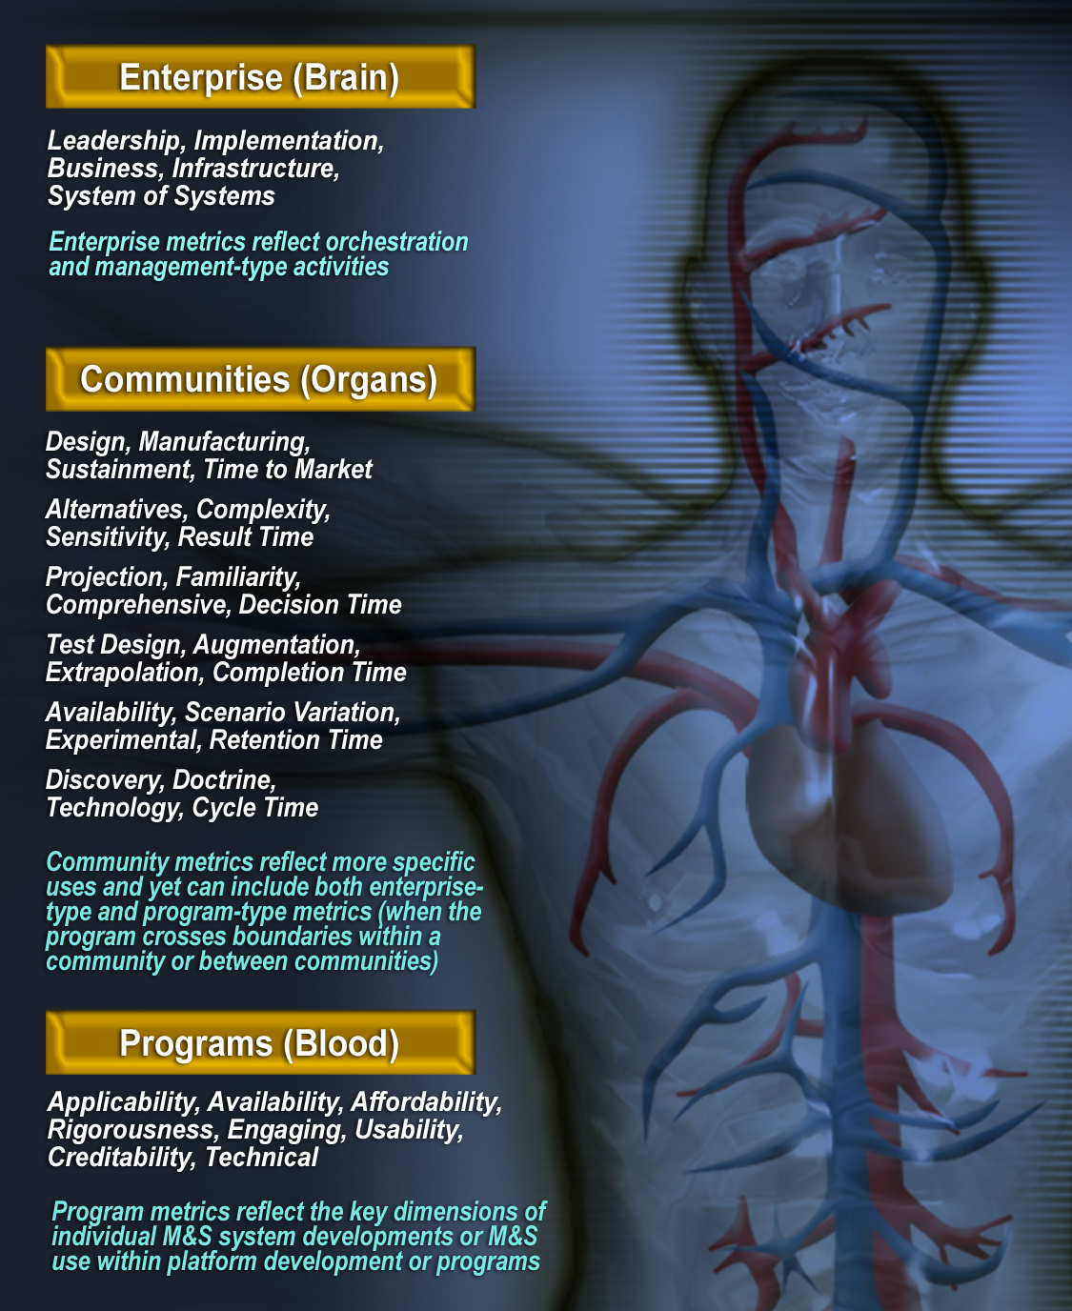
M&S Value Calculation Varies by Level
Enterprise - DoD / Cross Service
  Leadership, Standardization
  Foster, Facilitate, Coordinate
Application Area
  Design - MBSE / Production
  Analysis - AoA, Force Structure
  Decision Support - Span of Interest, Insight Gained
  Testing - FQT, DT, OT, FOT&E
  Training - Staff, Units, Individuals
  Experimentation - Labs, Events
M&S Programs
  “ilities”
  HCI/MMI
  VV&A
AoA: Analysis of Alternatives, DT: Developmental Testing, FOT&E: Follow-on OT&E, FQT: Factory Qualification Testing, HCI: Human Machine Interface, MMI: Man-Machine Interface, OT&E: Operational Test and Evaluation, VV&A: Verification, Validation, and Accreditation

Slide 19
M&S Investment Varies by Phase - Notional
Similar to a Movie or Game
Investment - $s
Planning - Pre-Production - Production - Testing - Pre-Launch - Launch - Utilization - Retirement

Slide 20

The Crystal Ball - ROI of a Future System
What if we desire to determine ROI of a new capability?
  One approach is to use an Expected Value process
Expected Value in the classical sense
  Multiply the predicted net $ gain/loss by the probability of that situation occurring
  E(V) = (net $ of option A)*P(A) + (net $ of option B)*P(B) + (net $ of option C)*P(C) + …

Slide 21
Expected Value ROI Example
Company A desires to launch a new product line. They believe if there is a high sales volume they will net $2.5M. If the reaction to the product is average sales, then they will net $1.0M and if the product line does not do well, they will lose $1.75M. Market research shows the probability of the response is:
    High: 20%
    Average: 50%
    Low: 30%
E(V) = $2.5M x (.20) + $1.0M x (.50) - $1.75M x (.30) = $475,000
Project gets a 👍

Slide 22
ROI of Future System Approach Without $
Use a similar process
You have an option for a new simulation. SMEs research the situation and believe there is a 25% chance that it will be widely applicable and adopted across organizations. There is a 40% chance that it will have average use with a 35% chance that it will end up not applicable and unused. The “util” values for each situation is:
    High use: 80 utils
    Average use: 20 utils
    Low use: - 25 utils
  E(U) = 80 x .25 + 20 x .40 – 25 x .35 = 19.25 Utils

Slide 23
USMC Example of M&S Value Assessments
USMC desired to determine how simulator-based training impacted proficiency
Proof of concept study¹ tracked training of three 3-person tank crews from initial familiarization through live fire qualification
Each crew showed consistent increase in proficiency
Simulation training transferred to live fire performance
The crew performing the best in the simulator also performed the best in live fire
Conclusion was that the simulator provided value by increasing proficiency
¹ Dunne, R., Cooley, T., Gordon, S., “Proficiency Evaluation and Cost-Avoidance Proof of Concept M1A1 Study Results”, I/ITSEC 2014.

Slide 24
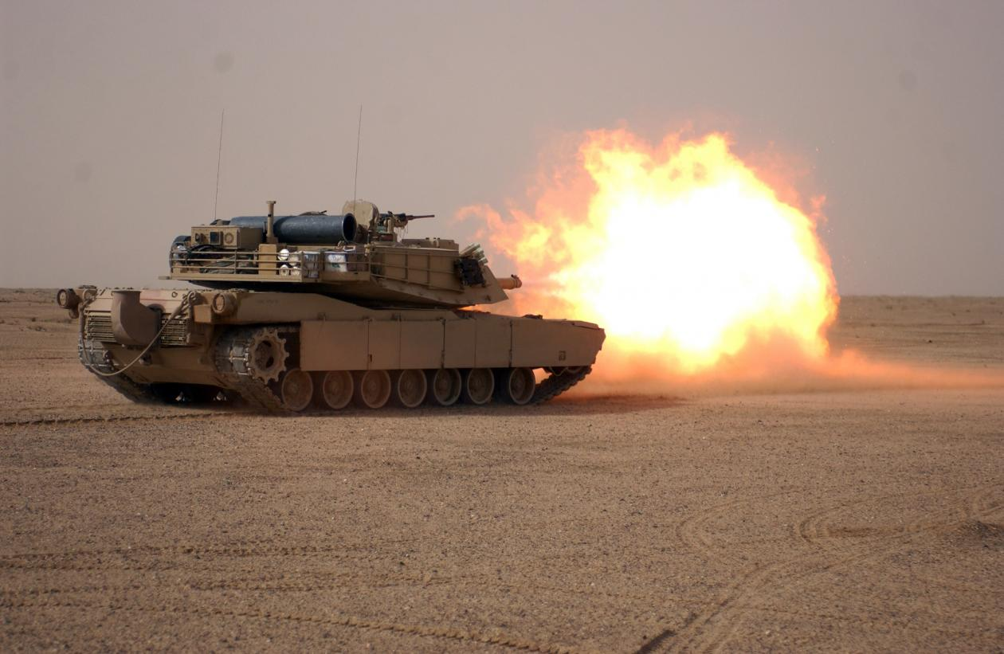
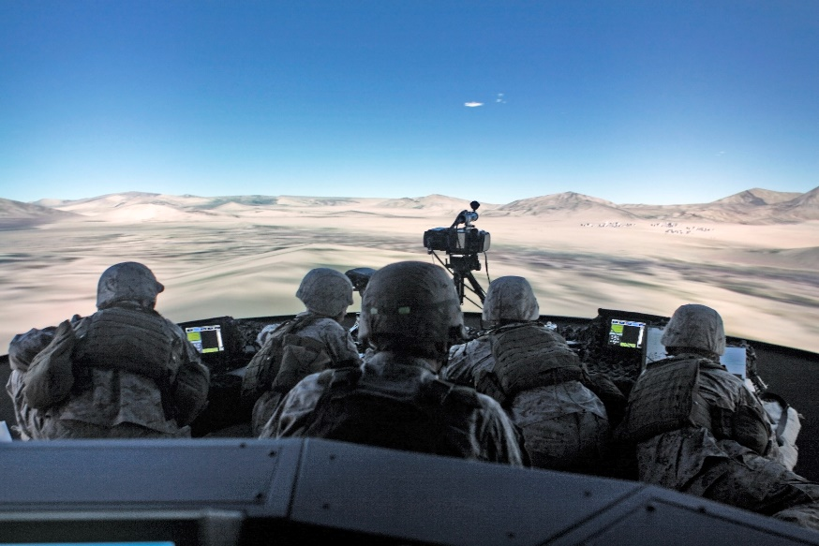
USMC M&S Cost Avoidance
Cost Avoidance of USMC simulation-based training has been calculated for over 10 years.
  Most systems provide significant value by avoiding tens or hundreds of $M in costs vs performing the training live
  Rigorous analysis of USMC M&S training vs live training has shown comparative ROI of over 150 on one simulator and consistently above 10 for most systems
This coupled with the proficiency study show simulation-based training’s value to the USMC

Slide 25
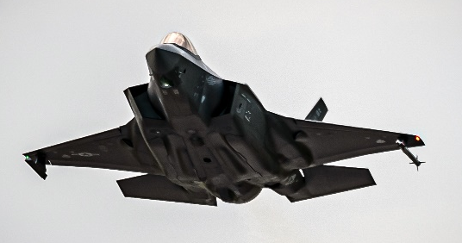
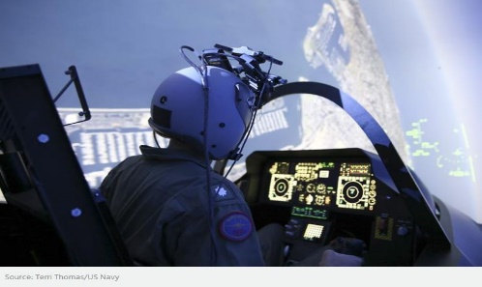
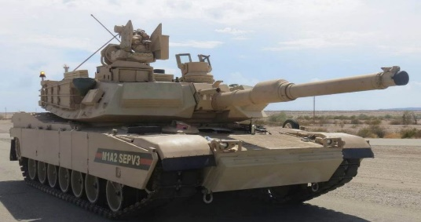
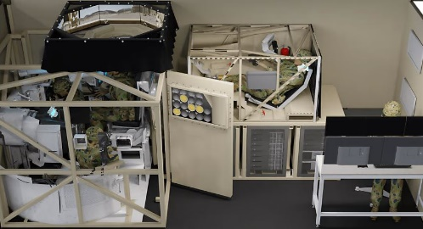
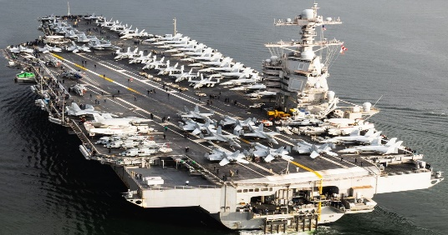
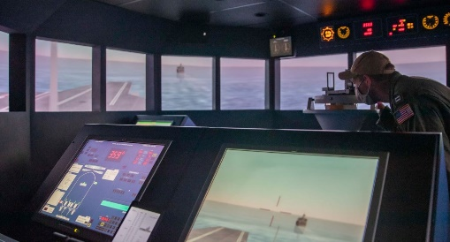
ROI Drivers
Training Operators of Air, Land, and Sea Platforms
LIVE
SIM
F-35 / Joint Simulation Environment (JSE)
  F-35 = ~$110M per aircraft, 1 pilot, ~$34K/hour to fly
  JSE = $65.5M + ~63M in base upgrades = ~$128M
  JSE = Probably about twice F/A-18, so: ~$2K-ish/hour to operate
M1A2 Abrams SEPv3 / Immersive Tactical Trainer (ITT)
  M1A1 = ~19M per tank, 4 in crew, ~$450/hour to drive
  ITT = ~$4M per trainer, Probably about ~$30/hour to operate
CVN-78 / Kongsberg Polaris V2 Simulator
  CVN-78 = ~$13.3B, ~4500 in crew, ~$300K/hour to operate
  KPV2S = Perhaps ~$5M-ish per trainer, ~$250/hour to operate
ROI
  Cost, Personnel Risk, Embarrassment…
  CVN-78 / Kongsberg Polaris V2 Simulator Wins!
https://www.af.mil/About-Us/Fact-Sheets/Display/Article/478441/f-35a-lightning-ii/
https://www.flightglobal.com/fixed-wing/true-sense-of-fear-us-military-expands-pilot-training-at-virtual-test-range-created-for-f-35/157737.article
https://marvingroup.com/story/m1a2-abrams-modernization/
https://www.defenceconnect.com.au/land/13195-production-commences-on-advanced-abrams-tank-simulators
https://www.seaforces.org/usnships/cvn/CVN-78-USS-Gerald-R-Ford.htm
https://www.facebook.com/photo/?fbid=3246720392083077&set=pcb.3246720795416370

Slide 26
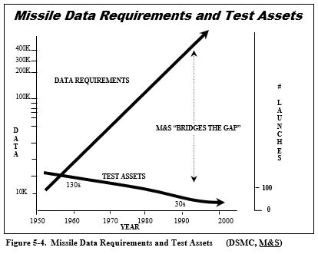
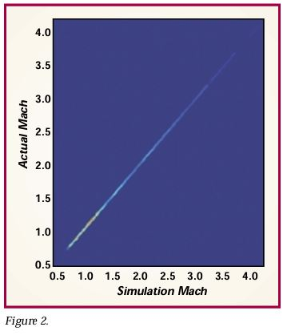
AAW Example of M&S Value Assessments
“AIM-9X is built around the existing AIM-9 rocket motor and warhead and incorporates a new imaging infrared array for the seeker and a new fin design that integrates vector thrust control for maneuvering.”¹
Simulation reduces the number of live missile tests and helps avoid the cost of program delays incurred by test failures.
The AIM-9X program, assumed $1 million per test firing and a two-month delay per flight test failure.²
Upper Right Figure - Then¹
  Shows the total number of firings from research and development through OT&E.
  The downward trend was driven by cost and schedule.
Lower Right Figure - Now²
  Shows data comparing actual Mach numbers vs. simulated Mach numbers at any time in a flight. A total of about 2,000,000 data points are represented. The 90th percentile deviation (deviation from the 45-degree line) is less than three percent.
Simulations maintained or increase the level of understanding of system performance even though the number of tests decreased.
AKA, positive ROI!
AAW: Air to Air Warfare, 1 - IDA AIM-9X: A Modeling & Simulation Success Story, Research Summaries. 2 - ATFM&S Final Report, 20 June 1995

Slide 27
Digital Twin Example
You have a development project that requires prototyping. Previous methods have required constructing 3 physical prototypes at a cost of $250K each.
There is an option now to build a Digital Twin of the prototype which costs $80K per model and there is a $200K initial investment in the modeling tools, etc.
It is believed that the time to prototype with the digital twin is 3 months vs 6 months with all physical prototypes and each month of acceleration in the project saves $100K per month.
What is the best method and what is the ROI?

Slide 28
Digital Twin ROI Calculations
We will assume the same return in both cases (Return = prototype for project)
Previous Method Cost:
  3 Physical models at $250K each = $750K
  6 months of effort at $100K per month = $600K
Digital Twin Cost:
  1 Physical model at $250K = $250K
  1 Digital Twin model at $80K = $80K
  Digital Twin Toolbox = $200K
  3 month of effort = $300K
ROI of Digital Twin Toolbox = (1,350-830)/200 = 2.6 or 260%
Does not factor in re-use of the toolbox and perhaps re-use of the digital twin
TOTAL COST = $1,350K
TOTAL COST = $830K

Slide 29
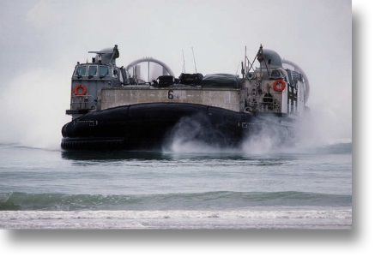
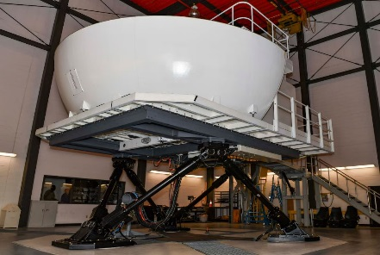
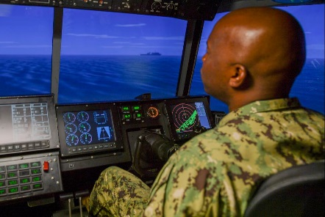
Moving Toward a Comprehensive Measure of M&S Value
One that includes: Results, Risk, Time, and Cost
Results:
  Availability / complexity of scenarios / profiles
    FMT avoids weather, ship availability, and similar restrictions
Risk
  Environmental impact
    FMT allows training without impacting beach wildlife, exceeding noise restrictions, etc.
  Allows system casualty training without endangering personnel
    Such training is impossible on an operational LCAC
Cost
  Simulator cost = $300 / hour
  LCAC cost = $3,000 / hour
Time
  FMT reduced actual LCAC flying time by an estimated 40-45 hours per crew training course
Landing Craft Air Cushion (LCAC)
Full Mission Trainer (FMT) / Device 20G6
A 6DOF Mock-up of the LCAC Cockpit: 3 crew and OIC positions
How would one develop such a comprehensive - but rigorous assessment and build associated equations?
1045-1130 LCAC Full Motion Trainer (FMT) and Strategic Sealift presentation, 12 August 2021, https://www.surfpac.navy.mil/MediaWeek/Article/2730026/1045-1130-lcac-full-motion-trainer-fmt-and-strategic-sealift-presentation/

Slide 30
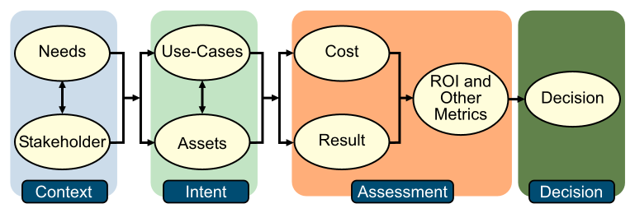
M&S ROI Metrics Methodology Overview
A structured approach, made up of at most eight activities
  Context Setting
  Needs Analysis
  Stakeholder Definition
  Use Cases Derivation
  Asset Identification
  Cost Assessment
  Results Determination
  Decision Input
Each step has features unique to M&S ROI Metric Calculation

Slide 31
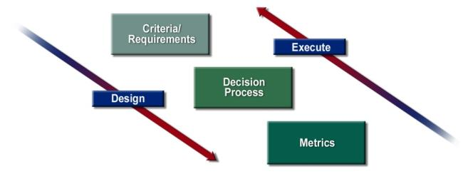
M&S ROI Metrics Methodology Components
1. Needs and Requirements Analyses
Using a top-down approach to define requirements being met with M&S, associated decision processes, and relevant metrics. Then going bottom-up to measure metrics that inform decisions to meet requirements.

Slide 32
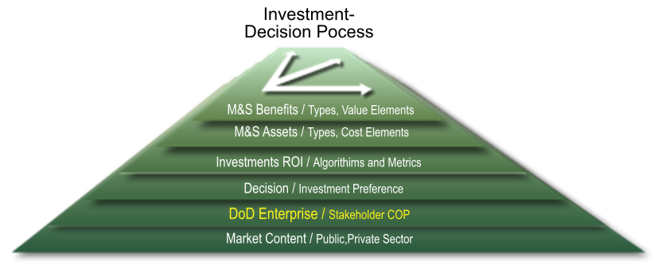
M&S ROI Metrics Methodology Components
2. Stakeholder and Community of Practice
Recognizing how sensitively investment preferences vary across the DOW M&S communities and action-agent role players.
COP: Community of Practice, DoD (DOW): Department of Defense / Department of War

Slide 33
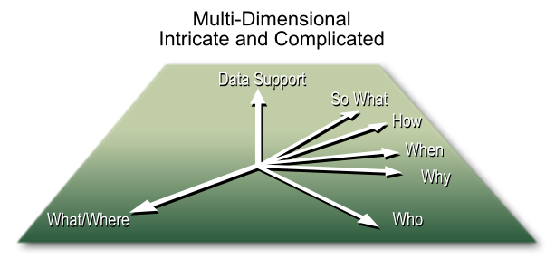
M&S ROI Metrics Methodology Components
3. Use Case
Developing use cases (explication and test scenarios) specifically from the application domain to help refine methodology components and to understand decision input sensitivities.

Slide 34
M&S ROI Metrics Methodology Components
4. Asset Identification
Addressing the set of processes and product artifacts that are candidates for DoD M&S investment and identifying their cost and result dependencies.
CAD: Computer Aided Design, CAM: Computer Aided Manufacturing, HW: Hardware

Slide 35
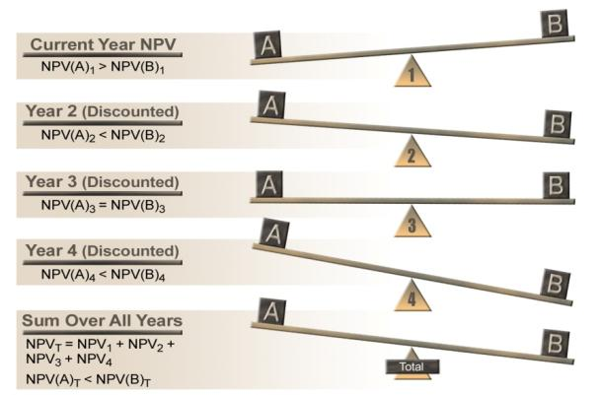
M&S ROI Metrics Methodology Components
5. Asset Investment Cost Analysis
Identifying asset cost factors and their circumstantial dependencies.
NPV: Net Present Value

Slide 36
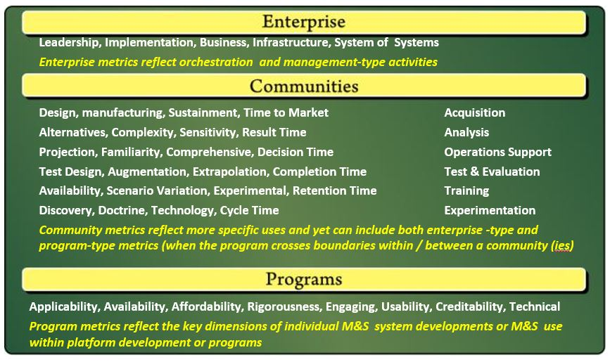
M&S ROI Metrics Methodology Components
6. Asset Results Analysis
Identifying asset result factors and their circumstantial dependencies. Approximately four hundred result metric types are currently postulated.

Slide 37
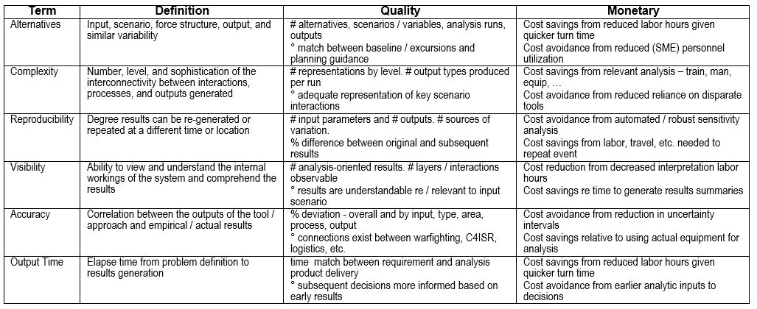
M&S ROI Metrics Methodology Components
Analysis Results and Cost Metrics Types

Slide 38
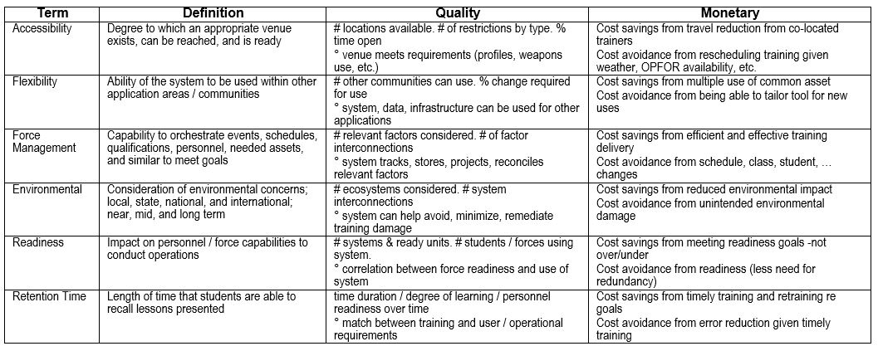
M&S ROI Metrics Methodology Components
Training Results and Cost Metrics Types
OPFOR: Opposing Forces

Slide 39
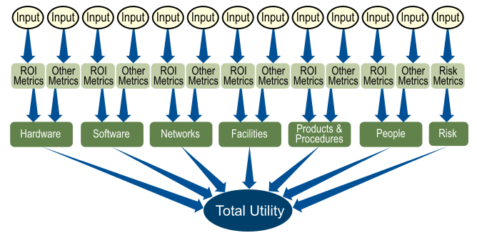
M&S ROI Metrics Methodology Components
7. Investment Decision Process
Applying a Multi-Attribute Decision Making (MADM) network that is robust, relatively explainable, objective, consistent, and once established, can be executed fairly simply

Slide 40
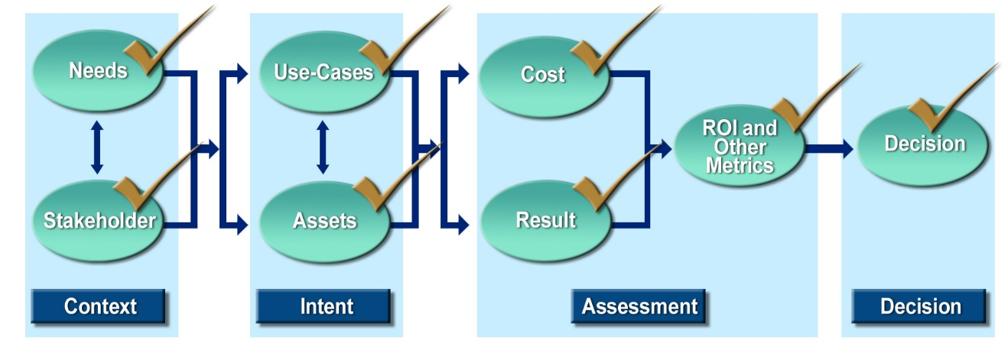
Case Study
A 4-day experiment is planned in Alaska to test the combat benefit of a friendly forces position determination system
The simulationist determines there are three reasonable options
  Traditional M&S solution used for previous Alaskan events
  A semi-automated simulation that reduces needed personnel but requires training and developing infrastructure
  All live forces for major elements with secondary roles as a constructive simulation
Costs for all three options need to be determined
Options are evaluated using the structure above

Slide 41
Case Study - Needs
Needs for the scenario are determined as:
  Three live helicopter crews acting as downed crew members using current identification systems in some trials and the new system in others
  Hostile mobile ground forces searching for evading crew members – can be live or partly live and partly constructive
  Friendly ground command and control forces (Combat Search and Rescue (CSAR)) from an Air Operations Center with radar and radio feeds – live forces to conduct rescue
  Friendly surveillance forces – Airborne Warning and Control System (AWACS) – can be live, virtual, or constructive
  Friendly combat air patrol represented by 3 fighter simulators
  Other necessary command and control, surveillance, and forces will be represented in a constructive simulation

Slide 42
Case Study - Stakeholders
Stakeholders
  Commander of Alaska Command
  Program manager for the Positioning system
  Warfighting commands desiring to use system

Slide 43
Case Study – Use Cases (Alternatives)
Alternative A – traditional M&S solution used for other Alaskan events
  Distributed from another simulation center
  Uses 100 personnel at multiple locations for sim operators, control force, and role players
  25 personnel required to attend two planning conferences in Alaska
  No training of sim personnel, no databases need to be developed, little residual benefit
  Floor space in two facilities required
  Some distribution/communication lines to and within Alaska have to be leased

Slide 44
Case Study – Use Cases (Alternatives)
Alternative B - Semi-automated simulation
  Needs only two people to run simulation in Alaska simulation center plus one back-up
  Three personnel fill role player and control force requirements – two-week training required in continental US
  Database development required at cost of $50,000 and 60 day lead time needed
  Two planning conferences in Alaska for 10 people required
  One new laptop required
  Residual benefit is three trained simulation operators and Alaska database
  Communication lines within Alaska have to be leased

Slide 45
Case Study – Use Cases (Alternatives)
Alternative C – All Live forces for major roles
  Live forces used for transport, rescue, humanitarian relief, and disaster recovery roles
  All other secondary roles represented in constructive simulation due to cost
  Two planning conferences in Alaska required with similar personnel requirements as Alternative A
  No distribution/communication lines have to be leased

Slide 46
Case Study - Asset Identification
Assets considered in all alternatives include
  Live aircraft and personnel
  Traditional simulations with required hardware and software
  Semi-automated simulations with required hardware and software
  Data/Database for Alaska
  Facilities
  Distribution systems
  Support personnel

Slide 47
Case Study - Cost
Simulationist or cost analyst must gather cost data
Travel costs, labor costs, cost for operational assets (aircraft, vehicles, etc) per hour, equipment, and communication line costs are required
Estimate number of hours operational assets used, travel days, and labor hours
Source of data is government/DoD documents for FY of exercise
Following cost data is illustrative only and is not taken from current DoD records

Slide 48
Case Study - Cost Data - I
Partial list of Costs - Part II
Costs are illustrative only
Actual costs would need to be extracted from DoD documents for the FY of the exercise
Totals included in this table
Cost Element | Alternative A – Traditional Distributed M&S | Alternative B – Semi- Automated M&S | All Live Forces
People
Evading Crewmembers | $20,100 | $20,100 | $20,100
Hostile Forces | $40,200 | $40,200 | $40,200
SAF Simulation Training |  | $40,200
CSAR Team | $134,000 | $134,000 | $134,000
AWACS Team | $67,000 | $67,000 | $67,000
1 Pilot Each in 3 Fighter Sims | $20,100 | $20,100 | $20,100
Simulation Staff | $670,000 | $20,100
Planning Conference #1 | $335,000 | $67,000 | $335,000
Planning Conference #2 | $335,000 | $67,000 | $335,000
Rescue Helicopter Crewmembers | $33,500 | $33,500 | $33,500
Ground Support for Live Assets | $40,200 | $40,200 | $321,600
Products and Procedures
SAF Database |  | $50,000
Total Cost (Current Year) | $2,045,500 | $932,000 | $6,042,300
AWACS: Airborne Warning and Control System, CSAR: Combat Search and Rescue, SAF: Semi-Automated Forces

Slide 49
Case Study - Cost Data - II
Partial list of Costs - Part II
Costs are illustrative only
Actual costs would need to be extracted from DoD documents for the FY of the exercise
Totals included in this table
Cost Element | Alternative A – Traditional Distributed M&S | Alternative B – Semi- Automated M&S | All Live Forces
People
Evading Crewmembers | $20,100 | $20,100 | $20,100
Hostile Forces | $40,200 | $40,200 | $40,200
SAF Simulation Training |  | $40,200
CSAR Team | $134,000 | $134,000 | $134,000
AWACS Team | $67,000 | $67,000 | $67,000
1 Pilot Each in 3 Fighter Sims | $20,100 | $20,100 | $20,100
Simulation Staff | $670,000 | $20,100
Planning Conference #1 | $335,000 | $67,000 | $335,000
Planning Conference #2 | $335,000 | $67,000 | $335,000
Rescue Helicopter Crewmembers | $33,500 | $33,500 | $33,500
Ground Support for Live Assets | $40,200 | $40,200 | $321,600
Products and Procedures
SAF Database |  | $50,000
Total Cost (Current Year) | $2,045,500 | $932,000 | $6,042,300
AWACS: Airborne Warning and Control System, CSAR: Combat Search and Rescue, SAF: Semi-Automated Forces

Slide 50
Case Study - Results
Semi-automated simulation
  Lowest cost
  Trained cadre of simulation operators for future events
  Leave behind databases – accelerates time-line for follow-on events
  Less risk due to lack of long-haul distribution requirements
  Hard to quantify last three benefits

Slide 51
Case Study - ROI Calculations
ROI Calculations
  Since benefit is similar in all alternatives and the benefit is difficult to compute, comparative ROI will be assessed
  Compare best cost alternative to other alternatives
Decision Maker/Stakeholder may set a threshold which has to be met to attempt an alternative that is different than standard; for example, perhaps 50% or higher. In this case Comparative ROI is very high and worth trying a new method.
(Other Alt Cost – Best Alt Cost)
Comparative ROI =
Best Alt Cost
ROI_{B to A} = $\frac{({Cost}_{A}−{Cost}_{B})}{{Cost}_{B}}$ = $\frac{2,045,500 −932,000}{932,000}$ = 1.19 or 119%
ROI_{B to C} = $\frac{({Cost}_{C}−{Cost}_{B})}{{Cost}_{B}}$ = $\frac{6,042,300 −932,000}{932,000}$ = 5.48 or 548%

Slide 52
Case Study - Decision
Choose Alternative B
Working through methodical, repeatable process yields a decision that is justifiable and explainable to decision makers and funding agencies

Slide 53
Next Steps - Background
Training in blended Live, Virtual, and Constructive (LVC) worlds is a reality
A persistent environment which seamlessly integrates L, V, and C simulations is increasingly becoming the state-of-the-art
Building an LVC environment, upgrading systems to effectively operate in the environment, and modernizing operational assets to meet DOW missions in a highly technical world stretches budgets
Therefore, ROI is more relevant - and measurable now - than ever!

Slide 54
Next Steps - Actions
We must understand the value of the training systems
  Continue and improve those that add benefit
  Retire those systems that provide little value
  Develop new systems to fill gaps
We must optimize the balance between L, V, and C
  Perform rigorous cost and trade-off analyses between different L, V, and C blends
  Requires developing unbiased and measurable training outcome metrics
  Understanding the strengths and weaknesses of each type of training is essential
Applying a methodical, repeatable, and understandable process to these problems is necessary

Slide 55
ROI Tutorial Learning Objectives
After this tutorial, attendees will be able to:
  Define Return on Investment
  Explain what M&S ROI is and what it is not
  Summarize the differences in calculating M&S ROI where profit is not the motive - e.g., DOW
  Construct metrics for use in the ROI calculation
  Recall real world examples and considerations (level and type of ROI metrics)
  Describe how to apply the ROI concepts provided to your / real world use cases

Slide 56
References 1 of 3
Used in this Tutorial
Metrics for Modeling and Simulation (M&S) Investments, DoD M&S Coordination Office, 9 March 2009
The Utility of Modeling and Simulation in the Department of Defense: Initial Data Collection. 1996, Institute for Defense Analyses.
Why Spend One More Dollar for M&S? Observations on the Return of Investment (Chapter 15), and Does M&S Help? Operationalizing Cost Avoidance and Proficiency Evaluations (Chapter 16), The Modeling and Simulation Profession, John Wiley & Sons, 2017.
Saving Your Simulation Dollar: Evaluating M&S Investments, Society for Simulation in Healthcare, International Modeling and Simulation in Healthcare Conference, January 2013.
Calculating Return on Investment for U.S. Department of Defense Modeling and Simulation, Acquisition Research Journal, April 2011.
Carter, John, A Business Case for Modeling and Simulation. 1995, Simulation Councils, Inc. p. 587-594.
Dunne, R., Cooley, T., Gordon, S., “Proficiency Evaluation and Cost-Avoidance Proof of Concept M1A1 Study Results”, Interservice/Industry Training, Simulation, and Education Conference (Presentation and Proceedings), December 2014.
Frost, Robin, The Economics of Modeling and Simulation. 1999.
McGarry, John, Practical Software Measurement : Objective Information for Decision Makers. 2002, Boston, MA: Addison-Wesley. xvii, 277 p.
Army Training - Computer Simulations Can Improve Command Training in Large-Scale Exercises. 1991, U.S. General Accounting Office - Report to the Chairman, Subcommittee on Readiness, Committee on Armed Services, House of Representatives.
Brown, David, Building a Business Case for Modeling and Simulation. Acquisition Review Quarterly, 2000: p. 15.
Specific References
Establishing the Value of Simulation (VoS): Methodology and Case Study, Institute for Defense Analyses; Interservice/Industry Training, Simulation and Education Conference, December 2013.
Approaches to Process Performance Modeling: A Summary from the SEI Series of Workshops on CMMI High Maturity Measurement and Analysis, CMU/SEI-2009-TR-021, Carnegie Mellon University Software Engineering Institute, January 2010.
Modeling and Simulation, Experimentation, and Wargaming - Assessing a Common Landscape, The MITRE Corporation, August 2016.
Software Process Improvement (SPI): Modeling Return on Investment (ROI), Carnegie Mellon University Software Engineering Institute, 2002.
General References
Department of Defense Instruction 7041.3. Economic Analysis for Decision-making, Enclosure 3: Procedures for Economic Analysis 1995.
Study on the Effectiveness of Modeling and Simulation in the Weapon System Acquisition Process (Final Report). 1996, Prepared for the Director, Test, Systems Engineering and Evaluation Office of the Under Secretary of Defense for Acquisition, Logistics and Technology.
Measuring Intangible Assets: A Price on the Priceless. The Economist, 1999.
Glossary of Defense Acquisition Acronyms & Terms. 2005, Defense Acquisition University Press.
Defense Modeling, Simulation, and Analysis: Meeting the Challenge. 2006, The National Academies Press.
Strategic Vision for DoD Modeling and Simulation. 2008.
Abbott, Lawrence, Economics and the Modern World. 2d ed. 1967, New York,: Harcourt. xx, 876 p.
Allen, W. Bruce, Managerial Economics : Theory, Applications, and Cases. 6th ed. 2005, New York: W.W. Norton. xxiv, 832, 88 p.
Anthony, Robert Newton, David F. Hawkins, and Kenneth A. Merchant, Accounting : Text and Cases. 12th ed. 2007, Boston Mass.: McGraw-Hill Irwin. xxvi, 933.

Slide 57
References 2 of 3
Arora, Ashish, Andrea Fosfuri, and Alfonso Gambardella, Markets for Technology : The Economics of Innovation and Corporate Strategy. 2002, Cambridge, Mass.: MIT Press. xi, 338 p.
Baetjer, Howard, Towards Estimating Software Value. 2000, Paper presented at the Los Angeles Software Improvement Network (LA SPIN).
Banks, Jerry, Putting a Value on Simulation. IIE Solutions, 2000.
Bannock, Graham, R. E. Baxter, and Evan Davis, Dictionary of Economics. 1998, New York: John Wiley & Sons. 439 p.
Berman, Karen, Joe Knight, and John Case, Financial Intelligence for It Professionals : What You Really Need to Know About the Numbers. 2008, Boston, Mass.: Harvard Business Press. xv, 296 p.
Boehm, Barry W., Software Engineering Economics. Prentice-Hall Advances in Computing Science and Technology Series. 1981, Englewood Cliffs, N.J.: Prentice-Hall. xxvii, 767 p.
Brealey, Richard A. and Stewart C. Myers, Principles of Corporate Finance. 6th ed. The Irwin/Mcgraw-Hill Series in Finance, Insurance, and Real Estate. 2000, Boston: Irwin/McGraw-Hill. xxvi, 1093 p.
Chatham, Ralph and Joe Braddock, Training Superiority & Training Surprise, Final Report. 2001, DSB Task Force on Training Superiority and Training Surprise.
Clements, Paul, Rick Kazman, and Mark Klein, Evaluating Software Architectures : Methods and Case Studies. SEI Series in Software Engineering. 2002, Boston: Addison-Wesley. xxv, 323 p.
Conklin, Jeff, Wicked Problems & Social Complexity - Chapter 1 Of "Dialogue Mapping: Building Shared Understanding of Wicked Problems. 2006, Wiley For more information see the CogNexus Institute Copeland, Tom; Koller, Tim; Murrin, Jack, Valuation: Measuring and Managing the Value of Companies. 3rd edition ed: McKinsey & Company.
Cozby, Rick, Examining the Business Case for Modeling and Simulation. 2001 NDIA SBA Conference.
Dubin, Dr. Hank, The Business Case for SBA - Developing Confidence in M&S, in SBA Conference. 2001.
Dunn, William, Chip Cobb, and Ross Dickenson, Army Model and Simulation Office (AMSO) Benefits Initiative (Bi). 1999.
Erlandson, Marc and Steven Gordon, Economics of Simulation Data Compilation Work Group. 1995.
Fishburn, Peter C. (Personal author), A Survey of Multiattribute/Multicriterion Evaluation Theories, P.S.U.U.P.C.O.B.A.C. author), Editor. 1977.
Fletcher, J. D., Measuring the Cost, Effectiveness, and Value of Simulation Used for Military Training, A. Institute for Defense Analyses, VA, Editor.
Freeman, Rhonda, Tony Lashley, and Jeff Swanger, The Benefits of Modeling and Simulation. 1996.
Fujimoto, Richard Future Trends in Distributed Simulation and Distributed Virtual Environments - a Peer Study Final Report, S. Strassburger, Editor, Fraunhofer IFF, Magdeburg, GE.
Fülöp, János Introduction to Decision Making Methods, Laboratory of Operations Research and Decision Systems, Computer and Automation Institute, Hungarian Academy of Sciences.
Gardner, Cost and Training Effectiveness Analysis for Large-Scale Simulations. 1999.
Garrabrants, William; Hutchinson, Aaron; Katz, Warren; McGinn, Jack; Perme, David; Roberts, Bruce; Waite, Bill, Novel Business Model Approach for Future JSIMS Acquisition, in I/ITSEC. 2004: Orlando, FL.
Geisler, Eliezer, The Metrics of Science and Technology. 2000, Westport, Conn.: Quorum Books. xvi, 380 p.
Gordon, Dr. Steven, Determing the Value of Simulation, in SCSC 2000. 2000: Vancouver, Canada.
Gordon, Dr. Steven, Bill Waite, Gunnar Ohlund, and Asa Bjork, Review and Update of Findings from Economics of Simulation Study Groups. 2005, NMSG-035/RSY-005.
Gordon, Steve, Determing the Value of Simulation. 1995, Simulation Councils, Inc. p. 969-973.
Groppelli, Angelico A. and Ehsan Nikbakht, Finance. 3rd ed. Barron's Business Review Series. 1995, Hauppauge, N.Y.: Barron's Educational Series. xi, 491 p.
Group, National Training Systems Association Industry Steering, Value to Industry of Defense Modeling and Simulation Office Accomplishments. 2002.
Guilhon, Bernard, Technology and Markets for Knowledge : Knowledge Creation, Diffusion, and Exchange within a Growing Economy. Economics of Science, Technology, and Innovation. 2001, Boston; Norwell, Mass.: Kluwer Academic Publishers ; Distributors for North, Central and South America: Kluwer Academic Publishers. xx, 206 p.
Hillegas, Anne, Findings on the Economics of Modeling and Simulation from the DOD&E M&S Survey. 2001.
Hillier, Frederick S. and Gerald J. Lieberman, Introduction to Operations Research. 8th ed. 2005, Boston: McGraw-Hill Higher Education. xxv, 1061 p.
Hubbard, Douglas W., How to Measure Anything : Finding the Value Of "Intangibles" In Business. 2007, Hoboken, N.J.: John Wiley & Sons. xv, 287 p.
Jacobson, Ivar, Object-Oriented Software Engineering : A Use Case Driven Approach. 1992, [New York] Wokingham, Eng. ; Reading, Mass.: ACM Press ; Addison-Wesley Pub. xx, 524 p.
Jones, Reuben, William Tucker, and Renee Walton, The Economic Benefits of Simulation: Toward Closed Form Equations. 2000.
Lewis, Bob, VV&A Cost Estimating.
Ling, David C. and Wayne R. Archer, Real Estate Principles : A Value Approach. 2nd ed. 2008, Boston: McGraw-Hill/Irwin. xxvi, 661 p.

Slide 58
References 3 of 3
Mahon, Richard, Modeling & Simulation Return on Investment (ROI) "Real Savings" Vs. Indirect Savings and Cost Avoidance. 1999.
Mankiw, N. Gregory, Principles of Economics. 1998, Fort Worth, TX: Dryden Press. xxxv, 797 p.
McGinnis, M. L. , Measuring the Effectiveness of Simulation-Based Training, G.F.I. Stone, Editor. 2006, Proceedings of the 28th conference on Winter Simulation. 934-938. 2006. New York, NY, ACM Press.
McGough, Ms. Lan-Thanh, Meaningful Metrics for M&S Utility in Acquisition.
McMohon, Richard, Modeling & Simulation Return on Investment (ROI) "Real Savings" Vs. Indirect Savings and Cost Avoidance. 1999.
Moore, James F., Predators and Prey: A New Ecology of Competition. Harvard Business Review, 1993(May-June 1993): p. pages 75-86.
National Research Council (U.S.). Committee on Modeling and Simulation Enhancements for 21st Century Manufacturing and Acquisition., Modeling and Simulation in Manufacturing and Defense Systems Acquisition : Pathways to Success. 2002, Washington, D.C.: National Research Council. xiii, 183 p.
Nesselrode, M. C. , Grasping the Intangible: Real Solutions for Return on Investment in the Realm of Training and Operations in ITEC. 2008.
Perez, Carlota, Technological Revolutions and Financial Capital : The Dynamics of Bubbles and Golden Ages. 2002, Cheltenham, UK ; Northampton, MA, USA: E. Elgar Pub. xix, 198 p.
Rench, M. E., Cost Benefit Analysis for Human Effectiveness Research: Distributed Mission Training-Aircrew, S. Johnson, Editor. 2001, Report for Air Force Research Laboratory, Human Effectiveness Directorate: Wright-Patterson AFB, OH.
Render, Barry, Ralph M. Stair, and Nagraj Balakrishnan, Managerial Decision Modeling with Spreadsheets. 2003, Upper Saddle River, N.J.: Prentice Hall. xxiii, 616 p.
Resnik, Michael D., Choices : An Introduction to Decision Theory. 1987, Minneapolis: University of Minnesota Press. xiii, 221 p.
Roztocki, N., An Integrated Activity-Based Costing and Economic Value-Added System as an Engineering Management Tool for Manufacturers, K.L. Needy, Editor. 1998, 1998 ASEM National Conference Proceedings, Virginia Beach. p. pp. 77-84.
Saaty, Thomas L., Theory and Applications of the Analytic Network Process : Decision Making with Benefits, Opportunities, Costs, and Risks. 3rd ed. 2005, Pittsburgh: RWS Publications. xiv, 352 p.
Samuelson, Paul Anthony, Economics; an Introductory Analysis. 7th ed. 1967, New York,: McGraw-Hill. xxi, 821 p.
Scott, David Logan, Wall Street Words : An a to Z Guide to Investment Terms for Today's Investor. 3rd ed. 2003, Boston: Houghton Mifflin. viii, 424 p.
Sutton, John, Technology and Market Structure : Theory and History. 1998, Cambridge, Mass: The MIT Press. xv, 676 p.
Vallerand, Andrew L., SimSummit 03 Business Case & Common M&S/SE "Matrix". 2003, DND SECO.
VMASC, Developing a Repeatable and Reliable Methodology to Determine Return-on-Investment - Final Report, J. Sokolowski, Editor. 2007, Submitted to: Joint Forces command, Joint Warfighting Center.
Vogel, Harold L., Entertainment Industry Economics : A Guide for Financial Analysis. 7th ed. 2007, Cambridge ; New York: Cambridge University Press. xxii, 621.
Vries, Michiel S. de, Calculated Choices in Policy-Making: The Theory and Practice of Impact Assessment. 1999, New York, N.Y.: St. Martin's Press. xvi, 220 p.

Slide 59
Return on Investment (ROI) Tutorial Learning Objectives
After this tutorial, attendees will be able to:
  Define Return on Investment
  Explain what M&S ROI is and what it is not
  Summarize the differences in calculating M&S ROI where profit is not the motive - e.g., DOW
  Construct metrics for use in the ROI calculation
  Recall real world examples and considerations (level and type of ROI metrics)
  Describe how to apply the ROI concepts provided to your / real world M&S use cases

