Slide 1
Signal Modeling: From Spectrum Analyzers
to Mixed Reality – Topic #25T65
Jad Meouchy, BadVR, Inc.
Suzanne Borders, BadVR, Inc.

Slide 2
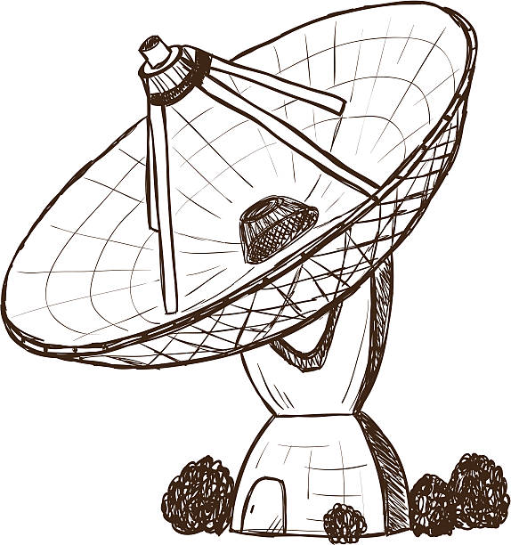
Tutorial Overview
5 min | Introduction and Learning Objectives
10 min | Background on Radio Frequencies
15 min | Traditional Signal Visualization
30 min | Immersive Signal Visualization
10 min | Summary and Conclusions
5 min | Acknowledgements
10 min | Q&A
2

Slide 3
Learning Objectives
Understand limitations of existing radio signal modeling workflows
Discover the benefits of using mixed reality for signals intelligence and electronic warfare
Develop an understanding of the application of new tooling and techniques to both real and simulated SIGNIT environments
Understand the impact of XR radio signal visualization; now and in the future

Slide 4
Terminology and Concepts
Fourier Transform – Mathematical function that converts time-domain signal data into frequency-domain magnitudes and phases
Modulation/Demodulation – Encoding and extracting information from a carrier wave
RSSI – Received signal strength indication, a measurement of received power
TSCM – Technical Surveillance Countermeasures, colloquially understood as “bug hunting”
Immersion, AR, VR – a collection of holographic technologies including Augmented Reality and Virtual Reality
Metaverse – Umbrella buzzword representing the next generation of 3D computing and connectivity
SIGINT – Signals Intelligence, intelligence gathering by interception of signal communications between people
Spatial Anchors – Specific locations in virtual space that persist in the real world

Slide 5
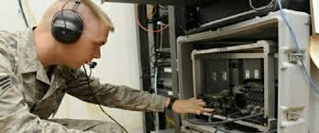
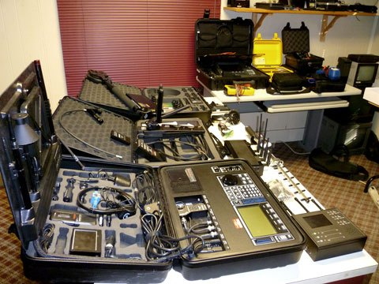
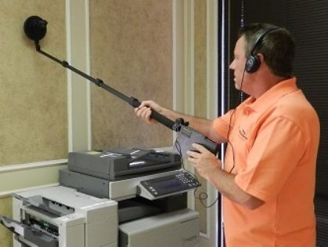
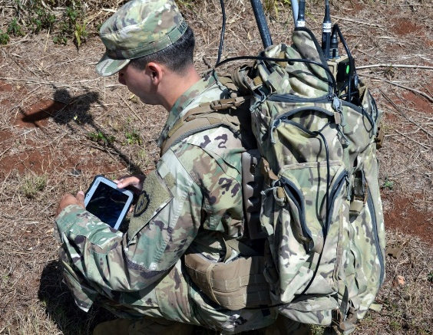
The Challenge
Traditional modeling and visualization tools are no longer suitable to address the scale and complexity of modern signals
Complicated
Cumbersome
Slow
Distracting

Slide 6
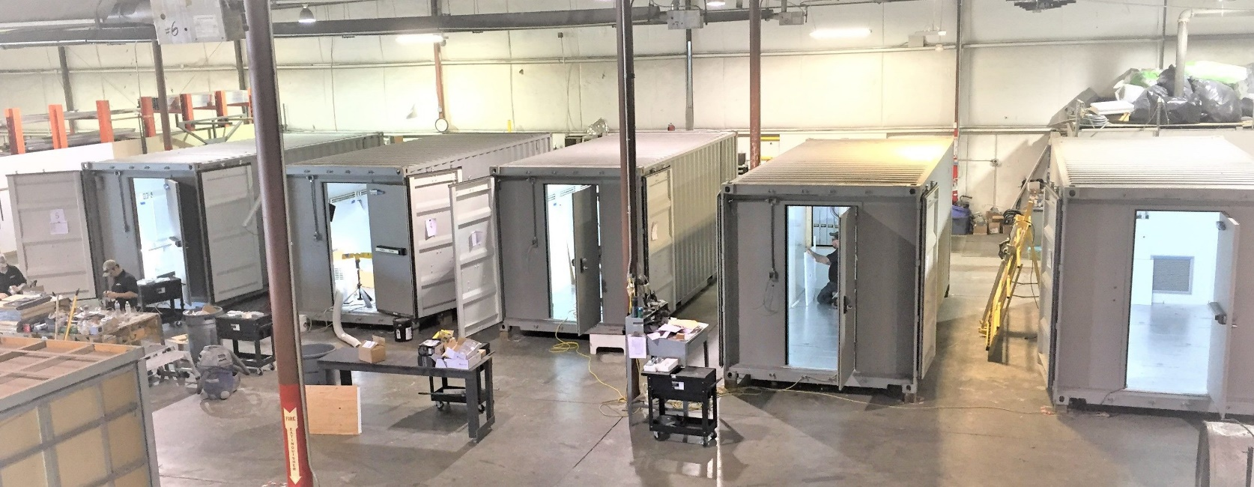
Security Implications
Defense industry spends billions each year for SIGINT, EW, and wireless security
Secure facilities typically restrict wireless
Meeting rooms are shielded from RF
Wireless is a primary attack vector
Backdoors are hidden inside chip firmware by foreign manufacturers
100’s millions people affected by breaches

Slide 7

Impact
Training
Reduce education burden for learning RF
Increase access to signals awareness
Modeling
AI/ML-powered radio propagation
Ideation and predictive analytics
Simulation
Reproduction of complex signal fields
Comms systems planning and testing

Slide 8
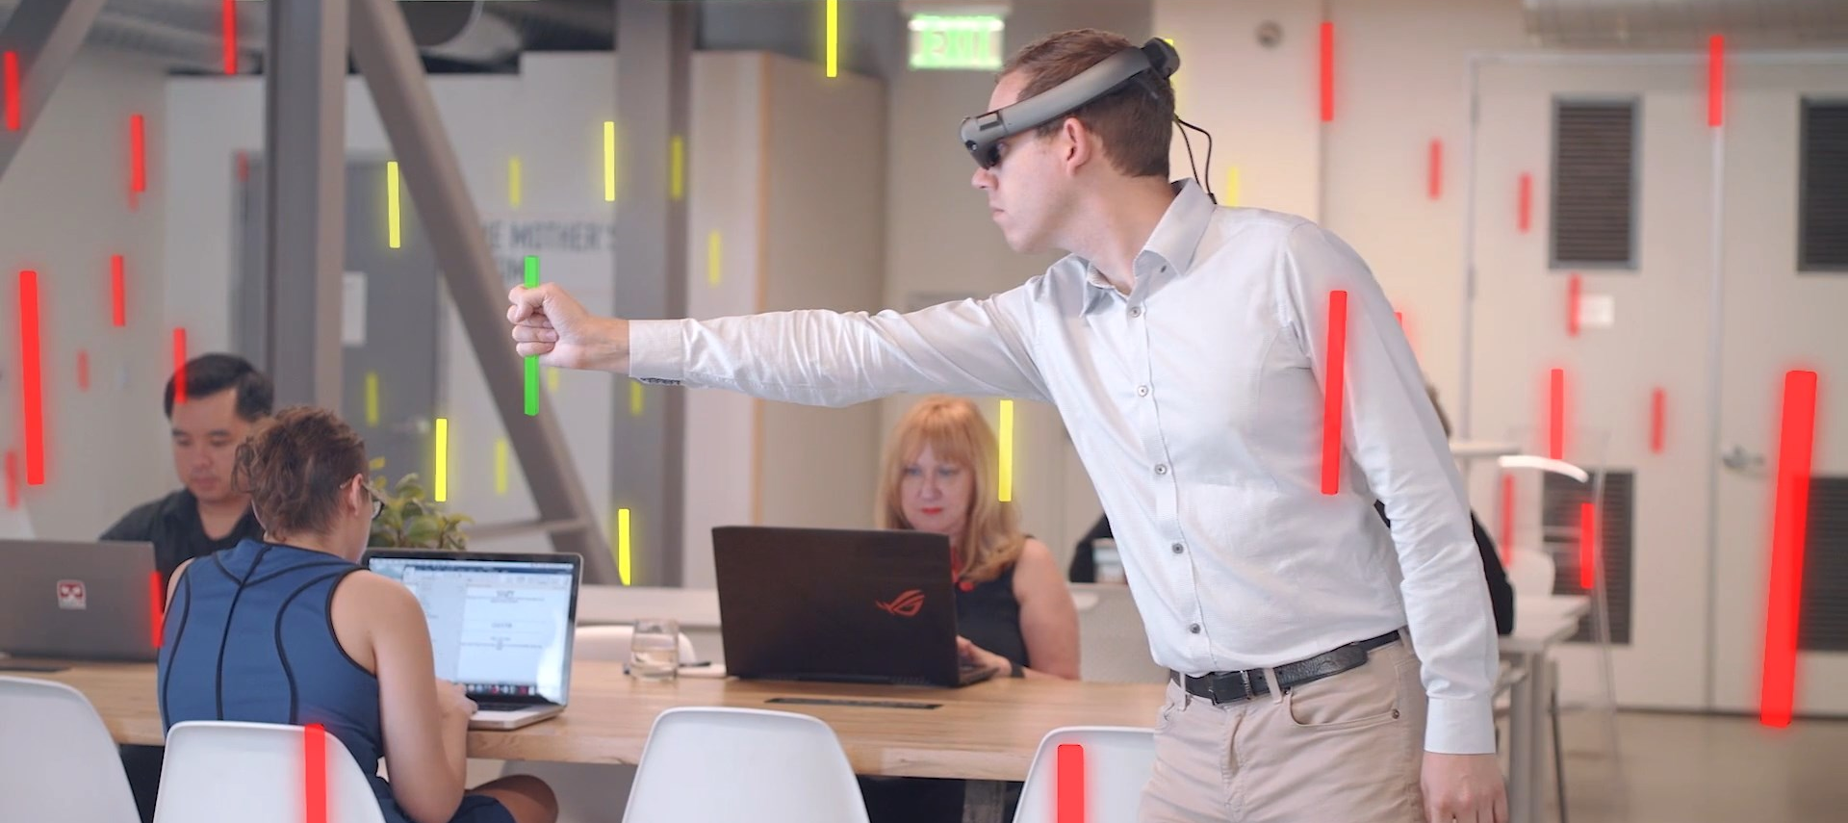
Immersive Signal Visualization

Slide 9
Background on Radio Frequencies

Slide 10
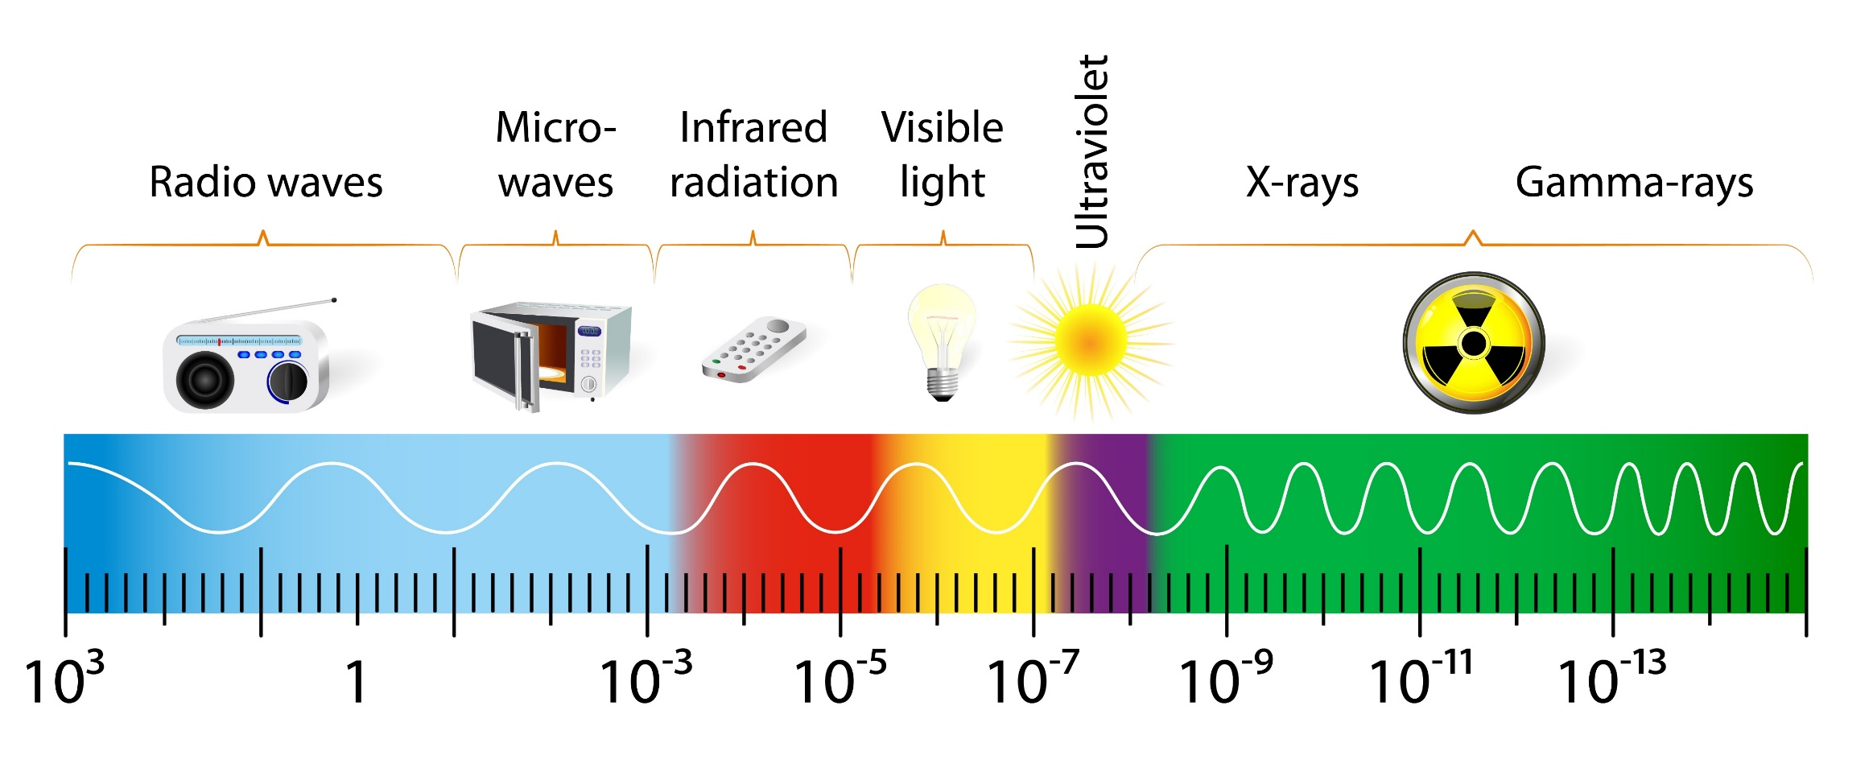
Introducing The Spectrum
The Electromagnetic Spectrum
Hz
Hz

Slide 11
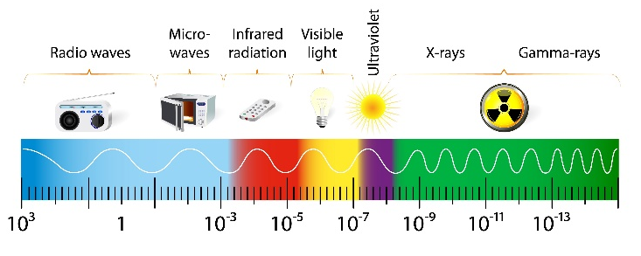
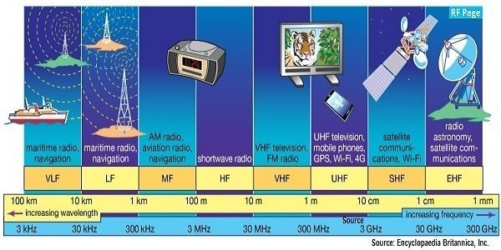
Radio Frequencies
Credit: TeraSense

Slide 12
DoD Use Of Radio Spectrum

Slide 13
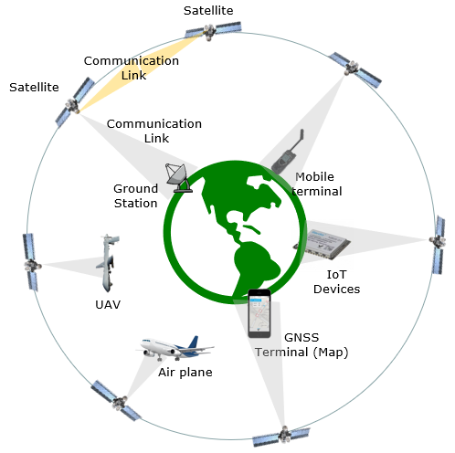
Satellite Frequency Bands

Slide 14
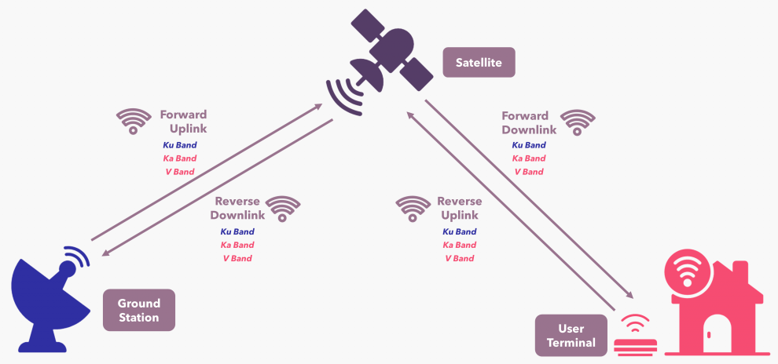
Starlink Example

Slide 15
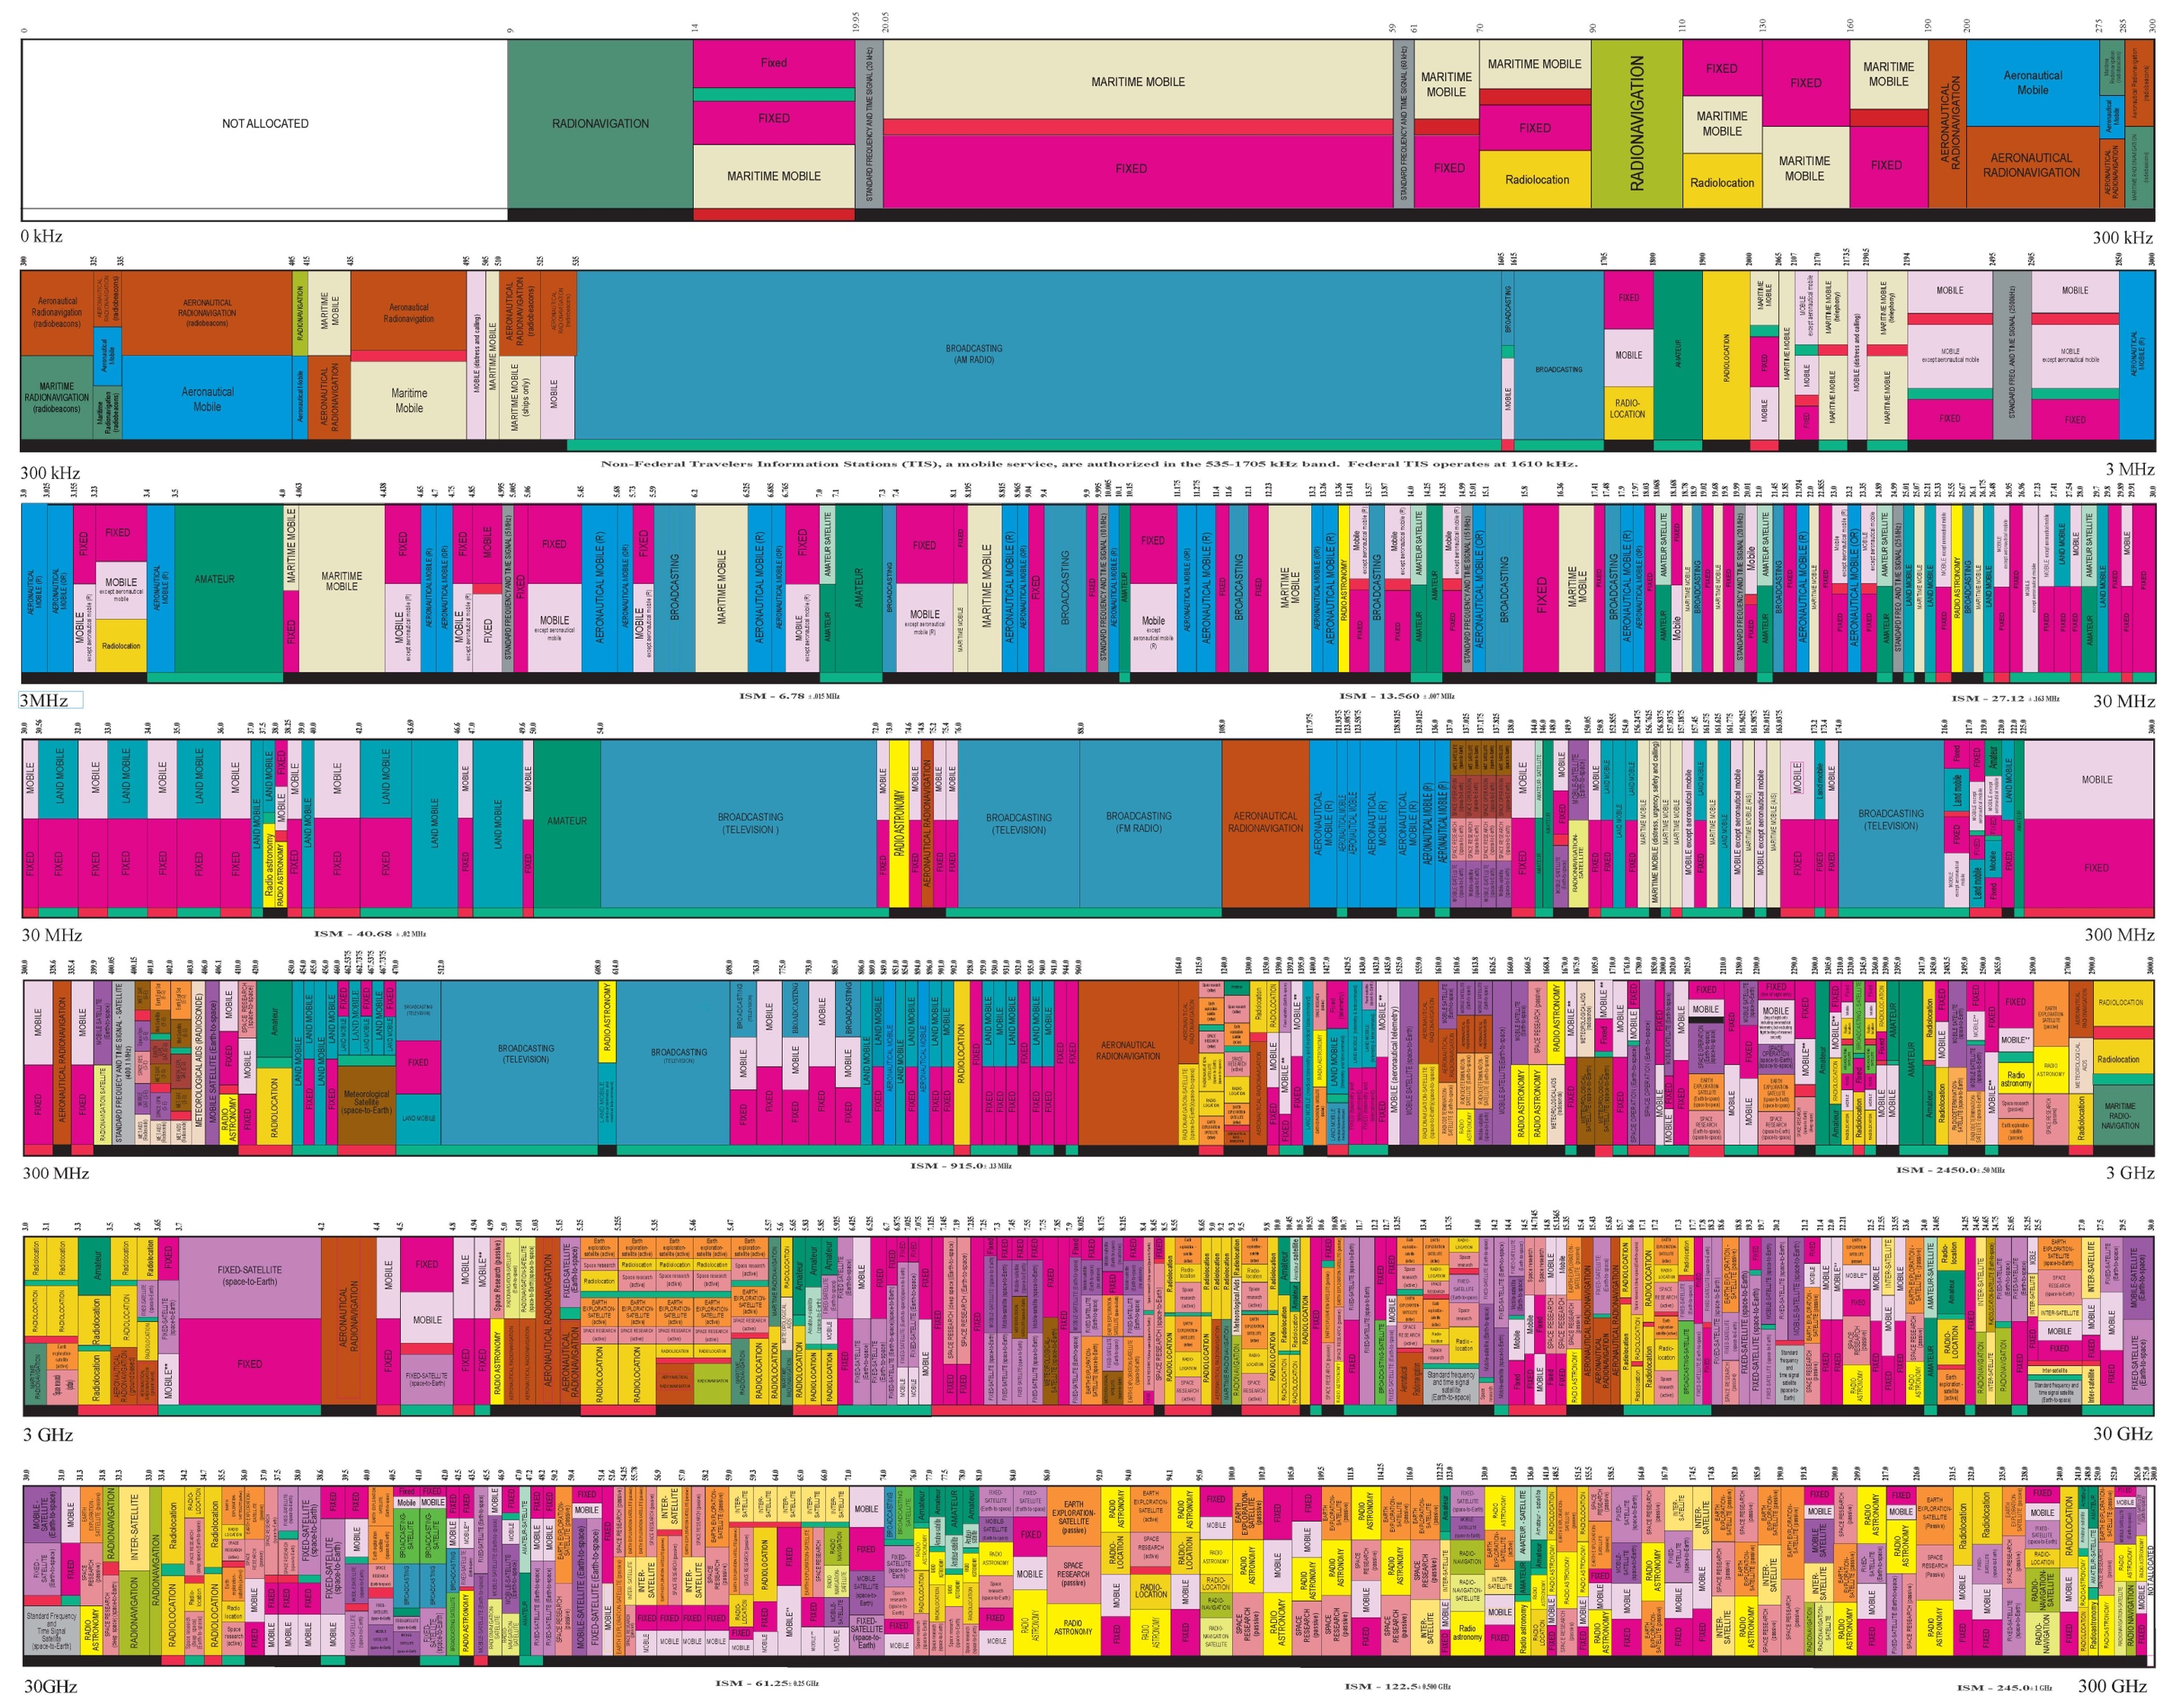
Regulating The Spectrum
Federal Communications Commission (FCC)
Assign operating ranges for civ/mil
Certify RF-emitting devices
Prevent interference

Slide 16
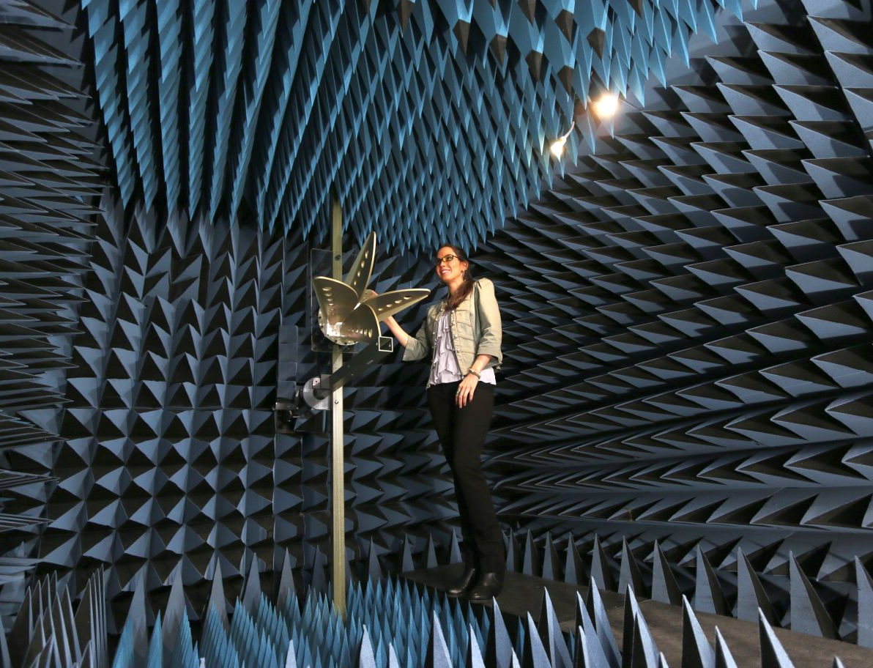
Anechoic Chambers
Fully shielded room with RF-absorbing wall materials
Measure antenna gain, efficiency, and radiation pattern
Controlled evaluation of RF emission
Ensure compliance with standards

Slide 17
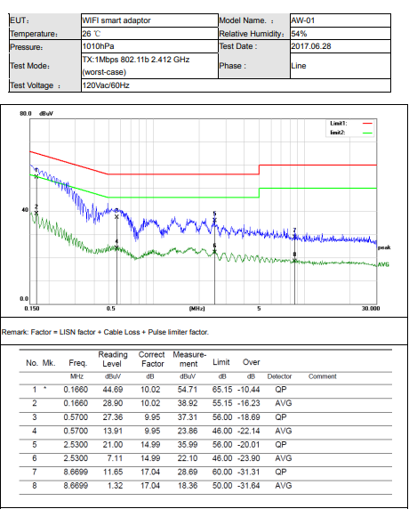
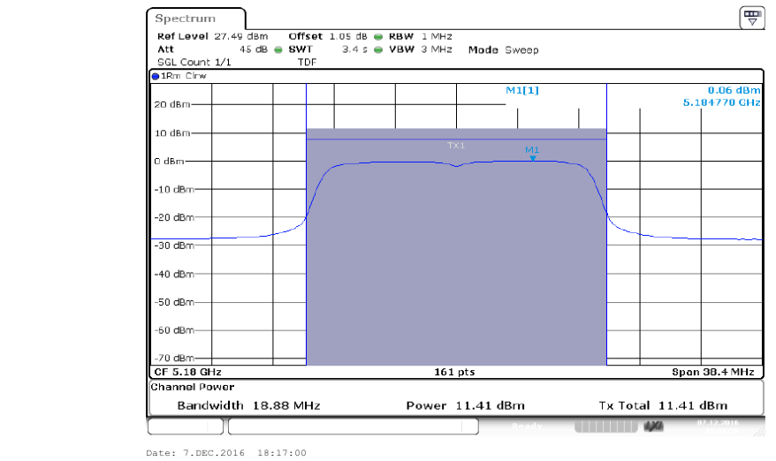
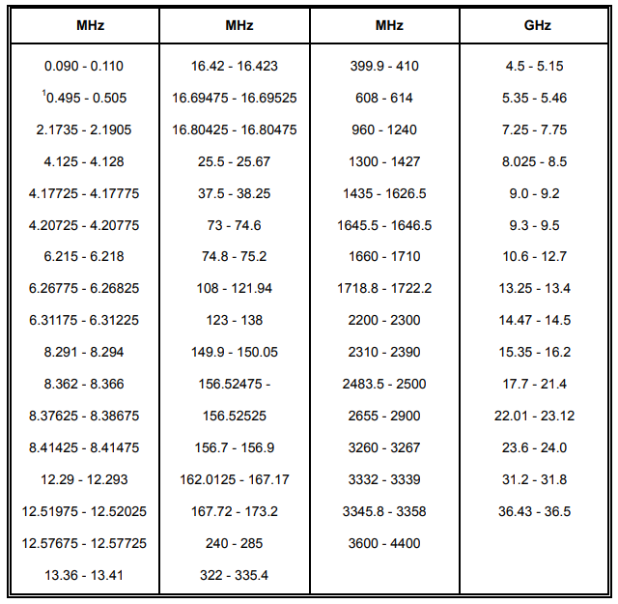
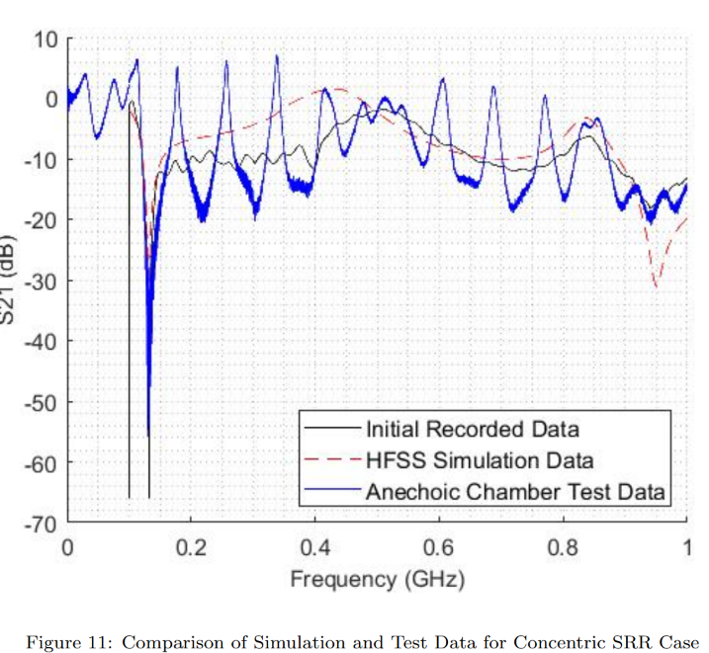
Examples of Lab Testing Reports

Slide 18
Traditional Signal Visualization

Slide 19
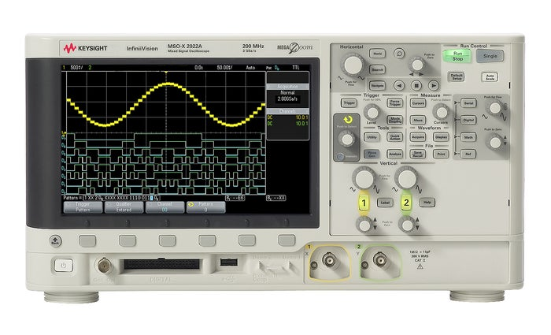
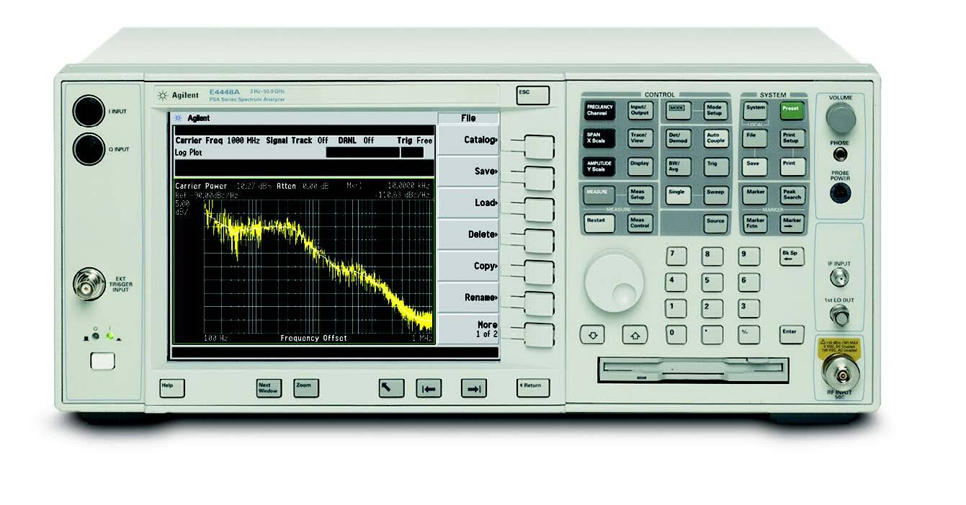
Common Laboratory Equipment
Oscilloscope
Spectrum Analyzer
Graphical indication of voltage change
Plot of 1D signal over time
Measure signal power across a frequency range
Display amplitude over signal frequency

Slide 20
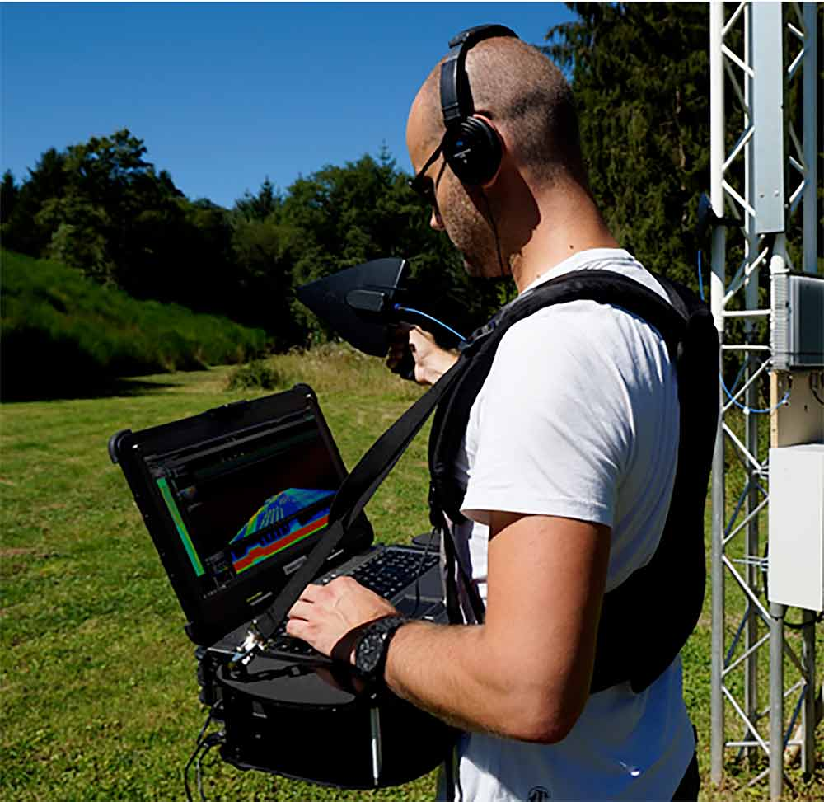
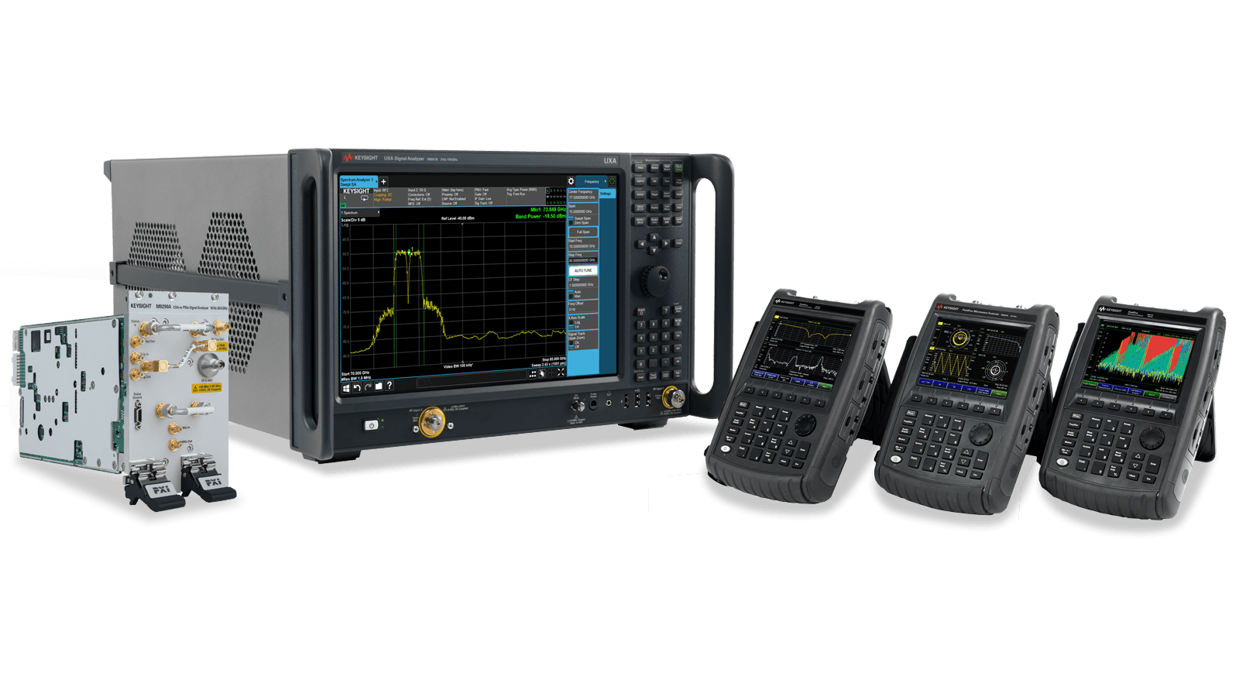
Portable Analysis Tools
Field tools are made portable with mounted screens and audio outputs

Slide 21
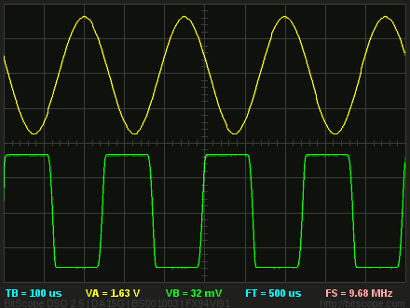
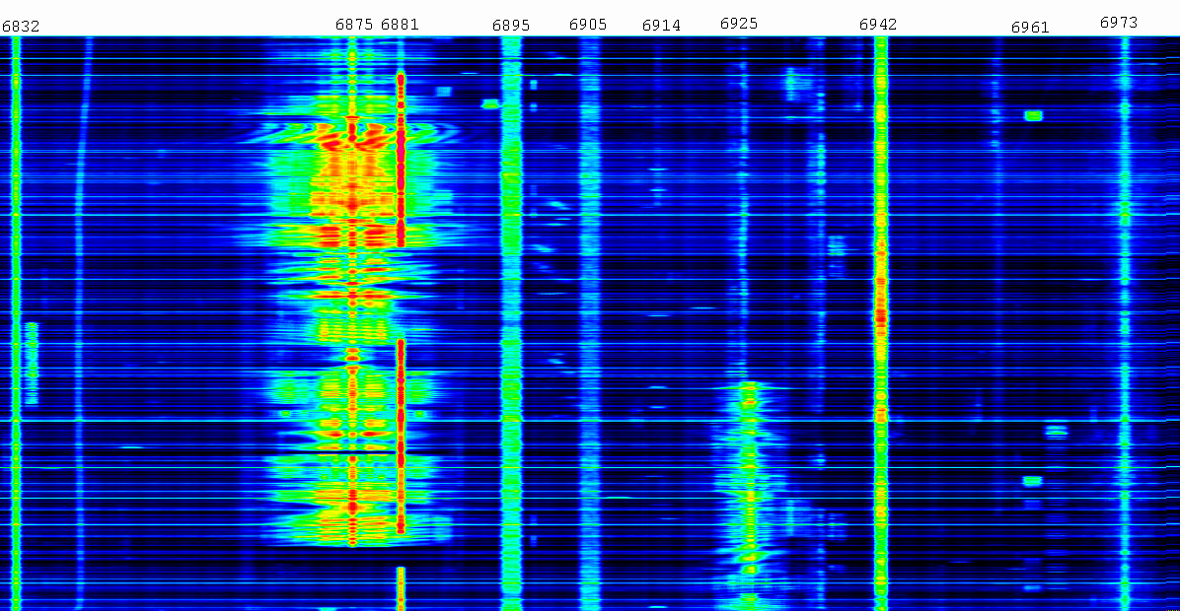
1D Signal Visualization
Oscilloscope
Waterfall Display
Low information density
Small display sizes
Needs logging
High information density
Frequently on laptops and tablets
Continuous scrolling top to bottom

Slide 22
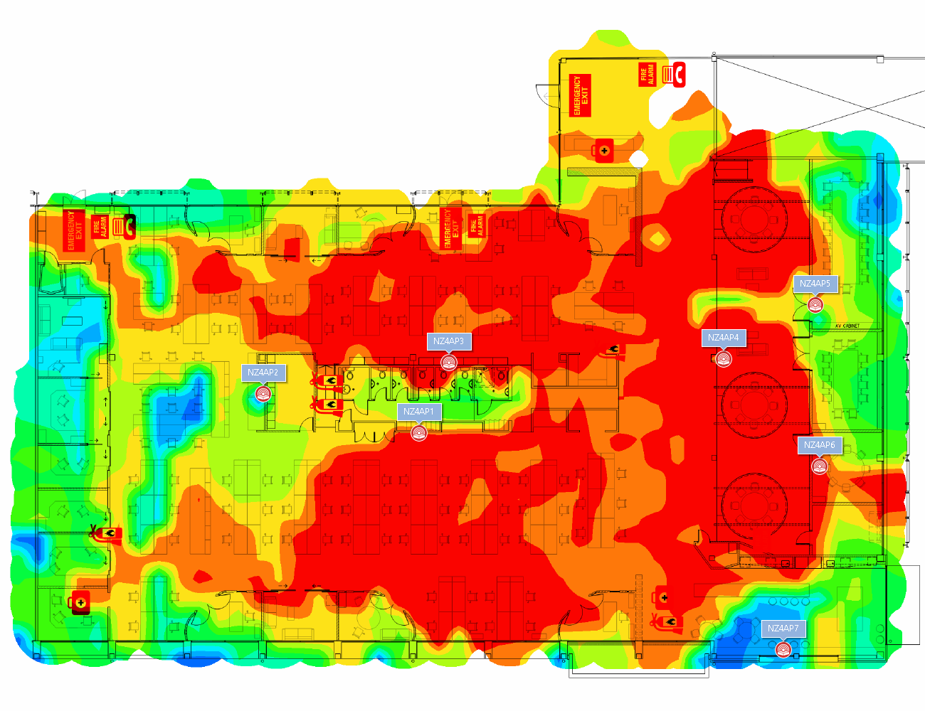
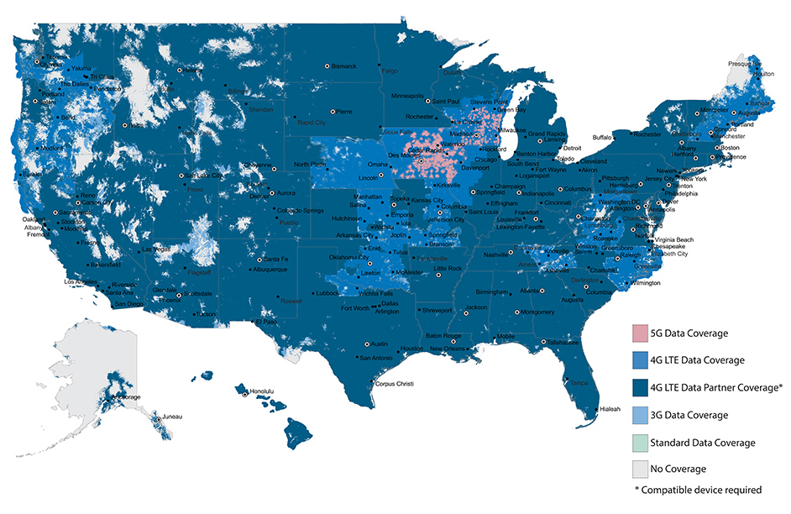
2D Signal Visualization
Heatmaps represent X-Y samples and projected values of signal strength
Reflects real world space
Typically extrapolated
“Can you hear me now?” only shows outdoor coverage
***Shows highest speeds; better coverage may be available at slower speeds

Slide 23
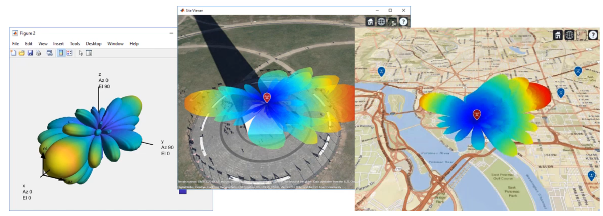
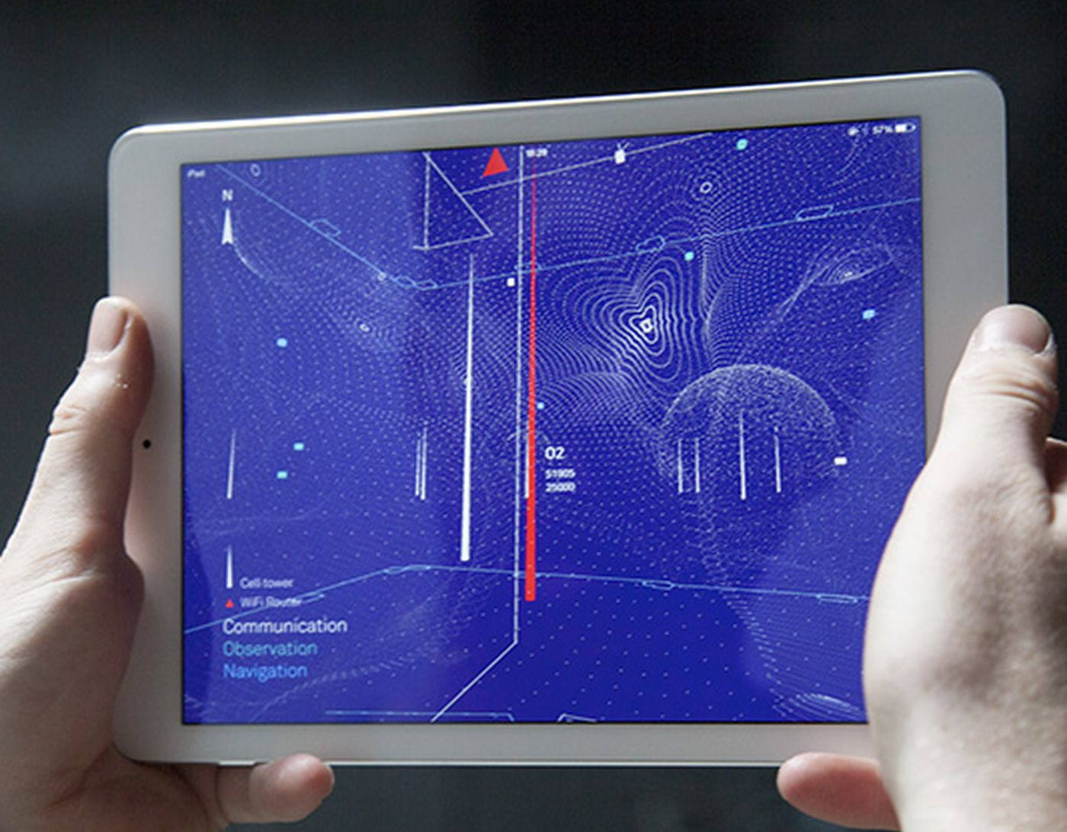
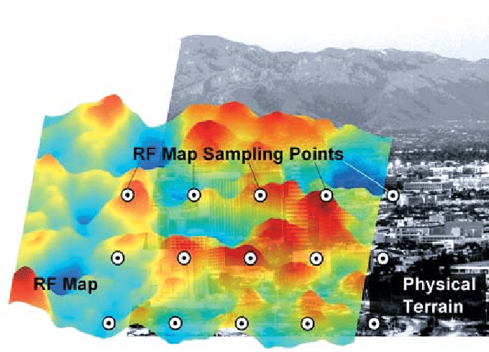
3D Signal Visualization
Adds Z dimension
Performs advanced modeling
Uses graphics and gaming engines
Important to keep up w/UAS tech progress

Slide 24
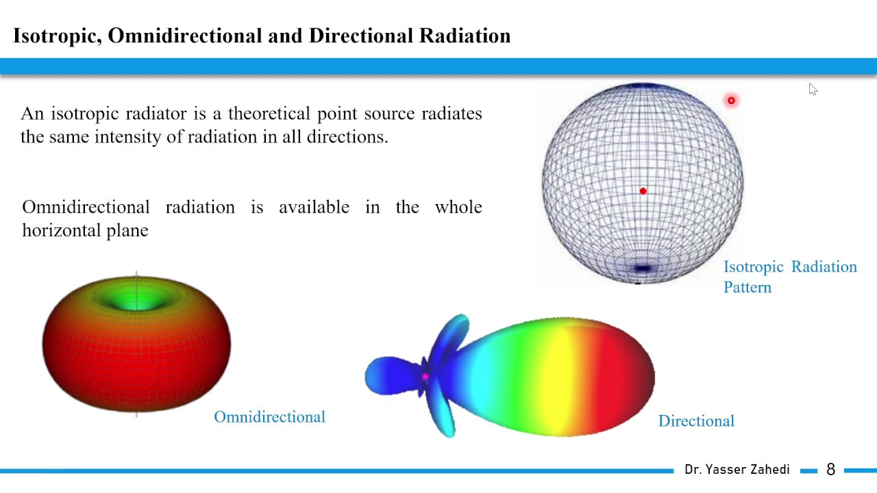
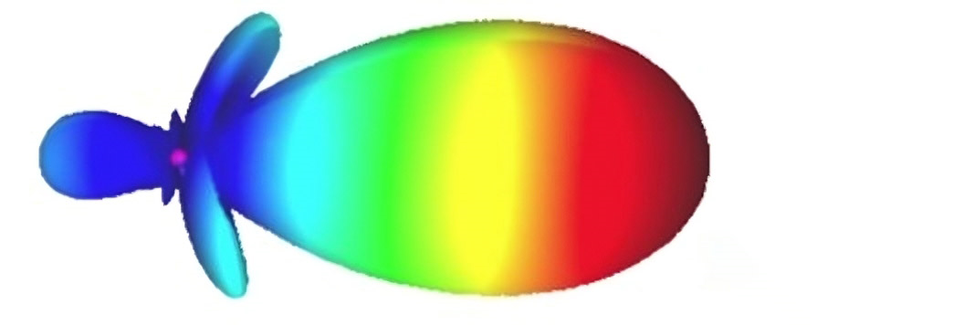
Antenna Radiation Patterns
Graphic of the directional (Angular) dependence of the strength of the radio waves from the antenna or other source, power based on distance

Slide 25

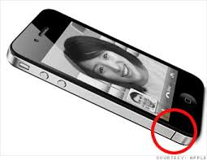
Interference
Modern steel/concrete/tinted glass buildings are “radio opaque”
Material density causes attenuation
Trees and foliage can block RF
Metallic surfaces can cause counterintuitive radio reflections
Human bodies interfere also; remember “antenna gate”
Anderson (2017)

Slide 26
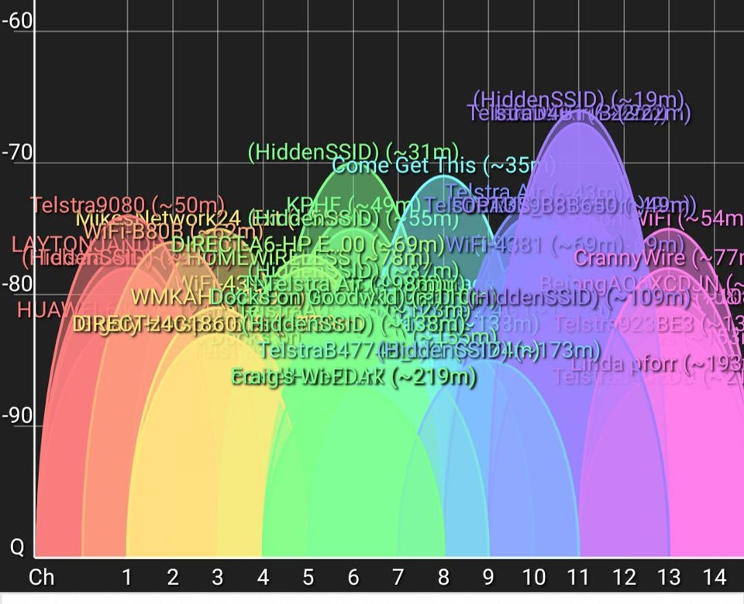
Channel Congestion
There are a fixed number of Wi-Fi, Bluetooth, Cell, etc. channels
With too many connected devices, channels become saturated
Net result is denial of service
Infrastructure never designed volume
IoT is already a worst-case scenario

Slide 27
Challenges of 5G & LEO
 | 5G | LEO
Infrastructure | Build 1M small cells and base stations | Manufacture and launch 30K satellites
Spectrum | Businesses fight for access to frequency bands | Managing constellations is highly technical
Interference | mmWave blocked by foliage and buildings | Weather, handover, doppler shift, coexistence
Latency | Needs edge compute resources | Large distances, must obey laws of physics

Slide 28
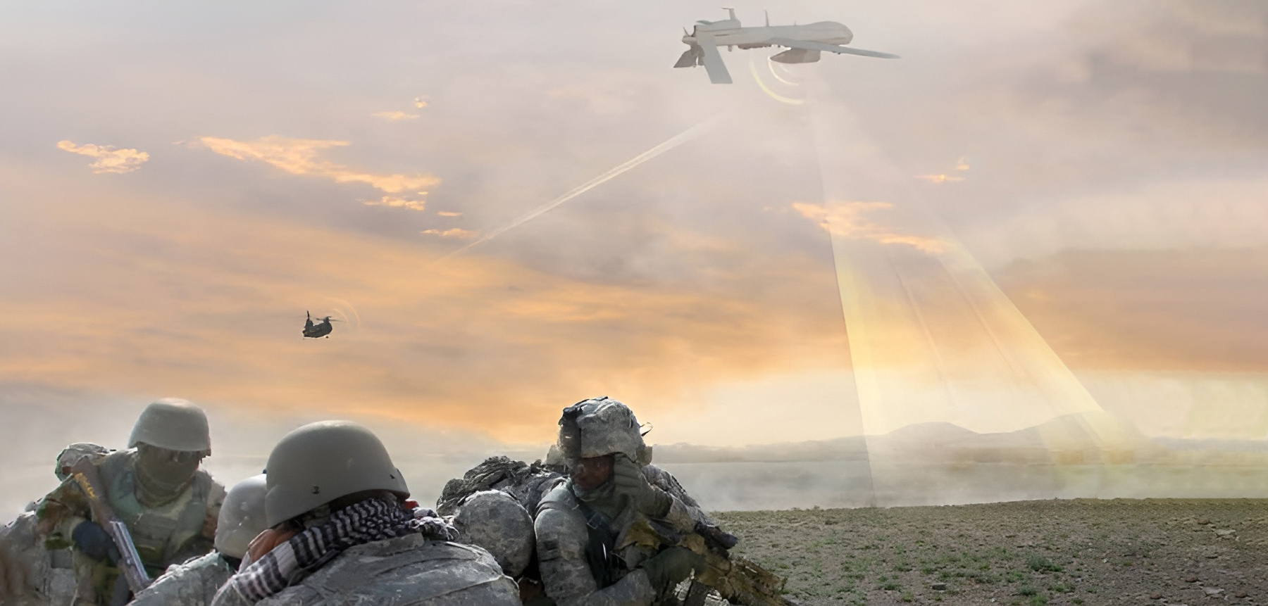
SIGINT / TSCM in Practice
The ability to seize, retain and exploit the spectrum is critical to battlefield superiority.
SIGINT & EW capabilities are being added to manned and unmanned vehicles.

Slide 29
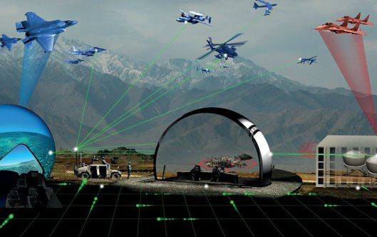
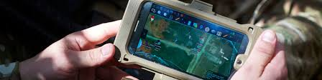
Resilient Training Environments
LVC Simulation
Everyone expects reliable comms fabric
Must create testing/sims to prepare for degraded / disconnected activity
Model jamming, injection, and cyberattacks
Support both BLUFOR and OPFOR endeavors (comms, intel, EW, etc.)
EXAMPLE: RF mesh network with connected ATAK during live training

Slide 30
Immersive Signal Visualization
Definition and Impact

Slide 31
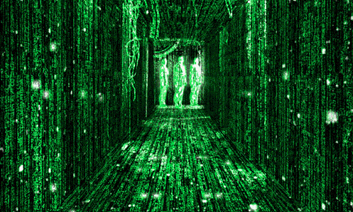
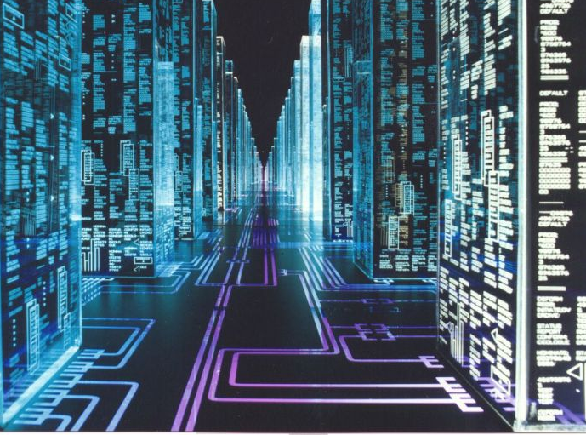
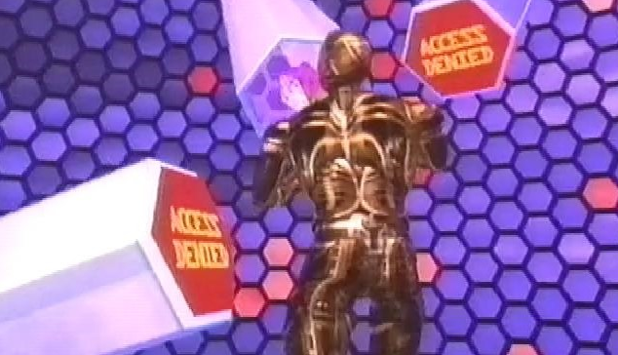
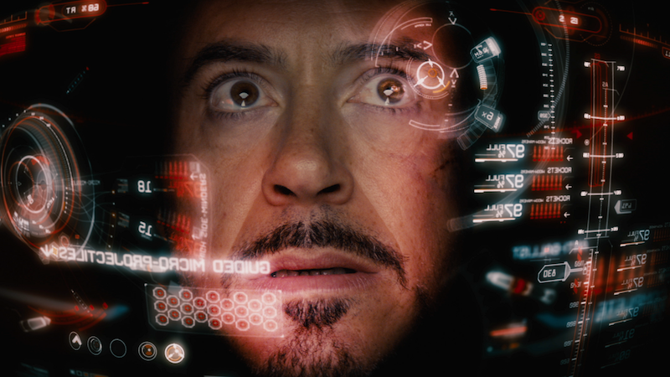
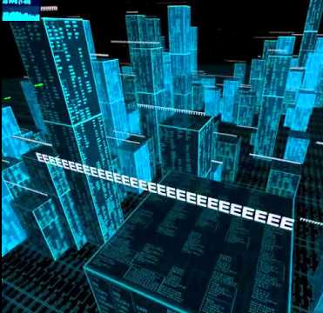
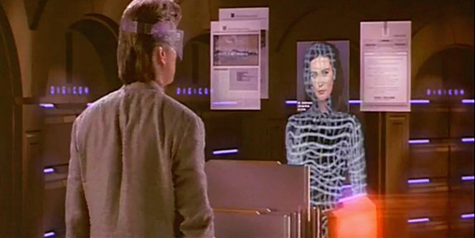

Immersive / AR / VR / Metaverse

Slide 32

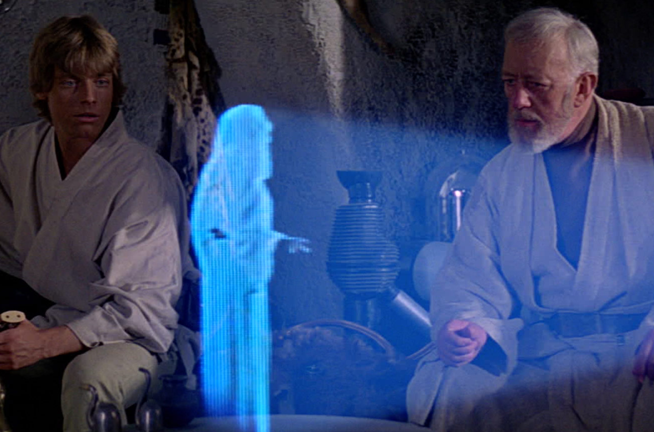
Augmented Reality (AR)
Overlay holograms into real-world objects and environments
Merge the real and the virtual using sensors and trackers

Slide 33
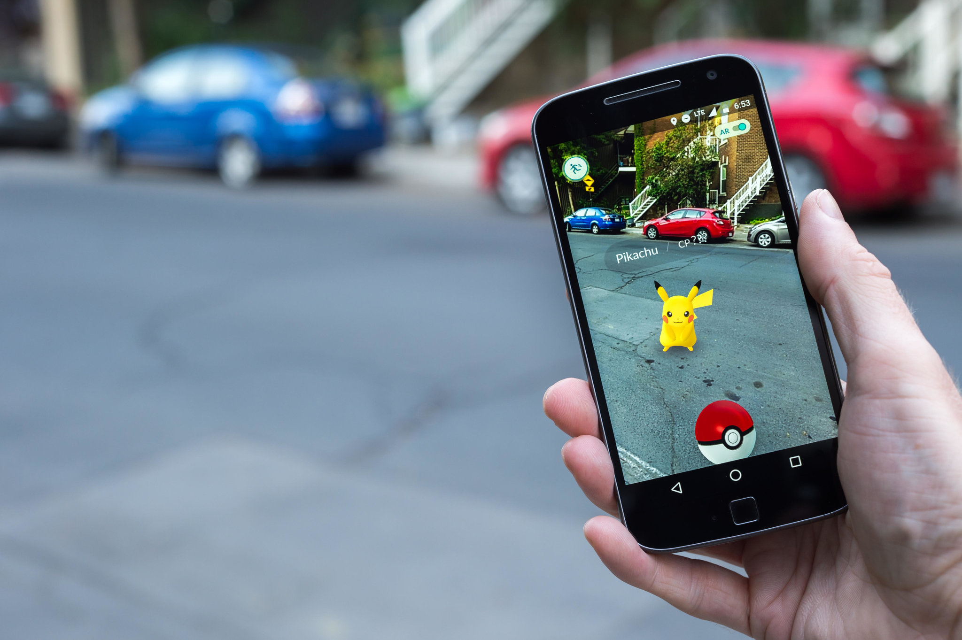
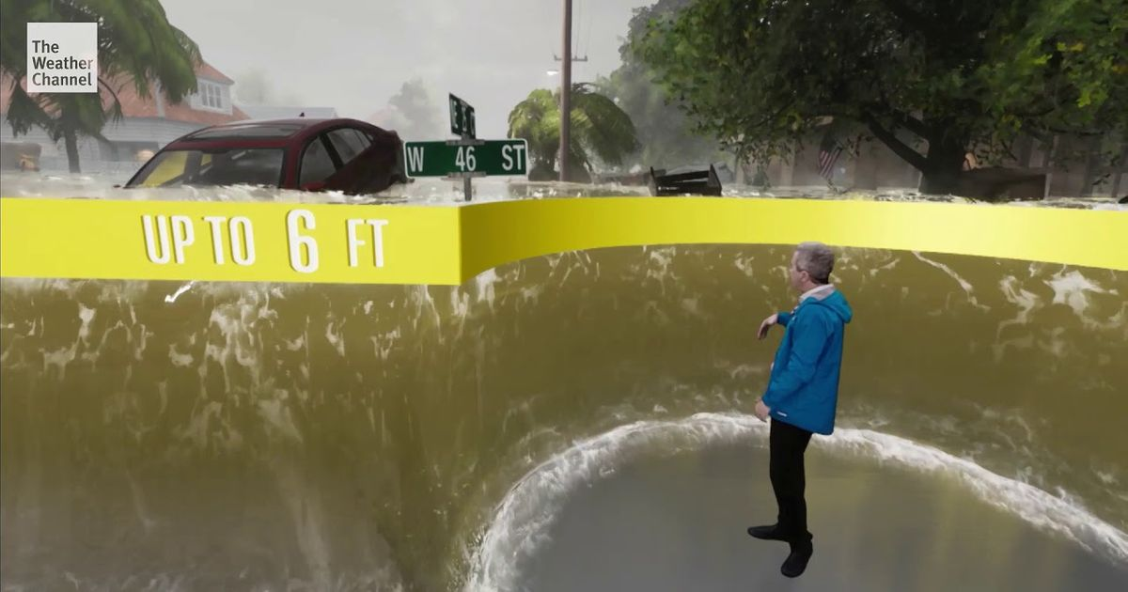


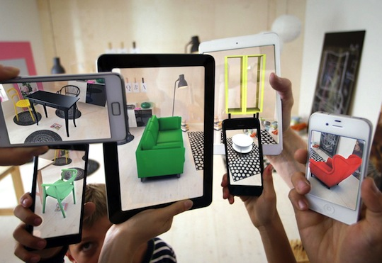
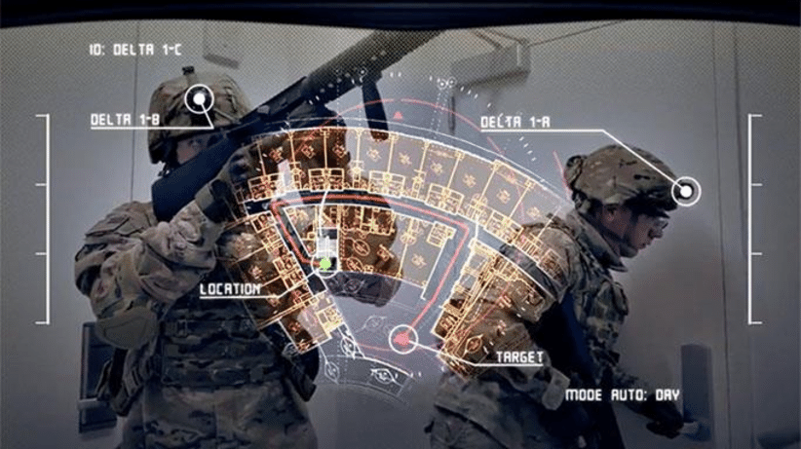
Examples

Slide 34
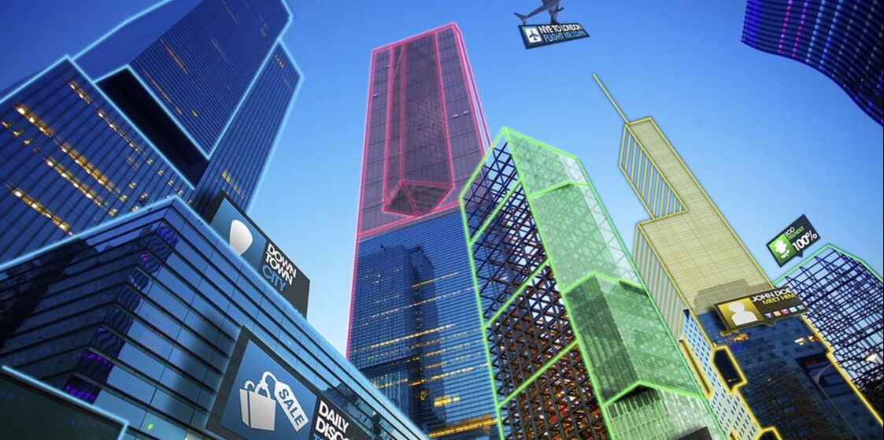
Spatial Awareness
Spatial mapping and computational geometry understand your physical space to provide situational awareness

Slide 35
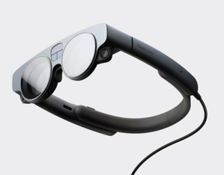
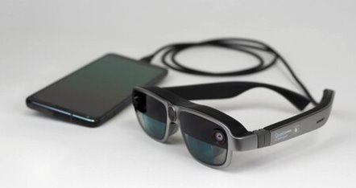


Equipment
Popular current and upcoming AR headsets:
Magic Leap 2
Qualcomm
(Reference Design)
Microsoft HoloLens 2
Meta Orion

Slide 36

Increased Adoption
Pandemic sped adoption of immersive technologies
Enhanced use in education, training, virtual events, etc.
Example: US Army immersive combat training in Synthetic Training Environment
Source: Ball et. Al, 2021, World Economic Forum, 2022

Slide 37






Device Pros and Cons
Strengths
Good battery life
Wireless connectivity
Spatial awareness
Weaknesses
Limited FOV
Durability & brightness
High hardware cost
Opportunities
Size and weight
Integrated biometrics
AI/ML assistants

Slide 38




XR Signal Visualization
Early mainstream implementations of AR signals:

Slide 39


XR Signal Visualization (CONT’D)
Research focusing on AR, spatial mapping and ray tracing channel prediction algorithms to visualize wireless channels in real-time

Slide 40
Immersive Signal Visualization
Design and Development

Slide 41

Design Considerations
Hardware Display
Field-of-view (FOV) limitations
Indoor/outdoor affects holograms
Hands-free w/ gesture and voice

Slide 42

Design Considerations (CONT’D)
User Interface Design
Ergonomics of interactables
Direct interaction with objects versus onscreen controls
Colors, shapes, and symbology
Multi-User interactions

Slide 43






Example of 3D Spatial Signals
Intuitive perception of Relative Signal Strength Indicator (RSSI)

Slide 44



Interaction Methods
Enables users to access contextual information with simple movements and gestures

Slide 45


Holographic Representation
To skeuomorphism or not?
Density of information
Sizing of symbols
“Spatial Grid”
Use perfect cube as a “base”
Types of Dimensions
Color
Height below 0
Height above 0
Texture?
(Multi Networks)
What other kinds
of signal characteristics
could / should we represent?
Frequency? Speed? Band?
Wi-Fi (Opaque)
“stick”
Can bands be a slider for Technical / Debug version?
“Spatial Grid”
Cellular
(Transparent)
“ring”

Slide 46



Example: Direction Finding
Find the strongest emitting device
Show relative distance and bearing, for navigation

Slide 47




Example: HUD
Heads-Up Display
Persistent information
Track head angle
Clear center area

Slide 48


HUD Implementation
View seen through lens of heads-up display

Slide 49


Example: Relative Positioning
Show user in context with all available data,
track according to a single reference point

Slide 50


User Engagement
Augment user’s senses with surface patterns and a “slicing” tool
Imbue tracked hands with surface modeling to “feel” wireless signals
Cut into 3D RF model volume to perform cross-section analysis

Slide 51


Floorplan Modeling
Enable precision overlay with real and virtual spaces, enabling integrated measurements and dimensionality

Slide 52









Integration of Sensor Peripherals
Ubertooth One
RTL-SDR
Enterprise SDR

Slide 53

Common Operating Picture
Paint simulated signals and effects into a mission planning interface

Slide 54




Bridging 2D to AR

Slide 55

Spatial Signal Simulation
Spatial representation of observable signals
Highly dynamic indoor environment
Used for modeling networks
Signal source

Slide 56

Model Validation
On-site signal collection in network telecoms lab
Walk along path with device away from signal source
Collect data on position, direction and signal strength

Slide 57

Affiliation With AI/ML
On-the-fly control and interaction with the AI/ML algorithms
to assist the user in their quest for discovering insight

Slide 58

Defensive vs. Offensive
Find transmitting devices inside SCIF
Identify and locate target device, disable
Model EW jamming range and source
Detect incoming drones

Slide 59

Testing and Tuning
Only 3-5 min hands-on training
Swift detection of random spectrum attack
Full physical discovery of source attack device

Slide 60

Operational Deployment

Slide 61
Best Practices
Leverage real-world concepts
Draw inspiration from media
Add visual/auditory feedback
Embrace ergonomics
Minimize text

Slide 62
Summary and Conclusion

Slide 63

Future Work
Smart Cities
IoT sensor networks
5G, 6G, 7G, and beyond
Construction preplanning
Transportation
Aviation systems
Connected mobility
Traffic smart metering
Health
Safe training
Remote surgery
Extrasensory perception
Source: Alharbi et. Al. (2019)

Slide 64



Additional Signals
Chemical, biological, radiological and nuclear (CBRN) sensor data
Software Defined Radios (SDR)
Ubertooth/Bluetooth devices
Medical devices
Utilize AI/ML
Source: NIH (2022) , Wikimedia (2005)

Slide 65

Into Space
Space Defense
Improve modeling effectiveness
Anti-Access/Area denial strategies target RF communications to inhibit movement
Jamming of signals for low-power satellites, and counter-jamming
Reduce freedom of action
Source: Airbus

Slide 66



Takeaway
Immersive technology will enhance modeling of signals in real world
Cumbersome, focused on screen instead of scene, 1D/2D
Preserve use of hands, ​maintain situational awareness,​ expand comprehension in 3D

Slide 67
Revisit Goals
Confirm Learning Objectives
Learned the limitations of existing workflow for radio signal modeling
Discovered the theory and practice of mixed reality for signals intelligence and electronic warfare
Developed technical insight into applying new tools and techniques in both real and simulated environments
Understood the impact of XR radio signal visualization now and in the future

Slide 68
Bibliography
Airbus. https://airbusus.com/laser-communication/
Anderson (2017). “Reduce EMI to Improve Radio Range”. https://medium.com/tempo-automation/improve-radio-range-by-lowering-emi-dac7135f77f9
Alharbi et. Al. (2019). “Roles and Challenges of Network Sensors in Smart Cities”. https://iopscience.iop.org/article/10.1088/1755-1315/322/1/012002/pdf
Altium (2017). “How to Choose a Test Lab for FCC Certification of IoT Products”. https://www.altium.com/subscription
Antenna Test Lab. “What is an Anechoic Chamber?”. https://antennatestlab.com/antenna-education-tutorials/what-is-an-anechoic-chamber
ARSensor. https://play.google.com/store/apps/details?id=com.ken.arsensor&hl=en_US&gl=US
ARwave. https://apps.apple.com/us/app/ar-wave-visualization-of-wifi/id1470866212
Army Futures Command (2022). “Synthetic Training Environment offers multi-dimensional combat preparation”. https://www.army.mil/article/254005/synthetic_training_environment_offers_multi_dimensional_combat_preparation
Ball et. Al. (2021). “Virtual reality adoption during the COVID-19 pandemic: A uses and gratifications perspective”. https://www.sciencedirect.com/science/article/pii/S0736585321001672
BAE. "Unmanned SIGINT/Electronic Warfare". https://www.baesystems.com/en/product/unmanned-sigint-electronic-warfare
Bloom (2001). “What is Bloom’s Taxonomy”. https://bloomstaxonomy.net/
FrontierUS. https://frontiercomputercorp.com/specifying-the-right-antenna/

Slide 69
Bibliography (cont’d)
HouseTechLab. “Difference between spectrum analyzer and oscilloscope” https://housetechlab.com/difference-between-spectrum-analyzer-and-oscilloscope/
iBWave. https://info.ibwave.com/augmented-reality/
Koutitas et. Al. (2020). “In Situ Wireless Channel Visualization Using Augmented Reality and Ray Tracing”. https://www.mdpi.com/1424-8220/20/3/690/htm
McKinsey (2018). “The road to 5G: The inevitable growth of infrastructure cost”. https://www.mckinsey.com/industries/technology-media-and-telecommunications/our-insights/the-road-to-5g-the-inevitable-growth-of-infrastructure-cost
NBC (2015). “App Visualizes Radio Waves From Cell Towers, Satellites Around You”. https://www.nbcnews.com/tech/innovation/app-visualizes-radio-waves-cell-towers-satellites-around-you-n469781
NIH (2022). “Electric & Magnetic Fields”. https://www.niehs.nih.gov/health/topics/agents/emf/index.cfm
NTIA (2016). https://www.ntia.doc.gov/files/ntia/publications/january_2016_spectrum_wall_chart.pdf
Pieper (2018). “Introducing WiFiman”. https://blog.ui.com/2018/12/11/introducing-wifiman/
RF Page (2021). “What are Radio Frequency bands and its uses?”. https://www.rfpage.com/what-are-radio-frequency-bands-and-its-uses/
Rockwell Collins (2016). "LVC demonstration completed by Rockwell Collins in France, U.K., and U.S." https://militaryembedded.com/radar-ew/test/lvc-demonstration-completed-by-rockwell-collins-in-france-u-k-and-u-s
TeraSense. “Radio Frequency Bands”. https://terasense.com/terahertz-technology/radio-frequency-bands/

Slide 70
Bibliography (cont’d)
Wikimedia (2005). https://commons.wikimedia.org/wiki/File:An_instructor_at_the_Defence_NBC_Centre_operates_the_Manportable_Chemical_Agent_Detector_MOD_45148143.jpg
Wikitude (2021). “How to Apply UX Design Principles in Augmented Reality”. https://www.wikitude.com/blog-ux-design-for-augmented-reality/
World Economic Forum (2022). “Immersive Media Technologies: The Acceleration of Augmented and Virtual Reality in the Wake of COVID-19”. https://www3.weforum.org/docs/WEF_Immersive_Media_Technologies_2022.pdf

Slide 71
Contact Info
BadVR, Inc.
10312 Norris Ave. Ste. D​
Pacoima, CA 91331
(833) 600-DATA
Jad Meouchy, CTO​
jad@badvr.com
Suzanne Borders, CEO​
suzanne@badvr.com

