Slide 1



Minimizing Cybersickness in the Design,
Implementation, and Management of Learning
Systems with Virtual Environments
Perry McDowell, MOVES Institute/Naval Postgraduate School
LCDR Nicholas Adriaanse, RAN, NSWCDD DNA
Dr. Bruce Haycock, University Health Network – KITE

Slide 2

Why is it important?
Motion sickness affects everyone
1 in 3 people are considered highly susceptible
Two mega-trends make motion sickness highly relevant today:
Relevance
Photo by Pixabay from Pexels
Notes:
MS affects almost everyone, even the blind.
Only those with a complete bilateral vestibular loss cannot get MS
~35% highly susceptible to MS! Evidence this is hereditary, with associated genetic markers.
MS is an old phenomenon – even ancient Greek knew MS; Still, MS is highly modern concern for the general population for two reasons…

Slide 3

Current challenges
Automated vehicles
Reducing current collision costs at $37B CAD and saving thousands of lives
Notes:
Automated vehicles:
promise to increase safety, reducing collision costs by billions, saving thousands of lives.
And, make more efficient use of your time (working, reading etc.) → all those activities increase the risk of MS!

Slide 4
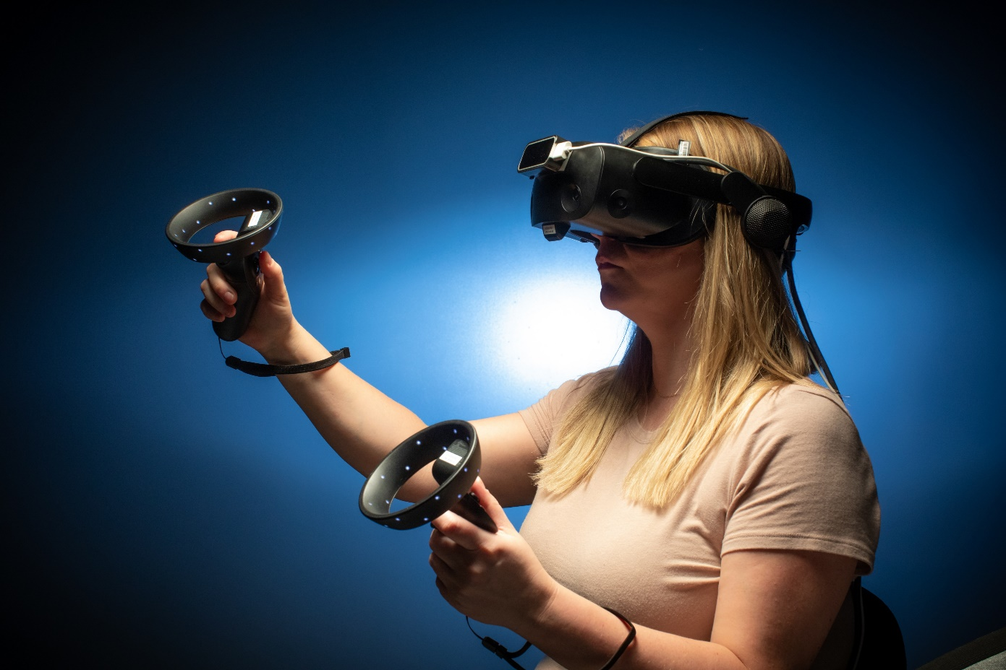
Current challenges
Automated vehicles
Virtual reality applications
Reducing current collision costs at $37B CAD and saving thousands of lives
Million of users worldwide with an estimated market value of $14.8B USD
Notes:
VR:
Mainstream in many domains, increasing application in various contexts such as health care, rehab, entertainment… market is set to grow dramatically and MS is a key limitation of VR success.
Large contracts have been cancelled due to issues with MS in testing.

Slide 5
Audience
Designers of Virtual Environments (VEs)
Program managers involved in acquisition, creation and implementation of training systems utilizing VEs
Curriculum managers incorporating VEs in their courses
Instructors operating and managing VEs in their classrooms
Notes:
Nick – 2
Won’t bog you down with the science – but a little bit is necessary to ensure we are all talking with the correct vocabulary. This is about practical application of the science to fielding a VE in a training environment.
Purpose: This tutorial is designed to provide those involved in producing and implementing VEs for training with a basic knowledge of CyS. This is significant because CyS can reduce the training effectiveness of systems utilizing VEs and visual simulations, even to the point of making it unusable. Mitigating the effects of CyS begins in the design of the system, where minor decisions can result in substantial differences in the CyS effects of the final system. Likewise, curricula design can greatly impact the degree that CyS affects students.
Militaries across the globe are planning on utilizing VEs to improve their training, whether they be traditional simulators using screens or the most up-to-date technology such as head mounted displays for virtual reality, augmented reality, mixed reality, or extended reality. There is a general belief among both the general public and the training community that the technological advancements in the latest generation of these devices have eliminated the effects of CyS.. However, this is decidedly not true

Slide 6
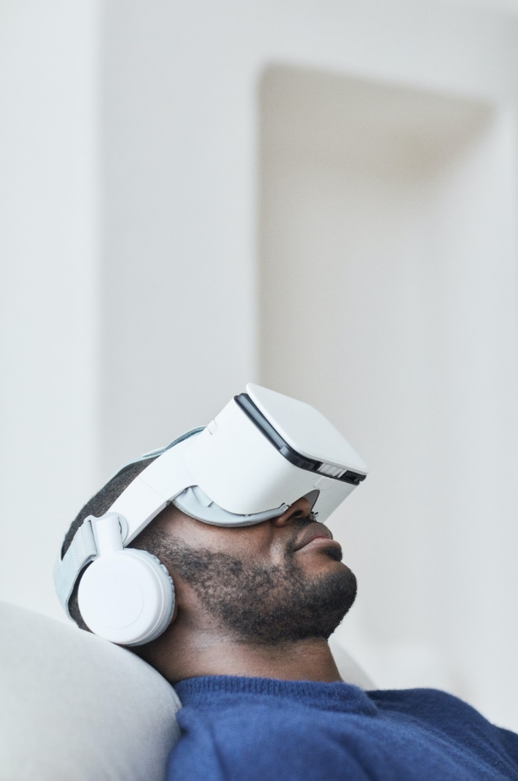
Let’s look at some stats...
1
15
31
15,000
364,000
9,600,000
171,000,000
105,890,000,000
1,710,000
– % of people experiencing motion sickness in VEs
– number of minutes until Oculus Rift V2 sold out
– % of users who use Virtual Reality at least once a month
VR sickness
– number of HTC Vive headsets sold in first 10 minutes
– number of google hits for “VR sickness” OR “cyber sickness”
– number of non-mobile VR/AR headsets sold in 2022
– number of VR users worldwide in 2022
– Projected VR market value in 2030 (USD)
– Number of users who are at risk of experiencing cybersickness
Photo by August de Richelieu from Pexels
Notes:
- Little intro with numbers: 1% highly underestimating the actual number of VR sickness (70%), but the lowest number that can be found in the literature. Taking this conservative number to get to the last number (1.7 mil) to show that even with this low number MS in VR is a huge issue

Slide 7
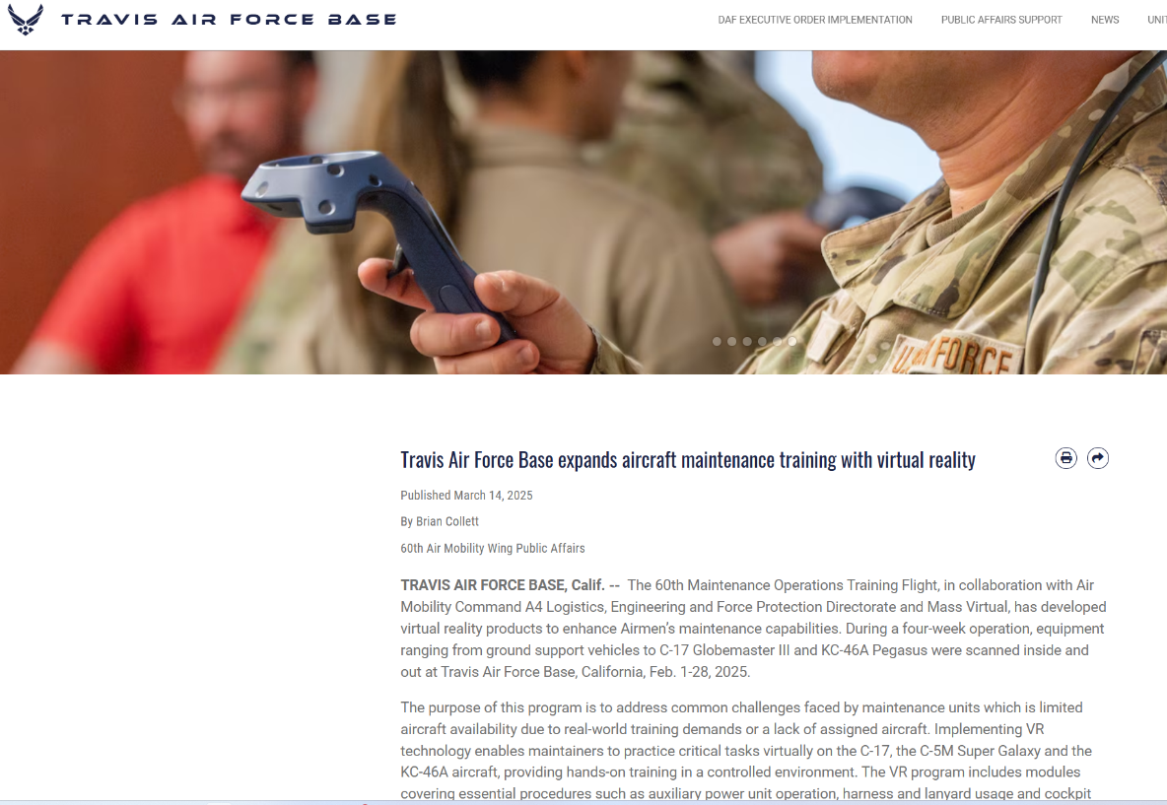
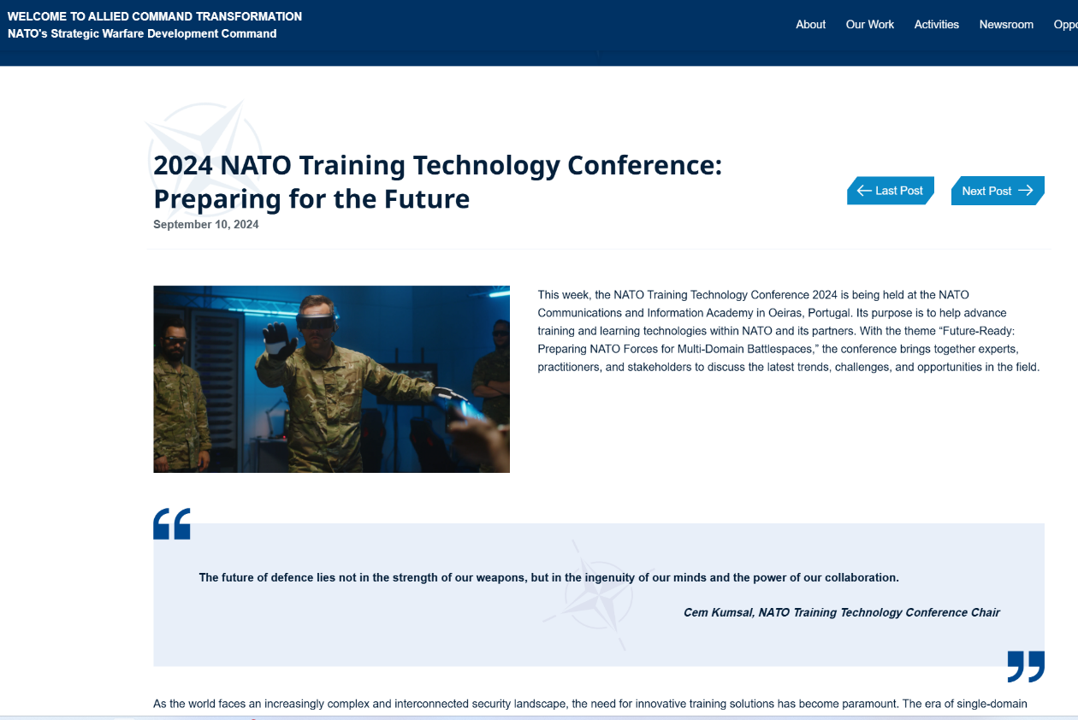
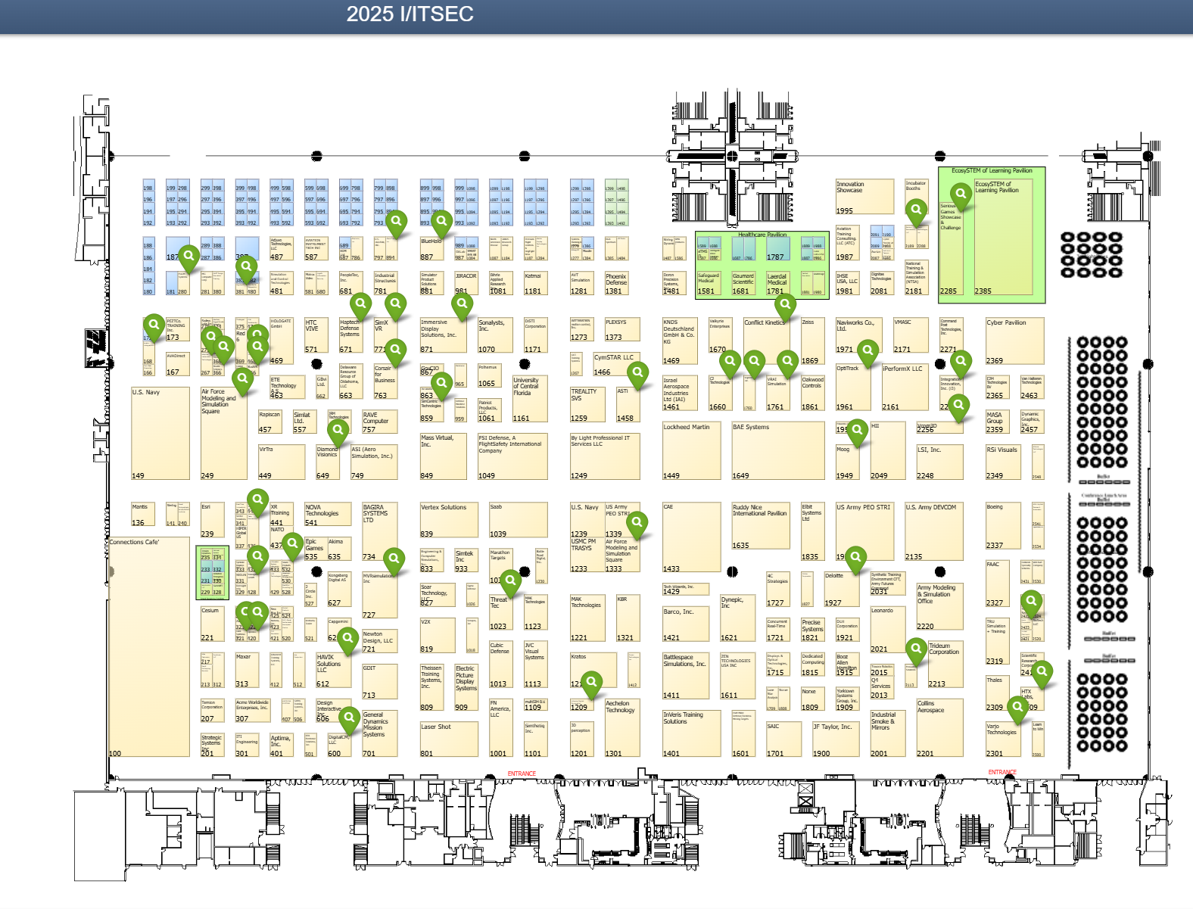
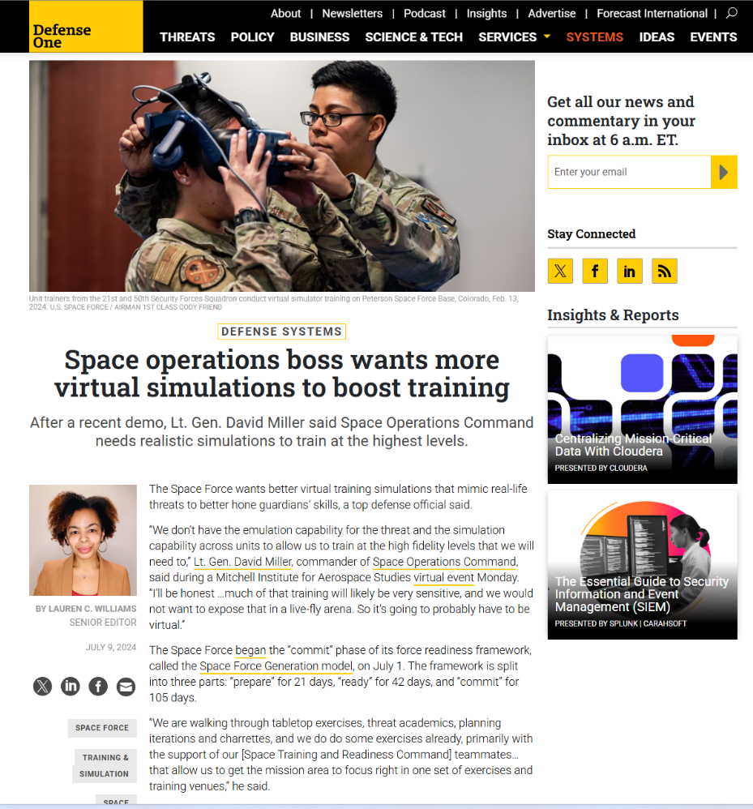
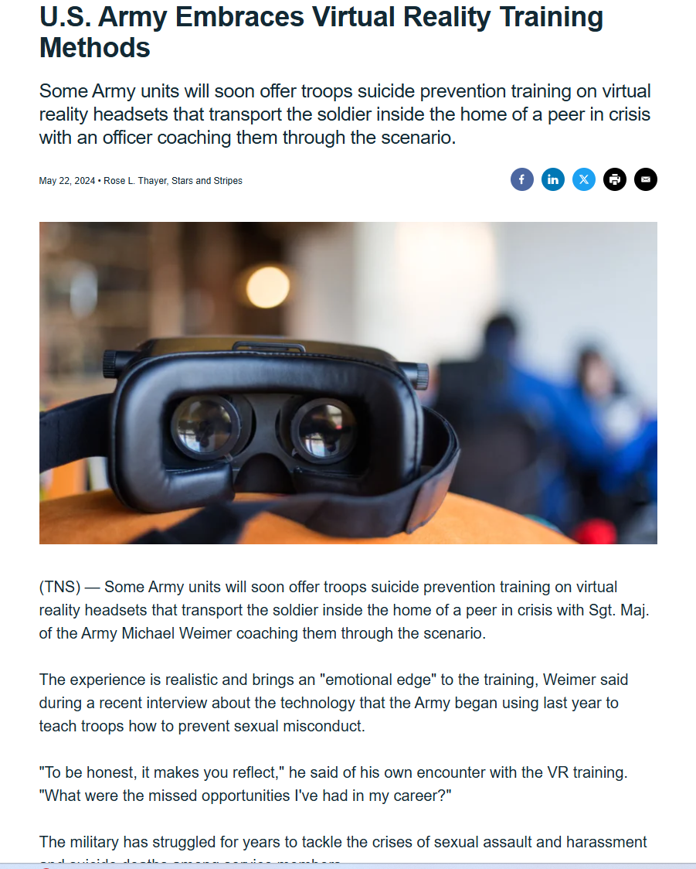
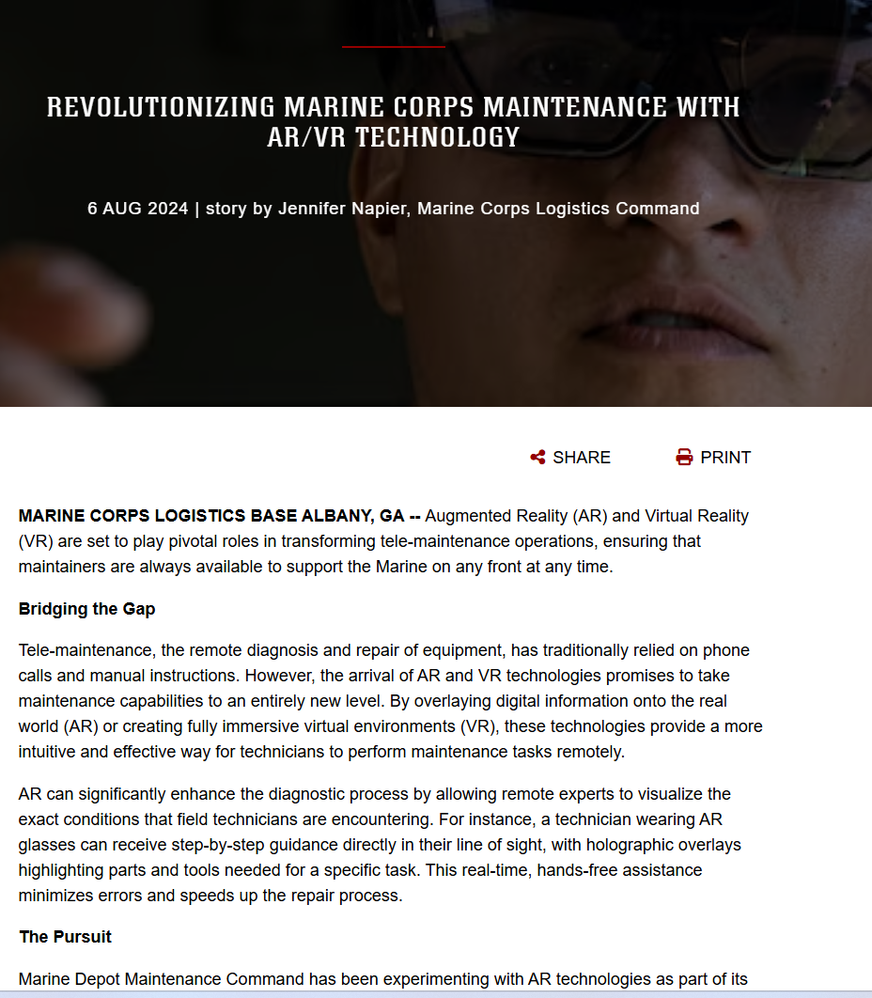
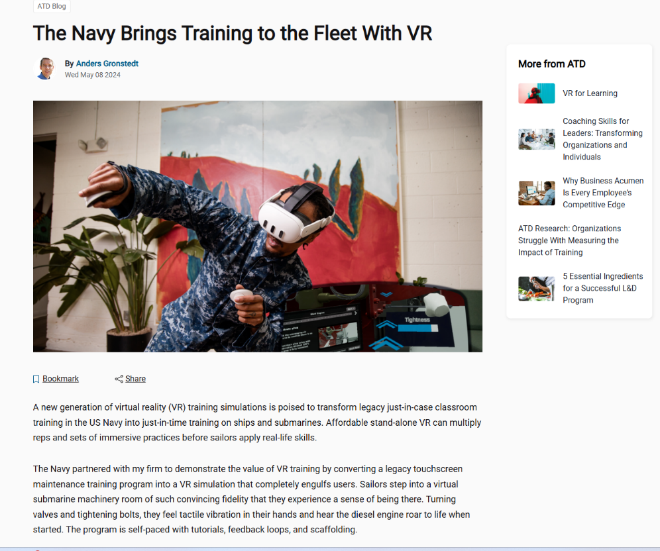
DoD using More AR/VR/MR/XR
Notes:
Perry – 0
NEED TO REHEARSE THIS ONE.
It’s used for
parachuting training…
pilot training by the USAF
Army for a wide range of training
By more and more companies both domestic and international
And what got us interested, the Navy for very basic training.
And beyond, training it’s also being implemented more for operational uses such as mission planning, visualization, even maintenance.
If you don’t believe me, when you walk the floor this week, see how many different booths have HMDs or simulators.
[CLICK]

Slide 8
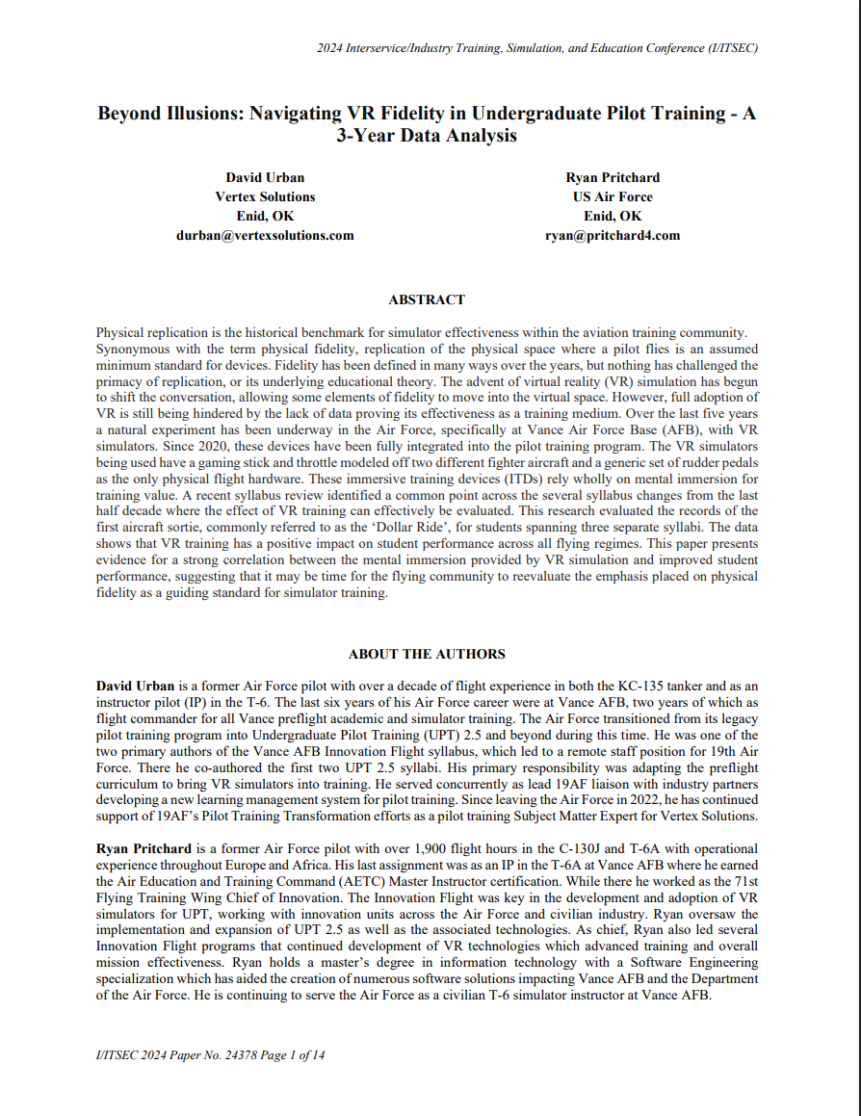
2024 Best Paper
Last year’s best paper showed the effectiveness of VR-based trainers
The system wouldn’t have been effective if the students were sick while using the simulator
Likely more future utilization of VR trainers
Inclusion

Slide 9
Why is cybersickness important?
Military using far more AR/VR/MR/XR in multiple areas
Despite claims, technology is unlikely to eliminate CyS
CyS will affect learners in/after virtual environments
CyS can have significant impact upon learning
Relevance
Photo by Pixabay from Pexels
Notes:
Perry – 1.5
But if the military is using this far more than in the past, shouldn’t it fully understand any potential issues with it?
If we’re putting Soldiers/Sailors/Airmen/Marines into these systems, we owe it to them that the systems are safe and aren’t causing issues for them.
Because, despite that claims of many of those building the latest and greatest head-worn systems, technology is unlikely to completely eliminate CyS. Claire will show you in a few minutes that the causes of CyS are not necessarily a hardware problem or a software problem, but primarily a wetware problem, i.e., .a human issue, that new technology is unlikely to eliminate for quite a while.
Also, we need to better understand the effects of CyS upon this VE-based learning paradigm. Think about many of the symptoms of cybersickness when in an environment
Headache Dizziness Eye strain Vertigo Nausea Malaise Blurred vision
And think about how well you would learn from a lecture or perform when you’re suffering from some or all of these symptoms. I’m not going to ask for a show of hands, but did anyone ever show up to an eight o’clock class hungover from the night before?
A quick personal anecdote: when I was a midshipman, we went to Pensacola for a week of aviation familiarization where we got to fly in T-34s. . (BTW, this was one month after Top Gun came out, so you can imagine what we were thinking walking around in flight suits.) I was smart enough not to go out the night before flying, but two nights before the flight, we all went out late. The next morning, I was suffering from CyS symptoms, and not paying attention to the class. I remember suddenly realizing that the subject being covered, although unlikely to be needed, would be extremely important to know if it was needed. The subject was “How to bail out of a T-34.” But even after realizing that, I don’t think I got very much out of the lecture. Luckily, my T-34 remained airborne.
So, imagine users trying to learn in a VE while battling symptoms that mimic a hangover.
Likewise, imagine utilizing an HMD for training in a morning class and then trying to learn in the afternoon when you are suffering from the post-exposure symptoms of
Ataxia (the clumsy movements that affect walking, balance, speech, swallowing, and eye movements.),
Sopite syndrome (Drowsiness, Fatigue, Mood changes, Apathy, Depression, Lethargy, Irritability, Malaise, and Impaired concentration), Visual disturbances/blurred vision
So VEs can be implemented to improve training effectiveness, but CyS might make it impossible to learn effectively in them.

Slide 10

Learning Objectives
The learning objectives are for attendees to be able to:
Describe the basic science and causes of CyS
Identify and measure CyS experienced by users
Express how to design a VE to minimize CyS effects in users
Minimize CyS through curricula design
Apply protocols to minimize the CyS impact of a VE during usage
An overview of motion sickness focusing on four components:
Focus
Notes:
LEARNING OBJECTIVES

Slide 11





Agenda
5 Segments:
1. Foundation
Terminology, Theories, Symptomatology, Causes of CyS
2. Susceptibility
Factors that affect CyS: Personal, hardware, content
Focus
3. Measurement
Measuring CyS: Questionnaires, rating scales, physiological measures
4. Solutions
Reducing CyS during the design and development stages, Protocols to reduce CyS
Acronyms
CyS - Cybersickness
5. Progress
Latest work in CyS

Slide 12

Theoretical Foundations
of Visually Induced
Motion Sickness (VIMS)
and Cybersickness (CyS)
Background
Photo by Mikhail Nilov from Pexels

Slide 13









Terminology
Theoretical Foundations
Motion Sickness
Traditional¹
Visually Induced²
car sickness
cinerama sickness
air sickness
gaming sickness
sea sickness
simulator sickness³
space sickness
VR/cybersickness⁴
camel sickness
¹Keshavarz, B., & Golding, J. F. (2022). Motion sickness: current concepts and management. Current Opinion in Neurology, 35(1), 107–112.
²Keshavarz, B., Hecht, H., & Lawson, B. D. (2014). Visually induced motion sickness: Characteristics, causes, and countermeasures. In K. S. Hale & K. M. Stanney (Eds.), Handbook of Virtual Environments: Design, Implementation, and Applications (2nd ed., pp. 648–697). CRC Press.
³Kennedy, R. S., Hettinger, L. J., & Lilienthal, M. G. (1990). Simulator sickness. In G. H. Crampton (Ed.), Motion and Space Sickness.
⁴Rebenitsch, L., & Owen, C. (2016). Review on Cybersickness in Applications and Visual Displays. Virtual Real., 20(2), 101–125.

Slide 14
Cybersickness
Theoretical Foundations
CyS is a phenomenon that occurs when individuals experience symptoms while/after using simulation technology, such as flight simulators or XR training systems
¹Rebenitsch, L., & Owen, C. (2016). Review on Cybersickness in Applications and Visual Displays. Virtual Real., 20(2), 101–125.

Slide 15
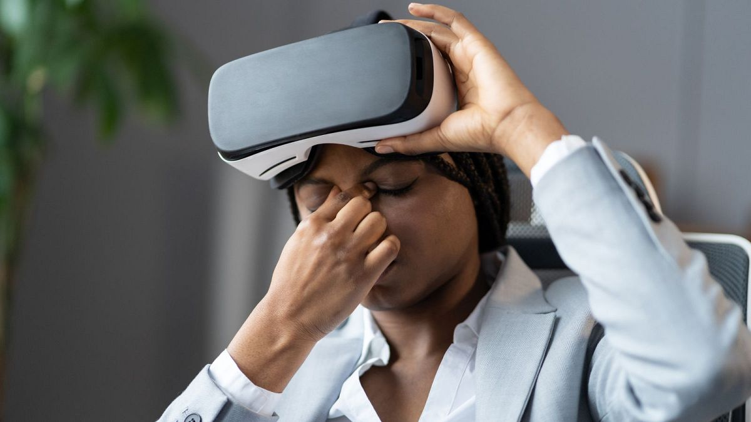
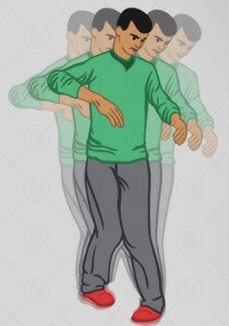
Theoretical Foundations
During: XR Exposure
After: Adverse Physiological Maladaptation
Ataxia
Blurred Vision
Sopite Syndrome
After
Visual Disturbances
Reduced Dexterity
Headache
Pallor
Rapid Breathing
Dizziness
Blurred Vision
Eye Strain
During
Malaise
Vertigo
Burping
Sweating
Nausea
Vomiting
Notes:
Perry – 2.5
As we cover the symptoms, it’s also important to remember that not every user suffers each of these symptoms – suffering one or more is sufficient to be considered to be suffering cybersickness.
It’s also very important to note that our definition used the terms “during/after” because the symptoms of CyS don’t affect people only while they are in a VE. In fact, they can continue for several hours after leaving. And while many of the symptoms experienced during and after are similar, there are some differences.
So let’s start with the symptoms users might suffer while in the environment are:
Headache Dizziness Eye strain Vertigo
Sweating Nausea, up to reaching the point of Vomiting, albeit this severe a reaction is rare,
Burping Malaise Blurred vision Rapid breathing Pallor
The symptoms suffered after leaving the environment include:
Ataxia (basically clumsy movements that affect walking, balance, speech, swallowing, and eye movements.)
Sopite syndrome (Drowsiness, Fatigue, Mood changes, Apathy, and many similar feelings)
Reduced dexterity
Visual disturbances/blurred vision
The most common way of quantifying these symptoms is via the simulation sickness questionnaire (SSQ), which Kennedy and other proposed in their 1993 paper:. Users are asked to rank their level of discomfort in each of these [LASE SCREEN] common symptom areas from 0 (none) to 4 (severe) before and after exposure to the simulator or VE.
The SSQ breaks the symptoms down into three major areas: Ocular motor, Nausea, and Disorientation, where each of these [LASE SCREEN] symptoms falls into one of more of these categories. The users’ rankings are used to create a score in each area, and the three areas are combined in a weighted fashion to create an overall score.
Just as there are many symptoms, there are also many names for these effects… [CLICK]

Slide 16
Theoretical Foundations
Diagnostic criteria
IMPORTANT
MS/VIMS are natural responses and not disease or illness.
Every healthy individual can get motion sick; patients with complete bilateral vestibular loss are immune to motion sickness.
Acute episode of MS/VIMS¹
At least one of the following:
Nausea/gastrointestinal disturbance
Thermoregulatory disruption
Alterations in arousal
Dizziness and/or vertigo
Headache and/or ocular strain
Symptoms appear during real/visual motion exposure
Symptoms stop (eventually) after cessation of real/visual motion²
Symptoms are not better accounted for by another disease or disorder
¹Cha, Y.-H., Golding, J., Keshavarz, B., Furman, J., Kim, J.-S., Lopez-Escamez, J. A., Magnusson, M., Yates, B. J., Lawson, B. D., Staab, J., & Bisdorff, A. (2021). Motion sickness diagnostic criteria: Consensus document of the classification committee of the Bárány society. Journal of Vestibular Research: Equilibrium & Orientation.
²But not necessarily immediately.

Slide 17





Theories
Theoretical Foundation of VIMS
Sensory conflict
Postural instability^{1,2}
Eye movements³
DVP ⁴ (diff in virtual and physical head pose)
Evolutionary Hypothesis⁵
¹Riccio, G. E., & Stoffregen, T. A. (1991). An ecological Theory of Motion Sickness and Postural Instability. Ecological Psychology, 3(3), 195–240. https://doi.org/10.1207/s15326969eco0303_2
²Smart, L. J., Jr, Stoffregen, T. A., & Bardy, B. G. (2002). Visually induced motion sickness predicted by postural instability. Human Factors, 44(3), 451–465.
³Ebenholtz, S. M., Cohen, M. M., & Linder, B. J. (1994). The possible role of nystagmus in motion sickness: A hypothesis. Aviation, Space, and Environmental Medicine, 65(11), 1032–1035.
⁴Palmisano, S., Allison, R. S., & Kim, J. (2020). Cybersickness in Head-Mounted Displays Is Caused by Differences in the User’s Virtual and Physical Head Pose. Frontiers in Virtual Reality, 1.
⁵Treisman, M. (1977). Motion sickness: An evolutionary hypothesis. Science, 197(4302), 493–495.
Notes:
Numerous theories on how and why we experience MS.
- SC will talk more about in a minute, most popular.
- PI, MS arises from prolonged postural instability
- Eye movements: limiting eye movements can reduce MS; fixation cross often used to reduce MS (can work to some extent)
- DVP: very new theory, suggesting that the lag causing differences in the virtual and physical head pose is the main cause of VR sickness
- Evolutionary hypothesis: not a theory explaining how you get sick, but rather tries to explain why you show the specific symptoms (nausea, vomiting)

Slide 18





Sensory Conflict^{1,2}
Theoretical Foundation of VIMS
Visual-vestibular conflict (Type II): reading in a car
Visual-vestibular conflict (Type III): driving simulator
¹Reason, J. T., & Brand, J. J. (1975). Motion sickness. Academic Press.
²Bles, W., Bos, J. E., de Graaf, B., Groen, E., & Wertheim, A. H. (1998). Motion sickness: Only one provocative conflict? Brain Research Bulletin, 47(5), 481–487.

Slide 19
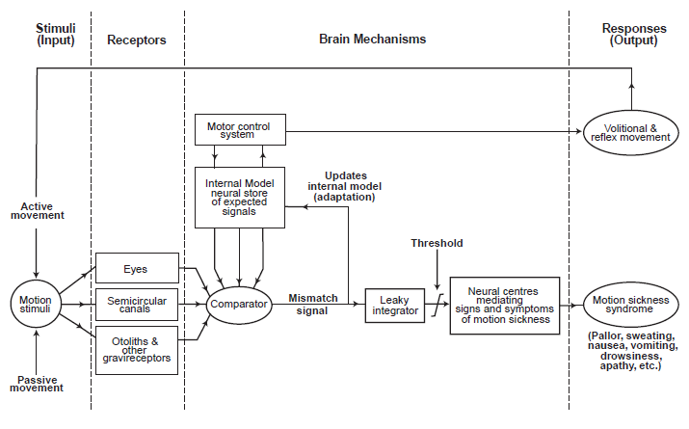
Theoretical Foundation of VIMS
Sensory Conflict^{1,2}
Picture taken from A. Benson
¹Reason, J. T. (1978). Motion sickness adaptation: A neural mismatch model. Journal of the Royal Society of Medicine, 71(11), 819–829.
²Oman, C. M. (1990). Motion sickness: A synthesis and evaluation of the sensory conflict theory. Canadian Journal of Physiology and Pharmacology, 68(2), 294–303.
Notes:
Crucial aspect: neural store – storage that includes all sensory patterns of past motion (visual, vestibular, proprioceptive).
When adequate model found from the neural store matching the current actual sensation, no MS will occur
ONLY if the sensory conflict pattern is unique (i.e., no adequate expectation formed), then MS will occur (not conflict alone!)

Slide 20

Factors determining the susceptibility to Cybersickness
Prediction
Photo by Tim Mossholder from Pexels

Slide 21


Factors Determining Susceptibility to Cybersickness
Personal Factors
Sex/Gender¹
Age²
Ethnicity³
Women more susceptible than men?
Peak 8-10 yrs. for traditional MS. Older adults more susceptible to CyS?
East Asians potentially more susceptible to CyS?
¹Flanagan, M. B., May, J. G., & Dobie, T. G. (2005). Sex differences in tolerance to visually-induced motion sickness. Aviation, Space, and Environmental Medicine, 76(7), 642–646.
²Keshavarz, B., Ramkhalawansingh, R., Haycock, B., Shahab, S., & Campos, J. L. (2018). Comparing simulator sickness in younger and older adults during simulated driving under different multisensory conditions. Transportation Research Part F: Traffic Psychology and Behaviour, 54, 47–62.
³Klosterhalfen, S., Pan, F., Kellermann, S., & Enck, P. (2006). Gender and race as determinants of nausea induced by circular vection. Gender Medicine, 3(3), 236–242.
Notes:
Sex: many studies suggest that women are more susceptible than men, but only in 50% of studies this was found. Potential explanation: hormonal differences or openness to report symptoms (gender effect). Particularly with CyS, some of this could be IPD with older devices
Age: babies immune to MS, peak susceptibility between 8-10 years, then decline in susceptibility. BUT: In VR there might be second peak in older adults (65+), although mixed findings have been reported. VR sickness in adolescents only sparsely tested, but the few studies suggested that kids are not prone to VR sickness
Ethnicity: east Asians potentially hyper-susceptible, but weak evidence in the literature

Slide 22

Factors Determining Susceptibility to Cybersickness
Hardware Factors
Field of view¹
Larger FOV often increases CyS
¹Bos, J. E., de Vries, S. C., van Emmerik, M. L., & Groen, E. L. (2010). The effect of internal and external fields of view on visually induced motion sickness. Applied Ergonomics, 41(4), 516–521.
Notes:
Field of view: larger -> stronger vection -> more likely to experience VIMS
Peripheral vision often shown to be more impactful than central field – can be experienced with no forward view.
But, can’t just go smaller!

Slide 23

Factors Determining Susceptibility to Cybersickness
Hardware Factors
Field of view¹
Visual Setup²
Larger FOV often increases CyS
Screen resolution, refresh rate, time lag
¹Bos, J. E., de Vries, S. C., van Emmerik, M. L., & Groen, E. L. (2010). The effect of internal and external fields of view on visually induced motion sickness. Applied Ergonomics, 41(4), 516–521.
²Saredakis, D., Szpak, A., Birckhead, B., Keage, H. A. D., Rizzo, A., & Loetscher, T. (2020). Factors Associated With Virtual Reality Sickness in Head-Mounted Displays: A Systematic Review and Meta-Analysis. Frontiers in Human Neuroscience, 14.
Notes:
Visual setup: All the things beyond FOV.
Time lag being biggest factor – often thought of as refresh rate / frame rate (often locked),
But also frames of delay for rendering, processing in the display itself afterwards, VR motion tracking before.
Resolution and LED switching times
Vergence / accommodation mismatch. Focal distance of display vs. virtual distance of objects.
Tracking errors.

Slide 24

Factors Determining Susceptibility to Cybersickness
Content Factors
Optical Flow¹
Scene characteristics (density, retinal speed)
¹Keshavarz, B., Philipp-Muller, A. E., Hemmerich, W., Riecke, B. E., & Campos, J. L. (2019). The effect of visual motion stimulus characteristics on vection and visually induced motion sickness. Displays, 58, 71–81.
Notes:
In addition to the hardware used to present experiences, factors arising from the actual content being presented.
Optical flow:
directly impacts the level of self-motion perception (vection) and have also been shown to impact CyS – speed, density etc.,
Flicker
Visual lag
Rest frames (countering flow or anchoring orientation)

Slide 25

Factors Determining Susceptibility to Cybersickness
Content Factors
Optical Flow¹
Visual Rotations²
Scene characteristics (density, retinal speed)
Single vs. combined axes, angular rates
¹Keshavarz, B., Philipp-Muller, A. E., Hemmerich, W., Riecke, B. E., & Campos, J. L. (2019). The effect of visual motion stimulus characteristics on vection and visually induced motion sickness. Displays, 58, 71–81.
²Keshavarz, B., & Hecht, H. (2011). Axis Rotation and Visually Induced Motion Sickness: The Role of Combined Roll, Pitch, and Yaw Motion. Aviation, Space, and Environmental Medicine, 82(11), 1023–1029.
Notes:
Visual rotations: combined axis rotations are quite bad for VIMS, tends to be worse than single.
yaw axis not as bad as pitch and roll in some instances (starfields etc), large yaw can be very bad.

Slide 26

Factors Determining Susceptibility to Cybersickness
Content Factors
Optical Flow¹
Visual Rotations²
Navigation Type
Scene characteristics (density, retinal speed)
Single vs. combined axes, angular rates
POV walking vs. smooth vs. teleport
¹Keshavarz, B., Philipp-Muller, A. E., Hemmerich, W., Riecke, B. E., & Campos, J. L. (2019). The effect of visual motion stimulus characteristics on vection and visually induced motion sickness. Displays, 58, 71–81.
²Keshavarz, B., & Hecht, H. (2011). Axis Rotation and Visually Induced Motion Sickness: The Role of Combined Roll, Pitch, and Yaw Motion. Aviation, Space, and Environmental Medicine, 82(11), 1023–1029.
Notes:
Both can be heavily impacted / minimized by navigation type (hyperjump, teleport etc. to potentially avoid flow altogether)

Slide 27

Measuring Cybersickness
Measures
Photo by Timur Weber from Pexels

Slide 28

Measures
Measuring Cybersickness
Simulator Sickness Questionnaire¹ (SSQ) – 16 items
Nausea Profile² (NP) – 0-100% overall, 3 subscales
Misery Scale³ (MISC) – 0-9 scale
CyS susceptibility A⁴ (CSSQ)
Visually induced motion sickness susceptibility questionnaire⁵ (VIMSSQ)
Virtual reality neuroscience questionnaire (VNSQ)
Questionnaires
¹Kennedy, R. S., Lane, N. E., Berbaum, K. S., & Lilienthal, M. G. (1993). Simulator Sickness Questionnaire: An Enhanced Method for Quantifying Simulator Sickness. The International Journal of Aviation Psychology, 3(3), 203–220.
²Muth, E. R., Stern, R. M., Thayer, J. F., & Koch, K. L. (1996). Assessment of the multiple dimensions of nausea: the Nausea Profile (NP). Journal of psychosomatic research, 40(5), 511–520.
³Bos, J. E., MacKinnon, S. N., & Patterson, A. (2005). Motion sickness symptoms in a ship motion simulator: effects of inside, outside, and no view. Aviation,
Space, and Environmental Medicine, 76(12), 1111–1118.
⁴Freiwald, J.P, Göbel, Y., Mostajeran, F., and Steinicke,F. (2020). The cybersickness susceptibility questionnaire: predicting virtual reality tolerance. In Proceedings of Mensch und Computer 2020 (MuC '20). Association for Computing Machinery, 115–118.
⁵Keshavarz, B., Murovec, B., Mohanathas, N., & Golding, J. F. (2023). The Visually Induced Motion Sickness Susceptibility Questionnaire (VIMSSQ): Estimating Individual Susceptibility to Motion Sickness-Like Symptoms When Using Visual Devices. Human factors, 65(1), 107–124. https://doi.org/10.1177/00187208211008687
Notes:
Many different questionnaires exist – SSQ the most prominent one (several adaptations for VR have been proposed), but SSQ still the most used one. Adaptation of the MSAQ/MSQ
Misery scale: measures different symptoms in a single score, with different scores representing different severities. Simple, yet needs some training to be able to accurately use.

Slide 29
Measuring Cybersickness
Measures
Fast Motion Sickness Scale (FMS)¹
¹Keshavarz, B., & Hecht, H. (2011). Validating an Efficient Method to Quantify Motion Sickness. Human Factors: The Journal of the Human Factors and Ergonomics Society, 53(4), 415–426.
Notes:
FMS: Simple and effective tool; 20 point scale; established as one of the most often used single-rating scales for the nausea aspect of motion sickness
Useful for getting IRB approval – NPS student study.

Slide 30

Measuring Cybersickness
Measures
Gastric activity (EGG)
Heart Rate & HR variability (ECG)
Sweating response (EDA)
Breathing rate
Body temperature
Physiology^{1,2,3}
¹Tauscher, J.-P., Witt, A., Bosse, S., Schottky, F. W., Grogorick, S., Castillo, S., & Magnor, M. (2020). Exploring neural and peripheral physiological correlates of simulator sickness. Computer Animation and Virtual Worlds, 31(4–5), e1953.
²Dennison, M. S., Wisti, A. Z., & D’Zmura, M. (2016). Use of physiological signals to predict cybersickness. Displays, 44, 42–52.
³Hu, S., Grant, W. F., Stern, R. M., & Koch, K. L. (1991). Motion sickness severity and physiological correlates during repeated exposures to a rotating optokinetic drum. Aviation, Space, and Environmental Medicine, 62(4), 308–314.
Notes:
[TARGET 45:00]
MANY studies looked into physiological correlates. Very mixed findings.
Some interesting correlations, but nothing robust that could be used as an objective measure of MS
Electrogastrography (EGG) showed good results, but a signal that is extremely prone to movement artifacts, making it de facto impractical.
LOOK INTO PUPILOMETRY.

Slide 31

Countermeasures against Cybersickness
Solutions
Photo by Zoltan Tasi on Unsplash
Notes:
Reducing CyS during the design and development stages

Slide 32
Countermeasures
Reducing Cybersickness
Method
Pharmacological
Non-pharmacological
technological
behavioural
situational

Slide 33

Pharmacological Treatments^{1,2,3}
Reducing Cybersickness
Cholinergic
Histaminergic
Antipsychotics
Benzodiazepines
Neurokinin-1 antagonists
Barbiturates
¹Schmäl, F. (2013). Neuronal mechanisms and the treatment of motion sickness. Pharmacology, 91(3–4), 229–241. https://doi.org/10.1159/000350185
²Stankovic, A. S., Alvarenga, D. L., Coleman Daniels, V. R., Simmons, R. G., Buckey, J. C., & Putcha, L. (2019). Intranasal Scopolamine for Motion Sickness. Aerospace Medicine and Human Performance, 90(11), 917–924. https://doi.org/10.3357/AMHP.5456.2019
³Golding, J. F., & Gresty, M. A. (2015). Pathophysiology and treatment of motion sickness: Current Opinion in Neurology, 28(1), 83–88. https://doi.org/10.1097/WCO.0000000000000163
Notes:
Overview of the many pharmacological solutions that exist
PRO: they do work for most people, inexpensive, easily accessible
CON: side effects (drowsy, temporary mild cognitive impairment etc.) – not useful for testing performance or attention in simulation studies. Need to find non-pharmacological solutions

Slide 34

Reducing Cybersickness
Technological
Time Lag¹
Higher update rates and minimal buffering
¹Moss, J. D., & Muth, E. R. (2011). Characteristics of Head-Mounted Displays and Their Effects on Simulator Sickness. Human Factors: The Journal of the Human Factors and Ergonomics Society, 53(3), 308–319.
Notes:
Time delays are a killer. Reduced lag is always better for VIMS.
So high STABLE update rates beats pretty scenery
Check / try different rendering settings for fewer processing frames.
120 Hz beats 4K.
If head tracking within control, use lead (or look for headset with gyros, not just position tracking)

Slide 35

Reducing Cybersickness
Technological
Time Lag¹
Reference Frame²
Higher update rates and minimal buffering
Provide stable visual reference or horizon
¹Moss, J. D., & Muth, E. R. (2011). Characteristics of Head-Mounted Displays and Their Effects on Simulator Sickness. Human Factors: The Journal of the Human Factors and Ergonomics Society, 53(3), 308–319.
²Prothero, J. D., Draper, M. H., Furness, T. A., 3rd, Parker, D. E., & Wells, M. J. (1999). The use of an independent visual background to reduce simulator side-effects. Aviation, Space, and Environmental Medicine, 70(3 Pt 1), 277–283.
Notes:
Stable ref frame. Keyword Stable.
Video pass through it not stable, optical pass through is (typically).
Somewhat context dependent – can actually increase conflict if there are strong visual cues to the contrary.
As such, most useful with smaller FOV devices

Slide 36

Reducing Cybersickness
Technological
Time Lag¹
Reference Frame²
Wearable Tech^{3,4}
Higher update rates and minimal buffering
Provide stable visual reference or horizon
Reduce sensory conflicts
¹Moss, J. D., & Muth, E. R. (2011). Characteristics of Head-Mounted Displays and Their Effects on Simulator Sickness. Human Factors: The Journal of the Human Factors and Ergonomics Society, 53(3), 308–319.
²Prothero, J. D., Draper, M. H., Furness, T. A., 3rd, Parker, D. E., & Wells, M. J. (1999). The use of an independent visual background to reduce simulator side-effects. Aviation, Space, and Environmental Medicine, 70(3 Pt 1), 277–283.
³Keshavarz, B. (In progress). Improving user experience and comfort in Virtual Reality applications with smart wearables.
⁴Benelli A. et al., (2023). Frequency-Dependent Reduction of Cybersickness in Virtual Reality by Transcranial Oscillatory Stimulation of the Vestibular Cortex. Neurotherapeutics 20(6), 1796-1807.
Notes:
Transcranial stimulation, vibratory tactile vests,

Slide 37
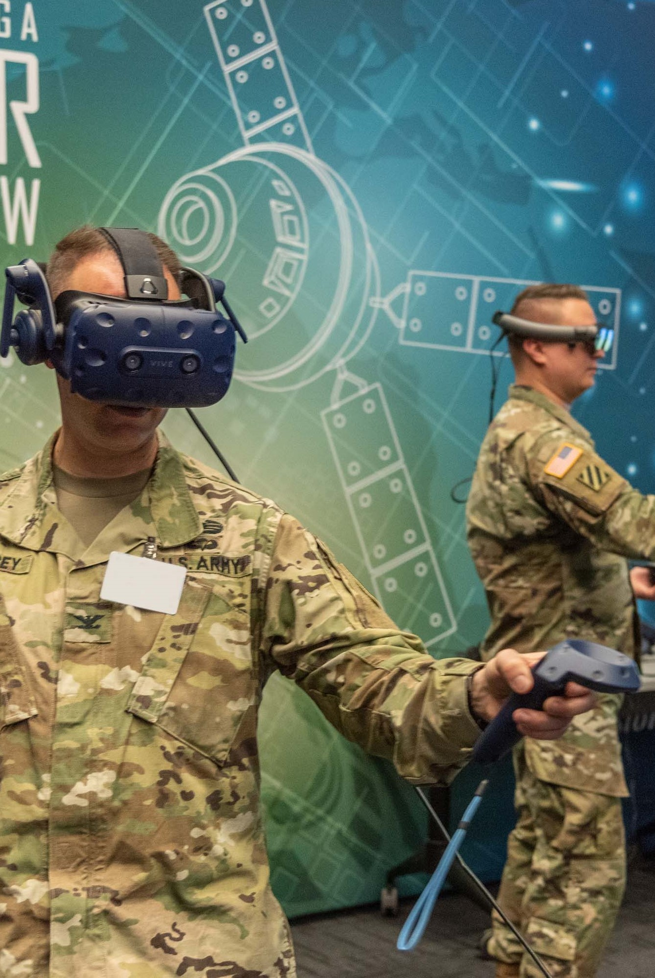
Protocols to reduce cybersickness in design and development
Solutions

Slide 38




Design VE Stimulus to Minimize Adverse Effects
Design
the System
Parallax Cues
Teleportation ¹
Acceleration
FOV
Minimize motion parallax cues, especially early in sim
Reduces CyS, but can increase disorientation/ hinder spatial awareness
Limit or slow forward speed/ acceleration
Modify FOV based on speed and angular velocity
¹Joel Teixeira, Sebastien Miellet & Stephen Palmisano (03 Apr 2024): Investigating the Relative Contributions of Unexpected Vection and Postural Instability to VR Cybersickness, International Journal of Human–Computer Interaction, DOI: 10.1080/10447318.2024.2330041
Notes:
CyS must be THE key factor in design and development of XRs
If people can’t use it, does it matter how “good” the product is?
Icons:
Teleport taken from https://iconduck.com/icons/25968/teleport on June 13, 2025 under CC license.
Parallax from https://www.flaticon.com/free-icon/parallax_5560941?term=parallax&page=1&position=9&origin=tag&related_id=5560941
Acceleration: https://www.flaticon.com/free-icon/acceleration_1819372
.

Slide 39


Quantify VE Stimulus Intensity
Quantify
the System
Test
Questionnaires
Physiology
Performance
Collection of data to evaluate system, not individuals
$
Does the system perform to baseline expectations (FPS, Lag, Delay)
Test early and test often
Collection of data to evaluate system, not individuals
¹ Vlahovic, S., Skorin-Kapov, L., Suznjevic, M. et al. Not just cybersickness: short-term effects of popular VR game mechanics on physical discomfort and reaction time. Virtual Reality 28, 108 (2024). https://doi.org/10.1007/s10055-024-01007-x
² Stanney, K., Lawson, B. D., Rokers, B., Dennison, M., Fidopiastis, C., Stoffregen, T., … Fulvio, J. M. (2020). Identifying Causes of and Solutions for Cybersickness in Immersive Technology: Reformulation of a Research and Development Agenda. International Journal of Human–Computer Interaction, 36(19), 1783–1803. https://doi.org/10.1080/10447318.2020.1828535
³Stanney, K. M., Hughes, C. L., Bailey, P., Ruiz, E., & Fidopiastis, C. (2023). Cybersickness in immersive training environments. In Human Factors in Simulation and Training (pp. 159-180). CRC Press.
Notes:
Focus on the fact that while the data being collected is focused on individual participants it is really only useful in aggregate for making design decisions at this stage.
Nick – 2.5
Optical flow
Cumulative optical flow entropy
Horizontal flow, vertical flow, magnitude – contribute differently
Number of optical flow events can vary significantly between VE sequences (movement, elements in environment)
Difference between focused vs peripheral vision
Questionnaires
CyS susceptibility questionnaire (CSSQ)
Simulator sickness questionnaire (SSQ)
Visually induced motion sickness susceptibility questionnaire (VIMSSQ)
Virtual reality neuroscience questionnaire (VNSQ)
Optical flow is an approximation measure of image motion using projection of a 3D surface on a 2D plane. When analyzed in time sequence structures of the optical flow field can recover 3D motion and motion of the original sensor. Used in many computer vision tasks. It provides insight into motion regularity and complexity.
Using entropy metrics to characterise the signal of optical flow
Tian, N., & Boulic, R. (2024). The Least Increasing Aversion (LIA) Protocol: illustration on identifying individual susceptibility to cybersickness triggers. IEEE Transactions on Visualization and Computer Graphics
Smith, S. P. (2021). Comparing virtual environments for cybersickness using a cumulative optical flow entropy metric. IEEE Access, 9, 68898-68904.
We really need more data here for longer learning type experiences. The data is often focused on short (<15 minute), ride like experiences (rollercoasters) which doesn’t necessarily translate well into an educational setting.
Challenging to compare across systems as well. i.e. how much of the issue is due to limited resolution when comparing say Oculus DK 1 vs a Quest 3 or Varjo?
Does the frame rate that the data was captured at have an impact?
Kourtesis, P., Collina, S., Doumas, L. A., & MacPherson, S. E. (2019). Validation of the virtual reality neuroscience questionnaire: maximum duration of immersive virtual reality sessions without the presence of pertinent adverse symptomatology. Frontiers in human neuroscience, 13, 417.
MAKE QUESTIONNAIRES TOP LEVEL BULLET
ADD FMS TO LIST
REMOVES CSSQ BECAUSE IT IS PREDICTIVE???
Add biometrics under Questionnaires
.

Slide 40
Quantify VE Aftereffects of Target System
Quantify
the System’s Aftereffects
Questionnaires
Physiology
Performance
Capture Data on Aftereffects
Capture Data on Aftereffects
Evaluate Aftereffects on ability to perform basic tasks
¹ Kourtesis, P., Collina, S., Doumas, L. A., & MacPherson, S. E. (2019). Validation of the virtual reality neuroscience questionnaire: maximum duration of immersive virtual reality sessions without the presence of pertinent adverse symptomatology. Frontiers in human neuroscience, 13, 417.
² Stanney, K., Lawson, B. D., Rokers, B., Dennison, M., Fidopiastis, C., Stoffregen, T., … Fulvio, J. M. (2020). Identifying Causes of and Solutions for Cybersickness in Immersive Technology: Reformulation of a Research and Development Agenda. International Journal of Human–Computer Interaction, 36(19), 1783–1803. https://doi.org/10.1080/10447318.2020.1828535
³Stanney, K. M., Hughes, C. L., Bailey, P., Ruiz, E., & Fidopiastis, C. (2023). Cybersickness in immersive training environments. In Human Factors in Simulation and Training (pp. 159-180). CRC Press.
Notes:
Focus on the fact that this is measuring the average time for a participant of your system to return to baseline. Or to determine the percentage of users of your system that will experience lingering aftereffects.
Tian, N., & Boulic, R. (2024). The Least Increasing Aversion (LIA) Protocol: illustration on identifying individual susceptibility to cybersickness triggers. IEEE Transactions on Visualization and Computer Graphics
Smith, S. P. (2021). Comparing virtual environments for cybersickness using a cumulative optical flow entropy metric. IEEE Access, 9, 68898-68904.
We really need more data here for longer learning type experiences. The data is often focused on short (<15 minute), ride like experiences (rollercoasters) which doesn’t necessarily translate well into an educational setting.
Challenging to compare across systems as well. i.e. how much of the issue is due to limited resolution when comparing say Oculus DK 1 vs a Quest 3 or Varjo?
Does the frame rate that the data was captured at have an impact?
Kourtesis, P., Collina, S., Doumas, L. A., & MacPherson, S. E. (2019). Validation of the virtual reality neuroscience questionnaire: maximum duration of immersive virtual reality sessions without the presence of pertinent adverse symptomatology. Frontiers in human neuroscience, 13, 417.
.

Slide 41
Protocols to reduce cybersickness in implementation
Solutions

Slide 42
Identify Individual Capacity of Target User Population to Resist Adverse Effects of VE Exposure
Identify Individual Capacity of Target User Population
Target Population
Questionnaires
Performance
Expected Personal Factors
Identify Early
Predict Dropout Rate/ Determine Acceptability
¹ Tian, N., Lopes, P. & Boulic, R. A review of cybersickness in head-mounted displays: raising attention to individual susceptibility. Virtual Reality 26, 1409–1441 (2022). https://doi.org/10.1007/s10055-022-00638-2
Notes:
What are the of your training audience?
Identify trainees likely to have problems early
Via MSSQ/VIMSSQ
Provide time for exposure/habituation
Place VR lessons later in curriculum to allow those susceptible time to adjust??
Predict drop-out rate and determine acceptability DOES THIS BELONG HERE??
.

Slide 43




Countermeasures
Behavioural
Postural support¹
Breathing²
Exposure³
Habituation⁴
Resticting body movements may reduce MS
Controlled breathing has shown promising results
Stepwise exposure is helpful
Best method, but has some disadvantages
¹Keshavarz, B., Novak, A. C., Hettinger, L. J., Stoffregen, T. A., & Campos, J. L. (2017). Passive restraint reduces visually induced motion sickness in older adults. Journal of Experimental Psychology: Applied, 23(1), 85–99.
²Yen Pik Sang, F. D., Billar, J. P., Golding, J. F., & Gresty, M. A. (2003). Behavioral methods of alleviating motion sickness: Effectiveness of controlled breathing and a music audiotape. Journal of Travel Medicine, 10(2), 108–111.
³Domeyer, J. E., Cassavaugh, N. D., & Backs, R. W. (2013). The use of adaptation to reduce simulator sickness in driving assessment and research. Accident Analysis & Prevention, 53, 127–132.
⁴Stanney, K. M., Kennedy, R. S., Drexler, J. M., & Harm, D. L. (1999). Motion sickness and proprioceptive aftereffects following virtual environment exposure.
Applied Ergonomics, 30(1), 27–38.
Notes:
Fallout VR vs Beatsaber (and associated popularity/success)
BH – for content to be merged. Also, temperature+airflow
Postural support: going back to the theory, providing support of the body (i.e., restricting motion) can indeed reduce MS, but not fully eliminate. Also mixed findings in the literature
Breathing: controlled breathing has been shown across few studies to reduced MS significantly
Exposure: stepwise adaptation to the simulator can be very useful in reducing the occurrence and severity of MS
Habituation: best non-pharma treatment available. BUT: very time consuming, not pleasant for the user, expensive – not always feasible.

Slide 44



Provide Warnings for those with Severe Susceptibility to CyS
Provide Warnings for those with Severe Susceptibility to CyS
Post-Experience
Management Protocols
Training
Articulate limitations and observation periods
Articulate management protocols for affected users
Training for Instructors
Notes:
.

Slide 45
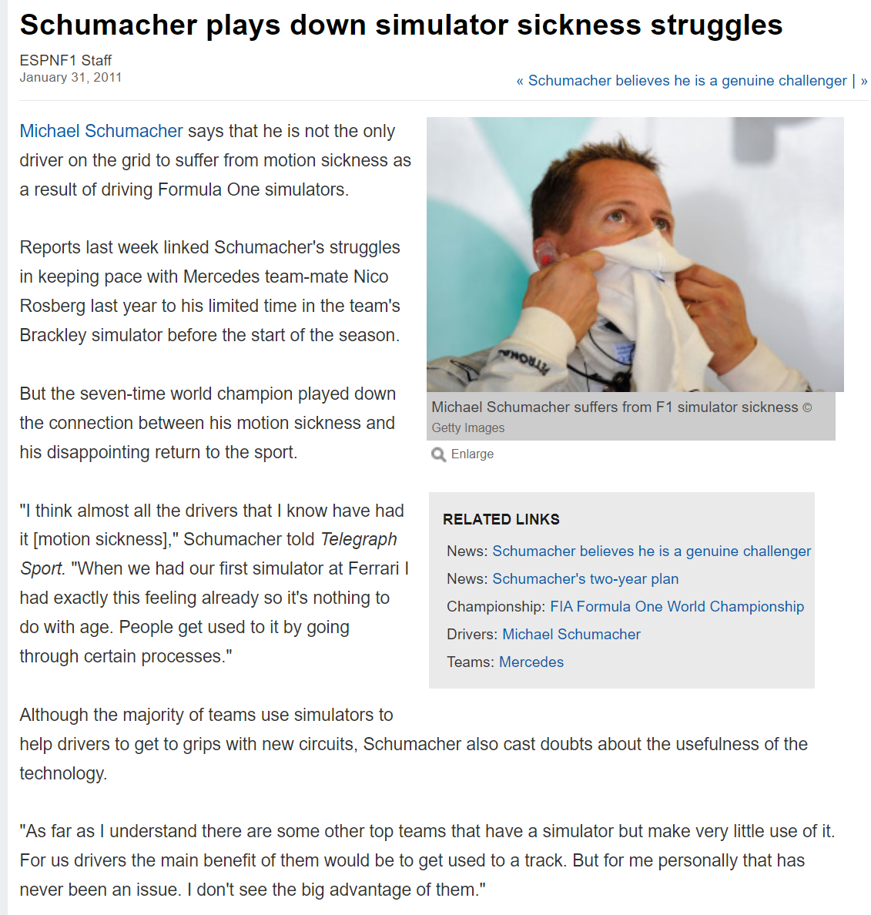
Notes:
And I’m going to leave you with a worst case that I’ll talk about again when talking about designing curricula.
Michael Schumacher won a record-setting seven Formula One World Drivers' Championship titles, a record which was tied by Lewis Hamilton in 2020. At the time of his retirement in 2006, Schumacher held the records for most wins (91), pole positions (68), and podium finishes (155), while some of his records still stand.
He returned to driving in 2010 for three years, he never won a race and never finished higher than eighth in the overall Formula One standings during his comeback. Now, there are lots of possible reasons for this, but one of them was that Schumacher suffered from CyS and could not use the simulators teams started to use to prepare drivers for new circuits.
So think about what we do with troops who are otherwise outstanding in their field but can’t use simulators or HMDs for training?
Now that I’ve covered a bit of the higher level items, our next speaker will be Claire Hughes, who will cover much of the science of CyS.

Slide 46


Placement of VE Sessions
Placement of VE Sessions
Habituation
Stepwise Exposure
Course Length
Early and Often
Build Exposure Length over time
Work within the available time
Notes:
.

Slide 47


Length of VE Sessions
Length of VE Sessions
Learning Outcomes¹
Schedule
Does it achieve the Learning Outcomes?
Is it achievable?
¹ Ng WX, Cheng ZY, Peh LC. Application of Virtual Reality (VR) in Facility Management Competency-based Training (CBT) in the Era of Industrie 5.0. IgMin Res. April 09, 2024; 2(4): 189-198. IgMin ID: igmin165; DOI: 10.61927/igmin165; Available at: igmin.link/p165
Notes:
.

Slide 48
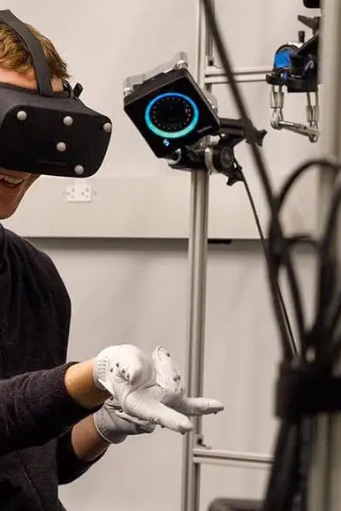
Success Stories
Progress

Slide 49



Oculus Rift CV1
Development
Problem
Modified
Result
Oculus Rift DK1 & DK2 induced unacceptable CyS
CV1 refresh rate, screen resoultion, tracking, latency
Dramatic decrease in CyS and allowed longer sessions and commercial applications
^{From} https://en.wikipedia.org/wiki/Oculus_Rift#:~:text=In%20June%202013%2C%20a%20prototype,main%20criticism%20of%20the%20DK1.ferences
Notes:
Problem:
The Oculus Rift Development Kits (DK1 & DK2) were known for inducing cybersickness due to:
High latency.
Low refresh rates (60Hz).
Lower resolution.
Lack of positional tracking in DK1.
Modifications:
Oculus improved the system in the Consumer Version (CV1) by:
Increasing refresh rate to 90Hz.
Improving screen resolution.
Adding positional tracking ("constellation" tracking system).
Reducing latency through asynchronous timewarp and better rendering pipelines.
Result:
Dramatic decrease in cybersickness reports.
Became viable for longer sessions and commercial applications.

Slide 50
VR Training for Navy Pilots
Development
Problem
Modified
Result
Early version caused CyS in 40% of trainees
Added predictive head tracking, FOV, frame rate/latency, added motion
CyS reduced by over 50%, allowed longer and more frequent training use
^{Find references}
Notes:
VR Training for Military Pilots (U.S. Navy)
Problem:
Early versions of VR-based flight simulators caused nausea in up to 40% of trainees due to:
Mismatch in motion cues.
Poor synchronization between visual input and vestibular sensations.
Modifications:
Introduced predictive head tracking.
Adjusted field of view (FOV) dynamically (aka FOV restrictors or "tunneling").
Improved frame rates and latency with more powerful GPUs.
Added motion platforms to give congruent physical sensations.
Result:
Drop in cybersickness incidence by over 50% in test groups.
Made systems acceptable for longer and more frequent training use.

Slide 51

Latest Work in Cybersickness
Progress

Slide 52



Latest Work in CyS: XAI to Reduce CyS
Explainable AI (XAI)
Train AI
Study
Results
LLM trained to detect CyS from physiological readings
Compared reduction in CyS from traditional methods and XAI methods
XAI significantly reduced CyS
Kumar K. R., & Anuarul H. K. (2025). RelaxVR: Cybersickness Reduction in Immersive Virtual Reality Through Explainable AI and Large Language Models. IEEE Access, 13, 84689–84712. https://doi.org/10.1109/ACCESS.2025.3566958
Notes:
Leveraged XAI for cybersickness predictions, explanations, and reduction through an interactive LLM-based dialogue engine for conversation” These are then mapped to appropriate cybersickness reduction techniques and recommended to users. We implemented RelaxVR on the HTC Vive Pro and conducted a mixed factorial user study, comparing the effects of different cybersickness reduction techniques with RelaxVR. Our user study revealed that the aptness of our proposed RelaxVR significantly reduces VR cybersickness with minimal impact on user immersion (UIX), and 94% of users agreed it is highly effective and easy to use for interacting with the cybersickness detection model through the dialogue engine.
All icons downloaded on 6/26/25:
AI icon from: https://www.flaticon.com/free-icon/artificial-intelligence_5145108?term=artificial+intelligence&page=1&position=2&origin=search&related_id=5145108
Study icon from: https://www.flaticon.com/free-icon/search_2717575?term=research&related_id=2717575&origin=search
Results: https://www.flaticon.com/free-icon/dashboard_11068820?term=results&page=2&position=3&origin=search&related_id=11068820

Slide 53
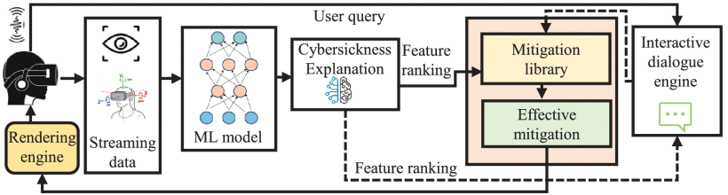
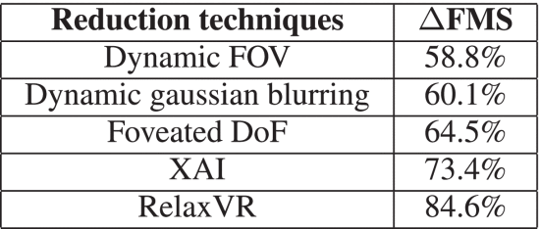
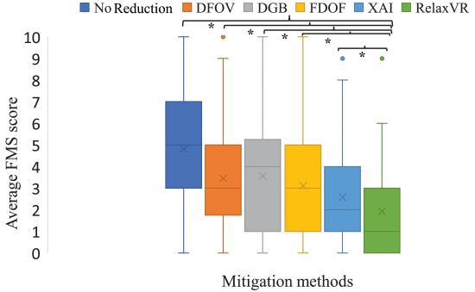
Latest Work in CyS: XAI to Reduce CyS

Slide 54
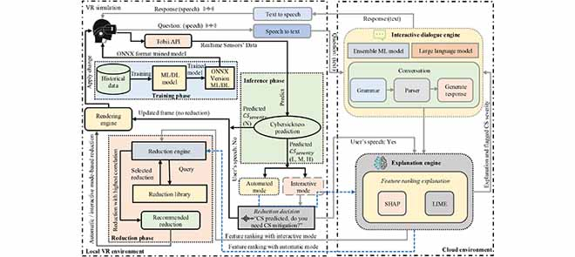
Latest Work in CyS: XAI to Reduce CyS
Kumar K. R., & Anuarul H. K. (2025). RelaxVR: Cybersickness Reduction in Immersive Virtual Reality Through Explainable AI and Large Language Models. IEEE Access, 13, 84689–84712. https://doi.org/10.1109/ACCESS.2025.3566958

Slide 55

Latest Work in CyS: Preprocessing EEG to Reduce CyS
Electro-encephalogram (EEG)
EEGs
Study
Results
EEGs have been proven to detect CyS
Compared different methods of preprocessing EEGs
Both minimal and advanced pre-processing shows improvement in CyS detection
Rosanne, O., Benesch, D., Kratzig, G., Paré, S., Bolt, N., & Falk, T. H. (2025). To pre-process or not to pre-process? On the role of EEG enhancement for cybersickness characterization and the importance of amplitude modulation features. Frontiers in Virtual Reality, 6. https://doi.org/10.3389/frvir.2025.1468971
Notes:
What’s important about this study is that we’re moving beyond the “Let’s see if this might work” stage and into the “We’ve shown it works, now we need to engineer solutions that are feasible for use in the real world” stage.
Rosanne et al. answer three research questions:
What neural patterns are indicative of cybersickness levels?
Do EEG amplitude modulation features convey more important and explainable patterns?
What role does EEG pre-processing play in overall cybersickness characterization?
“Experimental results show that minimal pre-processing retains artifacts that may be useful for cybersickness detection (e.g., head and eye movements), while more advanced methods enable the extraction of more interpretable neural patterns that may help the research community gain additional insights on the neural underpinnings of cybersickness.”
All icons downloaded on 6/26/25:
EEG icon from: https://www.flaticon.com/free-icon/eeg_4305203?term=eeg&page=1&position=1&origin=search&related_id=4305203
Study icon from: https://www.flaticon.com/free-icon/search_2717575?term=research&related_id=2717575&origin=search
Results icon from: https://www.flaticon.com/free-icon/dashboard_11068820?term=results&page=2&position=3&origin=search&related_id=11068820

Slide 56
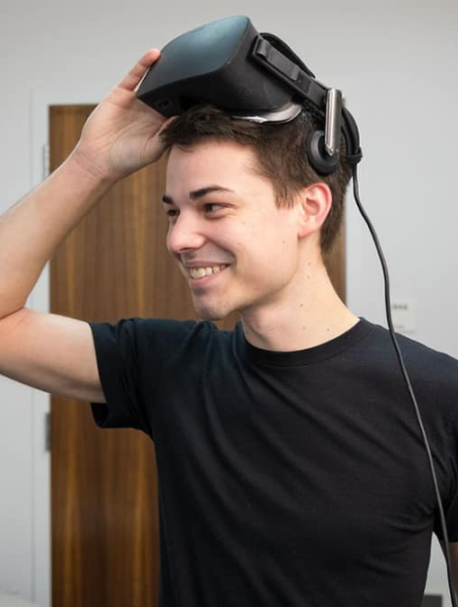
Summary
The End
Notes:
Image from https://www.techexplorist.com/study-probes-effect-virtual-reality-learning/20730/

Slide 57

Summary
Cybersickness is a key limitation of modern technologies that needs to be addressed to allow the full potential of the technology to unfold
Various factors affect the susceptibility to cybersickness, making accurate predictions challenging
Objective measurements for cybersickness do not currently exist, self-report measures are currently the most useful
Non-pharmacological treatments exist, but they cannot fully prevent cybersickness
Take home message

Slide 58
Summary
Key recommendations as related to points given:
Design your stimulus with regards to the training objective: Avoid unnecessary elements causing visual clutter/optical flow
Minimize excessive or abrupt visual motion. No motion is better than bad motion!
Provide a multisensory simulation (vision, hearing, touch, vestibular, physical motion, etc.) only as necessary to meet training objectives
Test early to determine and correct CyS issues
Take home message

Slide 59
Summary
Key recommendations as related to points given:
Use questionnaires to assess susceptibility of trainees to CyS and act accordingly
Let users slowly familiarize themselves with the VE
Provide a comfortable environment for the user (airflow, water, etc.)
Take home message

Slide 60
Summary
Key recommendations as related to points given:
Monitor signs of CyS closely and use appropriate measures
Create a testing protocol to ensure there are no CyS issues initially and periodically thereafter
Have a plan if students cannot utilize the training system due to CyS
Take home message

Slide 61
Summary
Learning Objectives Recap
Describe the basic science and causes of cybersickness.
Identify and measure CyS experienced by users
Express how to design a VE to minimize CyS effects in users
Use key actions/methods to design curricula which minimize CyS
Apply protocols to minimize the CyS impact of a VE
✓
An overview of motion sickness focusing on four components:
✓
Take home message
✓
✓
✓
Notes:
Describe the basic science and causes of cybersickness (CyS)
Identify and measure CyS experienced by users
Express how to design a VE to minimize CyS effects in users
Use key actions/methods to design curricula which minimize CyS
Apply protocols to minimize the CyS impact of a virtual environment (VE)

Slide 62
Questions?
Contact Details:
Perry McDowell
mcdowell@nps.edu
C: +1 831 915 8396
W: +1 831 656 7591
LCDR Nick Adriaanse
nicholas.j.adriaanse.fm@us.navy.mil
C: +1 419 908 9894
W: +1 757 492 8362
Dr. Bruce Haycock
bruce.haycock@uhn.ca
C: +1 416 312 7157

Slide 63
Icon Attributions
Movement icons created by Freepik - Flaticon: https://www.flaticon.com/free-icons/movement
Exam icons created by Freepik - Flaticon: https://www.flaticon.com/free-icon/exam
Performance icons created by Freepik - Flaticon: https://www.flaticon.com/free-icon/performance
Problem icons created by Freepik - Flaticon: https://www.flaticon.com/free-icons/problem
Online class icons created by muh zakaria – Flaticon: https://www.flaticon.com/free-icons/online-class
Stair icons created by Those Icons – Flaticon: https://www.flaticon.com/free-icons/stair
Schedule icons created by Freepik – Flaticon: https://www.flaticon.com/free-icons/schedule
Purchase icons created by fatihicon – Flaticon: https://www.flaticon.com/free-icons/purchase
Emergency icons created by HAJICON – Flaticon: https://www.flaticon.com/free-icons/emergency
Instructor icons created by Dewi Sari – Flaticon: https://www.flaticon.com/free-icons/instructor
Parallax icons created by Freepik – Flaticon: https://www.flaticon.com/free-icons/parallax
Teleport taken from https://iconduck.com/icons/25968/teleport under CC license 13 Jun 2025
AI taken from: https://www.flaticon.com/free-icon/artificial-intelligence_5145108?term=artificial+intelligence&page=1&position=2&origin=search&related_id=5145108
Study taken from: https://www.flaticon.com/free-icon/search_2717575?term=research&related_id=2717575&origin=search
Results taken from: https://www.flaticon.com/free-icon/dashboard_11068820?term=results&page=2&position=3&origin=search&related_id=11068820
EEG taken from: https://www.flaticon.com/free-icon/eeg_4305203?term=eeg&page=1&position=1&origin=search&related_id=4305203

