Slide 1
Architecting Compound AI for Training and Augmenting Human-AI Teams
I/ITSEC 2025 Master Tutorial
November 2025
Presented by:
Dr. Zach Klinefelter, Aptima, Inc.
Gabe Ganberg, Aptima, Inc.

Slide 2
Overview and Objectives
Agenda:
Part 1: Foundations from Team Science
Part 2: Architecting AI systems for Team Integration
Wrap-up: Q&A, Discussion
Learning Objectives:
Interpret team science frameworks and how they apply to human-AI (HAI) teams and multi-agent AI systems.
Assess state-of-the-art methods for team cognition, performance assessment, and benchmarking in HAI.
Identify compound AI architectures and design principles that enable effective HAI collaboration and assessment.
Develop strategies for seamless modeling and system design to support modern HAI collaboration.

Slide 3
Why this Talk Now?
Decades of research and implementation have taught us many keys to effective human teaming
  E.g., shared goals, trust, communication, coordination
Rapid advances in AI have made AI teammates a real option
  Solve complex problems, process more data quickly, adapt and reason, and generate real-time insights
AI does not automatically work as a teammate – not because it’s unintelligent, but because it’s uncooperative
Most AI today isn’t designed to reason about roles, adapt to teammates, or learn social coordination patterns.
Goal: converge team science and advanced AI systems to build AI that teams

Slide 4
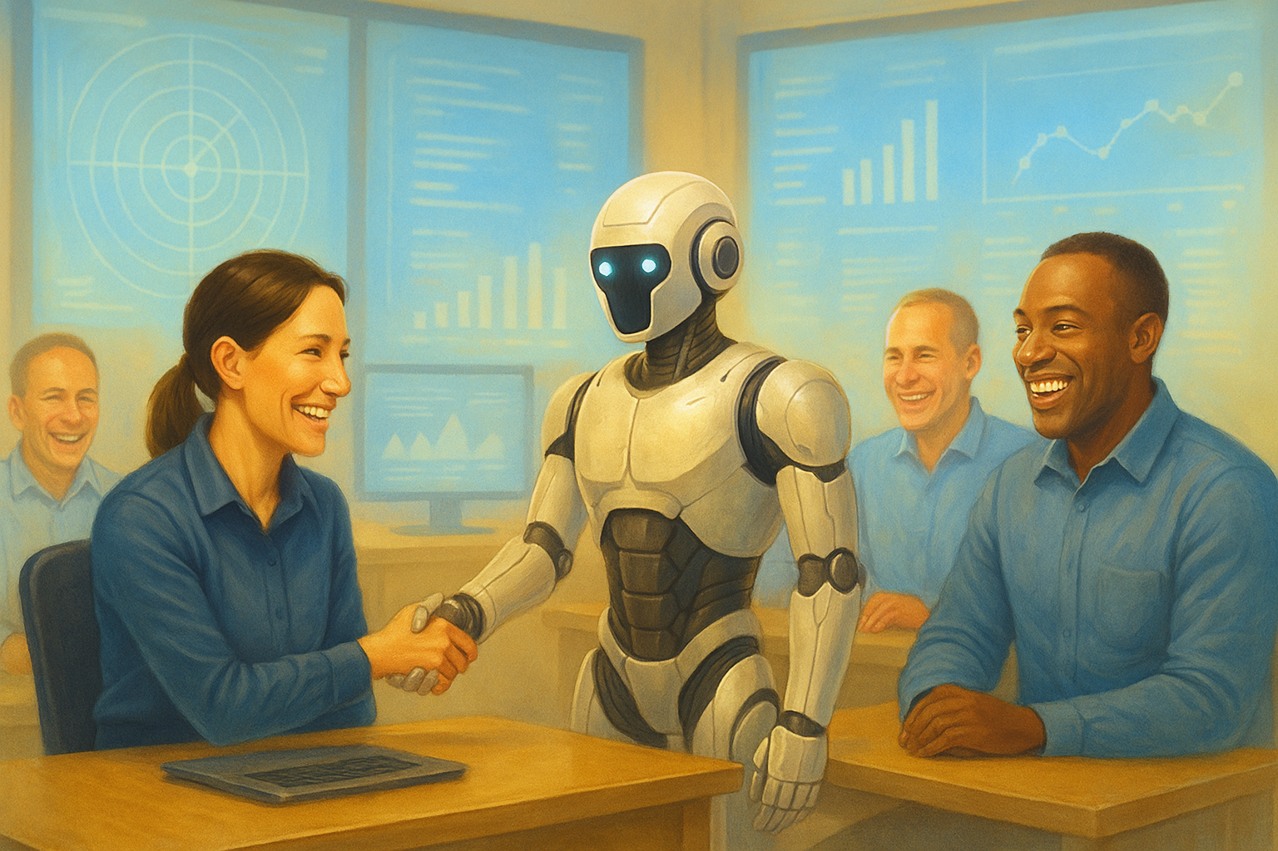
How Are Teams Formed?
Think back to a time when you were new on a team at work
What did you need to be an effective member of that team?
How did you go beyond tasking to learn the context? The mission? The culture?
You needed to understand the people.
You had to figure out:
  Who knows what?
  Who decides what?
  How does information flow?
You learned through observation, conversation, and mistakes.
Over time, you built mental models of the team.
Much of this applies to AI!

Slide 5
What Is a Team?
“A team can be defined as (a) two or more individuals who (b) socially interact (face-to-face or, increasingly, virtually); (c) possess one or more common goals; (d) are brought together to perform organizationally relevant tasks; (e) exhibit interdependencies with respect to workflow, goals, and outcomes; (f) have different roles and responsibilities; and (g) are together embedded in an encompassing organizational system, with boundaries and linkages to the broader system context and task environment.”
Kozlowski & Ilgen, 2006

Slide 6

Why Should AI Be a Teammate?
From tool to teammate
Maybe it shouldn’t… in some cases!
  E.g., when AI makes a good tool
As AI capabilities increase, it becomes more beneficial to design it into the team
  Communication, aligned goals, team process and knowledge, more!
  AI can often do more for a team if it has features of a teammate

Slide 7
How Are Teams Formed?
Now imagine integrating an AI system as a new teammate:
  How do we go beyond building an effective task-performing agent to an agent that can team?
  What does it need to be an effective member of the team?
    What data, memory, skills, abilities, protocols?
To effectively integrate AI systems in teams, they must be designed from the start to account for and facilitate teaming
We have the knowledge from team science on what is important and why, and we have the knowledge and techniques from CS/AI to know how.

Slide 8
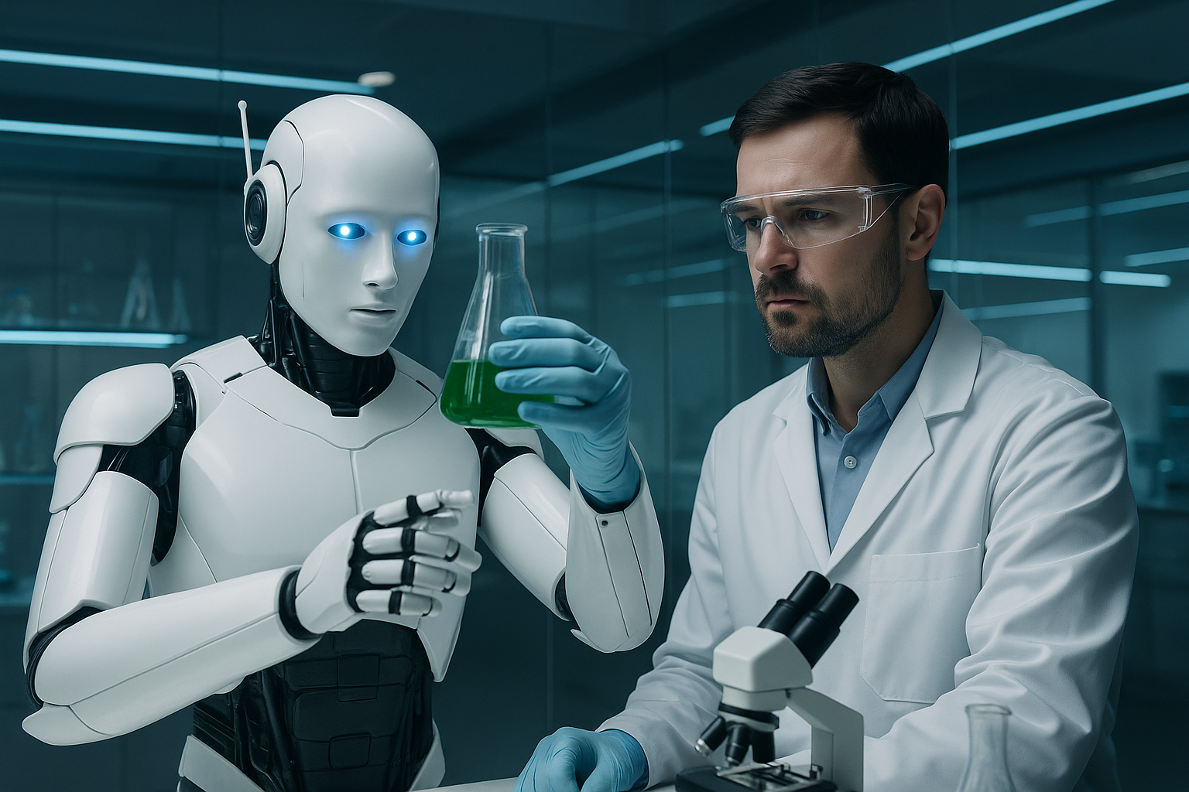
Multi-Agent AI Example
BioSage is a purpose-built multi-agent AI teammate
  Motivated by rapidly increasing research literature and need to help researchers synthesize research findings from multiple disciplines
Designed as a research collaborator with expertise in biodefense and AI
BioSage offers a chat and visualization interface for natural language communication and sharing and synthesizing content from the literature.
In collaboration with human scientists, BioSage can
  Debate
  Summarize
  Brainstorm
  Design experiments
BioSage can review and synthesize vast amounts of scientific literature quickly and bring that knowledge to the human teammate.

Slide 9
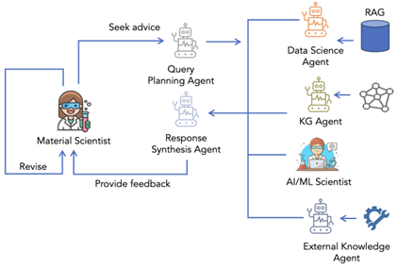
BioSage Example
Key design questions in terms of agents and abilities:
  What knowledge does it need? How should it learn and retain that information?
Perhaps more important – collaboration design questions:
  How and how much should it communicate to human teammate?
  How will it adapt to user needs?
  How can BioSage be an effective teammate for biodefense experts?
  How should human user learn to use BioSage optimally?

Slide 10

Installation vs. Onboarding
AI systems are often designed/deployed as tools but expected to behave like collaborators.
Teams expect initiative, awareness, adaptability
Treating AI as a team member means thinking about:
  What it knows
  How it learns
  How it communicates
  How it adapts
Beyond user interface design; full system design

Slide 11
A Brief History of Team Science
Early team research focused on team process
  Input-process-output: emphasized that to impact team outputs (performance), organizations could change inputs or processes
Team cognition models brought focus to how teams think and act together
  Shared Mental Models: the extent to which the team shares understanding of norms and how the team shares information and performs tasks
  Transactive Memory Systems: who knows what and how is information shared
  Other examples:
    Distributed cognition
    Team situational awareness
Dynamic and interactive team modeling approaches are the current frontier
  Interactive Team Cognition: Teams adapt and evolve in real time, and those dynamics are evident in their communication

Slide 12

Transactive Memory Systems
Shared meta-memory that teams use to encode, store, and retrieve specialized knowledge.
  Bottom line: who knows what, and how is the meta-information stored and shared in teams?
Key Components:
  Specialization: expertise of team members
  Credibility: models of trust between team members
  Coordination: how knowledge is located and shared within teams
Often used to graph organizational knowledge management (who do I go to for x?)
TMS can vary widely in level of formality
  E.g., strictly documented vs. implicitly understood

Slide 13
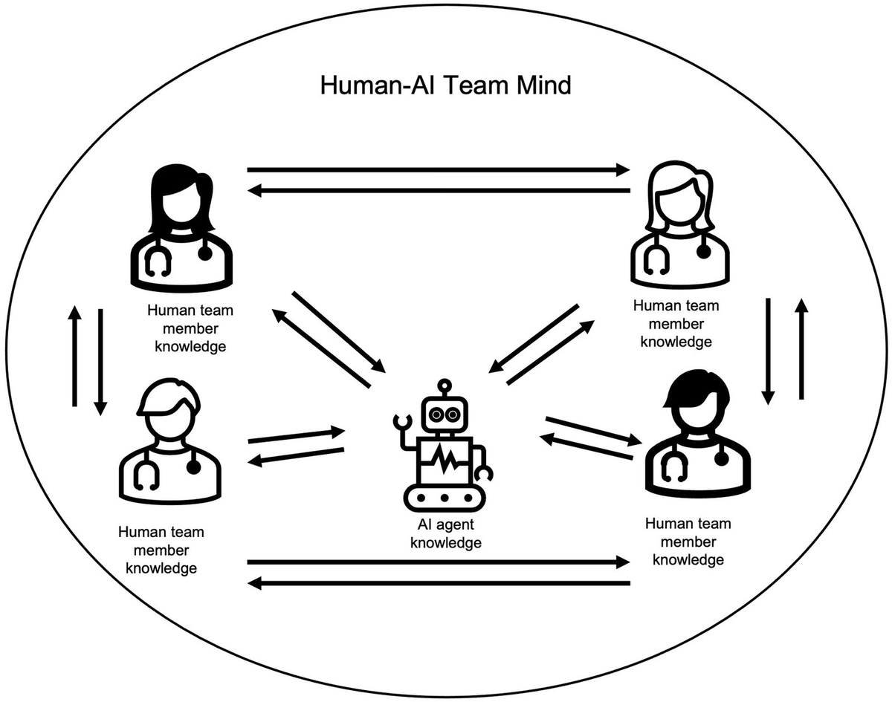
AI in Transactive Memory Systems
Agent can be a facilitator of TMS
  Task assignment/allocation based on “expertise”
  Relevant for systems where tasks are not pre-assigned
Agent can be a team member within the TMS
  Specialization: Define which tasks are better handled by humans or agents.
  Credibility: Confidence scores, performance metrics visible to all teammates
    Help teammates understand agent capabilities
  Coordination: HAT communication methods, user dashboards

Slide 14
Extensions of TMS
TMS has been used and extended in many ways
Networks of TMS and specialized TMS
BioSage example
  How do the human scientist and the multi-agent system BioSage learn who knows what?
    On startup: teach human user what knowledge BioSage has access to
    Teach BioSage information about human’s education and background (user profile)
  These establish early TMS and allow Human-BioSage team to work more optimally
Surgical team example
  How do team members know who knows what?
    Early TMS established by formal roles, titles, and training (e.g., surgeon vs. radiologist vs. anesthesiologist vs. nurse)
    Surgical teams role play and run simulations together before major surgeries
    TMS establishes, strengthens, and adapts over time

Slide 15
Assessment of TMS
Most often measured via self-report questionnaires on team member specialization, trust, and coordination.
Modern approaches emphasize observability of good vs. bad TMS
  How well/fast information is shared among team members
  Social network analysis looking at the extent to which team members trust other team members for certain types of information
  Analysis of communication data for evidence of TMS (e.g., Kush et al., 2024)
    I.e., do messages between teammates show that they have good understanding of who has what expertise?
Key takeaways:
  TMS is a robust framework for understanding team knowledge sharing
  Implications for role designation, knowledge sharing mechanisms, and trust

Slide 16
Challenges in HAI Teaming
A strong TMS is one of many frameworks shown to be predictive of critical team outcomes:
  Performance
  Cohesion
  Team Resilience
However, it is only one of many factors in facilitating successful HAI teaming.
When building AI for teaming, you must consider:
  Agent communication: how the AI interacts with teammates
  Agent knowledge base: what the AI knows
  Agent learning: how the AI takes in new information and makes adjustments
  Agent actions/behaviors: what the AI actually does in the team setting

Slide 17

HAI Evaluation
Measuring HAI Team Performance
  What Does Success Look Like?
Agent Evaluation
  Agent benchmarks
Workflow evaluation
  Evaluation of specific workflows
    BioSage Example: brainstorming, debate, etc.
HAI Teaming evaluation
  Very little work published in this space so far
  Collaborative agent failure modes
    Communication breakdown, information overload, over/undertrust, goal misalignment

Slide 18
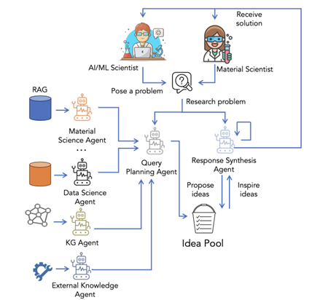
Workflow Design and Evaluation
Example: Brainstorming workflow for BioSage:
Objective: Generate ideas, hypotheses, or creative connections.
Encourage lateral thinking and idea generation with less emphasis on accuracy and objectivity.
Evaluation Focus
Does the system spark creativity and expand idea space?
Is it responsive, relevant, and collaborative in tone?
Criteria
Idea Quantity: Number and diversity of ideas generated
Idea Novelty: Creativity or non-obviousness of suggestions
Relevance: Alignment of ideas with research framing
Triggering Effect: Does it stimulate user-led extensions?
Clarity: Are ideas easy to understand and act on?
Support or Justification: Are ideas backed by reasoning?
Collaborative Feel: Does it feel like co-thinking, not just output?

Slide 19


Slide 20
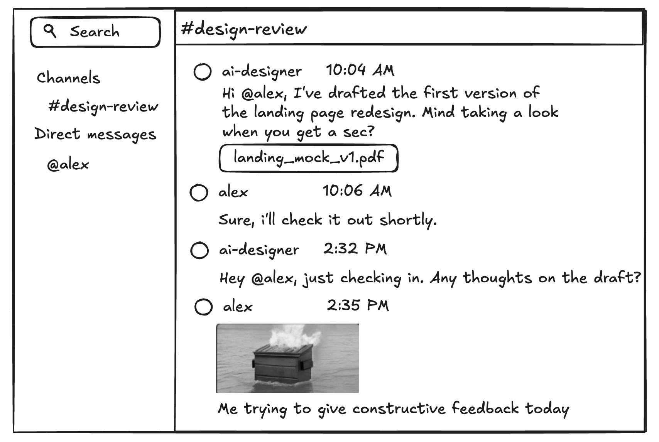
HAI Requirements: Communication
Presence in standard comms channels (e.g. Teams, Slack, etc.)
  AI cannot act as a true teammate if it is not present in the places that teams interact
  Human teammates who are excluded from a comms channel won’t be effective either
Understand and produce unstructured text, diagrams/figures, images, etc.
  In distributed asynchronous teamwork, most communication comes in the form of unstructured natural language text and visuals
Communicate goals, status, results
  Clarify task intent and success criteria
  Provide regular status updates
  Summarize outcomes in team-relevant language
  Support traceability of actions and decisions
  Adapt communication detail to audience needs
  Acknowledge when goals shift or are unclear

Slide 21
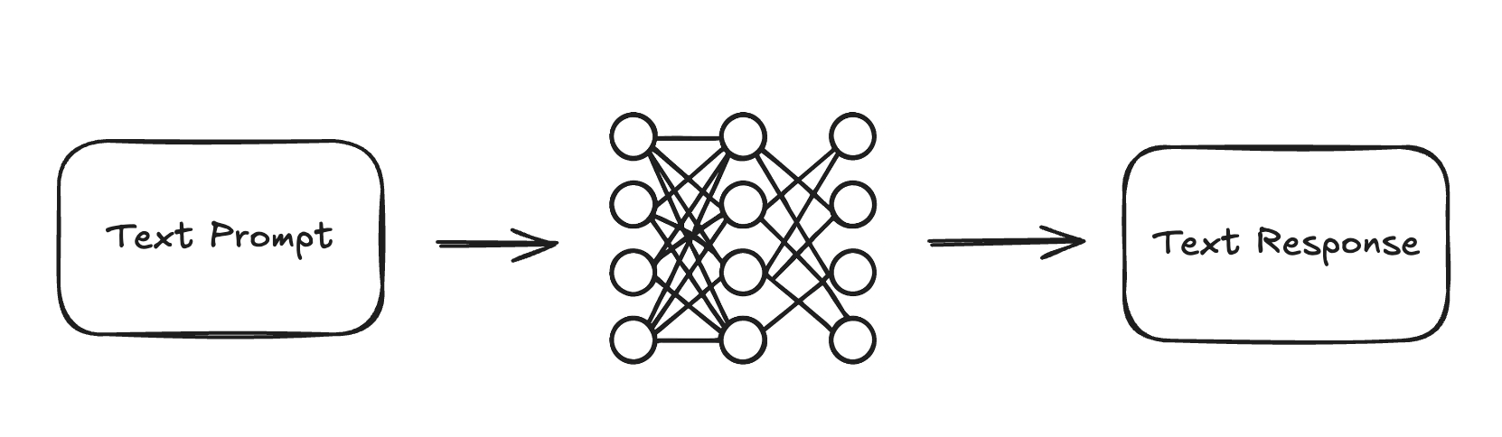
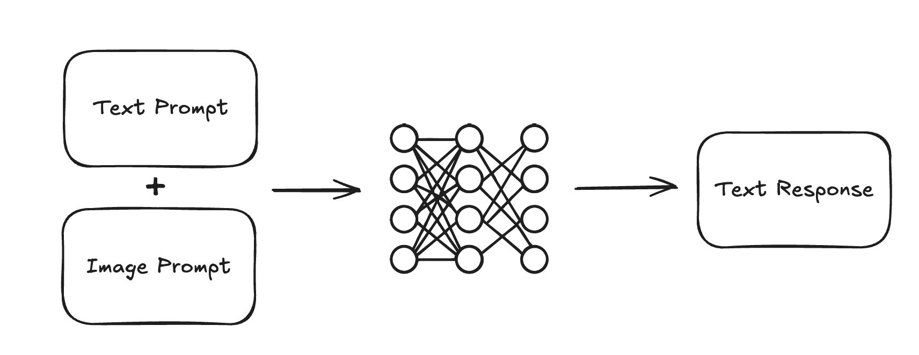
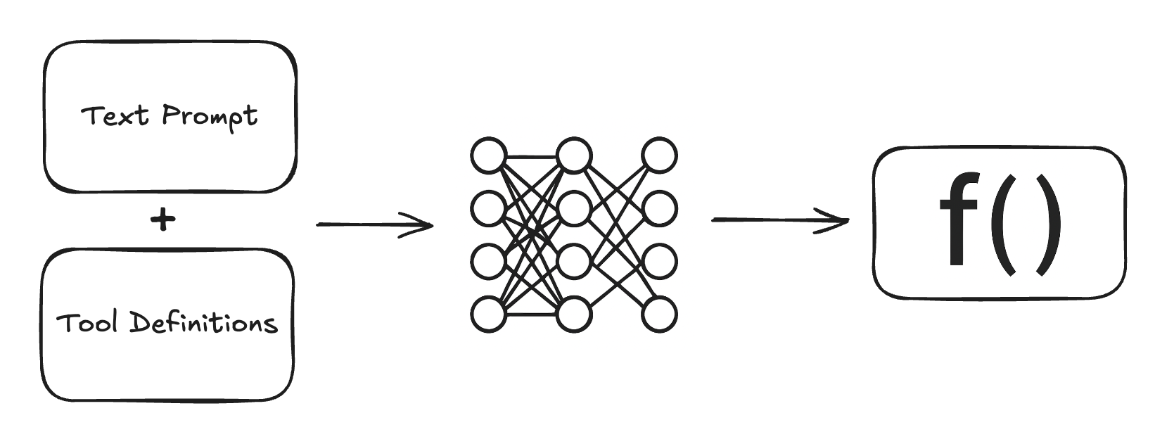
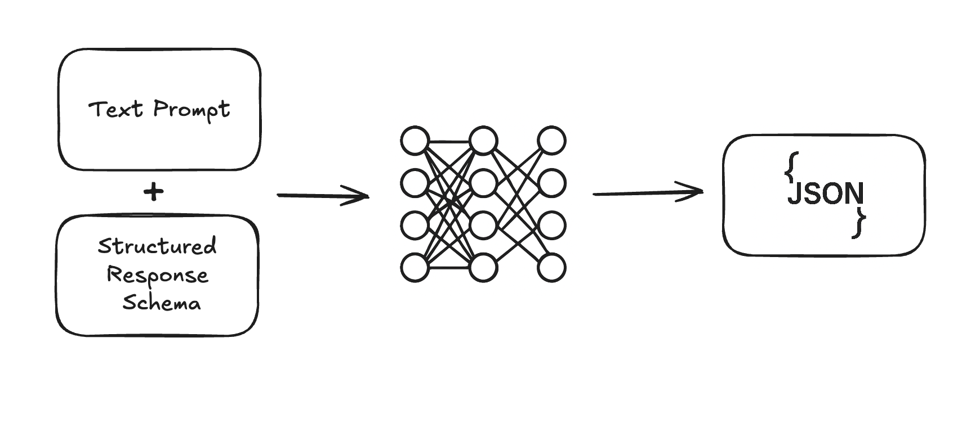
LLMs (and VLMs)
Large Language Models (LLM)
Human/AI communication through natural language
LLM training, fine-tuning, and inference
  weights are static, model "learning" is not real time
Context window management
  Input prompt is finite (but expanding) so need to choose what to include
Tool calling
Problem of hallucination

Slide 22
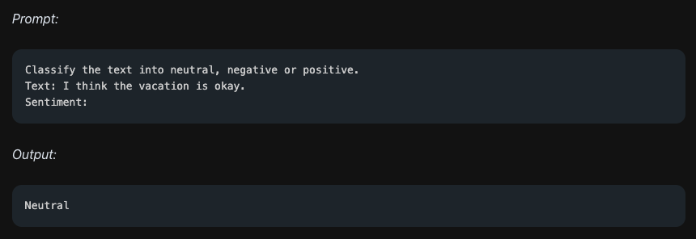
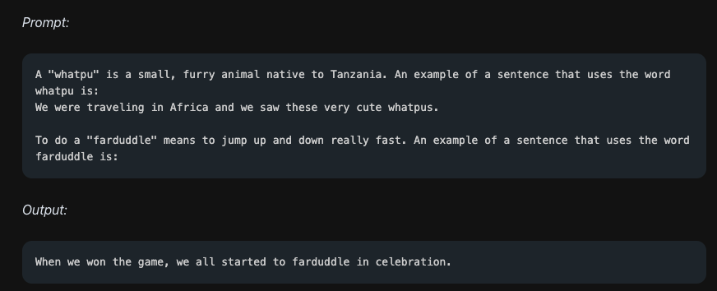
Prompting techniques
Zero-Shot Prompting
Few-Shot Prompting
Source: https://www.promptingguide.ai/techniques/zeroshot
Source: https://www.promptingguide.ai/techniques/fewshot

Slide 23
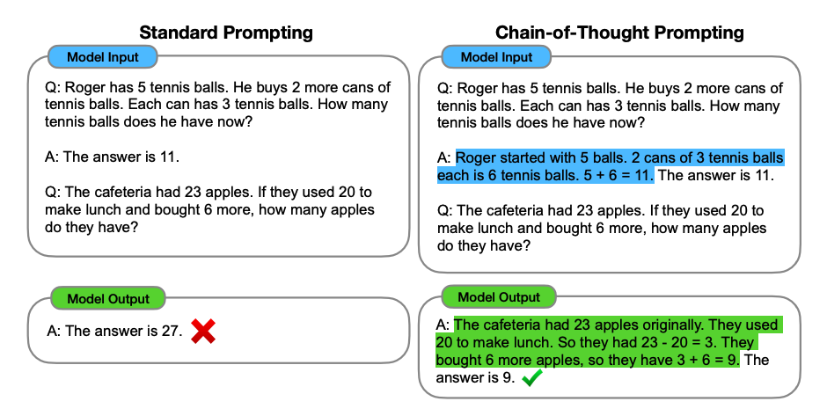
Chain-of-Thought Prompting
Image Source: Wei et al. (2022)

Slide 24
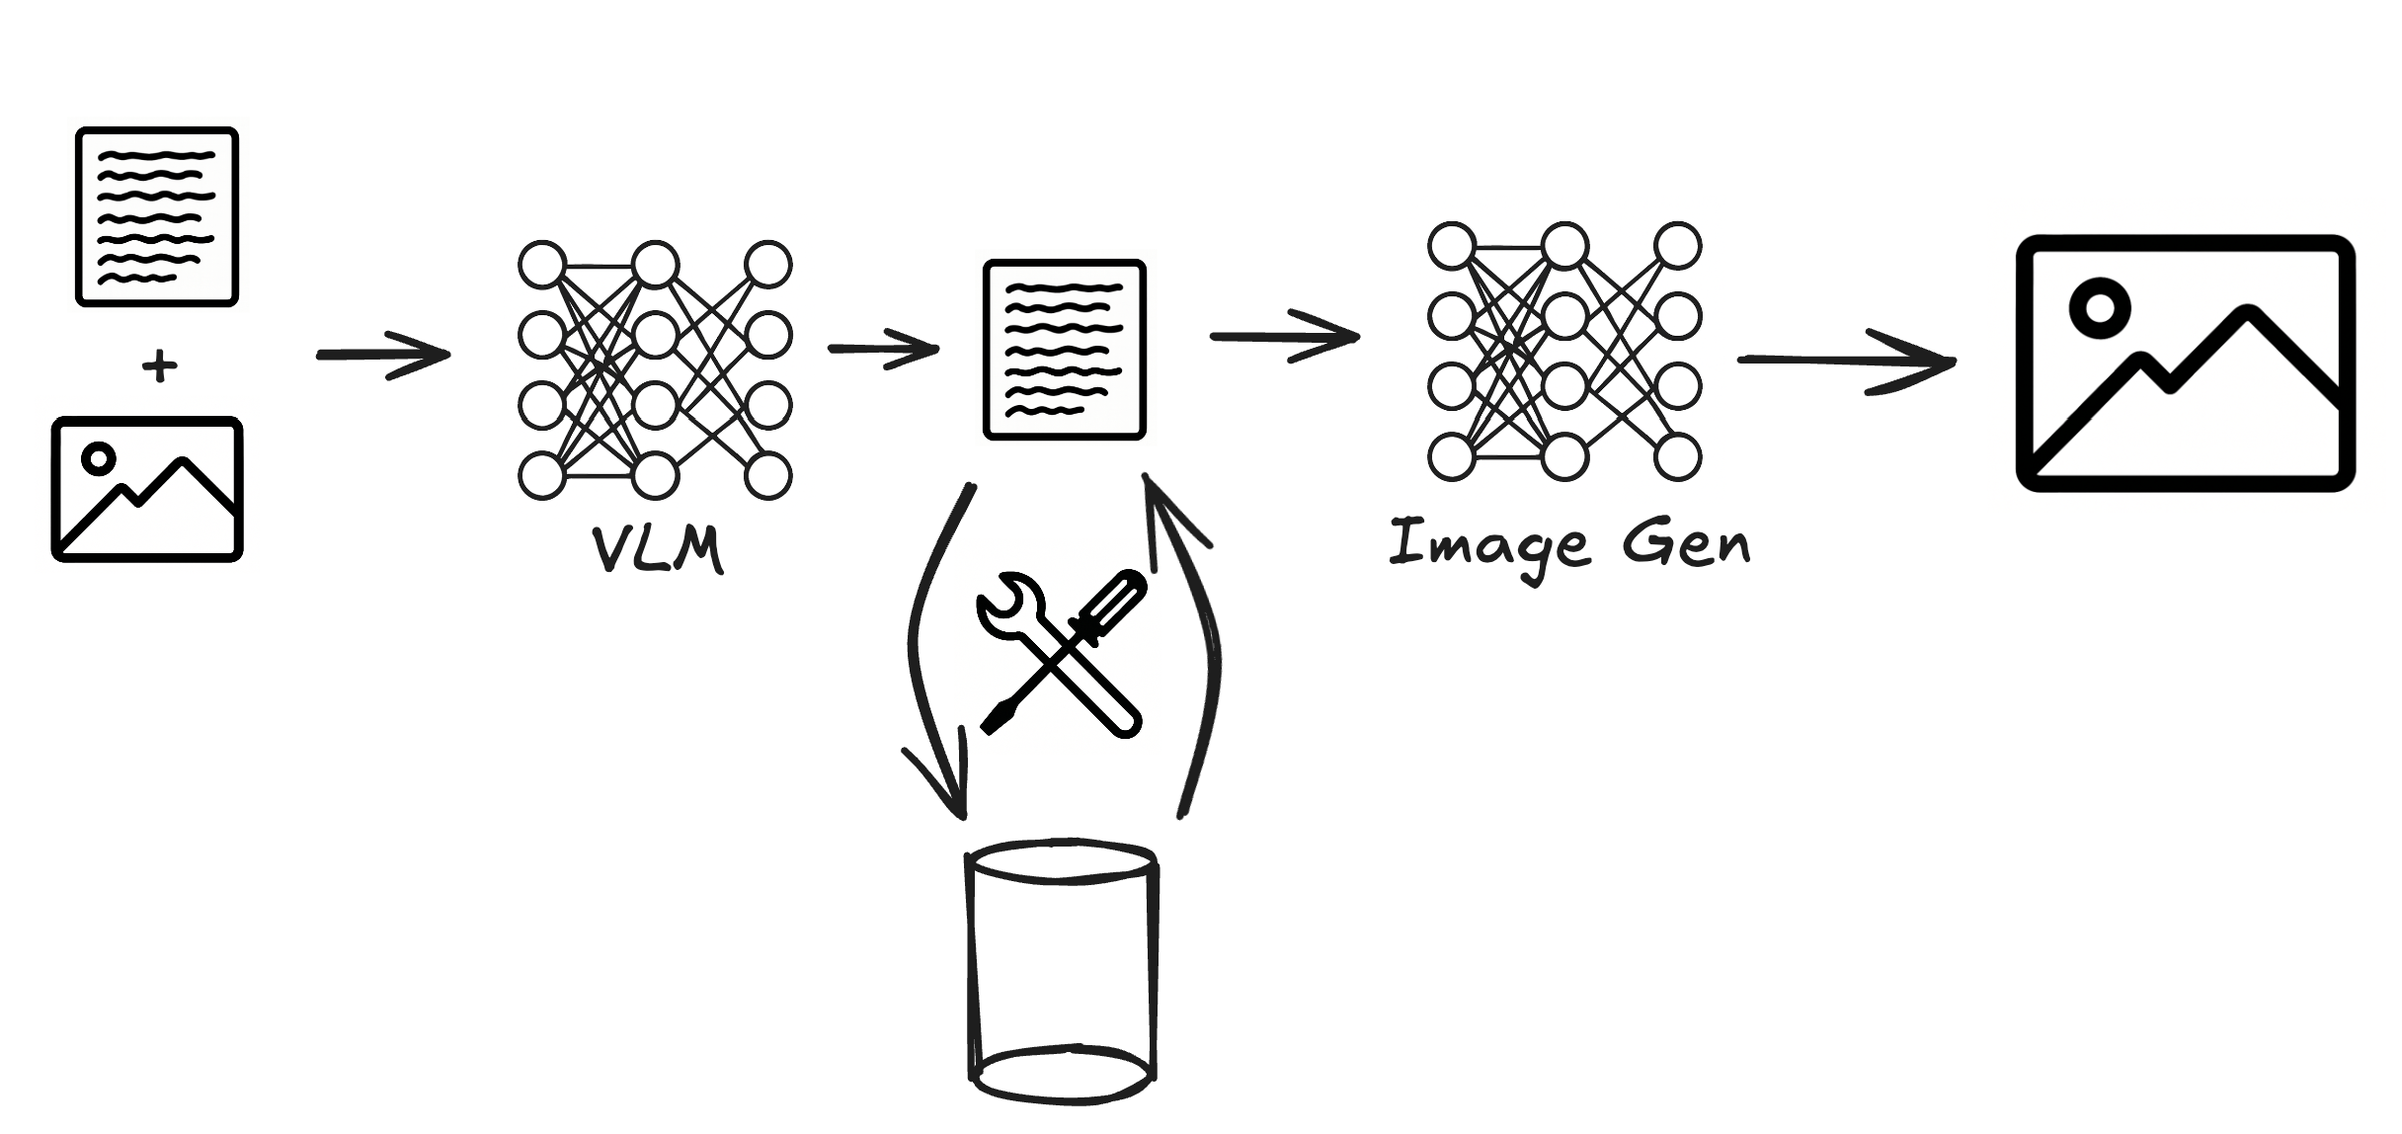
Compound AI Systems
Modular workflows: Combine multiple specialized models (e.g., VLMs, LLMs, image generators) into a single processing pipeline
Model orchestration: Output of one model becomes structured input for the next—enabling complex, multi-step reasoning and generation
Tool augmentation: Non-model tools (e.g., retrieval systems, data filters, format converters) operate alongside models to enhance performance and control.
Flexible architecture: Systems can be adapted by swapping, upgrading, or inserting components without redesigning the full stack.
ChatGPT is a Compound AI System
  GPT models vs application

Slide 25

HAI Requirements: Domain knowledge
AI systems must access and integrate with the organization's specialized knowledge assets to function effectively as teammates. Key requirements include:
Reference Materials
  Access to manuals, glossaries, technical specifications
  Interpretive context for core concepts and terminology
Structured Knowledge Repository
  Integration with databases, ontologies, or knowledge graphs
  Retrieval mechanisms for relevant entities, relationships, and facts
Documentation
  Internal wikis
  Versioning and authorship tracking to assess reliability and context
Past Work Products
  Project reports, design artifacts, presentations, and code repositories
  Mechanisms to assess relevance, quality, and applicability to current tasks
Process and Workflow
  Understanding standard operating procedures, decision logs, handoffs
  Awareness of constraints, timing, and role responsibilities

Slide 26
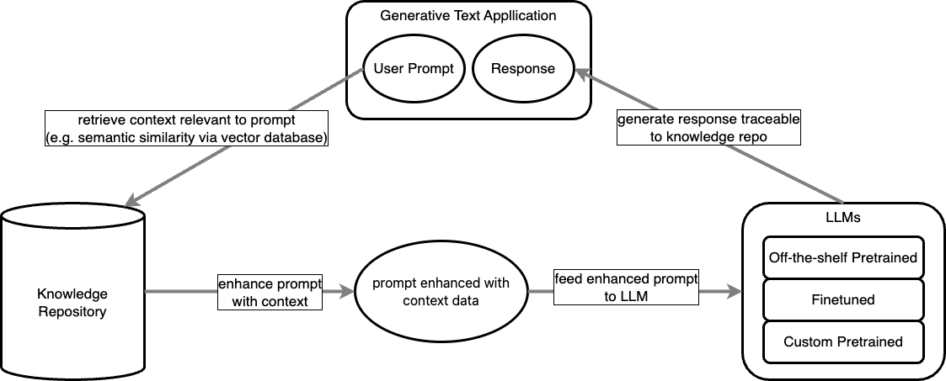
Retrieval-Augmented Generation (RAG)
Dynamic knowledge access: Instead of relying solely on static training, RAG systems retrieve up-to-date information from a structured knowledge repository (e.g., prior work, documentation, procedures).
Response traceability: RAG enables outputs to be linked back to their knowledge sources—critical for transparency, auditability, and trust in team settings.

Slide 27
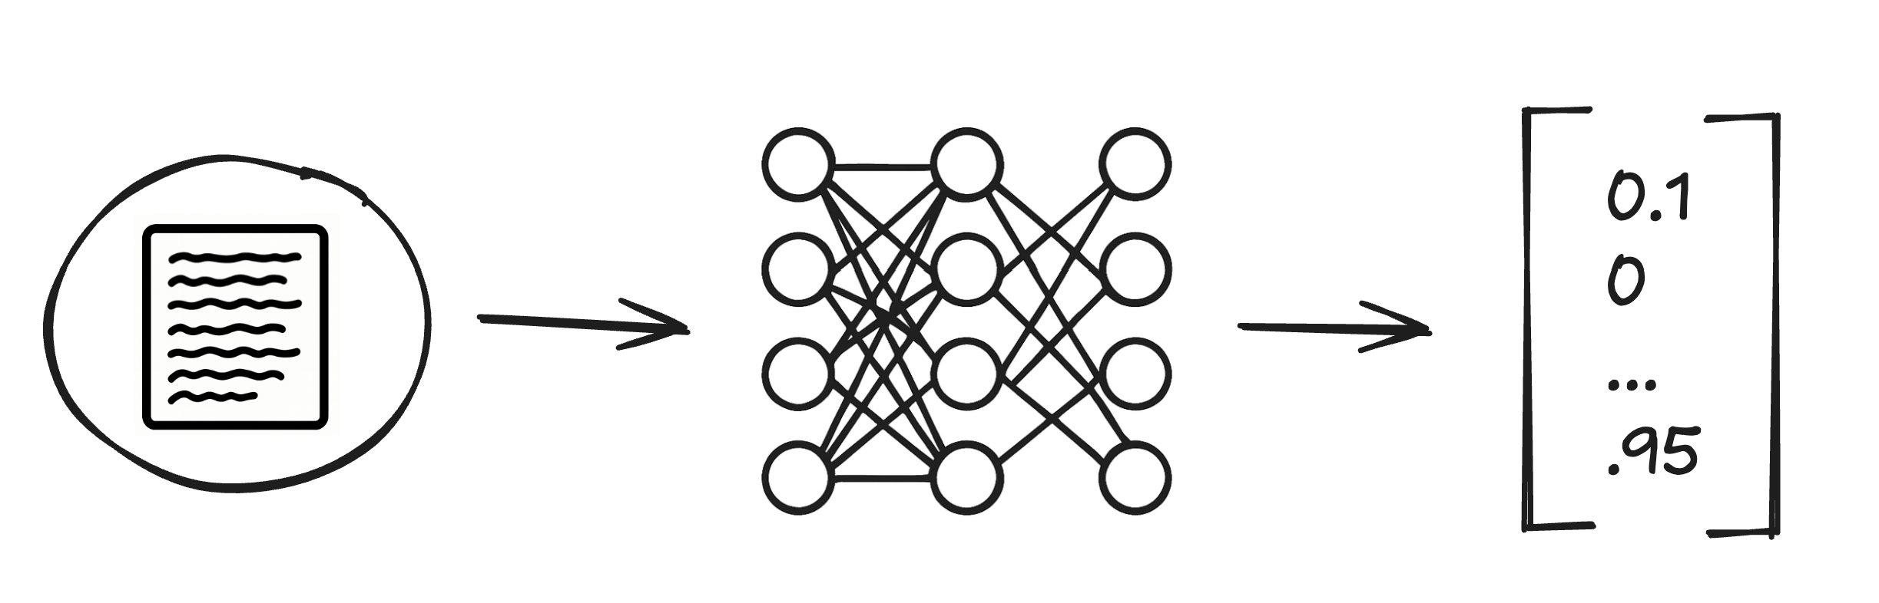
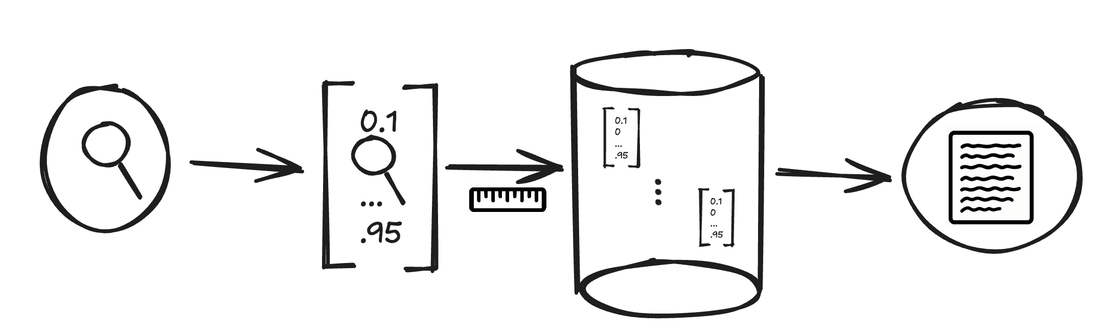
Embeddings and Semantic Retrieval
Text embeddings
  Semantic encoding: Captures the meaning of text beyond surface-level word forms
  Fixed-size vectors: Represents variable-length input (words, sentences, documents) as fixed-dimensional vectors
  Proximity reflects similarity: Similar meanings → vectors close in embedding space (e.g., cosine similarity).
  Contextual sensitivity: Embeddings reflect meaning based on surrounding text (especially with transformer-based models).
Semantic Retrieval through Vector Database
  Approximate nearest neighbor (ANN) search: Efficiently finds vectors semantically closest to a query
  Enables retrieval based on meaning rather than exact keyword matches
  Can combine semantic similarity with structured filters (e.g., tags, timestamps) for hybrid retrieval.

Slide 28
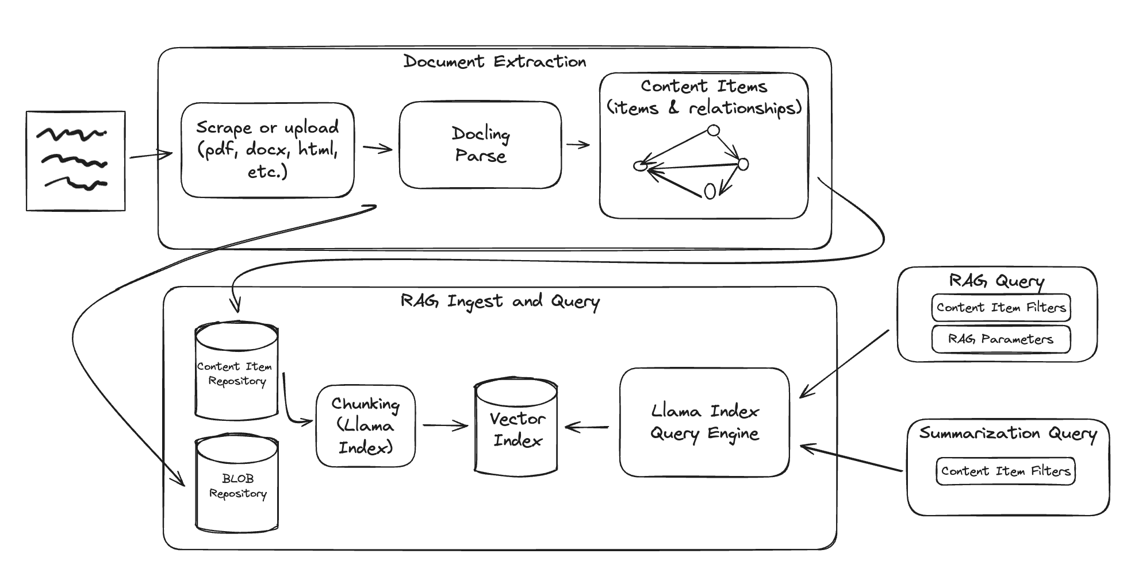
Operationalizing RAG
Extracting clean text content from documents is not trivial
  Each format presents its own challenges
  Multiple text columns
  Absolute positioning of text
  Libraries like Docling can help, but will never provide the 100% general solution
Large documents need to be chunked into small text blocks that can be retrieved as context for a query
At query-time, the ability to select specific sub-corpuses or perform term filtering can improve the results of semantic similarity search

Slide 29
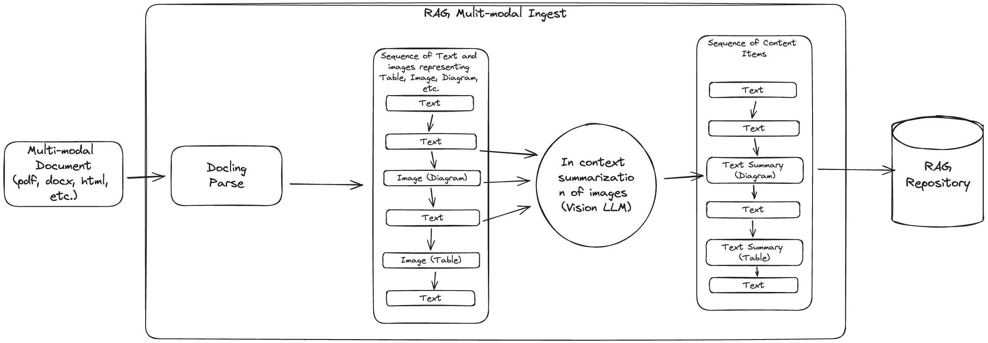
Multi-modal Document Ingest
PDFs, Word docs, Power Points, and HTML are multi-modal formats where critical information can be in non-textual form
Multi-modal documents can be extracted into linearized sequence of text, images, tables, and diagrams
Vision Language Models can be used to summarize visual elements within the context of the surrounding text
Multi-modal RAG query can retrieve based on text summaries, but re-summarize with respect to the query at generation time

Slide 30
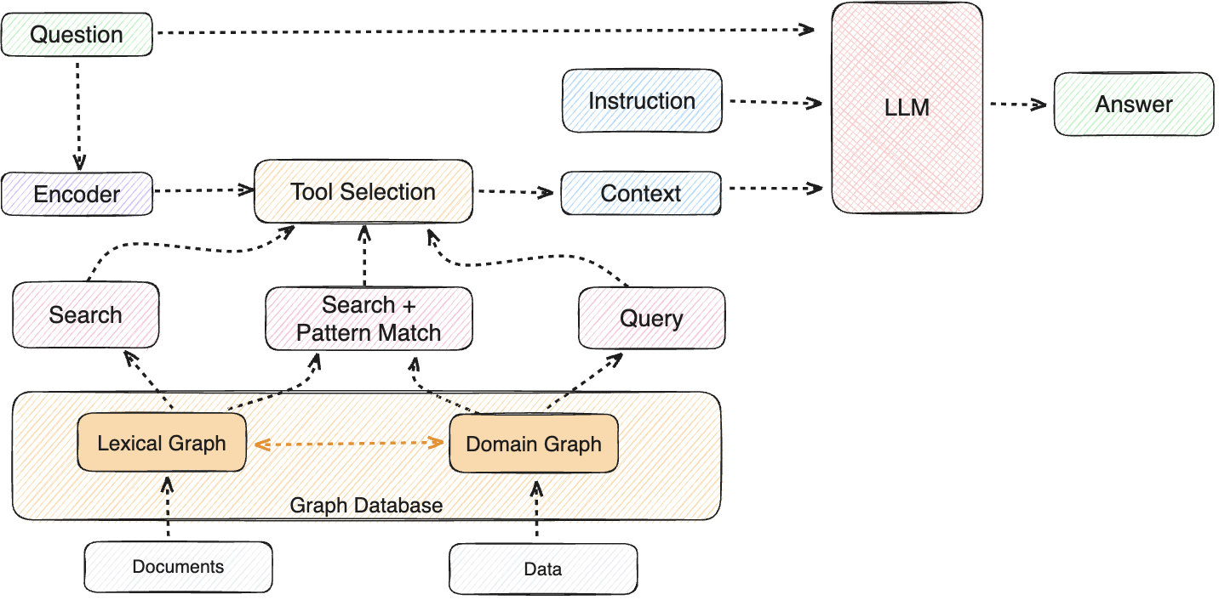
Graph RAG
Lexical Graphs:
  Nodes represent text chunks; edges connect chunks with overlapping vocabulary or key terms.
  Captures surface-level textual relationships—useful for bridging loosely related documents.
Domain Graphs:
  Nodes represent concepts or entities; edges encode expert-defined or data-derived relationships.
  Reflects structured domain knowledge (e.g., ontology, taxonomy, workflow).
Hybrid Graphs:
  Combine lexical proximity with structured domain edges.
  Enable both fuzzy similarity search and precise, logic-based navigation.
Use in Graph RAG:
  Graph traversal surfaces context-relevant nodes for prompt augmentation.
  Allows retrieval to follow meaningful paths—semantic, conceptual, or procedural—rather than relying on dense vector similarity alone
Source: https://graphrag.com/concepts/intro-to-graphrag/

Slide 31






AI Stack: Vector DB
Specialized options:
  Designed for high-performance similarity search and ANN (approximate nearest neighbor).
  Examples: Pinecone, Weaviate, Chroma, Faiss.
General-purpose databases evolving:
  Adding vector support to reduce stack complexity and leverage existing infrastructure.
  Examples: PostgreSQL (pgvector), OpenSearch, Elasticsearch, Neo4j (with graph + embedding synergy).
Considerations:
  Tradeoff between optimized retrieval performance and ecosystem integration.
  Evaluate scalability, hosting model (managed vs self-hosted), and hybrid retrieval support.
PostgreSQL

Slide 32



AI Stack: RAG Libraries
Simplify retrieval-augmented generation pipelines: chunking, indexing, retrieval, prompt construction.
Examples:
  LangChain, LlamaIndex, Haystack.
Trend:
  Increasing overlap with agent orchestration and tool use.
Considerations:
  Abstracts complexity but may constrain flexibility.
  Pay attention to how libraries manage prompt formatting, caching, observability.

Slide 33
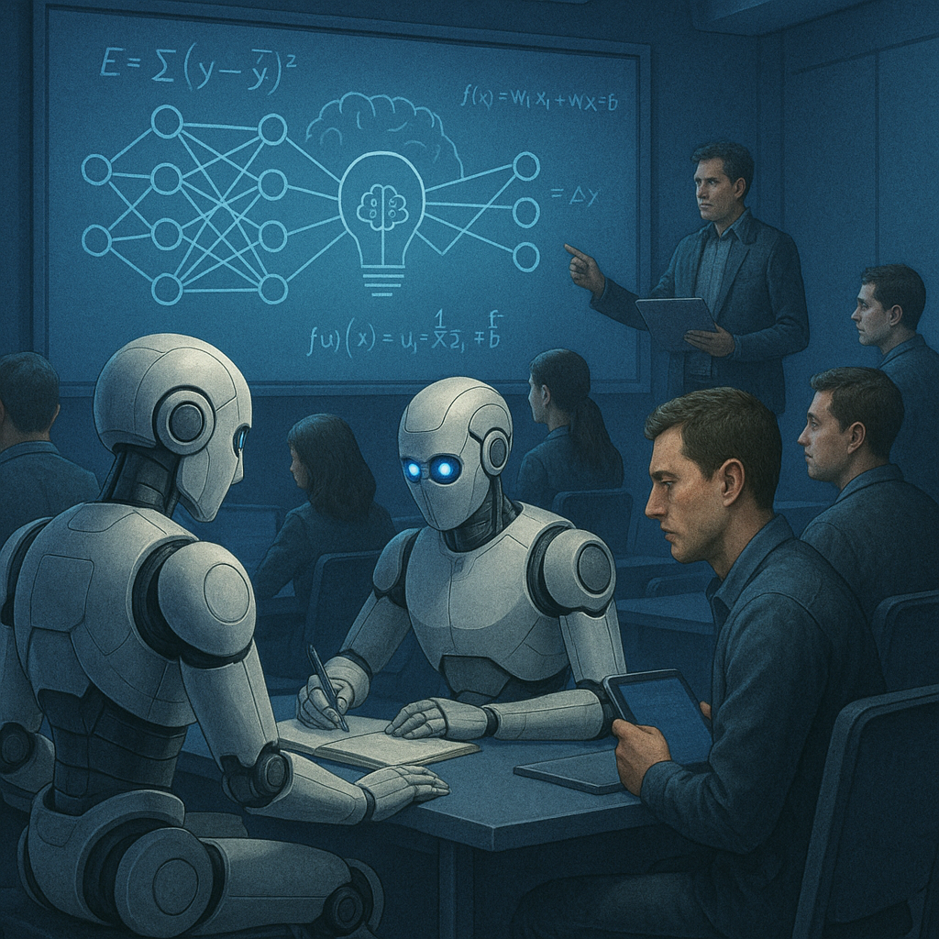
HAI Requirements: Learn
Effective human-AI teaming requires the ability to learn from experience, adapt to evolving conditions, and maintain awareness of team knowledge distribution
Short-Term Memory
  Maintain context across a current interaction or task thread
  Track immediate goals, decisions, and references
  Enable coherent multi-turn exchanges and follow-through
Long-Term Memory
  Retain relevant past interactions, outcomes, and decisions
  Generalize patterns to inform future behavior and recommendations
  Support personalization by adapting to user/team preferences over time
Transactive Memory System (TMS)
  Track who knows what across the team—both human and AI roles
  Identify and update responsibility assignments (e.g., who owns task X)
  Route questions and tasks to the right teammate (human or AI)
  Adapt to dynamic team structures (e.g., onboarding, departures)
  Maintain awareness of shifting roles, cross-training, or evolving expertise
Continuous Learning & Adaptation
  Incorporate user feedback (explicit and implicit)
  Adjust behavior based on task outcomes and social cues
  Identify and fill knowledge gaps
  Refine models of team norms, preferences, and communication styles

Slide 34
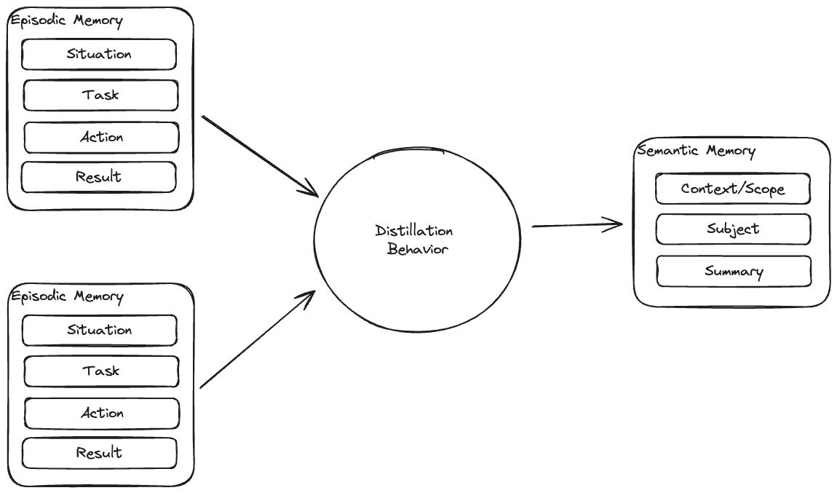
Agent Memory
Memory Architecture
  Episodic memory captures discrete past experiences
  Semantic memory stores distilled, generalizable knowledge
Memory Distillation
  Agents convert episodic memories into semantic knowledge through:
    Pattern recognition across tasks
    Outcome-based evaluation
    Abstraction of reusable knowledge
  This process is key for long-term learning and reducing redundant reasoning
Why it matters for HAI teams
  Builds agent understanding of domain norms, workflows, and best practices
  Enables agents to explain, justify, or revise behavior based on history
  Supports lifelong learning, contextual reasoning, and shared team memory

Slide 35
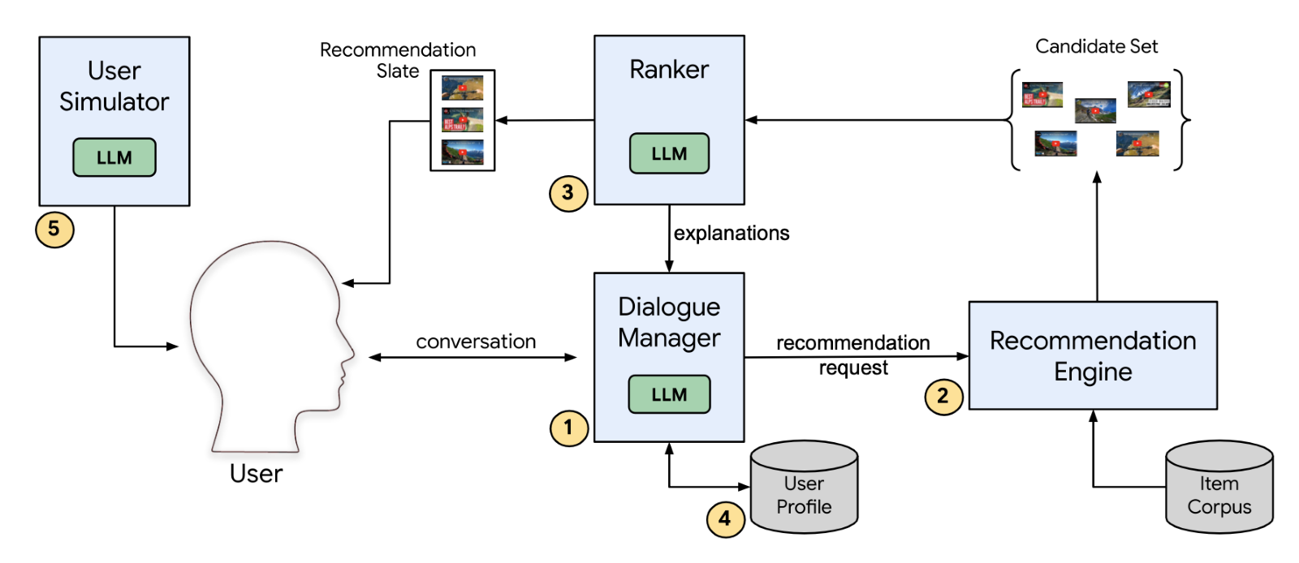
Natural Language User Profiles
Distil knowledge about a user into text form
Supports transparency because the user can understand exactly what the AI knows
User can proactively correct the AI understanding through editing text representation
Radlinski, Filip et al. 2022. “On Natural Language User Profiles for Transparent and Scrutable Recommendation.” In Proceedings of the 45th International ACM SIGIR Conference on Research and Development in Information Retrieval, 2863–74. doi:10.1145/3477495.3531873

Slide 36
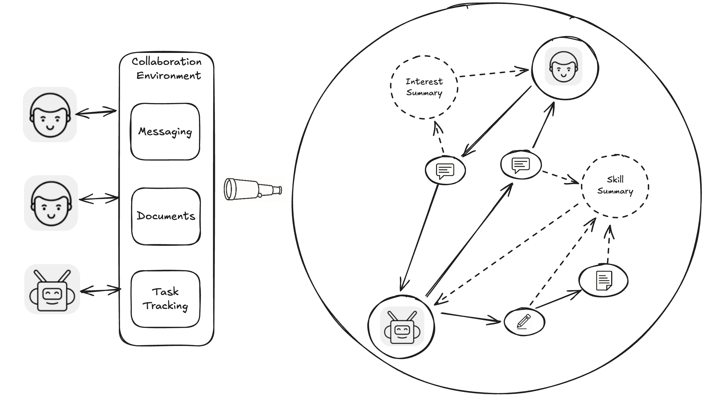
Artificial Transactive Memory System
Observing interactions with the environment allows inference of skills and interests of team participants
Represented as multi-layered knowledge graph

Slide 37
HAI Requirements: Action
AI must be able to take meaningful actions within team workflows, not just observe or advise.
Presence in Work Channels
  Operate directly in productivity tools (e.g., Word, PowerPoint, Excel)
  Integrate with coordination platforms (e.g., Jira, GitLab, Trello)
  Act within the same environments as human teammates to avoid friction
Reactive vs. Proactive
  Respond to human prompts and tasks (reactive)
  Anticipate needs, flag issues, or initiate steps without waiting (proactive)
Suggest / Recommend vs. Do
  Provide options or advice with rationale when appropriate
  Take autonomous action when trust, clarity, or low-risk conditions are met
  Allow human teammates to toggle between suggestion and execution modes
Create Content
  Draft reports, slides, summaries, plans, or code
  Refine and iterate based on feedback
  Match tone, structure, and format to team norms
Plan and Coordinate
  Help define milestones, dependencies, and task breakdowns
  Track progress, flag blockers, and reassign work as needed
  Align actions with shared team goals and timelines

Slide 38
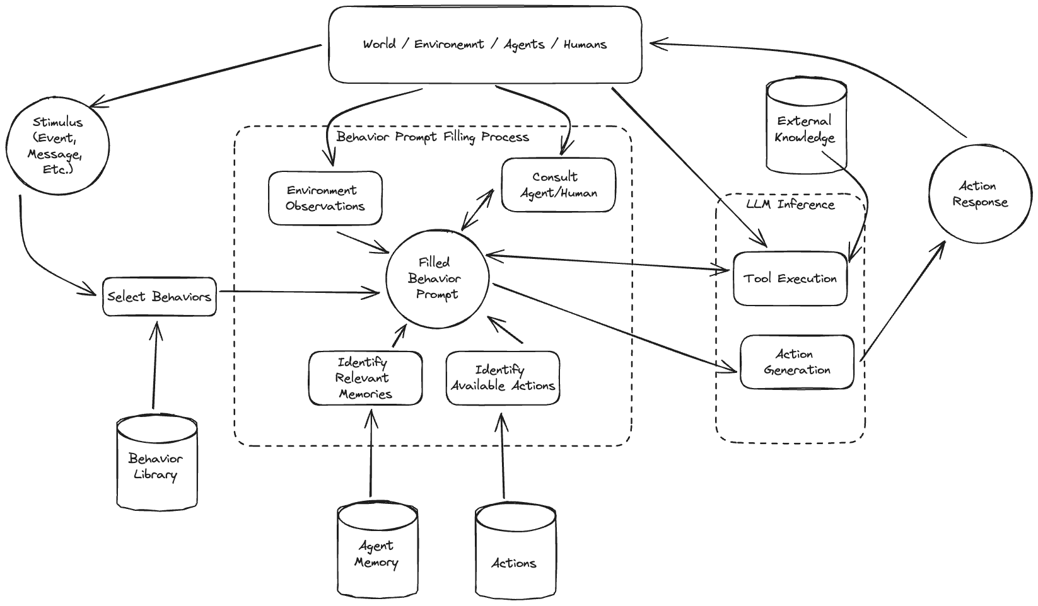
Agentic Systems
Observing the environment
Reacting to stimulus
Reasoning over current situation as well as historical
Acting in environment

Slide 39
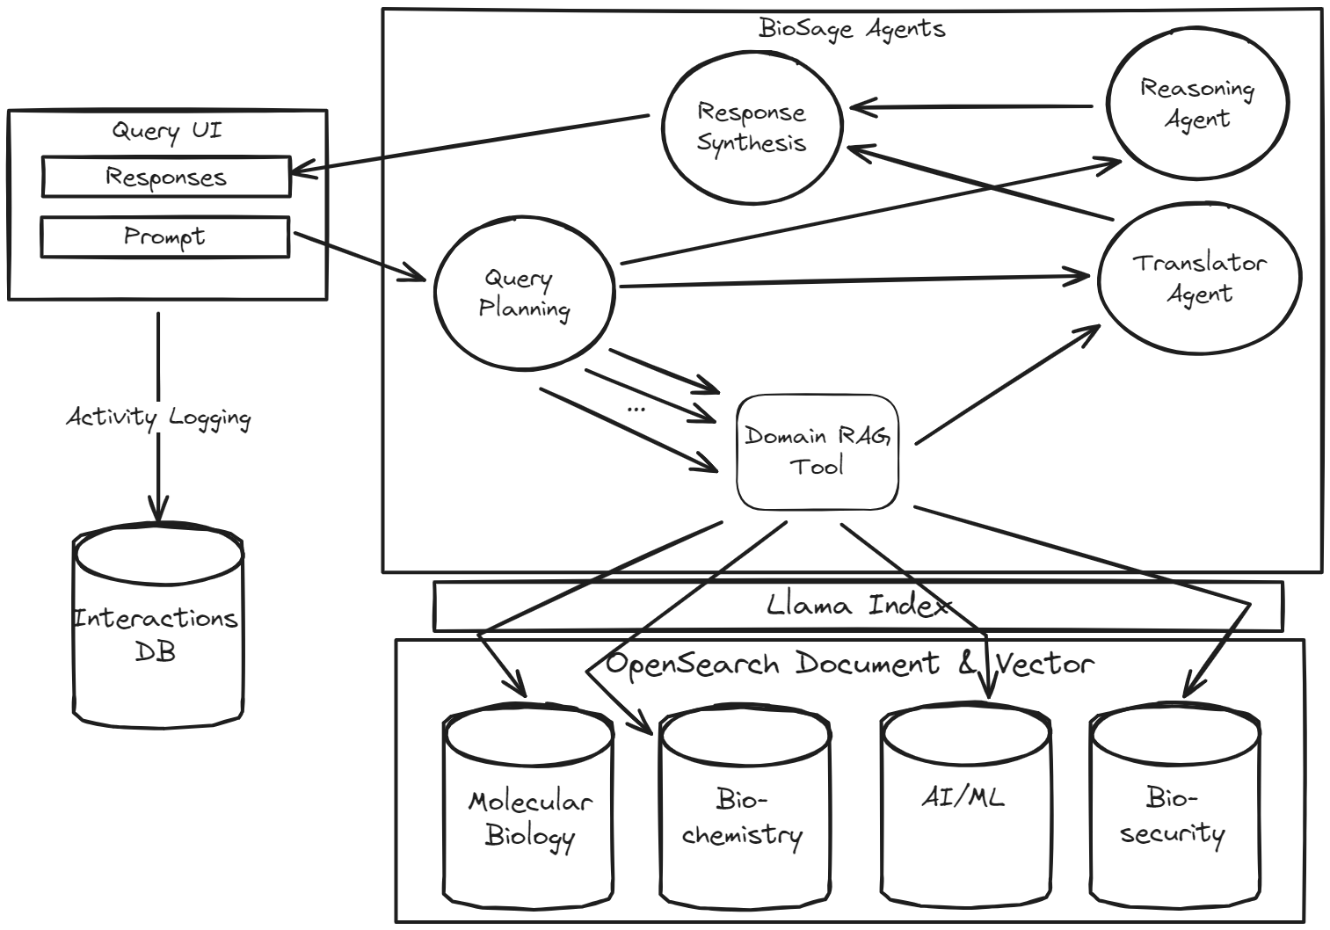
Example: BioSage
Defined AI agent roles & communication patterns with other agents and humans
Problem decomposition
Coordinating across multiple experts

Slide 40



AI Stack: Agent Frameworks
Enable autonomous and semi-autonomous behavior using LLMs with memory, planning, and tool-use capabilities.
Examples:
  AutoGen, PydanticAI, LangGraph, CrewAI, AutoGPT.
Trends:
  Rapid evolution; early-stage fragmentation; emerging standards for agent memory and coordination.
Considerations:
  Many frameworks tightly couple to specific models or libraries—watch for lock-in.

Slide 41
AI Stack: Cross-Cutting Concerns
Speed vs control:
  Rapid prototyping tools help validate value, but may become bottlenecks in production.
  Plan migration paths from POC to robust infrastructure.
Standard software architecture principles still apply:
  Favor stability, avoid vendor lock-in, and prioritize modular designs with defined APIs.
  Isolate unstable components behind stable abstractions
Observability and debugging:
  AI pipelines require inspection at multiple levels: retrieval logs, prompt traces, model outputs, tool calls.
  These are complex, non-deterministic distributed systems!
Choosing no-framework is a valid decision

Slide 42
Conclusion
Grounding in team science and innovative architecture are both critical for successful HAI implementation
Teaming frameworks like TMS and shared mental models teach us ways to build AI that participates in teams
AI capabilities and architecture techniques are advancing rapidly
  It is increasingly feasible to integrate AI as a teammate
Building AI teammates instead of just tools allows
  Optimal user-centered workflows
  Adaptive interaction and agent performance
  Successful integration of AI with shared trust and improved team outcomes

Slide 43


Thank you!
Questions?
Dr. Zach Klinefelter
Senior Scientist
Lead, Collaborative AI Science
Aptima, Inc.
zklinefelter@aptima.com
Gabe Ganberg
Chief Architect
Technical Operations
Aptima, Inc.
ganberg@aptima.com

