Slide 1
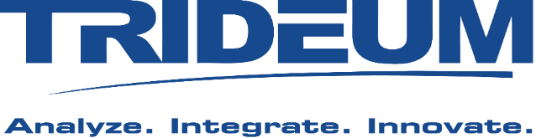

LVC Interoperability 101
Mr. Kurt Lessmann
Chief Technology Officer
Trideum Corporation
Mr. Damon Curry
President
Simulation Interoperability Standards Organization

Slide 2
Agenda
Learning Objectives
LVC Interoperability Overview
Interoperability Through Standards
Interoperability Using Gateways and Cross Domain Solutions
LVC Interoperability Use Case
Summary

Slide 3
1. Learning Objectives
This tutorial provides high-level insights about Live, Virtual and Constructive (LVC) interoperability.
The tutorial’s target audience consists of:
  program managers
  decision-makers
  anyone new to Live, Virtual, and Constructive (LVC) systems and applications
Desired Learning Outcome: a top-level understanding of LVC concepts, technologies, supporting standards, and processes, presented via:
  Overview: recommended concepts, processes and tools to achieve interoperability
  Use Case: demonstrating interoperability solutions meeting a military training need
  Summary with Recommendations

Slide 4
What's New?
This tutorial is an overview of Live, Virtual and Constructive (LVC) interoperability technologies and process
The material found in this tutorial receives periodic updates to provide additional clarity when presenting key definitions, processes or technologies
Recent updates include
  Updated architectural advancements from the major LVC solution providers
  Revisions to critical definitions to provide additional clarity
  Information that describes Interoperability vs Interconnectivity
  Enhancements to Cross Domain Solution and Gateway descriptions
  Enhancement of the LVC use case found at the end of this tutorial
Notes:
Thinking we need to describe simulation and interoperability

Slide 5
2. LVC Interoperability Overview
Simulation Definitions
LVC Interoperability Definitions
Distributed Environment Overview
Notes:
Thinking we need to describe simulation and interoperability

Slide 6
LVC Interoperability Overview
Simulation: a software model that runs over time
Simulation Interoperability: the ability of connected components and systems to communicate and function together
Combine interoperable components to create an application
Compose a system of multiple applications
Combine systems to create a System of Systems (SoS)
Notes:
Thinking we need to describe simulation and interoperability

Slide 7
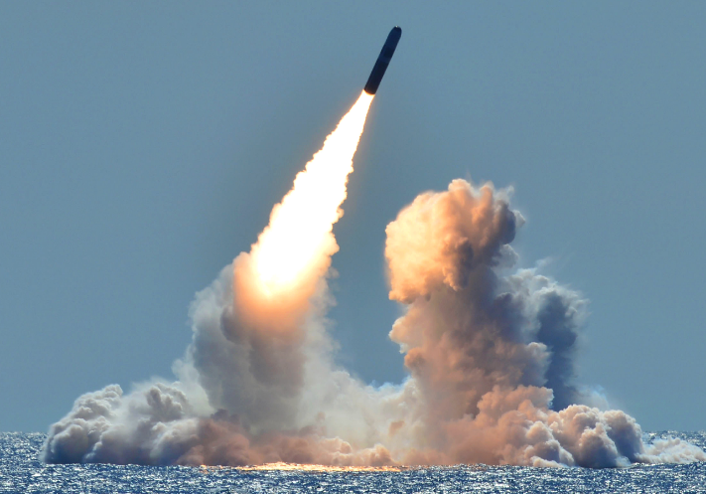
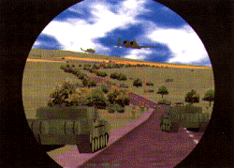
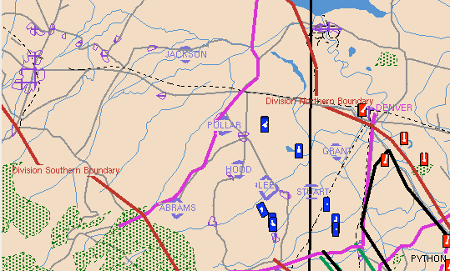
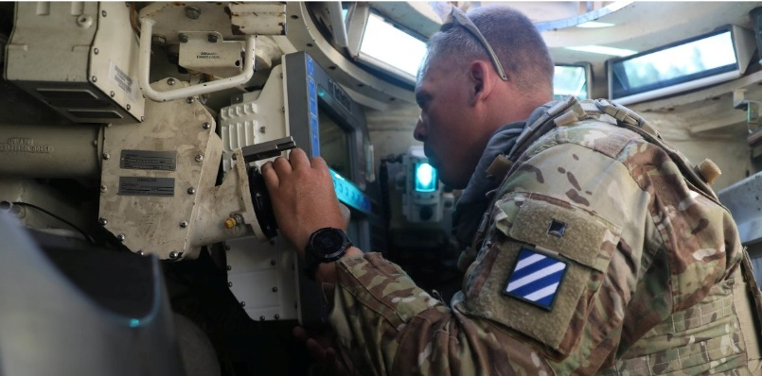
Live Virtual Constructive (LVC) Definition
Live Simulation
Real people operating real systems
Virtual Simulation
Real people operating simulated systems
Constructive Simulation
Computer-generated entities and behaviors
Real people
Real systems
Real environment
Real-time
Real people
Various platform simulators
Virtual environment
Real-time
Computer Generated Forces (CGF)
Virtual environment
Real-time or Faster/Slower than real-time

Slide 8
Distributed Simulation
A distributed simulation:
  Involves several independent processes executing on one or more computational nodes
  Ideally is loosely coupled having minimal dependencies on each other
    simulation terminology: “loosely coupled” = “federated”)
  Interoperates using a common services and/or protocol over a network
  Allows components to be interchanged, replaced or upgraded easily
  Add more computational power easily, if needed
  Allows growth over time
Notes:
Thinking we need to describe simulation and interoperability

Slide 9
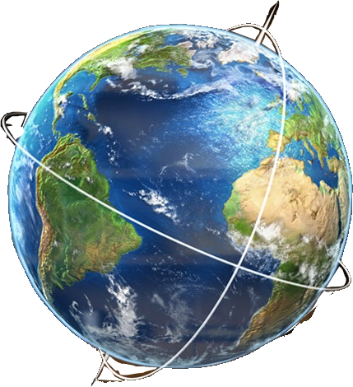
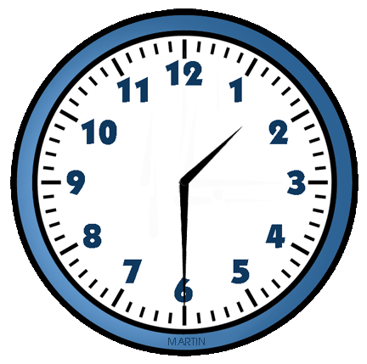

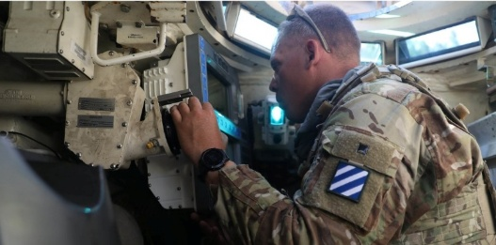
Distributed LVC Event
Distributed LVC Event
  An activity to integrate and execute LVC simulations in a virtual environment so that “real-world” processes and “things” can be exercised to investigate and solve complex issues
  LVC events support and improve Training, Experimentation, Research, Development, Test and Evaluation (RDT&E), and many more
  LVC events improve effectiveness, reduce risk, reduce cost
+
+
=
Common Understanding of Time
Real-time, faster than real-time or slower than real-time)
Interoperable LVC models or systems
Virtual or Real
Environment
Distributed LVC Event
Notes:
Thinking we need to describe simulation and interoperability

Slide 10
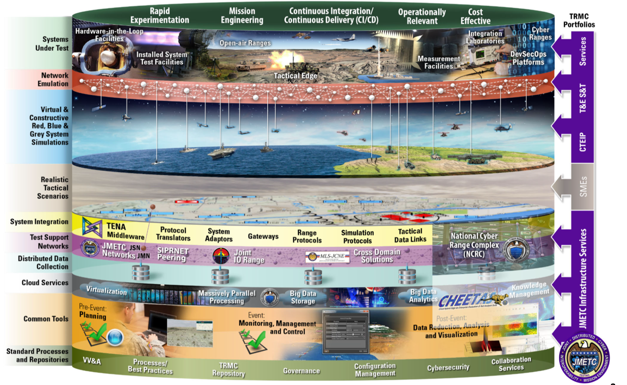
LVC Distributed Event Environment
Test Resource Management Center (TRMC) Joint Mission Environment Test Capability (JMETC) depiction of an LVC Event Environment
A concept of layered and interoperable solutions is the key, not the details

Slide 11
Interoperability Requirements
Live, Virtual, and Constructive (LVC) Interoperability is a foundational concept in modern military training, modeling, and simulation.
  It allows real-world systems (Live), human-in-the-loop simulators (Virtual), and computer-generated entities or environments (Constructive) to operate together seamlessly as part of an integrated training or experimentation environment.
Interoperability requires
  An ability to meaningfully communicate
    A common “language” to describe the LVC systems
    A data distribution mechanism with well-defined rules and/or services
    A reliable network
  A common context
    A common understanding of the environment and time
    A robust common technical process

Slide 12
Typical Interoperability Discussions
It’s a unique language and skill set that takes time to understand and adopt
  Involvement with the interoperability community optimizes this process
Applying standard architectures, processes, technologies and lexicon is a key to success
What is the Information Data Exchange Model?
Step 1: What is the conceptual model of the entire exercise?
What coordinate systems are used? Conversions?
What logical sequences of interactions are required?
Fair fight?
What algorithms (such as line of sight) need to be shared?
What object names (markings) are used? Object types?
What representation of the environment is used?
Time handling? Start/Stop? Freeze? Restart? Scenario handling?

Slide 13
Identify Integration Process
Suggested standards and guidelines include
  IEEE Std 1730-2010 - IEEE Recommended Practice for Distributed Simulation Engineering and Execution Process (DSEEP)
  IEEE Std 1730.1-2013 - IEEE Recommended Practice for Distributed Simulation Engineering and Execution Process Multi-Architecture Overlay (DMAO)
  TENA Concepts of Operations (CONOPS)
HLA Distributed Simulation Engineering and Execution Process (DSEEP) Overview
  DSEEP (IEEE 1730-2010) was developed based on authoritative systems engineering processes that were adopted and extended to address distributed simulation requirements
  Identifies and describes the sequence of activities necessary to construct and run distributed simulations
  DSEEP is a high-level process that is relevant to and can facilitate the development of solutions
  DSEEP is independent of interoperability architectures
Define Simulation Environment Objectives
Perform Conceptual Analysis
Design Simulation Environment
Develop Simulation Environment
Integrate
and Test Simulation Environment
Execute Simulation Environment
Analyze Data and Evaluate Results
1
2
3
4
5
6
7

Slide 14
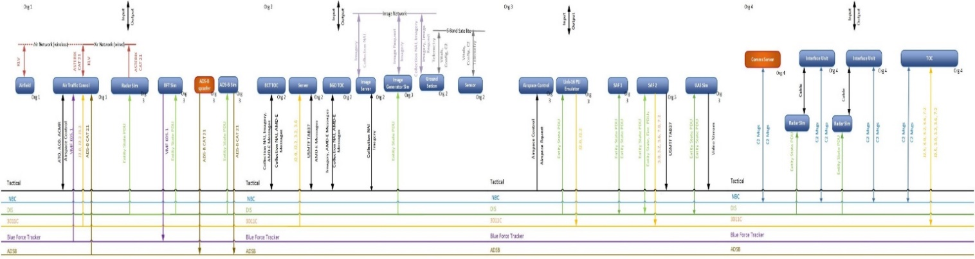
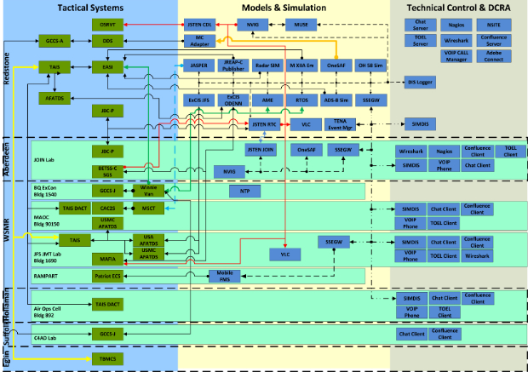
Focus on Integration Process and Communication
example interface matrices and diagrams
Integration process tools are effective at communicating event design across the team
  Clear communication reduces risk and optimizes event execution and data collection
  These diagrams ensure clear communication and ensures event implementation mirrors design
  Key data includes: Location, IP, Port, Protocol, messages, and system name

Slide 15
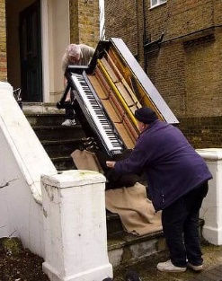

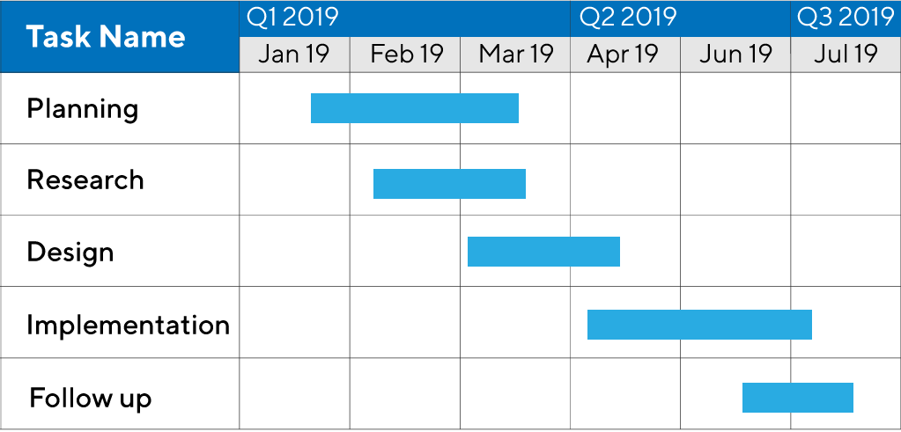
3. Interoperability through Standards
The Value of Standards
  Save Money
  Save Time
  Reduce Risk
Past and Current Interoperability Standards
  DIS, HLA, and TENA
Recommended LVC Integration Approach

Slide 16


The Value of Interoperability Standards
Obsolete Method
Modern Method
Use my proprietary architecture!
No, use my proprietary architecture!
Open
Standards-Based
Solutions
Adaptable, Structured Data Model
Well-Defined Application Programmers Interface (API)
Proven, Well-Documented Integration Processes
No, no!! Use my proprietary architecture!
My proprietary architecture is really good.
Remove Stovepipes
Good for all
now and in the future
Good for me right now
16

Slide 17
Goals of Interoperability Standards
Technical Aspects
Business Aspects
Enable efficient distributed simulation
  Throughput, latency, scalability, etc.
Support simulation-specific requirements
  Not limited to data distribution
  Provide common services (Remote Methods, Time Management, Ownership (control over data elements), etc.)
Isolate simulator from physical transport method (i.e. network)
  Avoid technology lock-in
Promote interoperability and reuse
  Leverage existing solutions for other needs
  Increased customer support
Vendor independent
  Vendors and organizations equally comfortable with the standard
  Open standard for contributions and influence
  Easily replace interoperability implementation
Domain neutral
  Support the simulation market as a whole … multi-purpose
  Possibility to attract a large number of vendors and users
17

Slide 18

Interoperability Approaches of the Past
Standardize on a single vendor’s solution
  Usually, this approach was optimized for a specific need
  Created a vendor-lock situation for computers and/or software
Standardize on one computer programming language
  Usually, this approach was optimized for a specific need
  Problems arose when maintaining code developed using older programming languages and compilers … remember the mandate to use the ADA language?
These approaches made it very difficult to incorporate new software technologies, such as Service Oriented Architectures (SOA), cloud based solutions, scripting languages, etc.
  These approaches were adopted when reuse, composability, and interoperability were not high priorities
18

Slide 19

Modern Interoperability Approaches
Standardize on the Data Model
  Data Model is the defined (1) network protocol, or (2) network message format
  This approach defines the data needed to interoperate
Standardize on a software Application Programmers Interface (API)
  Provides a software interface to interoperability services and solutions for distributed simulations
Standardize on Processes
Do All Three!!
  These Modular Open Systems Architecture (MOSA) concepts enable success and solution flexibility … now and in the future
19

Slide 20
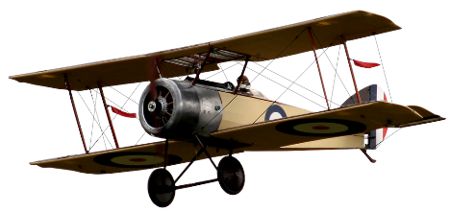

Interoperability Standard: Data Models
Enables semantic interoperability among simulation applications
Provides the “common language” that all simulation applications use to communicate
Data Model aka Object Model aka Data Exchange Agreement
Conceptual Level
common understanding of information
Object Model
A document describing the data that will be exchanged
<attribute>
…
<name> LandingLightsOn </name>
<datatype> boolean </datatype>
….
</attribute>
Pragmatic/Dynamic Level
common use of information
Semantic Level
information exchange
Syntactic Level
data exchange
“Airplane”
“Airplane”
Technical Level
networking
Levels of Interoperability (Dr. Andreas Tolk)
20
Notes:
The FOM describes the information exchange in a federation. It is different for defense, space, manufacturing, etc
The HLA standard defines a format or an Object Model Template for how to define the language needed to exchange the required data.
With the HLA Evolved update of the standard it is possible to use FOM modules and extend existing modules without ´breaking backward compatibility.

Slide 21
Interoperability Standard: API
An Application Programmers Interface (API) enables interoperability via standard services
  Time Management
    Manage and synchronize time between participating applications
  Quality of Service (in simulation)
    Services that manage how data is distributed on the network
  Ownership Management
    Transfer of modelling responsibility/control from one participating application to another
  Data Distribution Management (DDM)
    Data filtering based on regions or any other attribute, to reduce data load
  Remote Method Invocation (RMI)
    Participating applications have methods that can be remotely invoked by other applications
  These services have made significant enhancements to LVC interoperability. Understanding these capabilities and implementing them using common practices improves performance and reduces risk.
21

Slide 22
Interoperability Standards: Integration Process
A well-defined Integration Process is critical to success
  The first step in planning an LVC Environment is to identify and adopt a proven process to support design, integration and execution of the environment
  To ensure the environment is designed and configured to meet the event requirements, a structured process is necessary to properly identify needs, designs and solutions
    Several standard, and proven, processes exist
    Do not add risk to your program by “winging it” through a complex endeavor

Slide 23
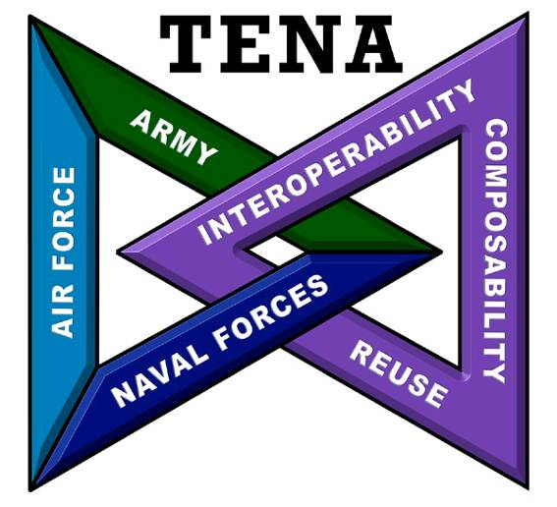
Open Standards
According to the Software Engineering Institute, a system is OPEN if:
  It is fully defined
  It’s readily available to the general public
  It’s maintained according to group consensus
Support organizations for Interoperability standards:
  Simulation Interoperability Standards Organization (SISO) www.sisostandards.org/
    SISO is the Simulation Interoperability affiliate of the Institute of Electrical and Electronics Engineers (IEEE) www.ieee.org/standards/index.html
  Joint Mission Environment Test Capability (JMETC) Configuration Control Board (CCB) www.tena-sda.org
23

Slide 24
The “Big 3” LVC Interoperability Architecture Standards
DIS standardizes the bits and bytes “on the wire” … how to format data on the network … down here.
Live
Virtual
Constructive
Network
HLA and TENA standardize on the connection API … up here.
Live
Virtual
Constructive
API
API
API
Middleware
Enterprise Service Bus (ESB) architecture
Network
24

Slide 25
The “Big 3” LVC Interoperability Architecture Standards
Distributed Interactive Simulation (DIS) - IEEE 1278
  Protocol standard
  Covers several levels of interoperability
  Broadcast/Multicast UDP (Best effort) is required
OPEN Interoperability Standard:
Data Model
High Level Architecture (HLA) – IEEE 1516-2025 and NATO STANAG 4603
  API standard
  Separate semantic model expressed in a (Federation) Object Model
  Services standard – A rich set of interoperability services
OPEN Interoperability Standard:
Data Model, API & Process
Test and Training Enabling Architecture (TENA)
  API standard –auto-generated user software for quality & usability
  Semantic model expressed in a Standard Object Model
  Includes standard object model, extensive middleware services and a set of interoperability & event support tools
US GOVT Interoperability Standard:
Data Model, API & Process
25

Slide 26


Timeline Of Interoperability Standards
TENA v6.1
2025
DIS v8
2023
Space FOM
2026?
NATO standard NETN FOM
2018
Compressed
DIS
TENA v6.0.x
2013
DIS v7
2024
2010
TENA
2012
2002
HLA 1516
2000
1999
RPR FOM
HLA
ALSP
1998
DIS
1990s
1993
SIMNET
1980s
26

Slide 27
Interoperability vs Interconnectivity
Data Distribution Service (DDS)
  API standard
    Available through the Object Management Group (OMG) … www.omg.org
    For real-time interconnectivity of systems exchanging data via DDS
    Common application is for “Internet of Things” (IoT), to enable interconnected systems to exchange data over a network
  DDS uses some similar concepts as TENA and High Level Architecture (HLA)
    Publish-Subscribe architecture
    Data model … HLA has a “Federation Object Model” … DDS has a “Data Space”
  Targeted use = interconnectivity, e.g. Internet of Things (IoT) applications
  Does not provide runtime interoperability services (e.g. time management) like HLA
  Cannot be used in place of HLA but could be used in conjunction with HLA
  Often confused item:
    HLA has run-time management software: “Run Time Infrastructure” (RTI) … DDS has no equivalent
    The best known company providing DDS software is “Real-Time Innovations” (RTI)
27

Slide 28
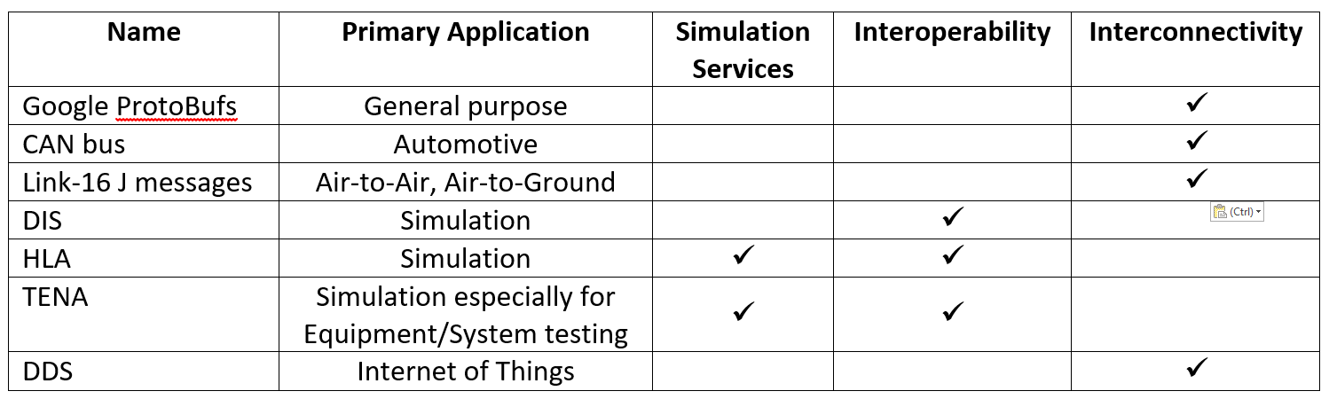
Interoperability vs Interconnectivity
LVC “Interoperability” requires data exchange with other systems without requiring modification to already connected systems, thus permitting flexible connections.
“Interconnectivity” involving some data exchange protocols requires system-wide changes, recompilations of source code, re-linking to new software libraries, etc, thus implementing specific connections.
Many (an infinite number?) of data messaging methods exist. Examples are:
28

Slide 29
Distributed Interactive Simulation (DIS) Overview
Live
Virtual
Constructive
Network
DIS (IEEE 1278) is an “Over the Wire” specification
  Defines the structure of data sent over the network using a bit pattern known as a Protocol Data Unit (PDU)
  DIS is a binary protocol where individual bits are defined and bit order and byte order is mandated
  Defines behavior of message handling. Receiving participants must review each packet for applicability
  DIS does not include an “API”
  Follows the COTS and Open Source business models
  Primarily focused on military systems & requirements
DIS participants must Broadcast or Multicast data on a local network using UDP network transfer protocol
29

Slide 30
Distributed Interactive Simulation (DIS) Example PDU
Live
Virtual
Constructive
DIS ‘Entity Type’ Identification
Network
Entity Kind
Domain
Country
Category
Sub Category
Specific
Extra
8 bit enumeration
8 bit enumeration
16 bit enumeration
8 bit enumeration
8 bit enumeration
8 bit enumeration
8 bit enumeration
Examples: DIS ‘Entity Type’ PDU
  USAF F-16C Falcon
    Entity Kind = 1
    Domain = 2
    Country = 225
    Category = 1
    Sub Category = 3
    Specific = 3
    Extra = 0
  USAF F-22B Raptor
    Entity Kind = 1
    Domain = 2
    Country = 225
    Category = 1
    Sub Category = 6
    Specific = 2
    Extra = 0
Enumerations are listed in
SISO-REF-010
30

Slide 31
High Level Architecture (HLA) Overview
Live
Virtual
Constructive
Run-Time Services are provided by the Run-Time Infrastructure (RTI)
Federation Mgt
Declaration Mgt
Object Mgt
Ownership Mgt
Time Mgt
Data Distribution Mgt
API
API
API
Run-Time Infrastructure
Network
HLA provides services for simulation data exchange and coordination
Applications (simulations) access the Run-Time Services through a standardized application programmer’s interface (API)
A data model … Federation Object Model (FOM) … expressed in a standardized text file (in XML format), defines how objects interact with each other
Information exchange governed by Federation Agreements and supporting federation Information Data Exchange Models (IDEM)
  e.g. when, where and how to utilize the service to distribute data in order to exchange information
Uses COTS and Open Source business models
Federation Object Model
<FOM>
<Shared object classes>
<Shared interaction classes>
<More>
</FOM>
31

Slide 32
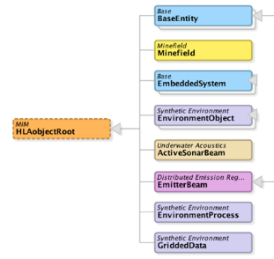
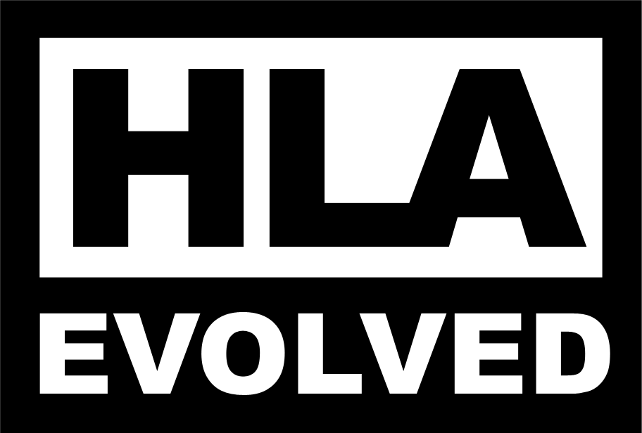










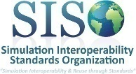
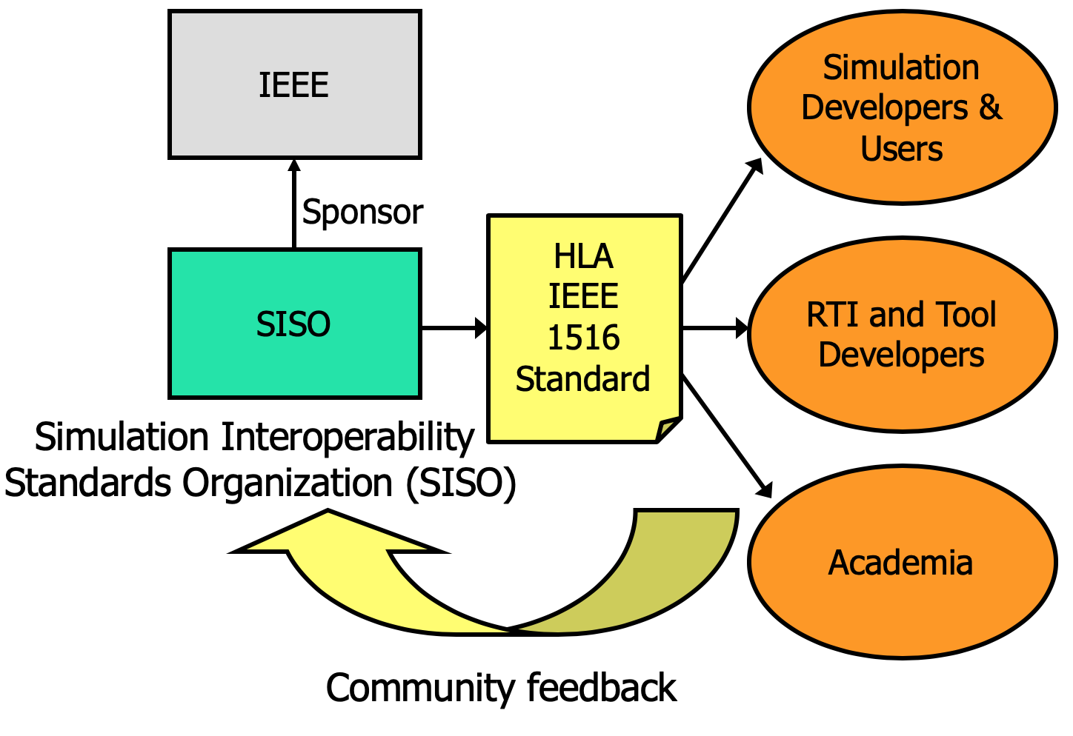

DIS and HLA Data Model & Standardization
Physical
Entities
Aggregates
Radio
Logistics
Synthetic
Environment
Objectification
HLA Real-time Platform Reference FOM (RPR-FOM) SISO-STD-001
Warfare
Underwater
Acoustics
Minefield
Simulation
Management
Emissions
DIS (IEEE 1278) Data Model
- Government
Industry
Academia
DIS and HLA are maintained through SISO
- COTS, GOTS
In-house
Open source
- Other
Research
Student projects
Courses
IEEE is the external standards body for SISO
32

Slide 33
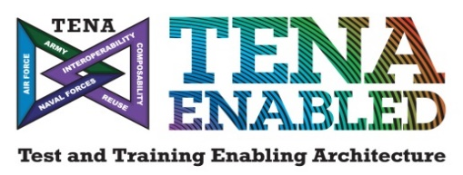
TENA Overview
TENA is the DoD GOTS live range integration architecture
What does TENA enable?
  Integration of Live, Virtual, and Constructive assets (locally or distributed)
  Interoperability between inter- and intra-range systems
  Sharing and reuse of common capabilities across existing and new investments
  Efficient upgrades to range capabilities
  Elimination of proprietary interfaces to range instrumentation
What is included in the TENA architecture?
  Customizable “data contracts” that standardize repeatable information exchange
  Interoperability-enabling, auto-code generated software libraries
  A core set of tools that address common test and training requirements
  Collaboration mechanisms that facilitate sharing and reuse
TENA continue to evolve with institutional funding from US DoD

Slide 34
TENA-Enabled Interoperability
Common specifications for test and training data
Data Dissemination across variable applications, platforms, programming languages, networks, and classification levels
Data Collection and Playback
Local and Remote Command and Control
Health & Status Monitoring
Simulation Interoperability (Virtual, Constructive, Digital Twin)
Integration of live sensors and instrumentation
Connecting range systems using Gateways, Adaptors & Transmogrifiers
Eliminating proprietary interfaces to range instrumentation
Sharing and reuse of common range tools and capabilities
Online Collaboration and File Sharing
Data Management
Event Management
LVC Integration
Sharing & Reuse

Slide 35
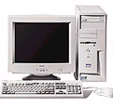
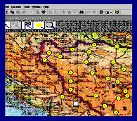
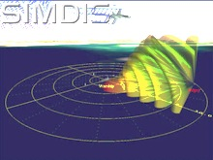
Test and Training Enabling Architecture (TENA) Overview
TENA Applications
TENA Tools
TENA Middleware
100% Government off the Shelf (GOTS)
  Initially developed to support the demands of live system testing
  Provides tools for common Event Planning, Execution, and Analysis functions
  Provides Subject Matter Experts to support distributed exercise and system integration
  Community-managed Open Architecture and Standards
  Constantly improved to meet new user requirements
  Download TENA Middleware and tool set
    www.tena-sda.org
HWIL
Range Resource
Application
Range
Resource
Application
Range
Resource
Application
Reusable
Applications
Reusable
Applications
TENA
Object
TENA
Object
TENA
Object
TENA
Repository
Logical
Range Data
Archive
TENA Middleware
TENA Common Infrastructure
Infrastructure Management and Planning Utilities
TENA
Data
Collectors
Repository Utilities
Gateways
Object Model Utilities
Non-TENA Communications
Non-TENA System
Non-TENA System
TENA Utilities
Non-TENA Applications
35

Slide 36
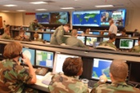
TENA Data Model & Standardization
The DoD maintains the extensive and extendable TENA Standard Object Model V2.0
TENA-LVC Object Models (OMs) align with DIS IEEE 1278 PDUs
“--” → “TENA-”
“Instr-” → “Instrumentation-”
--Exceptions
--Time
--TSPI
--Geospatial-Waypoint
--Geospatial-TSPIcovariance
--Geospatial-PointOfInterest
--Geospatial-LineOfBearing
--Hardware-System
--Hardware-PowerController
--AudioVideo-StreamDescriptor
--Instr-IFF
--Instr-LiftoffIndicator
--Instr-SpectrumAnalyzer
--Instr-TrackAzimuth
--Instr-TrackAzimuthElevation
--Instr-TrackRadialVelocity
--Instr-TrackRange
--Instr-Track-RangeAzimuth
--Instr-Track-State3D
--Instr-PointableSystem
--Instr-Telemetry-Docummutator
--Instr-Telemetry-Receiver
--Instr-Telemetry-AntennaControlSystem
--Instr-Optics-System
--Instr-Radar-TrackingSystem
--Instr-Radar-SurveillanceSystem
--WeatherServices-Parameters
--WeatherServices-Server
--Instr-Weather-Station
--LVC-Common
--LVC-EntityAppearanceCapabilities
--LVC-EntityType
--LVC-IDs
--LVC-Track
--LVC-Entity
--LVC-Engagement
--LVC-LVC-RadarSystem
36

Slide 37
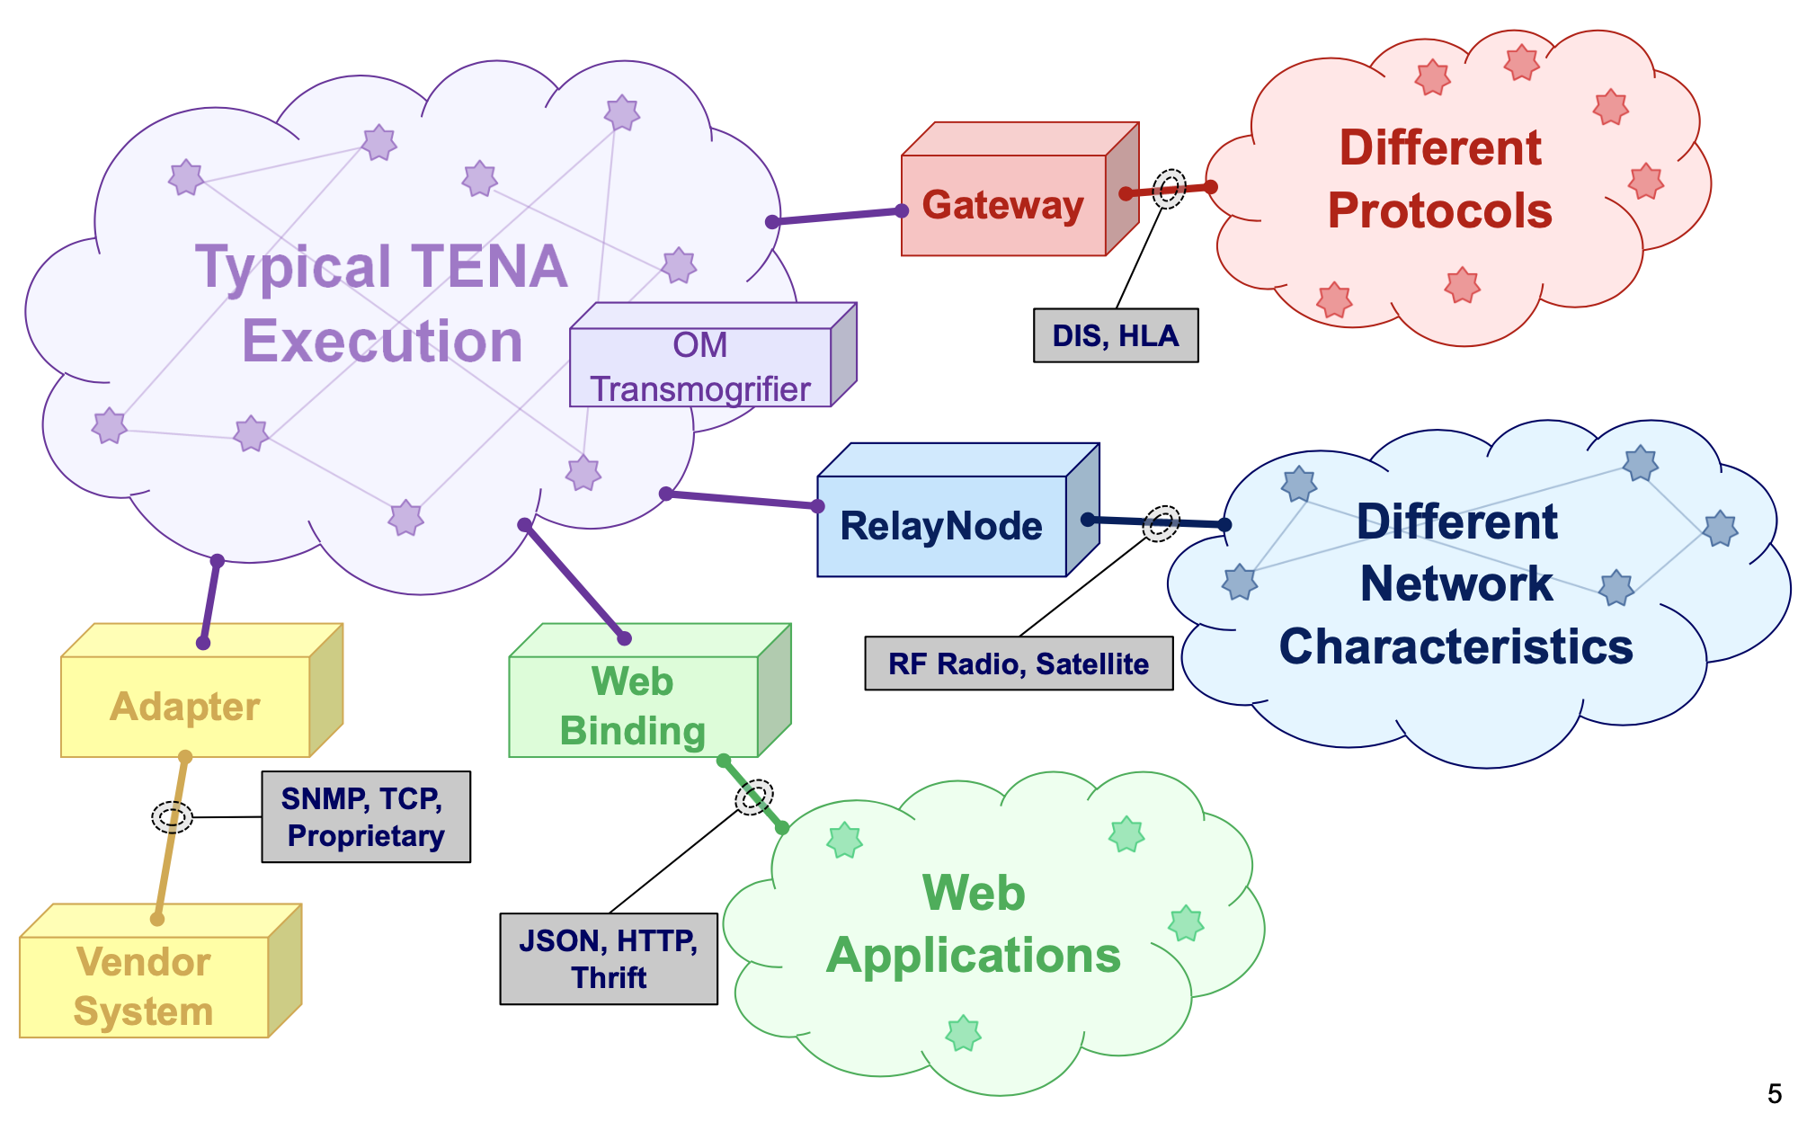
TENA-Enabled Interoperability
Gateways – Applications that enable interoperability with existing protocols (TENA to Many)
Adapters – Similar to Gateways but are purpose built to a legacy system (TENA to One)
Transmogrifiers – Fun name given to gateways that enable interoperability between legacy TENA and current TENA Object Models

Slide 38
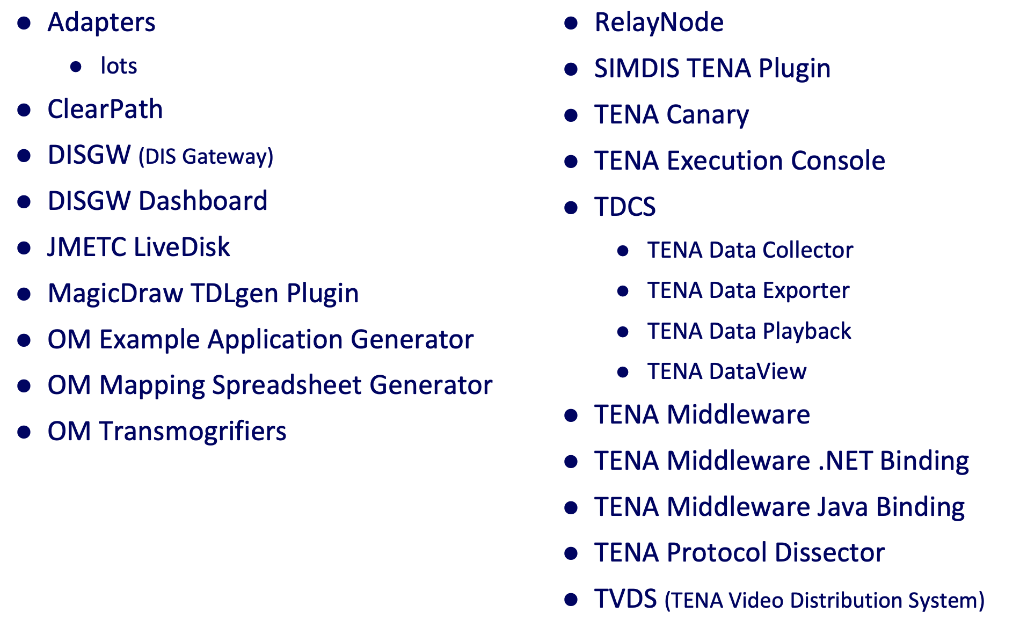
TENA Tools
38

Slide 39
HLA : TENA : DIS
HLA and TENA provide standard APIs for distributed simulation, while DIS defines a standard binary protocol for inter-federate communications.
  In other words, HLA and TENA provide you with a powerful software library of many complex functions, while DIS defines numeric values for entities, interactions, etc.
  When you need those complex functions in your DIS-based federation, to process the numeric values defined by DIS, you must code those functions.
If you need interoperability with DIS-based systems, consider these options:
  Purchase commercial off-the-shelf (COTS) software libraries or cloud solutions
  Develop “home-grown” (in-house) software, and plan to maintain it through its Life Cycle
  Search for open-source software --- modify as needed, and plan to maintain it through its Life Cycle
  Identify Government Off the Shelf (GOTS) solutions --- modify as needed, and plan to coordinate requirements and changes through your products’ Life Cycle
39

Slide 40
Recommended Integration Approach
Identify a Common Architecture
  Utilize horizontal integration using Enterprise Service Bus (ESB) concept (HLA, TENA, etc.) when possible
ESB Provides Ability to Meaningfully Communicate for Reuse and Composability
  Standard Data Model to describe the data communicated
  Standard Services Interfaces (API)
    Software provides the Standard Services using Standard APIs
          e.g. Services to distribute the data model
Subsystems are called Federates. The Integrated System is called a Federation.
Federates
API and
Data Models
Software infrastructure
40

Slide 41
4. Interoperability Using Gateways
Complex LVC environments may require interoperability between simulation federations using different architectures
Gateways are bridges between different simulation architectures
  Examples:
    TENA used at a test range interoperating with other facilities using DIS, HLA, or both
    A legacy DIS-based system interoperating with newer HLA-based systems
Example gateway
HLA/DIS Gateway
HLA 1516-2010
HLA
DIS
DIS v7
41

Slide 42
Interoperability Using Gateways
Gateways
  Translate data and services between different middleware, object models, and services
  Can filter data, transferring some data while blocking other data
  Can provide logging, monitoring, and detection and notification of errors or issues
Caution: Placing a gateway may create a single point of failure for the system
  Careful system design can minimize this potential problem.
A top-level “system design” trade-off analysis, considering schedules, costs, technical factors, etc., should determine which of two implementation methods is best:
  Selecting a common architecture for the entire LVC environment, or
  Implementing, integrating, testing, operating, and maintaining gateways.
42

Slide 43

Interoperability Using Gateways
Commonly used gateways are available as Commercial Off-The-Shelf (COTS) products from numerous vendors
  Check carefully the product’s list of translated data types, models, and services!!
TENA-related gateways can be downloaded from the TENA website
Sometimes unique modifications are indeed needed, especially when a gateway is interfaced to a “stove-piped” (non-standards-based) system
43

Slide 44
Multiple Levels of Security
Definitions:
Security Domain
  System or group of systems operating under a common security policy
Cross Domain Solution (CDS)
  An information assurance solution that provides the ability to access or transfer information between two or more security domains
  Enables data transfers between Unclassified, Secret, Top Secret, Top Secret/SCI
When establishing a complex distributed environment, information transfer between two or more security domains may be needed
  Most organizations do not have any effective means to address this issue
    As a result, too often the “solution” is brute-force denial of access to information, thus severely limiting system effectiveness

Slide 45
Purpose of Cross Domain Solutions
(totally open)
Level of Trust
(totally protected)
Rule Set
Logic, Math, & Comparative Operations
Low Security Domain
Network 1
High Security Domain
Network 2
Filter Decisions
Block
Sanitize
Pass
Enforces Relevant Security Classification Guidance
  The CDS default state is to block all traffic
  Data owner guidance is implemented through user-definable, event-specific, Rule Sets
  Rule Sets define if and how designated traffic can pass through
    Rules must support event objectives and classification guidance
      Logical operations (e.g. AND, OR, NOT)
      Mathematical operations involving object attributes (e.g. addition, subtraction, multiplication, division, exponents, logs, trig)
      Comparative operations (<, ≤, >, ≥, =): how object attributes relate to fixed values

Slide 46
CDS: Multiple Protocol Example
Gateways enable broader use of existing Cross Domain Solutions
Unclassified HLA Federation
HLA/TENA Gateway
CDS
TENA/HLA Gateway
Classified
HLA Federation
Unclassified Network
Classified Network
Our Example Above: Assumption #1: There are two federations running in different Security domains, each using HLA to interoperate
Assumption #2: The example CDS meets security requirements, yet has a native TENA interface
Solution: Use gateways to translate between HLA-based federations and TENA

Slide 47

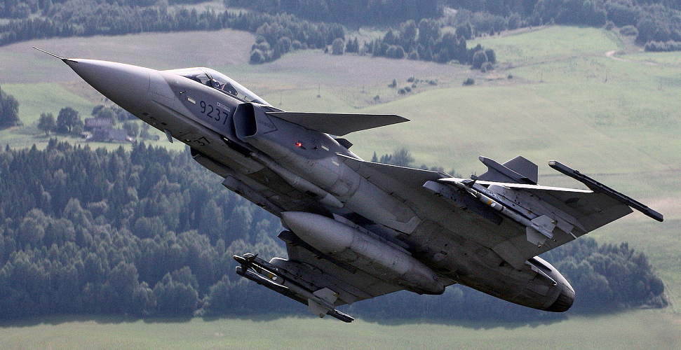
5. LVC Interoperability Use Case
The Task: A ground-based Command and Control (C2) system is being enhanced and must be tested.
  The present test method stimulates the C2 system under test with real data sent from a live aircraft via a Tactical Data Link (radio).
  This is a *very* expensive way to test a ground-based C2 system.
  Great savings would be achieved if the tests used a flight simulator instead of a real aircraft.
C2 system under test
Tactical Data Link (TDL), e.g. Link16

Slide 48
LVC Interoperability Use Case
An available flight simulator has a Link 16 “Data Link Processor” (interface), so the flight simulator can be used to stimulate the C2 system under test.
C2 system under test
Tactical Data Link (TDL), e.g. Link16
Data Link
Processor
  Everything’s good … right?

Slide 49
LVC Interoperability Use Case
Analysis of the “real world” reveals:
  The flight simulator has an older HLA 1.3 interface … and uses a vendor-modified version of the RPR-FOM (“Didn’t anyone tell them to avoid building stove-pipes?!!”)
  A scenario generator, with DIS & SIMPLE interfaces, is available to insert simulated tracks of other aircraft into the Link 16 network.
  The data link processor has a SIMPLE interface.
  Link 16 is represented in two ways, standards-based and non-standards-based.
C2 system under test
Tactical Data Link (TDL), e.g. Link16
HLA 1.3 with proprietary additions to FOM
Data Link
Processor
SIMPLE
DIS
Scenario
Generator

Slide 50
LVC Interoperability Use Case
DSEEP-driven feasibility study suggested:
  Use HLA as the common interoperability solution
  Insert an HLA to HLA bridge to filter/modify vendor-specific (non-standard) RPR-FOM extensions
  Use a gateway from HLA/RPR-FOM to DIS, to connect with the Scenario Generator
Some Limitations Accepted:
  Simulator data is accepted as the “ground truth”
  “J messages” from flight simulator are not bridged
  No voice communications
C2 system under test
Tactical Data Link (TDL), e.g. Link16
HLA 1.3 with proprietary additions to FOM
Data Link
Processor
standard HLA 1516
SIMPLE
Bridge
HLA 1.3 to
HLA 1516
Gateway
HLA-DIS
DIS
Scenario
Generator

Slide 51
LVC Interoperability Use Case
An integration spiral (test) demonstrated:
  Selecting HLA as a standard was appropriate due to HLA technology and performance plus existing HLA-based solutions and experience
  RPR-FOM extensions, HLA to DIS gateway, and HLA 1.3 to HLA 1516 bridge were acceptable
  The DIS network did not work due to computer clocks not being in sync (or set correctly)
  The scenario generator’s DIS interface only worked in one direction
  Security aspects needed further analysis
Success! Initial tests produced good results with previously known limitations
Additional actions required:
  Update the Scenario Generator’s DIS interface
  Get approval from responsible authorities to synchronize the computer clocks
  Get approval to run tests with a dedicated Link16 network and the participating real aircraft on the ground (when the flight simulator was not being used as a substitute for the real aircraft), to validate test data
51

Slide 52
6. Summary: Standards
There are several standards available for Live-Virtual-Constructive interoperability
  Some are especially made to support simulation
  Some are focused on use with live systems
Standards need to be maintained and updated
  New requirements emerge over time
Standards need to be balanced between stability and flexibility
  Stable enough to allow systems to be developed that support the same version of the standard
  Flexible enough to be useful and support current requirements plus new and evolving requirements

Slide 53
Summary: Standards (2)
Standards should not be selected only on technical merits
  A “Community of Users” helps tremendously
    Ensures long-term use of a standard … avoids obsolescence
    Promotes evolution of a standard
    Communication forum about common LVC applications, problems, and solutions
  Industry Support (the marketplace) is very important
    Government and Commercial Off-The-Shelf (GOTS/COTS) products generally cost less than custom-developed solutions
    On-demand training courses
    On-demand technical assistance
    Promotes adoption and evolution of standards (e.g. trade show demos)
Organizations should try to use a limited number of interoperability LVC standards
  Deviations must be expected to fit unusual situations
  Develops “in-house” skills and experience that will be needed on future programs
  Adopt Gateways as an initial approach to integrate disparate architectures

Slide 54
Summary: Standards (3)
Integrating LVC-based systems via distributed simulation is a powerful capability
  LVC interoperability across domains, e.g. involving multiple military groups, creates operationally realistic environments
        Supplementing a single system with other LVC systems greatly enhances realism of training
          The whole is greater than the sum of its parts
        Integrating C2 systems with LVC systems builds environments that are operationally realistic
            “Train As We Fight”
  Standards enhance integration and reuse of other LVC assets, tools and technologies
  Standards eliminate or greatly reduce time, cost, and performance risks of developing specialized systems (remember: “Avoid stove-pipes.”)
  Standards-based instrumentation and management functions within an environment provide coordination of planning and execution, data collection and analysis, and repeatability
  Leveraging existing standards and existing networks let program managers “do more with less”

Slide 55
Summary: Standards (4)
Distributed simulation has advanced greatly since first attempts in the 1980’s. Simulation developers today can establish LVC environments to solve very complex problems, at the System of Systems level, relatively easily and quickly.
  Selection of the appropriate interoperability architecture … DIS, HLA, or TENA … is sometimes at the user’s discretion, but other factors may favor one architecture over the others, such as technical features, the need to connect with systems already in place, or organizational policies.
  Be sure to choose between DIS, HLA, or TENA, based on current information!
    We’re in the year 2025 now, not 1986, 2000, or even 2020
Best advice …Get involved with the simulation community and standards organizations!!!
55

Slide 56
Bibliography
IEEE Std 1278.1-2012 - IEEE Standard for Distributed Interactive Simulation Application Protocols, IEEE Standard 1278.1, 2012.
IEEE Std 1516.1-2010 (Revision of IEEE Std 1516.1-2000) - IEEE Standard for Modeling and Simulation (M&S) High Level Architecture (HLA)-- Federate Interface Specification, IEEE Standard 1516.1,2010
IEEE Std 1516-2010 (Revision of IEEE Std 1516-2000) - IEEE Standard for Modeling and Simulation (M&S) High Level Architecture (HLA)-- Framework and Rules, IEEE Standard 1516,2010
IEEE Std 1730-2010 - IEEE Recommended Practice for Distributed Simulation Engineering and Execution Process (DSEEP) , IEEE Standard 1730, 2010
Powell, Edward, et al (2006). Test and Training Enabling Architecture (TENA) Architecture Reference Document (ARD), Office of the USD(AT&L) Test Resources Management Center (TRMC), 2016
Tolk, Andreas, et al (2003) The Levels of Conceptual Interoperability Model, 2003 Fall Simulation Interoperability Workshop, 2003
Websites
TENA Project: www.tena-sda.org

