Slide 1

Building the Bridge: Evolving V&V Methods to Address AI Driven Simulation
Simone M. Youngblood
The Johns Hopkins University Applied Physics Laboratory
240-228-7958 Simone.Youngblood@jhuapl.edu
Katherine M. Ruben
The Johns Hopkins University Applied Physics Laboratory
240-228-9148 Katherine.Ruben@jhuapl.edu

Slide 2
Building the Bridge Tutorial Learning Objectives
Primary Objective: Identify the challenges associated with Verification and Validation (V&V) of AI driven simulation.
Key Learning Objectives:
  Define and distinguish key verification and validation terms and basic concepts
  Construct an effective referent in non-ideal circumstances
  Match validation methods to the available referent
  Determine the unique V&V challenges applied to AI Models (e.g., Rule Based, Machine Learning (ML) Based)
  Characterize the applicable V&V methods and gaps associated with AI driven simulation
2

Slide 3
Presentation Outline
Building a strong verification case
  Leveraging existing verification data
  Leveraging developer testing
  Supplemental V&V testing
Building a strong validation referent
  Developing the referent as the basis for validation comparison
  Challenges and obstacles to developing the referent
  Best practices and obstacle mitigation
  SME Based Referents
Building a strong validation case
  V&V Methods Considerations
  Referent to Validation Method Mapping
Verification and Validation Challenges associated with Artificial Intelligence (AI) Models
  Basic AI Concepts
  AI Validation Methods
  Subject Matter Expert (SME) Review and Explainability
Verification and Validation Challenges associated with AI driven training simulation
  Contributions of AI to the M&S
  Training Applications
  V&V Challenges
Conclusions
3

Slide 4
Tutorial Motivation
Have spent years building a foundational understanding of Modeling and Simulation (M&S) Verification, Validation, and Accreditation (VV&A) by:
  Defining fundamental relationships and processes
  Enhancing the understanding of Validation techniques and the Referent
  Developing Policy, Recommended Practices and Guidance documents
There is a continuous need to evolve V&V to address:
  Increasingly sparse real world referent data
  Advances in simulation technology
  Integration with AI Machine Learning (ML)
The question to answer is:
  What does V&V of an AI ML mean?
  How does it differ or how is it similar to M&S V&V?
  What are the issues when you integrate ML and M&S?
4

Slide 5
Modeling and Simulation VV&A
5

Slide 6
Key VV&A Terms: Intended Use
Intended use The purpose for or function of a model; what the model will be used for; the problem to be addressed by the model. [DOD, 2012]
Characteristics [Piersall, 2014]
  “Not a capability, solution, or implementation”
  Expressed from the perspective of the user
  Should be formally specified
“Any attempt to suppress the role of the intentions of the investigator, B, leads to circular definitions or to ambiguities about essential features ...” [Minsky, 1965]
“Modeling and simulation is always goal-driven, … , we should know the purpose of our potential model before we sit down to create it.” [Cellier, 1991]
6

Slide 7
Key VV&A Terms: Verification and Validation
Verification The process of determining that a model implementation and its associated data accurately represents the developer’s conceptual description and specifications. [DOD, 2024]
  Transformational accuracy [Balci, 2002] - transform specifications to code
  Software engineering quality - Software engineering methods apply
Validation Determining the degree to which a model or simulation and its associated data are an accurate representation of the real world from the perspective of the intended uses of the model. [DOD, 2024]
Comparing model results with experimental data [Velten, 2009]
  Representational accuracy [Balci, 2002] - recreate simuland with results
  Modeling quality - special validation methods needed
Referent The body of knowledge available to the modeler or validation agent regarding the simuland.
  Quantitative and formal, e.g., differential equations for aircraft flight dynamics
  Qualitative and informal, e.g., pilot’s expectation of buffet before stall
7

Slide 8
Key VV&A Terms: Accreditation, Acceptance, and Certification
Accreditation The official certification that a model, simulation, or distributed simulation is acceptable for use for a specific purpose [DOD, 2024].
  Evidentiary requirements and acceptance / acceptability criteria are set by the accreditation authority
  Accreditation authority is granted by instruction
  Accreditation agents (usually independent of the developers and the accreditation authority organization) can be used to coordinate activities, provide assessment and make recommendations
Acceptance is a concept applied by organization if formal accreditation is not specified.
  Certification and / or accreditation is the outcome from an acceptance process
  Establishing acceptance / acceptability criteria is fundamental to the process
Model developer / Proponent may provide accreditation recommendation letters that a particular model or simulation provides a credible representation compared to the test objectives and intended use.
  Methods, techniques, and criteria are at the discretion of the developer
8

Slide 9
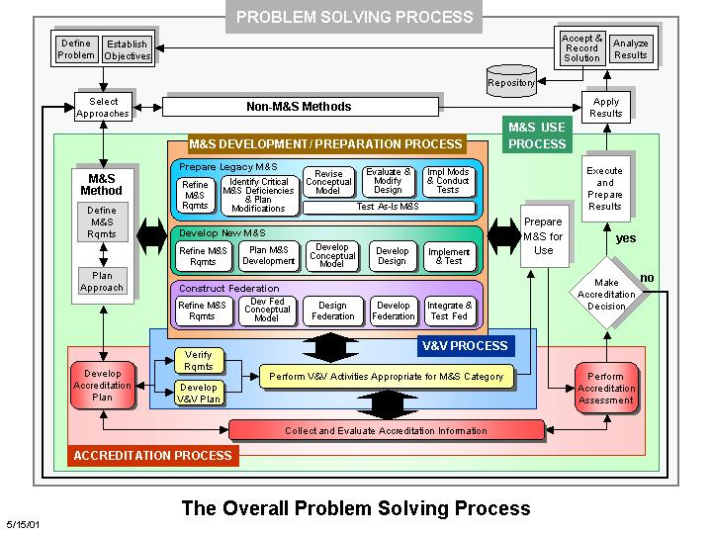
The VV&A Process Model
Plan the Accreditation Effort
Characterize the Simulation’s Use and define Objectives
Construct the Validation Referent
Plan the V&V Effort
Apply Relevant Historical Information
Verify & Validate the Simulation Conceptual Model
Perform Supplemental Verification
Apply the Verification Products to Validation
  Infer the Simulation Capabilities from the Verification Products
  Infer the Simulation Limitations from the Verification Products
  Infer the Information Gaps from the Verification Products
Verify & Validate the Data & Knowledge Sets
  Identify the Data & Knowledge Sources & Their Pedigrees
  Verify the Data & Knowledge Sets
  Validate Data & Knowledge Sets Where Needed
Validate Simulation Results
  Leverage Developer Test Results for Results Validation
Integrate the V&V Evidence
Develop the Recommendations for M&S Use
[VV&A RPG, 2011]
9

Slide 10
Tailoring the VV&A Processes
Use Risks
Use Risk from Unknown Simulation Uncertainties
Use Risk from Uncertainties in V&V Results
VV&A Resources
Time Available to Perform VV&A
Personnel Required to Perform VV&A
Information Available to Support VV&A
Consequences of Any Simulation Limitations on the Intended Use
Every VV&A problem is differs in
  Uses of simulations
    M&S requirements
    Tolerable use risks
  Resource constraints
    Available information
    People & skills
    Funding
    Time
  When VV&A starts in the simulation life cycle
No single set of VV&A activities & tasks can efficiently accommodate all of these differences.
10

Slide 11
Levels of M&S V&V
Level of VV&A | Impact on M&S Intended Use | Reliance on M&S | VV&A Level Description | Approximate LOE
Level 0: No Accreditation | Low | Supplemental Source used to address intended use | The defined M&S intended use(s) does not have a direct impact on program objectives so M&S is acceptable as is. | NONE
Level I: Survey | Low to Medium | Secondary Source used to address intended use | The intended use(s) to which the M&S will be applied has a potential impact on program objectives. An initial survey will be performed to determine the pedigree of the M&S and identify existing V&V information | 2 to 3 Weeks
Level II: Quick Look | Low to Medium | Secondary Source used to address intended use | The intended use(s) to which the M&S will be applied has a potential impact on program objectives. A follow-up assessment will be performed to determine the V&V status of the M&S. | 2 to 3 Weeks
Level III: Standard | Medium to High | Primary Source used to address intended use | The intended use(s) to which the M&S will be applied has a significant impact on program objectives. The standard VV&A assessment will follow processes defined in the DoD VV&A Recommended Practices Guide and VV&A Guidance. | 2 to 6 Months
Level IV: Independent V&V | High | Only Source used to address intended use | The intended use(s) to which the M&S will be applied has a critical impact on program objectives. The critical nature of the M&S application demands a third party, rigorous assessment. | > 6 Months
V&V Level of Effort (LOE) Balances M&S Impact vs. Reliance
11

Slide 12
Leveraging Developer Testing
Model/Simulation development undergo levels of testing
  Unit
  Pairwise
  Multi-way
  Integrated
  At scale
Simulation environment differences
Testing within federated environments
  Substitutes for interactions with M&S participants
Testing scope and negative testing
(CDC)
(IT&V)
12

Slide 13
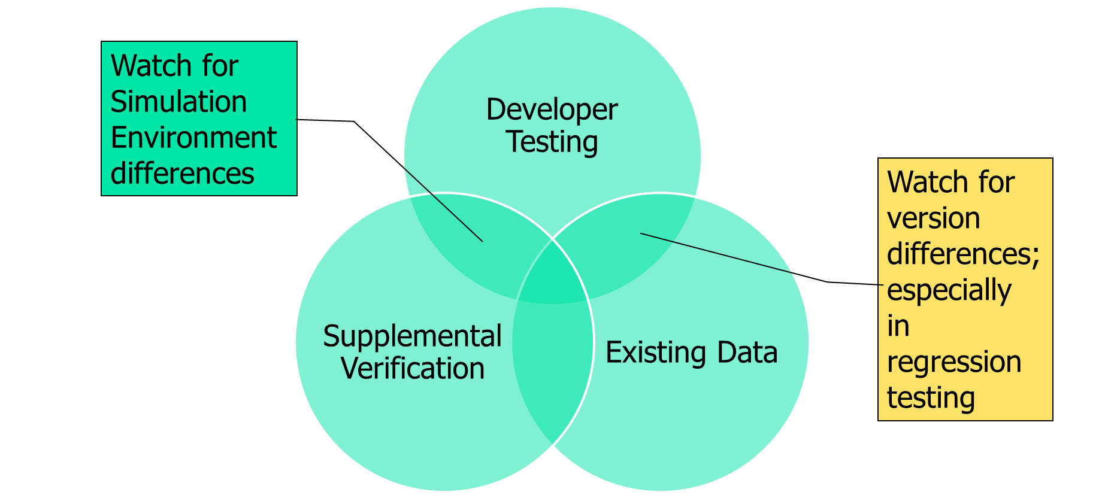
Supplemental Simulation Verification Testing
Supplemental is not Regression
Regression implies an exact duplication of previously executed testing
Supplemental may be
  Additional tests at the same level
  Test case replication at a different level
  Comparison between levels
Benefits from / for digital engineering
13

Slide 14
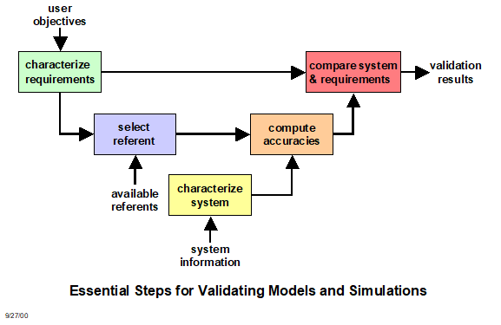
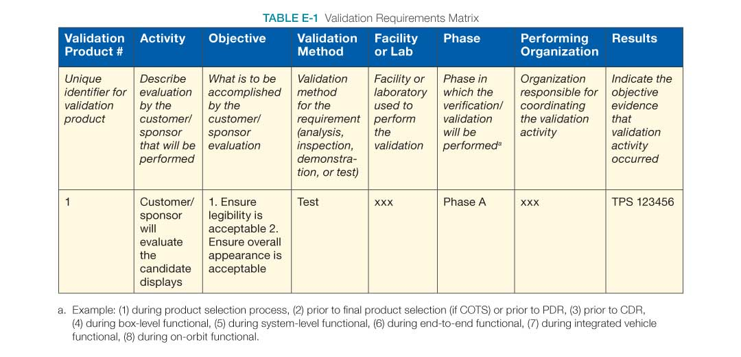
Essential Steps for Validating Models and Simulations
Sample Documentation
Downloaded from [NASA, 2023] on 6/21/23
14

Slide 15
M&S Validation and the
Validation Referent
15

Slide 16
The Ideal Referent
Covers the operational/domain space of interest as bounded by the intended use [Gilmore, 2016]
  Provides data on the aspects of the operational envelope/behavior space that will be covered by the M&S
  Addresses variations in factors affecting performance/behavior with regard to response variables of interest
  Supports interpolation between known data points vice extrapolation
Is drawn from observations of the simuland [RPG, 2011]
  Under controlled circumstances such as tests and experiments
  Under natural or operational circumstances
Is drawn from authoritative data
  Test data adjudicated by a Data Authentication Group review to address measurement errors, incomplete data, etc. [ATEC, 2004]
  Provides scenario information in a format that aligns with M&S inputs
Identifies any areas of known uncertainty
16

Slide 17
Referent Sources
Empirical data - observations of the simuland, collected either under controlled circumstances, e.g., tests or experiments, or in the field
Theoretical data - calculated using equations or algorithms that describe simuland characteristics, behaviors, and relationships; equations known or assumed to be correct
Simulation data - results generated by simulations; models known or assumed to be valid
Subject Matter Expert knowledge
Combinations of these
[VV&A RPG, 2011]
17

Slide 18
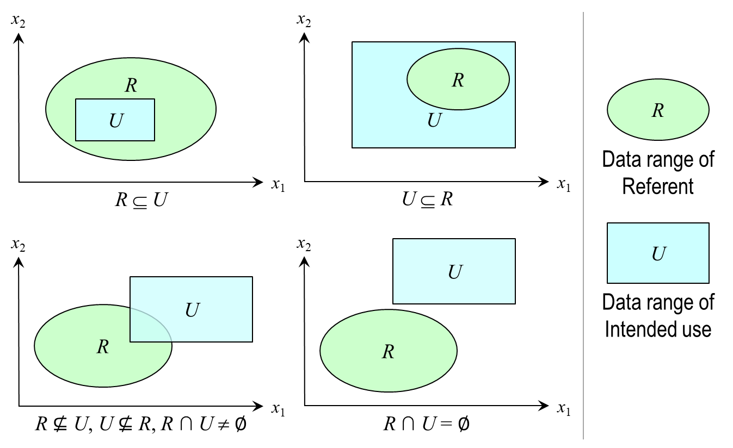
Referent Challenges and Obstacles
Ill defined intended use
  Lack of definition of the model/simulation’s coverage of the domain space
  Lack of test scenarios that will align test and simulation data
Inconsistencies between referent and simulation data
  Metrics of interest
  Factors that affect performance
Limited/no referent data available
  Complexity of system/behaviors represented imposes limitations (e.g., resource, economic) on the development of quantitative referent data
  Domain of Interest does not support quantitative referent development (e.g., Department of Energy, NASA)
Economic limitations
18

Slide 19
Referent Best Practices
Start early – validation referents take time to develop
  Need to identify scope of information needed
  Need to coordinate with others (e.g., testers, Subject Matter Expert (SMEs)) to produce referent data
  Need to budget for referent development
Ensure accreditation authority concurrence
“Grow” referent information over time
  Leverage all sources of test data (e.g., ground test, hardware-in-the-loop (HWIL), live fire)
Maximize extent of referent coverage of the operational/behavioral space as defined by the intended use
Define areas of uncertainty
  Limitations of M&S coverage
  Limitations of referent data
19

Slide 20
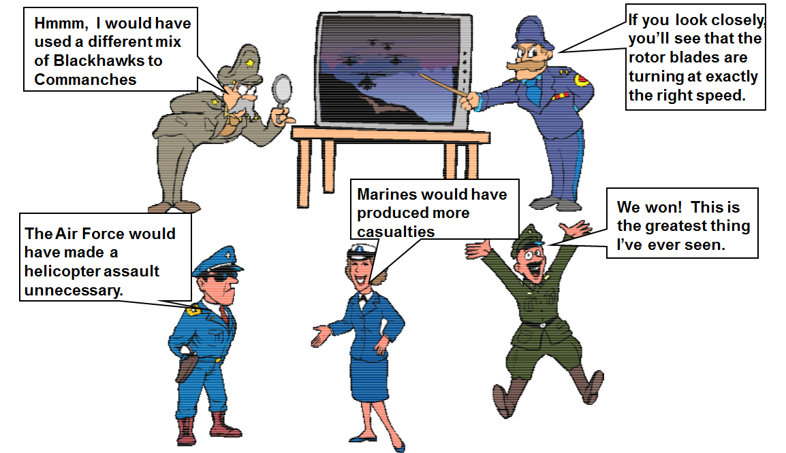
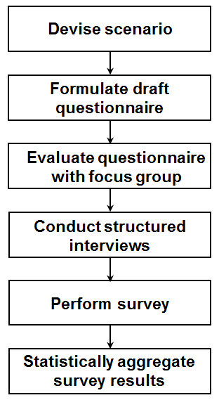
Developing a Rigorous SME Referent
Quantitative referent not available for comparison - reliant on the more qualitative SME assessment
Strengthen qualitative result by increasing SME sample size (from one to multiple)
Apply best practice in survey research to develop questionnaire
Statistically aggregate survey results to identify common trends as well as to assign meaningful uncertainties to the referent characteristics
Knowledge of referent uncertainty is necessary for evaluating M&S Use Risk
Simulation Results
Simulation Referent
Differencing
Student’s T-test
Validation Results
Accuracies
Confidences
20

Slide 21
Challenges Associated with Rigorous Validation
Referent
  Coverage
  Availability
Selection of Validation Method
  Driven by available Referent Data
  Characteristics of Validation Metric (e.g., point value, time series, multimodal)
Viability of Validation Method
  Measuring the performance of the validation methods used to assess model accuracy
Understanding Uncertainty
21

Slide 22


V&V Methods Considerations
01010100010100101
10010101000100101
10101011101010111
10110010100101000
10010101101010101
h(t) = –4.9t² + vt + s
Model
Referent
Certain methods apply best to specific types of model
Certain methods require specific types or amounts of referent data
Method
Some methods require more resources than others
Some methods require specific skills to apply
Resources
Skills
Problems can arise if the considerations conflict
22

Slide 23
Referent to Validation Method Mapping
Sources of
referent information
Forms of referent information
Applicable rigorous
validation methods
Empirical data
Single observation or few observations
Confidence intervals
Multivariate confidence intervals
Theoretical data
Many observations
Hypothesis tests for means, variances, proportions, and distributions
Simulation data
Paired observations
Regression analysis
Subject Matter
Expert knowledge
Expectations and
experience
Structured face validation
Turing test
23

Slide 24
Basic AI Concepts
24

Slide 25
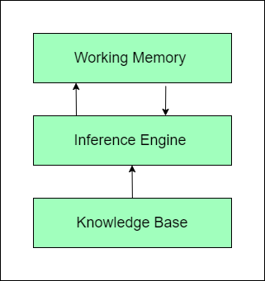
Key AI Related Terms: Artificial Intelligence
Artificial Intelligence (AI) is “the theory and development of computer systems able to perform tasks that normally require human intelligence (e.g., visual perception, speech recognition, decision-making, and translation between languages)”.
Trust in AI can be defined as “the willingness of people to accept AI and believe in the suggestions [and] decisions made by the system.”
Artificial Intelligence
Machine Learning
Deep Learning
[University of Illinois, 2025]
Rule Based AI Model
[Afroogh, 2024]
[GfG, 2024]
25

Slide 26
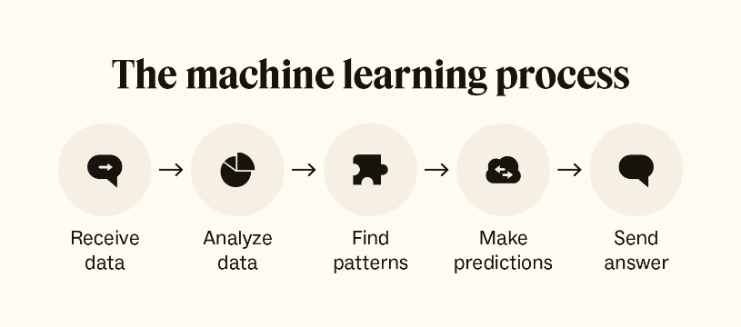
Key AI Related Terms: Machine Learning
Machine Learning (ML) is “an application of AI that that provides systems the ability to automatically learn and improve from experience without being explicitly programmed. ML computer programs can access data and use it to learn for themselves”. Three common ML models include:
  Supervised Learning – ML where “the algorithm learns on a labeled dataset, providing an answer key that the algorithm can use to evaluate its accuracy on training data”.
  Unsupervised Learning – ML that “provides unlabeled data that the algorithm tries to make sense of by extracting features and patterns on its own”.
  Reinforcement Learning - ML where “an agent learns to make decisions by performing certain actions and receiving rewards or penalties”.
AI Machine Learning Model
[Grieve, 2025]
Definitions from [University of Illinois, 2025]
26

Slide 27
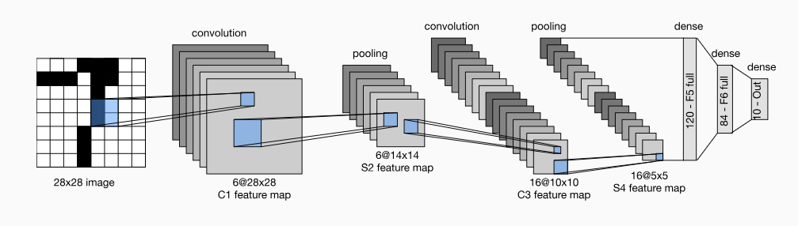
Key AI Related Terms: Deep Learning
Deep Learning is a subset of machine learning. “While basic machine learning models do become progressively better, they still need some guidance. When an AI algorithm returns an inaccurate prediction - an engineer has to step in and make adjustments”. With a deep learning model, an algorithm self determines “if a prediction is accurate or not through its own neural network”.
Definitions from [University of Illinois, 2025]
LeNet-5 Convolutional Neural Network Deep Learning Model
[Zhang, 2023]
27

Slide 28
Rule Based vs. Machine Learning AI
 | Rule Based AI Models | Machine Learning AI Models
Description | An AI Model that uses explicit rules and fixed algorithms | An AI Model that uses statistical models, algorithms, and training data to learn and improve its ability to make decisions
Applications | Medical Diagnosis Financial Services | Recommendations Predictive Maintenance Image Recognition
Benefits | Transparency/Explainability Consistency Straightforward Implementation | Improves over time Can address more complex problems
Limitations | Scaling can become cumbersome Does not learn Not flexible when information is ambiguous | Lack of Transparency Decision Process is Increasingly more opaque as “self learning” increases Potential of Overfitting to data Difficult to validate
[GfG, 2024]
[Grieve, 2025]
28

Slide 29
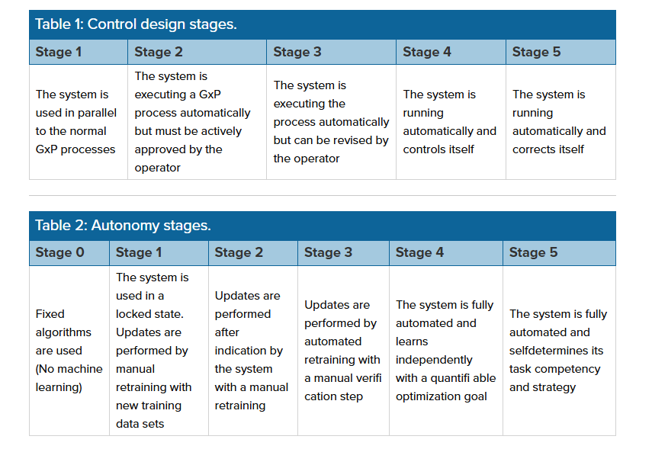
A Proposal for Establishing the Level of AI Validation Effort
The International Society for Pharmaceutical Engineering (IPSE) AI validation groups (including Germany, Austria, and Switzerland) developed an Industry-specific AI Maturity Model
This proposal balances AI Validation LOE based on:
  Autonomy of the AI Model
  Control Design of the AI Model
[Erdman,2022]
GxP = “good practice” quality guidelines and regulations
[Erdman, 2022]
29

Slide 30
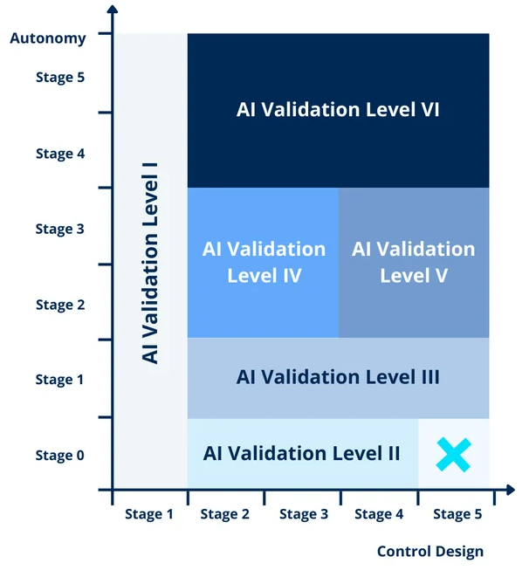
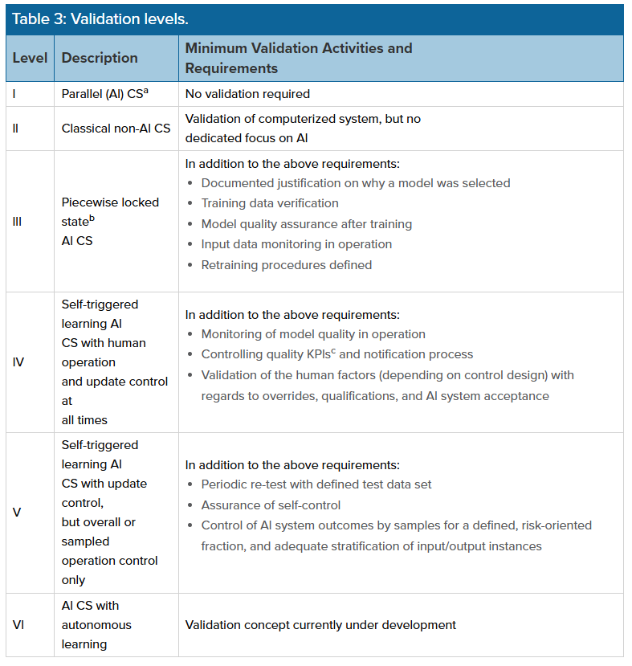
Determining AI Validation Level of Effort
Increasingly
Opaque
AI Validation Level of Effort Categories
[Erdman, 2022], [Smits, 2022]
CS = computerized system
KPI = key performance indicators
[Erdman, 2022]
30

Slide 31
AI V&V Methods
31

Slide 32
AI Models and M&S V&V Processes
Key Steps in an assessment of trust for an M&S
  Solidify Intended use
  Foundational M&S Verification
    Software Development Process
    Key Algorithm Review
  Requirements Verification
  Data Verification and Validation
  Referent Based Validation
Key Questions leading to an assessment of trust for an AI Model [Hand,2020]
Is the AI Model’s objective properly defined?
Is the AI Model free of software bugs?
Is the AI Model based on properly representative data?
Is the AI Model able to handle anomalies and data glitches?
Is the AI Model sufficiently accurate? [Hand,2020] [Wilson, 2025]
32

Slide 33
Question 1: Mapping to the M&S V&V Processes
The intended use drives M&S development, assessment, and application
The concept of purpose/objective is equally important for AI Models, given that it drives:
  The AI Model focus
  The selection of the training and testing data sets
  The formulation of underlying algorithms
A clear understanding of purpose is a first and critical step to answering the V&V questions:
  Was it built right?
  Was the right thing built?
33

Slide 34
Question 1: Is the Objective Properly Defined?
Focuses on answering the questions:
  How will the AI Model be applied?
  What is the Domain of Interest?
  What should the AI Model output?
[Hand, 2020] suggests that this step might involve “exploration of design documents and specifications in an effort to detect problems, anomalies, and oversights, as well as … unexpected conditions”
[Hand, 2020] acknowledges that the complexity, variability and range of real world scenarios impacts the “adequacy” of a comprehensive design and recommends trying to identify as many likely scenarios as possible.
34

Slide 35
Question 2: Mapping to the M&S V&V Processes
AI Models are code based so the basic concepts of software engineering and software V&V apply
Software Verification provides the solid foundation for follow on validation activities by:
  Identifying if undiscovered/unaddressed coding errors exist in the AI Model results and predictions
  Ensuring that configuration management and regular verification “maintenance” activities are implemented as essential elements of strong code
1012-2016 - IEEE Standard for System, Software, and Hardware Verification and Validation provides guidance for software based V&V tasks and products
35

Slide 36
Question 2: Have Software Bugs been Addressed?
Any code based system should be verified to ensure that:
  The conceptual specifications and design has been implemented correctly
  That the underlying algorithms work as expected and are not subject to coding issues
  Interprets and translates (where needed) input data correctly
Formal verification techniques (i.e., mathematical proofs) can be applied to establish correctness
Verification becomes more difficult as the AI model adapts and learns
[Hand, 2020] notes that system behavior may be “nondeterministic”, with internal sources of randomness (e.g., genetic algorithms, neural networks, and stochastic approximation) leading to “state space explosion”
36

Slide 37
Question 3: Mapping to M&S V&V Processes
Data plays a critical role for both M&S and AI Models
M&S [Oren, 2001] [DoD, 2011]
  Input data drives the algorithms that compute results
  Referent data serves as the basis of comparison for validation assessments
  M&S definitions for validation and accreditation focuses both on the model or simulation and its associated data
AI Model
  Data drives the AI Model
  Used to learn and improve AI Model over time
  Used to test AI Model performance
Understanding the quality (e.g., Garbage In, Garbage Out) and completeness of the data is another critical step in the V&V processes for both M&S and AI
37

Slide 38
Question 3: Is the Data Representative?
AI Models are highly dependent on data that serves as the basis for training the system. If the data is biased, not representative, or incomplete it can result in inaccurate results.
[Hand, 2020] states that “the validity of the results of an analysis depends on the quality of the input data”
Data quality issues to be addressed include:
  Identifying and assessing the impact of “breakdown points” when poor data quality is introduced [Hand, 2020]
  Merging/combining multiple datasets that might have “different degrees of quality and compatibility” [Hand, 2020]
  Issues of “population drift” where the “nature of the underlying population changes over time” [Hand, 2020]
38

Slide 39
Question 3: Steps to Address Data Issues
[Bronsdon, 2024] [Wilson, 2025] discuss data preparation/preprocessing methods that can be applied to facilitate accurate model performance:
  Handle Missing Data
    Input or remove missing data points
    Remove duplication in the data
    Handle unusual observations (e.g., outliers) so the training data is not skewed
    Understand quality of data
  Standardize Data Formats
    Implement data transformation equations as needed
    Ensure data formats map to algorithm input requirements
  Detect and Remove Bias
    Evaluate differences in performance based on statistical demographics
    Adjust the data to address statistical skewness if detected
39

Slide 40
Question 4: Mapping to M&S V&V Processes
Stress Testing and Sensitivity Analysis are to methods employed to assess the stability and robustness of an M&S
  Stress Testing assesses the M&S system representations under extreme conditions, generally in the form of stressing scenarios. Focus is on edge cases or boundary conditions.
  Sensitivity Analysis is applied to assess the impact that changes in input parameters has on the M&S results.
Stress Testing is employed to ensure the M&S representations don’t “fall apart” in challenging conditions
Sensitivity Analysis is used to understand the relationship between M&S inputs and outputs, particularly when the code is not accessible (e.g., proprietary M&S, executable only)
40

Slide 41
Question 4: How robust is the AI Model?
Required level of robustness differs based on Objective/Intended Use
As ML systems become more self-contained, sensitivity analysis of the “black box” is the most tractable validation effort
Test methods to assess robustness include:
  Injecting problematic data into the AI Model to see how it responds
  Studying the edge cases where performance is likely to change
  Defining and testing stressful scenarios
  Assessing the impact of input distribution shifts
[Hand, 2020] emphasizes the need to understand the “trade-off between the robustness of a system … and [its] accuracy”
41
Notes:
Different systems require different robustness levels:
A medical diagnosis AI must handle missing or corrupted patient data gracefully.
A self-driving car AI must stay safe under sensor malfunctions or poor visibility.
A fraud detection AI should still flag anomalies during holiday seasons (data distribution shift).

Slide 42
Question 5: Mapping to M&S V&V Processes
Both M&S and AI model validation focus on the concept of accuracy, with however, different perspectives
M&S validation is focused on behavior and/or phenomena representation
  Validation achieved by comparison to referent data
  Acceptability Criteria define thresholds of agreement
  Validation informs Accreditation
AI model validation is focused on the accuracy of responses
  Validation achieved by registration of model output to referent data
  Aligns with concept of Software validation (per IEEE 1012-2016)
  Subject Matter Experts may be used to validate outputs
42

Slide 43
Question 5: Is the System sufficiently Accurate?
AI Model Validation evaluates how well the trained system performs beyond the training data set (e.g., a test data set).
Key concepts that apply to AI Model Validation:
  Training Data that the AI Model “learns” from.
  Test Data that assesses the trained AI Models performance.
  Overfitting occurs when the algorithm fits too closely to the training data resulting in in poor performance outside the training data set
Validation Methods include:
  Cross-Validation (K-Fold, Leave One Out, Stratified) [Carrascosa, Jan 2025] [MLJourney, 2025] [GfG, 2025]
  Holdout Validation
  Bootstrapping
43

Slide 44
Holdout and K-Fold Cross Validation
Holdout Validation
Training Set Observations | Testing Set Observations
[0-19] | [20-24]
Test
K-Fold Cross Validation
Iteration | Training Set Observations | Testing Set Observations
1 | [5-24] | [0-4]
2 | [0-4, 10-24] | [5-9]
3 | [0-9, 15-24] | [10-14]
4 | [0-14, 2] | [15-19]
5 | [0-19] | [20-24]
Test
Test
Test
Test
[GfG, 2025]
Test
[GfG, 2025]
44

Slide 45
Comparison of K-Fold Cross Validation and Holdout Validation
The trade-offs between the two methods include:
Bias
Variance
Cost
[GfG, 2025]
45

Slide 46
SME Assessment
Subject Matter Experts serve as critical information sources for both the development and assessment of an AI Model – providing critical domain knowledge and insights
As with M&S, SMEs provide insights on the front end of the AI model development by:
  Helping to establish objectives
  Identifying representative training and testing data
  Defining relevant scenarios
  Identifying impactful features, minimizing “noise” [Carrascosa, Jan 2025]
As with M&S, SMEs support backend assessment by:
  Reviewing AI Model output to determine accuracy and identify unrealistic outcomes
  Determining how well the AI Model addresses edge cases, uncommon events, critical decision points
  Identifying biases that might result in unbalanced model outcomes [Carrascosa, Jan 2025]
46

Slide 47
Establishing Trust: Explainable AI
Explainable AI is focused on articulating the decision making process that drives an AI Model
An emerging area of AI that is driven by the need to have “confidence” in the AI Model
Explainable AI particularly focuses on Deep Machine Learning where the model is more opaque and operates as a “black box”
  Employs techniques and methods that “trace and explain” the decisions made in the ML
  Seeks to understand how the underlying AI algorithms reach a result [IBM, 2023]
  Often driven by legal requirements [IBM, 2023] [Hand, 2020]
The European Union’s General Data Protection Regulation specifically calls out “the right to … obtain an explanation of the decision reached” [Hand, 2020]
47

Slide 48
V&V Challenges for AI Driven
Simulation
48

Slide 49
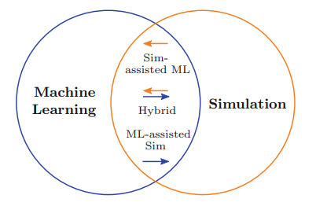
The Bridge between AI Models and M&S
[Von Reude, 2020] provides an excellent description of the relationship between ML Models and Simulation
Three categories are defined:
  ML Assisted Simulation
    ML used to develop conceptual model
    Provide input data
    Serve as a Surrogate Model
    Issues of concern include Combining Data and Parameter Dependence
  Simulation Assisted ML
    Creates training data for the ML
    Supports Validation of the ML results – particularly “novel” results
    Supports iterative development of the ML through reinforcement learning
  Hybrid
[Von Rueden, 2020]
[Von Rueden, 2020]
49

Slide 50
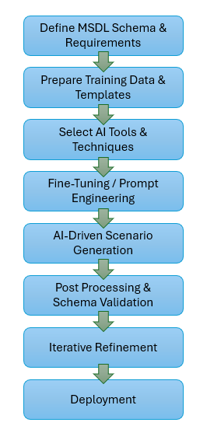
V&V Scope for AI Driven M&S (AI Inputs)
V&V of integrated ML and M&S Models needs to be addressed for the ML, the M&S, and the interface that supports the integration
API
  [RPG, 2011]
ML
M&S
Data Formatting
Spatial Consistency
Temporal
Consistency
  [BridgesXR, Feb 2025]
API = Application Programming Interface
50

Slide 51
Distributed Simulation Engagement and Engineering Process (DSEEP)
The DSEEP is an IEEE Recommended Practice that defines a comprehensive systems engineering process for development, integration, and execution of distributed simulations
The DSEEP is based on Authoritative Systems Engineering best practices as well as lessons learned from a wide range of applications
The DSEEP would provide insights that would facilitate ML assisted Simulation
[Möller, 2022]
51

Slide 52
Steps Needed to Integrate AI ML into a Military M&S
Steps defined by query to CHAT GPT
[CHAT GPT, 2025]
52

Slide 53
Steps Needed to Integrate AI ML into a Military M&S
Steps defined by query to CHAT GPT
[CHAT GPT, 2025]
53

Slide 54
Technical Interoperability Issues
Technical Interoperability is characterized by the ability of linked simulation elements to physically connect and exchange data
Requires the use of common standards, compatible interfaces and coordinated data structures
Aspects of technical interoperability include
  Temporal resolution
  Spatial resolution
  Time management coordination
  Standards compatibility
54

Slide 55
Training Applications for AI Driven M&S
Military Training is a Domain that is rapidly adapting its training methods to apply AI driven simulation
Both rule-based and Learning Models (LMs) are being considered as methods to:
  Personalize Training based on “individual strengths, weaknesses, and learning style” [Kramer, 2024] [BridgesXR, Feb 2025]
  Enhance Wargaming by accelerating and improving the quality of the decision making process [Breeden, 2024]
  Expanding and adapting training scenarios [Ortmann, 2024]
  Implement Adaptive and Unpredictable adversary behavior for stand-alone [Breeden, 2024] and Live-Virtual-Constructive (LVC) training simulations [Simpson, 2024]
  Improving Logistics Planning [Ortmann, 2024]
  Applications include: NATO [Ortmann, 2024], UK [Simpson, 2024], and the US [Breeden, 2024] [Kramer, 2024]
55

Slide 56
An Example: Defining Scenarios for
Training Simulations
AI-Driven MSDL Scenario Generation
The BridgesXR newsletter [BridgesXR, Feb 2025] provides an integration and workflow design for generating scenarios
Scenarios would be based on the Military Scenario Description Language (MSDL) [SISO, 2015] that could be used to support training simulations
Scenarios would include parameters for entities, entity attributes, environmental impacts, etc.
The process described aligns well with the ML Verification and Validation Processes discussed earlier in this tutorial.
  [BridgesXR, Feb 2025]
56

Slide 57
Training Applications for AI Driven M&S:
V&V Challenges
The ML Model outputs have to be representative of the Domain of Interest as well as the Training Objectives
The ML Model needs to be assessed to ensure that negative training does not occur [Ortmann, 2024]
  Data needs to be properly combined
  The ML Model needs to be properly integrated with the M&S
  Trainers need to understand the underlying ML decision making process to determine how it impacts the training objectives (e.g., does not result in erroneous AI behaviors)
  ML output needs to provide the correct stimulus to the M&S
  ML output needs to “speak” to the Trainees in a meaningful way
ML V&V would need to inform an Accreditation Decision
57

Slide 58
Conclusion
58

Slide 59
Final thoughts
AI Models and Constructive (code based) M&S share similar development characteristics:
  Defining Objectives Requirements
  Conceptualizing/Designing the desired data and algorithmic context
  Implementing and testing (i.e., verifying) the coded product
Validation methods diverge for the two model types
  The behavior and phenomenology represented by the M&S are assessed for accuracy by comparing against a “real world” referent
  Responses generated by the AI Model are assessed for reliability and accuracy beyond the training data. Referent sources include an Authoritative data set and/or SMEs.
AI validation, particularly as control decreases and autonomy increases (i.e., Deep Learning Models) are difficult if not impossible to validate
  Explainable AI seeks to provide insight into the AI Model’s decision process
  Continued research efforts are needed to support validation efforts for increasingly opaque models
59

Slide 60
Learning Objectives Addressed
 | Define V&V Terms and Basic Concepts | Construct an Effective Referent | Map Validation Methods to Referent | Determine AI V&V Challenges | Characterize V&V for AI Driven Simulation
M&S VV&A | Slides 6-14
M&S Validation and the Validation Referent |  | Slides 16-20 | Slides 21-23
Basic AI Concepts |  |  |  | Slides 25-30
AI V&V Methods |  |  |  | Slides 32-47
V&V Challenges for AI Driven Simulation |  |  |  |  | Slides 49-57
60

Slide 61
References and bibliography (1 of 4)
[Afroogh, 2024] S. Afroogh, A. Akbari, E. Malone, M. Kargar, and H. Alambeigi, “Trust in AI: progress, challenges, and future directions” In Nature.com at https://www.nature.com/articles/s41599-024-04044-8, 18 November 2024.
[ATEC, 2004] Army Test and Evaluation Command (ATEC) Pamphlet 73-1, System Test and Evaluation Procedures, April 19 2004.
[Balci, 2002] O. Balci, R. E. Nance, J. D. Arthur and W. F. Ormsby, “Expanding Our Horizons in Verification, Validation, and Accreditation Research
and Practice”, Proceedings of the 2002 Winter Simulation Conference, San Diego CA, December 8-11 2002, pp. 653-663.
[Breeden, 2024] J. Breeden II, “Adding Generative AI to Wargame Training can Improve Realism, but not Without Risk”, 13 February 2024.
[BridgesXR, Jan 2025] “Turning Raw Data into Insights with AI”, Downloaded from https://bridgesxr.com/turning-raw-data-into-insights-with-ai/, 8 January 2025.
[BridgesXR, Feb 2025] “Using AI for Automated MSDL Scenario Generation in Military Simulations”, Downloaded from: https://bridgesxr.com/using-ai-for-automated-msdl-scenario-generation-in-military-simulations/, 19 February 2025.
[Bronsdon, 2024] C. Bronsdon, “Best Practices for AI Model Validation in Machine Learning”, https://galilelo.ai/blog/best -practices-for-ai-model-validation-in-machine-learning, 27 October 2024.
[Carrascosa, Jan 2025] I. P. Carrascosa, “A Complete Guide to Cross-Validation”, downloaded from: https://www.statology.org/complete-guide-to-cross-validation/, 7 January 2025.
[Carrascosa, Apr 2025] I. P. Carrascosa, “The Role of Domain Knowledge in Machine Learning: Why Subject Matter Experts matter”, published in Practical Machine Learning, 21 April 2025.
[Cellier, 1991] F. E. Cellier, Continuous System Modeling, Springer-Verlag, New York NY, 1991.
61

Slide 62
References and bibliography (2 of 4)
[CHAT GPT, 2025] Information generated by the following query to CHAT GPT “Walk through the steps needed to integrate AI into a Military Simulation”, queried on 12 June 2025.
[DoD, 2024] Department of Defense Instruction (DoDI) 5000.61, “DoD Modeling and Simulation Verification, Validation, and Accreditation M&S VV&A”, 17 September 2024.
[DoD, 2012] Department of Defense Standard Practice, MIL-STD-3022 with Change 1, Documentation of Verification, Validation, and Accreditation
(VV&A) for Models and Simulations, April 5 2012.
[DoD, 2011] Department of Defense VV&A Recommended Practices Guide, https:/www.cto.mil/sea/vva_rpg/, 2011.
[Erdman, 2022] N. Erdmann, R. Blumenthal, I. Baumann, Markus Kaufmann, “AI Maturity Model for GxP Application: A Foundation for AI Validation”, Pharmaceutical Engineering, March/April 2022.
[GfG, 2024] “Rule-Based System in AI”, retrieved from https://www.geeksforgeeks.org/rule-based-in-ai/, 27 August 2024.
[GfG, 2025] “Cross Validation in Machine Learning”, retrieved from https://www.geeksforgeeks.org/cross-validation-machine-learning, 10 May 2025.
[Gilmore, 2016] Director Operational Test and Evaluation Memorandum, Guidance on the Validation of Models and Simulation used in Operational
Test and Live Fire Assessments, 14 March 2016.
[Grieve, 2025] P. Grieve, “Deep Learning vs. Machine Learning: A complete Guide”, retrieved from https://www.Zendesk.com/blog/machine-learning-and-deep-learning/, 14 March 2025.
[Hand, 2020] D.J. Hand and S. Khan, “Opinion: Validating and Verifying AI Models”, Patterns, https://doi.org/10.1016/j.patter.2020.100037, June 12, 2020, pp. 1-3.
[IBM, 2023] “What is Explainable AI”, downloaded from https://www.ibm.com/explainable-ai/, 29 March 23.
62

Slide 63
References and bibliography (3 of 4)
[IEEE 1012, 2016] IEEE 1012-2016, “Standard for System, Software, and Hardware Verification and Validation provides guidance for software based V&V tasks and products”, 29 September 2017.
[Kramer, 2024] SGM K. J. Kramer, “Training Transformed: AI and the Future Soldier”, In: https://madsciblog.tradoc.army.mil/495-training-transformed-ai-and-the-future-soldier/, 20 June 2024.
[Minsky, 1965] M. L. Minsky, Matter, Mind, and Models, Artificial Intelligence Memo No. 77, Massachusetts Institute of Technology, March 1965,
Online at http://dspace.mit.edu/bitstream/handle/1721.1/6119/AIM-077.pdf ?sequence=2, Accessed, July 19 2015.
[MLJourney, 2025] “Best Practices for Cross-Validation in Machine Learning”, downloaded from https://mljourney.com/best-practices-for-cross-validation-in-machine-learning/, 19 May 2025.
[Möller, 2022] B. Möller and K. Morse, “Introduction to HLA”, tutorial presented at the 2022 I/ITSEC, 28 November – 2 December 2022.
[NASA, 2023] Requirements Verification Matrix, downloaded from https://www.nasa.gov/sites/default/files/thumbnails/image/seh_app-d_table_d1.jpg on June 21, 2023.
[Oren, 2001] T.I. Oren, “Impact of data on simulation: from early practices to federated and agent-directed simulations”, In: Heemink A et al (eds) Proceedings of EUROSIM 2001, Delft, 26–29 June 2001.
[Ortmann, 2024] M. Ortmann, “Artificial Intelligence in Combat Simulations: How AI is changing NATO Soldier Training”, Defense Magazine, 26 August 2024.
[Piersall, 2014] C. H. Piersall and F. E. Grange, “The Necessity of Intended Use Specification for Successful Modeling and Simulation of
System-of-Systems”, CrossTalk, September/October 2014, pp. 20-24.
[RPG, 2011] DoD VV&A Recommended Practices Guide, RPG Validation Referent Special Topic Paper, https://www.cto.mil/sea/vva, January 2011.
63

Slide 64
References and bibliography (4 of 4)
[Simpson, 2024] S. Simpson, “British Army Training Simulations to be Enhanced by Generative AI”, In: https://www.defenseadvancement.com/new/british-army-training-simulation-to-be-enhanced-by-generative-ai, 05 February 2024.
[SISO, 2015] Simulation Interoperability Standards Organization, “Standard for Military Scenario Definition Language”, Reaffirmed 11 May 2015.
[Smits, 2022] P. Smits, “AI and Machine Learning Validation: Strategies and Examples”, retrieved from https://www.qbdgroup.com/en/blog/ai-machine-learning-validation-strategies-and-examples, 26 July 2022.
[University of Illinois, 2025] “AI Definitions and Terminology: Essential AI Terms and Definitions for Better Understanding”, University of Illinois, https://www.uis.edu/resource/ai/ai-definitions-terminology, 2025.
[Velten, 2009] K. Velten, Mathematical Modeling and Simulation, WILEY-VCH, Weinheim Germany, 2009.
[Von Rueden, 2020] L. Von Rueden, S. Mayer, R. Sifa, C. Bauckhage, and J. Garke, “Combining Machine Learning and Simulation to a Hybrid Modelling Approach: Current and Future Directions”, In: Lecture Notes in Computer Science, April 2020.
[Wilson, 2025] E. Wilson, “Testing AI: How to Validate AI Models for Reliable Performance”, In: Business Outstanders: Empowering Entrepreneurs, 21 April 2025.
[Zhang, 2023] A. Zhang, Z. C. Lipton, M. Li, and A. J. Smola, “Dive into Deep Learning”, Chapter 7. Convolutional Neural Networks, Figure 7.6.1, https://d2l.ai/chapter_convolutional-neural-networks/lenet.html, Cambridge University Press, February 2023.
64

