Slide 1




Distributed Live Virtual Constructive (LVC) Event Process
Michael J. O’Connor
Simon Goerger
Kenneth G. LeSueur
Roy F. Zinser
LTC John Furr
(Transformation and Training Command (T2COM) )
Ed Lerz
(Huntington Ingalls Industries)
Brett Boren
Tilghman Turner

Slide 2
Learning Objectives
Describe and apply the 9-step Distributed LVC Event Process.
Execute and validate the event environment as outlined in Step 7: Integrate & Validate the Event Environment, including conducting integration testing and iterative validation to confirm system reliability and accuracy.
Analyze the relationship between the Distributed LVC Event Process and the overall Event Life Cycle, including the impact of each process step on planning, execution, and post-event assessment.
Apply process-driven risk mitigation strategies in distributed LVC event integration, including identifying common failure points and implementing corrective actions to prevent invalid configurations.
Notes:
Set expectations: “Before we dive in, here’s what you should walk away with > the ability to use a structured, repeatable process to reduce risk in distributed LVC events.”
Emphasize practical value: “We’re not just explaining a process > by the end you should be able to apply it, especially around Step 7 where most failures historically occur.”
Highlight the lifecycle connection: “A big takeaway is understanding how the 9-step process ties directly into the broader event life cycle > why every step matters for planning, execution, and analysis.”
Underscore risk mitigation: “A core theme throughout this tutorial is risk > how we identify it early, how the process mitigates it, and how this prevents invalid environments or failed record runs.”
Frame their mindset: “Think of this as a toolkit you can tailor to your event > small, large, training, test > but always grounded in process discipline.”

Slide 3
Agenda: LVC Integration Tutorial
Topic | Presenter | Estimated time (min)
Purpose & Background of the Process | Mike O’Connor | 5
Step 1: Project Initiation |  | 5
Step 2: Perform Conceptual Analysis |  | 3
Step 3: Conduct Wargame Exercise |  | 3
Step 4: Develop Digital Twin |  | 5
Step 5: Design Operational Wrap-Around |  | 5
Step 6: Develop Operational Wrap-Around |  | 5
Step 7: Integrate & Validate Environment |  | 45
Step 8: Plan & Execute Event | LTC John Furr | 2
Step 9: Analyze Data and Evaluate Results | LTC John Furr | 2
Applying the Process to the Stages of an Event Cycle | LTC John Furr | 5
Wrap –up | Tilghman Turner | 5
 |  | 90 min

Slide 4
Typical Distributed LVC Event Common Problems
Conducted to support many different domains
  Training, testing & evaluation, research & development, concept development, acquisition, and mission rehearsal
Complex environments
  Unique networks
  Multiple Security Classifications
  Encroaching cyber / information security controls (RMF, ATOs, etc.)
  Evolving Mission Command / C4I Systems
  Need to develop novel M&S and data
  Vague and/or conflicting Objectives
  Multiple Stakeholders
For many years, a small set of very experienced teams created these environments
  Events with less skilled teams often failed, overran costs, or did not meet schedule
Short timelines, busy schedules, & other ongoing work and events
  These all distract from the detailed work needed to build and integrate complex environments
Must generate trusted data and results
  An incorrectly created environment can lead to negative training, false test results, bad research, and failed missions
Notes:
Distributed LVC environments are inherently complex, often more than organizations expect.
They require strong technical expertise and disciplined project management. Without both, teams struggle to assemble a coherent environment.
When the environment is built incorrectly, the consequences show up quickly in failed expectations, wasted resources, and timelines that start to slip.
These challenges highlight the need for a structured approach that reduces risk and helps teams of varying experience levels succeed.
Transition: With that context in mind, the next step is understanding why a defined event process becomes essential, especially as environments grow larger and more distributed.

Slide 5
Purpose of a defined LVC Event Process
Solving the common problems of Distributed LVC events requires:
A useful Life Cycle framework to reduce risk when building complex M&S environments
A well-defined process that:
  Allows for less reliance on highly skilled practitioners
  Is comprehensive, but easy to tailor
  Is repeatable
Notes:
A defined process provides structure that reduces risk when building complex LVC environments and removes guesswork.
It lowers reliance on a small group of highly experienced experts by capturing their methods so teams can operate consistently.
It ensures critical steps are not overlooked, which is essential because small gaps early often become major failures later.
The process is flexible and can be tailored for different event sizes, security levels, and architectures.
It becomes the backbone of the entire event lifecycle, supporting planning, integration, validation, and execution.
Transition: Understanding this purpose makes it easier to see how the process addresses the recurring challenges that show up across most distributed LVC events.

Slide 6
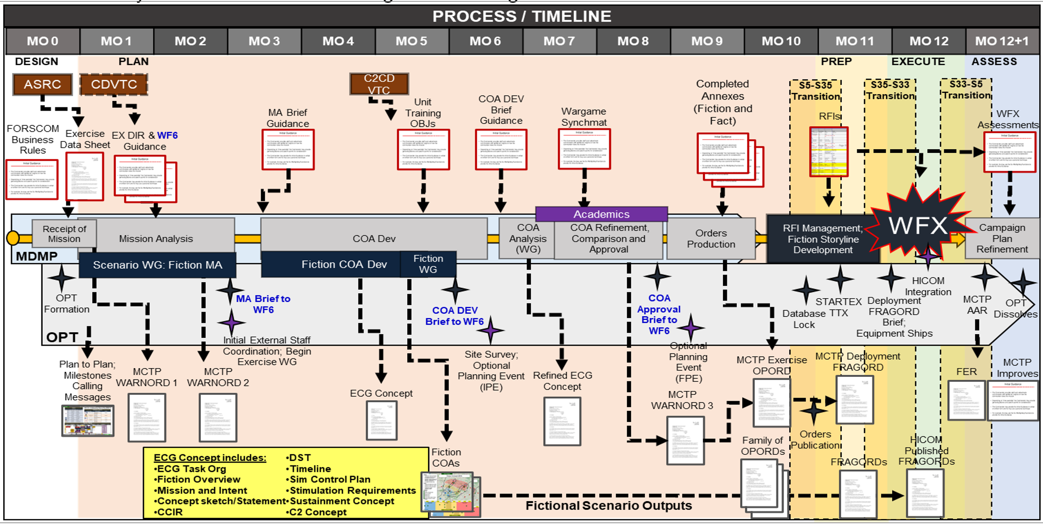
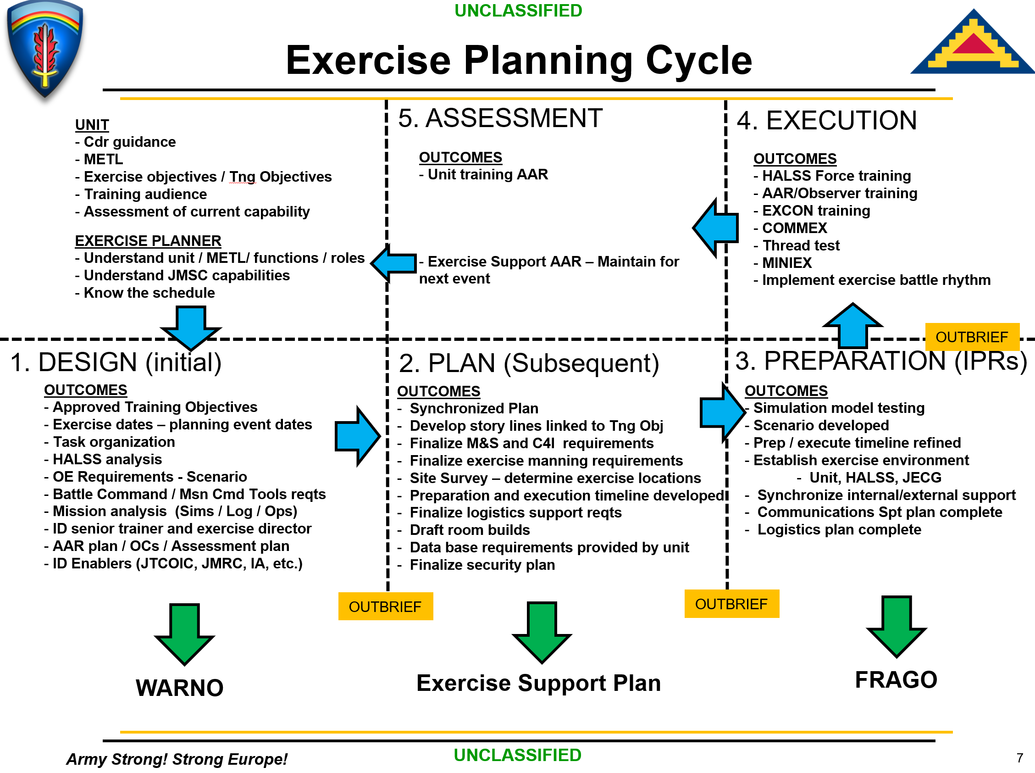
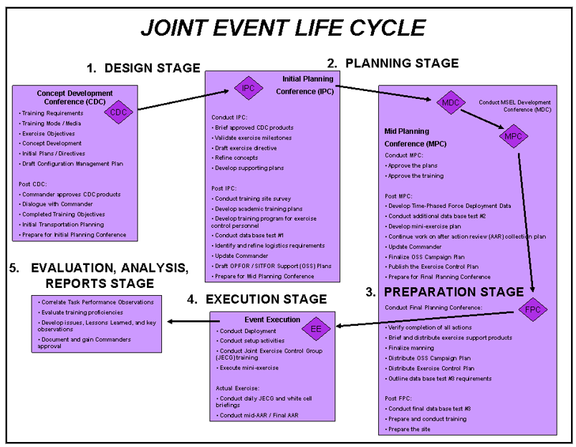
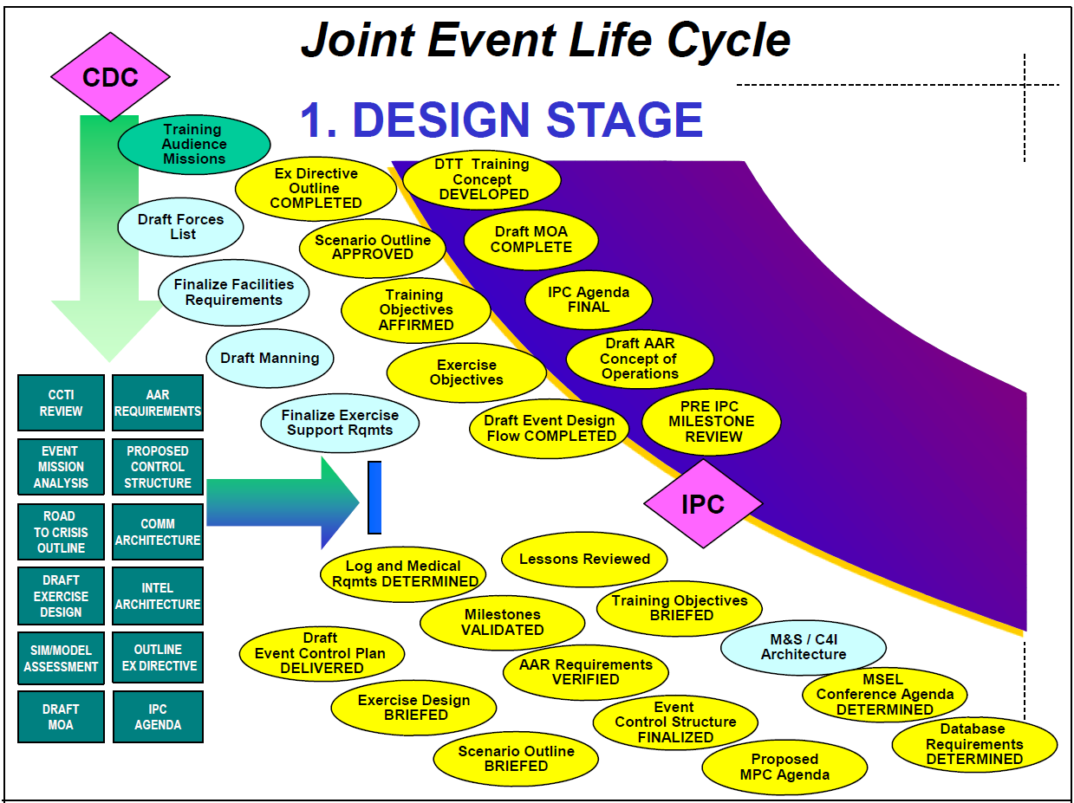
How does this fit with other existing Life Cycles?
Notes:
Organizations with strong, mature life cycles and disciplined integration practices often operate well within their established frameworks.
Those environments typically rely on controlled databases, governed object models, and stable simulation architectures, so additional processes may seem unnecessary.
The challenge comes when these environments must incorporate new, unique, or experimental LVC components. That is where a structured process like the one in this tutorial becomes valuable.
It provides a way to manage integration risk when stepping outside the normal playbook or when legacy systems and new technologies must coexist.
Examples include enterprise-level constructs like JELC and JLVC as well as major training centers such as MCTP, KBSC, JMSC, NTC, JRTC, and local MTCs. Each can encounter circumstances that fall outside their standard practices.
Transition: This leads to the broader question of how process discipline connects to existing event life cycles and where gaps often emerge.

Slide 7



Distributed LVC Event Life Cycle
5 Stages
DESIGN
PLAN
PREPARE
EXECUTE
ASSESS
CDC
IPC
Wargame
MDC
MPC
MSC
FPC
TIM
IRR
ERR
AAR
Event Life Cycles provide a framework for building and conducting a distributed LVC event
These Life Cycles still lack the detailed process for how to create and test the LVC products that provide the environment
Workgroups are not enough
AAR: After Action Review
CDC: Concept Development Conf.
ERR: Execution Readiness Review
FPC: Final Planning Conf.
IPC: Initial Planning Conf.
IRR: Integration Readiness Review
MDC: MSEL Development Conf.
MPC: Mid Planning Conf.
MSC: MSEL Synch Conference
TIM: Technical Interchange Meeting
Notes:
Transition: With the life cycle established, the next step is understanding how our process fits into existing models and where it adds the depth needed for distributed environments.

Slide 8
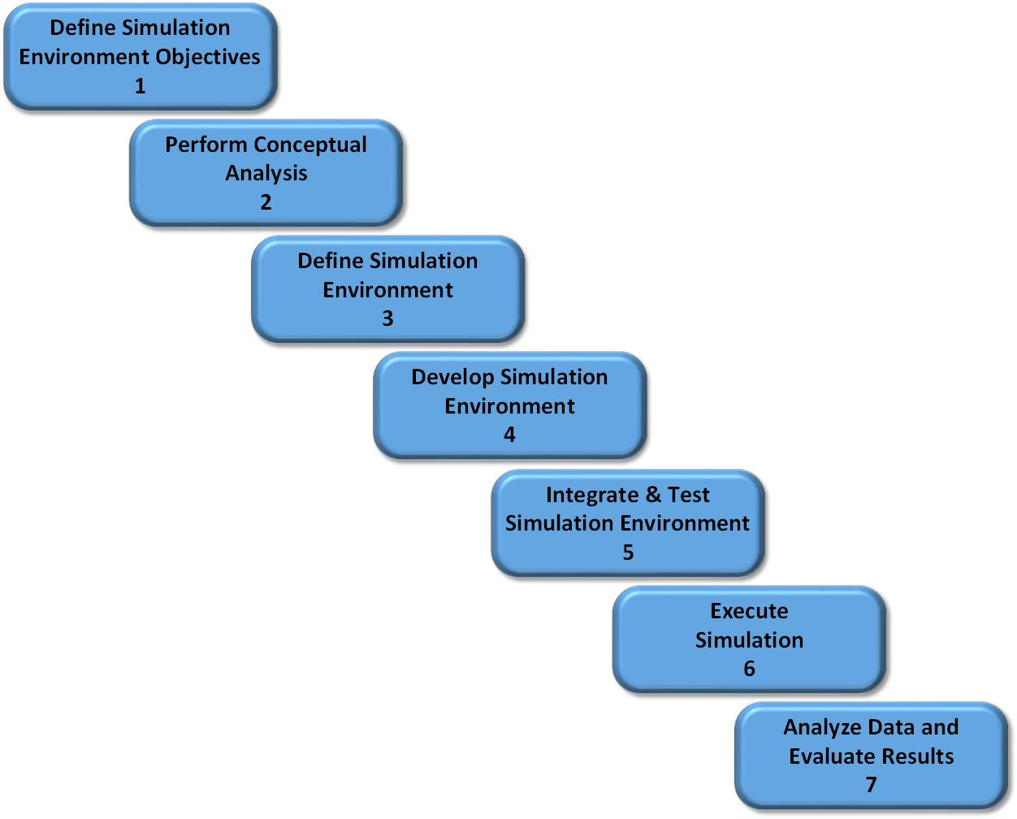
DSEEP
Distributed Simulation Engineering and Execution Process (DSEEP)
IEEE Std 1730-2010, developed by Simulation Interoperability Standards Organization (SISO)
Distributed simulation architecture independent
Process model for the integration of distributed simulations
The Process model must be instantiated with a set of processes and supporting material
DSEEP divides each step into activities
Notes:
DSEEP outlines what a distributed simulation process should look like, but it does not give teams the detailed steps they need to run an event.
It describes the model at a conceptual level, so we cannot apply it directly without additional structure.
To use DSEEP effectively, we must translate its high-level steps into real tasks, products, and configuration work.
The Distributed LVC Event Process does exactly that by turning the DSEEP model into an actionable, repeatable process for real events.
Transition: Next, I will show how this instantiated process gives teams the practical guidance they need to integrate and validate a complete LVC environment.

Slide 9
Distributed LVC Event Process
This is an instantiated process based on the DSEEP model
The steps and activities support all Event Live Cycle conferences and stages
The processes documented here are based on years of experience integrating distributed LVC simulation events
Distributed simulation events come in varied sizes and have different objectives, but the same approach can be used for all of them with some tailoring
This tutorial describes how to tailor activities based on the size and nature of the event being planned
Notes:
The Distributed LVC Event Process gives teams a clear, structured way to build and manage a complex LVC environment from start to finish.
It organizes the technical and operational work into steps that teams can follow, regardless of event size or experience level.
The process helps teams coordinate across sites, systems, and architectures so the environment develops in a controlled and predictable way.
By following this process, teams apply consistent methods, reduce rework, and avoid the integration failures that occur when activities are ad hoc.
Transition: With the process introduced, we can now turn to the fundamental risks it is designed to control.

Slide 10
It Is All About Risk
There are many risks in Integrating and Executing a distributed event
But there are two fundamental risks:
  Risk that integration will fail, preventing execution
  Risk of building an invalid LVC environment, which could lead to unreliable results
Notes:
Some teams rely on a big bang approach, bringing all systems together for the first time late in the schedule.
This approach can work, but it introduces significant risk
Integration Fail
Environment Fail
A structured process reduces that risk by forcing teams to build, test, and validate the environment in smaller, controlled steps.
Using an incremental approach gives the team time to identify problems early and fix them before they cascade.
Transition: To understand why this matters, we need to look at the two major risks that drive the need for disciplined integration

Slide 11
Integration Failure Risk
This risk is readily apparent to all participants
Causes of the risk:
  Poorly defined objectives results in building the wrong environment
  Incomplete planning leaves gaps in the environment
  Lack of documentation means all the required interfaces are not present
  Inadequate testing does not find issues with system behaviors
Results of the risk:
  Environment only partially meets objectives
  Integration fails completely and the team cannot execute record runs
Notes:
Integration failure risk represents the most visible threat to any distributed LVC event because it prevents the environment from running at all.
This risk usually appears when objectives are unclear, planning is incomplete, or documentation fails to define all required interfaces and configurations.
When teams do not conduct thorough testing, they miss issues that only emerge when every system comes together during integration.
If integration fails, the environment cannot support record runs, and the team either operates with missing capabilities or cannot execute the event.
Transition: The more serious risk, however, is the one that often goes unnoticed until it affects results, which is the risk of creating an invalid environment.

Slide 12
Invalid Environment Risk
This risk is likely not recognized before conducting the event
Causes of this Risk:
  Lack of understanding the real-world environment
  Creating artificial virtual interoperability that does not exist in the real-world environment
  Not validating the virtual environment
Results of the Risk:
  For R&D focused events the results may drive research in wrong directions
  For Training Events, participants may receive negative training that could result in real world accidents
  For Acquisition focused events, leaders may make poor decisions
  For Test & Evaluation (T&E) events, inaccurate test results may overstate or understate performance metrics
Notes:
Invalid environment risk represents the most dangerous threat because teams often do not recognize it until after the event has produced results.
This risk appears when the simulated environment does not accurately reflect real-world systems, conditions, or interactions that the event is meant to represent.
It grows when teams create artificial interoperability, make assumptions about system behavior, or skip validation steps that confirm accuracy.
When the environment is invalid, the event produces misleading outcomes that affect training quality, test results, acquisition decisions, or research direction.
Transition: With both risks defined, we can now focus on how the process mitigates them and why disciplined execution is essential for reliable results.

Slide 13
Process to Mitigate Risk
Both risks are bad outcomes of an integration
The Invalid Environment Risk is more significant because the failure will not become apparent until later in the event life cycle (if at all)
A well-defined process does not eliminate the risk, but does mitigate it
A process only works if the team follows it, everyone must embrace the process
  Top-level management support is critical! If mangers do not consider the process important, shortcuts and missed steps will jeopardize the record runs
  Practitioners must receive training on the process and accept the reasons to follow it
When there is schedule pressure, the leadership almost always abandons the process
  The schedule pressure often results from not following the process (e.g., poor planning)
  Further process shortcuts create more schedule slippage, or induces added risks
The verification activities in the process mitigate the Integration Failure risk
The validation activities in the process mitigate the Incorrect Environment risk
Notes:
A structured event process reduces both integration failure and invalid environment risks by guiding teams through the activities that uncover issues early.
The process cannot eliminate risk entirely, but it forces teams to follow steps that reveal gaps, inconsistencies, and configuration errors before record runs.
The process only works when leadership and practitioners commit to it, because skipped steps and shortcuts directly increase the likelihood of failure.
Teams often feel schedule pressure, but rushing the work usually reflects earlier process lapses and creates even more delays and uncertainty.
The verification activities in the process address integration failure, while the validation activities address the deeper risk of an incorrect environment.
Transition: With the risks and mitigation approach established, we can step into the process itself and walk through the sequence of steps that guide an LVC event from start to finish.

Slide 14
Process Steps
Step 1
Step 2
Step 3
Step 4
Step 5
Step 6
Step 7
Step 8
Step 9
Project Initiation
Perform Conceptual Analysis
Conduct Wargame Exercise
Develop
Digital Twin
Design Operational Wrap-Around
Develop Operational Wrap-Around
Integrate & Validate Environment
Plan & Execute
Event
Analyze Data and Evaluate Results
Develop
Objectives
Develop
Scenario
Wargame Preparation
Select
Digital Twin Applications
Select
Wrap-Around Applications
Develop
System Interface Model
Plan
Integration
Plan
Execution
Analysis & Evaluation
1.1
2.1
3.1
4.1
5.1
6.1
7.1
8.1
9.1
Conduct
Initial Planning
Develop
Conceptual Model
Conduct Wargame
Acquire Resources
Design
Environment
Establish Environment Agreements
Integrate Environment
Conduct
Record Runs
Reporting
1.2
2.2
3.2
4.2
5.2
6.2
7.2
8.2
9.2
Develop Environment Requirements
Post
Wargame Analysis
Build
Digital Twin
Design
Wrap-Around
Applications
Develop
Wrap-Around Applications
Validate Environment
Prepare
Data Outputs
Lessons Learned & Retirement
2.3
3.3
4.3
5.3
6.3
7.3
8.3
9.3
Wargame Reporting
Implement Wrap-Around Infrastructure
3.4
6.4
Notes:
The Distributed LVC Event Process organizes the work into nine steps and twenty-eight activities, each with defined inputs, tasks, and outputs.
The process appears linear, but in practice we revisit many steps as products mature and new information becomes available.
This structure gives teams a complete view of the work while allowing them to tailor the depth of each step based on the scale and scope of the event.
Teams have used this process for short, highly focused efforts as well as year-long, multi-architecture events because the framework adapts to both.
As we progress thru the tutorial, we’ll deep dive on key activities as we step through the process and we’ll focus on Step 7 with a detailed walk through of the integration actions.

Slide 15
Process is not sequential
5 Stages
DESIGN
PLAN
PREPARE
EXECUTE
ASSESS
TIM
CDC
IPC
Wargame
MDC
MPC
MSC
FPC
IRR
ERR
AAR
Step 1
Step 2
Step 3
Step 4
Step 5
Step 6
Step 7
Step 8
Step 9
Project Initiation
Perform Conceptual Analysis
Conduct Wargame Exercise
Develop
Digital Twin
Design Operational Wrap-Around
Develop Operational Wrap-Around
Integrate & Validate Environment
Plan & Execute
Event
Analyze Data and Evaluate Results
Develop
Objectives
Develop
Scenario
Wargame Preparation
Select
Digital Twin Applications
Select
Wrap-Around Applications
Develop
System Interface Model
Plan
Integration
Plan
Execution
Analysis & Evaluation
1.1
2.1
3.1
4.1
5.1
6.1
7.1
8.1
9.1
Conduct
Initial Planning
Develop
Conceptual Model
Conduct Wargame
Acquire Resources
Design
Environment
Establish Environment Agreements
Integrate Environment
Conduct
Record Runs
Reporting
1.2
2.2
3.2
4.2
5.2
6.2
7.2
8.2
9.2
Develop Environment Requirements
Post
Wargame Analysis
Build
Digital Twin
Design
Wrap-Around
Applications
Develop
Wrap-Around Applications
Validate Environment
Prepare
Data Outputs
Lessons Learned & Retirement
2.3
3.3
4.3
5.3
6.3
7.3
8.3
9.3
Wargame Reporting
Implement Wrap-Around Infrastructure
AAR: After Action Review
CDC: Concept Development Conf.
ERR: Execution Readiness Review
FPC: Final Planning Conf.
IPC: Initial Planning Conf.
IRR: Integration Readiness Review
MDC: MSEL Development Conf.
MPC: Mid Planning Conf.
MSC: MSEL Synch Conference
TIM: Technical Interchange Meeting
3.4
6.4
Notes:
The first thing to understand is that the process steps do not map one-to-one with the stages of the event life cycle. Each step supports multiple parts of the life cycle.
The process generally flows from left to right, but it does not follow a strict waterfall. We revisit steps as information develops and products evolve.
Many activities span multiple life cycle stages, so teams must treat the process as iterative rather than sequential.
This flexibility allows the process to adapt as the event becomes more defined, especially when new systems, data, or objectives emerge.
Transition: With that perspective, we can now begin walking through the steps themselves, starting with Step 1: Project Initiation.

Slide 16
Step 1: Project Initiation
Step 1
Step 2
Step 3
Step 4
Step 5
Step 6
Step 7
Step 8
Step 9
Project Initiation
Perform Conceptual Analysis
Conduct Wargame Exercise
Develop
Digital Twin
Design Operational Wrap-Around
Develop Operational Wrap-Around
Integrate & Validate Environment
Plan & Execute
Event
Analyze Data and Evaluate Results
Develop
Objectives
Develop
Scenario
Wargame Preparation
Select
Digital Twin Applications
Select
Wrap-Around Applications
Develop
System Interface Model
Plan
Integration
Plan
Execution
Analysis & Evaluation
1.1
2.1
3.1
4.1
5.1
6.1
7.1
8.1
9.1
Conduct
Initial Planning
Develop
Conceptual Model
Conduct Wargame
Acquire Resources
Design
Environment
Establish Environment Agreements
Integrate Environment
Conduct
Record Runs
Reporting
1.2
2.2
3.2
4.2
5.2
6.2
7.2
8.2
9.2
Develop Environment Requirements
Post
Wargame Analysis
Build
Digital Twin
Design
Wrap-Around
Applications
Develop
Wrap-Around Applications
Validate Environment
Prepare
Data Outputs
Lessons Learned & Retirement
2.3
3.3
4.3
5.3
6.3
7.3
8.3
9.3
Wargame Reporting
Implement Wrap-Around Infrastructure
3.4
6.4
Notes:
Step 1 establishes the foundation of the event by defining clear objectives and initiating the planning effort.
During this step, we work with the System Owner to confirm intent, scope, constraints, and expected outcomes so the team builds the right environment.
System Owner engagement is essential because their input shapes priorities, identifies required systems, and guides decisions that affect the entire event.
By completing this step, the team aligns on purpose and direction before committing time and resources to detailed design and integration work.
Transition: With objectives established and planning underway, we can move into Step 2, where we analyze the operational concept and understand what the environment must represent.

Slide 17
Step 2 : Perform Conceptual Analysis
Step 1
Step 2
Step 3
Step 4
Step 5
Step 6
Step 7
Step 8
Step 9
Project Initiation
Perform Conceptual Analysis
Conduct Wargame Exercise
Develop
Digital Twin
Design Operational Wrap-Around
Develop Operational Wrap-Around
Integrate & Validate Environment
Plan & Execute
Event
Analyze Data and Evaluate Results
Develop
Objectives
Develop
Scenario
Wargame Preparation
Select
Digital Twin Applications
Select
Wrap-Around Applications
Develop
System Interface Model
Plan
Integration
Plan
Execution
Analysis & Evaluation
1.1
2.1
3.1
4.1
5.1
6.1
7.1
8.1
9.1
Conduct
Initial Planning
Develop
Conceptual Model
Conduct Wargame
Acquire Resources
Design
Environment
Establish Environment Agreements
Integrate Environment
Conduct
Record Runs
Reporting
1.2
2.2
3.2
4.2
5.2
6.2
7.2
8.2
9.2
Develop Environment Requirements
Post
Wargame Analysis
Build
Digital Twin
Design
Wrap-Around
Applications
Develop
Wrap-Around Applications
Validate Environment
Prepare
Data Outputs
Lessons Learned & Retirement
2.3
3.3
4.3
5.3
6.3
7.3
8.3
9.3
Wargame Reporting
Implement Wrap-Around Infrastructure
3.4
6.4
Notes:
Step 2 defines the operational environment the event must represent so the team can build an accurate and relevant LVC setup.
We establish the scenario to give context for operations and to show how participating systems are expected to behave during the event.
We develop the conceptual model to capture the detailed understanding of the systems, assets, and interactions that the event focuses on.
Together, the scenario, conceptual model, and event objectives produce a set of precise environment requirements that guide all work in later steps.
Transition: Once we understand the operational environment, we can begin examining the interactions through a structured wargame in Step 3.

Slide 18
Step 3 : Conduct Wargame
Step 1
Step 2
Step 3
Step 4
Step 5
Step 6
Step 7
Step 8
Step 9
Project Initiation
Perform Conceptual Analysis
Conduct Wargame Exercise
Develop
Digital Twin
Design Operational Wrap-Around
Develop Operational Wrap-Around
Integrate & Validate Environment
Plan & Execute
Event
Analyze Data and Evaluate Results
Develop
Objectives
Develop
Scenario
Wargame Preparation
Select
Digital Twin Applications
Select
Wrap-Around Applications
Develop
System Interface Model
Plan
Integration
Plan
Execution
Analysis & Evaluation
1.1
2.1
3.1
4.1
5.1
6.1
7.1
8.1
9.1
Conduct
Initial Planning
Develop
Conceptual Model
Conduct Wargame
Acquire Resources
Design
Environment
Establish Environment Agreements
Integrate Environment
Conduct
Record Runs
Reporting
1.2
2.2
3.2
4.2
5.2
6.2
7.2
8.2
9.2
Develop Environment Requirements
Post
Wargame Analysis
Build
Digital Twin
Design
Wrap-Around
Applications
Develop
Wrap-Around Applications
Validate Environment
Prepare
Data Outputs
Lessons Learned & Retirement
2.3
3.3
4.3
5.3
6.3
7.3
8.3
9.3
Wargame Reporting
Implement Wrap-Around Infrastructure
3.4
6.4
Notes:
Step 3 strengthens our understanding of the scenario and the conceptual model by walking through how the event is expected to unfold.
We conduct a wargame to surface issues, assumptions, and problem areas early, before the team begins building the environment.
If the event includes significant cyber operations or focuses on cyber testing, we use a Cyber Tabletop to identify mission-based cyber risks and refine event objectives.
The CTT approach is widely adopted because it prioritizes cyber impacts based on mission relevance rather than isolated technical details.
Transition: With the wargame complete and insights captured, we can move forward to designing the digital representation of the live systems in Step 4.

Slide 19
Step 4 : Develop the Digital Twin
Step 1
Step 2
Step 3
Step 4
Step 5
Step 6
Step 7
Step 8
Step 9
Project Initiation
Perform Conceptual Analysis
Conduct Wargame Exercise
Develop
Digital Twin
Design Operational Wrap-Around
Develop Operational Wrap-Around
Integrate & Validate Environment
Plan & Execute
Event
Analyze Data and Evaluate Results
Develop
Objectives
Develop
Scenario
Wargame Preparation
Select
Digital Twin Applications
Select
Wrap-Around Applications
Develop
System Interface Model
Plan
Integration
Plan
Execution
Analysis & Evaluation
1.1
2.1
3.1
4.1
5.1
6.1
7.1
8.1
9.1
Conduct
Initial Planning
Develop
Conceptual Model
Conduct Wargame
Acquire Resources
Design
Environment
Establish Environment Agreements
Integrate Environment
Conduct
Record Runs
Reporting
1.2
2.2
3.2
4.2
5.2
6.2
7.2
8.2
9.2
Develop Environment Requirements
Post
Wargame Analysis
Build
Digital Twin
Design
Wrap-Around
Applications
Develop
Wrap-Around Applications
Validate Environment
Prepare
Data Outputs
Lessons Learned & Retirement
2.3
3.3
4.3
5.3
6.3
7.3
8.3
9.3
“Digital Twin” = Digital Twin Analog, Live Systems, Command & Control Systems, HITL, HWIL, or System Under Test
Wargame Reporting
Implement Wrap-Around Infrastructure
3.4
6.4
Notes:
Step 4 creates the digital representation of the primary systems, assets, or organizations that the event needs to emulate.
We build this digital twin so the environment behaves like the real-world system, even when the actual hardware or live elements are not available.
This step ensures we capture the capabilities, limitations, and interactions that matter for the event’s objectives.
Transition: On the next slide, we define how we use the term “digital twin” in this process and explain what elements it includes.

Slide 20
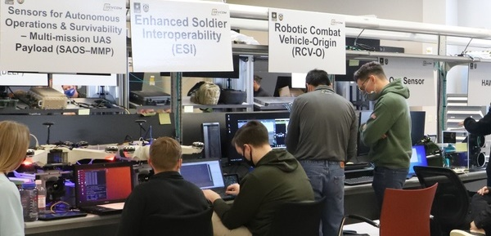
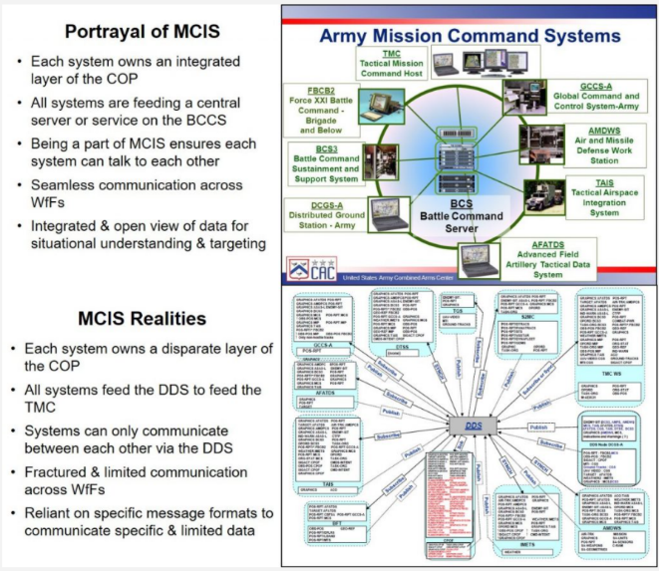
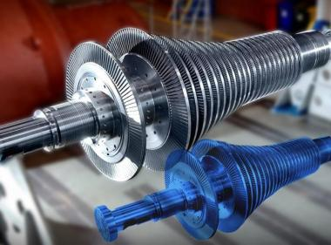
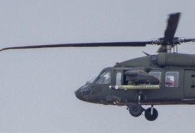
Digital Twin
Build
Digital Twin
4.3
“Digital Twin” = virtual representation that serves as the real-time digital counterpart of a physical object, Live Systems, Command & Control Systems, Hardware-in-the-Loop (HWIL), or the actual System Under Test
Essentially the “Live” component of the LVC event
Few events will have a full “real-world”/ “Live” element, so the team must create some representation of the actual system, organization, etc. to support the event.
Notes:
The term “digital twin” in this process represents all systems that make up the live portion of the LVC environment.
We use this term broadly to include any system that role players use or that serves as the focus of testing, evaluation, or analysis.
A digital twin may be a virtual model that mirrors the behavior of a real system, such as a software model of an aircraft flight computer.
It also includes physical components like hardware-in-the-loop rigs, actual platforms, command-and-control systems, or mission system installations used during the event.
Examples range from replicated command posts with operational C2 systems to aircraft cockpit simulators, Stryker C2 vehicles, or even a live aircraft connected to the virtual environment.
Together, these elements form the digital twin applications that represent the live systems within the distributed LVC environment.
Transition: With the digital twin defined, we can now shift to the next step and begin designing the operational wrap-around that connects all systems into a coherent event environment.
Graphics Source:
https://mwi.usma.edu/90s-america-online-dial-internet-fixing-armys-horribly-outdated-digital-information-systems/
https://www.dvidshub.net/search/?filter[type]=image&filter[tags][]=project-convergence&filter[date]=19691231-20220214&sort=date
https://www.ge.com/research/technology-domains/software-analytics/physical-digital-analytics

Slide 21
Step 5 : Design Operational Wrap Around
Step 1
Step 2
Step 3
Step 4
Step 5
Step 6
Step 7
Step 8
Step 9
Project Initiation
Perform Conceptual Analysis
Conduct Wargame Exercise
Develop
Digital Twin
Design Operational Wrap-Around
Develop Operational Wrap-Around
Integrate & Validate Environment
Plan & Execute
Event
Analyze Data and Evaluate Results
Develop
Objectives
Develop
Scenario
Wargame Preparation
Select
Digital Twin Applications
Select
Wrap-Around Applications
Develop
System Interface Model
Plan
Integration
Plan
Execution
Analysis & Evaluation
1.1
2.1
3.1
4.1
5.1
6.1
7.1
8.1
9.1
Conduct
Initial Planning
Develop
Conceptual Model
Conduct Wargame
Acquire Resources
Design
Environment
Establish Environment Agreements
Integrate Environment
Conduct
Record Runs
Reporting
1.2
2.2
3.2
4.2
5.2
6.2
7.2
8.2
9.2
Develop Environment Requirements
Post
Wargame Analysis
Build
Digital Twin
Design
Wrap-Around
Applications
Develop
Wrap-Around Applications
Validate Environment
Prepare
Data Outputs
Lessons Learned & Retirement
2.3
3.3
4.3
5.3
6.3
7.3
8.3
9.3
Wargame Reporting
“Applications” = Software, Tools, System, Force Structure, Entities, Terrain, etc.
Implement Wrap-Around Infrastructure
3.4
6.4
Notes:
Step 5 designs the operational wrap-around that surrounds the digital twin and creates the full LVC event environment.
We define the wrap-around as the collection of simulations, cyber tools, management systems, and data-collection tools that make the environment operationally realistic.
This step identifies the member applications needed to support the event, whether they already exist or must be developed or modified.
We design the infrastructure and system architectures that connect the digital twin to these member applications and ensure they interact correctly.
By completing this step, we create the framework that enables the digital twin to operate within a complete, coherent, and mission-relevant environment.
Transition: we’ll deep dive into 5.2: Design the Environment

Slide 22
Activity 5.2: Design the Event Environment
Step 5
Design Operational Wrap-Around
5.2 Design Event Environment
5.2 Lead Role: Technical Coordinator
Inputs
Tasks & Techniques
Outputs
Conceptual Model
Event Environment requirements
List of selected digital twin and member applications & hardware
Analyze the environment requirements, digital twin and wrap-around application lists, and conceptual models
Evaluate the need for bridging or cross-domain solutions
Identify & diagram the infrastructure architecture for facilities, network, and hardware
Identify & diagram the system architecture for ports and protocols and system connectivity
Infrastructure Architecture:
  Site facility diagram
  Network diagram
  Hardware diagram
System architecture
  Connectivity diagram
  Ports & Protocols list
Notes:
Once we identify the digital twin components and the wrap-around applications, we begin designing the full event environment.
We define the infrastructure architecture by documenting the physical layout of the environment, including facilities, server rooms, labs, event spaces, network equipment, and hardware platforms.
We also design the system architecture, which captures how all hardware, networks, software, and member applications connect and interact.
During this activity, we document the ports, protocols, and communication paths each application uses so the team understands how information flows across the environment.
This step establishes the technical foundation of the event by showing how every system communicates, from physical hardware through network layers to application-level connections.
Teams often build detailed engineering diagrams or “horse blankets” to visualize the complete architecture and ensure nothing is overlooked.
Transition: The next slide shows examples of common infrastructure architecture diagrams used to represent these designs.

Slide 23
Infrastructure Architecture Diagrams
Design
Environment
5.2
Network Diagram
Footprint Diagram
Hardware diagram
Notes:
Infrastructure architecture diagrams help the team visualize how the event environment is organized at the physical level.
We use facility footprint diagrams to show the layout of event spaces, including computers, tactical equipment, live vehicles, and the furniture or briefing areas that support operations.
We use network diagrams to show how hardware, virtual networks, VLANs, and subnets connect. These diagrams help teams build, troubleshoot, secure, and validate the environment.
We use hardware architecture diagrams to map the physical placement of servers, switches, and routers, along with the cabling and connections between them.
Most teams create these diagrams using tools like Visio or systems engineering platforms such as Cameo or Enterprise Architect.
Transition: The next slide shifts from the physical view to the logical view by showing the system architecture diagram we typically use for LVC events.

Slide 24
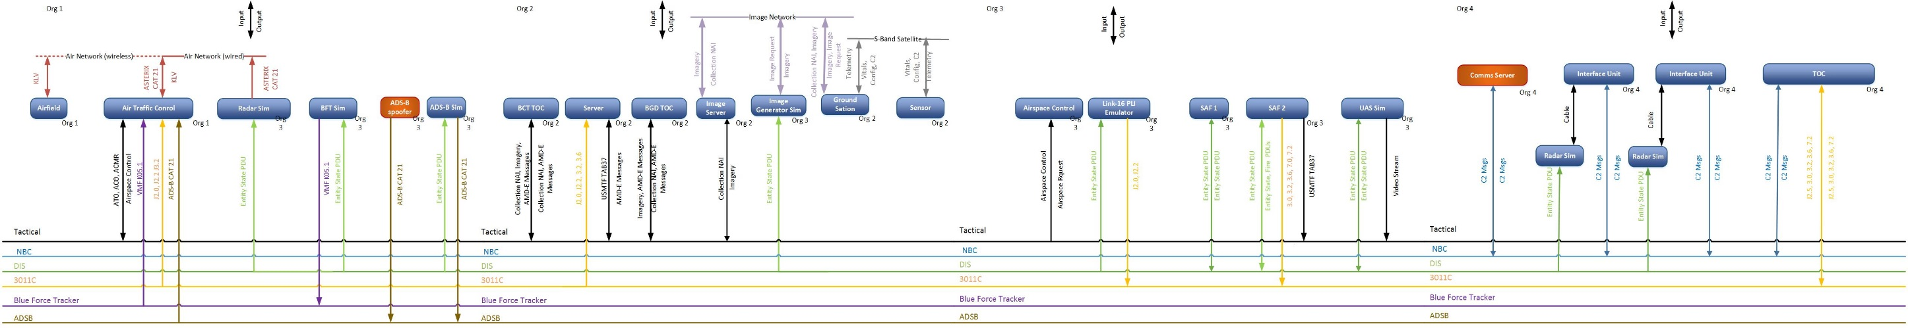
System Architecture: Connectivity Diagram
Design
Environment
5.2
The purpose of this diagram is to convey the connectivity between systems
The representation and data vary by event
Key data: Protocol, messages, and system names
Ease of briefing is a key consideration in selecting a diagram format or tool
Notes:
System architecture diagrams show how member applications connect across the event environment, grouped by their physical or organizational locations.
These diagrams illustrate the logical networks, protocols, and message exchanges that allow systems to communicate during the event.
We use these diagrams as a framework for technical discussions because they show system names, network paths, and key interfaces in a clear and organized way.
RTC uses a “guitar string” format built in Visio, which makes it easy to brief and review during technical working groups.
Transition: The next slide provides a more detailed example of a connectivity diagram and the information it captures.

Slide 25
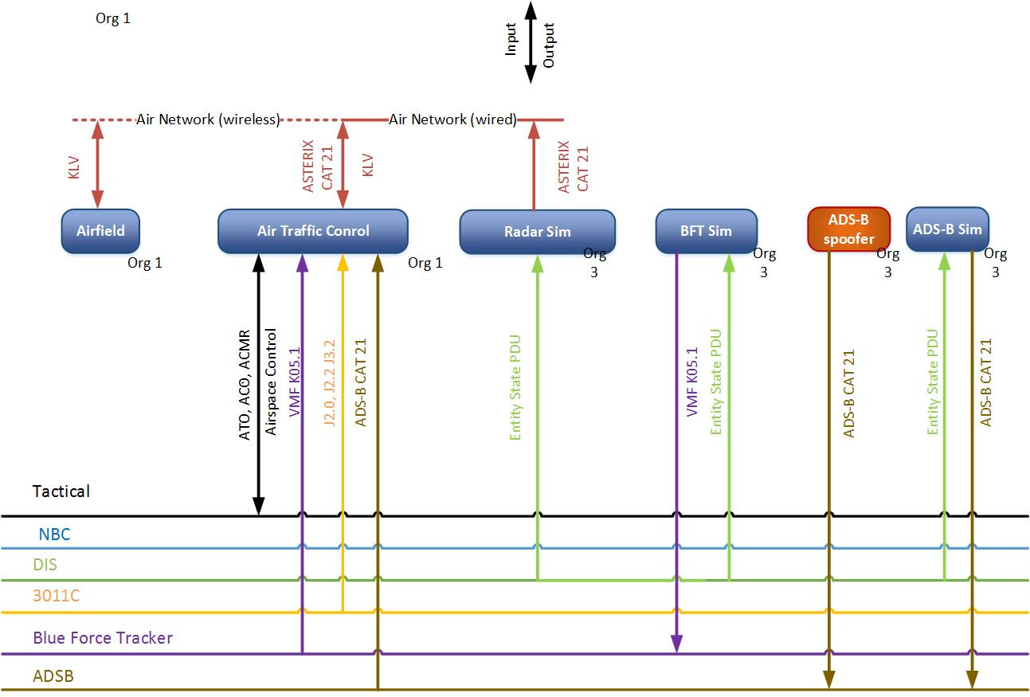
Connectivity Diagram Detail
Design
Environment
5.2
Notes:
The connectivity diagram shows how all member applications communicate by mapping the logical network connections between systems.
We group applications by physical location or site so the team can see where each system resides within the event environment.
The diagram captures the message types, formats, PDUs, and protocols each system uses so we understand exactly how data moves across the environment.
This level of detail helps the team identify missing interfaces, confirm compatibility, and prepare for integration activities in later steps.
Transition: With the connectivity diagram established, we can now move into Step 6 and begin building the detailed interface model that supports integration and testing.

Slide 26
Step 6 : Develop Operational Wrap-Around
Step 1
Step 2
Step 3
Step 4
Step 5
Step 6
Step 7
Step 8
Step 9
Project Initiation
Perform Conceptual Analysis
Conduct Wargame Exercise
Develop
Digital Twin
Design Operational Wrap-Around
Develop Operational Wrap-Around
Integrate & Validate Environment
Plan & Execute
Event
Analyze Data and Evaluate Results
Develop
Objectives
Develop
Scenario
Wargame Preparation
Select
Digital Twin Applications
Select
Wrap-Around Applications
Develop
System Interface Model
Plan
Integration
Plan
Execution
Analysis & Evaluation
1.1
2.1
3.1
4.1
5.1
6.1
7.1
8.1
9.1
Conduct
Initial Planning
Develop
Conceptual Model
Conduct Wargame
Acquire Resources
Design
Environment
Establish Environment Agreements
Integrate Environment
Conduct
Record Runs
Reporting
1.2
2.2
3.2
4.2
5.2
6.2
7.2
8.2
9.2
Develop Environment Requirements
Post
Wargame Analysis
Build
Digital Twin
Design
Wrap-Around
Applications
Develop
Wrap-Around Applications
Validate Environment
Prepare
Data Outputs
Lessons Learned & Retirement
2.3
3.3
4.3
5.3
6.3
7.3
8.3
9.3
Wargame Reporting
Implement Wrap-Around Infrastructure
3.4
6.4
“Applications” = Software, Tools, Systems, Datasets, Force Structure, Entities, Terrain, etc.
Notes:
Step 6 develops and instantiates the member applications.
We identify the messages, data formats, and protocols each system uses and document how they must interact to support the event objectives.
During this step, we modify or acquire member applications as needed to ensure they can send, receive, and process the required data.
We also prepare the physical environment for integration by confirming that hardware, networks, and system configurations are ready for testing.
This step creates the baseline interface model that guides the integration work in Step 7.
Transition: With the interface requirements defined, we can now begin building the detailed interface matrix that drives pairwise testing and full environment integration.

Slide 27
Activity 6.1: Develop the System Interface Model
Step 6
Develop Operational Wrap-Around
6.1 Develop System Interface Model
6.1 Lead Role: Technical Coordinator
Inputs
Tasks & Techniques
Outputs
Conceptual Model
Event Environment design & Connectivity Diagrams
Application Interfaces from Digital Twin, M&S applications, and Analysis Applications
Environment agreements on simulation interconnectivity or interoperability models / standards, enumerations, formats, etc.
Data dictionary elements from existing repositories
Review applicable member applications and data dictionaries to identify relevant protocol and message
Identify and diagram the sequence of data, message pathways, and data flow between member applications elements
Develop a system interface matrix that documents each pair of sender, receiver, message data types, protocol, and network
Verify that the System Interface Matrix supports the Event environment design and the conceptual model
System interface model including interface matrix
Notes:
Activity 6.1 expands the event design by documenting the specific message interfaces each application needs during runtime.
The key product of this activity is the System Interface Model, often represented as an interface matrix.
For the environment to function, the digital twin, simulations, cyber tools, and all supporting applications must exchange data correctly.
We identify the protocols and message formats each application uses, since the event may rely on both common standards and domain-specific interfaces.
Many applications use standard IT protocols such as TCP, UDP, HTTP, or SNMP.
Modeling and simulation systems often require specialized protocols such as DIS, HLA, or TENA.
Mission command systems may depend on additional domain-specific formats like DDS, PASS, JVMF, or Link 16.
Cyber tools may introduce their own protocols or routing behaviors that the environment must accommodate.
To support this activity, the team may need interface control documents, data-flow diagrams, or other technical references from each participating system.
Transition: The next slides walk through the interface matrix in more detail and show examples of how we represent these interfaces.

Slide 28
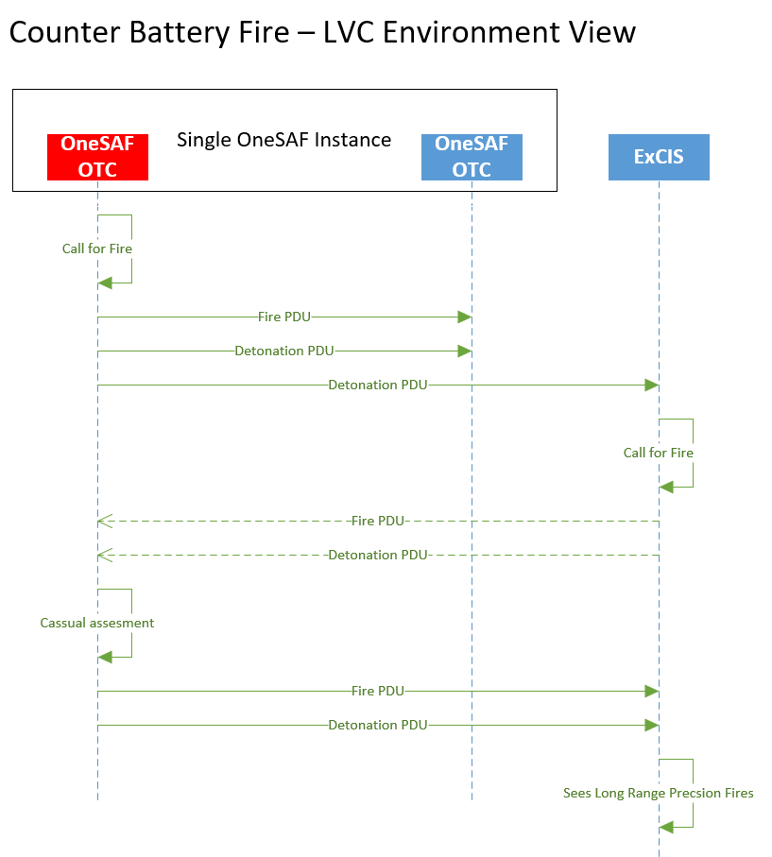
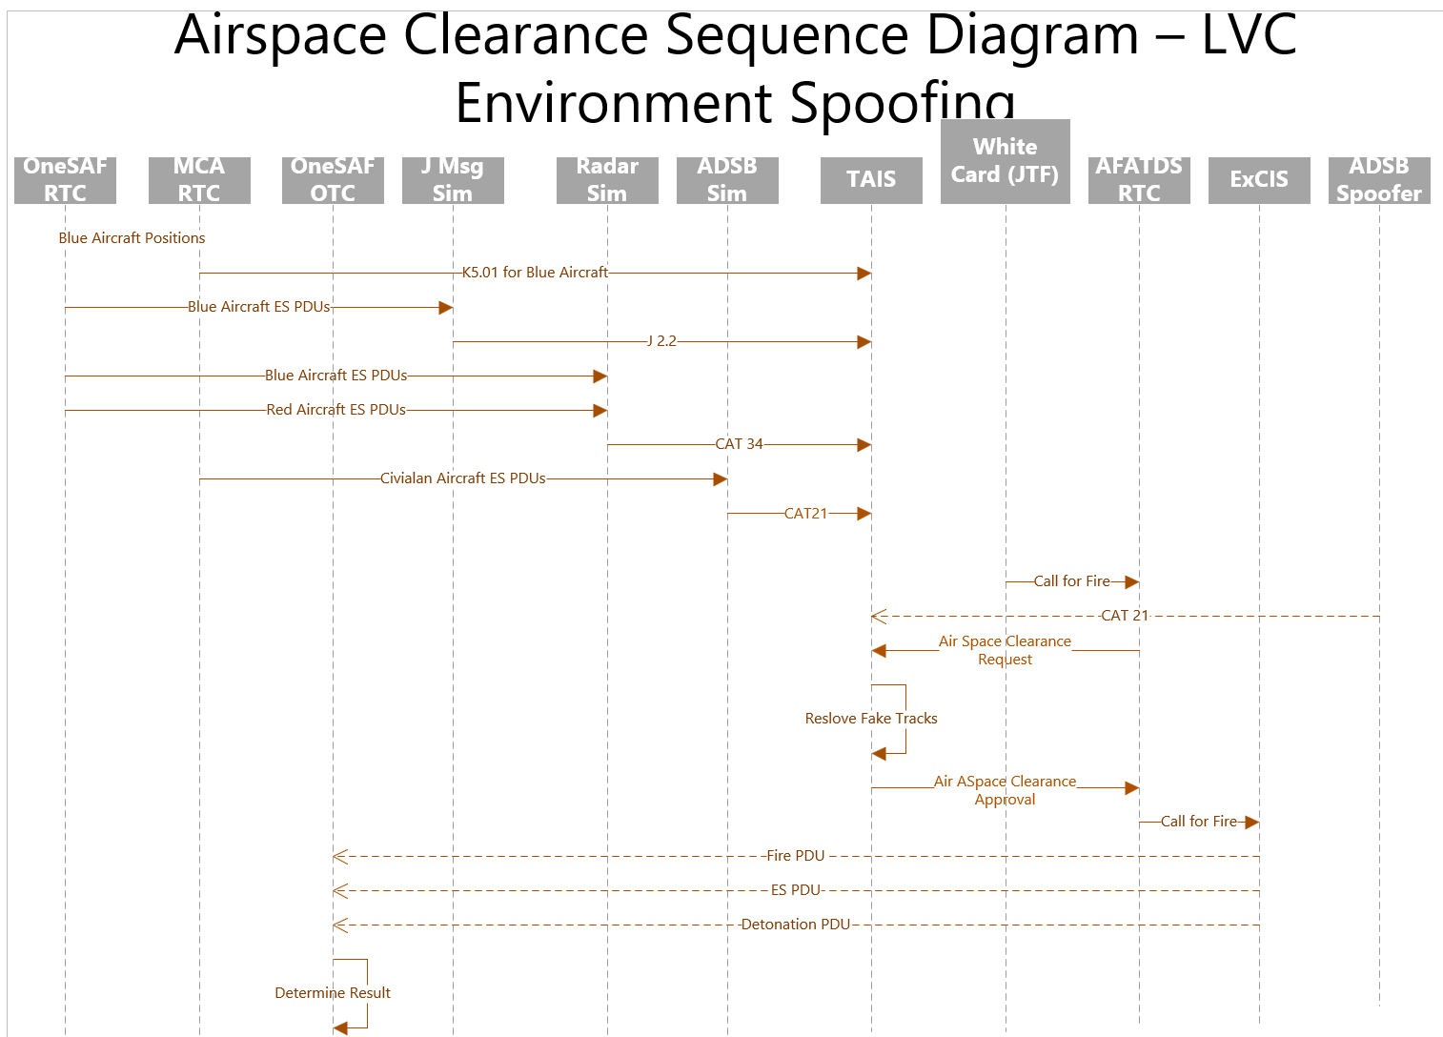
Systems Interface Model(s)
Notes:
These examples show different ways to represent how data moves between member applications during the event.
They illustrate the message paths, sequencing, and interactions that the team must understand before building the detailed interface matrix.
By reviewing these models, we verify that each system has a defined role in the data flow and that no required interactions are missing.
These early representations also help the team identify potential gaps or mismatches in protocols before integration begins.
Transition: Now that we have the high-level examples, we can shift to the interface matrix itself, which captures the detailed message-level information needed for integration and testing.

Slide 29
Interface Matrix
Develop
System Interface Model
6.1
The Interface Matrix documents all messages sent and received in the distributed LVC environment
  This includes all simulation and tactical messages
It is based on the data documented in the Connectivity Diagram
  Update the Connectivity Diagram if the team finds more interfaces when creating the Interface Matrix
Heavily used in Activity 7.2 to integrate the environment
In addition to listing each Source / Target / Message, the matrix includes all the configuration information for the interface
  All the configuration data may not be known in the first versions of the matrix
Notes:
The System Interface Model must document every interface and data exchange between applications so the environment operates correctly.
We build an interface matrix that lists the sending system, receiving system, message type, and transport details for each interaction.
We use the connectivity diagram from Activity 5.2 and any interoperability agreements from Activity 6.2 to identify the full set of required message flows.
Creating a complete interface matrix ensures the event environment supports all required capabilities and interactions across simulations, mission systems, cyber tools, and hardware.
Transition: The next slides show a sample interface matrix and walk through the specific details you need to capture when building one.

Slide 30
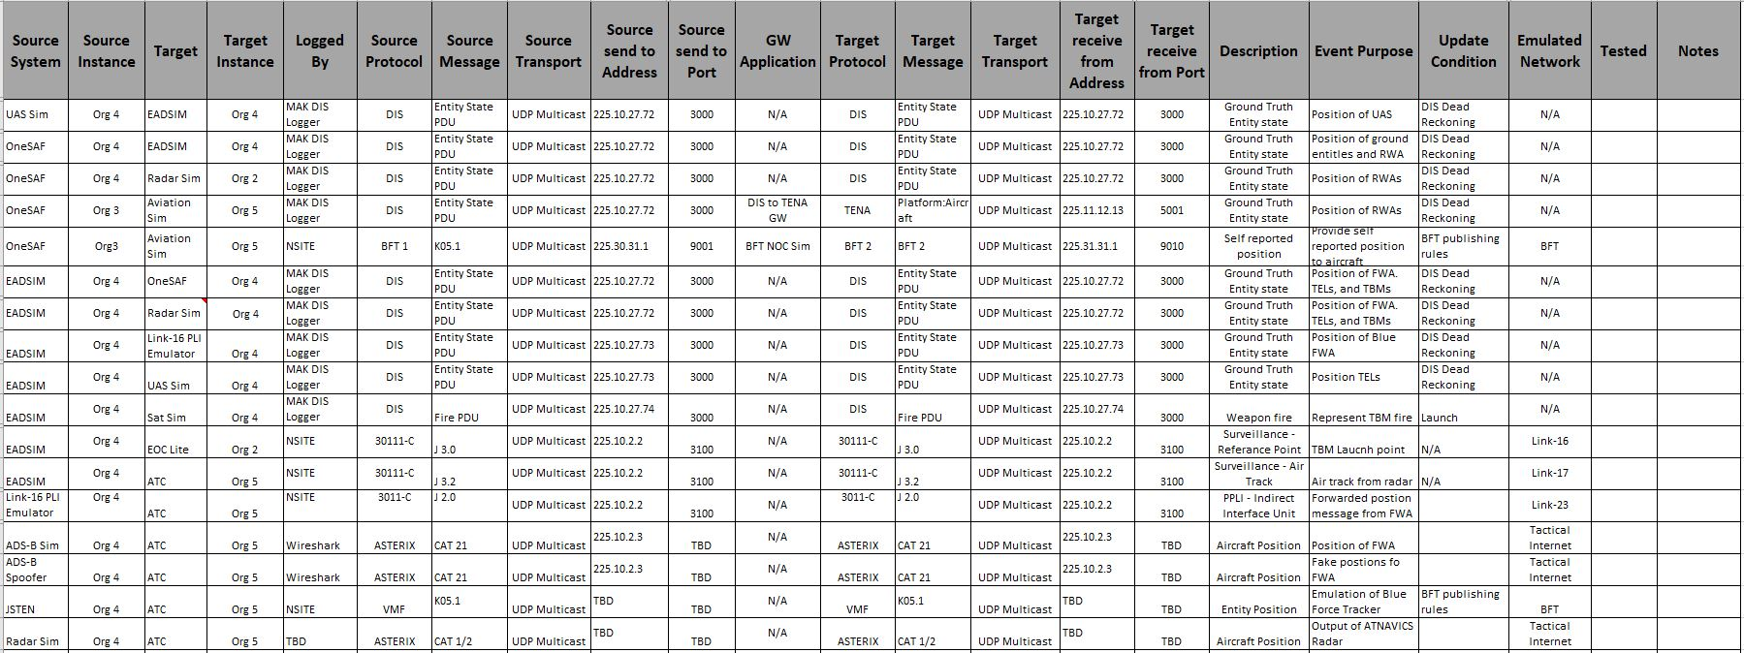
Interface Matrix (Sample)
Develop
System Interface Model
6.1
One row for each data message by source and target
Columns for all information needed to configure and test the systems
All addresses are notional
Notes:
The interface matrix represents every message exchanged in the environment by giving each source–target pair its own row.
Each row captures the configuration details needed to set up, test, and validate the interaction between those systems.
This sample matrix provides a visual reference for how we organize the information and how the team will use it during integration.
Transition: On the next slides, we will break down the key columns so you can see exactly what information belongs in each part of the matrix.

Slide 31
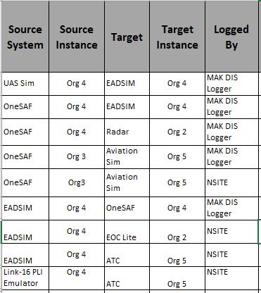
Interface Matrix Detail (1 of 3)
Develop
System Interface Model
6.1
System that is the source of the message
It is critical to list how to log the message
System that is the Target of the message
There may be more than one instance of the system potentially at different sites
There is a line for every source/target pair even if it is the same message
Notes:
The first part of the matrix documents the source and target systems for each message so the team can trace exactly where data originates and where it must go.
We list every source–target pair, even when multiple systems send the same type of message or when a single message fans out to several destinations.
We specify system instances and site locations to avoid ambiguity, especially when similar systems appear at multiple sites.
We also document how each message will be logged so analysts and integrators can verify that the message was generated, transmitted, and received as expected.
This section of the matrix ensures the team understands every communication path before integration begins.
Transition: Next, we will look at the message fields, protocols, and transport details required to configure these interactions correctly.

Slide 32
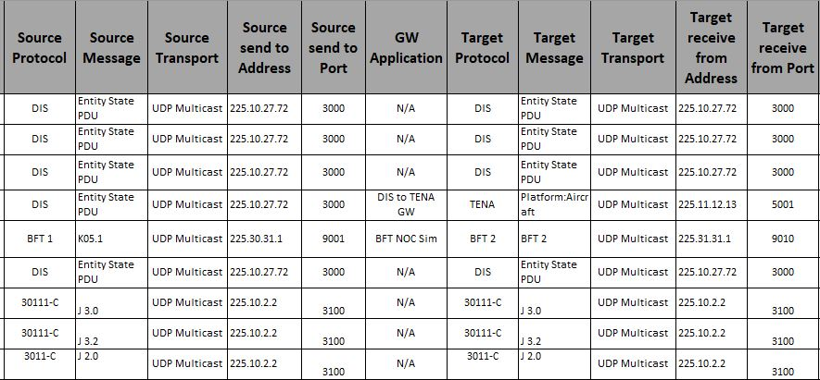
Interface Matrix Detail (2 of 3)
Develop
System Interface Model
Name of Gateway Application
6.1
Protocol can be distributed sim or tactical
The actual message being sent
Transport Examples: UDP Multicast, UDP Broadcast, TCP Unicast
There may be a “middle-man” between the sending and receiving applications
Therefore the address the message is sent to may not be the one the target application receives it on
The most common example of this is distributed simulation gateways, but is also used for some tactical systems as well
Address to send message to
Port to send the message to
All addresses are notional
Notes:
This section of the matrix documents the technical details needed to configure each message exchange correctly.
We identify the protocol the systems use, whether it is a distributed simulation protocol or a tactical protocol, so the team understands how the data is structured.
We list the specific message or PDU type to define exactly what information is being exchanged between systems.
We document the transport method, such as UDP multicast, UDP broadcast, or TCP unicast, because each transport requires different configuration steps.
We capture the destination address and port for each message so network and system teams can route traffic accurately.
We also identify any gateways involved since the address a system sends to may differ from the address the receiving application actually uses.
Transition: The final part of the matrix captures why each message exists, how it behaves, and where it belongs within the event network structure.

Slide 33
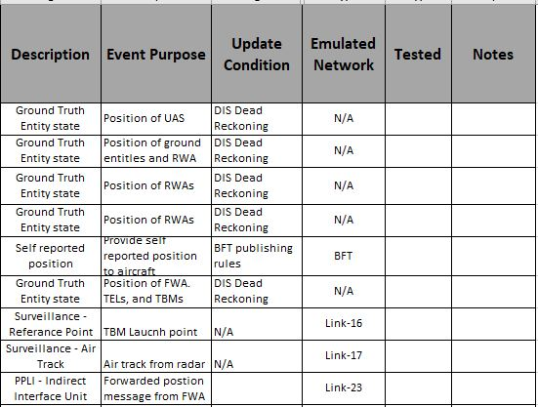
Interface Matrix Detail (3 of 3)
Develop
System Interface Model
6.1
Description of the message
Indicates confirmation of receipt of the message by the target
The name of real network the message would be sent on, or the VLAN used in the Event
The specific purpose of the message for the event, the same message may have different purposes based on the source/target pair
Update condition may be trigger based or rate based
Notes:
This final portion of the matrix explains why each message exists and how it behaves in the event environment.
We document the purpose of the message so the team understands what operational function it supports and how it contributes to the scenario.
We describe the update conditions, noting whether the message triggers on an event or updates at a defined rate, since this affects network load and timing.
We specify any required confirmations or acknowledgments so we can verify that the receiving system processed the message correctly.
We identify the real-world network or event VLAN associated with the message to ensure traffic flows on the correct segment during integration.
Together, these details let the team configure, test, and validate every interaction with full awareness of why the message matters.
Transition: With the interface matrix complete, we are ready to move into Step 7, where we begin integrating and validating the full event environment.

Slide 34
Step 7 : Integrate & Validate Environment
Step 1
Step 2
Step 3
Step 4
Step 5
Step 6
Step 7
Step 8
Step 9
Project Initiation
Perform Conceptual Analysis
Conduct Wargame Exercise
Develop
Digital Twin
Design Operational Wrap-Around
Develop Operational Wrap-Around
Integrate & Validate Environment
Plan & Execute
Event
Analyze Data and Evaluate Results
Develop
Objectives
Develop
Scenario
Wargame Preparation
Select
Digital Twin Applications
Select
Wrap-Around Applications
Develop
System Interface Model
Plan
Integration
Plan
Execution
Analysis & Evaluation
1.1
2.1
3.1
4.1
5.1
6.1
7.1
8.1
9.1
Conduct
Initial Planning
Develop
Conceptual Model
Conduct Wargame
Acquire Resources
Design
Environment
Establish Environment Agreements
Integrate Environment
Conduct
Record Runs
Reporting
1.2
2.2
3.2
4.2
5.2
6.2
7.2
8.2
9.2
Develop Environment Requirements
Post
Wargame Analysis
Build
Digital Twin
Design
Wrap-Around
Applications
Develop
Wrap-Around Applications
Validate Environment
Prepare
Data Outputs
Lessons Learned & Retirement
2.3
3.3
4.3
5.3
6.3
7.3
8.3
9.3
Wargame Reporting
Implement Wrap-Around Infrastructure
3.4
6.4
Notes:
Step 7 brings all components of the event environment together so the team can plan, integrate, verify, and validate the full system before execution.
We integrate the network, digital twin, simulations, cyber tools, hardware, and databases to confirm they operate as a single, coherent environment.
During this step, we verify that systems communicate correctly and behave as intended, and we validate that the environment accurately represents real-world operations.
This step relies on a structured set of 7 integration blocks, which guide the team through the sequence of tasks needed to build confidence in the environment.
We develop the overall integration plan in Activity 7.1, execute Integration Blocks 1 through 6 in Activity 7.2, and perform Block 7 in Activity 7.3.
Transition: The next slides walk through each integration block and show how they build the environment from basic connectivity to full scenario execution.

Slide 35
Activity 7.1: Plan Integration
Step 7
Integrate & Validate Event Environment
7.1 Plan Integration
7.1 Lead Role: Technical Coordinator
Inputs
Tasks & Techniques
Outputs
Scenario
Event Environment requirements
Validation Criteria
Event Environment design documentation and diagrams
System Interface Model
Event Environment Agreements
Draft Analysis Plan
Develop the Integration methodology for Event Environment integration
Write the Integration plan and publish to the event CoP
Write the Spiral Integration plans for each scheduled Spiral
Update the Configuration Management plan with procedures for establishing and managing configuration baselines
Conduct the Technical Integration Meeting (TIM)
Conduct the Integration Readiness Review (IRR)
Integration plan including each Spiral Plan
Formal VV&A Plans
Configuration Management Plan
IRR Approval to begin Integration
Notes:
Activity 7.1 develops the detailed plan the team will use to conduct integration testing across all participating sites.
We build an integration plan that outlines the tasks required to verify the technical implementation of the environment and ensure every system is configured correctly.
The plan defines what we will test, how we will test it, and the order in which the team will perform each activity.
We document the entrance and exit criteria for each phase so the team knows exactly what must be completed before moving forward.
By completing this activity, we create the roadmap that guides the verification and validation work performed in the integration blocks.
We’ll deep dive on the integration plan a bit more

Slide 36
Integration Planning
Plan
Integration
7.1
Integration Plan
Integration Blocks
  Set of activity blocks to integrate a distributed simulation system
Integration Planning
  Mapping activity blocks to integration spirals
  Scheduling integration spirals
  Integration Plan development
Spiral Planning
  Expanding Integration Plan
  Developing detailed integration spiral plan
Notes:
Integration planning lays the foundation for all work in Step 7 by defining how we will build, test, and validate the event environment.
We create an integration plan that identifies the tasks required to confirm technical implementation across all systems, networks, and applications.
We organize the work into activity blocks, then map those blocks into integration spirals so teams can focus on achievable sets of tasks in each cycle.
We schedule the spirals to give participants enough time to resolve issues, update configurations, and prepare for the next phase of integration.
As part of spiral planning, we expand the integration plan, refine task lists, and develop detailed spiral plans that outline the exact steps for execution.
This planning effort ensures the entire team is aligned on the sequence of work and the criteria required to progress through integration and validation.
Transition: With the integration planning framework in place, we can now begin walking through the integration blocks

Slide 37
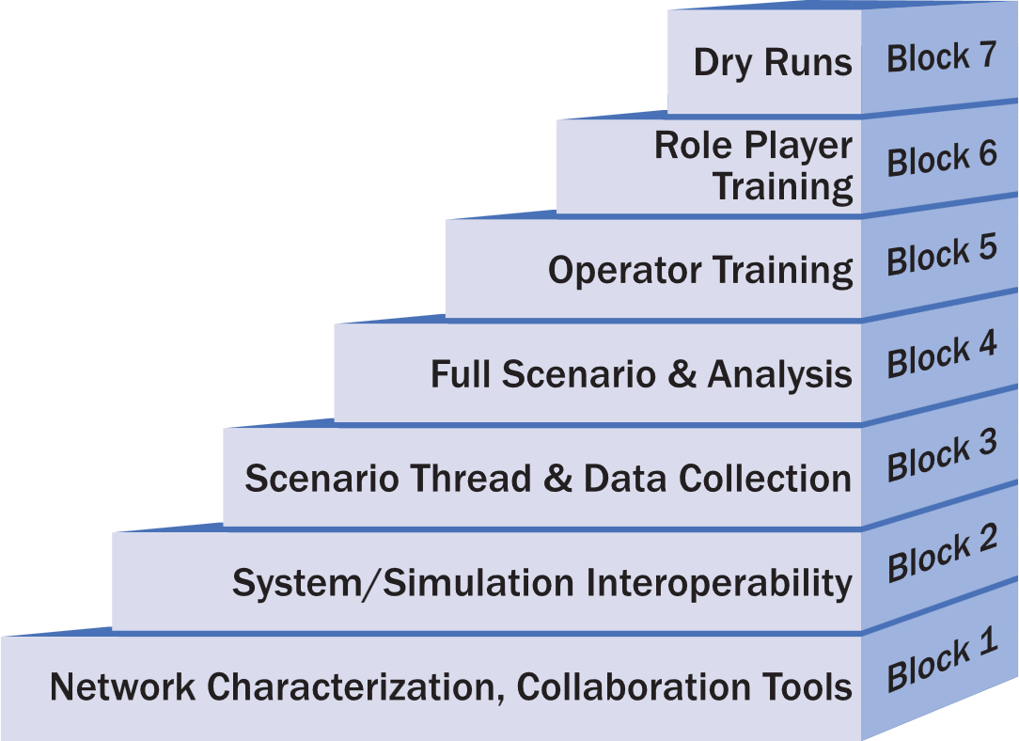
Integration Blocks (Overview 1 of 2)
Plan
Integration
7.1
We divide the activities to integrate the system into a series of seven blocks
Each block has a focus
Each block builds on earlier blocks
Tailor the block activities based on the nature of the event
Notes:
The integration blocks break the Integration testing into a structured sequence so the team can integrate systems in a controlled and predictable way.
Each block focuses on a specific set of integration tasks, starting with basic connectivity and progressing toward full scenario execution.
These blocks build on the work completed in the integration planning step, giving the team a roadmap that moves from low-level technical verification to operational realism.
The structure helps us uncover issues early, isolate them more easily, and avoid discovering critical problems late in the schedule.
By moving through these blocks in order, the team gains confidence that the environment is stable, connected, and ready for more complex interactions.
Transition: The next slide is a bit of an eye chart, where we list the details for each block on a single chart

Slide 38
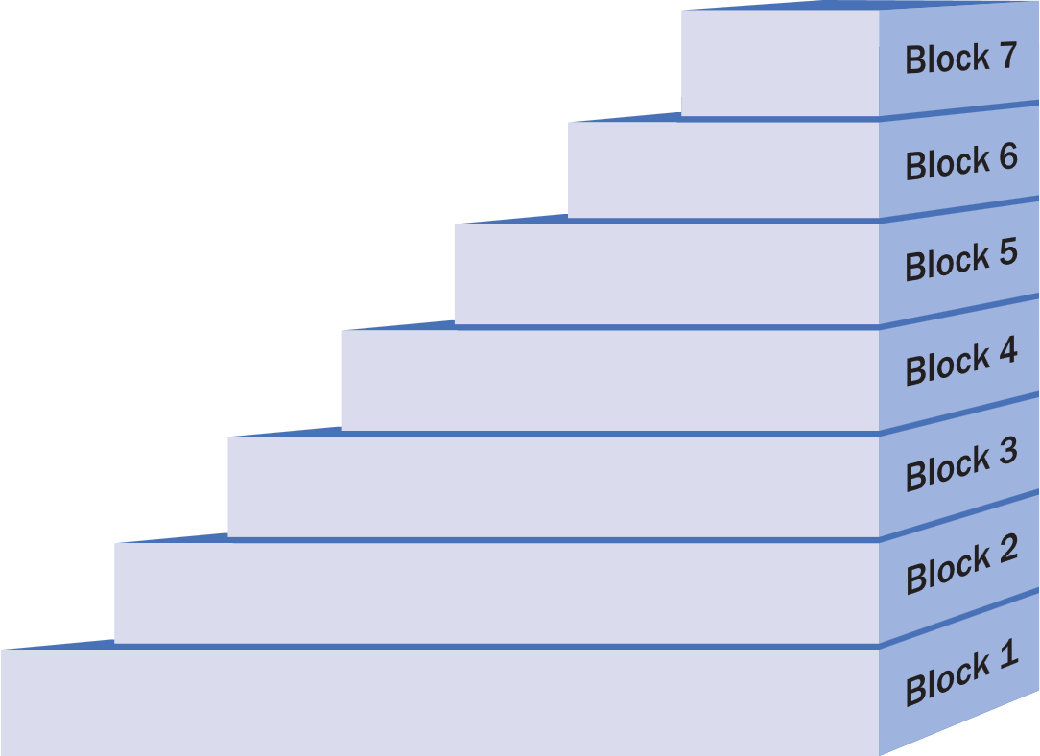
Integration Blocks (Overview 2 of 2)
Plan
Integration
7.1
Here we show the major tasks that occur during each block
Dry runs of all scenarios
Train role players on new equipment|
Tain role players on new processes|
Verify scenario timing with role players
Optional
Train all operators on the simulation or tactical systems | Train data collection operators on required tools | Train operators on processes they will be executing
Optional
Verify event timing | Perform full data collection | Perform full data analysis | Verify there is no extraneous network traffic |
Verify that the scenarios can be executed in the allotted time |
Verify that the network can support the load of the full scenario
Execute all scenario threads | Perform full data collection
Verify that all data required for analysis is being collected
Verify that required analysis can be performed
Initialize the environment using the defined procedures
Pairwise tests all interfaces | Weapon/target pairs | Verify critical enumerations | Terrain correlation
Test all multicast addresses | Full Distributed simulation architecture
Simulation initialization activity data | Critical data collection requirements | Analysis with collected data
Full mesh Ping | Network characterization | Checkout commercial and VOIP phones | Multicast transport
Maximum Transmission Unit (MTU) size | Time-to-Live (TTL) | Distributed simulation architecture | Test routes through emulate network
Coordination tool training | Access to coordination tools | Network monitoring software Time Server
Notes:
This slide is not intended for detailed reading during the briefing. It serves as a reference point when we develop the integration plan and schedule spirals.
It gives the team a complete view of all integration blocks so we can confirm the full scope of work and ensure we account for every required activity.
We use this overview during planning to verify that network, system, scenario, and data-collection tasks are all represented.
Next, we will overlay additional tasks that apply to cyber events and multi-architecture environments so you can see how the blocks adapt to those situations.

Slide 39
Integration Blocks – Cyber, Live, & Multi Architecture
Plan
Integration
7.1
Live systems scenarios
Final verification
Execute complete
red threats
Some events may need more tasks
  Live systems
  Multiple distributed simulation architectures
  Cyber events
Role players trained and certified
Verify red threats
Train cyber defense team
Train Operators on use and safety
Train red threat
Live systems activities
Multi-architecture activities
Cyber activities
Live Vehicle Timing
Verify no data collection issues related to multiple architectures
Repeat each verified scenario with cyber threats
Perform full cyber data collection
Operate live system threads Timelines for live systems Range Safety
Verify data collection across all architectures | Verify startup procedures
Execute any cyber-specific threads | Perform cyber data collection | Test cyber visualization tools
Pairwise test with live interfaces | Terrain correlation of critical live areas
Fully test distributed sim architectures | Test all gateway instances | Verify gateway translations
Verify all objects in interoperability intersection
Verify cyber threat tools | Verify cyber data collection tools | Test cyber threat tools messaging
Live System Interfaces
Verify each Architecture/SDEM Federation individually | Integrate Architecture/SDEM enclaves at all sites | Verify basic connectivity across all Architecture/SDEM enclaves | Test each Gateway | Verify no loops between enclaves
Verify Cyber systems network connectivity
39

Slide 40
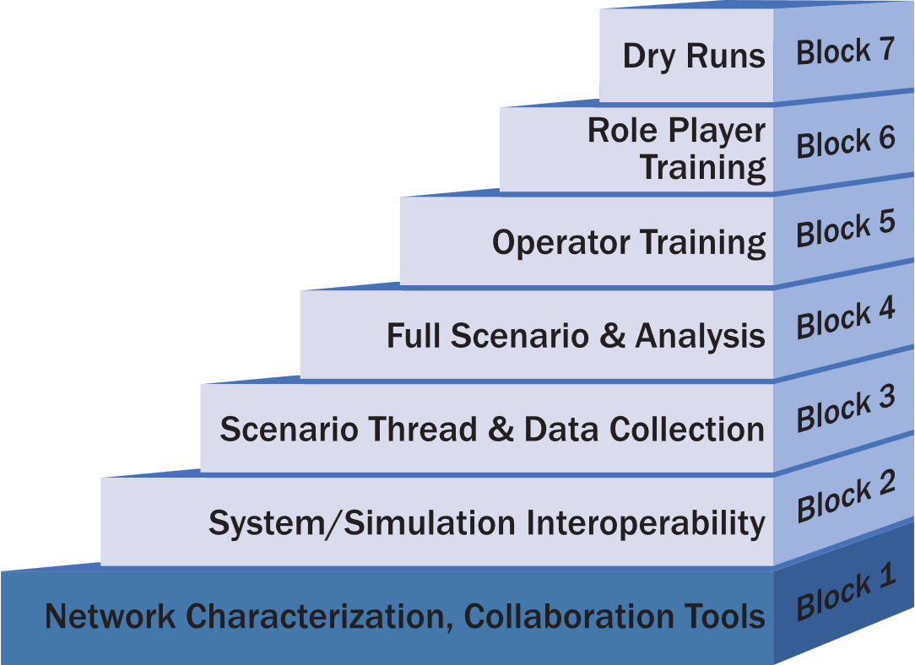
Block 1: Network Characterization, Collaboration Tools
Plan
Integration
7.1
Block 1 activities focus on establishing:
  the network
  infrastructure tools
The minimum entrance requirements for this block are:
  all sites on the network
  infrastructure tools installed

Slide 41
Block 1 : Network Characterization, Collaboration Tools (1 of 3)
Plan
Integration
7.1
General
Ping all sites from all other sites to verify full mesh connectivity
Find network latencies, jitter, and bandwidth by performing full mesh network characterization
Checkout commercial voice and VOIP coordination lines
If multicast transport is needed, verify at least one multicast address is working to make sure the rendezvous point is configured correctly
Determine the correct Maximum Transmission Unit (MTU) size for the network, and make sure all computers have correctly set the MTU
  MTU size is critical when using tunnels or encryptors
Verify systems have Time-to-Live (TTL) set based on network configuration

Slide 42
Block 1 : Network Characterization, Collaboration Tools (2 of 3)
Plan
Integration
7.1
General
Check out connectivity using the selected distributed simulation architecture(s)
Verify all sites have access to coordination/collaboration tools
Train the team on coordination tools including chat, file share, Time Ordered Event List (TOEL) server, visualization, and VTC
Implement and test network monitoring system
Verify all sites have access to a time server
If using emulated networks – verify routes through the emulated network
Live
Test connectivity to software and systems used to convert live data to simulation

Slide 43
Block 1 : Network Characterization, Collaboration Tools (3 of 3)
Plan
Integration
7.1
Multi-Architecture
Verify each Architecture / SDEM Federation individually
Integrate Architecture/SDEM enclaves at all sites
Verify basic connectivity across all Architecture/SDEM enclaves
Test an instance of each Gateway
Verify there are no loops between enclaves
Cyber
Verify Cyber systems network connectivity
SDEM: Simulation Data Exchange Model

Slide 44
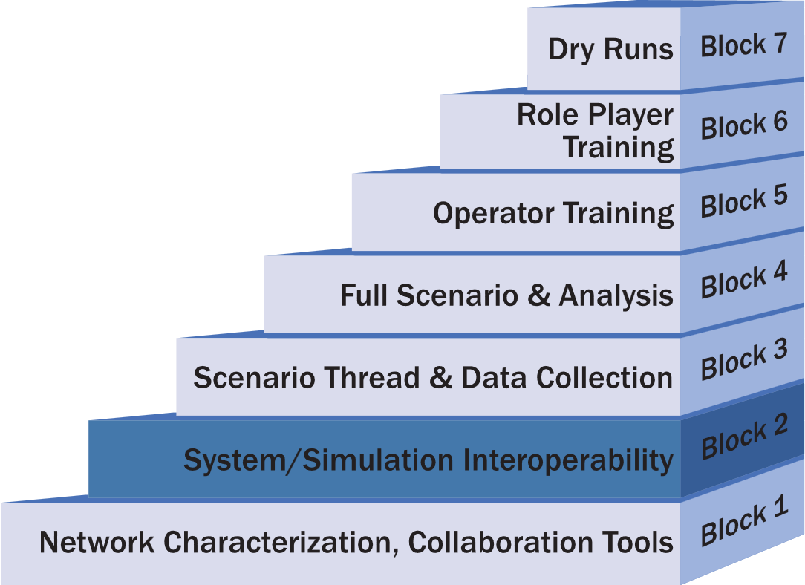
Block 2: System/Simulation Interoperability (1 of 4)
Plan
Integration
7.1
Block 2 Activities focus on: integration and testing the message interchanges between systems; checking enumerations between applications, testing parametric data and performance interactions between entities, and terrain correlation
The minimum entrance requirement for this block is an interface matrix showing all data exchanged between systems
It may be necessary to develop temporary data files, configurations, or stimulations to test pair-wise messaging between simulations/systems

Slide 45
Block 2: System/Simulation Interoperability (2 of 4)
Plan
Integration
7.1
General
Perform pairwise tests of all defined interfaces
Verify that all weapon/target pairs work as expected
Verify that critical enumerations process correctly
Perform terrain correlation to the level needed for the event
Test all multicast addresses
Fully test distributed simulation architecture
Collect data for simulation initialization activities
Check critical data collection requirements
Perform limited analysis using collected data

Slide 46
Block 2: System/Simulation Interoperability (3 of 4)
Plan
Integration
7.1
Live
Use surrogates to perform pairwise tests with live interface systems if the live systems are not available
Verify terrain correlation with live systems in critical areas
Multi-Architecture
Fully test distributed sim architectures across all sites
Test all gateway instances
Verify gateway enumeration translations
Verify all objects in Interoperability Intersection

Slide 47
Block 2: System/Simulation Interoperability (4 of 4)
Plan
Integration
7.1
Cyber
Verify cyber threat tools
Verify cyber data collection tools
If cyber threat tools send messages to other systems, include the cyber tools in pair-wise testing

Slide 48
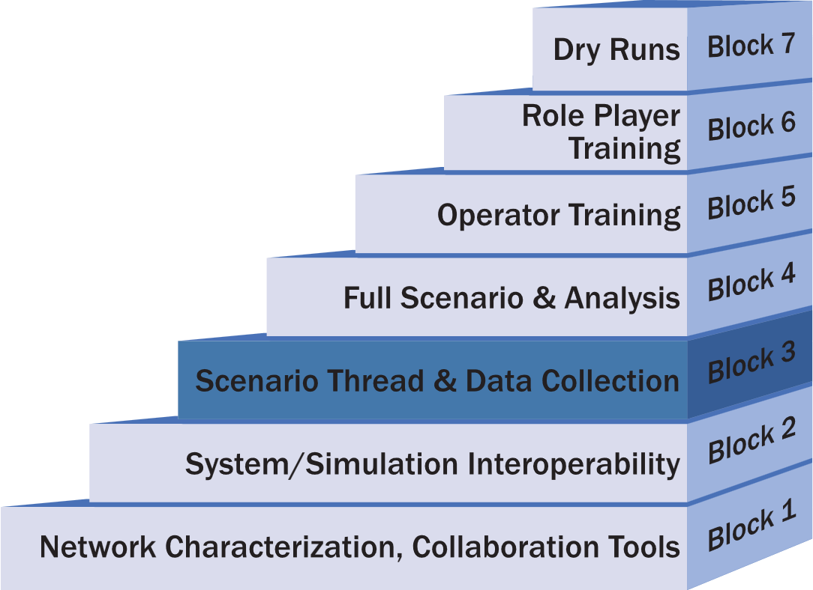
Block 3: Scenario Thread & Data Collection
Plan
Integration
7.1
Block 3 Activities focus on testing scenario threads
The minimum entrance requirement is having all scenarios defined
Develop a set of configuration files in advance to execute the test threads
Issues found in thread testing include
  Timing issues: Cannot perform all activities in the time specified
  Message issues: The simulations or tactical systems do not generate the expected output from the inputs
  Capability issues: The simulations or tactical systems cannot or do not perform the activities
Resolution of issues may require:
  Changes to the simulations
  Change in tactics
  Modification of the scenario

Slide 49
Scenario Testing Concept
Plan
Integration
7.1
Avoid the “Big-Bang” approach, running the scenario full up the first time
Review the scenario to look for:
  Activities that repeat multiple times
  Critical activities that are key to the scenario
  New or novel activities, not exercised before
  Very complex activities
  Activities that involve many participants
Document the message flows and actions needed for each of the identified threads
GOAL: eliminate issues at a small scale before attempting the full scenario

Slide 50
Definitions
Plan
Integration
7.1
Scenario: The scenario is the overall set of simulation and tactical activities that create an operationally relevant LVC environment
  Multiple similar activities that occur simultaneously
  Multiple different activities that occur simultaneously
  Involves all participants in the event
  Is long in duration
  Includes initial conditions for all entities (i.e., starting location, fuel state, etc.)
Thread: A thread is a single important scenario chain of actions, or actions that are likely to repeat throughout the scenario.
  Is a single activity
  Involves a subset of participants in the event
  Is short in duration
  Includes the conditions for the entities involved in the thread at start of the thread

Slide 51
Block 3: Scenario Thread & Data Collection (1 of 2)
Plan
Integration
7.1
General
Execute all scenario threads and verify correct execution
Perform full data collection for each thread
Verify data collection needed analysis for each thread
Verify analysts can perform needed analysis
Initialize the environment using the defined procedures
Live
Operate live systems as part of threads
Plan the timelines to get live vehicles on station
Ensure threads do not violate range safety constraints

Slide 52
Block 3: Scenario Thread & Data Collection (2 of 4)
Plan
Integration
7.1
Multi-Architecture
Verify data collection across multiple architectures
Verify startup procedures are correct for the multi-architectures
Cyber
Execute cyber specific threads
Perform cyber data collection
Test cyber visualization tools

Slide 53
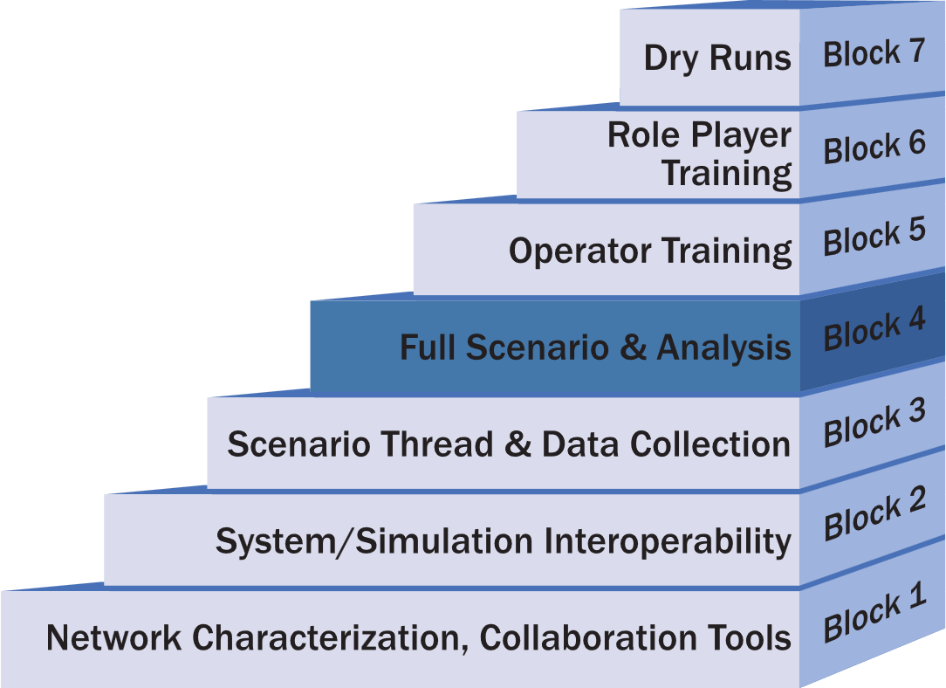
Block 4: Full Scenario & Analysis (1 of 3)
Plan
Integration
7.1
Block 4 activities focus on executing full scenarios
Conduct complete data analysis
The minimum entrance requirement is to verify all scenario threads

Slide 54
Block 4: Full Scenario & Analysis (2 of 3)
Plan
Integration
7.1
General
Execute each scenario to verify event timing
Perform full data collection for each scenario
Perform full data analysis for each scenario
Verify that the team can execute required number of scenarios in the allotted time
Verify that the network can support the load of the full scenario
Verify there is no extraneous network traffic
Live
Verify timing of live vehicles as part of the scenario

Slide 55
Block 4: Full Scenario & Analysis (3 of 3)
Plan
Integration
7.1
Multi-Architecture
Verify there are no data collection issues across the multiple architectures
Cyber
Repeat each verified scenario with cyber threats
Perform full cyber data collection
Perform full cyber analysis for each scenario

Slide 56
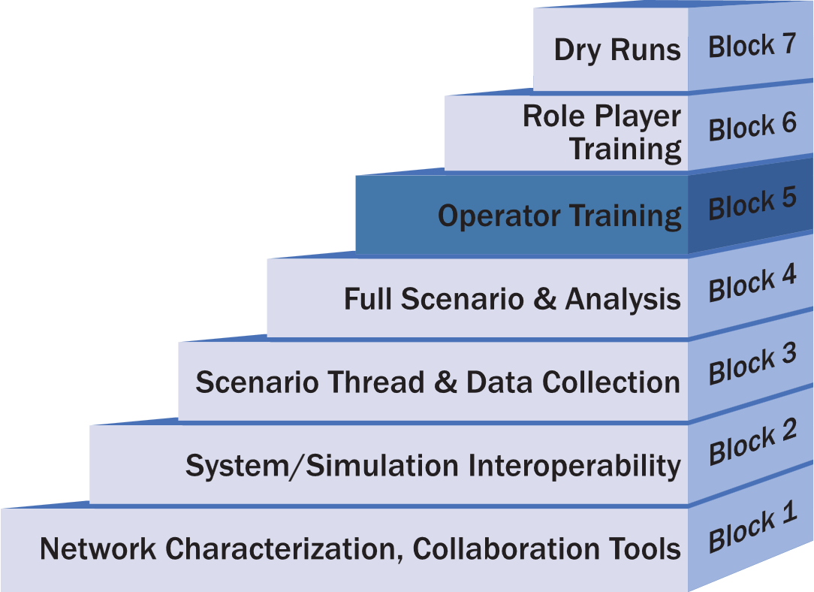
Block 5: Operator Training (1 of 2)
Plan
Integration
7.1
Block 5 activities focus on training simulation operators on the systems and tools
Depending on the requirements for the event, operator training may occur during prior activities

Slide 57
Block 5: Operator Training (2 of 2)
Plan
Integration
7.1
General
Train all operators on the simulation or tactical system they will be using
Train data collection operators on required tools including digital and manual collection
Train operators on processes they will be executing
Live
Train all operators on the use and safety requirements of live systems
Cyber
Train red threat operators

Slide 58
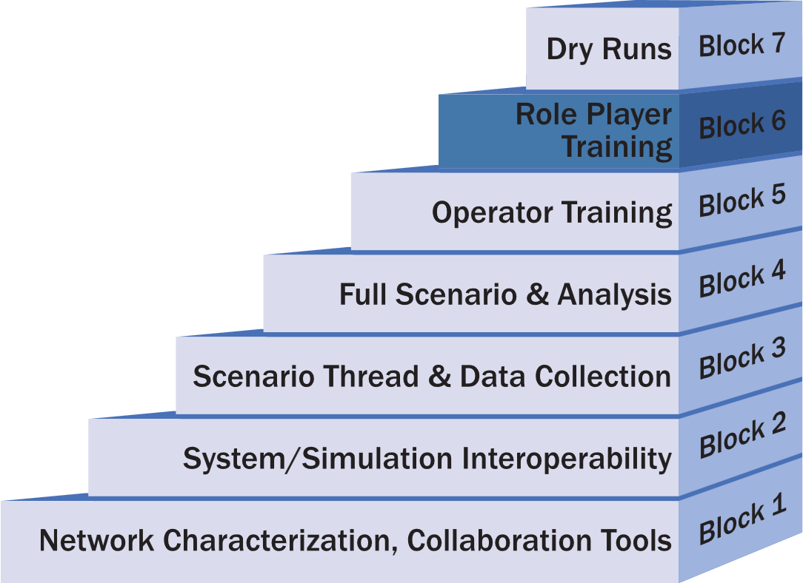
Block 6: Role Player Training (1 of 2)
Plan
Integration
7.1
Block 6 activities focus on training role players
Omit this block if there are no role players
Conduct dedicated Role Player training when:
  The event equipment is new to the role players
  If the event Tactics, Techniques, or Procedures (TTPs) are different than the ones the role players normally use
Cyber threat introduction if applicable to the event

Slide 59
Block 6: Role Player Training (2 of 2)
Plan
Integration
7.1
General
Train role players on new equipment
Train role players on new processes
Verify scenario timing with role players
Verify role players can perform or react to cyber threats
Live
Train and/or certify roles players to operate the live systems
Cyber
Verify red threats
Cyber defense team training

Slide 60
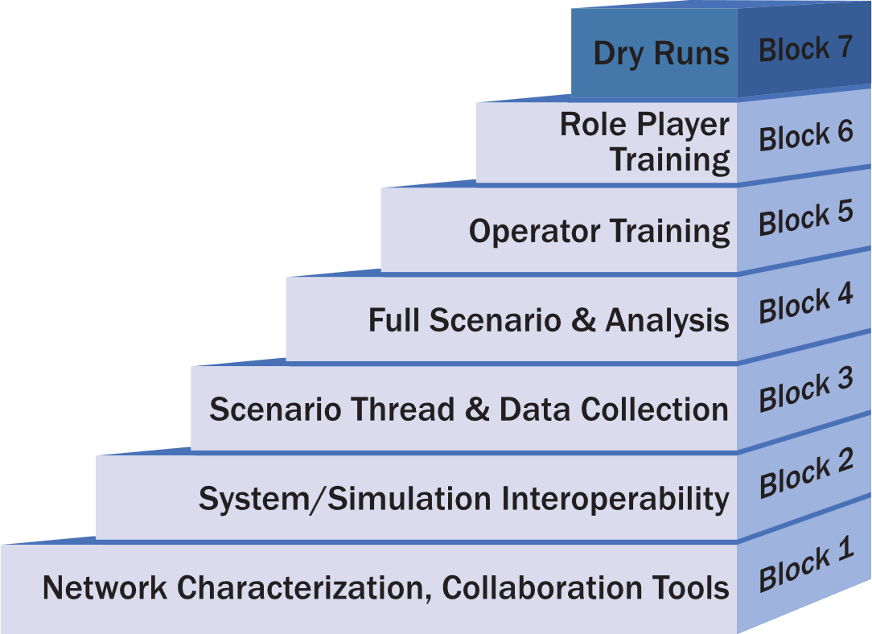
Block 7: Dry Runs (1 of 2)
Plan
Integration
7.1
Block 7 activities focus on conducting dry-runs of scenarios
This set of activities is required when data collection, test, or training requirements are dependent on an exact scenario execution

Slide 61
Block 7: Dry Runs (2 of 2)
Plan
Integration
7.1
General
Run each scenario with full data collection and role players
Live
For each of the scenarios, conduct at least one dry run with all live systems
Multi-Architecture
Final verification of distributed simulation architectures used in the event
Cyber
Execute complete red threats

Slide 62
Integration Planning - Spiral Scheduling
Plan
Integration
7.1
The number, duration, and schedule of the integration spirals is dependent on the nature of the event and the participating sites
In general, schedule each spiral for one week
A nominal schedule for a medium sized event is three integration spirals over three months, with the following assumptions:
  Medium sized event with experienced sites
  Neither dedicated operator nor role play training is required
  The number and complexity of the scenarios is such that the team can perform both Block 3 and 4 activities in a single spiral

Slide 63
Nominal Spiral Schedule
Plan
Integration
Spiral | Activities | Week
Spiral 1 | Block 1 | Week 1
 |  | Week 2
 |  | Week 3
Spiral 2 | Block 2 | Week 4
 |  | Week 5
 |  | Week 6
Spiral 3 | Block 3 & Block 4 | Week 7
 |  | Week 8
 |  | Week 9
Spiral 4 (Dry Runs) | Block 7 | Week 10
Execution | Record Runs | Week 11
7.1

Slide 64
Scheduling Considerations
Plan
Integration
7.1
The time between the spirals is as important as the spiral
Conducting spirals too close together will not allow time to address issues found or prepare for the next spiral
In general, plan at least two weeks between integration spirals
An exception for performing Block 5 and 6 back-to-back
The amount of time between spirals is also dependent on the confidence level that the team can perform all spiral activities in the time scheduled for each spiral

Slide 65
Example Spiral Tasks
Plan
Integration
7.1
ID | Task
1 | Establish network connectivity between DTCC and JOIN Lab
2 | Characterize network performance over several days and times of day
3 | RTC users log-in to Confluence using accounts on Active Directory
4 | JOIN Lab users log-in to Confluence using accounts on Active Directory
5 | Have a TENA application (Canary) join TENA EM at DTCC
6 | Pass TENA platform data from DTCC to SIMDIS located at JOIN Lab
7 | Test VOIP call manager
Notes:
Example of the objectives that might be listed in the Integration Plan

Slide 66
Example Entrance Criteria
Plan
Integration
7.1
Site | Entrance Criteria
All | Verify site is available to participate in spiral
All | ISA signed and approved
All | User accounts created for at least one person at each
Org1 | JMN in place
DTCC | JMN in place
NOC | Verify all CSTB PoC Sites connected on JMN
Org1 | Network check (ping test)
Org2 | Network check (ping test)
NOC | Establish multicast Rendezvous Point (RP)
DTCC | Distribute VoIP phone information to all sites
NOC | VoIP call manager operational
NOC | Chat server operational
DTCC | Confluence site created
DTCC | Adobe site created
All | Download network characterization tools from Confluence
Org1 | Have Linux computer on the network for network characterization tool
Notes:
Examples of the Entrance Criteria in an Integration Plan

Slide 67
Exit Criteria Example
Plan
Integration
7.1
Site | Exit Criteria
Org1 | Verify all user accounts for the distributed sites
All | Network performance is sufficient for event requirements
All | VoIP, chat, and Confluence between participating sites verified
All | Verified All sites connected to JMN
DTCC | Verified multicast group functionality
DTCC | Verified network monitoring approach
All | Infrastructure training complete: Confluence, Adobe Connect, Chat, and EventMan
Notes:
Example of an exit Criteria

Slide 68
Detailed Spiral Planning
Plan
Integration
7.1
Write and publish a Spiral Plan for each integration spiral
  The Integration Plan is the basis for each Spiral Plan
  Extend and refine the list of tasks, entrance criteria, and exit criteria as needed
Any unmet exit criteria or other issues from the previous spiral are also inputs to later Spiral Plans
  If there are many unmet tasks from the previous spiral, teams may need to schedule and plan an interim spiral
The Spiral Plan is based on a template that teams can modify to meet the needs of a specific program

Slide 69
Spiral Plan Content
Plan
Integration
7.1
Overview of the spiral
List of participating sites
Communication Plan: primary and backup phone lines
Tasks
Terrain databases
Entrance Criteria
Exit Criteria
Detailed schedule of the spiral

Slide 70
Detailed Spiral Schedule Example
Plan
Integration
7.1
Tuesday February 4
  9:00 AM Coordination teleconference
  9:30 AM Conduct network testing
  10:00 AM Verify Confluence/Active Directory interface
  11:00 AM Lunch
  12:00 PM Conduct network testing
  1:00 PM Have TENA Canary at JOIN connect to TENA EM at RTC
  3:00 PM Daily hotwash
Wednesday February 5
  9:00 AM Coordination teleconference
  9:30 AM Conduct network testing
  10:00 AM Publish TENA Platforms at RTC view on SIMDIS at JOIN
  11:00 AM Lunch
  12:00 PM Conduct network testing
  1:00 PM Setup and Test VOIP phones
  3:00 PM Daily hotwash

Slide 71
Activity 7.2: Integrate the Event Environment
Step 7
Integrate & Validate Event Environment
7.2 Integrate Event Environment
7.2 Lead Role: Technical Coordinator
Inputs
Tasks & Techniques
Outputs
Integration Plan
Event Planning Documents
Digital Twin & Wrap Around applications
Implemented Event Environment infrastructure
Supporting Databases
Execute Spiral Integration Blocks 1-6
Ping testing & pairwise tests of all defined interfaces
Terrain correlation
Entity performance data testing
Fully test distributed sim architectures across all sites
Execute all scenario threads and verify correct execution
Perform full data collection for each scenario
Train all operators on the simulation or tactical systems
Role Player Training
Planning document updates
Spiral Reports upon completion of each spiral
Integrated Event Environment
Draft Accreditation decision / memorandum
Notes:
The purpose of this activity is to bring the Digital Twin, M&S wrap-around applications, data collection tools, and any Event management tools into an integrated Event Environment.
This requires that all hardware and software assets are properly installed and interconnected in a configuration that can support the System Interface Model and Event Environment agreements.
The Technical Workgroup team and Analysis Workgroup teams should execute Spiral Integration Blocks 1 – 6 during this Activity in accordance with the Spiral Integration plan developed in the previous activity.

Slide 72
Spiral Execution
Integrate Environment
7.2
Hotwash: The team should review all the tasks assigned to the spiral and determine the status of their completion on the final day of each spiral should
Review the exit criteria and the status for each criterion determined
Write and publish a Spiral Report should at the completion of each spiral to document the results
  A critical element of the Spiral Report is any uncompleted activities being shifted to the following spiral

Slide 73
Initialization TOEL
Integrate Environment
7.2
Goal: Develop a repeatable approach to initializing the wrap-around environment
Teams should use a Timed Ordered Event List (TOEL) to initialize the Wrap-around environment
Collect data for the TOEL in Step 7.2
Initialize each system in the environment using the TOEL
Each time the system is initialized, changes are made to the TOEL to cover more actions
It is desirable to start all systems (simulation, tactical, etc.) from a cold start
  This ensures creation of a stable environment

Slide 74
Verification
Validate Environment
7.3
Completing Integration Blocks 1-6 provides sufficient information to verify the M&S and technical environment
  Do they work as designed?
Formal Verification will require completing respective agency processes and documentation
  MIL-STD-3022 documentation
  ATEC Pam 73-21
  Etc.
Notes:
7.2 completes the Verification of the models and the Federation Environment.
The early blocks gives the Technical Working Group, EXCON, and Analysts the opportunity to determine the extent the model and environment/federation, input data, and simulation output data represent the intended functions as defined in the application and environment design products.
The block testing is focused on testing for completeness, correctness, and consistency.

Slide 75
Activity 7.3: Validate the Event Environment
Step 7
Integrate & Validate Event Environment
7.3 Validate Event Environment
7.3 Lead Role: Event Lead, Technical Coordinator
Inputs
Tasks & Techniques
Outputs
Detailed Planning Documents
Event Environment Agreements
Event Environment description
Integrated Event Environment
Event Environment validation criteria
BLOCK 7: “Dry Runs”. Run each scenario with full data collection and role players
At least one run with all live systems per scenario
Final validation of the Environment
Final validation of the Digital Twin systems
Final validation of the wrap-around systems and M&S
Final validation of the Data Collection techniques
Rehearsed cyber attacks and MSEL process if applicable
Rehearsed Execution Control Plan, EXCON, and White Cell processes
Event Readiness Review (ERR)
Validated Event Environment:
  Digital Twin
  Role Player Training
  Wrap-Around system performance
  Wrap-Around entity & behaviors
  Runtime data collection
Event Director decision to Validate & Accredit the Event Environment
Event Director approval to commence event execution
Notes:
The purpose of this activity is to validate that the digital twin and all wrap-around applications interoperate at the level required for the event.
This activity completes the final technical preparation task, Block 7, where we conduct dry runs of the full scenario or vignettes.
The goal is to produce an event environment that is integrated, verified, validated, and ready for approval.
If the earlier integration and verification steps reveal obstacles, the Technical Working Group must take corrective actions before we can proceed.
We conduct a full rehearsal - often called a MINIEX or dry run - to confirm that the environment behaves correctly and fully represents both the digital twin and the operational wrap-around.
In some cases, these rehearsals may reveal issues that require additional fix-and-repeat cycles before the environment is ready.
The Execution Readiness Review serves as the final programmatic checkpoint before the event begins. During the ERR, the Event Conductor briefs the technical status, remaining gaps, and any deviations from the plan, and makes a recommendation to proceed or stop.
Transition: Lets focus on Validation a bit.

Slide 76
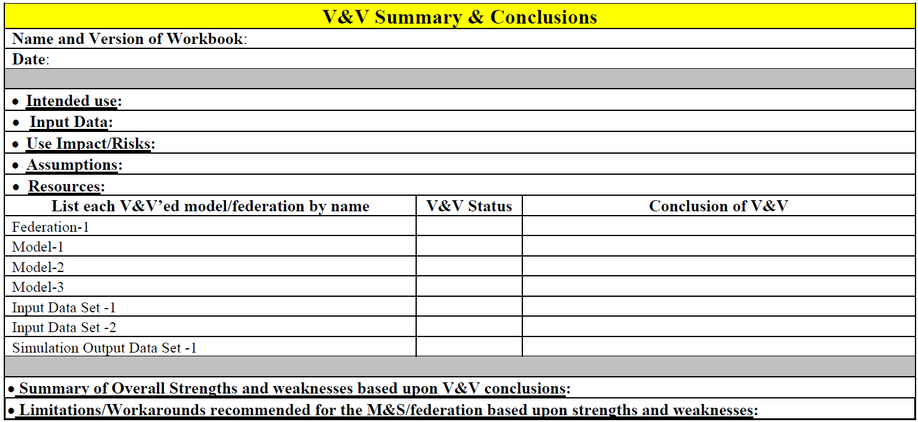
Validation
Validate Environment
7.3
Completing all Integration Blocks provides sufficient information validate the models and federation environment
Formal V&V will require completing respective agency documentation
  MIL-STD-3022
  ATEC Pam 73-21
  etc.

Slide 77
Event Readiness Review (ERR)
Validate Environment
7.3
The Event Director must accredit the environment and direct the team to proceed with record runs once the LVC Environment is fully integrated and validated
  The Technical Coordinator presents the technical readiness of the environment
  The Analysis lead reports on the readiness of analysis and data collection
  The Battle-master presents the readiness of the scenario and the level of operational realism
If the Event Director is not satisfied; document any deficiencies design a plan to address them
Notes:
Covered during the Life Cycle discussion

Slide 78
Step 8 : Execute Event
Step 1
Step 2
Step 3
Step 4
Step 5
Step 6
Step 7
Step 8
Step 9
Project Initiation
Perform Conceptual Analysis
Conduct Wargame Exercise
Develop
Digital Twin
Design Operational Wrap-Around
Develop Operational Wrap-Around
Integrate & Validate Environment
Plan & Execute
Event
Analyze Data and Evaluate Results
Develop
Objectives
Develop
Scenario
Wargame Preparation
Select
Digital Twin Applications
Select
Wrap-Around Applications
Develop
System Interface Model
Plan
Integration
Plan
Execution
Analysis & Evaluation
1.1
2.1
3.1
4.1
5.1
6.1
7.1
8.1
9.1
Conduct
Initial Planning
Develop
Conceptual Model
Conduct Wargame
Acquire Resources
Design
Environment
Establish Environment Agreements
Integrate Environment
Conduct
Record Runs
Reporting
1.2
2.2
3.2
4.2
5.2
6.2
7.2
8.2
9.2
Develop Environment Requirements
Post
Wargame Analysis
Build
Digital Twin
Design
Wrap-Around
Applications
Develop
Wrap-Around Applications
Validate Environment
Prepare
Data Outputs
Lessons Learned & Retirement
2.3
3.3
4.3
5.3
6.3
7.3
8.3
9.3
Wargame Reporting
Implement Wrap-Around Infrastructure
3.4
6.4
Notes:
Step 8 finalizes the detailed planning and carries the team into full execution of the record runs that meet the event objectives.
We refine and complete the planning documents developed in Activity 1.2 so they provide the guidance and control measures needed for reliable execution.
During this step, the event team and role players work through the scenarios and vignettes exactly as designed to generate the data required for analysis.
We monitor execution closely to ensure scenarios run as intended and that all data-collection tools capture the information the analysis team needs.
Once the record runs are complete, we organize and package all collected data so the analysis team can begin evaluating results in Step 9.
Transition: With execution complete and data collected, the final step is to analyze that data and evaluate the results produced by the event.

Slide 79
Step 9 : Analyze Data and Evaluate Results
Step 1
Step 2
Step 3
Step 4
Step 5
Step 6
Step 7
Step 8
Step 9
Project Initiation
Perform Conceptual Analysis
Conduct Wargame Exercise
Develop
Digital Twin
Design Operational Wrap-Around
Develop Operational Wrap-Around
Integrate & Validate Environment
Plan & Execute
Event
Analyze Data and Evaluate Results
Develop
Objectives
Develop
Scenario
Wargame Preparation
Select
Digital Twin Applications
Select
Wrap-Around Applications
Develop
System Interface Model
Plan
Integration
Plan
Execution
Analysis & Evaluation
1.1
2.1
3.1
4.1
5.1
6.1
7.1
8.1
9.1
Conduct
Initial Planning
Develop
Conceptual Model
Conduct Wargame
Acquire Resources
Design
Environment
Establish Environment Agreements
Integrate Environment
Conduct
Record Runs
Reporting
1.2
2.2
3.2
4.2
5.2
6.2
7.2
8.2
9.2
Develop Environment Requirements
Post
Wargame Analysis
Build
Digital Twin
Design
Wrap-Around
Applications
Develop
Wrap-Around Applications
Validate Environment
Prepare
Data Outputs
Lessons Learned & Retirement
2.3
3.3
4.3
5.3
6.3
7.3
8.3
9.3
Wargame Reporting
Implement Wrap-Around Infrastructure
3.4
6.4
Notes:
Step 9 analyzes and evaluates the collected event data to determine whether the event met its objectives and to provide results to the Event Customer or System Owner.
We review the data produced during record runs, apply the planned analytic methods, and generate findings that address the event’s goals.
We conduct an After-Action Review to capture lessons learned, identify what worked well, and recommend improvements to the process for future events.
We also complete any retirement actions required to close out the event, including archiving data, releasing resources, and documenting final outcomes.
Transition: With all steps complete, we can now wrap up the tutorial and reinforce how the structured process reduces risk and supports successful distributed LVC events.

Slide 80
Stages of the Event Life Cycle
5 Stages
DESIGN
PLAN
PREPARE
EXECUTE
ASSESS
CDC
IPC
Wargame
MDC
MPC
MSC
FPC
TIM
IRR
ERR
AAR
How do you APPLY the Process Steps to the Stages of an Event Life Cycle??
AAR: After Action Review
CDC: Concept Development Conf.
ERR: Execution Readiness Review
FPC: Final Planning Conf.
IPC: Initial Planning Conf.
IRR: Integration Readiness Review
MDC: MSEL Development Conf.
MPC: Mid Planning Conf.
MSC: MSEL Synch Conference
TIM: Technical Interchange Meeting
Notes:
We have reviewed the nine steps and twenty-eight activities that make up the Distributed LVC Event Process, but teams rarely schedule every step or activity on a POA&M exactly as written.
Way back in Activity 1.1, we introduced tailoring. Teams adjust the process to match the scale, scope, and complexity of the event. Some events may not require a digital twin, and others may reuse existing environments without repeating earlier steps.
Tailoring also applies to the event life cycle. Smaller or less complex events may not need every formal planning conference. Teams may replace some conferences with IPRs or focused working groups.
The key is not the name of the meeting but the function it provides. Event leads must still ensure there is a way to give guidance, monitor progress, identify issues, assign tasks, and approve products at the right points.
The conferences, meetings, and reviews shown here offer an archetype that helps teams understand how the entire process aligns across the life cycle.
We will walk through the event life cycle next and show how the process steps map to each stage.
Transition: With that context, we can now overlay the process onto the life cycle and show how each step supports planning, preparation, execution, and assessment.

Slide 81
Applying the Process Steps to the Event Cycle
5 Stages
DESIGN
PLAN
PREPARE
EXECUTE
ASSESS
Wargame
TIM
CDC
IPC
MDC
MPC
MSC
FPC
IRR
ERR
AAR
Step 1
Step 2
Step 3
Step 4
Step 5
Step 6
Step 7
Step 8
Step 9
Project Initiation
Perform Conceptual Analysis
Conduct Wargame Exercise
Develop
Digital Twin
Design Operational Wrap-Around
Develop Operational Wrap-Around
Integrate & Validate Environment
Plan & Execute
Event
Analyze Data and Evaluate Results
Develop
Objectives
Develop
Scenario
Wargame Preparation
Select
Digital Twin Applications
Select
Wrap-Around Applications
Develop
System Interface Model
Plan
Integration
Plan
Execution
Analysis & Evaluation
1.1
2.1
3.1
4.1
5.1
6.1
7.1
8.1
9.1
Conduct
Initial Planning
Develop
Conceptual Model
Conduct Wargame
Acquire Resources
Design
Environment
Establish Environment Agreements
Integrate Environment
Conduct
Record Runs
Reporting
1.2
2.2
3.2
4.2
5.2
6.2
7.2
8.2
9.2
Develop Environment Requirements
Post
Wargame Analysis
Build
Digital Twin
Design
Wrap-Around
Applications
Develop
Wrap-Around Applications
Validate Environment
Prepare
Data Outputs
Lessons Learned & Retirement
2.3
3.3
4.3
5.3
6.3
7.3
8.3
9.3
Wargame Reporting
Implement Wrap-Around Infrastructure
AAR: After Action Review
CDC: Concept Development Conf.
ERR: Execution Readiness Review
FPC: Final Planning Conf.
IPC: Initial Planning Conf.
IRR: Integration Readiness Review
MDC: MSEL Development Conf.
MPC: Mid Planning Conf.
MSC: MSEL Synch Conference
TIM: Technical Interchange Meeting
3.4
6.4
Notes:
The first thing to understand is that the process steps do not map one-to-one with the stages of the event life cycle.
The process generally moves from left to right, but it is not a strict waterfall. Many activities span multiple stages and reappear as products mature.
Some tasks that start early in the process continue through later stages because they support planning, integration, execution, or assessment in different ways.
Recognizing this overlap helps teams avoid treating the steps as one-time events and instead see them as iterative activities that evolve throughout the life cycle.
Transition: With that perspective in mind, we can now look at how the process overlays each life-cycle stage and supports planning, preparation, execution, and analysis.

Slide 82


Conduct the Initial Planning Conference (IPC)
5 Stages
DESIGN
PLAN
PREPARE
EXECUTE
ASSESS
CDC
IPC
MDC
MPC
FPC
IRR
ERR
AAR
Purpose is to (1) purpose is to finalize Event Guidance, (2) define requirements, and (3) initiate detailed planning.
Inputs
Tasks & Techniques
Outputs
Approved Event Objectives
Initial planning documents
Draft event requirements
Key Lessons Learned
Potential issues and implications
Draft Scenario Road-to-Crisis
Initial conceptual Model
Begin drafting the Event Control Plan (ECP)
Travel requirements
Rough draft of the simulation played items list
Support requests / taskings to supporting organizations
Concept for Scenario and Road-to-Conflict
Refine Digital Twin & Wrap-Around requirements
Develop the POA&M
Final Process Tailoring based on event scale & scope
Wargame Preparation
Plenary & Breakout workgroup sessions
Workgroups at the IPC
Scenario WG
Technical WG (Digital Twin, M&S)
Network WG
Analysis WG
Security
EXCON (Event Management, Support, & Logistics)
Draft Event Control Plan (ECP)
Detailed Conceptual Model
Draft Event requirements
Initial Event Support manning document
Initial Data Collection, Reduction, and Analysis Plan
Initial VV&A Plan
Initial KM / CM Plan
Initial Security Plan
Draft network Interconnect Service Agreements (ISO) if required
Draft ATO if required
Wargame guidance & Preparation
1.1
8.1
1.2
2.2
1.2
2.3
1.2
8.1
1.2
2.1
8.1
2.2
8.1
8.1
8.1
6.2
6.2
3.1
Notes:
this is a sample of the detailed diagrams we have for each stage and each key lifecycle event
The Design stage concludes when the team completes the Initial Planning Conference, or IPC.
The IPC finalizes event guidance, confirms the requirements, and initiates the detailed planning needed to build the event environment.
Multiple process steps contribute inputs to the IPC, and many of those same steps rely on IPC outputs to continue progressing.
The tasks shown here provide a strong starting point for building an IPC agenda and identifying breakout groups that will work specific issues.
The outputs from the IPC link directly to several process activities and help set the direction for planning, integration, and environment development.
Next, we will look at the steps and activities that feed into the IPC and those that depend on its outputs.
Transition: With the IPC aligned to the Design stage, we can now examine the graphic overlay that shows how process steps connect to this part of the life cycle.

Slide 83
Initial Planning Conference (IPC) supporting Activities
5 Stages
DESIGN
PLAN
PREPARE
EXECUTE
ASSESS
CDC
IPC
MDC
MPC
FPC
IRR
ERR
AAR
Step 1
Step 2
Step 3
Step 4
Step 5
Step 6
Step 7
Step 8
Step 9
Project Initiation
Perform Conceptual Analysis
Conduct Wargame Exercise
Develop
Digital Twin
Design Operational Wrap-Around
Develop Operational Wrap-Around
Integrate & Validate Environment
Plan & Execute
Event
Analyze Data and Evaluate Results
Develop
Objectives
Develop
Scenario
Wargame Preparation
Select
Digital Twin Applications
Select
Wrap-Around Applications
Develop
System Interface Model
Plan
Integration
Plan
Execution
Analysis & Evaluation
1.1
2.1
3.1
4.1
5.1
6.1
7.1
8.1
9.1
Conduct
Initial Planning
Develop
Conceptual Model
Conduct Wargame
Acquire Resources
Design
Environment
Establish Environment Agreements
Integrate Environment
Conduct
Record Runs
Reporting
1.2
2.2
3.2
4.2
5.2
6.2
7.2
8.2
9.2
Develop Environment Requirements
Post
Wargame Analysis
Build
Digital Twin
Design
Wrap-Around
Applications
Develop
Wrap-Around Applications
Validate Environment
Prepare
Data Outputs
Lessons Learned & Retirement
2.3
3.3
4.3
5.3
6.3
7.3
8.3
9.3
Wargame Reporting
Implement Wrap-Around Infrastructure
3.4
6.4
Notes:
This slide shows a sample of the detailed diagrams we use to map process steps and activities to each life-cycle stage and major event.
These overlays help teams understand exactly which steps contribute inputs to the IPC and which steps rely on IPC outputs to continue development.
We use diagrams like this to ensure we do not overlook any required tasks and to verify that every planning product is accounted for at the right time.
These visual overlays are especially valuable for teams working across multiple sites or organizations because they create a shared understanding of responsibilities and sequencing.
Transition: Now that we have looked at the IPC example, we will continue through the remaining key conferences and show how each one aligns with the process steps.

Slide 84
MSEL Development Conference (MDC) Activities
5 Stages
DESIGN
PLAN
PREPARE
EXECUTE
ASSESS
CDC
IPC
MDC
MPC
FPC
IRR
ERR
AAR
Step 1
Step 2
Step 3
Step 4
Step 5
Step 6
Step 7
Step 8
Step 9
Project Initiation
Perform Conceptual Analysis
Conduct Wargame Exercise
Develop
Digital Twin
Design Operational Wrap-Around
Develop Operational Wrap-Around
Integrate & Validate Environment
Plan & Execute
Event
Analyze Data and Evaluate Results
Develop
Objectives
Develop
Scenario
Wargame Preparation
Select
Digital Twin Applications
Select
Wrap-Around Applications
Develop
System Interface Model
Plan
Integration
Plan
Execution
Analysis & Evaluation
1.1
2.1
3.1
4.1
5.1
6.1
7.1
8.1
9.1
Conduct
Initial Planning
Develop
Conceptual Model
Conduct Wargame
Acquire Resources
Design
Environment
Establish Environment Agreements
Integrate Environment
Conduct
Record Runs
Reporting
1.2
2.2
3.2
4.2
5.2
6.2
7.2
8.2
9.2
Develop Environment Requirements
Post
Wargame Analysis
Build
Digital Twin
Design
Wrap-Around
Applications
Develop
Wrap-Around Applications
Validate Environment
Prepare
Data Outputs
Lessons Learned & Retirement
2.3
3.3
4.3
5.3
6.3
7.3
8.3
9.3
Wargame Reporting
Implement Wrap-Around Infrastructure
3.4
6.4
Notes:
This slide highlights the process activities that feed into the MSEL Development Conference.
We use the outputs from earlier steps, especially the scenario and conceptual analysis, to shape the mission events and injects needed for the MSEL.
The wargame often plays a major role here because it identifies decision points, problem areas, and operational dynamics that translate directly into meaningful injects.
The MDC uses these inputs to refine the event narrative and ensure the injects support the event objectives and scenario flow.
Transition: Next, we will continue mapping the process steps to the remaining life-cycle conferences to show how each stage contributes to building a complete and validated event environment.

Slide 85
Mid Planning Conference (MPC) supporting Activities
5 Stages
DESIGN
PLAN
PREPARE
EXECUTE
ASSESS
CDC
IPC
MDC
MPC
FPC
IRR
ERR
AAR
Step 1
Step 2
Step 3
Step 4
Step 5
Step 6
Step 7
Step 8
Step 9
Project Initiation
Perform Conceptual Analysis
Conduct Wargame Exercise
Develop
Digital Twin
Design Operational Wrap-Around
Develop Operational Wrap-Around
Integrate & Validate Environment
Plan & Execute
Event
Analyze Data and Evaluate Results
Develop
Objectives
Develop
Scenario
Wargame Preparation
Select
Digital Twin Applications
Select
Wrap-Around Applications
Develop
System Interface Model
Plan
Integration
Plan
Execution
Analysis & Evaluation
1.1
2.1
3.1
4.1
5.1
6.1
7.1
8.1
9.1
Conduct
Initial Planning
Develop
Conceptual Model
Conduct Wargame
Acquire Resources
Design
Environment
Establish Environment Agreements
Integrate Environment
Conduct
Record Runs
Reporting
1.2
2.2
3.2
4.2
5.2
6.2
7.2
8.2
9.2
Develop Environment Requirements
Post
Wargame Analysis
Build
Digital Twin
Design
Wrap-Around
Applications
Develop
Wrap-Around Applications
Validate Environment
Prepare
Data Outputs
Lessons Learned & Retirement
2.3
3.3
4.3
5.3
6.3
7.3
8.3
9.3
Wargame Reporting
Implement Wrap-Around Infrastructure
3.4
6.4
Notes:
This slide shows the process activities that feed into the Mid-Planning Conference and the activities that depend on its outputs.
During the MPC, we review scenario development, check progress on the environment design, and confirm that all member applications and data sources are on track.
The MPC gives the team an opportunity to assess readiness for integration spirals and identify any gaps that must be resolved before moving into detailed technical work.
We also refine roles, task assignments, and timelines during this conference so the team is aligned and prepared for the next phase of planning and integration.
Transition: Next, we will look at how the Final Planning Conference ties together the remaining process activities before the team transitions into full integration and execution.

Slide 86
Final Planning Conference (FPC) supporting Activities
5 Stages
DESIGN
PLAN
PREPARE
EXECUTE
ASSESS
CDC
IPC
MDC
MPC
FPC
IRR
ERR
AAR
Step 1
Step 2
Step 3
Step 4
Step 5
Step 6
Step 7
Step 8
Step 9
Project Initiation
Perform Conceptual Analysis
Conduct Wargame Exercise
Develop
Digital Twin
Design Operational Wrap-Around
Develop Operational Wrap-Around
Integrate & Validate Environment
Plan & Execute
Event
Analyze Data and Evaluate Results
Develop
Objectives
Develop
Scenario
Wargame Preparation
Select
Digital Twin Applications
Select
Wrap-Around Applications
Develop
System Interface Model
Plan
Integration
Plan
Execution
Analysis & Evaluation
1.1
2.1
3.1
4.1
5.1
6.1
7.1
8.1
9.1
Conduct
Initial Planning
Develop
Conceptual Model
Conduct Wargame
Acquire Resources
Design
Environment
Establish Environment Agreements
Integrate Environment
Conduct
Record Runs
Reporting
1.2
2.2
3.2
4.2
5.2
6.2
7.2
8.2
9.2
Develop Environment Requirements
Post
Wargame Analysis
Build
Digital Twin
Design
Wrap-Around
Applications
Develop
Wrap-Around Applications
Validate Environment
Prepare
Data Outputs
Lessons Learned & Retirement
2.3
3.3
4.3
5.3
6.3
7.3
8.3
9.3
Wargame Reporting
Implement Wrap-Around Infrastructure
3.4
6.4
Notes:
This slide highlights the process activities that support the Final Planning Conference and the activities that rely on its outputs.
The FPC confirms that the event environment, scenarios, data-collection plans, and role-player requirements are ready for integration and execution.
We use this conference to finalize technical products, verify that all dependencies are in place, and confirm that participating organizations are prepared for their roles.
The FPC also provides a final checkpoint before Integration Readiness Review, helping the team validate that all planning work is complete and no critical tasks remain open.
This conference ensures the team is aligned and ready to transition from planning into full integration and validation.
Transition: Next, we will look at the Integration Readiness Review, which marks the decision point for entering full integration and testing.

Slide 87
The FULL overlay of Activities to the Life Cycle
5 Stages
DESIGN
PLAN
PREPARE
EXECUTE
ASSESS
CDC
IPC
Wargame
MDC
MPC
MSC
FPC
TIM
IRR
ERR
ARR
Step 1
Step 2
Step 3
Step 4
Step 5
Step 6
Step 7
Step 8
Step 9
Project Initiation
Perform Conceptual Analysis
Conduct Wargame Exercise
Develop
Digital Twin
Design Operational Wrap-Around
Develop Operational Wrap-Around
Integrate & Validate Environment
Plan & Execute
Event
Analyze Data and Evaluate Results
Develop
Objectives
Develop
Scenario
Wargame Preparation
Select
Digital Twin Applications
Select
Wrap-Around Applications
Develop
System Interface Model
Plan
Integration
Plan
Execution
Analysis & Evaluation
1.1
2.1
3.1
4.1
5.1
6.1
7.1
8.1
9.1
Conduct
Initial Planning
Develop
Conceptual Model
Conduct Wargame
Acquire Resources
Design
Environment
Establish Environment Agreements
Integrate Environment
Conduct
Record Runs
Reporting
1.2
2.2
3.2
4.2
5.2
6.2
7.2
8.2
9.2
Develop Environment Requirements
Post
Wargame Analysis
Build
Digital Twin
Design
Wrap-Around
Applications
Develop
Wrap-Around Applications
Validate Environment
Prepare
Data Outputs
Lessons Learned & Retirement
2.3
3.3
4.3
5.3
6.3
7.3
8.3
9.3
Wargame Reporting
Implement Wrap-Around Infrastructure
3.4
6.4
Notes:
After walking through nine steps, twenty-eight activities, multiple conferences, and enough diagrams to qualify as an art exhibit… we have arrived here.
This glorious, intuitive masterpiece shows everything mapped onto everything else. It is the single diagram that proves we now understand the entire process… or at least pretend we do.

Slide 88
Wrap-Up
All distributed LVC events follow a typical Life Cycle.
A successful distributed LVC event depends on the completeness and correctness of the environment created.
A well-defined process provides the structure for a verification and validation of the environment by ensuring that the team follows all required products and procedures.
The goal of the process is to mitigate risk.
  The activities in the process lessen the risk that the creation of complete environment will fail
  Following the validation activities in the process will reduce the chance of creating an incorrect environment that could have long reaching impacts
Use this structured approach to de-risk your next LVC event—and ensure mission success.
Notes:
Don't "Wing It"
Use this process and life cycle structure
Modify it for your unique domain & tailor the depth and breath of the process & life cycle for each event
Carefully consider the steps and activities essential to successful verification & validation of the complete environment.
Finally, end the brief with anecdote from CABAIL about how it would have been a complete failure w/o the process.

Slide 89
Closing Comments & Questions
Distributed Live Virtual Constructive (LVC) Event Process
Michael J. O’Connor
moconnor@trideum.com
Simon Goerger
sgoerger@trideum.com
Kenneth G. LeSueur
klesueur@trideum.com
Roy Zinser
rzinser@trideum.com
LTC John Furr
john.m.furr.mil@army.mil
(Transformation and Training Command (T2COM))
Ed Lerz
edward.lerz@hii-tsd.com
(Huntington Ingalls Industries)
Brett Boren
brett.a.boren.civ@army.mil
Tilghman Turner
tilghman.a.turner.civ@army.mil

