Slide 1


Game Engines for Military Use 101
Quintin Oliver, Air Force Research Laboratory
Stephanie Fussell, Aptima, Inc.
Summer Rebensky, Aptima, Inc.
Stephen McGee, Air Force Research Laboratory
Notes:
Learning Objectives:
Identify different options of game engines useful for distributed training, part-task trainers, and general research.
Understand the difference between game engines and other simulation technologies.
Explain how game engines can be used to enhance training and learning methods.
Compare and contrast the advantages and limitations of using game engines for different types of training and research applications.
Audience intended for the Tutorial:
This tutorial is designed for a broad audience to provide a foundational understanding of the advantages of game engines, appropriate scenarios for their use, and best practices for developing game engine-based solutions for military purposes. There is no prerequisite knowledge needed for this tutorial.

Slide 2
Learning Objectives
Identify different options of game engines useful for distributed training, part-task trainers, and general research.
Understand the difference between game engines and other simulation technologies.
Explain how game engines can be used to enhance training and learning methods.
Compare and contrast the advantages and limitations of using game engines for different types of training and research applications.
Notes:
What are game engines? (20 minutes)
Considerations for game engine use (25 minutes)
Use Case Walkthrough (25 minutes)
Conclusion and summary (15 minutes)
Acknowledgements, contact information, and Q/A (5 minutes)
Learning Objectives:
Identify different options of game engines useful for distributed training, part-task trainers, and general research.
Understand the difference between game engines and other simulation technologies.
Explain how game engines can be used to enhance training and learning methods.
Compare and contrast the advantages and limitations of using game engines for different types of training and research applications.

Slide 3
Agenda
What are game engines?
Considerations for game engine use
Use case walkthroughs
Summary
Notes:
What are game engines? (20 minutes)
Considerations for game engine use (25 minutes)
Use Case Walkthrough (25 minutes)
Conclusion and summary (15 minutes)
Acknowledgements, contact information, and Q/A (5 minutes)
Learning Objectives:
Identify different options of game engines useful for distributed training, part-task trainers, and general research.
Understand the difference between game engines and other simulation technologies.
Explain how game engines can be used to enhance training and learning methods.
Compare and contrast the advantages and limitations of using game engines for different types of training and research applications.

Slide 4
What are Game Engines?

Slide 5



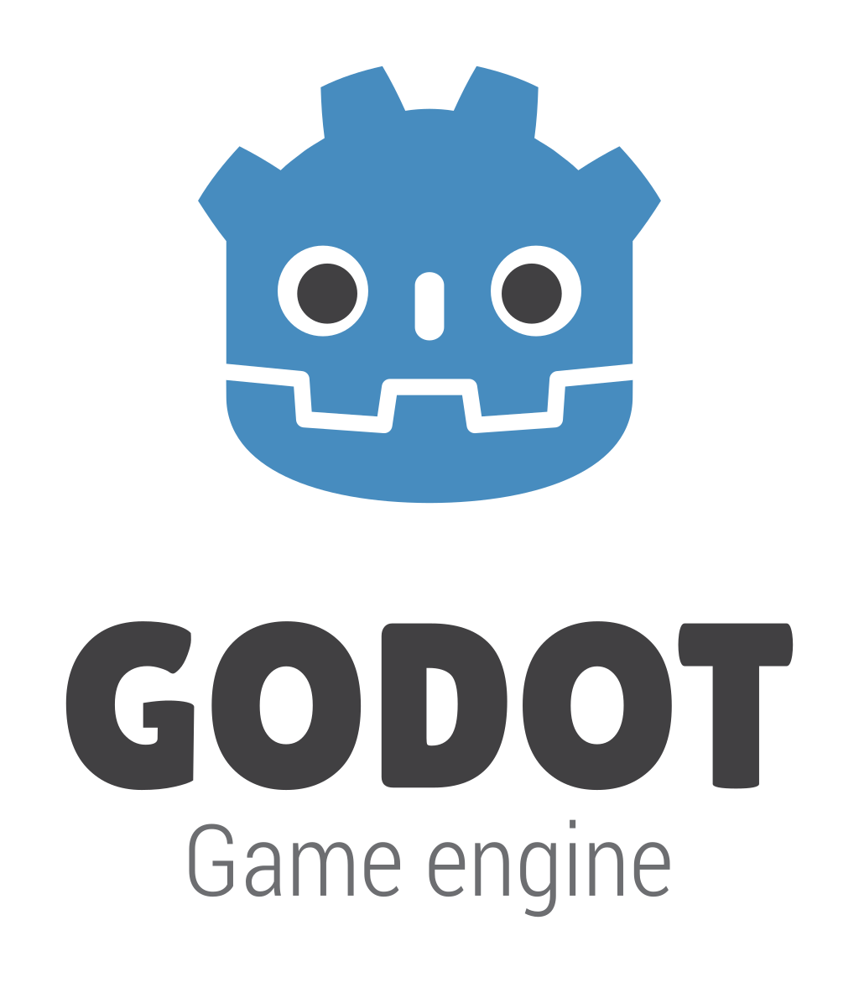
What Are Game Engines?
Software tools for game design and programming
Applicable to several domains (not just games!)
High-code/low-code/no-code development
…and many more
Image credits to each respective company
Notes:
Game engines are a set of software tools that can be used to create games, simulations, applications, and more. They can provide developers with a framework to handle the more complex operations such as physics calculations, rendering, animation, and cross-platform development.
There are several options for game engines. Some of the more popular engines are Unreal Engine, Unity, Godot, and CryEngine. Each engine has its own licensing terms, community, supported programming languages, and support.
Although each example here is focused on game development, they can be used for much more. These game engines provide a framework that can be expanded to virtually any domain. Other simulation technologies may focus on a specific domain, provide a subset of tools such as a dedicated physics engine, rendering engine, or animation tools requiring the use of multiple technologies or the creation of your own engines.
One aspect that sets game engines apart from each other is their coding approaches such as different programming languages or even low- or no-code development. These low and no-code development styles abstract even more complex functionality increasing accessibility. For example, Unreal Engine is known for its blueprint visual scripting system allowing developers to program complex models by connecting “nodes” that define the logical flow of the program while some other engines primarily utilize line-based programming such as Unity’s use of the C# programming language.
How game engines differ from other simulation technologies
Coding approaches (blueprints, assets, etc.)
Currently available game engines and their pros and cons

Slide 6



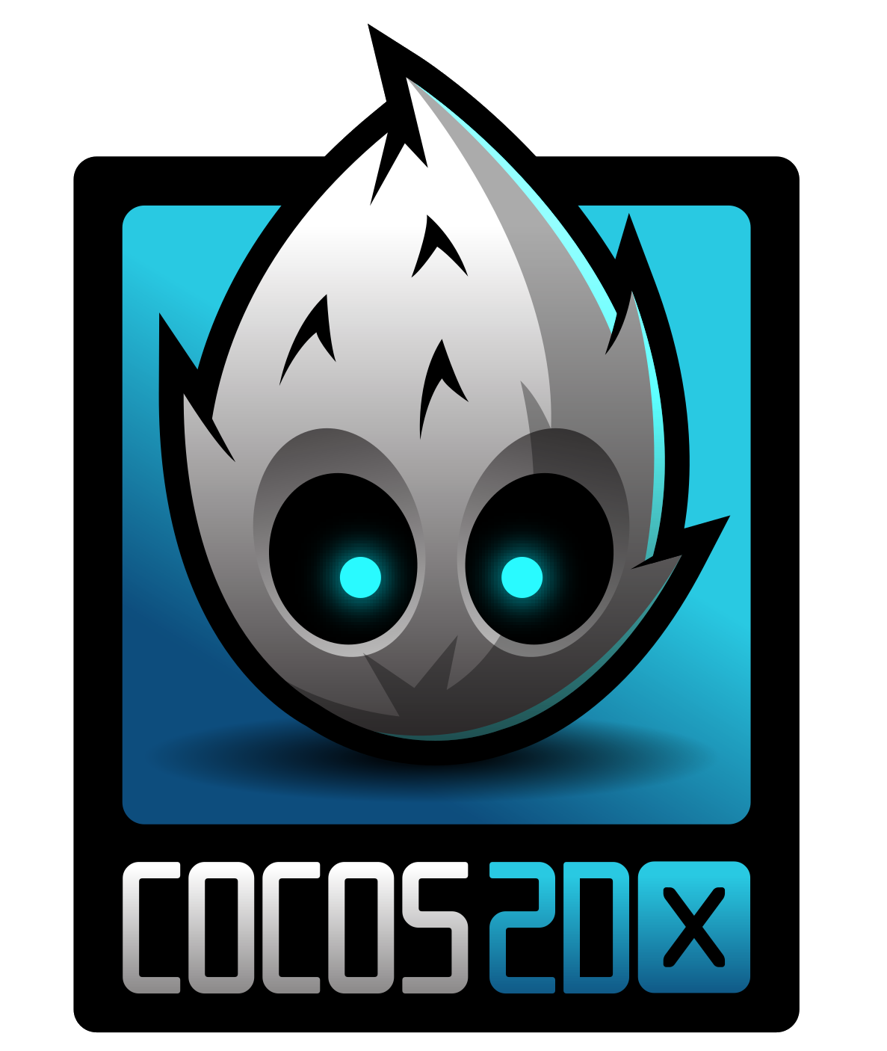
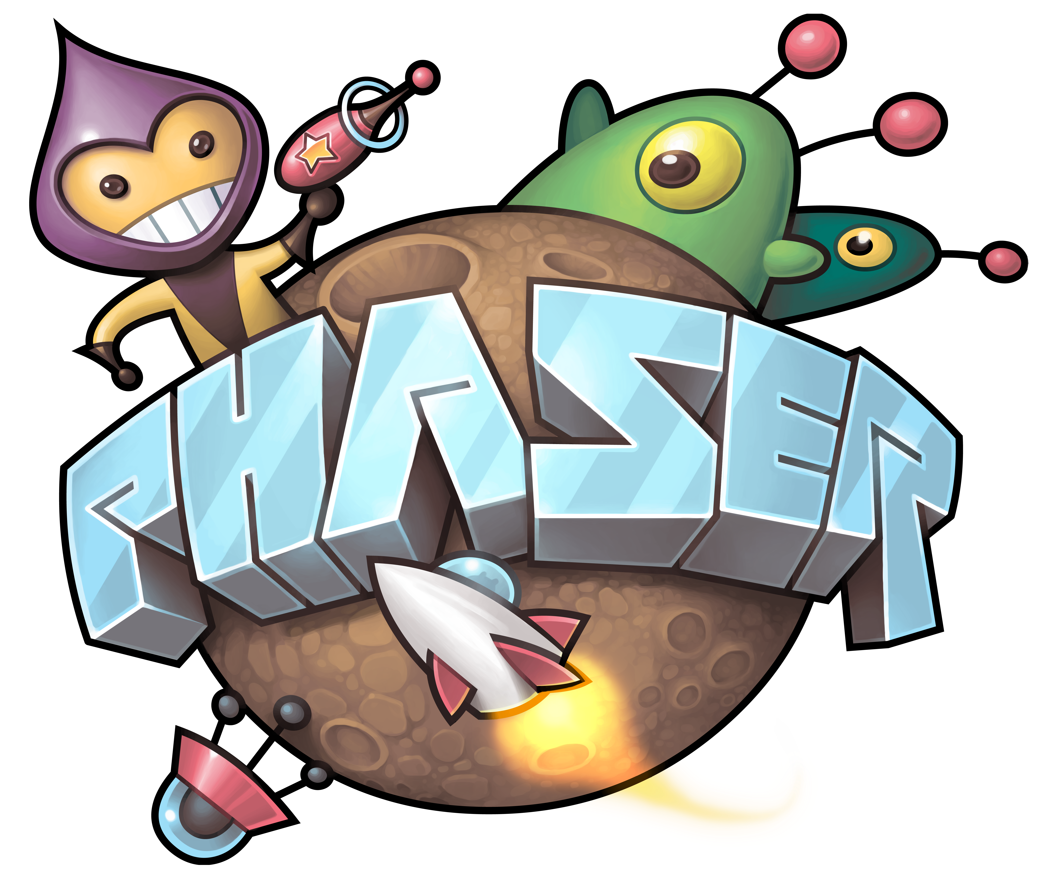








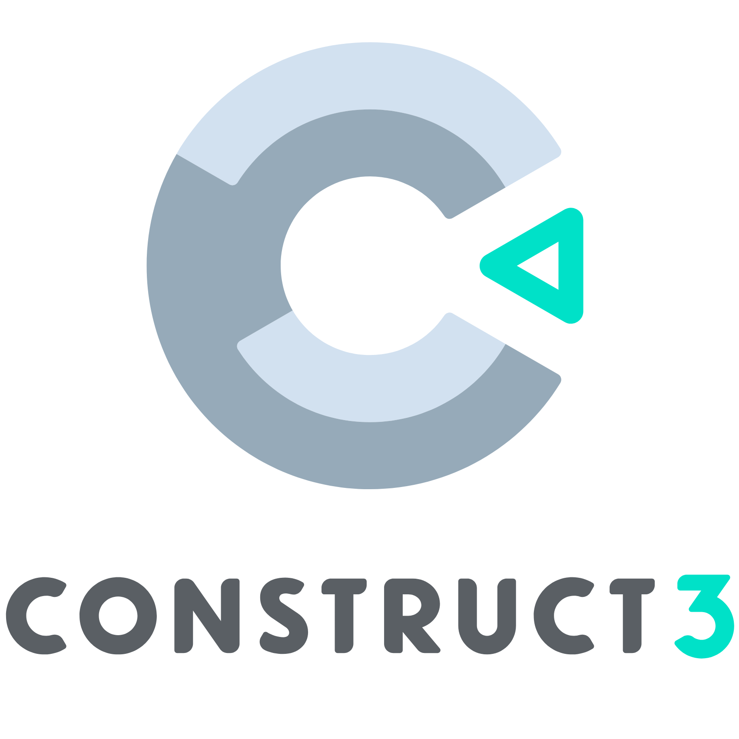
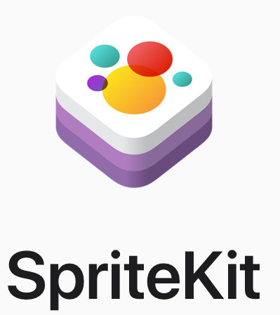
…and many more
2D-Focused | Browser-Based
No/Low-Code | Platform Specific
Image credits to each respective company
Notes:
explain why you chose the four that you did as your main focus to the audience.
2D-Focused- Designed for creating games with two-dimensional graphics
GameMaker
Defold
Cocos2dx
GDevelop
Browser-based- may use JavaScript-based frameworks such as Phaser, Babylon.js, which require coding but offer high flexibility; may use visual, online platforms like PlayCanvas and Construct, which provide web-based visual editors for creating games without complex coding
Phaser
Babylon.js
PlayCanvas
PixiJS
No/Low-Code- enable game creation without extensive programming, using visual interfaces and pre-built components
Construct 3
Buildbox
Twine
Platform Specific 3D game engines for large developer, parent companies
SpriteKit - Apple
Creation Engine – Bethesda Game Studios
Source Engine- Valve

Slide 7
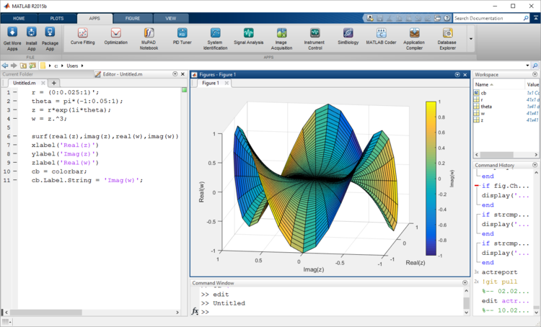
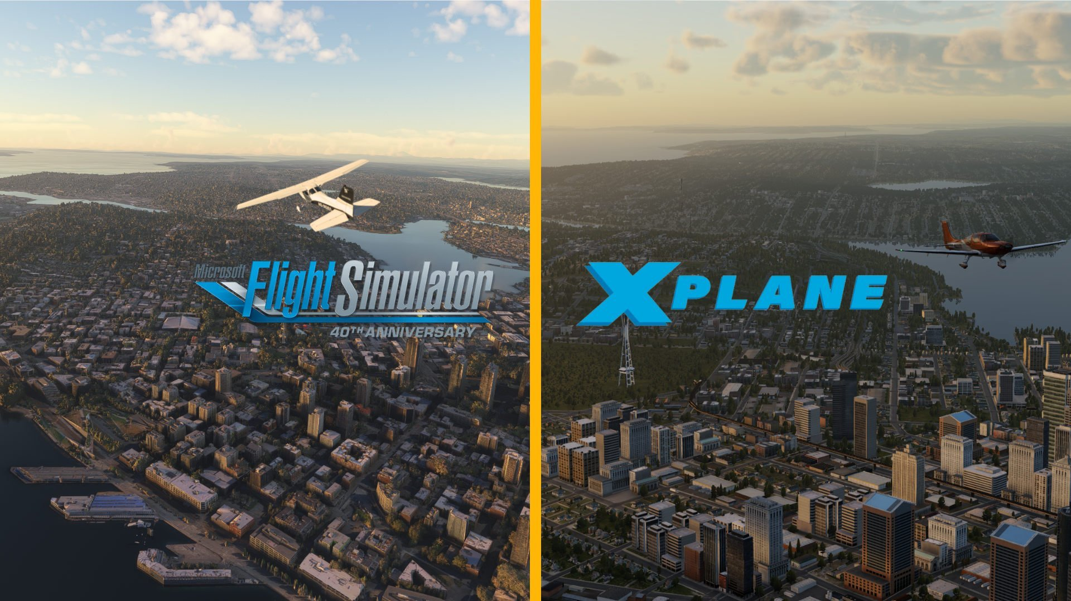
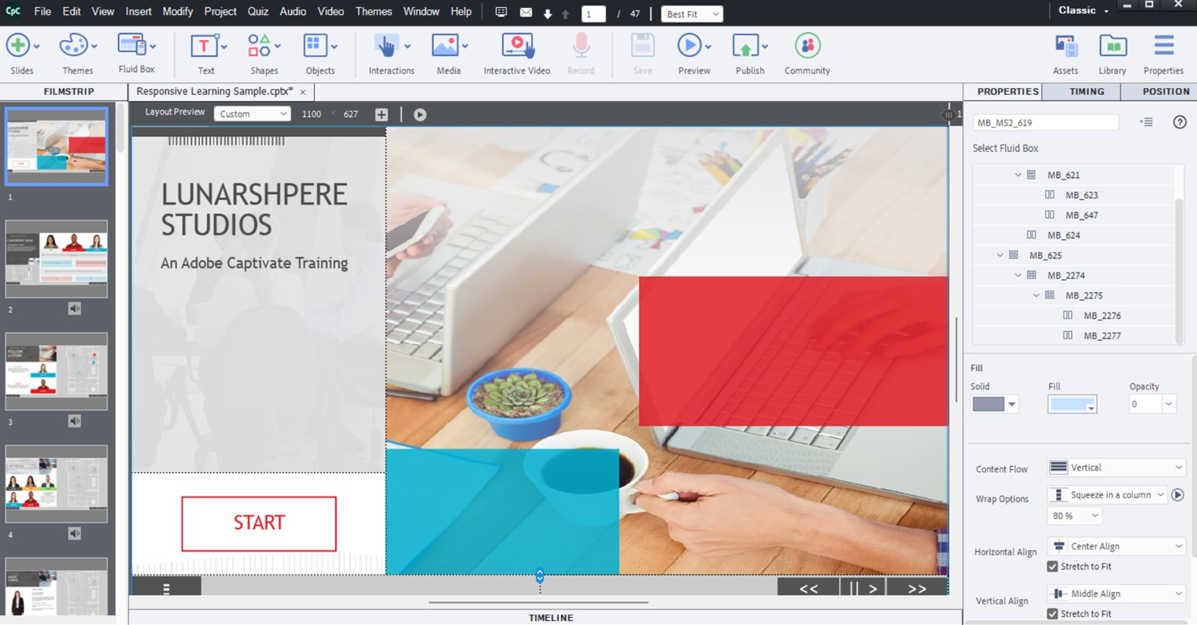
What is Simulation Software?
MATLAB, Simulink
SolidWorks (or any CAD) simulation
Excel
Prepar3D, X-Plane, Microsoft Flight Simulator
Articulate 360, Adobe Captivate
Image credits to each respective company
Notes:
I would suggest bringing up things like P3D (flight engines), Emphasizing that Simulation software is more-so a tailor made solution than it is an environment to create different experiences. (However a game engine could be used to make simulation software) which is the main relevance of this tutorial

Slide 8
Game Engines vs. Simulation Software
Game Engines
General-purpose development
Often focused on visual fidelity, responsiveness, and immersive user interaction
Ideal for custom, ground-up simulation creation
“Jack of all trades”
Simulation Software
Built for specific domains
Comes with built-in models, behaviors, and frameworks
Less flexibility but validated modeling, data fidelity, and integration
“Master of one”
Notes:
Example Domains
Game engines VR trainers, mission rehearsal, mobile apps, digital twins, sandbox simulations.
Sim software- Command staff training, constructive simulation, weapon systems modeling, tactical AI behavior simulation.

Slide 9
Applicable Domain
Game Engines
Broad: Ideal for custom, immersive 3D/Virtual Reality/Augmented Reality training environments, rapid prototyping, and visualization
High flexibility: Allows tailoring to specific use cases (e.g., infantry training, wargaming, command and control (C2) visualization
High fidelity in graphics and interaction; physics fidelity depends on custom development
Simulation Software
Focused and specific: Designed for doctrine-based simulation, constructive scenarios, and validated military modeling
Medium flexibility: Domain-specific, often constrained by built-in entities, behaviors, and doctrine
High fidelity in procedural and behavioral modeling; graphics often secondary to simulation accuracy
Notes:
Example Domains
Game engines VR trainers, mission rehearsal, mobile apps, digital twins, sandbox simulations.
Sim software- Command staff training, constructive simulation, weapon systems modeling, tactical AI behavior simulation.

Slide 10
Terms and Licensing
Game Engines
Varying pricing structures but often free or royalty-based
Full or partial source access (Unreal, Godot); or proprietary terms (Unity, CryEngine)
Use in defense is flexible, may require legal review for deployment in secure or export-controlled environments
Catered toward small developers
Simulation Software
Enterprise level solutions, per-seat or site license models, with strict export controls and government pricing
Generally closed source; some application programming interfaces (APIs) may be accessible via software development kits (SDKs) or vendor-specific scripting tools
Built for defense: licensing often includes International Traffic in Arms Regulations (ITAR) compliance, Military Standard (MIL-STD) alignment, and support frameworks
Rigid and reliable
Notes:
Example Domains
Game engines VR trainers, mission rehearsal, mobile apps, digital twins, sandbox simulations.
Sim software- Command staff training, constructive simulation, weapon systems modeling, tactical AI behavior simulation.

Slide 11
Training
Game Engines
Learning Curve: Moderate to steep, depending on engine and features used, especially for extended reality (XR) or networking
Community-based tutorials and official tutorials and training
Varying levels of documentation
Simulation Software
Learning Curve: Steep, especially for systems like OneSAF or VR-Forces, which require domain knowledge and custom scripting
Enterprise hosted tutorials, often classroom-based or via partner organizations
Very well documented
Notes:
Example Domains
Game engines VR trainers, mission rehearsal, mobile apps, digital twins, sandbox simulations.
Sim software- Command staff training, constructive simulation, weapon systems modeling, tactical AI behavior simulation.

Slide 12
Community and Assets
Game Engines
Community is large and global with active forums, open-source contributors, and asset creators
Huge asset marketplaces (Unity Asset Store, Unreal Marketplace); reusable code and visual content
Strong plugin support and community extensions; third-party libraries widely available
Simulation Software
Community is smaller, more niche communities, often limited to defense contractors and government users
Limited assets that are proprietary or developed in-house; models are domain-specific and vetted
Some extensibility via APIs or scripts, but less open — often depends on vendor relationships
Notes:
Example Domains
Game engines VR trainers, mission rehearsal, mobile apps, digital twins, sandbox simulations.
Sim software- Command staff training, constructive simulation, weapon systems modeling, tactical AI behavior simulation.

Slide 13
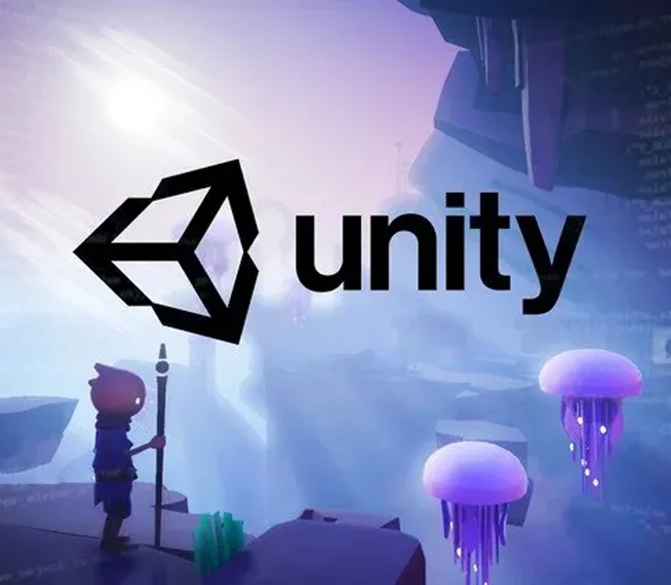
Unity 3D
Applicable domain
Wide use in cross-platform simulation and serious games
Terms and licensing
Multiple tiers for personal and commercial use
Training
Extensive official and third-party training
Community and assets
One of the largest development communities, support for third-party frameworks
Image credit: Unity 3D
Notes:
Unity
Unity is often the platform of choice for rapid development, cross-platform flexibility, and moderate-fidelity training environments. Its large ecosystem, ease of integration, and robust support for VR/AR make it ideal for everything from mobile trainers to immersive classroom simulators.
Applicable Domain
Widely used in military training, education, simulation, and serious games.
Common in cross-platform projects, including desktop, mobile, VR/AR, and embedded systems.
Terms and Licensing
Free tier for individuals and small organizations (Unity Personal).
Unity Pro required for commercial or institutional use beyond revenue/usage thresholds.
Recent licensing changes require attention, especially for offline/air-gapped deployment.
Training Options and Availability
Extensive official documentation, Unity Learn, and certified instructor-led courses.
Broad range of third-party tutorials and simulation-specific courses.
Military-focused partners offer Unity-based simulation platforms and training modules.
Community and Assets
One of the largest development communities.
Massive Asset Store with thousands of plug-ins, tools, environments, and character packs.
Strong support for simulation use via third-party frameworks (e.g., SIMDIS, MÄK plugins, and GIS data loaders).

Slide 14
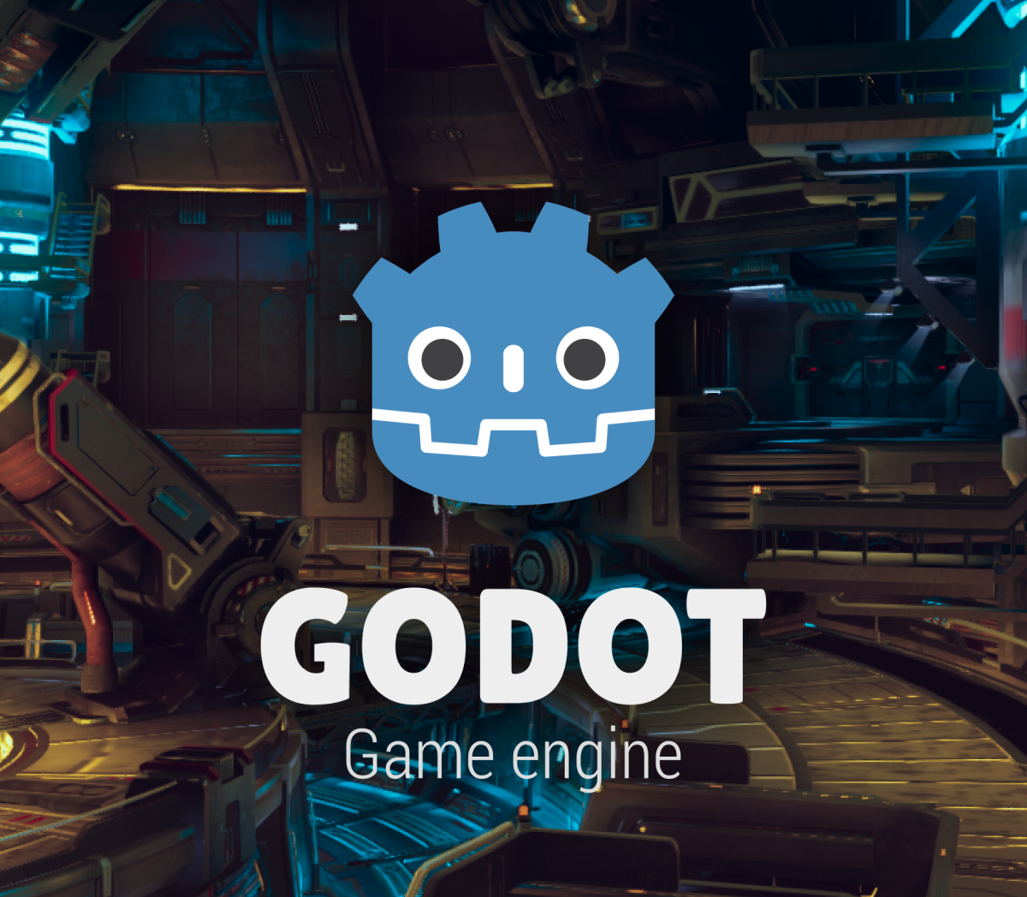
Godot
Applicable domain
Best suited for small-scale or customized simulation environments
Terms and licensing
Completely free and open-source
Training
Fewer resources from a moderate but growing ecosystem
Community and assets
User contribution to open-source community
Image credit: Godot
Notes:
Godot
Godot is the platform of choice when cost-effectiveness, open-source control, and lightweight deployment are the primary goals. Ideal for prototyping, academic research, or low-resource environments, it provides full engine access without licensing constraints—well-suited for custom, secure simulations.
Applicable Domain
Ideal for lightweight simulations, 2D training tools, procedural trainers, and open-source research.
Best suited for small-scale or customized simulation environments.
Terms and Licensing
Completely free and open-source under the MIT license.
No royalties, fees, or platform restrictions.
Source code is fully available for modification and redistribution.
Training Options and Availability
Moderate but growing ecosystem of community tutorials and courses.
Fewer simulation-specific resources, but strong for core engine education.
Suitable for in-house or academic training initiatives with full source access.
Community and Assets
Active and passionate open-source community.
Asset Library smaller than Unity’s or Unreal’s, but steadily growing.
Many users contribute tools and modules for niche use, including simulation.

Slide 15
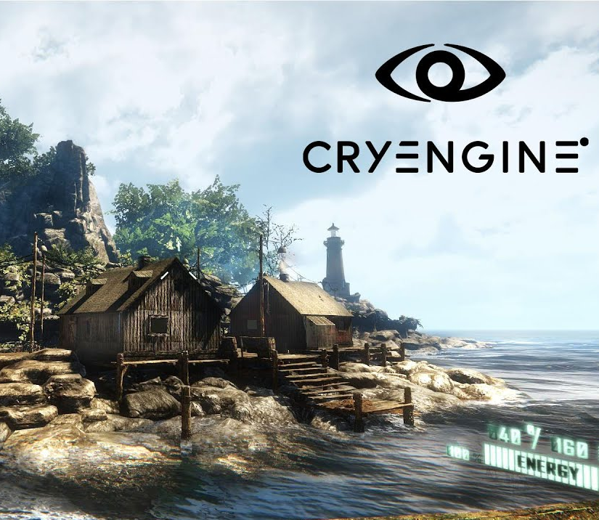
CryEngine
Applicable domain
Strong terrain-focused, first-person, or vehicle-centric simulations needing high-fidelity
Terms and licensing
Royalty-based or custom enterprise licensing
Training
Specific, official documentation
Community and assets
More limited ecosystem with fewer commercial-ready assets
Image credit: CryEngine
Notes:
CryEngine
CryEngine is selected when visual realism, terrain fidelity, and physics simulation are the highest priorities. It excels in creating outdoor, environmental, or vehicular simulations that demand accurate lighting, line-of-sight modeling, and destructible environments.
Applicable Domain
Strong in terrain-focused, first-person, or vehicle-centric simulations.
Often used for high-fidelity battlefield training or defense R&D environments.
Terms and Licensing
Royalty-based model (5% after $5,000 in annual revenue), or custom enterprise licensing.
Source code available under restrictions—requires adherence to Crytek’s EULA.
May involve negotiation for defense/government deployments.
Training Options and Availability
Official documentation is good but narrower than Unity or Unreal.
Limited military-specific training resources; often requires onboarding for C++ development.
Crytek provides learning materials and partner programs, mostly focused on visual fidelity.
Community and Assets
Smaller community, often concentrated in AAA and defense visualization sectors.
Asset ecosystem is limited, especially for simulation content.
Modding community is active, but commercial-ready assets are fewer.

Slide 16
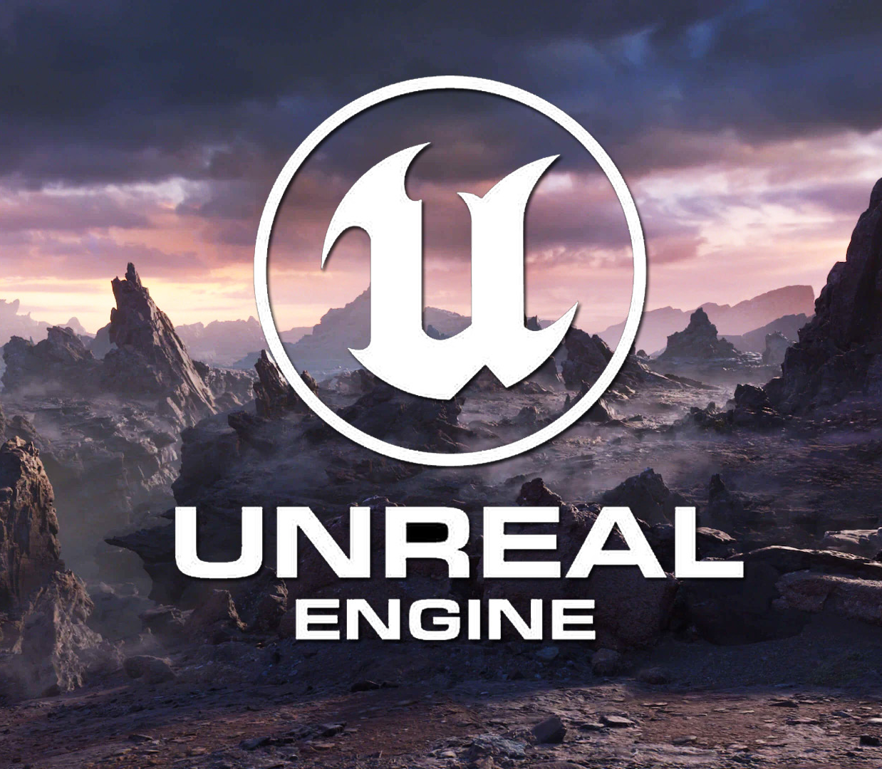
Unreal Engine
Applicable domain
High-fidelity, enterprise-level, multi-user systems
Terms and licensing
Free to use until revenue reaches $1m
Training
Robust official and third-party training options, including grants
Community and assets
Extensive Marketplace with strong community and support for external requirements
Image credit: Unreal Engine
Notes:
Unreal Engine
Unreal Engine is often the platform of choice for projects where fidelity, extensibility, and immersive realism are mission-critical. It is especially powerful for high-end VR simulators, large-scale multiplayer scenarios, and applications that must interface with external systems at an enterprise level.
Applicable Domain
Frequently used in high-end military simulations, VR/AR immersive trainers, and enterprise-level defense systems.
Especially strong in full-motion, multi-user, and mixed-reality simulation environments.
Terms and Licensing
Free to use; 5% royalty after first $1 million in revenue (per product).
Custom licensing available for government and defense sectors through Epic’s Simulation division.
Full C++ source access under Epic’s GitHub terms.
Training Options and Availability
Robust official curriculum: Unreal Online Learning, Epic Dev Grants, and in-person training.
Multiple defense contractors and institutions offer Unreal-specific simulation training.
Rich tutorial ecosystem via YouTube, Udemy, Coursera, and others.
Community and Assets
Very active community of developers, artists, and simulation specialists.
Extensive Unreal Marketplace with high-end assets, tools, and system frameworks.
Strong support for simulation-specific needs (e.g., GIS plugins, procedural environments, HLA connectors).

Slide 17
Considerations for Game Engine Use

Slide 18
What Should I Consider?
Project Content
Target Audience
3D Modeling and Animation
Single vs. Multiplayer Game Play
Integration with Outside Systems
Offline and Deployed Use
Distribution
Examples of Level of Immersion and Integration
Coding: High, Low, No
Data access, logging, and rights
Notes:
Data access: This is, quite literally, what data is available to me, what form does it come in, how can I access it, etc. Some programs do not provide direct access, it is an additional service. Or you can access it but you (as the regular customer) might not know how to interpret it or need a different software or knowledge set to do anything meaningful with it.
Another consdieration: I have data, so what? Data may not be immediately useful if you don't have a plan for what to do with it. Games may measure things we are not interested in and may not measure what we need to evaluate for training, etc
Agree with Stephanies points here. We may edit to say "Data access, logging, and rights" to make it clear that game made solutions don't readily output to learning management systems and the data it can track may not be an immediately insights (data does not equal assessment) and that some considerations should be given to how the game based solutions made should or could fit into other parts of ecosystems (DIS to play with other legacy sims or assessments to automate performance measurement in classrooms).

Slide 19
Project Content
Unity3D | Godot | CryEngine | Unreal Engine
Suited for tactical training simulations, mission rehearsal tools | Ideal for lightweight simulations | Suited for high-fidelity, terrain-heavy, realistic simulations | Ideal for high-fidelity, photorealistic simulations
Can model realistic physics, environmental conditions, and artificial intelligence (AI)-driven actors | Suitable for prototyping complex scenarios quickly | Can support line-of-sight modeling, weather effects, and physically based ballistics | Well-suited for complex and dynamic training operations
Supports layered complexity | Supports custom simulation logic, AI scripting, and event-based scenario control | Supports mission scenarios and layered complexity | Supports procedural environments, real-time physics
Notes:
This refers to the scope, structure, and type of simulation experience being built with the game engine. It includes everything from interactive 3D environments and user interfaces to scripted missions, AI behavior, training modules, and scenario logic. The project content defines the learning objectives, realism level, and complexity of the simulation.
UNITY
Project Content
Suited for tactical training scenarios, battlefield simulations, or mission rehearsal tools.
Can model realistic physics, environmental conditions, and AI-driven actors (e.g., enemy combatants or civilians).
Supports layered complexity—from basic drills to complex command-and-control simulations.
GODOT
Project Content
Ideal for lightweight simulations such as tactical decision exercises, command-level planning, or procedural training.
Excellent for 2D or stylized 3D content—suitable for prototyping complex scenarios quickly.
Supports custom simulation logic, AI scripting, and event-based scenario control using GDScript or C#.
CRY ENGINE
Project Content
Suited for high-fidelity combat simulations, terrain-heavy operations, and environmental realism (e.g., forest/jungle warfare, urban ops).
Excellent for line-of-sight modeling, weather effects, and physically based ballistics.
Supports mission scenarios involving ground vehicles, aerial assets, and dynamic destruction.
UNREAL ENGINE
Project Content
Ideal for high-fidelity, photorealistic military simulations—ranging from small-unit tactics to strategic-level simulations.
Well-suited for vehicle crew training, flight simulation, or complex terrain-based operations.
Supports procedural environments, real-time physics, and cinematic-quality after-action reviews.

Slide 20
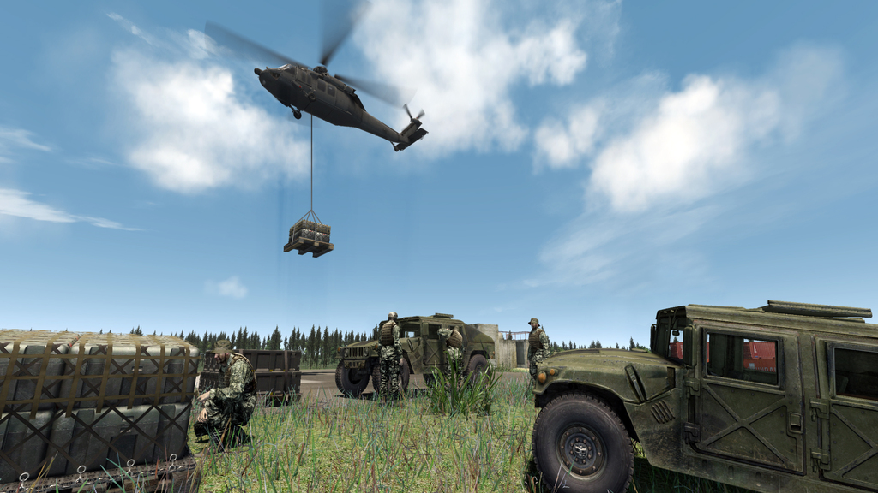
Project Content Example: CryEngine Military Sim Graphics
Image credit: GamingBolt.com

Slide 21
Target Audience
Unity3D | Godot | CryEngine | Unreal Engine
Developers supporting military simulations | Developers seeking open-source, low-cost simulation tools | Developers needing high-end visual realism and immersive training | Developers seeking cutting-edge realism
Developers creating custom training modules | Creators with defense-related simulation prototyping | Sims that need terrain-aware or visually intensive scenarios | Organizations with performance-intensive requirements
Analysts and planners for after-action review and mission planning | Users needing lean runtime for small unit or mobile training applications | Users requiring C++-level control over performance, physics, and rendering | Those with simulation-based concept testing or wargaming
Notes:
Target Audience
This identifies the intended users of the simulation or training application. It may include military personnel (e.g., infantry, pilots, or command staff), instructors, trainees, analysts, or even R&D teams. Understanding the audience helps shape the design — from realism and UI complexity to instructional content and accessibility.
UNITY
Target Audience
Military trainees, instructors, and command personnel.
Defense contractors and developers creating custom training modules.
Analysts and planners for after-action review and mission planning.
GODOT
Target Audience
Military instructors and developers seeking open-source, low-cost simulation tools.
Research and academic institutions exploring defense-related simulation prototyping.
Small-unit training environments or mobile field applications where lean runtime is key.
CRY ENGINE
Target Audience
Military and defense contractors focused on high-end visual realism and immersive battlefield training.
Simulation engineers creating terrain-aware or visually intensive scenarios.
Users requiring C++-level control over performance, physics, and rendering for advanced simulations.
UNREAL ENGINE
Target Audience
Military trainers, defense contractors, and simulation developers seeking cutting-edge realism.
Organizations with performance-intensive requirements (e.g., aircraft simulators, VR training labs).
Government and R&D entities involved in simulation-based concept testing or wargaming.

Slide 22
3D Modeling and Animation
Unity3D | Godot | CryEngine | Unreal Engine
Supports importing models from Blender, 3ds Max, Maya, etc., in FBX or OBJ formats | Compatible with standard formats like glTF, OBJ, DAE (Collada), and FBX (with third-party tools) | Designed for importing complex 3D assets (CryTIF, FBX, CGF formats) | Seamless integration with professional DCC tools (Maya, Blender, 3ds Max) using FBX and USD formats
Animations can be created with Unity’s Mecanim system | Built-in animation tools support skeletal animation, blend shapes, and keyframing | Advanced animation features include physics-driven ragdolls, and character locomotion blending | Supports advanced skeletal animation, facial rigs, blend shapes, and motion capture via Live Link
Compatible with rigged characters, inverse kinematics, and motion capture data | Can import assets directly from Blender using optimized pipelines | High-quality asset pipelines from tools like 3ds Max, Maya, or Blender (with additional processing) | Nanite and Lumen allow use of ultra-high-resolution models and real-time global illumination
Please see last slide for acronym definitions
Notes:
3D Modeling and Animation
This area covers how the engine handles 3D assets, characters, vehicles, and motion. It includes importing models from external tools, animating behaviors (walking, flying, interacting), and rendering visuals in real time. It’s crucial for creating lifelike simulations, realistic movement, and engaging visuals.
UNITY
3D Modeling and Animation
Supports importing models from Blender, 3ds Max, Maya, etc., in FBX or OBJ formats.
Animations for humans, vehicles, and machinery can be created with Unity’s Mecanim system.
Compatible with rigged characters, inverse kinematics, and motion capture data.
GODOT
3D Modeling and Animation
Compatible with standard formats like GLTF, OBJ, DAE (Collada), and FBX (with third-party tools).
Built-in animation tools support skeletal animation, blend shapes, and keyframing.
Can import assets directly from Blender using optimized pipelines like Better Collada or GLTF export.
CRY ENGINE
3D Modeling and Animation
Designed for importing complex 3D assets (CryTIF, FBX, CGF formats).
Advanced animation features include procedural animation, physics-driven ragdolls, and character locomotion blending.
High-quality asset pipelines from tools like 3ds Max, Maya, or Blender (with additional processing).
UNREAL ENGINE
3D Modeling and Animation
Seamless integration with professional DCC tools (Maya, Blender, 3ds Max) using FBX and USD formats.
Supports advanced skeletal animation, facial rigs, blend shapes, and motion capture via Live Link.
Nanite and Lumen allow use of ultra-high-resolution models and real-time global illumination.

Slide 23

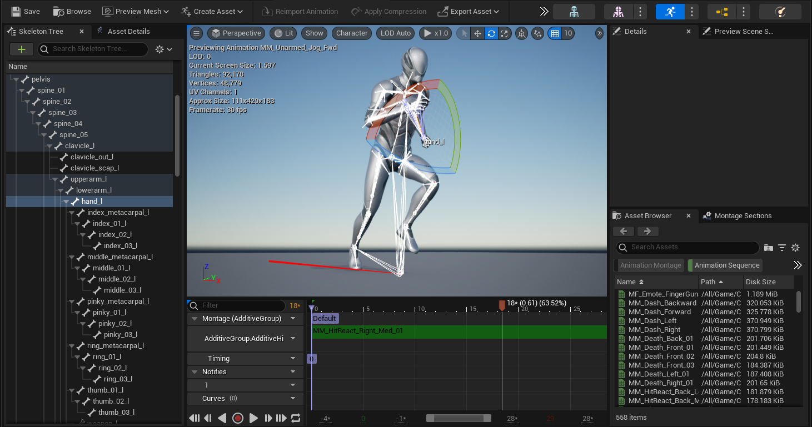
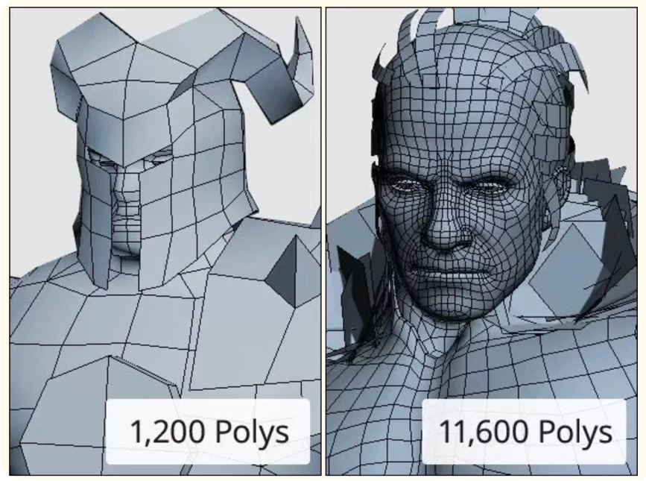
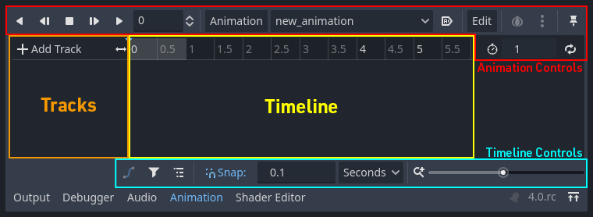
3D Modeling & Animation
Image credits: Delasign.com
Top image credit: Unreal Engine
Bottom image credit: Godot

Slide 24
Single vs. Multiplayer Game Play
Unity3D | Godot | CryEngine | Unreal Engine
Scalable for both single-user simulations and networked squad-level or joint-force training | Native networking features for multiplayer | Scalable for both single-user simulations and networked squad-level or joint-force training | Used in single and joint training exercises, remote unit simulations, and multi-role training environments.
Multiplayer via Unity’s Netcode or third-party libraries (Photon, Mirror) | Suited for local networked simulations or small-scale online sessions | Built-in multiplayer framework supports dedicated servers, lobby systems, and client-server architecture | Robust multiplayer networking using dedicated server architecture or peer-to-peer
Networked simulation for joint exercises and distributed training | Peer-to-peer or client-server architecture can be implemented with full control over data handling | Suitable for large-scale wargame simulations with complex data synchronization | Scalable for hundreds of AI agents or synchronized clients in a distributed simulation
Notes:
Single vs. Multiplayer Game Play
This describes whether the simulation is designed for individual users or multiple participants interacting in real time. Multiplayer capability allows for team-based training, joint mission rehearsals, or competitive exercises, while single-user modes may focus on self-paced learning or role-specific drills.
UNITY
Single vs. Multiplayer Game Play
Single-player for individualized training and performance assessment.
Multiplayer via Unity’s Netcode or third-party libraries (Photon, Mirror) for squad-based or team simulations.
Networked simulation for joint exercises and distributed training.
Godot
Single vs. Multiplayer Game Play
Native networking features for multiplayer (high-level and low-level APIs).
Suited for local networked simulations or small-scale online sessions.
Peer-to-peer or client-server architecture can be implemented with full control over data handling.
CryEngine
Single vs. Multiplayer Game Play
Built-in multiplayer framework supports dedicated servers, lobby systems, and client-server architecture.
Scalable for both single-user simulations and networked squad-level or joint-force training.
Suitable for large-scale wargame simulations with complex data synchronization.
Unreal Engine
Single vs. Multiplayer Game Play
Robust multiplayer networking using dedicated server architecture or peer-to-peer.
Used in joint training exercises, remote unit simulations, and multi-role training environments.
Scalable for hundreds of AI agents or synchronized clients in a distributed simulation

Slide 25

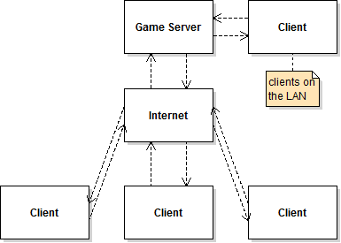
Single vs. Multiplayer Game Play
Larger infrastructure needs
Standalone deployable training kit
Image credit: Meta
Image credit: GameDeveloper.com
Notes:
https://www.google.com/url?sa=i&url=https%3A%2F%2Fwww.gamedeveloper.com%2Fprogramming%2Fserver-architecture-a-noobs-guide&psig=AOvVaw0lB0iqt4mNJfTTngtQHwqa&ust=1751198668735000&source=images&cd=vfe&opi=89978449&ved=0CBgQ3YkBahcKEwiAooPGiZSOAxUAAAAAHQAAAAAQBA

Slide 26
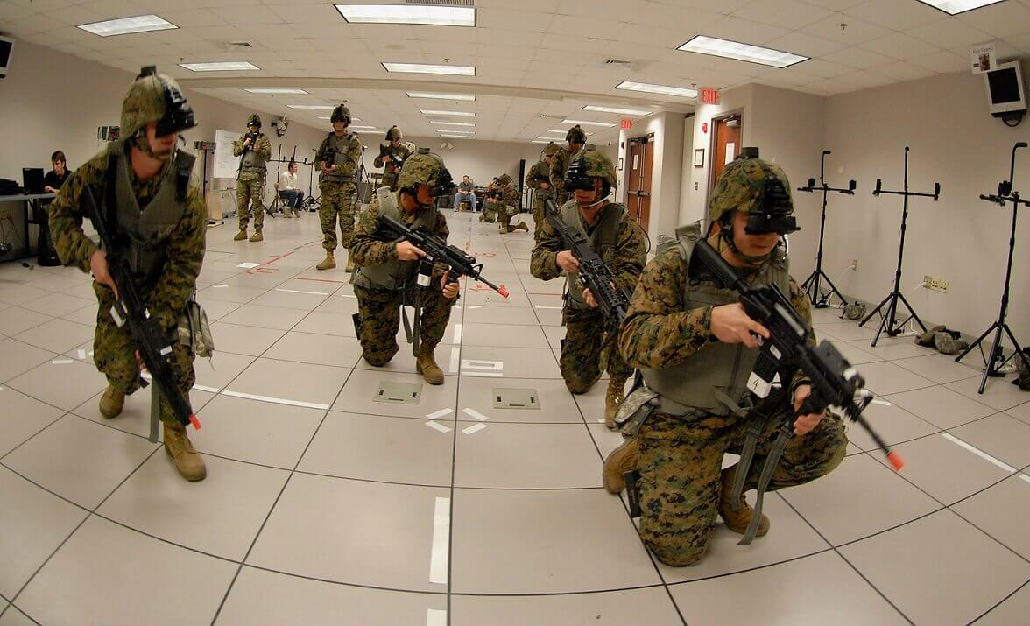
Multiplayer Example: Combat Scenario Training
Image credit: Jasoren

Slide 27
Integration with Outside Systems
Unity3D | Godot | CryEngine | Unreal Engine
Can connect to C4ISR, DIS/HLA protocols, or simulation middleware (e.g., VBS, MAK) | Flexible scripting (GDScript, C#, C++) allows integration with APIs and protocols (e.g., TCP/UDP, WebSockets) | C++ architecture allows integration with external simulators, battlefield management systems, and custom hardware | Highly extensible via C++, Blueprints, and plugin system for integration with C4ISR, HLA/DIS, or proprietary protocols
Interfaces with GPS, LIDAR, and sensor data inputs for real-time or replay-based training | Possible to interface with external hardware, simulators, or control systems using custom plugins or native modules | Compatible with middleware or protocols like HLA/DIS, especially when extended via SDK or plugins | Interfaces well with simulation middleware (e.g., MAK VR-Forces, Pitch, or BSI products)
Supports serial, TCP/IP, and RESTful API integration for external hardware and systems | Open-source nature allows deep-level customization to meet specific military system requirements | Can read/write to external telemetry, sensor feeds, and AI modules in real-time | Can ingest live or pre-recorded telemetry, geospatial data, and sensor streams for real-time situational training
Please see last slide for acronym definitions
Notes:
Integration with Outside Systems
This refers to how well the game engine can communicate with external platforms such as C4ISR systems, weapon simulators, learning management systems (LMS), or simulation protocols like HLA/DIS. Integration allows the simulation to fit into larger training ecosystems or pull in real-world data.
UNITY
Integration with Outside Systems
Can connect to C4ISR, DIS/HLA protocols, or simulation middleware (e.g., VBS, MAK). C4ISR - Command, Control, Communications, Computers, Intelligence, Surveillance, and Reconnaissance
Interfaces with GPS, LIDAR, and sensor data inputs for real-time or replay-based training.
Supports serial, TCP/IP, and RESTful API integration for external hardware and systems.
Godot
Integration with Outside Systems
Flexible scripting (GDScript, C#, C++) allows integration with APIs and protocols (e.g., TCP/UDP, WebSockets).
Possible to interface with external hardware, simulators, or control systems using custom plugins or native modules.
Open source nature allows deep-level customization to meet specific military system requirements.
CryEngine
Integration with Outside Systems
C++ architecture allows integration with external simulators, battlefield management systems, and custom hardware.
Compatible with middleware or protocols like HLA/DIS, especially when extended via SDK or plugins.
Can read/write to external telemetry, sensor feeds, and AI modules in real-time.
Unreal Engine
Integration with Outside Systems
Highly extensible via C++, Blueprints, and plugin system for integration with C4ISR, HLA/DIS, or proprietary protocols.
Interfaces well with simulation middleware (e.g., MAK VR-Forces, Pitch, or BSI products).
Can ingest live or pre-recorded telemetry, geospatial data, and sensor streams for real-time situational training.

Slide 28
Distribution
Unity3D | Godot | CryEngine | Unreal Engine
Easily integrated into learning management systems (LMS) or custom training frameworks | Open-source licensing simplifies integration | Engine source available under royalty-based licensing | Enterprise-friendly with custom licensing, supports LMS/other framework integration
Supports modular architecture | Supports modular game architecture | Supports modular scenario loading and encrypted asset packaging | Supports modular packaging with encrypted content delivery
Distribution via secure digital packages, local servers, or portable storage devices | Easy distribution via standalone executables or USB-deployable packages | May require more effort for automation and integration | Distribution through executable builds, secure containers, or local network deployment tools
Notes:
Distribution
This covers the process of packaging, delivering, and updating the simulation software across different systems or environments. It includes version control, encryption, modular content delivery, and support for automated updates or deployments within secure networks or enterprise systems.
UNITY
Integration and Distribution
Easily integrated into LMS (Learning Management Systems) or custom training frameworks.
Supports modular architecture—plug in new missions or scenarios without rebuilding the whole system.
Distribution via secure digital packages, local servers, or portable storage devices.
Godot
Integration and Distribution
Open-source licensing (MIT) simplifies integration into defense environments without legal/contractual encumbrances.
Supports modular game architecture—scenarios and content can be loaded dynamically at runtime.
Easy distribution via standalone executables or USB-deployable packages.
CryEngine
Integration and Distribution
Engine source available under royalty-based licensing—enables tailored distribution for defense or enterprise.
Supports modular scenario loading and encrypted asset packaging for secure distribution.
May require more effort for automation and integration than Unity or Godot, but allows deep customization and optimization.
Unreal Engine
Integration and Distribution
Enterprise-friendly with custom licensing through Unreal Engine for Simulation program. Supports integration into LMS or training systems.
Supports modular packaging, including encrypted content delivery
Distribution through executable builds, secure containers, or local network deployment tools (e.g., Pixel Streaming for controlled access).

Slide 29
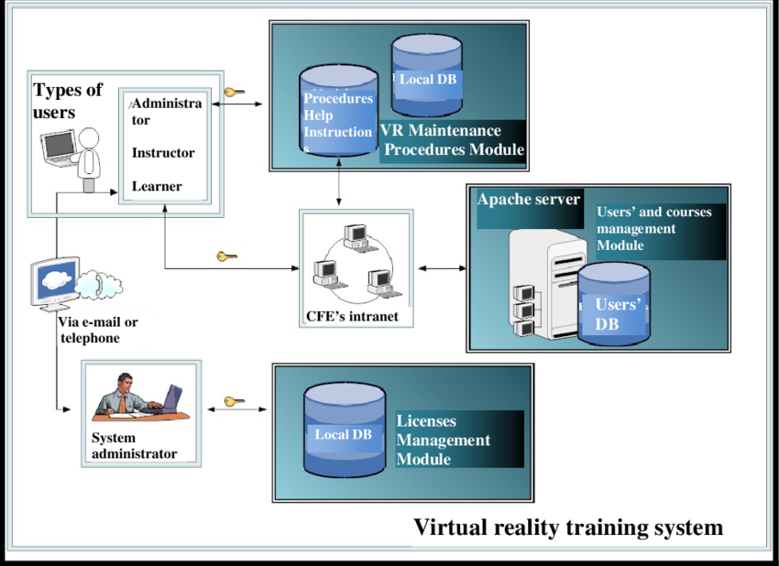
System Architecture for Virtual Reality as a Comprehensive Training Tool
From Pérez-Ramírez & Ontiveros-Hernández, 2009
Notes:
Pérez-Ramírez, Miguel & Ontiveros-Hernández, Norma. (2009). Virtual Reality as a Comprehensive Training Tool. 10.13140/2.1.1617.0246.

Slide 30
Offline and Deployed Use
Unity3D | Godot | CryEngine | Unreal Engine
Supports build targets for Windows, Linux, Android, and embedded systems | Can export to Windows, Linux, Android, and web (HTML5) | Can deploy on custom ruggedized hardware or simulation pods | Compiles to standalone executables across Windows, Linux, and custom embedded platforms
Can run offline in secure or remote environments | Very suitable for offline, portable, and secure deployments | Can be deployed in air-gapped or classified environments with proper packaging | Can operate in air-gapped environments, simulation domes, or deployable ruggedized kits
Supports portable and lightweight operation | Does not require internet activation or license validation | Exports as standalone applications with no internet requirement at runtime | Asset management supports versioned content and dynamic loading for modular field deployments
Notes:
Offline and Deployed Use
This concerns the simulation's ability to run without internet access or external servers, often a requirement in field-deployable or classified environments. Offline use includes support for local execution, secure storage of assets, and compatibility with portable or ruggedized hardware.
UNITY
Offline and Deployed Use
Supports build targets for Windows, Linux, Android, and embedded systems.
Can run offline in secure or remote environments (e.g., in field-deployable training kits).
Efficient asset bundling and resource loading allows portable and lightweight operation.
Godot
Offline and Deployed Use
Can export to Windows, Linux, Android, and web (HTML5)—with minimal overhead.
Lightweight footprint makes Godot highly suitable for offline, portable, and secure deployments.
Does not require internet activation or license validation, useful for classified or restricted environments.
CryEngine
Offline and Deployed Use
CryEngine’s performance makes it a candidate for deployment on custom ruggedized hardware or simulation pods.
Can be deployed in air-gapped or classified environments with proper packaging.
Exports as standalone applications with no internet requirement at runtime.
Unreal Engine
Offline and Deployed Use
Compiles to standalone executables across Windows, Linux, and custom embedded platforms.
Can operate in air-gapped environments, simulation domes, or deployable ruggedized kits.
Asset management supports versioned content and dynamic loading for modular field deployments.

Slide 31
Examples of Level of Immersion and Integration
 | Unity3D | Godot | CryEngine | Unreal Engine
Virtual Reality (VR) | Full-immersion, in-headset simulation support for many headsets | Experimental but functional via community plugins | Integrated support using plugins for specific headsets | Built-in integration for full immersion for many headsets
Augmented Reality (AR) | Excels with heads-up displays or real-world overlays during training | Emerging; better suited for custom builds on platforms like Android or through integration with third-party SDKs | Integration possible but less mature—may require custom SDK bridging or middleware | Supports heads-up displays or real-world overlays during training
Mixed Reality (MR) | Used with headsets like HoloLens for scenario-based, room-scale interaction |  |  | Supports fully immersive training environments, including tracked physical props and full-body simulation rigs
Notes:
type of Extended Reality Integration
This refers to how the simulation uses immersive technologies such as Virtual Reality (VR), Augmented Reality (AR), or Mixed Reality (MR). Game engines can support these modes to varying degrees, enabling different levels of immersion, interactivity, and physical-world integration (e.g., HMDs, tracked weapons, AR overlays).
UNITY
Type of Extended Reality Integration
Virtual Reality (VR): Full-immersion simulations for dismounted infantry or vehicle training.
Augmented Reality (AR): For heads-up displays or real-world overlays during training.
Mixed Reality (MR): Used with headsets like HoloLens for scenario-based, room-scale interaction.
Type of Extended Reality Integration
VR support is experimental but functional via community plugins (OpenXR, Godot XR Tools).
AR/MR capabilities are emerging; better suited for custom builds on platforms like Android or through integration with third-party SDKs.
Not as robust as Unity for XR, but usable for simpler immersive or heads-up display scenarios.
CRY ENGINE
Type of Extended Reality Integration
VR support is integrated, with compatibility for Oculus, OpenXR, and SteamVR via CryEngine plugins.
AR/MR integration is possible but less mature—may require custom SDK bridging or middleware.
Strong performance makes it suitable for high-end VR-based training simulators.
UNREAL ENGINE
Type of Extended Reality Integration
Industry-leading XR support: Built-in integration for VR (Oculus, HTC Vive, Varjo), AR (HoloLens, Magic Leap), and MR via OpenXR.
Supports fully immersive training environments, including tracked physical props and full-body simulation rigs.
Enables mixed reality sandtable, mission rehearsal, and battlefield visualization use cases.

Slide 32

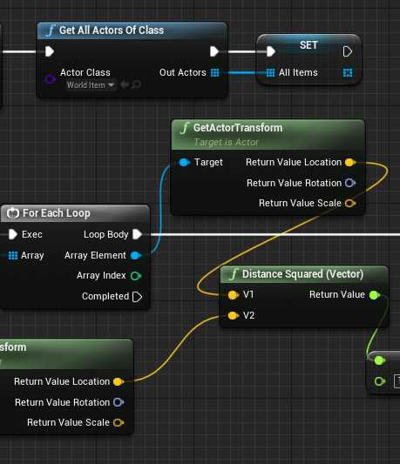
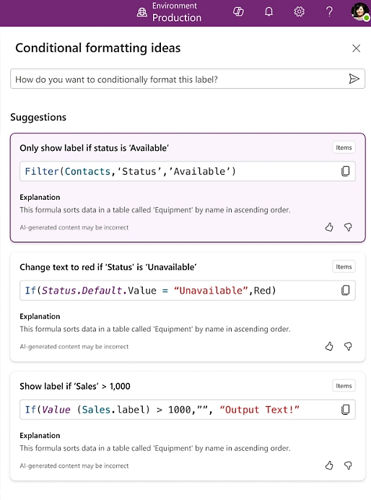
Coding: High, Low, No
Image credit: Unity 3D
Image credit: Unreal Engine
Image credit: Microsoft

Slide 33
Benefits and Drawbacks of Low/No Code Environments
Benefits
Low barrier to entry
Easier to visually digest
Easier to follow flows of logic
Fewer lines of code required
  Each block represents 1 or more line of code
Drawbacks
Platform limitations
Less control over code
Harder to transfer to other platforms
More difficult to collaborate through version control systems
This may be a use case for high code programming

Slide 34
Use Case Walk Through:
Training & Research

Slide 35
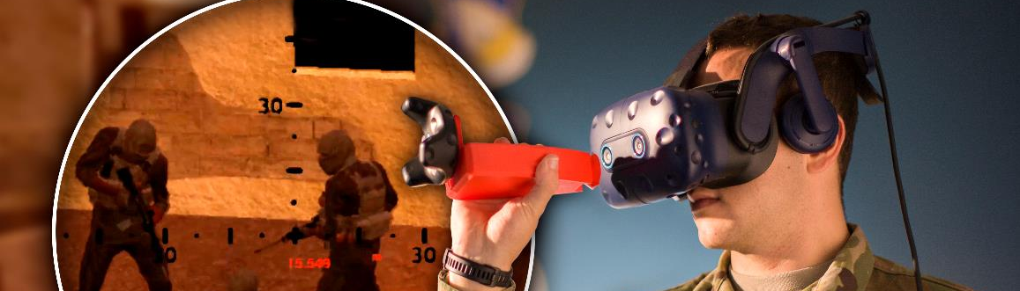
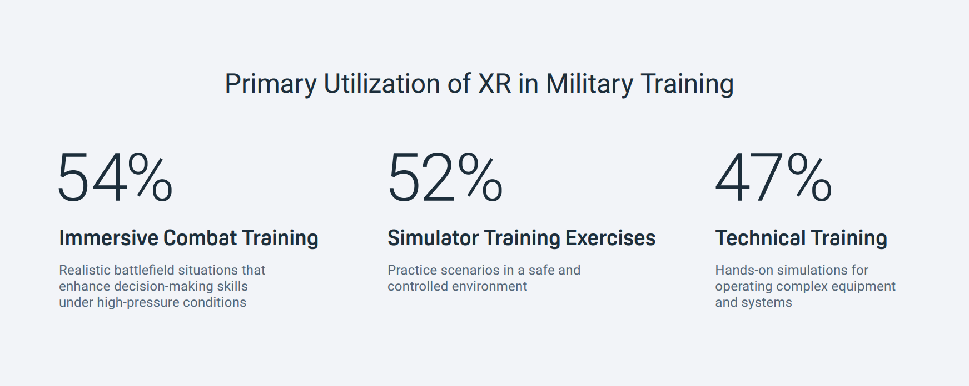
Use Cases in XR
Statistics figure from: VIVE, The state of extended (XR) training within the U.S. Armed Forces, Tech. Rep. (2023).

Slide 36
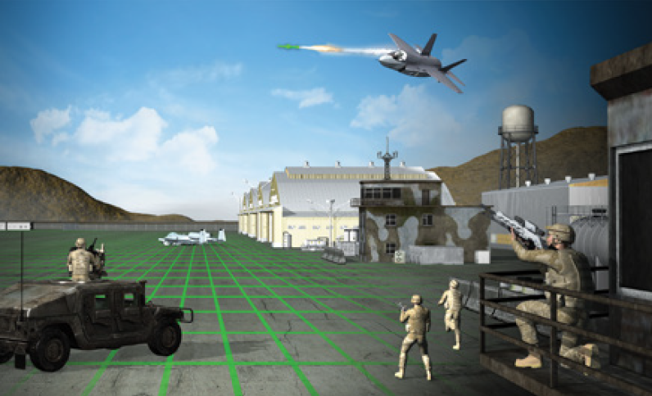
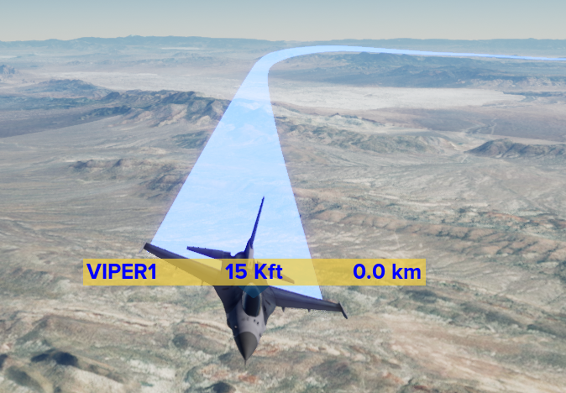
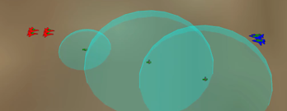
Distributed Training
User Benefits & Best Applications
Benefits: Integrate legacy simulations with game-based applications.
Applications: Live Virtual Constructive (LVC) training, joint exercises, mission lead visualization.
Considerations: Performance will be based on protocols used (DIS, HLA, etc.) and networking configuration/speed.
Image credits: Will Graver, AFRL
Notes:
Connection with legacy training systems
Standards and network communication
Designing for optimized distributed training

Slide 37
Distributed Training
Development Considerations:
Development Lift: Heavy unless using existing plugins for networking protocols.
Resource Strain: Requires live network connectivity, for large exercises, can be straining.
Modularity or Extensibility: Very extensible if format is supported and have representative models.
Image credits: Will Graver, AFRL
Notes:
Connection with legacy training systems
Standards and network communication
Designing for optimized distributed training

Slide 38
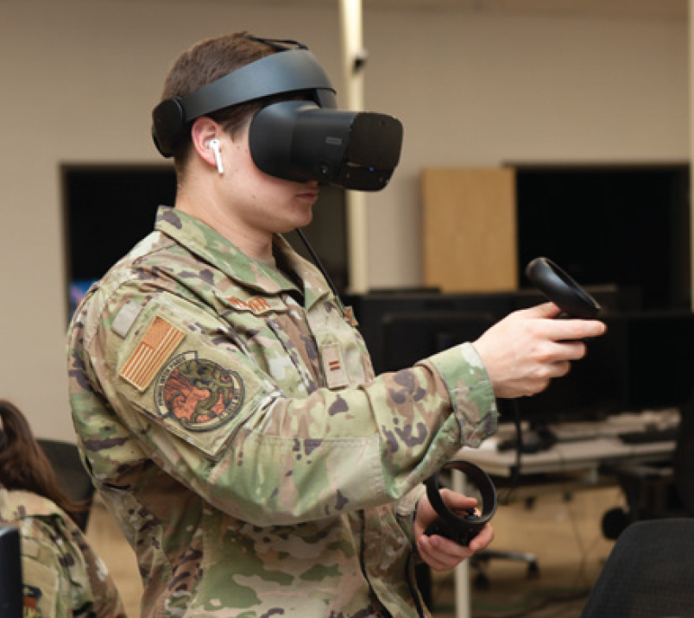
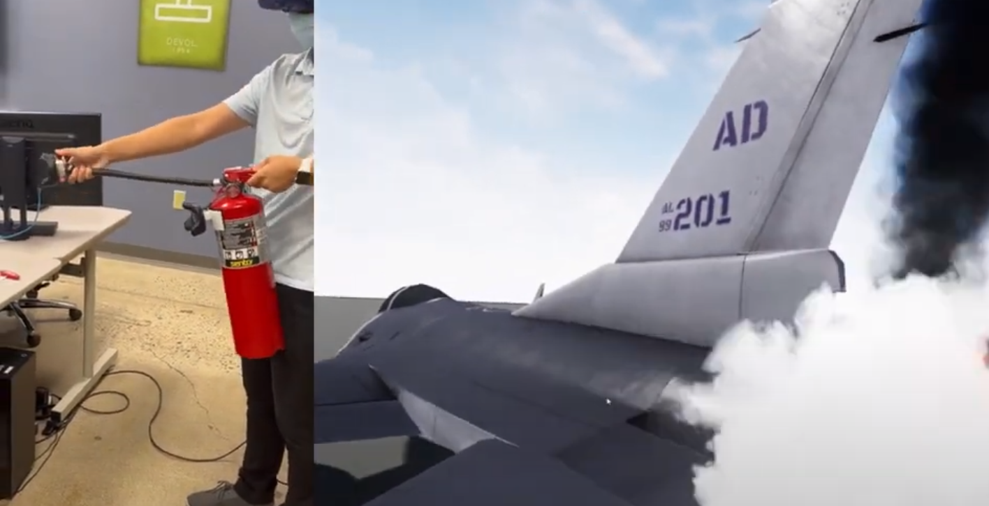
Part-task Training
User Benefits & Best Applications
Benefits: Physical objects mitigates the likelihood of negative training.
Applications: Can be a valid supplement or replacement to live training (particularly for procedural or emergency training tasks). Considerations: Solutions are highly context specific and will require redesign for each training application.
Image credits: GRILL

Slide 39
Part-task Training
Development Considerations:
Development Lift: Rapid Standup.
Resource Strain: Part task training is low footprint; usually easily deployed to stand alone systems.
Modularity or Extensibility: Highly contextualized and usually not generalizable.
Image credits: GRILL

Slide 40
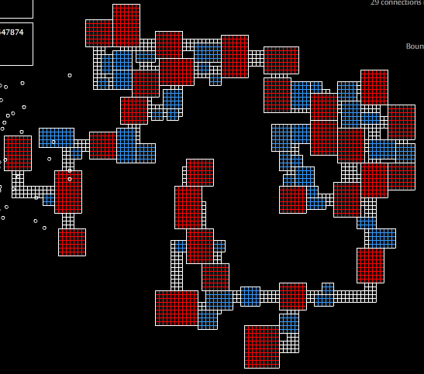
Research
Rich, time-synchronized data collection
  Events, performance, physio, interactions, etc.
Highly configurable & modular
Ability to expose to different conditions every time
  Pseudo-random decisions through seeding
  Procedurally generated maps
“Twenty minutes of VR use can generate approximately two million data points”
(Bailenson, 2018, as cited in Jerome & Greenberg, 2021)
Image credits: moddb.com
Notes:
Data rich ability for synchronized event logging and tracking
Small representations of full-scale training to explore training methods
High configurability for different experimentation settings

Slide 41
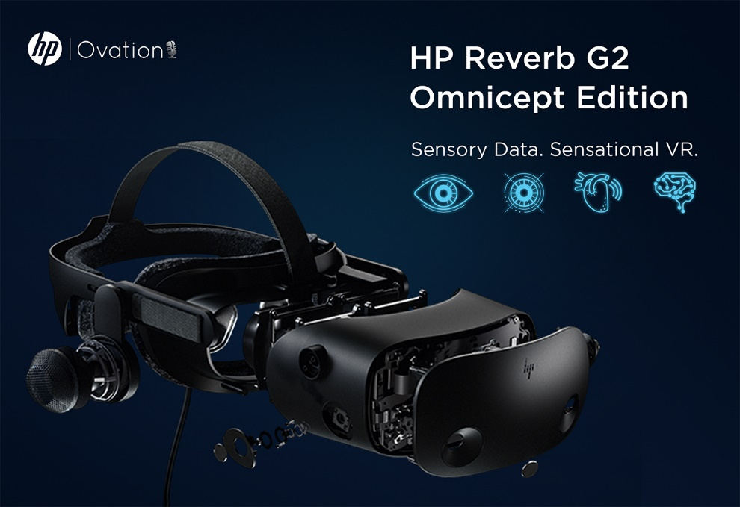

Data from XR headsets that can be captured in game engines
Physiological Indicators
Eye-tracking info
  Understand focus and assess scan patterns
  Use to train novices
  Dwell time as predictor of performance
  Insight into failures
Heart Rate
  Understand workload & stress
Brain Activity
  Understand immediate impacts on brain processes
Image credit: Ovation VR
Image credit: OpenBCI

Slide 42
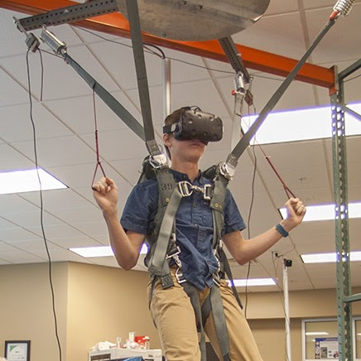
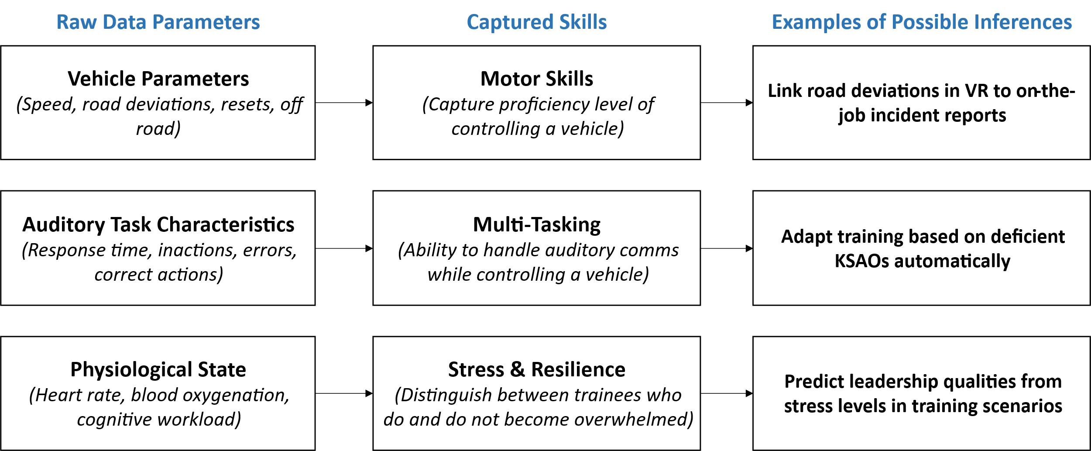
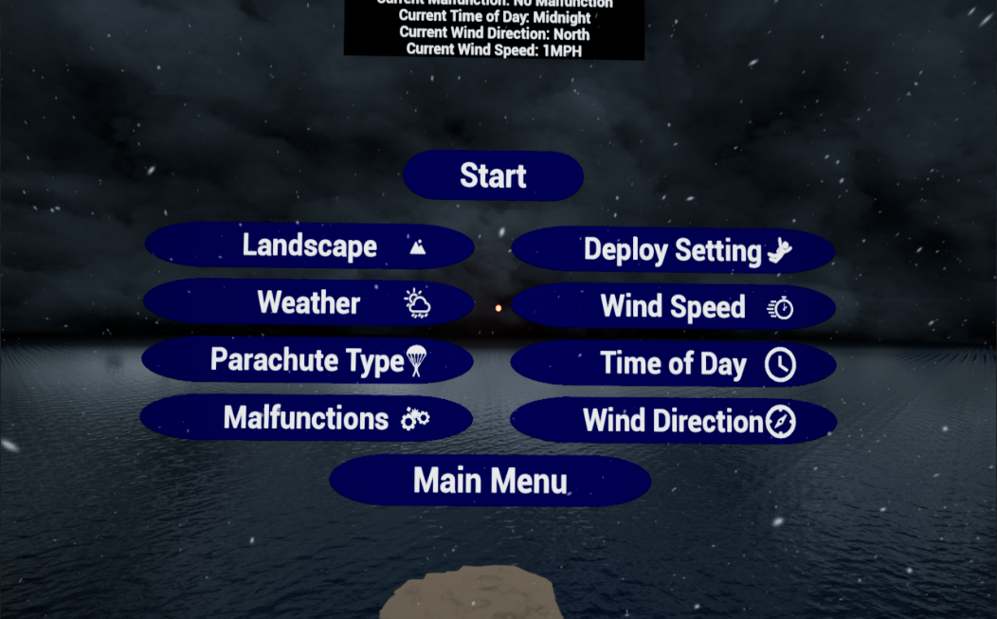
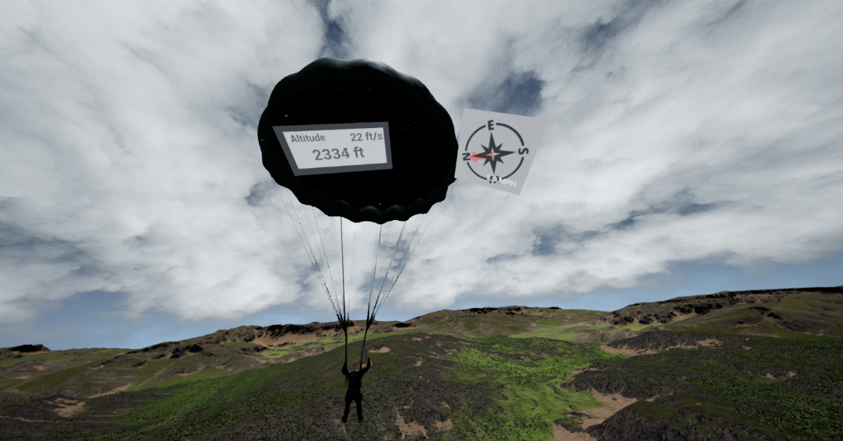
Example of Uses for Game Engine Data for Training & Research
Image credits: GRILL

Slide 43
Summarized Use Cases by Engine & Scenario
Use Case | Unity3D | Godot | CryEngine | Unreal Engine
Distributed Training | Networked VR classrooms, mobile team exercises | Lightweight LAN trainers | High-fidelity squad tactics | VR joint ops with HLA/DIS
Part-task Trainers | VR maintenance or procedure training | Desktop or touchscreen checklists | Gunnery station with optics physics | VR cockpit with haptics
Research Testbeds | User experience (UX) and AR prototyping, AI behavior | Open-source human-computer interaction (HCI) experiments | Visual recognition/ perception studies | High-end immersion + biosensors

Slide 44
Learning Objectives
Identify different options of game engines useful for distributed training, part-task trainers, and general research.
Understand the difference between game engines and other simulation technologies.
Explain how game engines can be used to enhance training and learning methods.
Compare and contrast the advantages and limitations of using game engines for different types of training and research applications.
Notes:
What are game engines? (20 minutes)
Considerations for game engine use (25 minutes)
Use Case Walkthrough (25 minutes)
Conclusion and summary (15 minutes)
Acknowledgements, contact information, and Q/A (5 minutes)
Learning Objectives:
Identify different options of game engines useful for distributed training, part-task trainers, and general research.
Understand the difference between game engines and other simulation technologies.
Explain how game engines can be used to enhance training and learning methods.
Compare and contrast the advantages and limitations of using game engines for different types of training and research applications.

Slide 45
Summary
Of the four most popular game engines
Unity: Flexible and fast for immersive, cross-platform training.
Godot: Open-source and lightweight for secure, custom sims.
CryEngine: High-fidelity visuals and physics for terrain-rich scenarios.
Unreal Engine: Enterprise-grade power for realistic, scalable simulations.
Notes:
Unity
Unity is often the platform of choice for rapid development, cross-platform flexibility, and moderate-fidelity training environments. Its large ecosystem, ease of integration, and robust support for VR/AR make it ideal for everything from mobile trainers to immersive classroom simulators.
Godot
Godot is the platform of choice when cost-effectiveness, open-source control, and lightweight deployment are the primary goals. Ideal for prototyping, academic research, or low-resource environments, it provides full engine access without licensing constraints—well-suited for custom, secure simulations.
CryEngine
CryEngine is selected when visual realism, terrain fidelity, and physics simulation are the highest priorities. It excels in creating outdoor, environmental, or vehicular simulations that demand accurate lighting, line-of-sight modeling, and destructible environments.
Unreal Engine
Unreal Engine is often the platform of choice for projects where fidelity, extensibility, and immersive realism are mission-critical. It is especially powerful for high-end VR simulators, large-scale multiplayer scenarios, and applications that must interface with external systems at an enterprise level.
Presentation Summary: This tutorial explores the use of game engines—Unity, Godot, CryEngine, and Unreal Engine—in military simulation contexts, comparing their strengths across key areas such as project content, target audiences, XR integration, 3D modeling, multiplayer capabilities, system interoperability, and deployment. Unity excels in rapid development and cross-platform immersive training; Godot offers open-source flexibility ideal for secure, lightweight, or academic use; CryEngine provides high visual and terrain fidelity suited for environmental and vehicle-based simulations; and Unreal Engine delivers enterprise-grade realism for scalable, high-end VR and multiplayer scenarios. Broader distinctions between game engines and simulation software are also discussed, noting that game engines prioritize interactivity and customization, while traditional simulation platforms emphasize validated models and domain fidelity. Use cases are mapped to distributed training, part-task trainers, and research testbeds, along with a comparison of licensing models, training availability, and community ecosystems—all framed to guide engine selection for defense-focused applications.

Slide 46
Game Engines Vs Simulation Software
Game Engines
Strengths: Customization, immersion, XR/VR, rapid prototyping
Weaknesses: Requires more custom development for realism
Best Fit: Visualization, experiential training, mobile/VR
Simulation Software
Strengths: Doctrine alignment, validated behaviors, military frameworks
Weaknesses: Less flexible, less graphically advanced
Best Fit: Constructive sims, command-level exercises

Slide 47
Game Engines for Training & Research
Pros
Data Rich
Interpretable with legacy systems
Ability for dynamic and novel scenarios
Limitations
Higher fidelity training requires larger amount of resources
  Multiplayer server
  Real world objective integration
  Higher fidelity headsets

Slide 48
Acknowledgements, Contact Information, and Q/A
Questions?
This work was supported by the Air Force Research Laboratory (AFRL) 711th Human Performance Wing (HPW/RHW) Gaming Research Integration for Learning Laboratory® (GRILL®).
GRILL STEM Booth: 2387
AFRLGRILL@af-grill.com

Slide 49
Acronym Definitions
AFRL: Air Force Research Laboratory
API: Application Programming Interface
AR: Augmented Reality
C4ISR: Command, Control, Communications, Computers, Intelligence, Surveillance, and Reconnaissance
CGF: Computer Generated Forces
DAE: Digital Asset Exchange
DIS: Distributed Interactive Simulation
glTF: Graphics Library Transmission Format
GRILL®: Gaming Research Integration for Learning Laboratory®
HCI: Human-Computer Interaction
HLA: High Level Architecture
KSAO: Knowledge, Skills, Abilities, and Other Characteristics
LMS: Learning Management Systems
LVC: Live Virtual Constructive
MR: Mixed Reality
OBJ: Wavefront Object
SDK: Software Development Kit
TCP: Transmission Control Protocol
TCP/IP: Transmission Control Protocol/Internet Protocol
UX: User Experience
UDP: User Datagram Protocol
VR: Virtual Reality
XR: Extended Reality

