Slide 1
Quantifying Training Value in the Age of Immersive Simulation
Sandro Scielzo Human Systems Technical Authority CAE USA
sandro.scielzo@caemilusa.com
Eric Ultes Chief Engineer Training Systems CAE USA
eric.ultes@caemilusa.com

Slide 2

By the end of this tutorial I will be able to…
… Describe immersive technologies and related training gains
… Summarize how to overcome training needs analyses limitations
… Identify media cost & capability tradeoffs
… Describe training value index driving factors

Slide 3


… a bit of Latin first!
Immersive Simulation
Immersion: From Late Latin immersionem, noun of action from past participle stem of immergere "to plunge in, dip into, sink, submerge."
Simulation: the imitative representation of the functioning of one system or process by means of the functioning of another.
etymonline
Merriam Webster

Slide 4

… a bit of Latin first!
Immersive Simulation
Immersion: From Late Latin immersionem, noun of action from past participle stem of immergere "to plunge in, dip into, sink, submerge."
Simulation: the imitative representation of the functioning of one system or process by means of the functioning of another.
Uses technologies such as virtual reality (VR), augmented reality (AR), and mixed reality (MR) to create realistic environments for learners!
etymonline
Merriam Webster

Slide 5
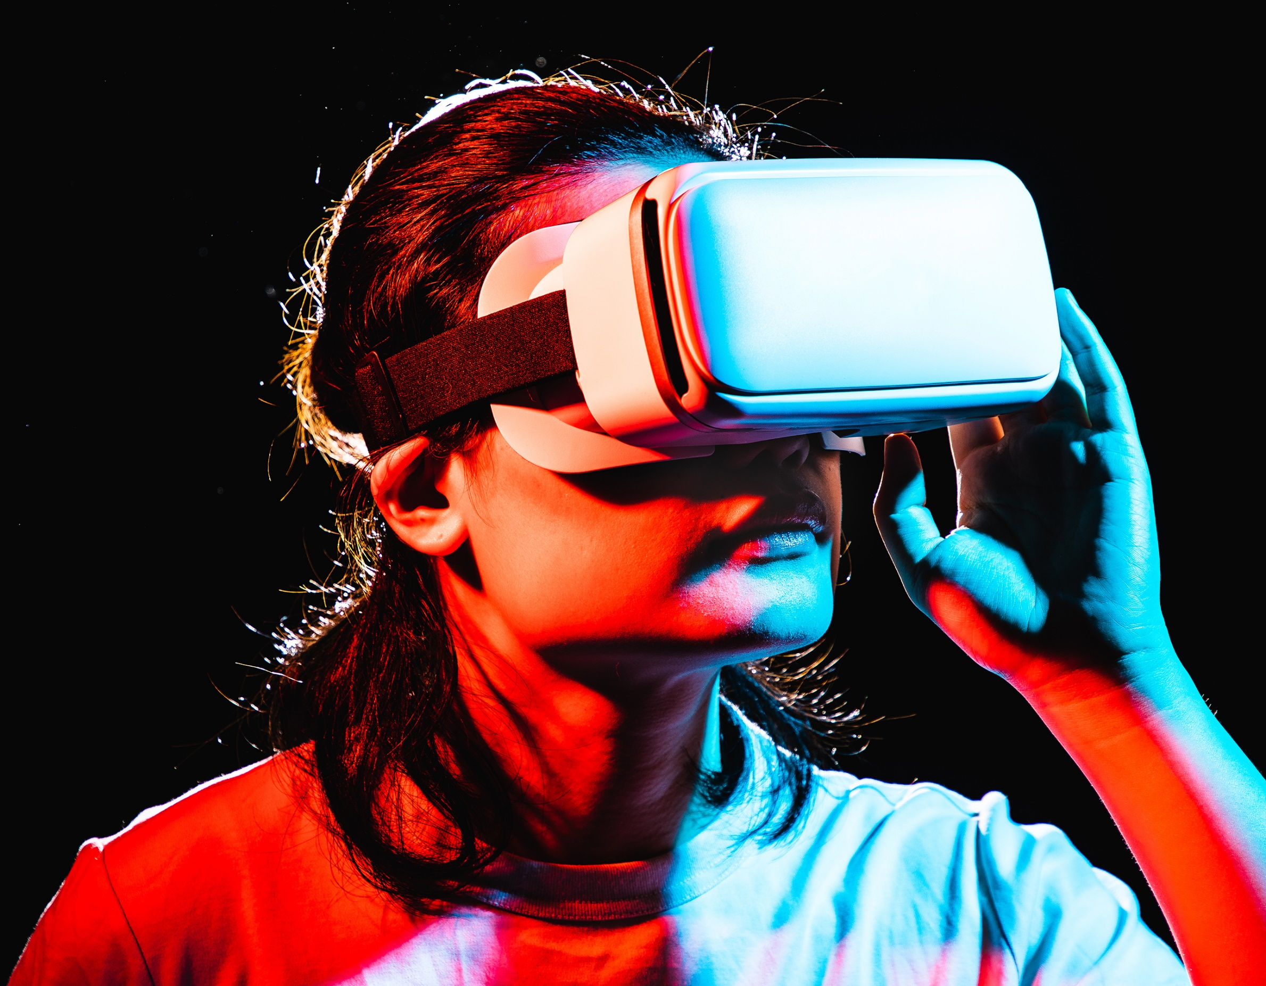
Do immersive technologies lead to
better training?
“provides many benefits including greater student interest”
“promotes higher order thinking skills and discovery”
“a huge influence in learning and how to think critically”
“a powerful medium to enhance learning”

Slide 6


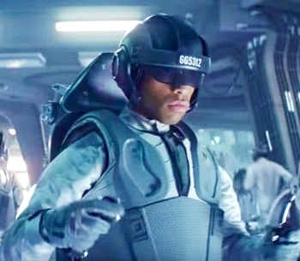
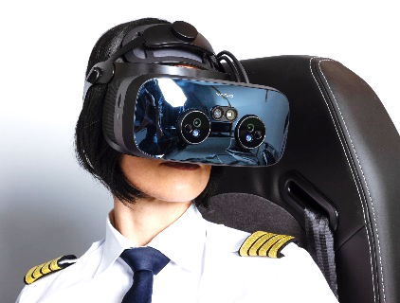
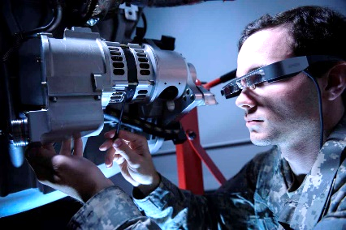


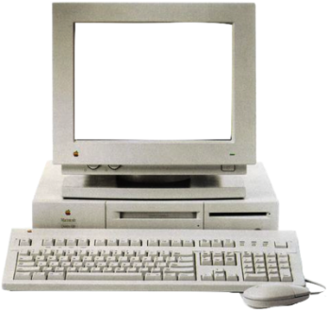


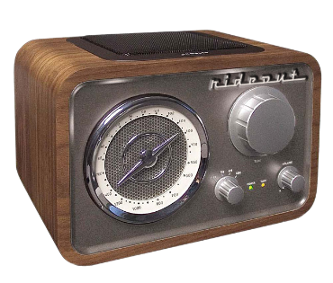
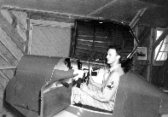
The promise of immersive technology
“This will enhance learning by simulating touch and motion”
Body Suits
“This media will let us learn in ways that aren’t otherwise possible or practical”
“The magic of presence changes everything”
“promotes higher order thinking skills and discovery”
“provides many benefits including greater student interest”
“a powerful medium to enhance learning”
“a huge influence in learning and how to think critically”
“This media will be the single largest innovation that will change the nature of learning”
MR
AR
VR
Tablets
Learning
PC
Television
Radio
Time

Slide 7

Beware of the shiny toy syndrome!
Do immersive technologies lead to
better training?

Slide 8

… and training devices based on AR,
VR, and MR can be very shiny!

Slide 9
Gartner’s Hype Cycle
Peak of inflated expectations
Plateau of productivity
Visibility
Slope of enlightenment
Trough of disillusionment
Technology trigger
Time

Slide 10
Towards a new training landscape…
(1) A history of training value
(2) New tech changing training solutions
(3) Immersive sim and training gains

Slide 11
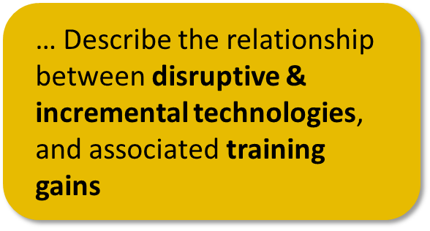
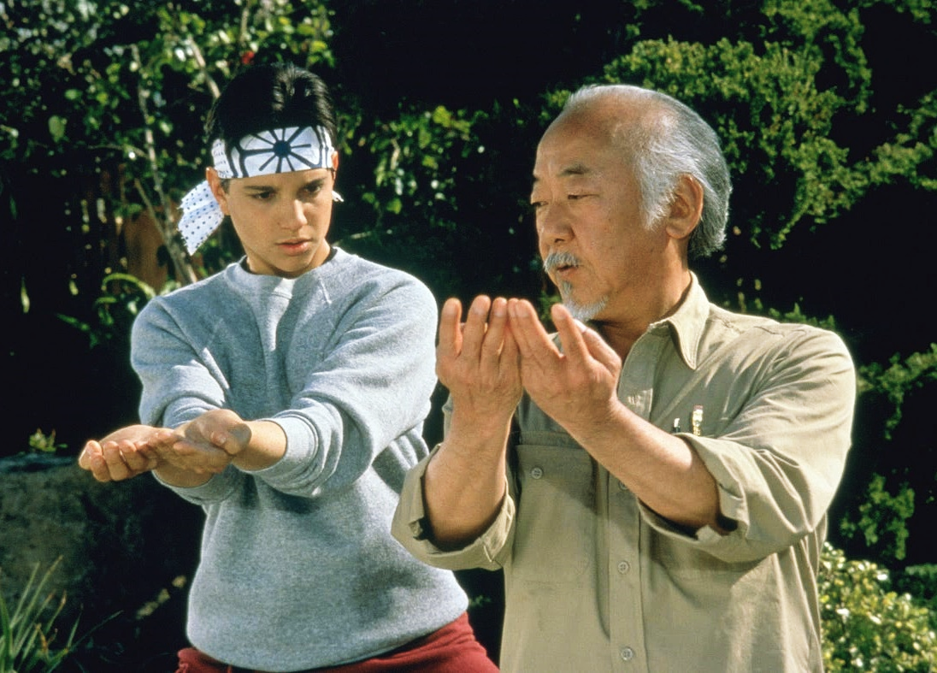
A History of Training Value
The master and the apprentice model
There’s no such thing as a bad student, only a bad teacher… The teacher says, the student does
One-on-one training is superior, but…
… it is by far the most expensive!

Slide 12

The 2 sigma problem
2
one-on-one training
# of students
traditional training
Student Proficiency

Slide 13
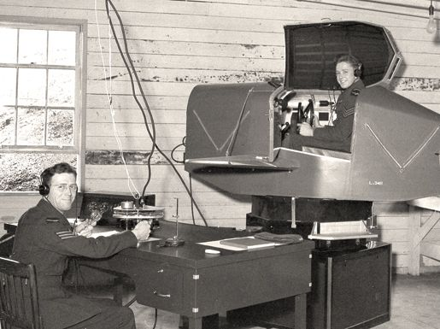
A traditional training value proposition
Safe training
Ed Link Trainer 1929
Due to World Wars, what is
Increased
the one key technological
throughput
innovation that contributed
more than any other to
Standardized
the evolution of pilot
proficiency
training?
the simulator
Cheaper than
aircraft sorties
Ground-based training was born!
Notes:
Quote from: Pilots Then and Now: Exploring the History of Pilot Training

Slide 14


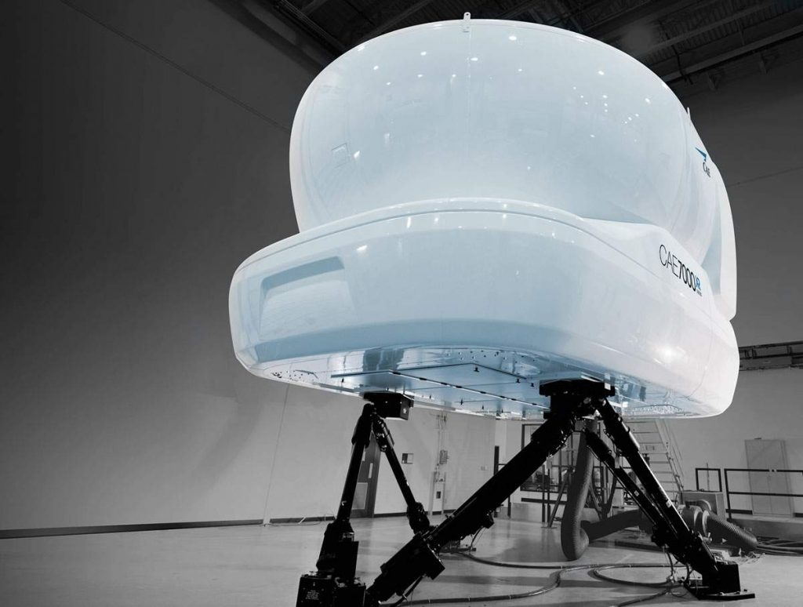

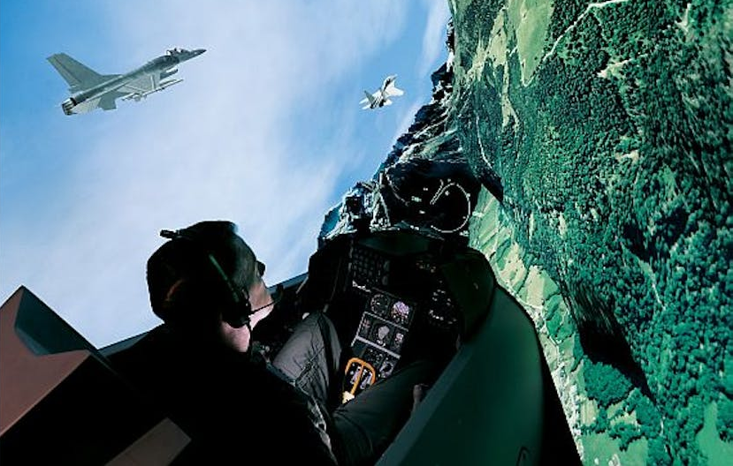
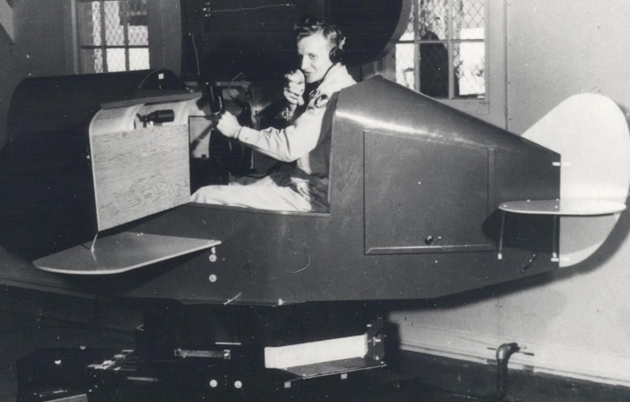
Great, but how does that relate to
the 2-sigma problem?
Learning Sciences
Simulation Technology
Science &
Instructional System Design
Technology
Full motion trainers…
Training needs
Learning objectives
Media pairing
Curriculum
High-fidelity weapons systems

Slide 15


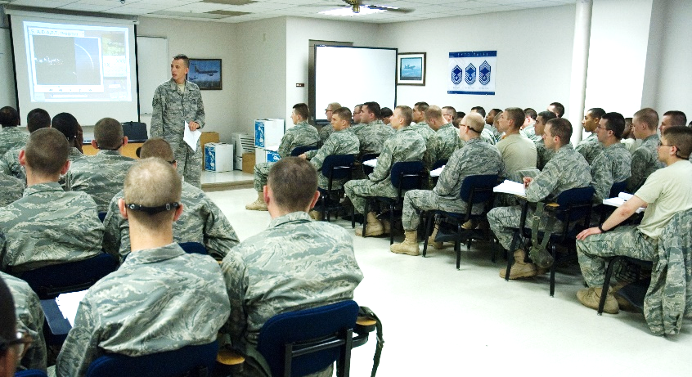
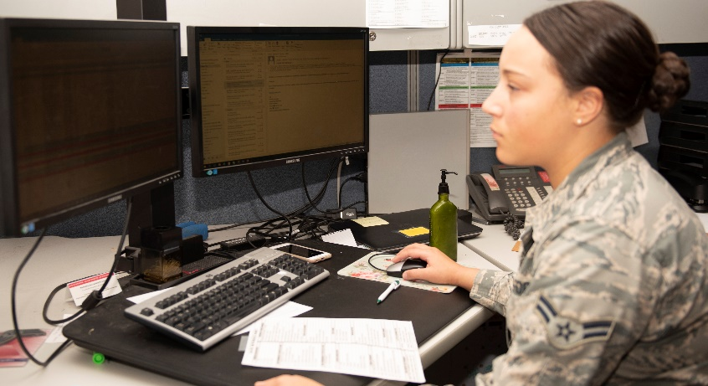
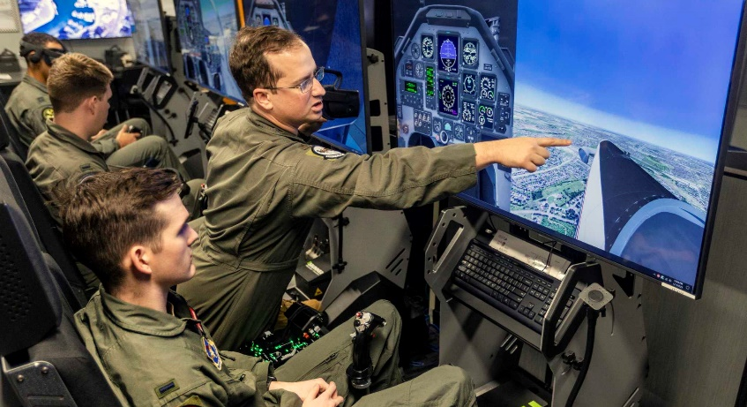
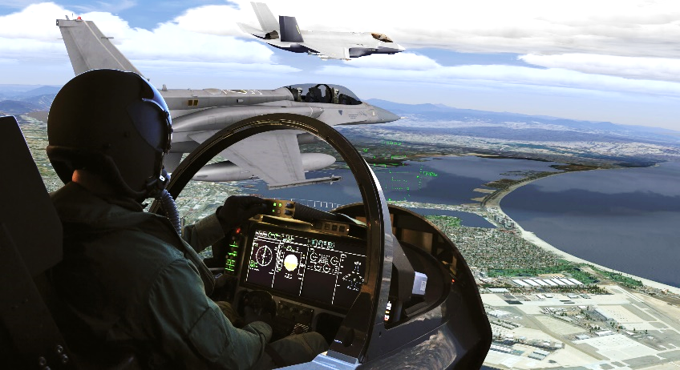
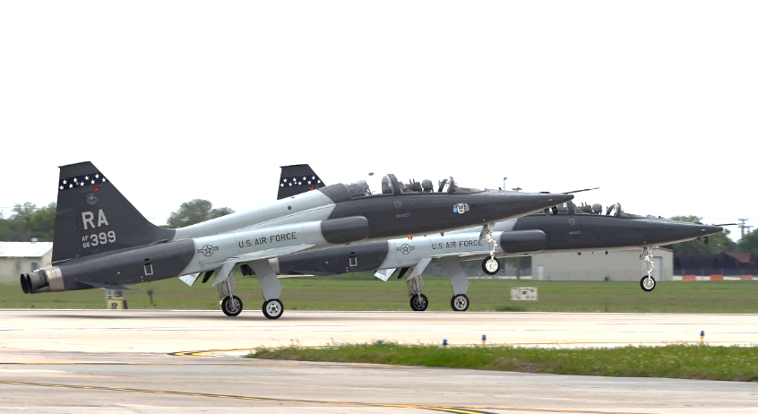
Ground-based training systems mix
media and student/instructor ratios
Knowledge-Based Training
Skill-Based Training
Classroom (ACA)
Computer-Based Training (CBT)
Part-Task Trainers (PTT)
High-Fidelity Simulation (SIM)
Aircraft (A/C)
Ratio = highest
Ratio = n/a
Ratio = up to 1:1
Ratio = 1:1
Ratio = 1:1
Fidelity = lowest
Fidelity = low
Fidelity = medium
Fidelity = high
Fidelity = highest
Cost = lowest
Cost = low
Cost = medium
Cost = high
Cost = highest

Slide 16



How can I maximize one-on-one training
and achieve proficiency requirements?
From novice to expert (ISD-driven process)
ACA
CBT
PTT
A/C
PTT
SIM
A/C
SIM
A/C
SIM
A/C
Locked-step, one-size-fits-all
Costly PPTs with limited training capabilities
High SIM footprint still required for overall training
Heavy reliance on A/C sorties

Slide 17
What is the promise of
immersive simulation?
From novice to expert (ISD-driven process)
ACA
ACA
Immersive SIM
CBT
PTT
A/C
PTT
SIM
A/C
SIM
A/C
SIM
A/C
Reduced need for classroom
Takes over CBT and downloads training tasks for high-fidelity SIM
High-fidelity SIM for advanced skills
Sorties focus on check rides

Slide 18

What is the promise of
That’s what I thought…
immersive simulation is the answer!
immersive simulation?

Slide 19
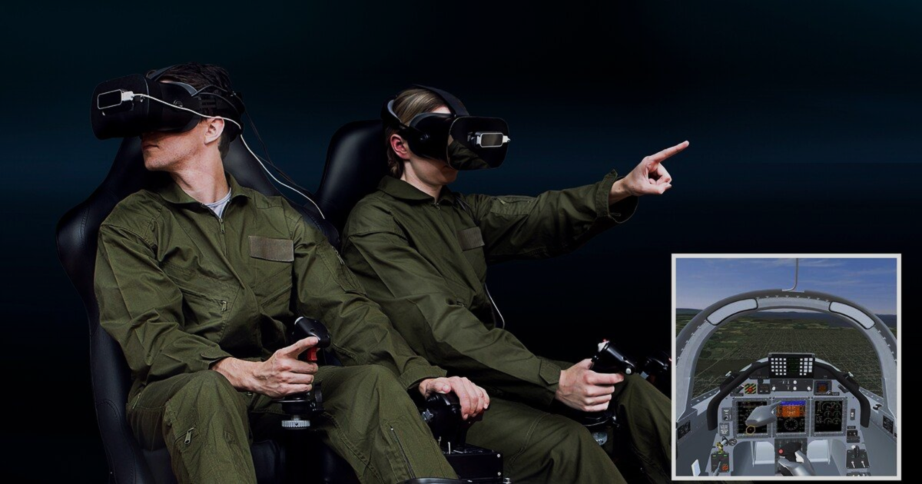
But how exactly is immersive simulation
New bold claims
changing the training landscape?
Small footprint! Low-cost! Covers 80% of your training tasks!

Slide 20
Too good to be true?
A new shiny toy or warfighter ready?

Slide 21
Immersive simulation as a disruptor
High end technology keep moving upmarket, beyond training need
Technology sustainment
High-end market
TRAINING NEED
Product performance
Low-end market
Immersive simulation tech is mature enough to enter market
Immersive sim innovation
2017
Time

Slide 22
Gartner’s Hype Cycle
Peak of inflated expectations
Disrupter through hype, and integrated through science!
Immersive simulation tech is mature enough to enter market
Plateau of productivity
Visibility
Slope of enlightenment
Trough of disillusionment
Technology trigger
2017
Today
Time

Slide 23
Is there an evidence-based method to
assess immersive simulation benefits?

Slide 24
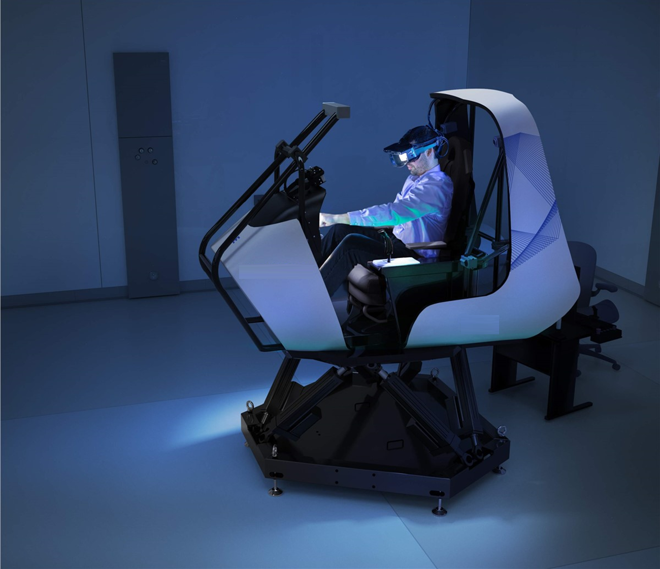


Immersive Sim Value Tradeoffs
Simulation Technology
Footprint
$
$$$
Headset & Image Generator (IG)
$
$$$
Model fidelity (game vs OFP)
$
$$$
Physical / virtual ratio
$
$$$
Aircraft controls & loadings
$
$$$
Negative training

Slide 25

Immersive Sim Value Tradeoffs
Where are the training gains?
Training task coverage
$
$$$
Proficiency needs
$
$$$
Learning Readiness Measures (LRM)
$
$$$
You need a training needs analysis!!
Notes:
The Short-Game Versus Long-Game: How to know when the investment juice short-term is worth the squeeze long-term versus staying perpetually on the investment bleeding edge
TRL and You: How to talk to your Industry partners about showing up with TRL 7+ solutions and not nifty design concepts
Fitting immersive training media in the training continuum (meeting learning objectives, sensory fidelity, proficiency level)

Slide 26
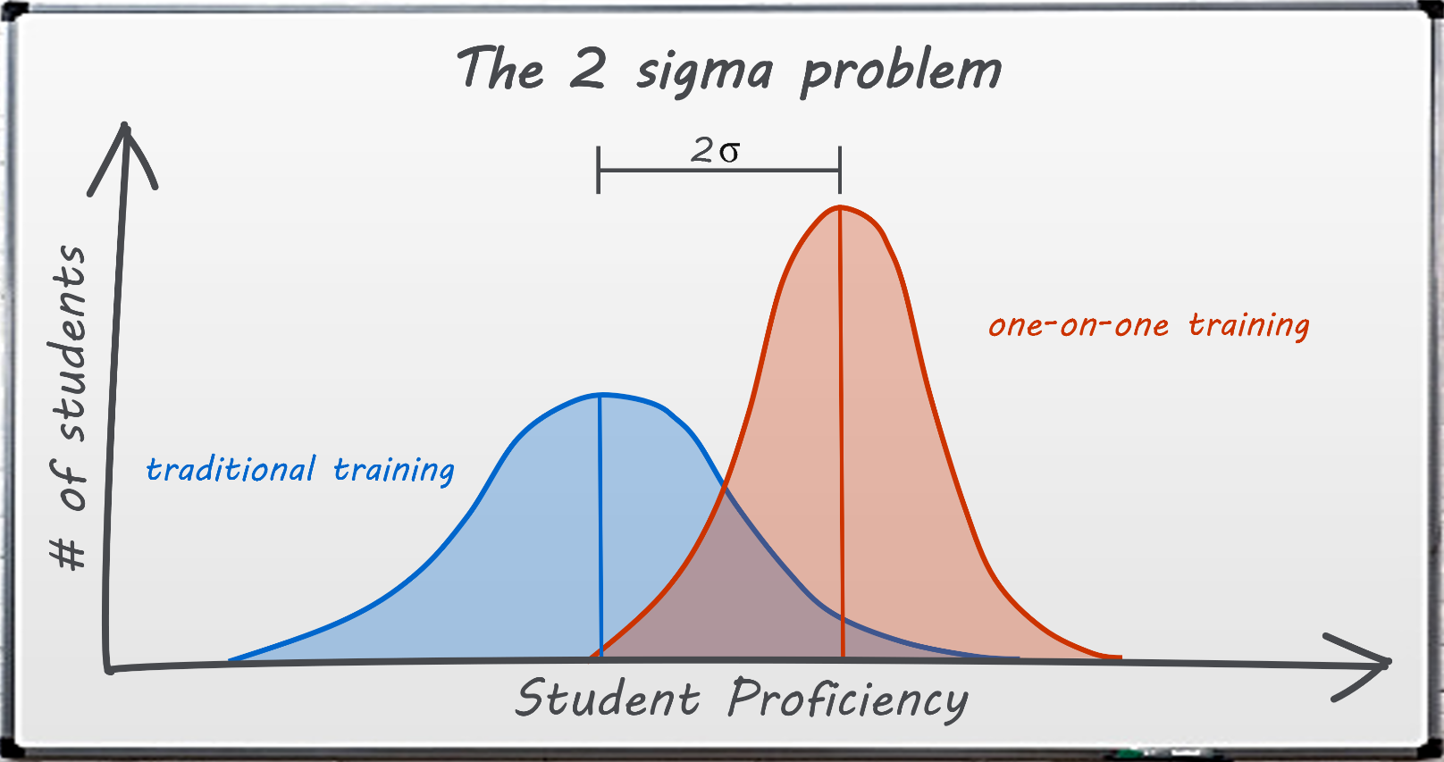

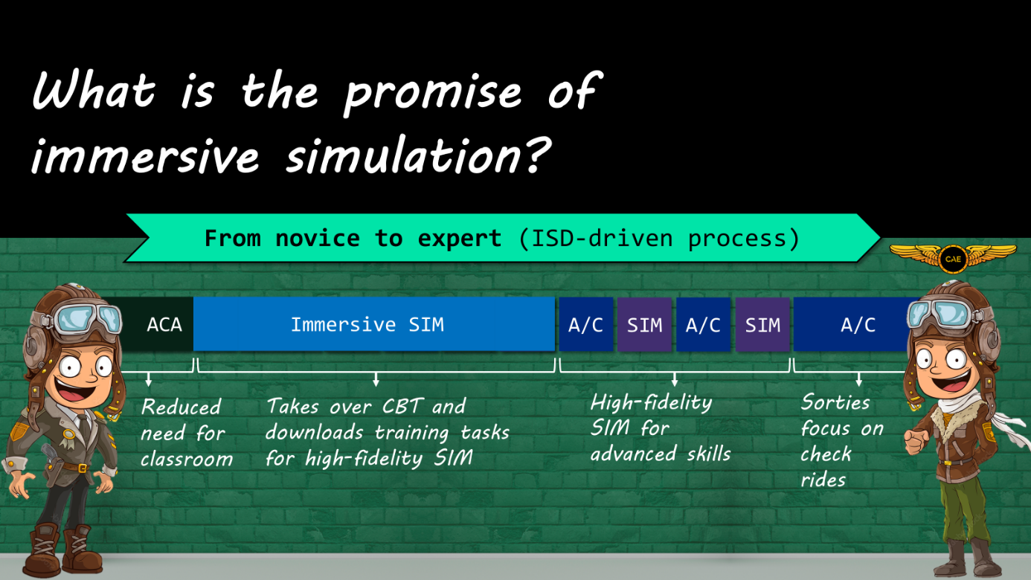
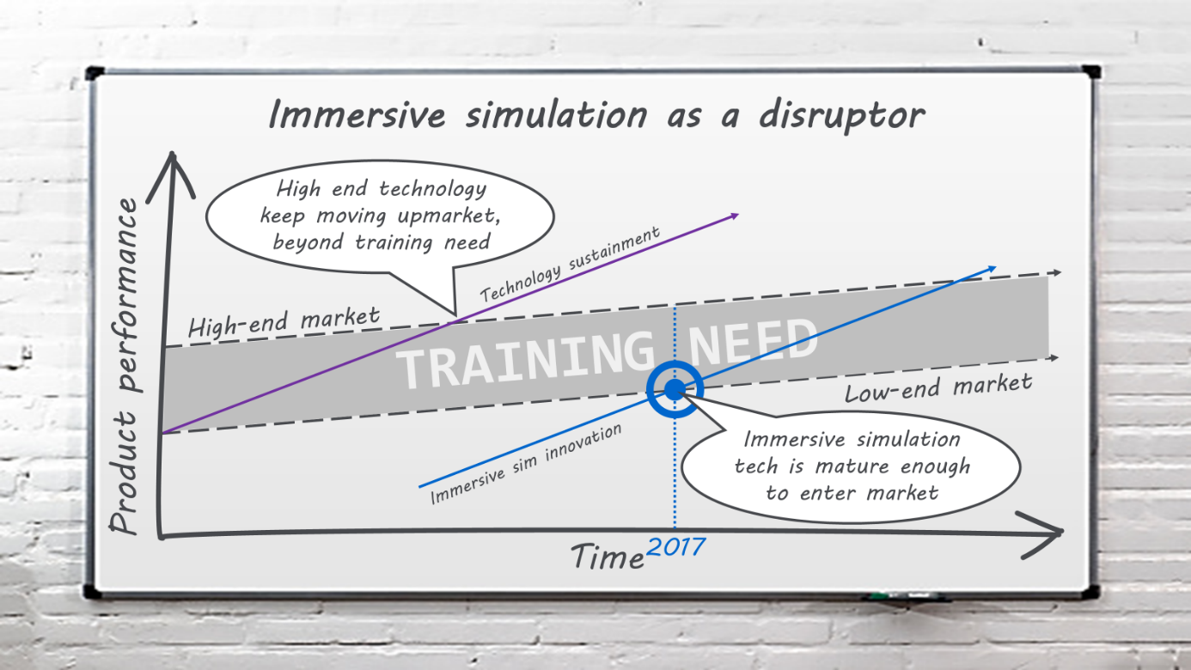
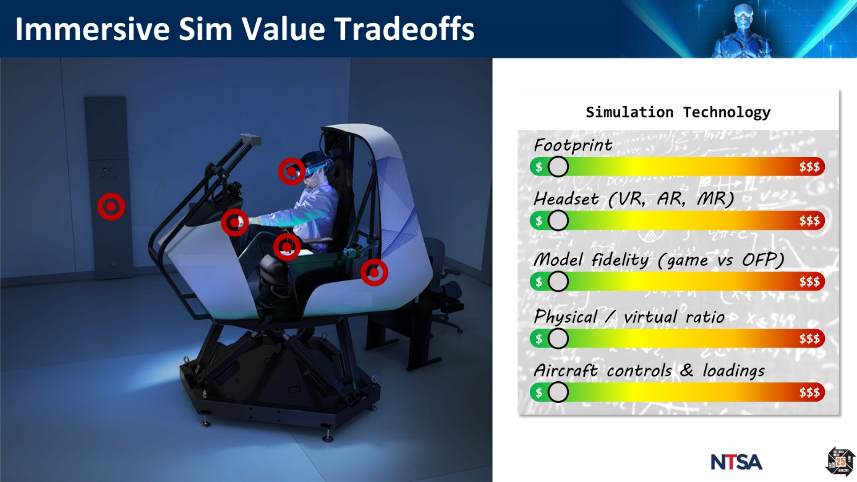
A New Training Landscape: A Recap!

Slide 27
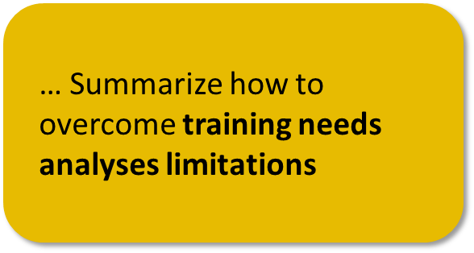

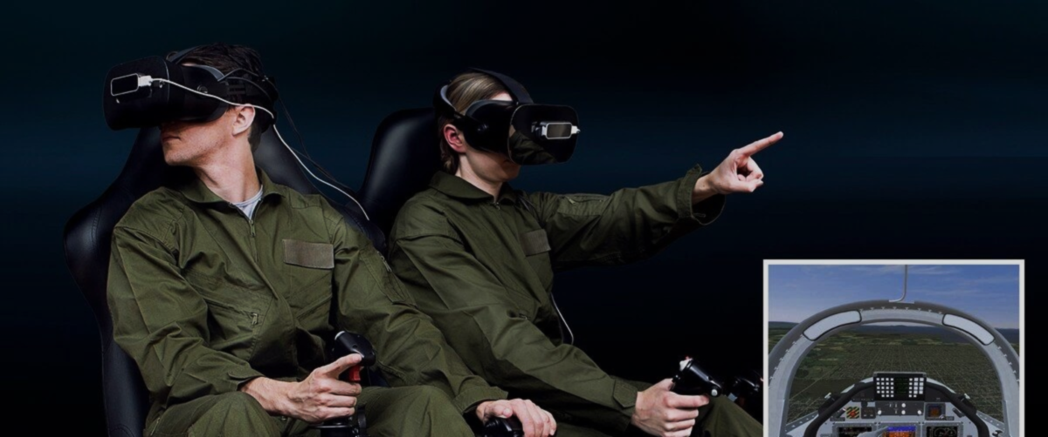




Augmenting Training Needs Analyses (TNA)
1
2
3
Traditional TNA
TNA Limitations
Augmenting TNA
Training needs cycle
Assessing immersive sim media
Blending Instructional System
Design and Human Factors
MTA
Mission
TRA
Reqs
OMA
Objectives
TSBA
Training basis
Tasks
Media
Skills
Syllabus
Sensory analysis limitation

Slide 28

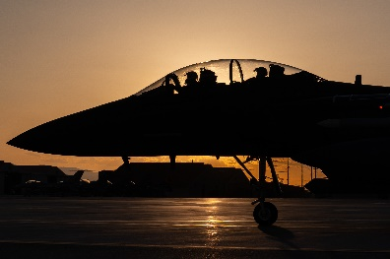


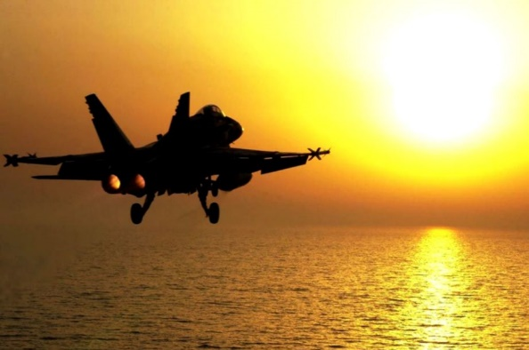
Traditional Training Needs Analysis
1
Traditional TNA
Mission Task Analysis (MTA)
Training needs cycle
Defines mission profiles and corresponding task lists
MTA
Mission
TRA
Reqs
OMA
Objectives
TSBA
Training basis
Tasks
Media
Skills
Syllabus
Platform
Missions
Tasks
- How many roles?
- Objectives?
- SME interviews
- A/C variants?
- Profiles?
- Task analysis
- Scenarios?
- Master Task List

Slide 29

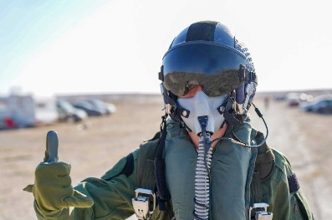
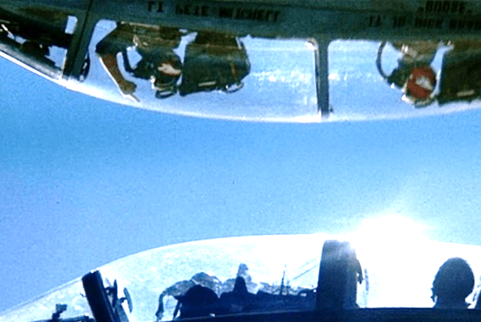
Traditional Training Needs Analysis
1
Traditional TNA
Training Requirements Analysis (TRA)
Training needs cycle
Identifies requirements to perform the job
MTA
Mission
TRA
Reqs
OMA
Objectives
TSBA
Training basis
Tasks
Media
Skills
Syllabus
Proficiency
SKAs
- Training level?
- Skills?
- Readiness?
- Knowledge?
- Aptitudes?

Slide 30

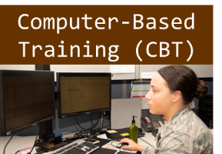


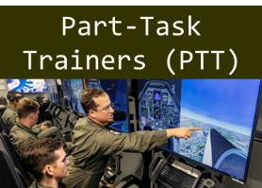

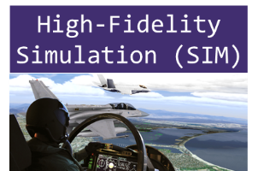
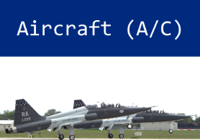
Traditional Training Needs Analysis
1
Traditional TNA
Objectives and Media Analysis (OMA)
Training needs cycle
Defines learning objectives (LO), media pairing, and syllabus
MTA
Mission
TRA
Reqs
OMA
Objectives
TSBA
Training basis
Tasks
Media
Skills
Syllabus
Objectives
Media
Syllabus
Step 3
Step 2
Step 1
- Enabling LOs
- Sensory analysis
- LO hierarchy
- Terminal LOs
- Media mapping
- Curriculum

Slide 31
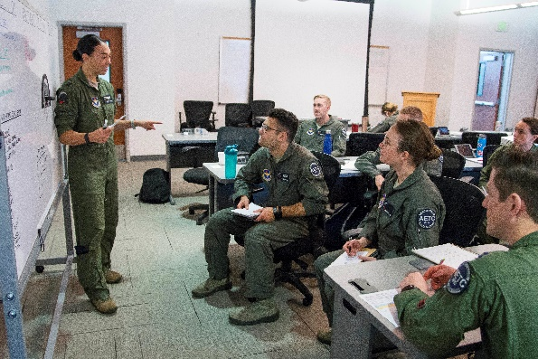
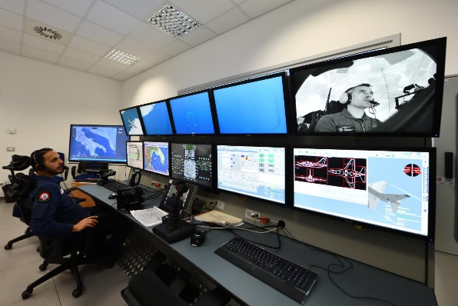
Traditional Training Needs Analysis
1
Traditional TNA
Training System Basis Analysis (TSBA)
Training needs cycle
Identifies overall training system options
MTA
Mission
TRA
Reqs
OMA
Objectives
TSBA
Training basis
Tasks
Media
Skills
Syllabus
Throughput
GBTS
- Student throughputs
- Media composition options
- Resource loaded schedules
- Customer tradeoffs

Slide 32
So, if a TNA leads to an optimized
training system, what is the issue
with immersive simulation?
Is it because TNAs follow old methods that can’t capture the awesomeness of immersive sim?

Slide 33
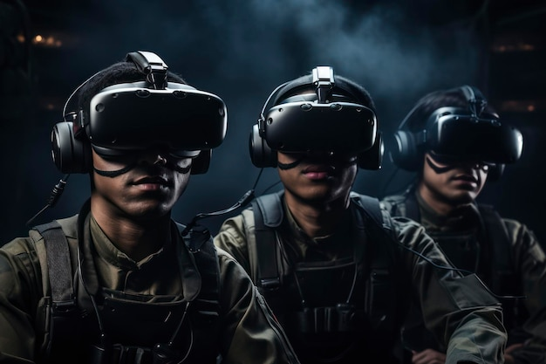
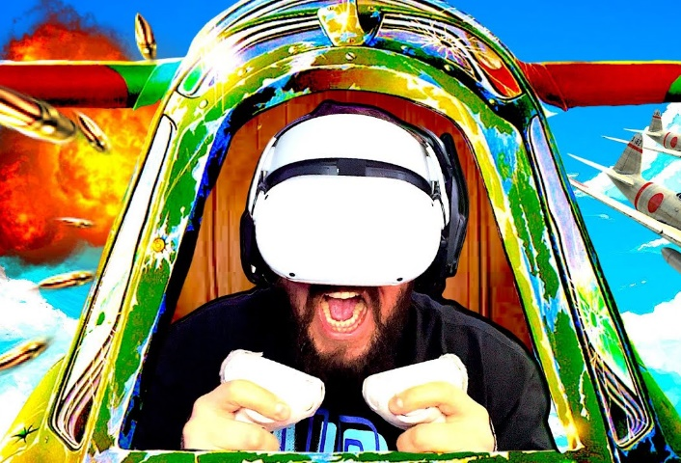
Instructional System Design Gap
2
TNA Limitations
Unique immersive simulation factors
Training needs cycle
ISD methods do not know how to assess the following…
Assessing immersive sim media
Sense of immersion
Proprioception: your body’s ability to
sense its position, movement, and action
without relying on visual cues
Suspension of disbelief: a temporary
loss of awareness of the “real” world
and immersion into an “alternate” reality
Failure leads to cyber-sickness and negative training

Slide 34
Instructional System Design Gap
2
TNA Limitations
Unique immersive simulation factors
Training needs cycle
ISD methods do not know how to assess the following…
Assessing immersive sim media
Sense of immersion
Proprioception assessment: determine
extent to which the virtual environment
maps to the physical one
Suspension of disbelief assessment: assess
factors that can detract from a
sustained immersion

Slide 35
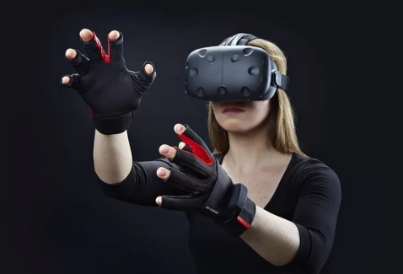
Instructional System Design Gap
2
TNA Limitations
Unique immersive simulation factors
Training needs cycle
ISD methods do not know how to assess the following…
Assessing immersive sim media
Tracking fidelity
Finger tracking accuracy: the ability to
precisely track fingertips in the virtual
environment
Rule of thumb: tracking needs to have
submillimeter accuracy

Slide 36
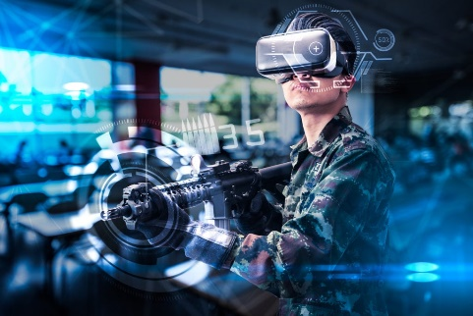
Instructional System Design Gap
2
TNA Limitations
Unique immersive simulation factors
Training needs cycle
ISD methods do not know how to assess the following…
Assessing immersive sim media
Haptic congruency
Haptics Congruency: “what I touch in the
virtual environment is consistent with
what it looks like and where it’s at”
Rule of thumb: frequently occurring and
high-importance tasks require high
haptic congruency

Slide 37
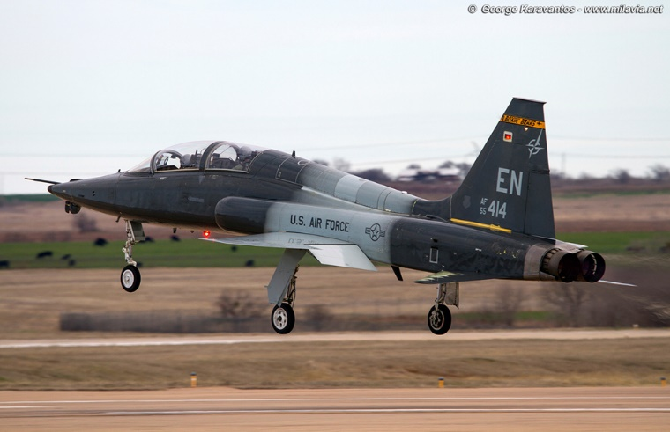

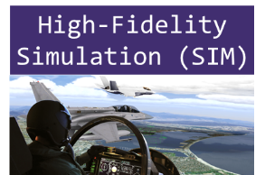



Instructional System Design Gap
2
TNA Limitations
Sensory analysis limitations
Training needs cycle
ISD looks at the sensory requirements to train a given task
In order to achieve desired proficiency
OMA Sensory analysis
MTA
Mission
TRA
Reqs
OMA
Objectives
TSBA
Training basis
Tasks
Media
Skills
Syllabus
Stimulus
Media
Perform normal takeoff
= high
= low
= high
analysis not granular enough to assess immersive sims

Slide 38
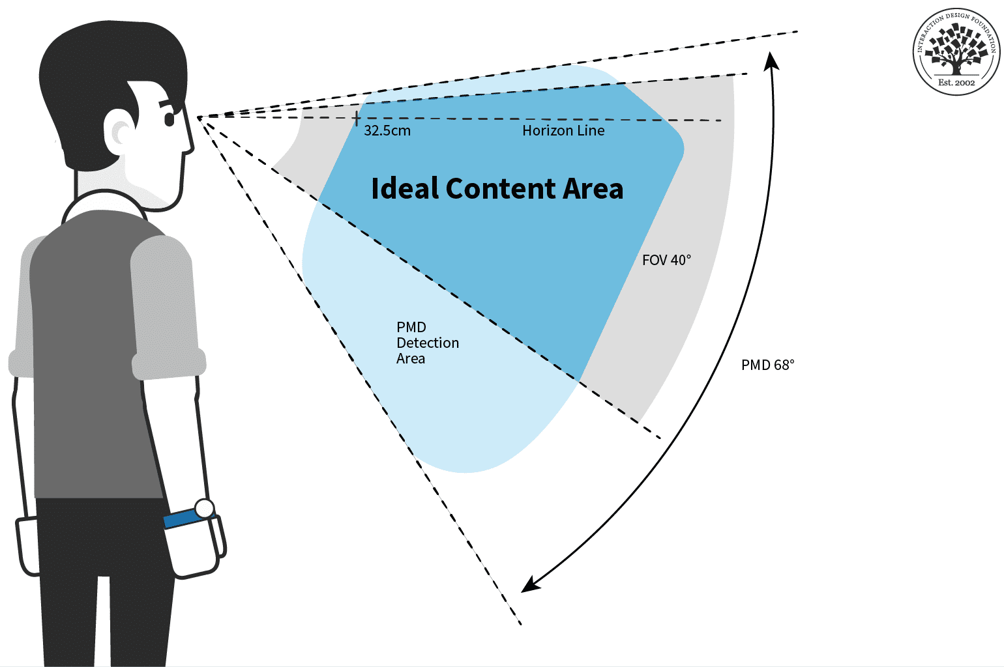
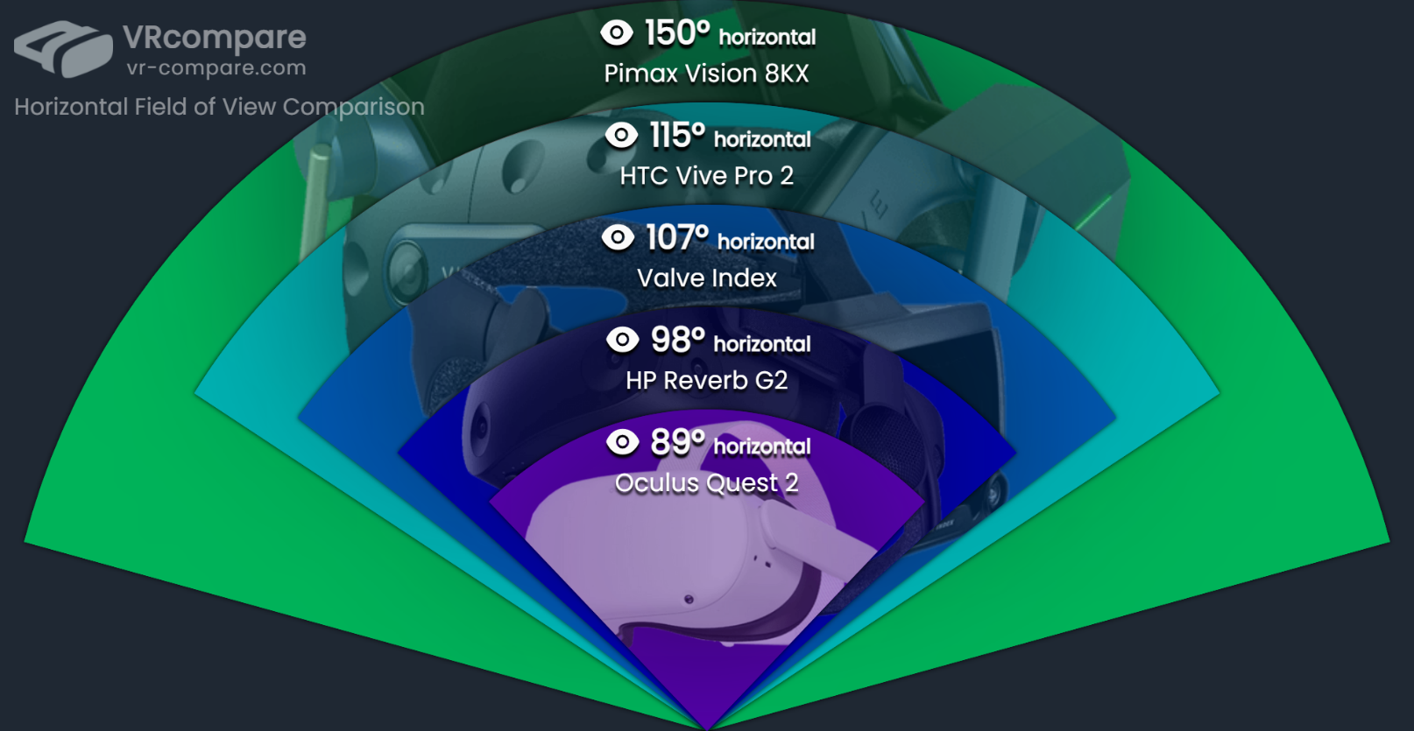
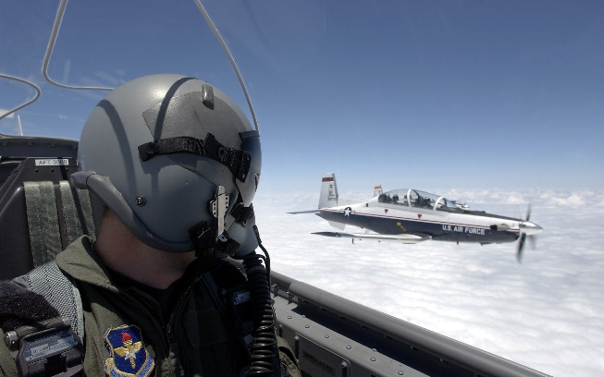
Augmenting TNA
3
Augmenting TNA
Combining ISD + Human Factors
Supplementing a sensory analysis with…
Blending Instructional System
Design and Human Factors
Field of View
Formation flight
Spot traffic
Crosschecks
Ensure headset FoV
Judge distances
supports training tasks
Peripheral vision can be critical!

Slide 39
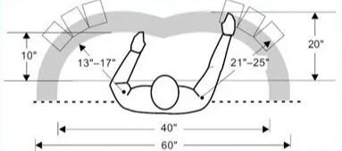
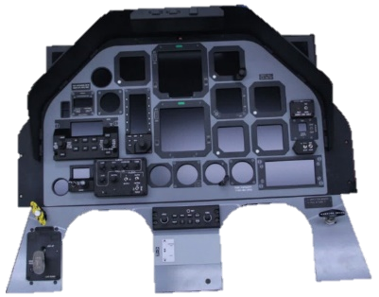
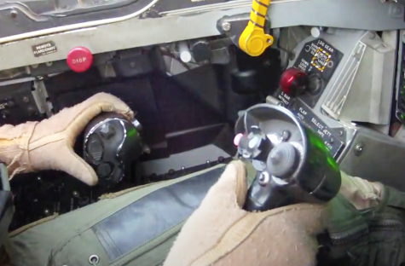
Augmenting TNA
3
Augmenting TNA
Combining ISD + Human Factors
Supplementing a sensory analysis with…
Blending Instructional System
design and Human Factors
Reach Envelopes
Ensure arm/leg
Main Instrument
Hands on Throttle
envelopes match
Panel (MIP)
and Stick (HOTAS)
Cockpit for key tasks
Maintain haptic congruency!

Slide 40
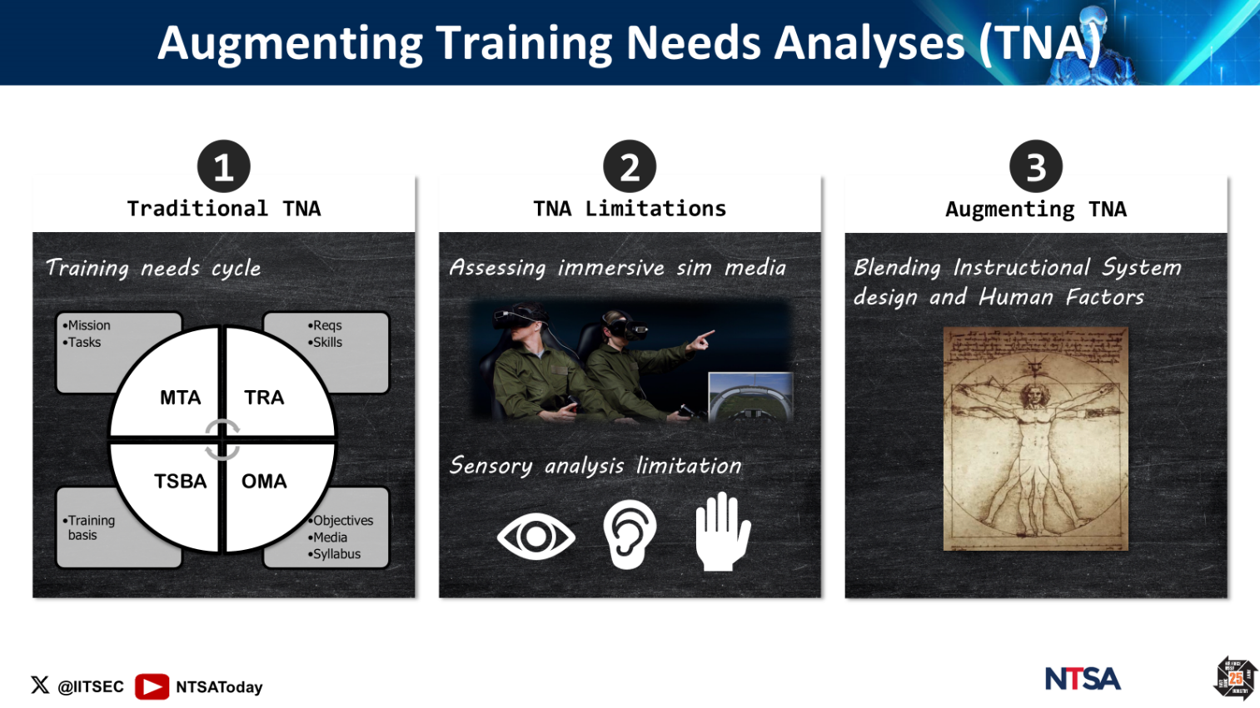
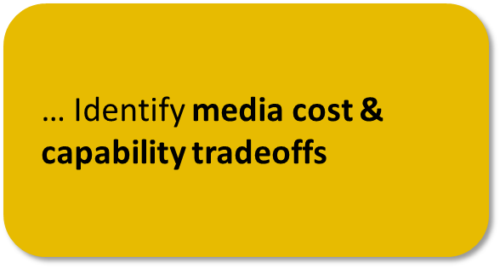



Augmenting TNA: A Recap!

Slide 41



Media Cost and Capability Tradeoff
1
2
A big mediating factor!
Visualizing Tradeoffs
What about AI?!
Optimizing media
composition!

Slide 42
Remember the master/apprentice
model?
…it’s the most effective
…it’s the most costly
Unless…

Slide 43

We help instructors with AI
surrogates, and…
…pair AI instructors with
immersive simulators
Powerful way to close
the 2-sigma gap!
Why?

Slide 44
We help instructors with AI
surrogates, and…
- Reduces instructor workload
- Standardizes basic skills
- Supports adaptive training
- Provides real-time coaching
- Prevents negative training

Slide 45

Are AI instructors the next big thing?
They are rapidly maturing, but…
- Beware of the shiny toy
syndrome!
- Make sure they are based on
field-tested technology
- Verify that they have high
Human/Learning Readiness Level!

Slide 46




Media Cost and Capability Tradeoff
2
Visualizing Tradeoffs
Cost/Capability Tradeoff
Optimizing media
composition!
Magnitude
Cost
Proficiency
Traditional media fidelity

Slide 47



Media Cost and Capability Tradeoff
2
Visualizing Tradeoffs
Cost/Capability Tradeoff
Optimizing media
composition!
Magnitude
Cost
Proficiency
Immersive Simulation fidelity

Slide 48



Media Cost and Capability Tradeoff
2
Visualizing Tradeoffs
Immersive sim force multipliers
AI
HRL
Optimizing media
Synthetic instructors
Human Readiness Levels
composition!

Slide 49

Media Cost and Capability Tradeoff
2
Visualizing Tradeoffs
Immersive sim force multipliers
I got it! Technology is important, but it must meet my needs!
AI
HRL
Optimizing media
Synthetic instructors
Human Readiness Levels
composition!

Slide 50


Media Cost and Capability Tradeoff
2
Visualizing Tradeoffs
Immersive sim force multipliers
LRM
Optimizing media
Learning Readiness Measures
composition!
Learning Engineering

Slide 51
Media Cost and Capability Tradeoff
2
Visualizing Tradeoffs
Immersive sim force multipliers
LRM
That’s a lot! So, are you saying learning readiness measures are key to optimizing media composition?
Optimizing media
Learning Readiness Measures
composition!
Learning Engineering

Slide 52

1) must be proven more effective
Value proposition for
immersive simulation
2) must be cost effective
From novice to expert
ACA
ACA
Immersive SIM
CBT
PTT
A/C
PTT
SIM
A/C
SIM
A/C
SIM
A/C
Reduced need for classroom
Takes over CBT and downloads training tasks for high-fidelity SIM
High-fidelity SIM for advanced skills
Sorties focus on check rides

Slide 53




Cost & Capability Tradeoff: A Recap!

Slide 54






Training Value Index Modeling
1
2
3
Media Profiles
Value Indices
Training System Impact

Slide 55

Media Profiles
Simulation Technology
Training Capability
Footprint
$
$$$
Training task coverage
Sensory immersion
$
$$$
$
$$$
Proficiency needs
TVI (0-100)
Training Value Index
Immersion = 52
Training = 54
Cost = 49
Model fidelity (game vs OFP)
$
$$$
$
$$$
Training Readiness Level (TRL)
Physical / virtual congruency
$
$$$
$
$$$
Aircraft controls & loadings
Human Readiness Level (HRL)
$
$$$
$
$$$

Slide 56
Media Profiles
Simulation Technology
Training Capability
Footprint
$
$$$
Training task coverage
Sensory immersion
$
$$$
$
$$$
Proficiency needs
TVI (0-100)
Training Value Index
Immersion = 65
Training = 70
Cost = 63
Model fidelity (game vs OFP)
$
$$$
$
$$$
Training Readiness Level (TRL)
Physical / virtual congruency
$
$$$
$
$$$
Aircraft controls & loadings
Human Readiness Level (HRL)
$
$$$
$
$$$

Slide 57
Media Profiles
Simulation Technology
Training Capability
Footprint
$
$$$
Training task coverage
Sensory immersion
$
$$$
$
$$$
Proficiency needs
TVI (0-100)
Training Value Index
Immersion = 87
Training = 85
Cost = 83
Model fidelity (game vs OFP)
$
$$$
$
$$$
Training Readiness Level (TRL)
Physical / virtual congruency
$
$$$
$
$$$
Aircraft controls & loadings
Human Readiness Level (HRL)
$
$$$
$
$$$

Slide 58
Media Profiles
Immersion = 2
Training = 10
Cost = 25
Immersion = 47
Training = 58
Cost = 52
Immersion = 97
Training = 95
Cost = 98

Slide 59
Training Value Index Modeling
2
Value Indices
Low-end immersive sim training value
Vs CBT
Vs PTT
Vs SIM
Better
51
44
47
28
Sim
Indices
5
Train
23
18
45
41
Cost
Worse
Traditional training media

Slide 60
Training Value Index Modeling
2
Value Indices
Mid-range immersive sim training value
Vs CBT
Vs PTT
Vs SIM
64
60
Better
33
Sim
18
14
Indices
37
3
32
Train
25
Cost
Worse
Traditional training media

Slide 61
Training Value Index Modeling
2
Value Indices
High-end immersive sim training value
Vs CBT
Vs PTT
Vs SIM
86
Better
75
40
17
Sim
Indices
14
Train
54
5
10
10
Cost
Worse
Traditional training media

Slide 62
Training Value Index Modeling
3
Training System Impact
We are
almost there!

Slide 63


Takes over CBT and some PTT
ACA
SIM
A/C
CBT
PTT
PTT
SIM
A/C
SIM
A/C
SIM
A/C
Augmenting training value opportunity

Slide 64

Takes over PTT and some high-fidelity sims
ACA
CBT
PTT
A/C
PTT
SIM
A/C
SIM
A/C
SIM
A/C
SIM
Augmenting training value opportunity

Slide 65

Takes over some PTT and some high-fidelity sims
ACA
CBT
PTT
A/C
PTT
SIM
A/C
SIM
A/C
SIM
A/C
SIM
Augmenting training value opportunity

Slide 66


Combining immersive simulation technologies can provide significant training value added!
ACA
A/C
Immersive SIM
CBT
PTT
PTT
SIM
A/C
SIM
A/C
SIM
A/C
Learning engineering quantifies training value

Slide 67




Cost & Capability Tradeoff: A Recap!

Slide 68




Useful References

Slide 69
Quiz time!
False: immersive sim has the potential to be a cost-effective training technology
False: current ISD processes need to be augmented with human factors methods to capture immersive sim sensory requirements
True or False: immersive simulation is a proven cost-effective training technology
True or False: current ISD training needs analyses capture immersive sim sensory needs well
… Describe immersive technologies and related training gains
… Summarize how to overcome training needs analyses limitations
True or False: pairing AI instruction to immersive sims has the potential to close the 2-sigma gap
… Describe training value index driving factors
… Identify media cost & capability tradeoffs
True: the potential is there, but validating corresponding technologies will be key!
True: immersive sim tradeoffs and value can be objectively quantified
True or False: immersive sim training value can be gauged quantitatively

Slide 70


That’s all Folks!
Sandro Scielzo Human Systems Technical Authority CAE USA sandro.scielzo@caemilusa.com
Eric Ultes Chief Engineer Training Systems CAE USA Eric.ultes@caemilusa.com

