Slide 1
Simulation and Cyber-Secure Hybrid Cloud (CSHC)
Tansel Kendir, Glenn Diehl, Katie VanErven

Slide 2
Agenda
5 Learning Objectives:
Identify key industry challenges
Describe foundational concepts of cloud technology
Analyze how cloud technology addresses training and simulation industry challenges
Describe the vision of digital transformation using Cyber-Secure Hybrid Cloud (CSHC)
Conceptualize CSHC approach transition from a successful example use case
Conclusion:
Confirmation of accomplished learning objectives
Bibliography / additional source of information for self-learning

Slide 3
Learning Objective 1
Identify key industry challenges
Legacy training systems with platform-specific designs
Next generation platforms
Customer top-level requirements

Slide 4
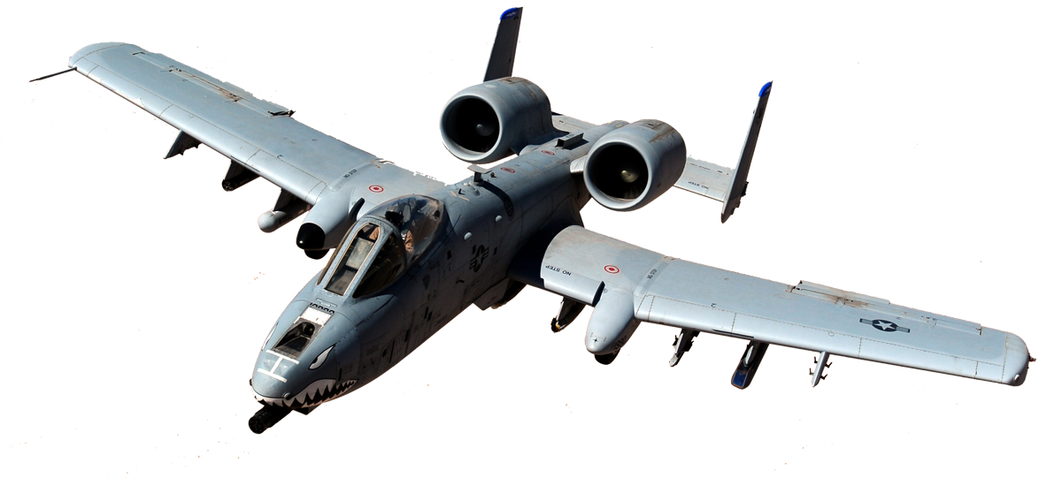
Problem Statement
Legacy training systems with platform-specific designs
Thousands of simulators, hundreds of locations, many platforms and OEMs
Proprietary and unique solutions
Standalone baseline designs; interoperability
Decades old software components and tools
Lack of initial design requirements; cybersecurity, modularity, scalability, sustainability
Substantial cost
Obsolescence and concurrency challenges
Cybersecurity and periodic sustainment
Platform updates
Unused computational power; space, heat, power
Training availability challenges
Sustainment consumes budget vs. improving capabilities

Slide 5
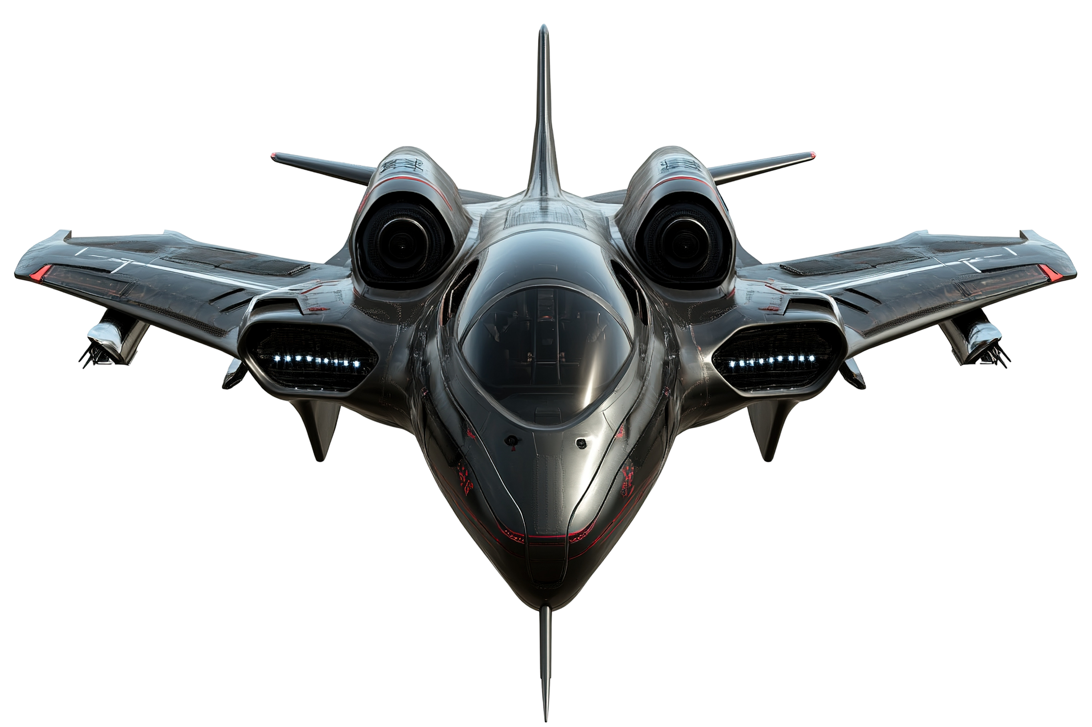
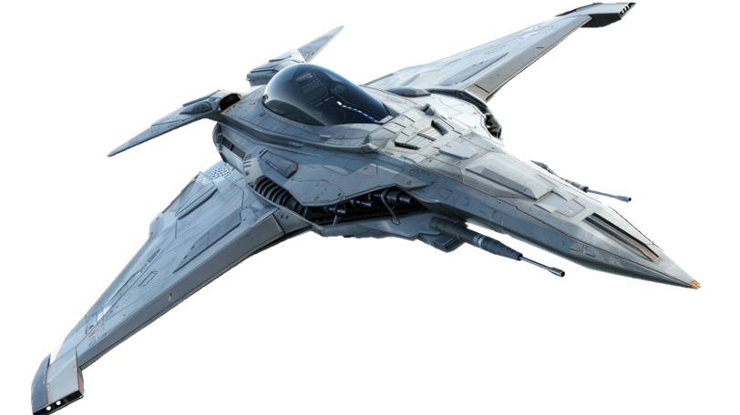
Problem Statement
Next generation platforms require:
Higher performance computational platform
High speed, high bandwidth, low latency LAN and WAN
Cross-domain solutions: new rule sets and higher-level classification
Higher-level fidelity and improved interoperability
Common synthetic environment: latest threats and sensors
Enhanced and effective sustainment and capability distribution:
Operational Flight Program (OFP) updates and distribution
Continuous technology insertion and capability distribution
Biggest challenge: Shared common synthetic environment with other platforms

Slide 6
Customer Top-level Requirements
Objective: Readiness for peer/near-peer conflicts – Win “Night 1” of any future conflict
Three Major Requirement Categories
Training realism & operational effectiveness
Distributed training with enhanced interoperability and scalability
Security, sustainment and cost efficiency
Robust, effective and efficient Operational Test & Training Infrastructure (OTTI)

Slide 7
Learning Objective 2
Describe foundational concepts of cloud technology
What’s up with the cloud?
Why are cloud services commonly used?
Types of clouds by service providers
Cloud building blocks
Cloud computing models
Primitives to advanced capabilities / services
Example training and simulation use cases of cloud technology
Note: The examples in this section uses common COTS products and their terminology to only describe the technology.

Slide 8


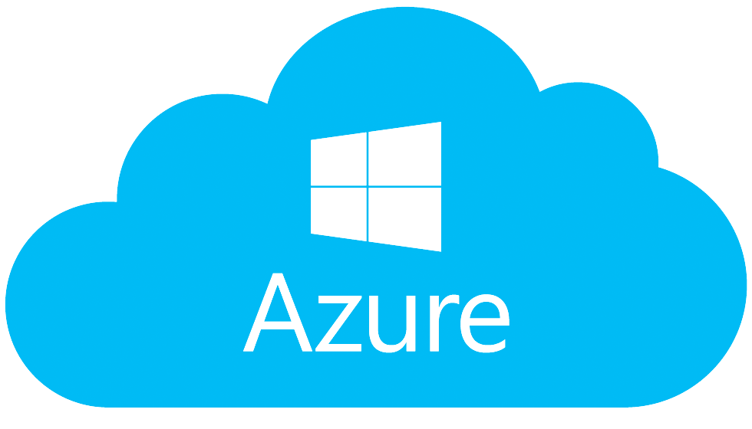



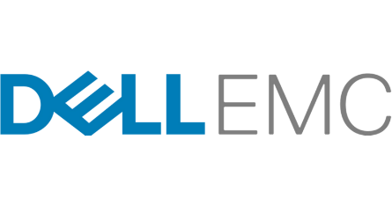


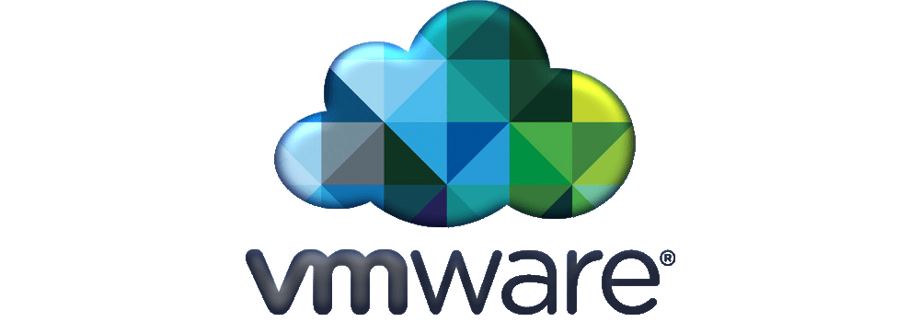

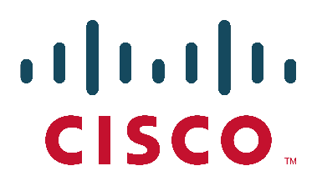



What’s up with the cloud?
Why major technology companies are investing billions of dollars in clouds
Why customers prefer cloud services
Cloud Services
HW /IOT/Handhelds
OPE
SW Licenses
Other Services
Pay as you use

Slide 9






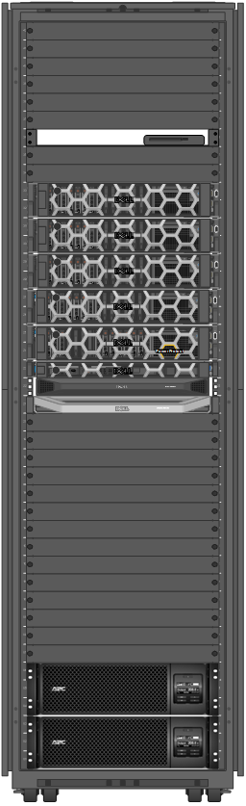


Customers prefer cloud services
Scalability
Centralized management
Distributed enterprise solutions
Sustainability
High availability
Geo-redundancy
Ready to use advanced services
Accessibility and collaboration
Minimum upfront investment
Cybersecurity

Slide 10
Types of clouds – Public & Private
Public Cloud
Key Features
Public accessibility
Operated by the service provider
Managed by the service provider
Secure for public use
Logically Segregated
Services
Cloud Service Provider
Internet
Public
Users
Public Cloud
Private Cloud
Key Features
Organization Intranet
Exclusive to one organization
Operated by the service provider
Managed by the organization
Enterprise level solution for medium and large distributed organizations
Org. Exclusive Services
External Users
Cloud Service Provider
Private Cloud
Organization Managed
Internal Users
Org. Locations

Slide 11
Types of clouds - Hybrid
Hybrid Cloud
Key Features
Combination of private on-premises cloud with private or public cloud
Managed by the organization or service provider
Local high performance and privacy
Shared Cloud
Services
Local
Services
Cloud Serv. Provider
Private or Public Cloud
Local Private Cloud
Local Users

Slide 12
Government and DoD clouds - Unclassified
Unclassified Government Cloud (IL-4)
Key Features
Organization Intranet
Available for defense contractors
Multi tenant private cloud
Managed by tenant organizations
Gov.
Cloud IL-4
External Users
Organization
Managed
Unclassified Government DoD Cloud (IL-5)
Key Features
Available for Gov. mission owners
Multi tenant DoD private cloud
Accessibility through NIPRNet
Secured internet accessibility
DISA and mission owner managed
DOD
Cloud IL-5
NIPRNet
External Users
Internet
DISA
Managed
Mission Owner
Government

Slide 13

Government and DoD clouds – Impact Level 6 & 7
DoD Cloud (IL-6)
Key Features
DOD
Cloud IL-6
SIPRNet
Available for Gov. mission owners
Multi tenant DoD private cloud
Accessibility through SIPRNet
DISA and mission owner managed
Government
DISA
Managed
SIPRNet
Transport Layer
Mission Owner
DoD Cloud (IL-7)
Key Features
DOD
Cloud IL-7
Very similar to IL-6 Cloud
Government
DISA
Managed
Transport Layer
Mission Owner

Slide 14
Cloud Computing Models: IaaS, PaaS and SaaS

Slide 15
Hypervisors and Virtual Machines
Software, firmware or hardware that gives the impression to guest machines (virtual machines) that they are operating on dedicated physical hardware
Multiple operating systems share single host and hardware

Slide 16
Containers
Standard unit of software that packages up code and its dependencies for runtime
Lightweight and standalone
Includes everything needed to run an application
Isolates software from its environment and ensures it works uniformly
Shares machine’s OS kernel and does not require OS per application
Lower OS licensing cost and higher efficiency

Slide 17
Virtual Machine vs Container
Virtual Machines (VMs):
Abstraction of physical hardware turning one server into many virtualized servers
Uses full copy of the operating system per VM
Containers:
Abstraction at the app layer, packages code and dependencies together
Multiple containers can run on the same machine and share the OS kernel with other containers
Uses fewer resources than VMs, can handle more applications and require fewer VMs and operating systems

Slide 18
What is kubernetes (K8s)?
Container orchestration platform
Dynamic container scalability based on number of users
Resilience
Security

Slide 19
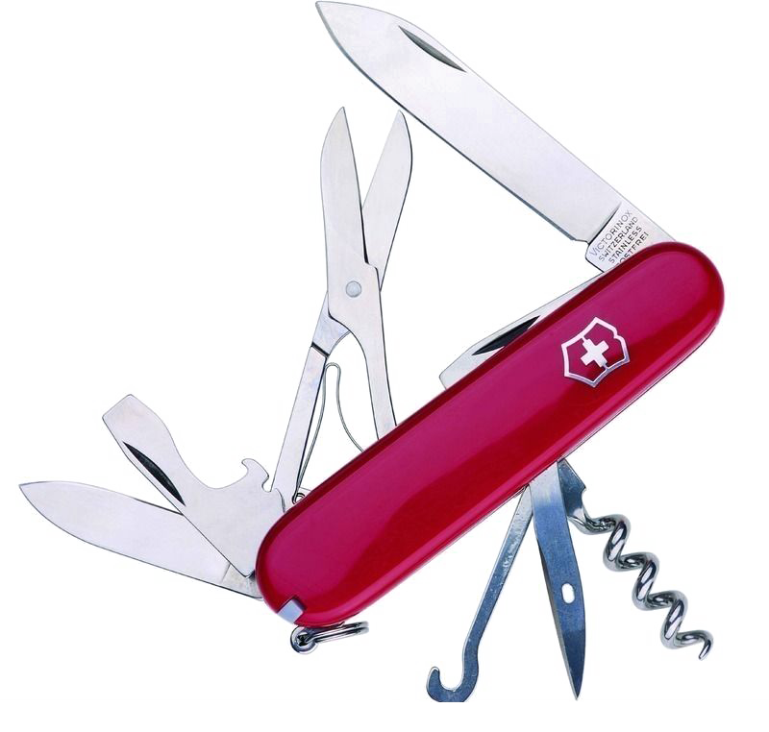
Why kubernetes?
Modularity / Versatility
Run containers on the fly for variety of tasks without overhead of configuring/maintaining many servers
Infrastructure-as-code
Deploy apps/services through version-controlled manifests
Security
Limit attack vectors through minimal vendor-provided OS
DOD-hardened Ironbank containers provide ready-to-run applications with Security Technical Implementation Guide (STIG) dependencies – simplified authority to operate (ATO) process
Resilience
Maximize uptime and minimize service disruptions
Intrinsic load-balancing, high-availability
Scalability
Automatically scale up resources to handle increased loads

Slide 20
Virtualizing GPUs (vGPU)

Slide 21

Multi-server architectures: advantages & management
vCenter is deployed as Appliance on an ESXi host
vCenter provides a central management interface to manage all the ESXi hosts and VMs
Reduces provisioning and uptime
Enables networking features like distributed vSwitches across the hosts
vCenter allows advanced futures such as:
VM Cloning
vMotion
High Availability Fault Tolerance
Distributed Resource Scheduler (DRS)
And more
Example based on

Slide 22
Converged and Hyper-converged Infrastructures

Slide 23
Virtualizing SAN (vSAN)
vSAN supports the high availability for the Infrastructure

Slide 24
Infrastructure as Code (IaC)
Ability to provision and support infrastructure using code instead of manual processes and settings
Provides the automation and orchestration for computing infrastructure
Saves substantial time and cost by eliminating manual processes
Easy duplications of environments
Reduced configuration errors
Example VM generation using IaC tooling

Slide 25
Virtual Desktop Infrastructure (VDI)
Software tool to centrally create and manage virtual desktops
Creates a virtual desktop on a central server, remote users can access from any physical machine
Quickly and efficiently sets up secure virtual desktops
Enables cost effective and flexible scale up of any enterprise desktop infrastructure
Other advantages:
Centrally managed desktops
Scalability
Increased accessibility
Maintaining security standards
Lower cost

Slide 26
Enterprise Services Automated Management & Sustainment
Example: Common Enterprise Services with VMware based IaaS

Slide 27
Use cases of cloud technology
Hypervisors: Virtualized training environment
VMs: Simulator subsystems
Containers: Scalable common simulation components
Kubernetes: Scalable, resilient orchestrated components such as red/blue forces on demand
vGPU: Multichannel virtualized IG infrastructure including sensors, AI, time sensitive calculations
vSAN: High availability, faster storage access and scalability
IaC: Configurable, repeatable, scalable and sustainable infrastructure including network topology, automated cold start and recovery
VDI: On demand scalable operator services e.g, Instructor Operator Station, Computer Generated Forces, Brief/Debrief Station, role player and viewer
Enterprise Services: Cybersecurity, remote sustainability, interoperability, operator services, system automation/orchestration, common tools and apps

Slide 28
Learning Objective 3
Analyze how cloud technology addresses training and simulation industry challenges
Cloud technology applicability to resolving training and simulation challenges
When are cloud services provided by commercial/federal service providers applicable?
When are Cyber-Secure Hybrid Cloud solutions applicable?

Slide 29
Cloud technology applicability to resolving challenges
Cloud technology provides:
Commonality, modularity and scalability
Highest cyber resilience
Highest availability
Remote sustainment with enterprise services
COTS-based solutions
On-demand, optimized and scalable computational resources
Space, Power and AC savings
New generation orchestration and automation tools automate processes
Multi-use computational platform
Supported by multi-billion-dollar industry with continuous improvements
Service provider managed:
Hardware obsolescence mitigated, continuous technology refresh without affecting training
Focus on new capabilities, periodic sustainment handled as services
Cloud technology resolves many training and simulation challenges

Slide 30

Applicability of cloud services provided by commercial/federal providers
Single classification level
Centralized training requirements
No restrictions on internet accessibility
No need for high performance computation at the edge
Lower up-front budget for infrastructure
Preference to generate a service contract
Need to use readily available services provided by specific cloud service provider
Centralized collaboration and software development by distributed developers

Slide 31

Applicability of Cyber-Secure Hybrid Cloud Solutions
Multiple classification levels within the Enterprise
Distributed training and/or Capability Centers requirement
Federal WAN connection requirements
Need high performance computation at the edge
Budget for up-front infrastructure investment
Government Owned Contractor Operated (GOCO) solution with Enterprise Services including centralized cybersecurity and remote sustainment
Multiple affiliates bring capabilities to a common infrastructure
Full control and no dependency to commercial/federal service provider

Slide 32
Learning Objective 4
Describe the vision of digital transformation using Cyber-Secure Hybrid Cloud (CSHC)
Enterprise level architecture with CSHC
Distributed Capability Centers with high-performance edge computing
Top-level layered reference architecture with CSHC core components
CSHC solution core components
On Premise Equipment (OPE) with Common Enterprise Services
Enterprise Networks
Operation Center
Run-time Trainer OPE, DevSecOps and more
Benefits of the CSHC approach for the Warfighter

Slide 33
CSHC-based Distributed Enterprise Platform for Digital Transformation
Modular, scalable with common Enterprise Services
Distributed architecture providing Capability Centers
High Performance Computing power at the edge
Centralized Cyber Security and Remote Sustainment
Supports Multiple Security Domains
Self-sufficient Capability Centers
Distributed & controlled data accessibility
Seamless transformation from legacy systems
Provides the Enterprise Platform for Affiliate’s contribution and collaboration

Slide 34
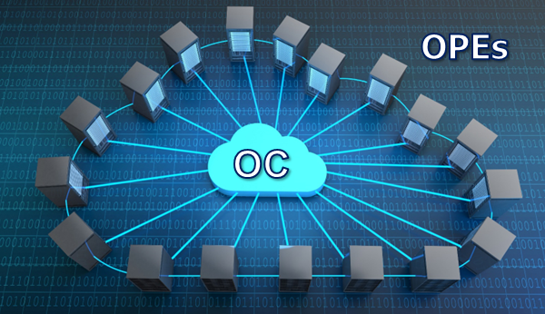

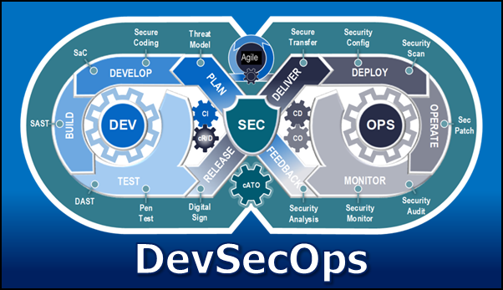

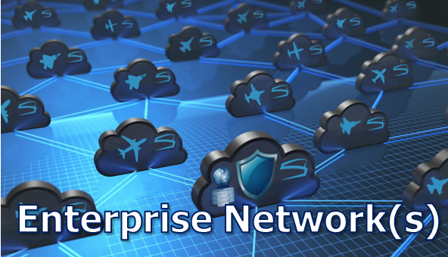
Top-level layered reference architecture with common industry taxonomy
Major applicability of the CSHC solution core components

Slide 35
Core Component: On-Premise Equipment (OPE)
Most common industry requirements and best practices:
All COTS with extended life hardware, well-managed supply chain
High Availability, hyper-converged infrastructure, uninterruptable power supply, power distribution
High-performance for time-critical tasks locally
High-performance rendering and AI capabilities
Data in Transit (DiT), Data at Rest (DaR) and boundary protection
Local and remote backup/recovery
Scalable and Modular
Self-sufficient without persistent WAN connectivity
Internal high bandwidth WAN connectivity capability
Local high speed LAN accessibility
Unified Management Dashboard (UMD) workstation for local management
Cost Effective – Optimized Solution

Slide 36
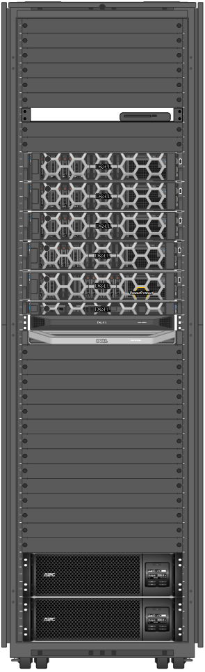
OPE with Common Enterprise Services
Most common industry requirements and best practices:
OPE Unified Management Services
Orchestration / automation / IaC, parent cloud access
Cyber Security Services
MFA, DiT, DaR & Boundary Protection, System Monitoring, Event Audit, Vulnerability Scanner, Cyber Resilience, Backup/Recovery
Remote / Local Sustainment Services
Linux/Windows patch, STIG, cold-start, licensing and key management
Operator Services
Remote desktop capability, thin-client support
App onboarding services
Common IaaS providing virtualized environment for VMs and containers
Optional PaaS and SaaS capabilities
Operational, test and development modes of operation
Common Enterprise Services

Slide 37

Core Component: Enterprise Network(s)
Most common WAN requirements for the industry:
High availability, low delay, consistent high bandwidth
Cybersecurity
Private network with Data in Transit Protection
Scalability with CONUS and OCONUS connectivity
Enhanced interoperability
Simultaneous and isolated, distributed exercise groups
Multiple security domain support
Cross-domain exercise support between security domains
Centralized and cyber-secure Operation Center (OC)
Cost effective
Enterprise Network(s)
Most Common Best Practices:
Multiprotocol Label Switching (MPLS) Layer 3 WAN by service providers
Hardware encryption devices to isolate network groups
DIS, HLA and other gateways with remote data package filtration capabilities
Approved Cross Domain Solutions (CDS) with required secure management

Slide 38

Core Component: Operations Center (OC)
Most common OC requirements and capabilities:
Centralized component of the distributed CSHC solution
Supports multiple security domains
Centralized Enterprise Management Services
Network Operation Services
Security Operation Services
Additional centralized capabilities
Help Desk
Library / App Store
Data Repository

Slide 39

Core Components: Runtime Trainer OPE, DevSecOps
Additional Core components:
Distributed Runtime Trainer OPEs
Self-contained DevSecOps
Other integrated solutions as capability centers with inclusion of services to common scalable baseline provided by OPE and enterprise services

Slide 40
Benefits of the CSHC approach for the Warfighter
Top five benefits of the CSHC approach for the Warfighter:
“Fair Fight” capabilities provided through next generation platforms with advanced interoperability and high performance at the edge
Uninterrupted training due to high availability features and enhanced cybersecurity
More enhanced training capabilities resulting from substantial lifetime cost savings which free up budget for industry innovation
Training infrastructure for Joint All Domain Operations with cross domain exercise capabilities
Concurrent advanced capability development and distribution to training platforms

Slide 41
Learning Objective 5
Conceptualize CSHC approach transition from a successful example use case
Requirements and key success factors
Example use case – USAF Simulator Common Architecture and Requirements (SCARS) Initiative
USAF SCARS Transformation

Slide 42
Transitioning from legacy systems to CSHC solution
Prerequisites:
Up front investment to save substantial lifetime cost
Contribution from all stakeholders, collaborative execution with prime contractor as infrastructure provider and Government partner. All affiliates provide platform level capabilities.
Key success factors:
Standardization
Virtualization
Standard architecture using features of cloud technology and MBSE
DevSecOps
Common apps and services
Use case: Simulator Common Architecture Requirements and Standards (SCARS) initiative describes this transition.

Slide 43
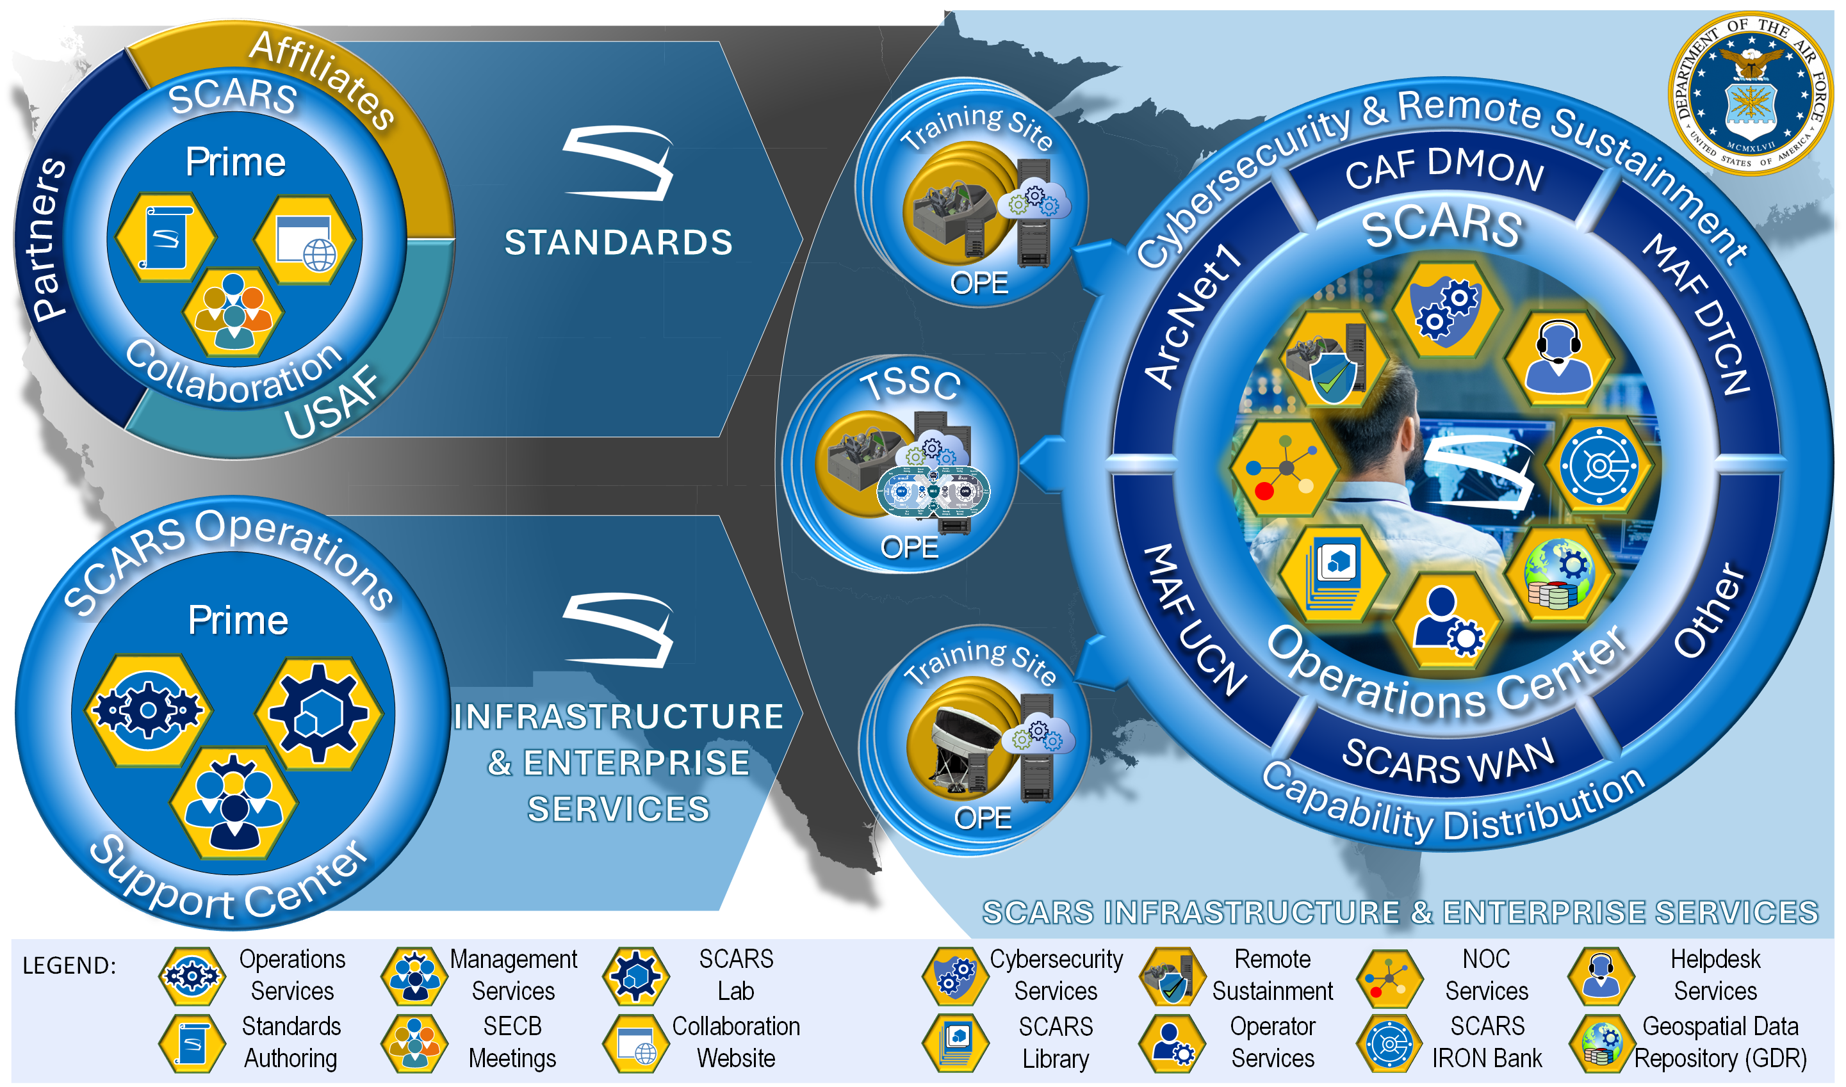

USAF SCARS Initiative
2400 Simulators
50 Platforms
300+ Locations
Multiple Security Domains

Slide 44

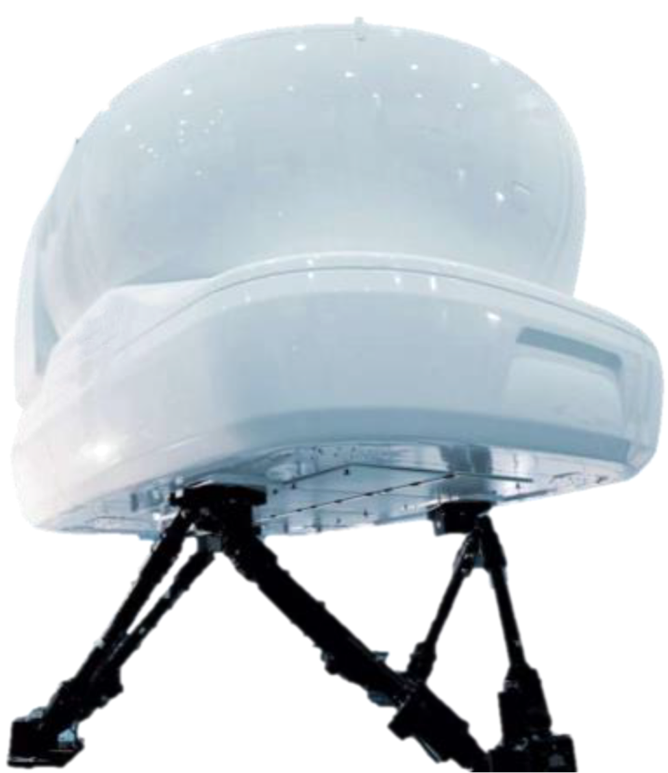
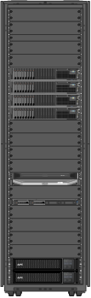
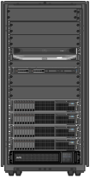
Example use case: USAF SCARS Transformation
Modularity
Key Features
Government Owned Contractor Operated
Common Computational Platform
High Performance & Scalable
All COTS with Periodic Tech Refresh
Virtualized Environment for
Platform in a Box (PIAB) Apps & Serv.
Joint Simulation Environment
Enterprise Serv. with Cyber Sustainment
Common Simulator Apps/Serv. for Reuse
High Availability
Supported with Integration Standards
Legacy Training Systems
Platform Specific
Commonality
On Premise Equipment (OPE)
Scalability
Virtualization
All Platform Unique
Standardization
STANDARDS
Challenges
Tightly Coupled
Not Modular/Scalable
Obsolescence
Cybersecurity & Sustainment
Platform Unique Software
Large footprint
Benefits
Modular Open Systems
Standardized, Modular & Scalable
Common and Future Proof
Life-time Remotely Sustainable & Cyber-secure
Reusable Common Simulator Apps & Services
Space and energy savings
Training Site Transformation to Commonality, Modularity & Future Proofing (Showing 1 of 300+ sites)

Slide 45
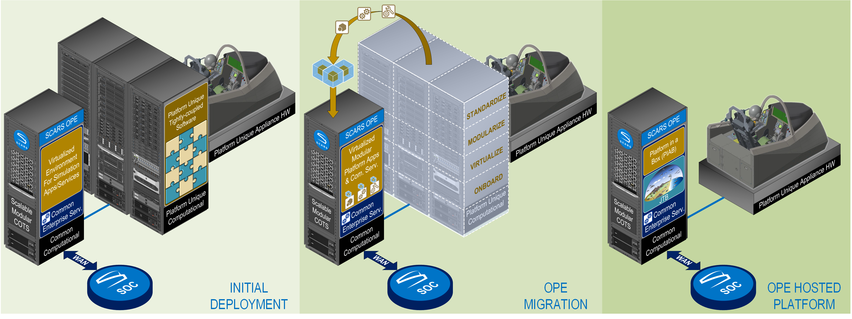
Phased Migration of Legacy Training System to OPE
CSHC based distributed infrastructure with OC
Local/Remote Cyber Security & Sustainment
Local/Remote Baseline Management
MBSE Supported Design
Multi Security Domain Support
SCARS DevSecOps for development centers
Training System Objective Architecture
Virtualization - App onboarding
SCARS library with reusable common Apps
Minimizing footprint
CSHC based Simulator
MOSA Compliant
Continuous development and ATO
Minimum platform specific HW & SW
Concurrent capabilities
Standardization to Simulator Common Architecture

Slide 46
Confirmation of accomplished learning objectives
5 Learning Objectives:
Identify key industry challenges
Describe foundational concepts of cloud technology
Analyze how cloud technology addresses the training and simulation industry challenges
Describe the vision of digital transformation using Cyber-Secure Hybrid Cloud (CSHC)
Conceptualize CSHC approach transition from a successful example use case

Slide 47
Bibliography / additional source of information for self-learning
Cloud Technology
https://cic.gsa.gov/basics/cloud-basics
https://www.vmware.com/topics/cloud-architecture
https://www.nvidia.com/en-us/data-center/virtual-solutions/
https://blogs.vmware.com/apps/2018/09/using-gpus-with-virtual-machines-on-vsphere-part-3-installing-the-nvidia-grid-technology.html
https://www.vmware.com/products/cloud-infrastructure/vsan
https://www.vmware.com/docs/vmware-vsan-datasheet
https://en.wikipedia.org/wiki/Omnissa_Horizon
https://techzone.omnissa.com/resource/what-omnissa-horizon
USAF OTTI
https://apps.dtic.mil/sti/trecms/pdf/AD1161437.pdf
USAF SCARS
https://www.cae.com/defense-security/program-highlights/simulator-common-architecture-requirements-standards-scars/

Slide 48
Thank You !
Tansel Kendir
Technical Fellow
CAE USA
Tansel.Kendir@caemilusa.com
Glenn Diehl
Technical Authority
CAE USA
Glenn.Diehl@caemilusa.com
Katie VanErven
System Architect
CAE USA
Katie.Vanerven@caemilusa.com

