Slide 1


But How Do You Know They Learned That?
Blair Lehman, PhD, Brighter Research
Jeanine A. DeFalco, PhD, Mixta Ré, Inc.
Notes:
Each of us briefly introduces ourselves

Slide 2
Agenda
Overview
How do people learn best?
Introduction to adaptive instructional systems (AISs)
Using AR/VR as an AIS
Designing for competencies is complicated
AI/ML to support evidence collection in AISs
Summary and conclusions
Acknowledgments
Bibliography
Contact information and Q&A
Notes:
Briefly go over the agenda for the tutorial session

Slide 3
Learning Objectives
Name the primary components of an AIS and how each one supports adaptive instruction.
Describe how learning engineering can be leveraged to design tasks that provide evidence of competency mastery.
Name and describe the three key types of evidence for competency mastery.
Describe the way in which AI/ML can be leveraged in each component of an AIS to support providing evidence of competency mastery.
Name at least three design considerations to achieve interactive, socially constructed AR/VR simulations.
Notes:
Briefly mention each learning objective and note that we will call out when the material relevant for each learning objective has been covered throughout the tutorial

Slide 4
Overview
Designing augmented reality (AR) and virtual reality (VR) simulations that provide effective and efficient training as well as insights into learners’ current mastery level of key competencies
Notes:
Or in other words - make sure the AR/VR simulations are actually doing what you want them to do

Slide 5
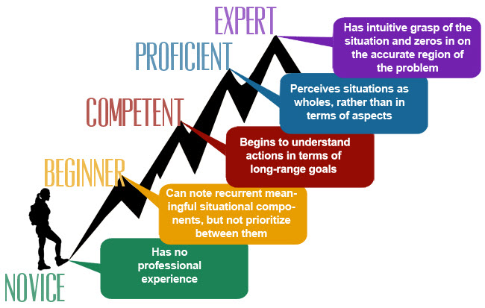
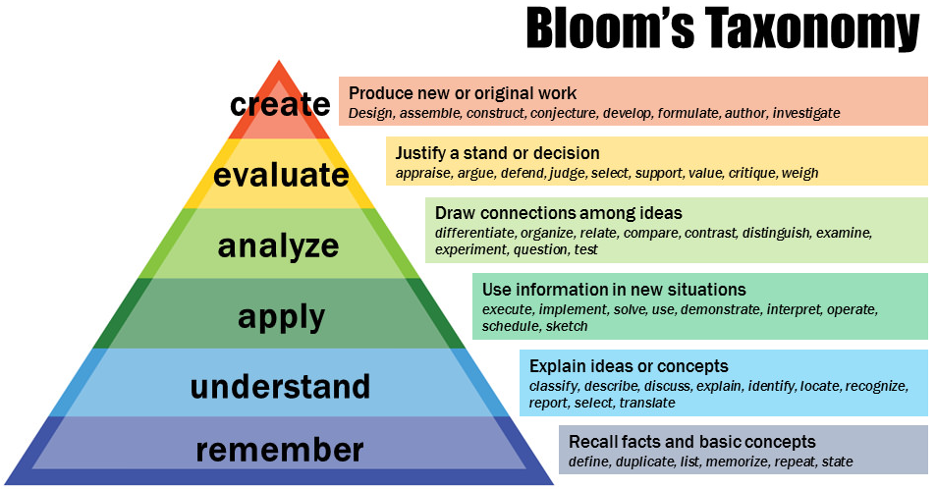
Moving from Novice to Expert
Notes:
Lots of different ways to conceptualize the change from novice to expert (briefly touch on a few components from these two models) - but there some commonalities that can be extracted

Slide 6
Moving from Novice to Expert
Factors to consider
Acquisition of knowledge
Automation of lower-level processes
Identification of underlying patterns despite changing surface features
Efficient application of knowledge and skills
Comfort with uncertainty
Not just about what you know or what result you achieve, but how you arrived at that result
Ideal scenario for AR/VR simulations that provide rich environments to observe process beyond traditional assessment tasks
Notes:
Briefly discuss the common factors
Briefly discuss why AR/VR simulations provide such a good environment for capturing evidence of the change from novice to expert

Slide 7
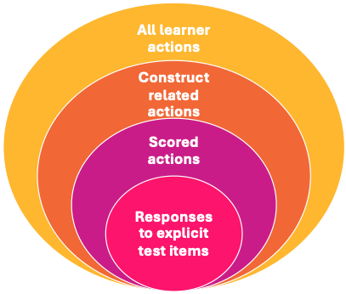
AR/VR for Competency Assessment
Goal of assessment: To make valid claims about what a learner knows and can do based on observable evidence
Questions to ask:
How to make the invisible visible?
Do we want binary Y/N observations, quantifiable data, qualitative characterizations?
What affordances might create construct- irrelevant variance?
Of the universe of all learner behaviors, which actions are evidence of competency?
Notes:
It’s important to keep in mind that all assessments, regardless of format, domain, audience, or stakes should have this common goal
To achieve this goal, it is important to ask yourself specific questions during the development process.

Slide 8
How Do People Learn Best?
People learn best through active, constructive engagement (ICAP), not passive exposure (Chi).
Passive
Active
Constructive
Interactive
Learning by doing—through simulations, role play, or real-world tasks—deepens retention and transfer (Dewey).
Knowledge is socially constructed
Tasks must be situated in real-life contexts
Notes:
Briefly discuss each of these practices that support learning

Slide 9
How Do People Learn Best?
Scaffolded practice within the learner’s zone of proximal development (Vygotsky) builds confidence and competence.
Learner is always actively ‘doing’ the task
Appropriate support is available
Exposure to increasingly complex problems enhances metacognition and adaptive problem-solving skills (Vygotsky).
Deeper learning is promoted as learners understand when and how to apply skills across situations that vary in surface and/or deep features
Experiential learning that includes reflection and feedback accelerates durable understanding and skill mastery (Bloom, Hattie).
Reflection activities allow learners to build a more coherent mental model as they not only implement actions to demonstrate skills but also construct why the skill should be implemented in particular situations
Notes:
Briefly discuss each of these practices that support learning

Slide 10
But how do we know?
While we have a good understanding of how people learn best, in technology mediated learning platforms, it’s a challenge to design and deploy systems that give us evidence of learning.
As learning engineers and instructional designers, we need to:
Tell the system what the data points are that give us evidence of learning
Design environments that include context, conditions, and complexities for evidence of competencies
In short, the tool (simulations, tutoring systems), its affordances, and the design rendered in these systems make the difference between bridging what we think we know about a learner and getting evidence of actual learning and competence.
Notes:
Importance of collecting evidence that allows us to make valid claims about the learner’s state - and how this needs to be a consideration during design and not after when data has already been collected

Slide 11
Learning Objectives
Learning Objective #2:
Describe how learning engineering can be leveraged to design tasks that provide evidence of competency mastery.
Notes:
Briefly provide the response to this learning objective.

Slide 12
Learning Objectives
Learning Objective #2:
Describe how learning engineering can be leveraged to design tasks that provide evidence of competency mastery.
Select environments that allow opportunities for learners to display evidence of skills
Design tasks that engage learners in real-world relevant activities that provide opportunities to show their knowledge and skills
Identify the specific in-task behaviors that correspond to specific skill(s) and to different proficiency levels
Notes:
Briefly provide the response to this learning objective.

Slide 13
Introduction to Adaptive Instructional Systems
Adaptive Instructional System
(e.g., single digital learning activity, a learning platform, multiple linked educational tasks)
Adaptation Module
Learner Module
Content Module
Notes:
Importance of modularity - allows for flexibility and ability to apply this architecture to different scenarios without building from scratch each time
Now let’s dive a little more into each component of this larger system

Slide 14
Introduction to Adaptive Instructional Systems
Adaptive Instructional System
(e.g., single digital learning activity, a learning platform, multiple linked educational tasks)
Supplies content as needed
Adaptation Module
Learner Module
Content Module
Content and associated metadata. Content may include instructional materials, assessment items, practice problems, feedback and hints.
Info about content
Mapping between content and KSAs or learner state
Notes:
Importance of modularity - allows for flexibility and ability to apply this architecture to different scenarios without building from scratch each time
Now let’s dive a little more into each component of this larger system

Slide 15
Introduction to Adaptive Instructional Systems
Adaptive Instructional System
(e.g., single digital learning activity, a learning platform, multiple linked educational tasks)
Data from system interactions and logged by the system
Supplies content as needed
Adaptation Module
Learner Module
Draw inferences about an individual’s knowledge, skills, abilities (KSAs), and/or state. Can include both traditional measurement models alongside models capturing other characteristics of the learner.
Content Module
Content and associated metadata. Content may include instructional materials, assessment items, practice problems, feedback and hints.
Info about individual
Info about content
Mapping between content and KSAs or learner state
Notes:
Importance of modularity - allows for flexibility and ability to apply this architecture to different scenarios without building from scratch each time
Now let’s dive a little more into each component of this larger system

Slide 16
Introduction to Adaptive Instructional Systems
Adaptive Instructional System
(e.g., single digital learning activity, a learning platform, multiple linked educational tasks)
Indicates content to deliver
Data from system interactions and logged by the system
Supplies content as needed
Adaptation Module
Directives guiding how the system changes and adapts. These may be in the form of if-then rules, algorithms, or even choices made by system user.
Learner Module
Draw inferences about an individual’s knowledge, skills, abilities (KSAs), and/or state. Can include both traditional measurement models alongside models capturing other characteristics of the learner.
Content Module
Content and associated metadata. Content may include instructional materials, assessment items, practice problems, feedback and hints.
Info about individual
Info about content
Mapping between content and KSAs or learner state
Notes:
Importance of modularity - allows for flexibility and ability to apply this architecture to different scenarios without building from scratch each time
Now let’s dive a little more into each component of this larger system

Slide 17
Introduction to Adaptive Instructional Systems
Adaptive Instructional System
(e.g., single digital learning activity, a learning platform, multiple linked educational tasks)
Indicates content to deliver
Data from system interactions and logged by the system
Supplies content as needed
Adaptation Module
Directives guiding how the system changes and adapts. These may be in the form of if-then rules, algorithms, or even choices made by system user.
Learner Module
Draw inferences about an individual’s knowledge, skills, abilities (KSAs), and/or state. Can include both traditional measurement models alongside models capturing other characteristics of the learner.
Content Module
Content and associated metadata. Content may include instructional materials, assessment items, practice problems, feedback and hints.
Info about individual
Info about content
Mapping between content and KSAs or learner state
Notes:
Importance of modularity - allows for flexibility and ability to apply this architecture to different scenarios without building from scratch each time
Now let’s dive a little more into each component of this larger system

Slide 18



Content Module
Competence Model
Scenario Model
Threat Model
Notes:
Competence model, scenario model (simulation task), and threat model (can be substituted with other relevant models)
Setting up the ‘world’ in which the task occurs - what is the target knowledge, what are the target task components that give opportunities to observe evidence connected to target knowledge

Slide 19
Content Module: Competence Model
What are the competencies (or knowledge, skills, and abilities; KSAs) that are needed to successfully complete the position or task?
Cognitive task analysis to decompose the activities that are completed
Determine ‘levels’ of competence - and what evidence is indicative of an individual being at different levels
Consider the circumstances under which competence is observed (e.g., competent at half-speed vs. competent at full-speed)
Notes:
Briefly discuss

Slide 20
Content Module: Scenario Model
What are the scenario(s) under which learning is occurring?
Identify the components of the context that are relevant for learning (e.g., increase the difficulty, relevance to specific competencies)
Consider the dynamic elements to maintain a current ‘snapshot’ to contextualize performance
Consider the importance of real-world relevance (e.g., devices are limited to their current functionality)
Notes:
Briefly discuss

Slide 21
Content Module: Threat Model
What are the autonomous or semi-autonomous elements in the learning environment?
Example: Threat Model
Guidelines for how a ‘threat’ can function to enable realistic and dynamic elements into the environment
Consider the dynamic elements to maintain a current ‘snapshot’ to contextualize performance
Notes:
Briefly discuss

Slide 22


Learner Module
Instructor
Learner
Observes
Makes inferences
What is going well?
What is the learner struggling with?
How interested is the learner in this topic?
What is the learner’s affect?
What are the learner’s interests?
What type of support has traditionally been helpful?
Learner module
Existing knowledge of the learner
Current context
Notes:
Learner modules are based on the processes that all instructors engage in when making inferences about each student’s current state

Slide 23



Learner Module
Use digital learning tool
Generates data
Learner
Send inferences
What is the learner doing?
What is going well?
What is the learner struggling with?
How engaged is the learner?
How has the learner engaged with similar activities in the past?
What type of support has traditionally been helpful?
Learner module
Accumulates into
Overall knowledge of the learner
Current context
Notes:
We then translated the instructor process into a digital system

Slide 24

Learner Module
Learner models are representations of different learner characteristics, which play a role in adaptation and content delivery.
Time / Observations
Notes:
Different types of learner models - persistent learner models allow for the model to accumulate evidence beyond a single interaction, which can allow for more accurate estimates of KSAs as more observations in more scenarios allow for better insights

Slide 25

Learner Module
Learner models are representations of different learner characteristics, which play a role in adaptation and content delivery.
Notes:
Different types of learner models - learner models can be built at the team level, although this is still an open area of research to determine the best way to develop a team learner model and how it interacts with and influences individual learner models

Slide 26




Learner Module
Learner models are representations of different learner characteristics, which play a role in adaptation and content delivery.
Notes:
Different types of learner models - learner models can be built at the team level, although this is still an open area of research to determine the best way to develop a team learner model and how it interacts with and influences individual learner models

Slide 27
Adaptation Module
Goal: Provide real-time supports that put learners in scenarios that maximize their abilities to improve their competencies and maximize the system’s ability to collect evidence of learners’ current competency level
Inner Loop:
Adaptations within the current task
Outer Loop:
Adaptations for the next task
Notes:
Modifications to current task, decisions about next task, feedback, scenario manipulation (e.g., pause the world, replay, retry)

Slide 28

Adaptation Module
Inner Loop - Feedback:
Notes:
Feedback about the current task or ‘step’ that a learner has completed

Slide 29

Adaptation Module
Inner Loop - Current Task:
Notes:
Learners can provide their own real-time feedback about the task they are completing or their experience - for example, if here green is engaged and red is bored, the learner can say that they are bored

Slide 30

Adaptation Module
Inner Loop - Scenario Manipulation:
Notes:
Scenario manipulation can be learner-driven or by the system - for example, instead of providing explicit feedback, the system could replay the learner’s most recent actions and ask them to reflect on the success of their chosen strategy

Slide 31

Adaptation Module
Outer Loop - Next Task Selection:
Notes:
Most often about difficulty or skill/competency - but could be about anything relevant (e.g., repeat of similar context or expand to new context)

Slide 32
Learning Objectives
Learning Objective #1:
Name the primary components of an AIS and how each one supports adaptive instruction.
Notes:
Briefly provide the response to this learning objective.

Slide 33
Learning Objectives
Learning Objective #1:
Name the primary components of an AIS and how each one supports adaptive instruction.
Content module – support flexible, adaptive deployment of relevant content to enable adaptation (e.g., coordination of competencies within current scenario)
Learner module – identifies the current proficiency level of learners to enable adaptive instruction that targets an individual learner’s needs
Adaptation module – leverages the content and learner modules to deploy the adaptation policy that will support the learner in building KSAs
Notes:
Briefly provide the response to this learning objective.

Slide 34
Using AR/VR as an AIS
From Task Completion to Competency Mastery:
Prioritize decision-making, reflection, and metacognition over rote interaction.
Personalized Learning at Scale:
AI-driven pathways adjust pace and complexity to learner proficiency (zone of proximal development (ZPD)-aligned).
Built-in Feedback and Assessment:
Integrate performance analytics and adaptive feedback for continuous improvement.
Notes:
Using AR/VR simulations as an AIS
Moving beyond 2D systems
Current standard AR/VR: procedural and knowledge base
Missing opportunities for competency development and assessment
Examples in the military context

Slide 35
Using AR/VR as an AIS
Why AIS, Not Just Immersion:
Move beyond static 2D or procedural AR/VR to enable real-time adaptation to learner behavior.
In Military Contexts:
AIS-enabled simulations can boost readiness by diagnosing gaps and scaling skill development in mission-critical environment, adding context and conditions for practice
Notes:
Using AR/VR simulations as an AIS
Moving beyond 2D systems
Current standard AR/VR: procedural and knowledge base
Missing opportunities for competency development and assessment
Examples in the military context

Slide 36
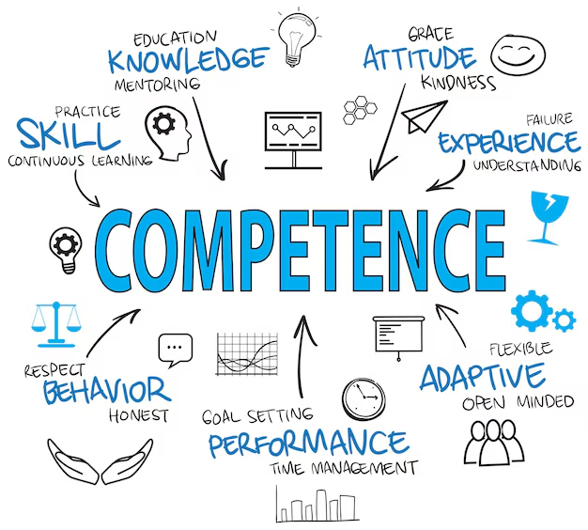
Designing for Competencies is Complicated
Notes:
Competence goes beyond simply checking off if someone does or does not have a particular knowledge, skill, or attribute. Competence is more complex - and so should require complex tasks to properly elicit evidence.

Slide 37
Evidence of Mastery
Important to consider what the learner has done, how the learner did it, and under what conditions the learner was able to do it
What
Evidence of specific elements of competency
How
Efficiency of task completion - time, number of actions, path directness
Support needed to complete task - nature of support, amount of support, requested vs. provided
Under what conditions
Demonstration of transfer - single scenario vs. multiple scenarios
Task manipulation - half-speed vs. full-speed
Notes:
Context is key when assessing mastery

Slide 38
Learning Objectives
Learning Objective #3:
Name and describe the three key types of evidence for competency mastery.
Notes:
Briefly provide the response to this learning objective.

Slide 39
Learning Objectives
Learning Objective #3:
Name and describe the three key types of evidence for competency mastery.
What the learner did – identifies the specific learner actions and how those connect to a specific proficiency level
How the learner did it – identifies the way in which the learner completed the actions to understand if there are still areas for improvement (e.g., efficiency)
Under what circumstances did the learner do it – identifies the degree to which skill acquisition and/or transfer has occurred
Notes:
Briefly provide the response to this learning objective.

Slide 40
Designing for Competencies
Voice conflicting opinion
Provide evidence
Assertiveness
Manage conversation
Collaboration
Provide evidence
Include collaborators in discussions
Cooperation
Ask questions
Notes:
Let’s take an overly simplified example of designing for competence in Collaboration.
First - we need to think about how the competence breaks down (not necessary for all competencies, but something as complex as collaboration needs sub-competencies).
Second - we need to think about what is evidence of the sub-competencies - this can be done in a task-agnostic manner (as it is here) or task- or context-specific (this will likely be easier if you have a particular task, context, or job that you will be working in).

Slide 41


Designing for Competencies
Voice conflicting opinion
Design Decision #1
Provide evidence
Manage conversation
Provide evidence
Include collaborators in discussions
Ask questions
Notes:
Ok, but we haven’t done any task designing yet!
I know, but all of that work will help with the designing process - also, note that you can find existing frameworks for competencies that you are interested in and use those as-is or, as has been my general experience, adapt the framework to your particular needs.
Design decision #1 - are collaborators virtual agents or humans
Importance for competencies - ability to consistently elicit evidence

Slide 42

Designing for Competencies
Voice conflicting opinion
Design Decision #2
Provide evidence
Manage conversation
Provide evidence
Include collaborators in discussions
Ask questions
Notes:
Design decision #2 - how many virtual collaborators?
Importance for competencies - ability to provide different collaboration scenarios to elicit evidence (e.g., voice conflicting opinion, manage conversation) / ability to provide more variations

Slide 43



Designing for Competencies
Voice conflicting opinion
Design Decision #3
Provide evidence
Manage conversation
Provide evidence
Include collaborators in discussions
Ask questions
Notes:
Design decision #3 - how is the learner going to engage in the collaboration?
Importance for competencies
-Menu-driven reduces the scope of options and could not fully represent what the learner was going to do
-Text chat - allows for greater variety + student generation, but depending on the context text may not be fully useful (text usual gets more thought behind responses than spoken)
-Spoken - allows for greater variety + student generation + replicate many real world interactions, but has tech requirements to be executed well (e.g., not understanding learners can impede their ability to engage with the scenario)
So this is before we’ve even gotten into specific scenario elements

Slide 44
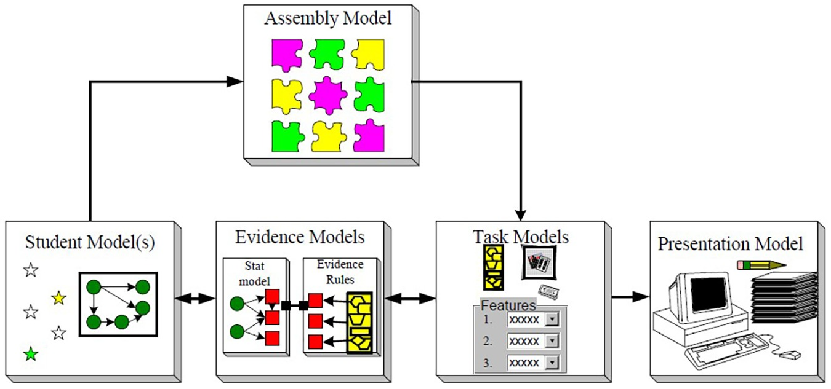
Designing for Competencies
Notes:
Evidence-centered design - is a model that was first created for assessments to ensure that assessments were designed to elicit the evidence needed for the insights that are desired, but has now been applied to learning scenarios as well, provides a nice framework to guide development
Note that the student model considers who the target group of learners is and also the range of learners that may interact with the task and depending on who the learner is, you can design for accommodations or to support personalization

Slide 45
Designing for Competencies
Theory of how learners represent knowledge and develop competence (cognition)
Notes:
Evidence-centered design - is a model that was first created for assessments to ensure that assessments were designed to elicit the evidence needed for the insights that are desired, but has now been applied to learning scenarios as well, provides a nice framework to guide development
Note that the student model considers who the target group of learners is and also the range of learners that may interact with the task and depending on who the learner is, you can design for accommodations or to support personalization

Slide 46
Designing for Competencies
How observations derived from tasks constitute evidence about the knowledge and skills being assessed (interpretation)
Notes:
Evidence-centered design - is a model that was first created for assessments to ensure that assessments were designed to elicit the evidence needed for the insights that are desired, but has now been applied to learning scenarios as well, provides a nice framework to guide development
Note that the student model considers who the target group of learners is and also the range of learners that may interact with the task and depending on who the learner is, you can design for accommodations or to support personalization

Slide 47
Designing for Competencies
Tasks or situations that prompt learners to say, do, or create something that demonstrates knowledge and skills (observations)
Notes:
Evidence-centered design - is a model that was first created for assessments to ensure that assessments were designed to elicit the evidence needed for the insights that are desired, but has now been applied to learning scenarios as well, provides a nice framework to guide development
Note that the student model considers who the target group of learners is and also the range of learners that may interact with the task and depending on who the learner is, you can design for accommodations or to support personalization

Slide 48
Learning Objectives
Learning Objective #5:
Name at least three design considerations to achieve interactive, socially constructed AR/VR simulations.
Notes:
Briefly provide the response to this learning objective.

Slide 49
Learning Objectives
Learning Objective #5:
Name at least three design considerations to achieve interactive, socially constructed AR/VR simulations.
Format of dialogue-based interaction
Well- or ill-defined task
Singular or multiple methods for learners to represent knowledge
Notes:
Briefly provide the response to this learning objective.

Slide 50



AI/ML to Support Evidence Collection in AISs
Notes:
We’ve gone over (briefly) the kinds of evidence that we want to collect to provide information about competency mastery and some ways to design to elicit that evidence. But the way we’ve been describing that evidence is still at a pretty high level - for example, how does ‘manage conversation’ manifest in a particular simulation?
We have to leverage the process or interaction data from the learner within the simulation - but process data often needs to be integrated and translated into a format that can provide insights.
In addition, we want to remain open to new evidence that may emerge from simulation interactions.

Slide 51

AI/ML to Support Evidence Collection in AISs
Notes:
This is where AI/ML come in! Both are great at identifying patterns from large, complex data sources.

Slide 52
AI/ML to Support Evidence Collection in AISs
Sensor-Free Inference: AI models track learner behavior (e.g., decision paths, timing, errors) without requiring wearables.
Allows for more flexible implementation in various conditions
Enables the processing of large amounts of data in real time
Natural Language Processing (NLP): Captures and analyzes speech/text responses to assess understanding and reasoning.
Allows for more natural interactions
Enables practice that is real-world relevant
Dynamic Data Capture: ML algorithms collect and interpret interaction data (e.g., object manipulation, scenario branching).
Allows for new data-driven insights
Enables new adaptation strategies based on enhanced insights
Notes:
Briefly discuss the different types of evidence and how they are useful

Slide 53
AI/ML to Support Evidence Collection in AISs
Competency Mapping: AI aligns learner actions with defined performance benchmarks in real time (context and condition complexity).
Allows for more frequent updating of learner proficiency in a more complex manner (e.g., accounting for when and how a skill was displayed)
Enables more nuanced adaptations (e.g., instead of rigid ‘branching points,’ adaptation can be tailored to the individual learner
Feedback & Adaptation: Evidence collected informs personalized feedback and adjusts difficulty or scaffolding in real time.
Allows for a better understanding of how feedback and adaptation impacts the learner
Enables personalized ‘schedules’ to most deliver feedback and implement adaptations that are most likely to effectively support the individual learner
Notes:
Briefly discuss the different types of evidence and how they are useful

Slide 54
AI/ML in AISs
Adaptive Instructional System
Adaptation Module
Learner Module
Content Module
Notes:
Validating AI/ML Approaches
-Content Module - dynamic generation is great but hallucinations occur, so it’s important to have quality control in place to not only check content that is generated but also iteratively refine the process for automated generation
-Learner Module - converting raw data into evidence or identifying new data sources requires rigorous evaluation in which the models are compared to a ‘ground truth,’ which typically involves a subsample of data being coded by trained raters or subject matter experts. Model performance standards vary based on construct and use, but it’s important to know the appropriate benchmarks and ensure that AI/ML models are meeting those benchmarks
Guardrails for AI/ML
-Content module - can build into the system for dynamic generation (e.g., real world constraints like gravity)
-Adaptation module - newly identified opportunities and approaches for adaptation are reviewed by SMEs before implementation

Slide 55
AI/ML in AISs
Adaptive Instructional System
Adaptation Module
Learner Module
Content Module
Dynamic generation of scenarios (GenAI) to expand scenario context
Integrate scenario components (e.g., competence model, scenario model, threat model) to provide interpretable context
Info about content
Scenario context to inform competence mastery level
Notes:
Validating AI/ML Approaches
-Content Module - dynamic generation is great but hallucinations occur, so it’s important to have quality control in place to not only check content that is generated but also iteratively refine the process for automated generation
-Learner Module - converting raw data into evidence or identifying new data sources requires rigorous evaluation in which the models are compared to a ‘ground truth,’ which typically involves a subsample of data being coded by trained raters or subject matter experts. Model performance standards vary based on construct and use, but it’s important to know the appropriate benchmarks and ensure that AI/ML models are meeting those benchmarks
Guardrails for AI/ML
-Content module - can build into the system for dynamic generation (e.g., real world constraints like gravity)
-Adaptation module - newly identified opportunities and approaches for adaptation are reviewed by SMEs before implementation

Slide 56
AI/ML in AISs
Adaptive Instructional System
Adaptation Module
Learner Module
Convert raw data from multimodal sources into meaningful evidence
Identify new data sources to support insights
Combine evidence across different scenarios to develop persistent learner model
Content Module
Dynamic generation of scenarios (GenAI) to expand scenario context
Integrate scenario components (e.g., competence model, scenario model, threat model) to provide interpretable context
Info about content
Info about individual
Scenario context to inform competence mastery level
Notes:
Validating AI/ML Approaches
-Content Module - dynamic generation is great but hallucinations occur, so it’s important to have quality control in place to not only check content that is generated but also iteratively refine the process for automated generation
-Learner Module - converting raw data into evidence or identifying new data sources requires rigorous evaluation in which the models are compared to a ‘ground truth,’ which typically involves a subsample of data being coded by trained raters or subject matter experts. Model performance standards vary based on construct and use, but it’s important to know the appropriate benchmarks and ensure that AI/ML models are meeting those benchmarks
Guardrails for AI/ML
-Content module - can build into the system for dynamic generation (e.g., real world constraints like gravity)
-Adaptation module - newly identified opportunities and approaches for adaptation are reviewed by SMEs before implementation

Slide 57
AI/ML in AISs
Adaptive Instructional System
Adaptation Module
Integrate learner and content insights to determine pedagogical insights
Identify new opportunities and approaches for adaptation
Learner Module
Convert raw data from multimodal sources into meaningful evidence
Identify new data sources to support insights
Combine evidence across different scenarios to develop persistent learner model
Content Module
Dynamic generation of scenarios (GenAI) to expand scenario context
Integrate scenario components (e.g., competence model, scenario model, threat model) to provide interpretable context
Info about content
Info about individual
Scenario context to inform competence mastery level
Notes:
Validating AI/ML Approaches
-Content Module - dynamic generation is great but hallucinations occur, so it’s important to have quality control in place to not only check content that is generated but also iteratively refine the process for automated generation
-Learner Module - converting raw data into evidence or identifying new data sources requires rigorous evaluation in which the models are compared to a ‘ground truth,’ which typically involves a subsample of data being coded by trained raters or subject matter experts. Model performance standards vary based on construct and use, but it’s important to know the appropriate benchmarks and ensure that AI/ML models are meeting those benchmarks
Guardrails for AI/ML
-Content module - can build into the system for dynamic generation (e.g., real world constraints like gravity)
-Adaptation module - newly identified opportunities and approaches for adaptation are reviewed by SMEs before implementation

Slide 58
Learning Objectives
Learning Objective #4:
Describe the way in which AI/ML can be leveraged in each component of an AIS to support providing evidence of competency mastery.
Notes:
Briefly provide the response to this learning objective.

Slide 59
Learning Objectives
Learning Objective #4:
Describe the way in which AI/ML can be leveraged in each component of an AIS to support providing evidence of competency mastery.
Content module – dynamic generation of scenarios
Learner module – identify new data to support insights
Adaptation module – integrate learner and content insights to identify insights relevant for pedagogical support
Notes:
Briefly provide the response to this learning objective.

Slide 60
Summary & Conclusions
AR/VR has great potential to enable efficient and effective training through adaptive instruction…
BUT there must be careful design that considers:
Key competencies
Task design to elicit evidence of key competencies
Technological capabilities to capture evidence
Connection between evidence and pedagogical adaptations
Combination of evidence and context when determining mastery level

Slide 61
Summary & Conclusions
We know this sounds like a lot…
And it is…
BUT advances in generative AI are reducing the burden of content generation
BUT BUT it is still critical to incorporate human oversight into the process as this is an approach that combines multiple areas of expertise and requires nuance to be done effectively

Slide 62
Summary & Conclusions
Do not go gentle into the black night of the current state of AR/VR training simulations…
Adopt these approaches and you will be able you to answer the question:
But How Do You Know They Learned That?

Slide 63
Acknowledgments
This material is based upon work supported by the National Science Foundation under SBIR Phase I Award No. 2451139, titled “Education and Training for an AI Integrated Future: Mixed-Reality, Competency-Based Learning,” awarded through the NSF Small Business Innovation Research (SBIR) Phase I Program (NSF 24-579). Any opinions, findings, conclusions, or recommendations expressed in this material are those of the author(s) and do not necessarily reflect the views of the National Science Foundation.
This material is based upon work supported by the National Science Foundation and the Institute of Education Sciences under Grant DRL-2229612. Any opinions, findings, and conclusions or recommendations expressed in this material are those of the author(s) and do not necessarily reflect the views of the National Science Foundation or the U.S. Department of Education.

Slide 64
Bibliography
Anderson, L. W., Krathwohl, D. R., Airasian, P. W., Cruikshank, K. A., Mayer, R. E., Pintrich, P. R., Raths, J., & Wittrock, M. C. (eds.) (2001). A taxonomy for learning and teaching and assessing: A revision of Bloom’s taxonomy of educational objectives. Addison Wesley Longman.
Benner, P. (1984). From novice to expert: Excellence and power in clinical nursing practice. Menlo Park, CA: Addison-Wesley Publishing.
Bloom, B.S., Engelhart, M.D., Furst, E.J., Hill, W.H. & Krathwohl, D.R. (1956). Taxonomy of educational objectives Handbook 1: cognitive domain. London, UK: Longman Group Ltd.
Chi, M. T., & Wylie, R. (2014). The ICAP framework: Linking cognitive engagement to active learning outcomes. Educational psychologist, 49(4), 219-243.
Gasteiger, N., van der Veer, S. N., Wilson, P., & Dowding, D. (2022). How, for whom, and in which contexts or conditions augmented and virtual reality training works in upskilling health care workers: Realist synthesis. JMIR Serious Games, 10(1), e31644. https://doi.org/10.2196/31644

Slide 65
Bibliography
Keehner M. (2024, July 17). Designing simulations for assessment of competency: Insights from research and assessment science. Sim Ops 2024 Convention, Aurora, CO, United States.
Kessler, A. (2022). The learning engineering process. In G. Goodell & J. Kolodner (Eds.), Learning engineering toolkit: Evidence-based practices from the learning sciences, instructional design, and beyond (p. 31). Routledge.
Lane, H. C., Hays, M. J., Core, M. G., & Auerbach, D. (2013). Learning intercultural communication skills with virtual humans. Journal of Educational Psychology, 105(4), 1026–1035. https://doi.org/10.1037/a0031843
Lockyer, J., Carraccio, C., Chan, M. K., Hart, D., Smee, S., Touchie, C., ... & ICBME Collaborators. (2017). Core principles of assessment in competency-based medical education. Medical Teacher, 39(6), 609–616. https://doi.org/10.1080/0142159X.2017.1315082
Ma, Y., Wiggins, J., Celepkolu, M., Boyer, K., Lynch, C., & Wiebe, E. (2021). The challenge of noisy classrooms: Speaker detection during elementary students’ collaborative dialogue. In Proceedings of the 22nd International Conference on Artificial Intelligence in Education.

Slide 66
Bibliography
McGrath, J. L., Taekman, J. M., Dev, P., Danforth, D. R., Mohan, D., Kman, N., ... & Won, K. (2018). Using virtual reality simulation environments to assess competence for emergency medicine learners. Academic Emergency Medicine, 25(2), 186–195. https://doi.org/10.1111/acem.13308
Mislevy, R. J., Almond, R. G., & Lukas, J. F. (2003). A brief introduction to evidence-centered design (ETS Research Report No. RR-03-16). Princeton, NJ: Educational Testing Service.
Monahan, S., Johnson, E., Lucas, G., Finch, J., & Gratch, J. (2018). Autonomous agent that provides automated feedback improves negotiation skills. In Proceedings of the 19th International Conference on Artificial Intelligence in Education (AIED).
Owens, K., & Goldberg, B. (2022). Competency-based experiential-expertise. In R. Sottilare, A. Graesser, X. Hu, & H. Holden (Eds.), Design recommendations for intelligent tutoring systems: Volume 9 – Adaptive educational systems (pp. 19–29). Army Research Laboratory.
Roberts, T. G. (2003). An Interpretation of Dewey's Experiential Learning Theory.

Slide 67
Bibliography
Shute, V. J., & Zapata-Rivera, D. (2012). Adaptive technologies for training and education. In P. Durlach & A. Lesgold (Eds.), Adaptive technologies for training and education (pp. 1–27). Cambridge University Press.
Williams, M. K. (2017). John Dewey in the 21st century. Journal of Inquiry and Action in Education, 9(1), 7.
Williamson, D. M., Bauer, M., Mislevy, R. J., & Behrens, J. T. (2003). An ECD approach to designing for reusability in innovative assessment. Paper presented at the annual meeting of the American Educational Research Association. Chicago, IL.
Zapata-Rivera, D., & Arslan, B. (2021). Enhancing personalization by integrating top-down and bottom-up approaches to learner modeling. In Proceedings of the 23rd HCI International Conference.
Zapata-Rivera, D., Lehman, B., & Sparks, J. R. (2020). Learner modeling in the context of caring assessments. In Proceedings of the 22nd HCI International Conference.

Slide 68

Contact Information:
Blair Lehman
blehman@brighter-research.com
Jeanine DeFalco
jdefalco@mixtareinc.com

