Slide 1


Sensory Factors Underlying Cybersickness:
Mechanisms and Implications
Douglas Gill, FlightSafety International
FlightSafety International Inc. (FSI) Copyright 2025. All rights reserved.
Images contained herein are subject to FSI and/or third-party rights and authorizations.
Third party content herein is provided for education and reference purposes only and is not intended to be used as an endorsement by FSI as a representation or warranty of any type regarding its contents. FSI does not represent or warrant that the third-party information is complete, reliable or otherwise accurate for medical purposes.
Approved for public release; distribution unlimited to include foreign nationals.

Slide 2
Douglas Gill Bio
Senior Staff Scientist, FlightSafety International, 27 years with FSI, BS/MS Computer Science
Primary work has been in visual systems (VITAL)
Flight Simulation’s immersive visual displays provide unique perspective
I was curious about why VR headsets always made me sick + had noticed it wasn’t just me
Research quickly convinced me that sickness is a clue leading to more broadly useful findings
Various forms of this work have been presented to
  AFRL (OBVA Vision Scientists have provided consultation throughout the research)
  FlightSafety
  EASA EFTEG (“Motion Sickness, Simulator Sickness, Virtual Reality Sickness: Phenomena and Implications”)
  FAA
  USAF DAFMSS
  Airline STIG
  Electronic Imaging/Stereoscopic Displays and Applications

Slide 3
Recent Cybersickness Work at I/ITSEC
Motion Sickness in Virtual Environments: Theory and Practical Considerations
  I/ITSEC 2024 Tutorial
  Dr. Behrang Keshavarz, Dr. Bruce Haycock
Mitigation and Management to Minimize Cybersickness in the Design and Implementation of Learning Systems with Virtual Environments
  I/ITSEC 2024 Tutorial
  Kay Stanney & Claire Hughes, Perry McDowell, LCDR Nicholas Adriaanse
Cybersickness Considerations for Curricula using Virtual Reality Training Systems
  I/ITSEC 2023 Paper
  LCDR Nicholas Adriaanse, RAN
Cybersickness is very active field including @ I/ITSEC

Slide 4
How this Work Differs
Prior work establishes that Cybersickness is a real syndrome
  It exists, is widespread, and is related to but differs from motion and simulator sickness
  It varies by individual but can affect anyone (e.g. Michael Schumacher)
  It manifests in a large cluster of symptoms that can be measured subjectively and objectively
  There are several general theories of causation (e.g. Sensory Conflict hypothesis)
  Cybersickness remains despite technology advances and mitigations are only partially satisfactory
This work assumes prior context, takes a new perspective, and provides fresh focus
  Examines sensory demands placed on users by XR devices
  Contrasts XR demands with operation of senses in natural environment
  Yields a novel synthesis of mechanisms which inform a substantial research agenda
  Is rooted in Flight Simulation but findings are general
  Phenomena apply to all XR devices – relatively small engineering differences
    VR, Camera-passthrough MR is primary focus
    Optical see-through MR, and AR has additional considerations
Mechanisms inform beyond sickness

Slide 5
Goals and Learning Objectives
List 5 clusters of sensory mismatch and limitation inherent to today's Extended Reality Devices
Describe 3 fundamental research questions that should be investigated based on these mechanisms
Describe 3 applied research questions whose efficacy should be evaluated based on the mechanisms of sensory limitation
Describe 5 specifications that should be defined for Extended Reality devices
Describe key technical differentiators among XR devices
Describe a framework facilitating incorporation of XR into the training ecosystem

Slide 6
Structure of this Tutorial
Preliminaries
  How Head Worn Displays are different
  Effect of scene content optical flow
  Senses involved
Sensory Mechanisms of Perception with Head Worn Displays (HWD)
  Five interacting clusters of novel demands
Applications of this knowledge
  Fundamental
  Applied
  Specifications
  Framework for use

Slide 7
Preliminaries
Novel sensory demands
Role of Optical Flow
Relevant Senses

Slide 8
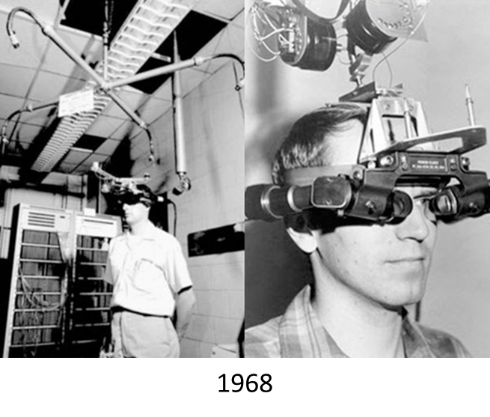
Adaptations of Human Sensorium
Human senses developed and evolved for self motion on land
First ocean voyages 60,000+ YA
First animal and cart transportation ~7500 YA
First motorized ground vehicles ~140 YA
First air vehicles ~120 YA
First simulators ~100 YA
First head worn display ~55 YA
YA – Years Ago
Novel Demands on Evolved Capabilities

Slide 9
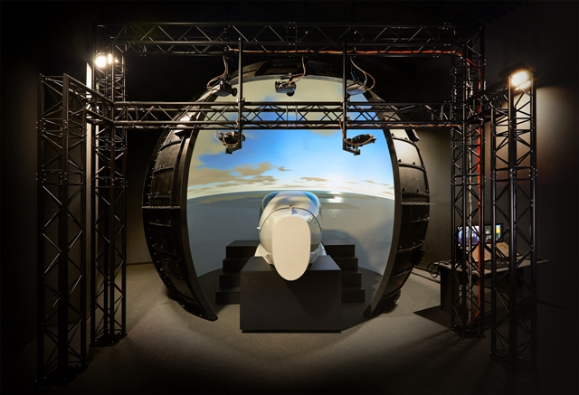
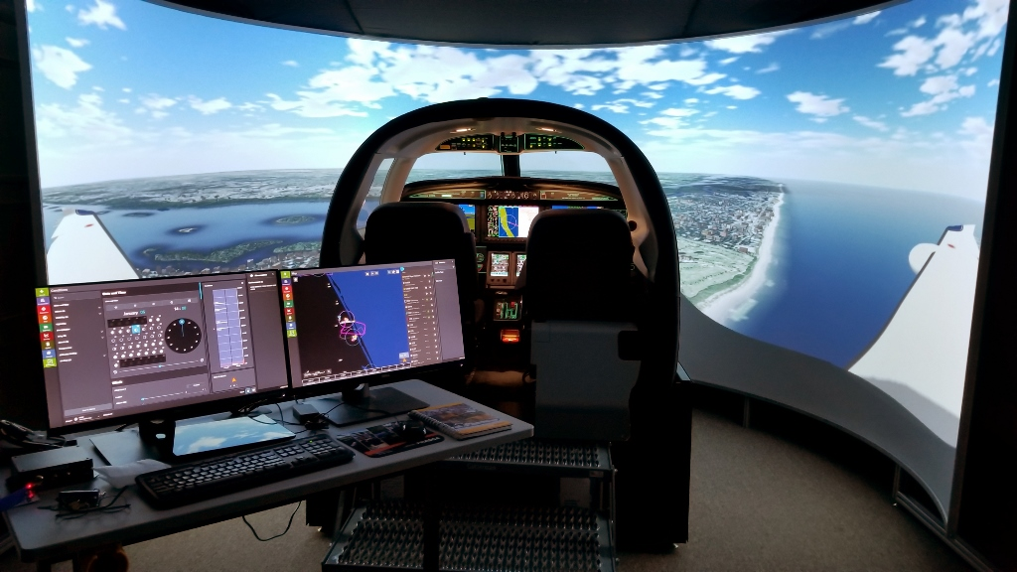
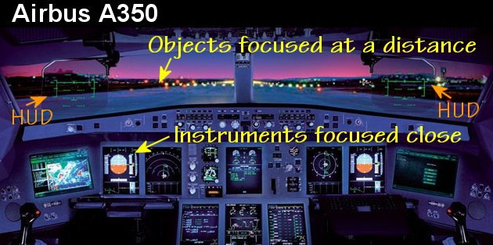
Conventional Flight Simulation Displays
System characteristics
  Fixed display – Virtual Out the Window
    Large Field of View – often total
  Physical cockpit
Dome, cylinder, flat panel displays
  OTW display surface ~1-3m
  Non-natural viewing
Cross-Cockpit Collimated displays
  Image focus at optical infinity >10m
  Parallel light as in natural viewing
  Natural gaze, focus, scan, physical, social configuration
Accepted Fidelities and Distortions

Slide 10
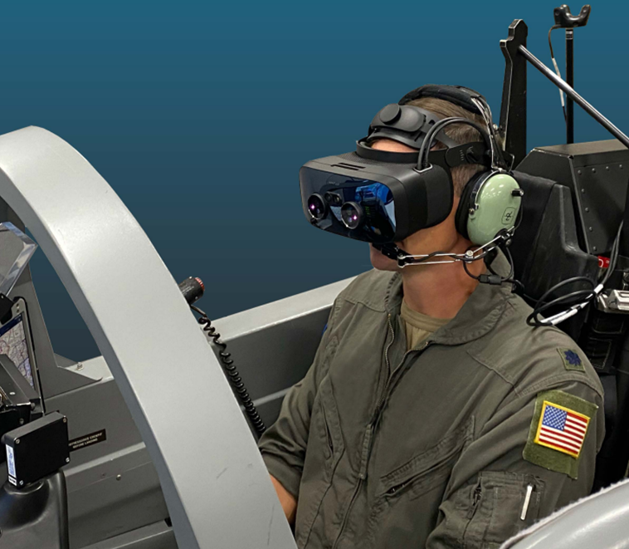
Head Worn Display Systems
Far virtual and near physical images combined
Delivered through single near-eye optical system
Image stream depends on head and eye position
HWD Present Many Challenges to Our Senses

Slide 11
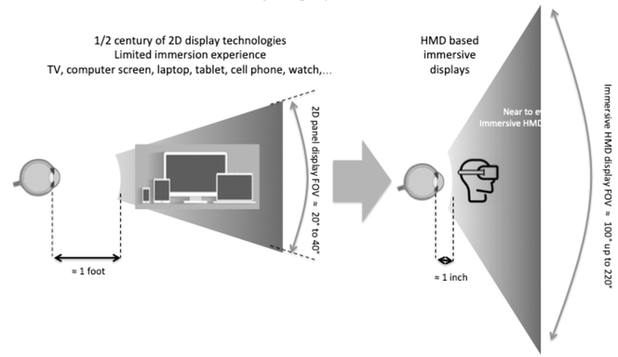
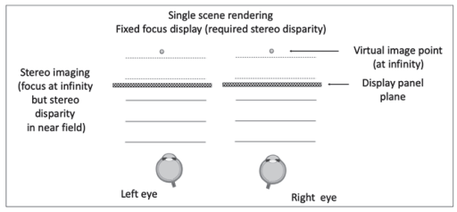
Novel Optical System
Complex optical, mechanical, and computational system
Limited field of view
Fixed focal plane
Bernard C. Kress, "Digital optical elements and technologies (EDO19): applications to AR/VR/MR," Proc. SPIE 11062, Digital Optical Technologies 2019, 1106222 (30 July 2019); https://doi.org/10.1117/12.2544404. License ID: 1629765-1
Bernard C. Kress, "Digital optical elements and technologies (EDO19): applications to AR/VR/MR," Proc. SPIE 11062, Digital Optical Technologies 2019, 1106222 (30 July 2019); https://doi.org/10.1117/12.2544404. License ID: 1629765-1
Top Level View of Optical System

Slide 12
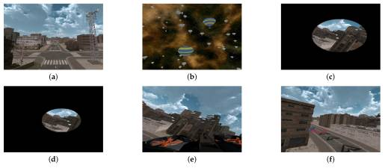
Image Content and Optic Flow
“Cybersickness and Its Severity Arising from Virtual Reality Content: A Comprehensive Study” (Oh and Son, 2022)
Reference images: 52 dynamic scenes with systematically varying optical flow
Population: 154 (of 203; 15 dropouts, 34 bad data)
Assess rotation, translation, simple/complex motion, FOV, duration, reference features, user control
Questionnaires and physiological measures
HTC Vive ~90Hz
Oh H, Son W. Cybersickness and Its Severity Arising from Virtual Reality Content: A Comprehensive Study. Sensors (Basel). 2022 Feb 9;22(4):1314. doi: 10.3390/s22041314. PMID: 35214216; PMCID: PMC8963115. Licensee MDPI, Basel, Switzerland. This article is an open access article distributed under the terms and conditions of the Creative Commons Attribution (CC BY) license (https://creativecommons.org/licenses/by/4.0
2022 Study Systematized a Fragmented Field

Slide 13
Dynamic Scene Content Sickness Factors
Most provocative factors
  Roll
  Pitch
  Long duration
High provocation
  High speed; acceleration
  Translations up, down, backward
  Lack of reference feature
  Uncontrollable
  Large FOV
Low provocation
  Yaw
  Forward translation
  Small FOV
  Constant speed, normal speed
  Reference feature
  Short duration
  Controllable
Varjo “VR Is Dead: Stories from Beyond the Metaverse”
  But it is getting to work
  Success cases respect limits
Scene Content Baseline Is Also a Stress Test

Slide 14
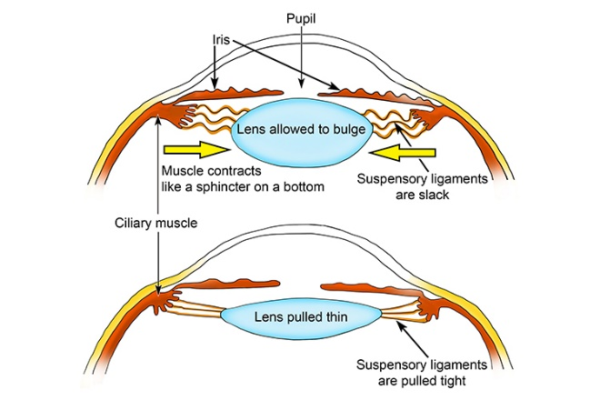
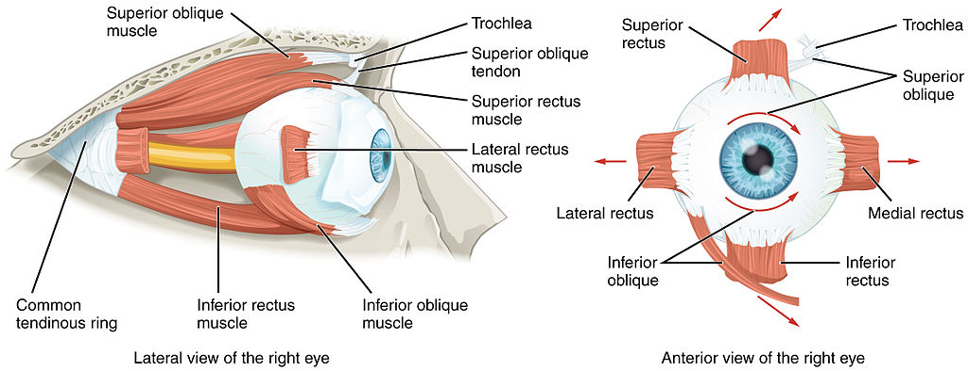
Senses Perceiving and Regulating Motion
Vision
OpenStax College, “Anatomy & Physiology” http://cnx.org/content/col11496/1.6/, 28 May 2013
Creative Commons License 3.0 DEED
External Sensing System

Slide 15
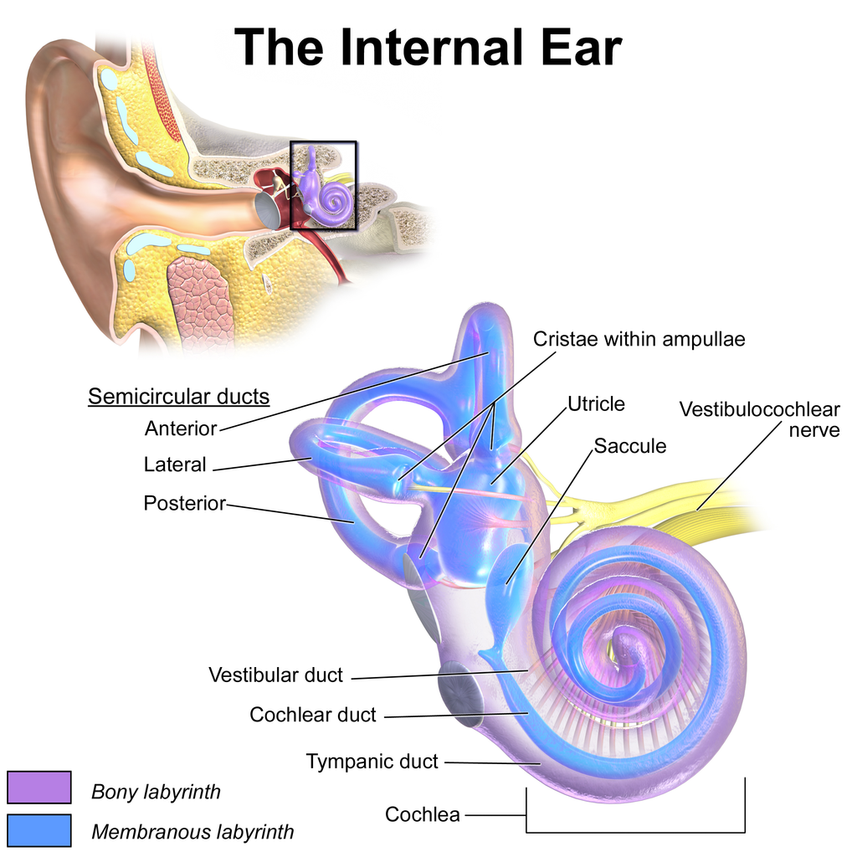
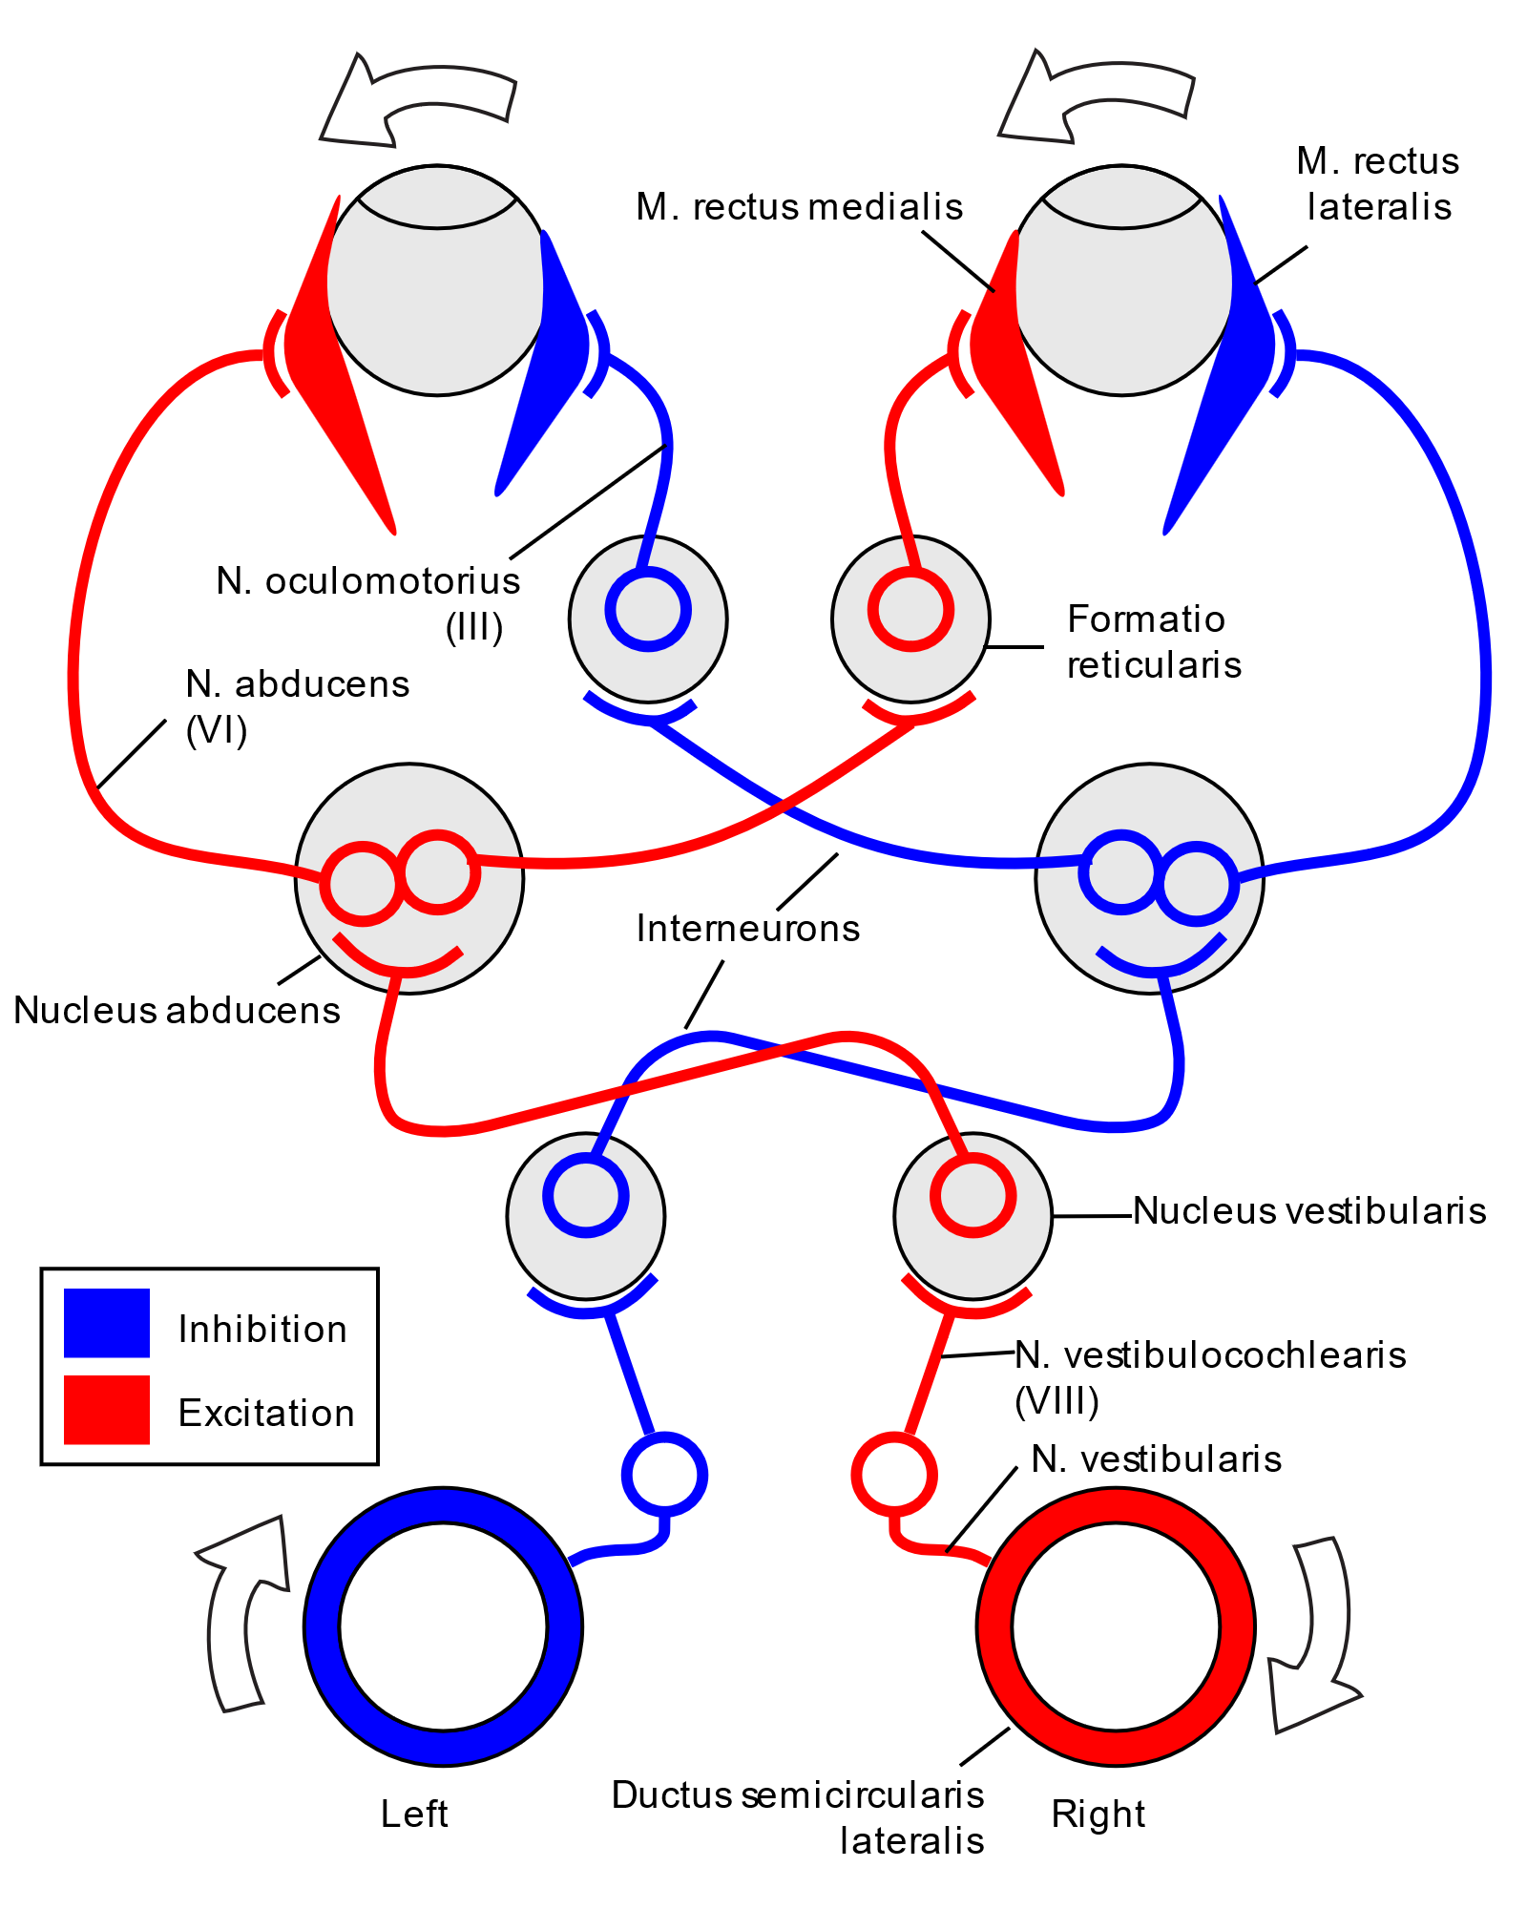
Senses Perceiving and Regulating Motion
Equilibrioception – Vestibular System – Balance and Spatial Orientation
Blausen.com staff (2014). "Medical gallery of Blausen Medical 2014". WikiJournal of Medicine 1 (2). DOI:10.15347/wjm/2014.010. ISSN 2002-4436. - Own work
B .Koen - Simple vestibulo-ocular reflex.PNG and ThreeNeuronArc.png
CC BY-SA 4.0, License #4130081
Internal and External Sensing Systems—Hearing Too!

Slide 16
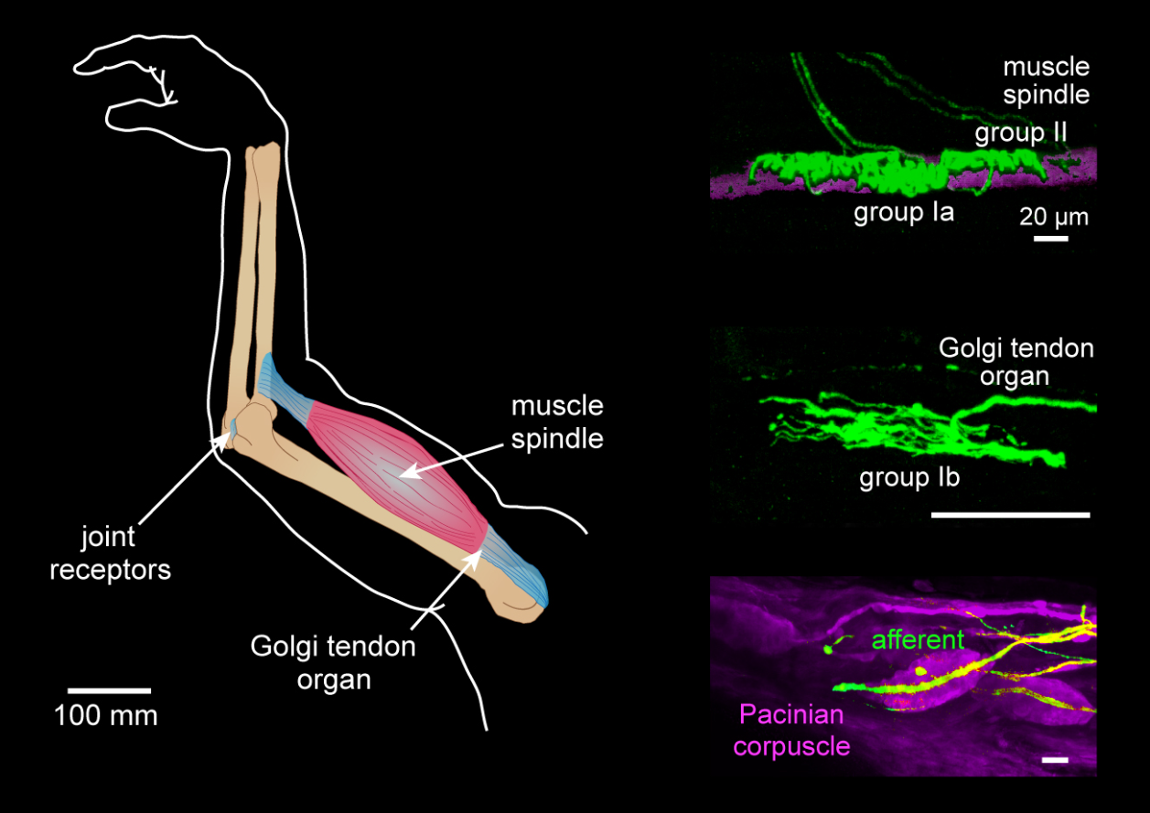
Senses Perceiving and Regulating Motion
Proprioception
Internal awareness
Body position and movement
Forces—self and externally generated
J. Tuthill, “Schematics and images of limb proprioceptors in mammals and insects” (2019). https://www.cell.com/current-biology/fulltext/S0960-9822(18)30097-6; Creative Commons License
Internal Sensing System

Slide 17
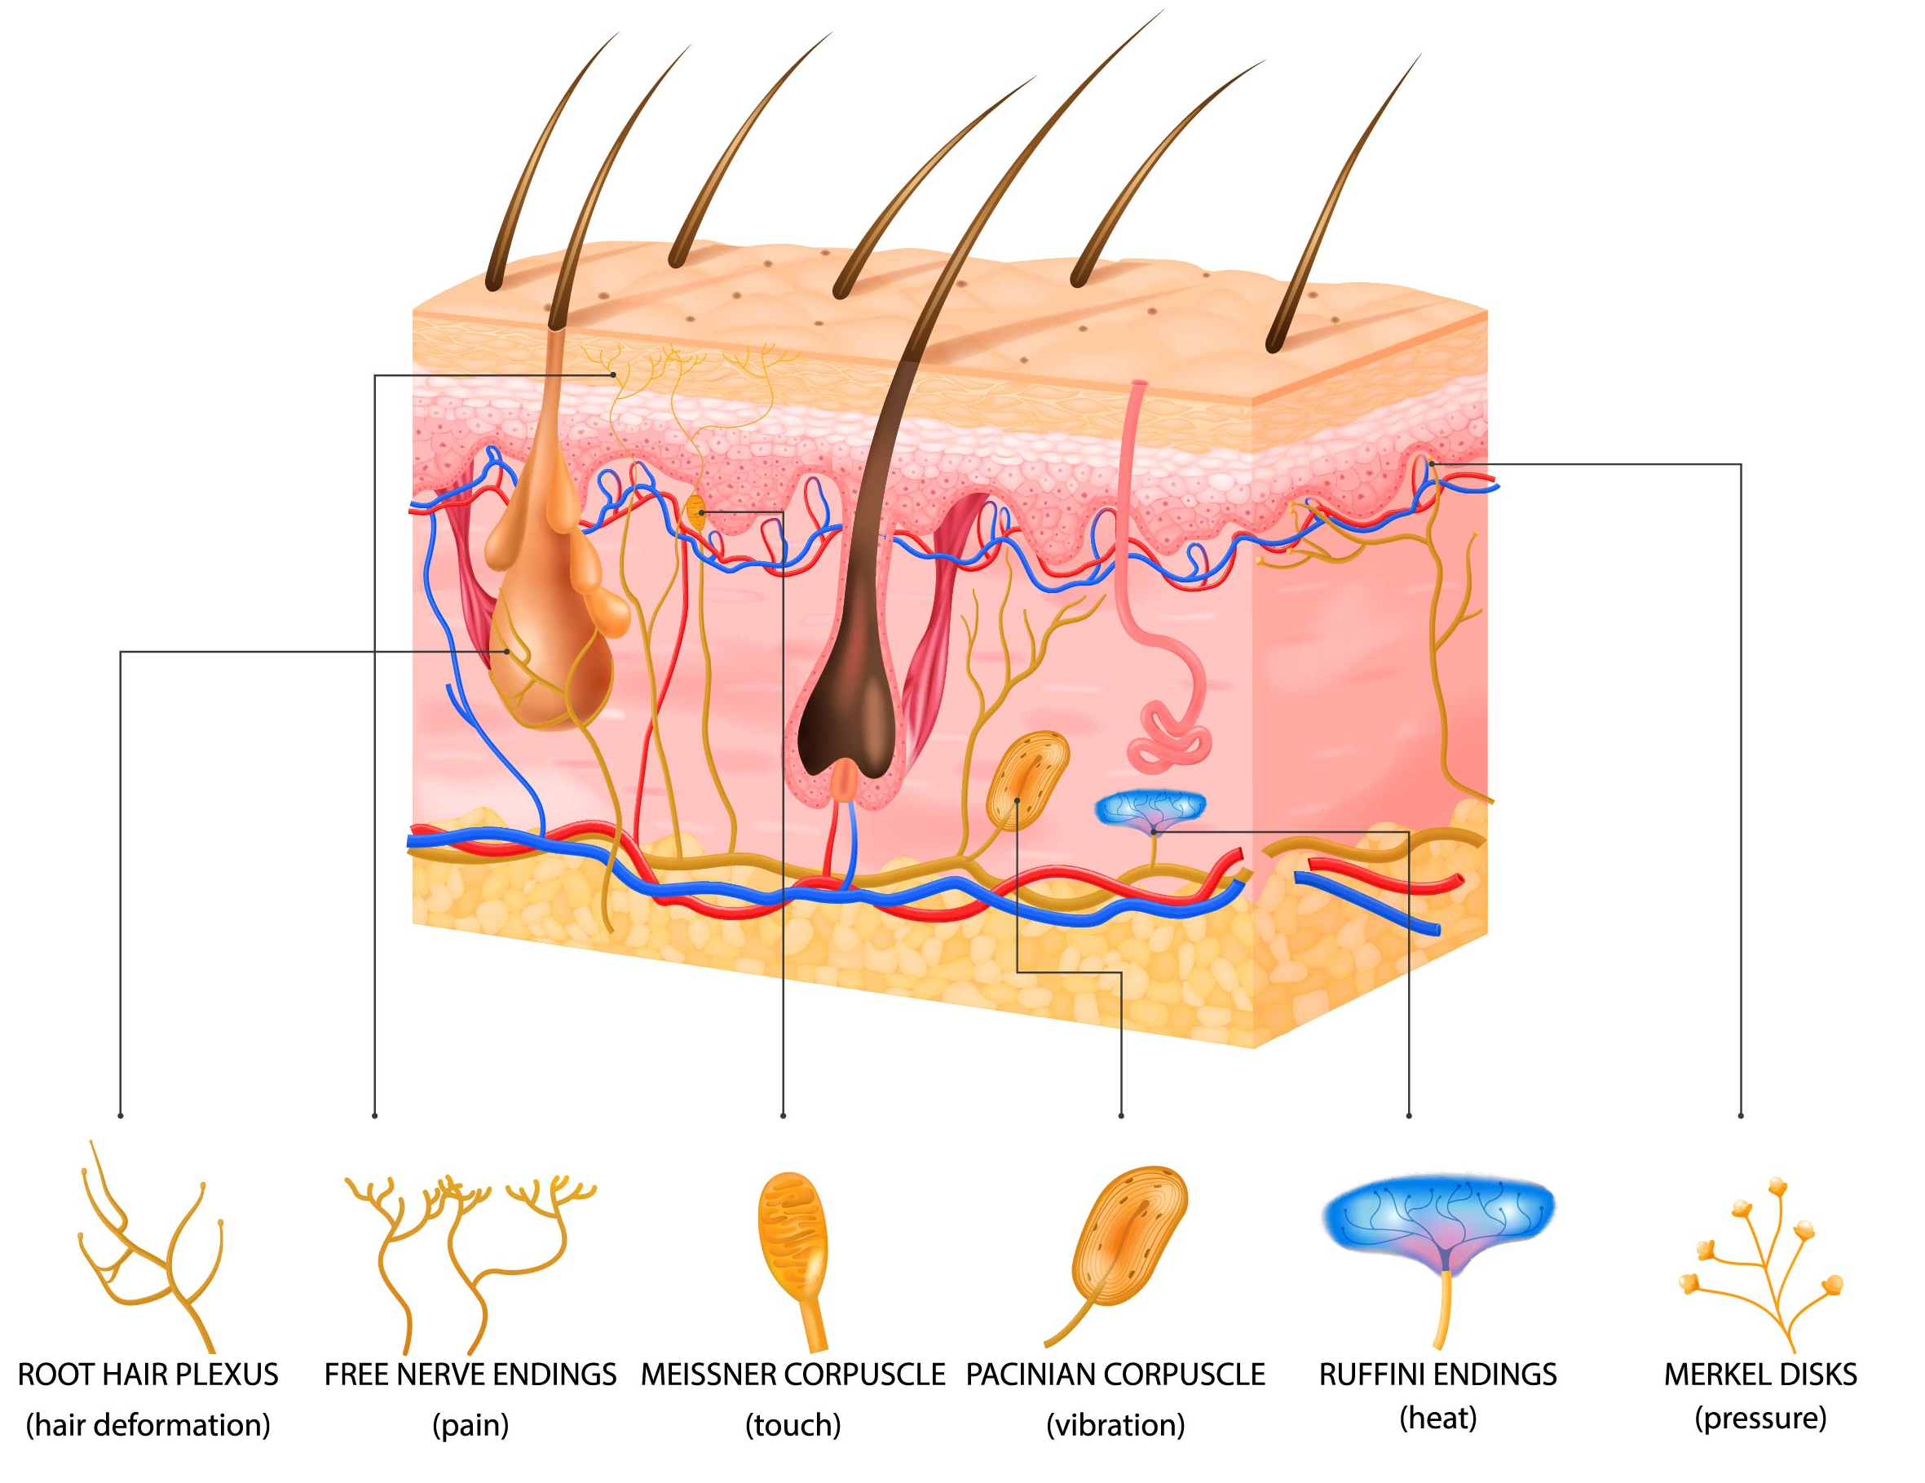
Senses Perceiving and Regulating Motion
Somatosensory
Environmental awareness
Skin sensory receptors
Touch, temperature, pain
Royalty-free stock vector ID: 1810849132
External Sensing System

Slide 18
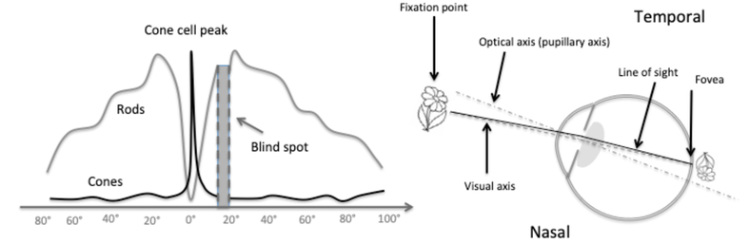
Human Eye Sensor Inputs
Fovea – Central Vision – Max Acuity and Contrast – Color – Bright – Cones
  ~7 million cones dominate
  1-3% of retinal area, 50% of visual cortex
Periphery – Sensitive – Dim – Rods
  ~100+ million rods dominate
  Detect light, change, help guide saccades
Eye optical geometry
  Visual axis line of sight to fovea ~5° off optical axis, downward bias
  Optic nerve blind spot ~18° off fovea
Bernard C. Kress, "Digital optical elements and technologies (EDO19): applications to AR/VR/MR," Proc. SPIE 11062, Digital Optical Technologies 2019, 1106222 (30 July 2019); https://doi.org/10.1117/12.2544404 License ID: 1629765-1
Additional Vision Mechanism Details

Slide 19
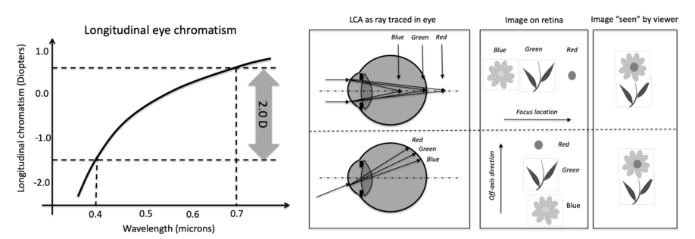
Human Eye Interaction with Color
Longitudinal Chromatic Aberration (LCA)
  Wavelengths of light refract differently through eye lens → depth spatial separation
  >2 diopter spread across visible spectrum!
Handling LCA
  On and off axis views of retinal and visual image
  Visual system resolves and uses chromatic blur to help focus
Bernard C. Kress, "Digital optical elements and technologies (EDO19): applications to AR/VR/MR," Proc. SPIE 11062, Digital Optical Technologies 2019, 1106222 (30 July 2019); https://doi.org/10.1117/12.2544404 License ID: 1629765-1
Additional Vision Mechanism Details

Slide 20
Sensory Mechanisms in Head Worn Displays
Field of View
Differences in Virtual and Physical Head Pose
Visual-Vestibular Conflicts
Depth Perception and Vergence-Accommodation Conflict
Binocular Stereoscopic Displays, Pipeline, and Distortions
Roughly Increasing Order of Intricacy

Slide 21
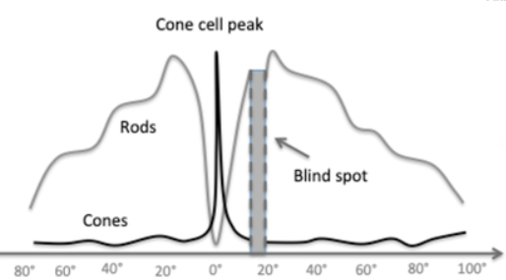
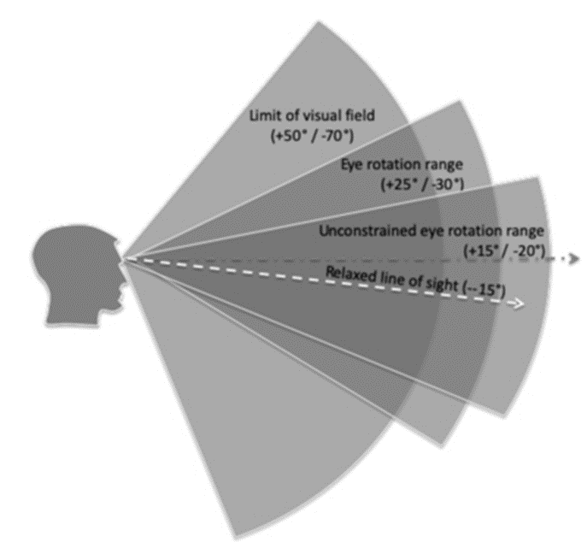
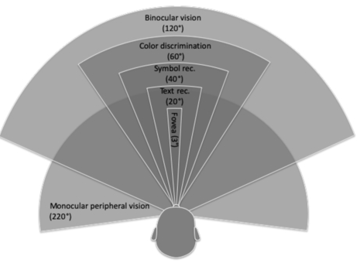
Human Visual Field of View
Field of View (FOV) (Instantaneous)
Field of Regard (FOR) (Head movement over time) 360°
Fig. 1
Fig. 2
Fig. 3
Figures 1, 2, & 3: Bernard C. Kress, "Digital optical elements and technologies (EDO19): applications to AR/VR/MR," Proc. SPIE 11062, Digital Optical Technologies 2019, 1106222 (30 July 2019); https://doi.org/10.1117/12.2544404 License ID: 1629765-1
Arcs of Sensitivity
Binocular and Monocular Peripheral Regions

Slide 22
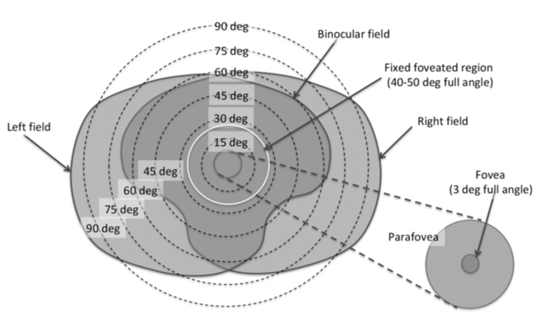
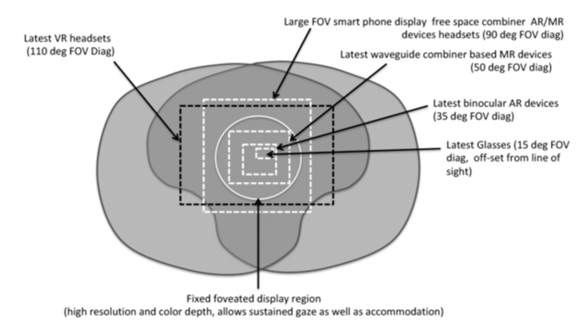
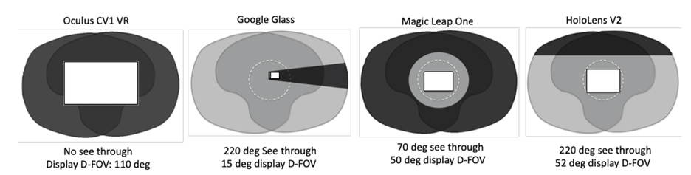
Human and HWD Field of View
Fig. 2
Fig. 1
Figures 1, 2, &3: Bernard C. Kress, "Digital optical elements and technologies (EDO19): applications to AR/VR/MR," Proc. SPIE 11062, Digital Optical Technologies 2019, 1106222 (30 July 2019); https://doi.org/10.1117/12.2544404 License ID: 1629765-1
Fig. 3
HWD FOV – Peripheral is Missing
Variable/Hard to Measure – Specs Questionable

Slide 23
Peripheral Vision Functions
Multi-tasking — multi-object tracking — gist
Monitor – detect hazards — act before fixate
Inform eye movements – saccades
Pilots
  Monitor instruments
  Interact with controls without looking
  Optic flow cues help maintain control, detect hazards
Quantitative definition varies – more below
  Flight Simulation – monocular peripheral (> +/- 60°)
  FAA Level D flight simulators >200° HFOV
  Vision science – no consensus
Bernard C. Kress, "Digital optical elements and technologies (EDO19): applications to AR/VR/MR," Proc. SPIE 11062, Digital Optical Technologies 2019, 1106222 (30 July 2019); https://doi.org/10.1117/12.2544404 License ID: 1629765-1
Periphery frames, guides, safeguards, and facilitates
vision and interaction

Slide 24
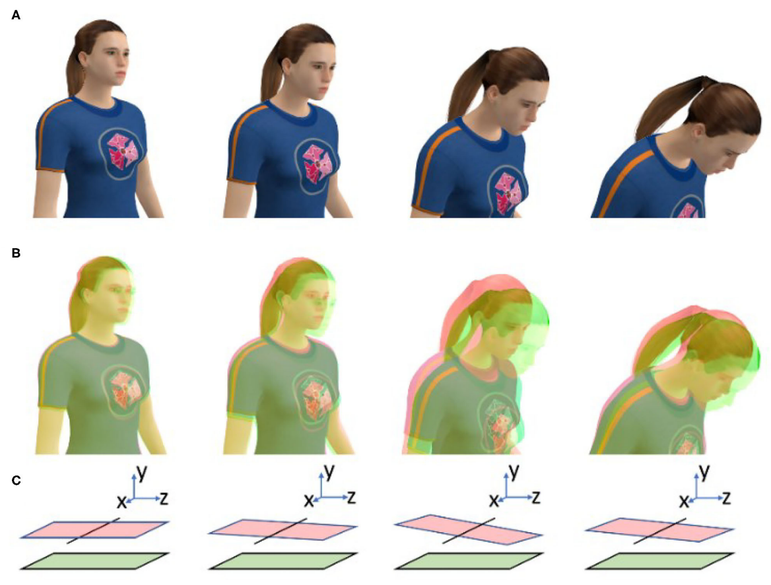
Differences in Virtual and Physical Head Pose
“Cybersickness in Head-Mounted Displays Is Caused by Differences in the User's Virtual and Physical Head Pose”
      Palmisano, Allison, Kim (November 2020)
Correct image depends on head position
Necessitates very accurate and timely head position measurement
HWDs provoke extra head movements
  Accessing unavailable peripheral
  Obtaining sufficient resolution to read instruments
Palmisano, Allison, Robert, Juno “Cybersickness in Head-Mounted Displays is caused by differences in the User’s Virtual and Physical Head Pose (2020). Frontiers in Virtual Reality, Vol. 1
CC BY 4.0 Deed | Attribution 4.0 International | Creative Commons
Imaging pipeline requires high accuracy, low latency input

Slide 25
Latency
Input to response – motion to photon
Head – vehicle control – hand track
Update rate – fixed vs. variable
Common visual refresh rates: 60Hz, 90Hz, 120Hz, 240Hz
Latency jitter and spikes
Managing Latency
In-depth measurement necessary
Predictive compensation
Latency specs are practical compromise
FAA fixed wing (150ms), Helo/EVS (100ms)
Lower latency is better
2004 NASA piloting study recommends 20 msec
Longer times altered head movements vs. normal operations
Systems may vary significantly
Poor Latency is the Fast Path to Sickness
HWD Adds to Pipeline

Slide 26
Visual-Vestibular Potential for Conflict
Visual and Vestibular are the primary motion senses
Visual contributions to motion perception
  Linear motion—accurate and precise
  Visually Induced Motion (VIM)—strong cue, peripheral is powerful input
Vestibular organs sense orientation and translation
  Support balance, spatial orientation, rotational motion
Simulators lack true motion
  Motion Cues (MC) stimulating motion sensation range from very good to infeasible
  Visually Induced Motion (VIM) can be powerful but depends on display FOV
  Accurate, in-phase MC provide most natural vestibular experience
  Poor MC creates VIM-MC conflicts and provokes sickness
    FAA MC required before visual field but no more than one field earlier
  No motion preferred to bad motion (e.g. fighter jet simulators)
Established Facts

Slide 27
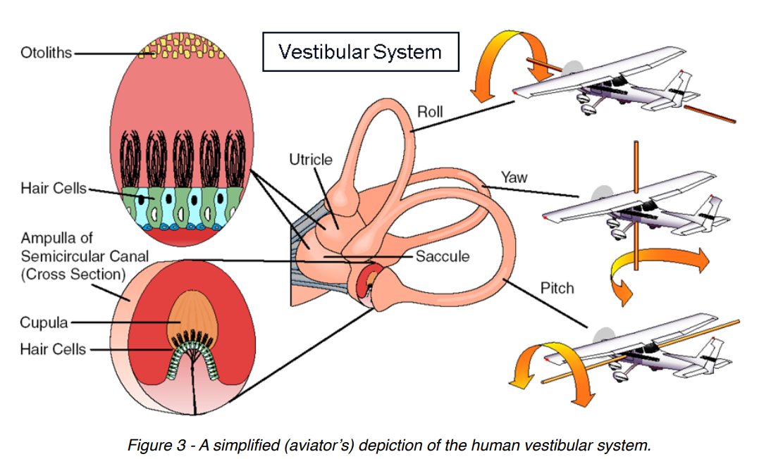
Vestibular Outputs and Inputs
Reflexes and Motion Perception
Vestibular-Ocular Reflex (VOR)
  Generates eye movements opposite head to maintain clear vision
  Directly wired to motor neurons controlling extraocular muscles
  Extremely fast, < 5-10msec
Vestibulocollic Reflex (VCR)
  Directly wired to neck musculature to control head—helps gaze
Vestibulospinal Reflex (VSR)
  Maintains balance when postural sway is detected
Air maneuvers can confound vestibular sensors
  Spatial Disorientation—pilots trained to manage
Motion perception, illusions, sickness created by brain
  Phenomena of multi-sensory integration
  Uses visual, vestibular, proprioceptive, somatosensory, auditory inputs
  Dynamically assesses, reweights, translates internal to world reference
S. Advani, “Optimization of Motion Cueing Parameters of Hawker 4000 and A320 Simulators by the International Development of Technology (IDT)”, Report Number IDT-R-14-01, Version No. 5, Issue Date 11 June 2014, Figure 3
Britton Z, Arshad Q. Vestibular and Multi-Sensory Influences Upon Self-Motion Perception and the Consequences for Human Behavior. Front Neurol. 2019 Mar 7;10:63. doi: 10.3389/fneur.2019.00063. PMID: 30899238; PMCID: PMC6416181. This is an open-access article distributed under the terms of the Creative Commons Attribution License (CC BY). The use, distribution or reproduction in other forums is permitted, provided the original author(s) and the copyright owner(s) are credited and that the original publication in this journal is cited, in accordance with accepted academic practice. No use, distribution or reproduction is permitted which does not comply with these terms.
B .Koen - Simple vestibulo-ocular reflex.PNG and ThreeNeuronArc.png
CC BY-SA 4.0, License #4130081
Neuroscience clarifies vestibular sense roles

Slide 28
Vestibular Outputs and Inputs
Reflexes and Motion Perception
S. Advani, “Optimization of Motion Cueing Parameters of Hawker 4000 and A320 Simulators by the International Development of Technology (IDT)”, Report Number IDT-R-14-01, Version No. 5, Issue Date 11 June 2014, Figure 3
B .Koen - Simple vestibulo-ocular reflex.PNG and ThreeNeuronArc.png
CC BY-SA 4.0, License #4130081
Neuroscience clarifies vestibular sense roles

Slide 29
Contribution of HWD to
Visual-Vestibular Conflicts
HWD truncates peripheral → weakens powerful visual motion cue
  Degrades visual motion cues vs. conventional flight simulators
HWD increases head movement → stimulates vestibular organs
  Possible negative training
HWD aggravates inherent latency conflict between VOR and imaging pipeline
  Vestibulo-Ocular Reflex → eye movement < 10msec (fundamental latency constraint)
  Head/eye position dependency
Multi-sensory cue expectation theory → accurate MC may be more important with HWD
HWD compromise accurate visual-vestibular simulation

Slide 30
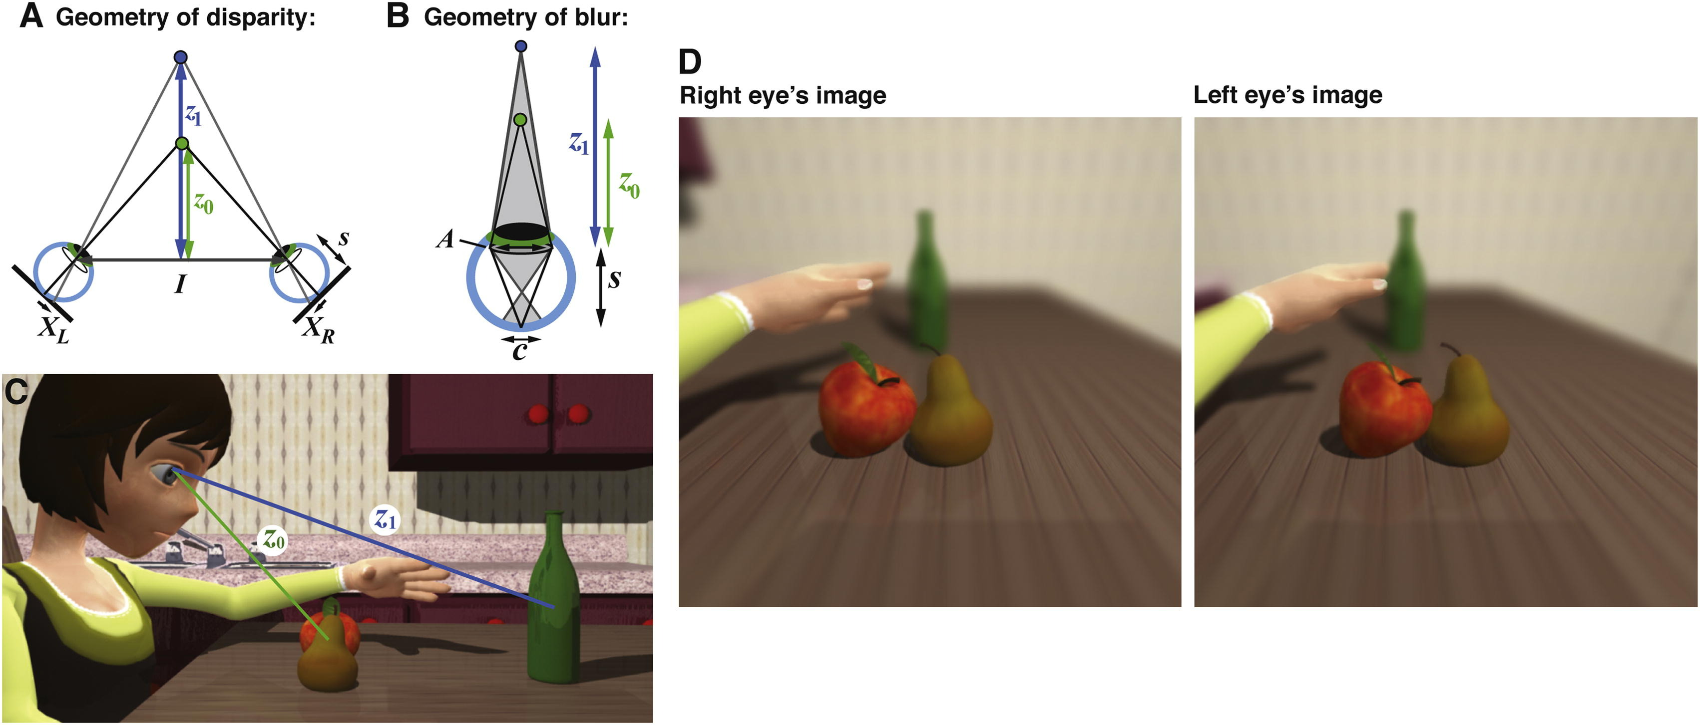
Natural Depth Perception
Disparity/Vergence and Blur-Focus/Accommodation Work Together
Binocular Disparity → Vergence
  Rotate eyes to fuse image
Retinal Blur → Accommodation
  Adjust of power of lens for sharp image
Geometry of disparity and blur same
  Identical cue distance
Vergence and Accommodation cross coupled
  A → V, V → A
Monocular and biocular blur only
Current Biology 2012 22426-431DOI: (10.1016/).cub.2012.01.033
Copyright © Elsevier Ltd, License #5776140184247
Natural V-A system works extraordinarily well and enables fast, accurate depth perception

Slide 31
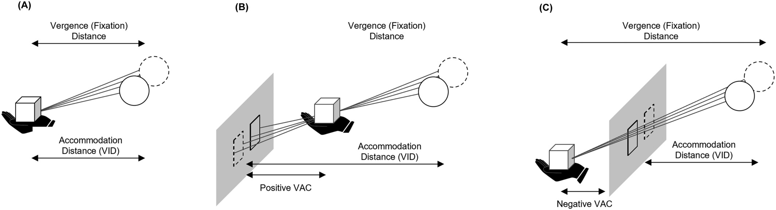
Vergence Accommodation Conflict
Stereo display causes Vergence-Accommodation Conflict (VAC)
Focus/accommodation fixed on display screen
Disparity/vergence vary with scene content
Visual system must dissociate naturally coupled responses
Natural – No Disparity
Crossed Disparity
Uncrossed Disparity
Spiegel DP, Erkelens IM. Vergence-accommodation conflict increases time to focus in augmented reality. J Soc Inf Display. 2024; 32(5): 194–205. https://doi.org/10.1002/jsid.1283 https://creativecommons.org/licenses/by-nc-nd/4.0/
Synthetic binocular displays fix accommodation
conflicting with nature

Slide 32
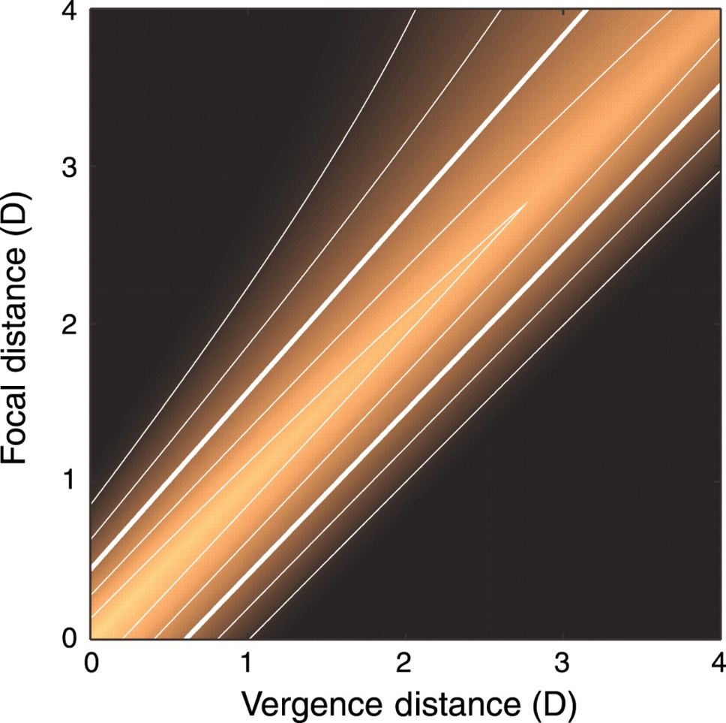
VAC and Comfort
Human Tolerance for VAC Disparity
Estimated zone of comfort per Shibata (2011)
Brighter → more comfortable
Larger conflicts less comfortable
Dark UL/LR → can’t fuse images
Limited comfortable tolerance range
  ~ +/- .25D-.5D
Related work substantially confirms
  Time to Focus (Spiegel and Erklens 2024)
  Rate of change
Near crossed VAC (cockpit) is most uncomfortable case
Optical distance of screen is key parameter
The zone of comfort: Predicting visual discomfort with stereo displays
Journal of Vision. 2011;11(8):11. doi:10.1167/11.8.11; License #1477316-1
Estimated Continuous Zone of Comfort (D)
VAC Comfort Range Creates Limits on HWD Designs

Slide 33
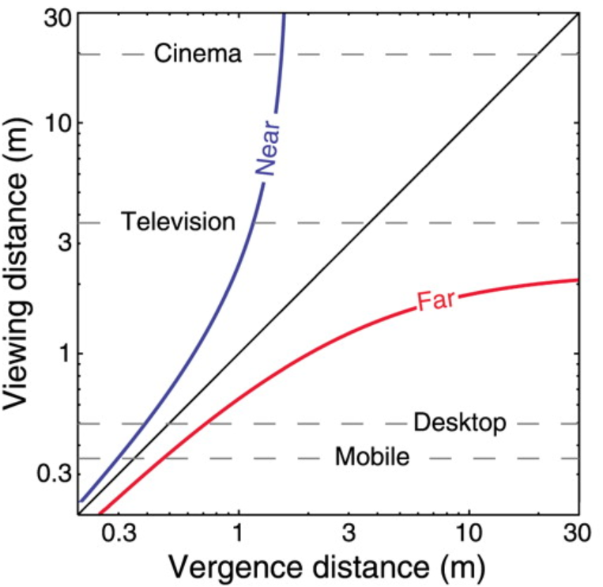
VAC and Comfort
Human Tolerance for VAC Disparity
Estimated zone of comfort per Shibata (2011)
Negative (Uncrossed)-behind conflicts (red)
Positive (Crossed)-in front conflicts (blue)
Significant distance tolerance at long range
Shibata, T., Kim, J., Hoffman, D. M., & Banks, M. S. (2011). The zone of comfort: Predicting visual discomfort with stereo displays. Journal of Vision, 11(8):11, 1–29, http://www.journalofvision.org/content/11/8/11, doi:10.1167/11.8.11. License ID: 1477316-1
Estimated Zone of Comfort (m)
Changing units matches experience and intuition

Slide 34
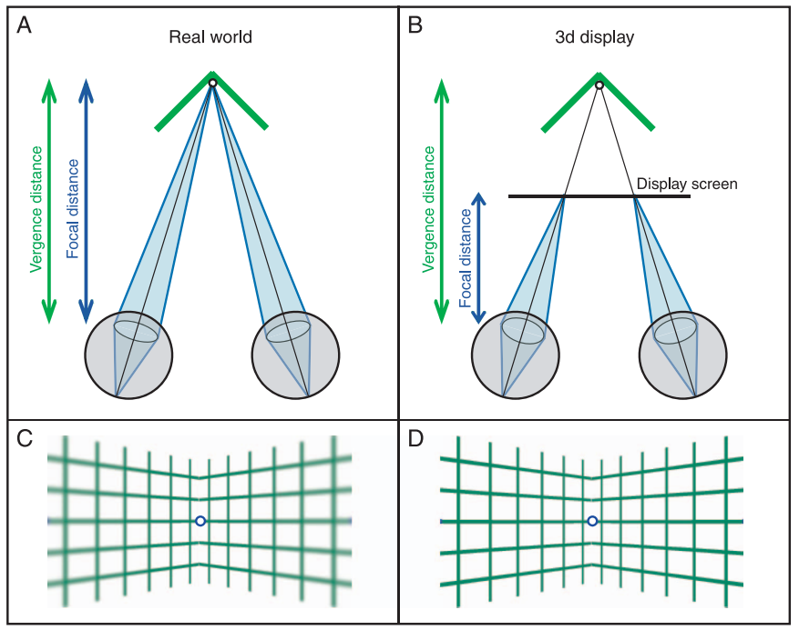
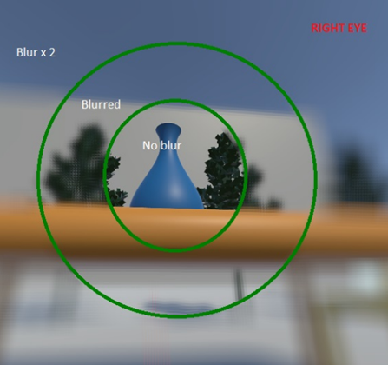
Image Blur in Nature and Simulation
Natural vision includes blur
Synthetic images typically photorealistic (no blur)
Foveated blur implementations are available
Computational and perceptual rationales
Vergence–accommodation conflicts hinder visual performance and cause visual fatigue
Journal of Vision. 2008;8(3):33. doi:10.1167/8.3.33, License #1477336-1
Hussain, R.; Chessa, M.; Solari, F. Mitigating Cybersickness in Virtual Reality Systems through Foveated Depth-of-Field Blur. Sensors 2021, 21, 4006. https://doi.org/10.3390/s21124006. This article is an open access article distributed under the terms and conditions of the Creative Commons Attribution (CC BY) license (https:// creativecommons.org/licenses/by/4.0/).
More differences between natural and simulated images

Slide 35
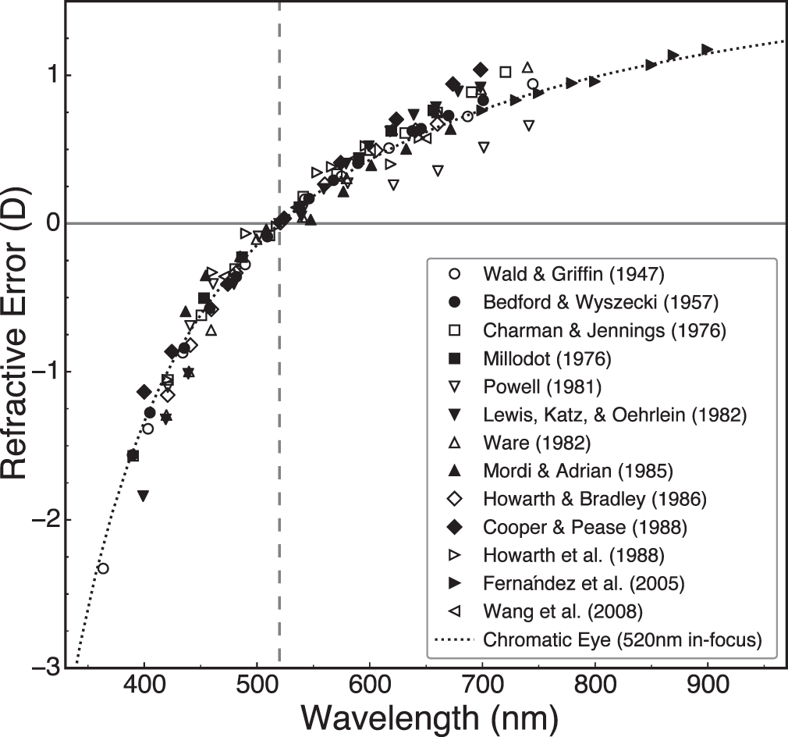
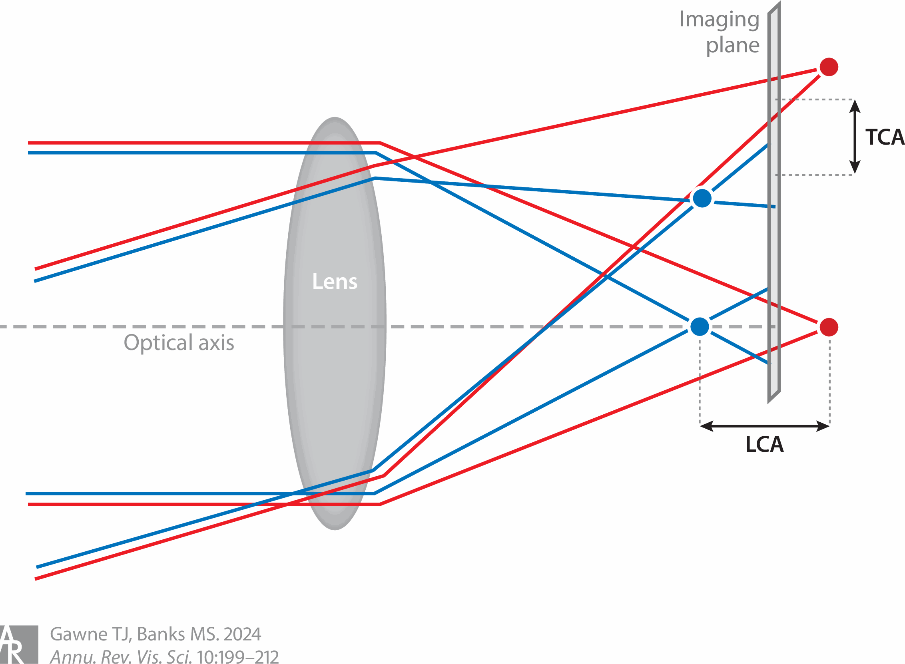
Chromatic Blur and Accommodation
Natural chromatic aberration (LCA) resolves sign of blur
  Monochrome blur is unsigned
  Short wavelengths (blue) focus near
  Long wavelengths (red) focus far
  HVS uses to accommodate in correct direction
Fixed display screen does not provide chromatic wavelength variation
  Chromatic blur missing—experimental validation
    S.A. Cholewiak 2017 and 2018
Pupil Near Response expands depth of field (Near Triad)
  Shrinks pupil when looking at near objects
  Intact in VR HWD
    Pielage H, Zekveld AA, van de Ven S, Kramer SE, Naber M. The pupil near response is short lasting and intact in virtual reality head mounted displays. J Eye Mov Res. 2023 Mar 27;15(3):10.16910/jemr.15.3.6. doi: 10.16910/jemr.15.3.6. PMID: 37162795; PMCID: PMC10164449.
Steven A. Cholewiak, Gordon D. Love, Martin S. Banks; Creating correct blur and its effect on accommodation. Journal of Vision 2018;18(9):1.
https://doi.org/10.1167/18.9.1. https://creativecommons.org/licenses/by/4.0/
Timothy J. Gawne¹ and Martin S. Banks² The Role of Chromatic Aberration in Vision. Vol. 10:199-212 (Volume publication date September 2024) https://doi.org/10.1146/annurev-vision-101222-052228
http://creativecommons.org/licenses/by/4.0/
Even More Natural / Simulated Image Differences

Slide 36
Binocular Stereoscopic Vision and Displays
Technical Challenges and Related Experiences
Cautionary related experience
  3D cinema and television circa ~2012
Natural viewing vs. viewing on screens
Eye movements in VR
Alignment of devices
Stereoscopic pipeline distortions
Scene content distortions
Why 3D Movies and TV Failed—and HWD May Be Better

Slide 37
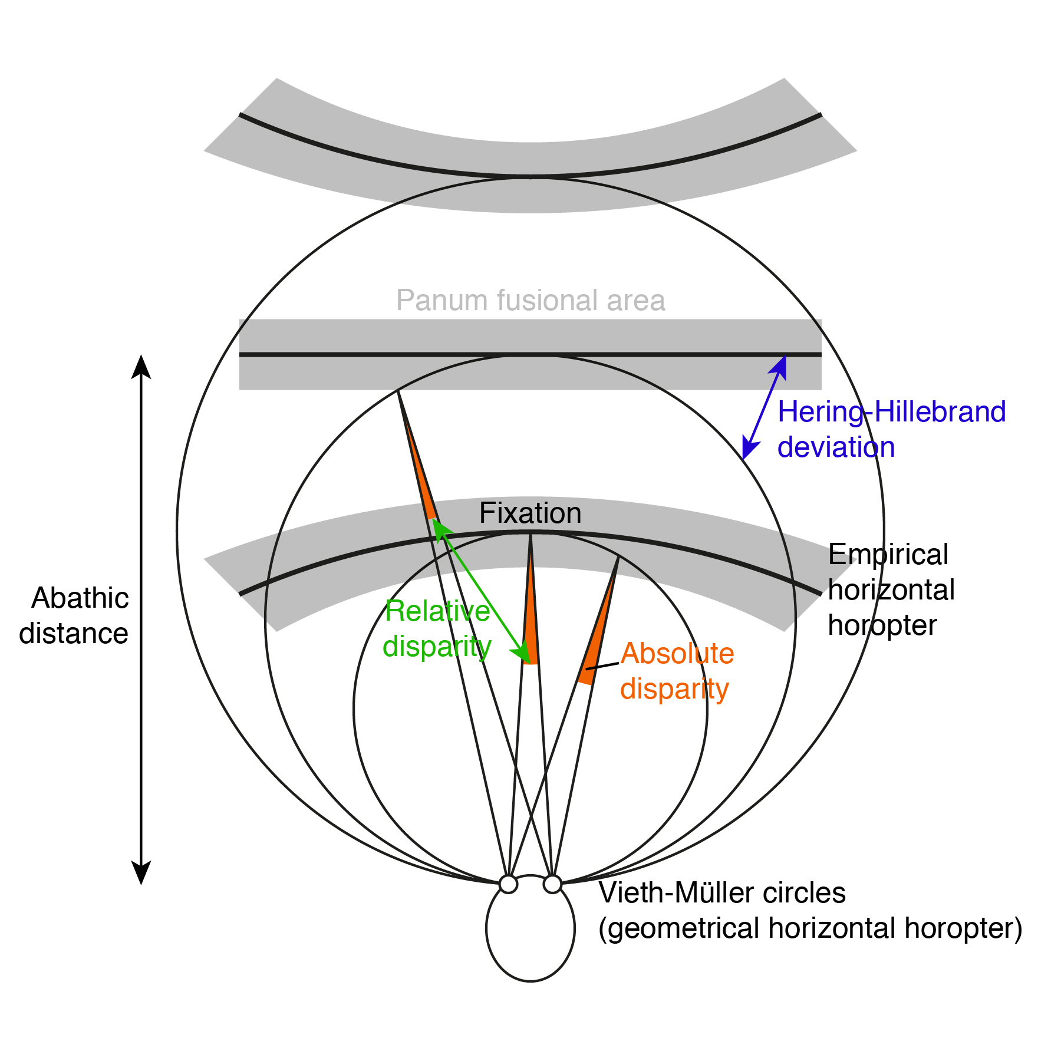
Binocular Geometry
Corresponding retinal points left eye/right eye perceiving common point in visual field
Horopter—the locus of points that project on the same pair of points on the retinas
Horizontal Geometric Horopter—the set of points with zero relative disparity to fixation
Horizontal Empirical Horopter—how our visual system makes correspondence, differs from geometric, includes fusible areas
  Concave → Convex as fixation distance increases
https://commons.wikimedia.org/wiki/File:Horopters.png E4zase1vrvlo6pe, CC BY-SA 4.0 <https://creativecommons.org/licenses/by-sa/4.0>, via Wikimedia Commons
Classic Analysis of Binocular Fixation and Fusion

Slide 38
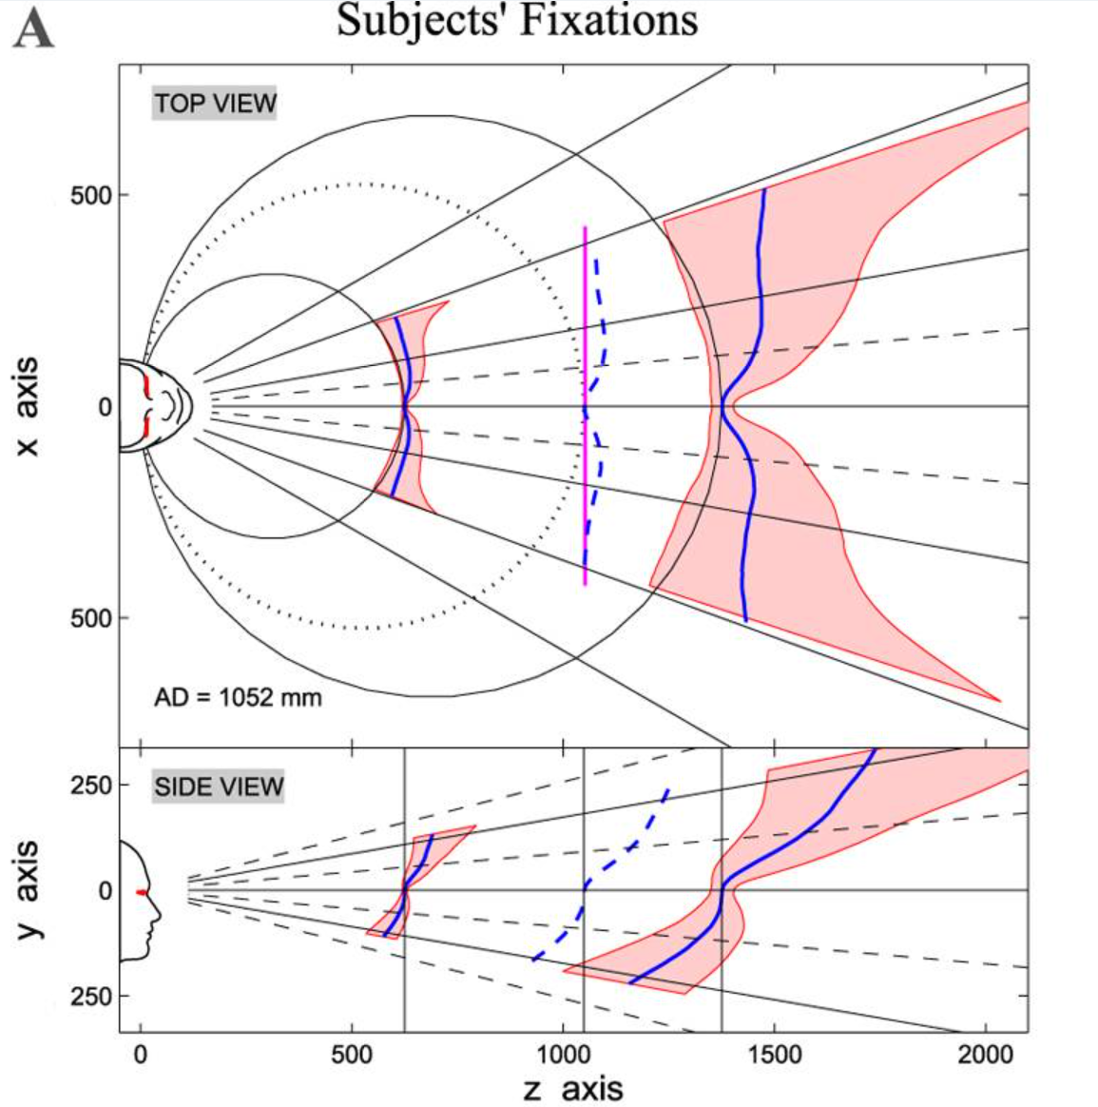
Natural Binocular Image Correspondence
Latest Estimate of Horopter Shape and Tolerance Range
Blue lines show latest estimate of shape of the horopter
  Pink shaded regions show Panum’s fusional area
  Area of tolerance around retinal point
  Increases with eccentricity
Bump consistent with
  Fine central vision
  Preference for near object surrounded by far background
Empirical horopter is innate and infinite family of matchable binocular regions dependent on fixation
Gibaldi, A. et al. The Active Side of Stereopsis: Fixation Strategy and Adaptation to
Natural Environments. Sci. Rep. 7, 44800; doi: 10.1038/srep44800 (2017). Deed - Attribution 4.0 International - Creative Commons
Stereoscopic Vision is Inbuilt and Adapted to Nature

Slide 39
Impact of Screens on Scene Structure
Screen restricts viewing geometry
Screen fixes accommodation and clashes with natural correspondence geometry
  Concave to convex horizontal
  Backward tilting vertical
Vergence-Accommodation Conflict +
Stereoscopic content best practices recommend presenting at distance similar to the screen
  Minimize VAC discomfort and conflicts
Training tasks including flight training entail natural not artistically controlled depth distribution
Gibaldi, A. et al. The Active Side of Stereopsis: Fixation Strategy and Adaptation to
Natural Environments. Sci. Rep. 7, 44800; doi: 10.1038/srep44800 (2017). Deed - Attribution 4.0 International - Creative Commons
Fixed screen conflicts with natural geometry

Slide 40
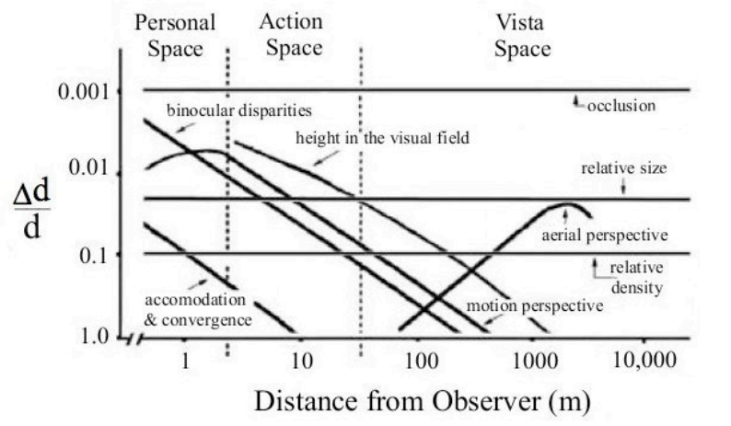
Strength and Range of Depth Cues
Many cues contribute to depth perception
Binocular stereoscopic cues
  Accommodation low resolution and near
  Disparity higher resolution but limited range
Aviation near/far visual tasks toggle between stereoscopic and non-stereoscopic regimes
  Cockpit
  Out the window
  Taxiing, helicopters near ground in between
Depth perception uses many cues dynamically and is robust, at least relatively
Beyond a few hundred meters, no stereoscopic information
Depth Perception, Cueing, and Control, Barbara T. Sweet and Mary K. Kaiser, NASA Ames Research Center, Moffit Field CA; AAIA Modeling and Simulation Technologies Conference 08-11 August 2011. https://ntrs.nasa.gov/api/citations/20180007277/downloads/20180007277.pdf. This material is declared a work of the U.S. Government and is not subject to copyright protection in the United States.
Limited Range of Binocular Stereoscopic Cues
Multiple Depth Cues Combine Robustly

Slide 41
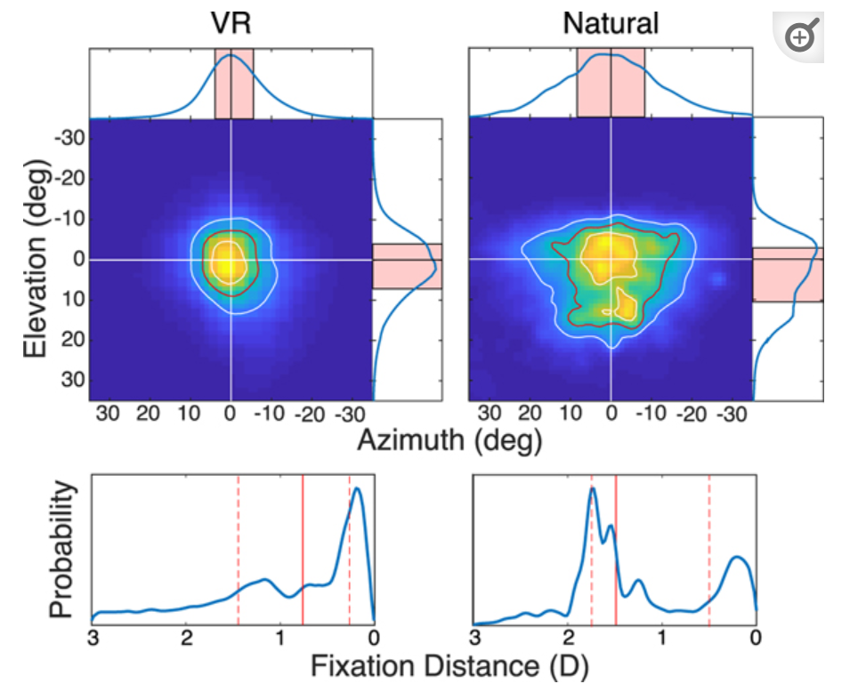
Eye Movements in VR and Natural Settings
Fixation Direction and Distance Looking Out from Eye
“The Statistics of Eye Movements and Binocular Disparities during VR Gaming: Implications for Headset Design”, 1/2023
  Marty Banks lab, UC-Berkeley
VR narrows and shifts fixations vs. natural
  Natural downward bias vs. VR straight ahead
  ~15° vs. ~5°
  VR distance longer and less varied
  VR smaller eye movements, larger head movements
Fixation distance and direction depends on task
  Study details are representative but differ from flight
Avi M. Aizenman, George A. Koulieris, Agostino Gibaldi, Vibhor Sehgal, Dennis M. Levi, and Martin S. Banks. 2023. The Statistics of Eye Movements and Binocular Disparities during VR Gaming: Implications for Headset Design. ACM Trans. Graph. 42, 1, Article 7 (January 2023), 15 pages. https://doi.org/10.1145/3549529 PMC Copyright notice This work is licensed under a Creative Commons Attribution International 4.0 License
VR Substantially Reduces Range of Eye Movement

Slide 42
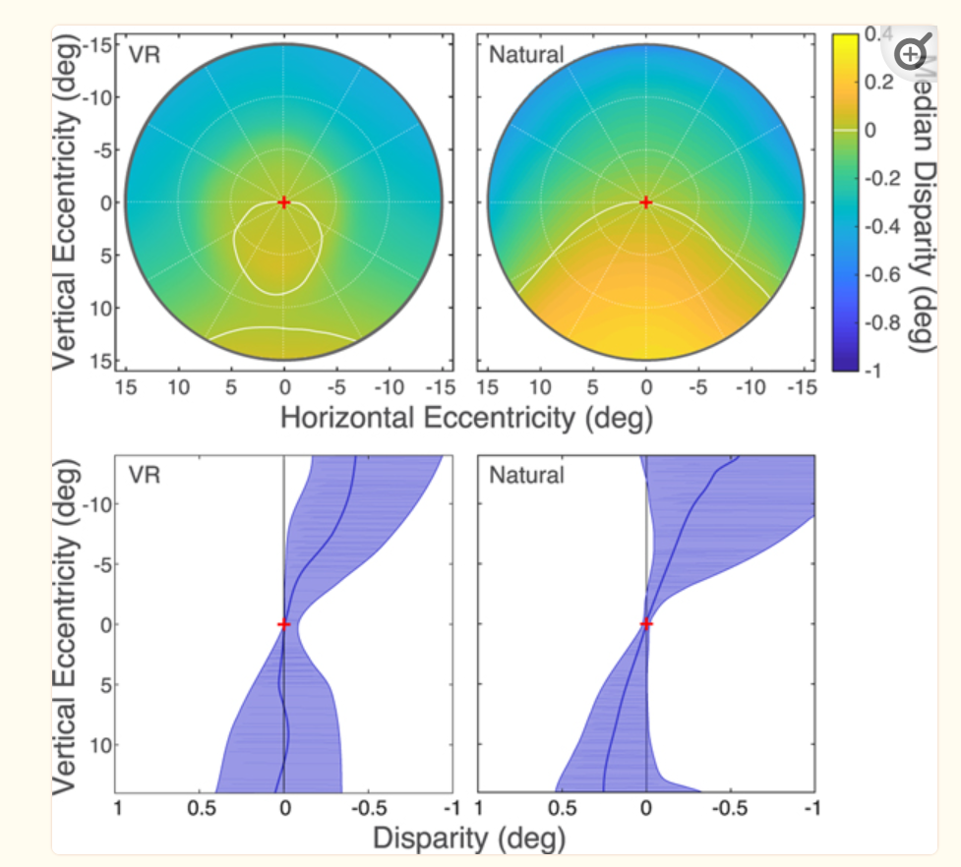
Disparities in VR and Natural Settings
VR Natural
Retinal Disparities—Scene Fixations Mapped to Retina
Median horizontal disparity across visual field
  Fovea centered
  Blue → uncrossed / Yellow → crossed
    Uncrossed → beyond fixation point
    Upward eye movements diverge
    Crossed → in front of fixation point
    Downward eye movements converge
Natural disparities match empirical horopter
Subtle but significant differences in VR
Human Visual System (HVS) uses environmental regularities to identify corresponding retinal points
Avi M. Aizenman, George A. Koulieris, Agostino Gibaldi, Vibhor Sehgal, Dennis M. Levi, and Martin S. Banks. 2023. The Statistics of Eye Movements and Binocular Disparities during VR Gaming: Implications for Headset Design. ACM Trans. Graph. 42, 1, Article 7 (January 2023), 15 pages. https://doi.org/10.1145/3549529 PMC Copyright notice This work is licensed under a Creative Commons Attribution International 4.0 License
VR Disparities Differ From Natural

Slide 43
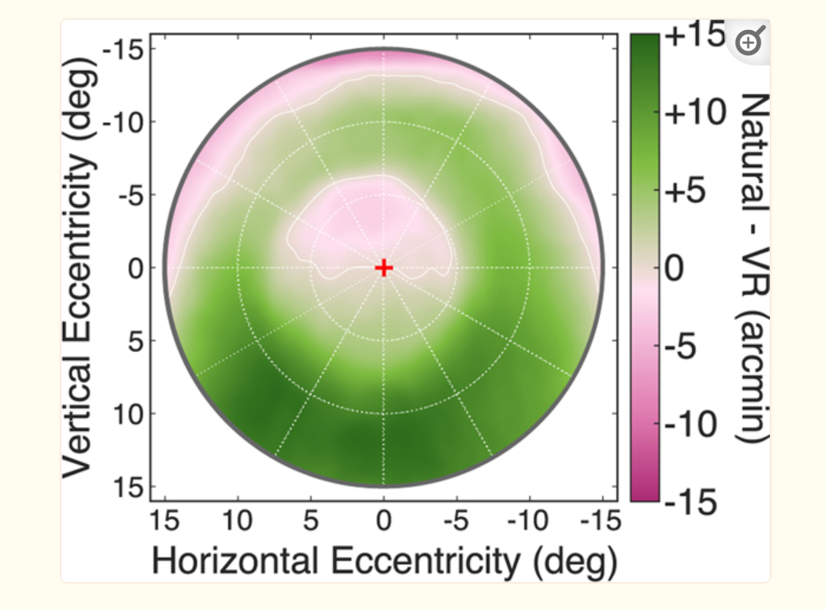
Disparity Differences Between Natural and VR
Plot Shows Natural Disparities Minus VR Disparities
VR lower field strong shift towards uncrossed
VR top to bottom does not match vertical horopter pitch
Left to right does not match horopter curvature
Conclusion:
  “We hypothesize that solving the binocular correspondence problem, obtaining fusion, achieving precise stereo vision, and making accurate vergence during saccadic eye movements are compromised in the VR-gaming environment.”
Avi M. Aizenman, George A. Koulieris, Agostino Gibaldi, Vibhor Sehgal, Dennis M. Levi, and Martin S. Banks. 2023. The Statistics of Eye Movements and Binocular Disparities during VR Gaming: Implications for Headset Design. ACM Trans. Graph. 42, 1, Article 7 (January 2023), 15 pages. https://doi.org/10.1145/3549529 PMC Copyright notice This work is licensed under a Creative Commons Attribution International 4.0 License
Systematic Mismatches Complicate Binocular Correspondence

Slide 44
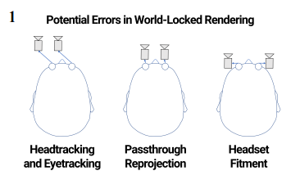
HWD Alignment
Alignment to human
  Head tracking
  Eye tracking
  Reprojecting passthrough camera
  Headset fitment and maintenance
Human IPD mismatch HWD IOD
  Inter Pupillary Distance
  Inter Ocular Distance
  “Virtual Reality is Sexist: But It Does Not Have to Be”, Stanney, Fidopiastis, Foster (Jan 2020) → IPD misfit dominates all other factors
  IPD/IOD mismatch drives stressful vergence movements
  Conventional display specifications limit oculomotor stressors
    Vergence, dipvergence, distortion
Phillip Guan, Eric Penner, Joel Hegland, Benjamin Letham, and Douglas Lanman. 2023. Perceptual Requirements for World-Locked Rendering in AR and VR. In SIGGRAPH Asia 2023 Conference Papers (SA Conference Papers ’23), December 12–15, 2023, Sydney, NSW, Australia. ACM, New York, NY, USA, 10 pages. https://doi.org/10.1145/3610548.3618134 https://creativecommons.org/licenses/by-nc-sa/4.0/
Misalignment Is Easy and Can Be Stressful

Slide 45
Stereoscopic Imaging Pipeline Creates Distortions
Original 3D Object → 2D Camera Image Pair → 2D Display Screen Projections → 3D Percept
Image Distortions in Stereoscopic Video Systems (1993) Woods, Andrew & Docherty, Tom & Koch, Rolf.
Misperceptions in Stereoscopic Displays: A Vision Science Perspective (2008) 2008 Held RT, Banks MS.
Instability of the perceived world while watching 3D stereoscopic imagery: A likely source of motion sickness symptoms (2014) Hwang AD, Peli E.
Correcting geometric distortions in stereoscopic 3D imaging (2018) Gao, Zhongpai & Hwang, Alex & Zhai, Guangtao & Peli, Eli.
Stereoscopic 3D geometric distortions analyzed from the viewer’s point of view (2020) Gao Z, Zhai G, Yang X.
Over 3 decades of studies showing inherent distortions in stereoscopic mathematics

Slide 46
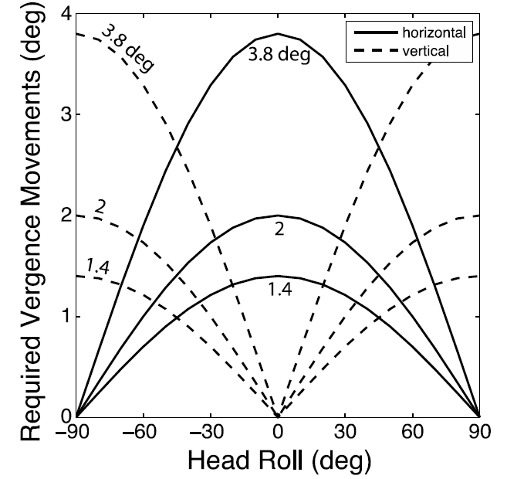
Observer Position Distortions
5DOF Offsets Distort vs. Ideal Viewing Position
Observer movement relative to screen can distort
Head translation – X, Y, and Z all distort
Head Rotation – yaw and roll distort
  Pitch does not distort—preserves fronto-parallel image
Roll is notably stressful
  Requires difficult vertical vergence movements
Head Worn Displays with accurate head tracking eliminate all these mismatches
  Plus motion parallax distortion
  Significant advantage of HWD vs. fixed screens for stereoscopic content
Kane D, Held RT, Banks MS. Visual Discomfort with Stereo 3D Displays when the Head is Not Upright. Proc SPIE Int Soc Opt Eng. 2012 Feb 9;8288:828814. doi: 10.1117/12.912204. PMID: 24058723; PMCID: PMC3777229. License ID: 1629755-1
Head Worn Displays Are Better than Free Standing Screens for Stereoscopic Viewing

Slide 47
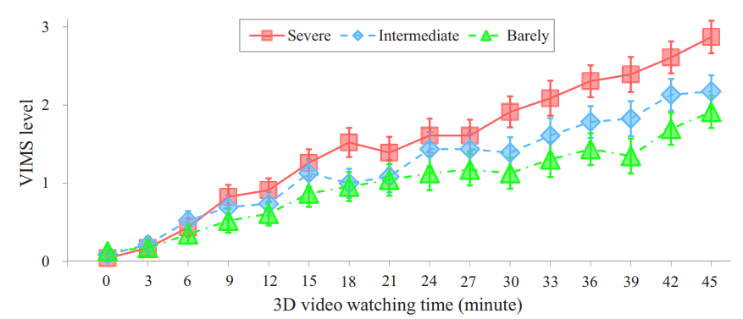
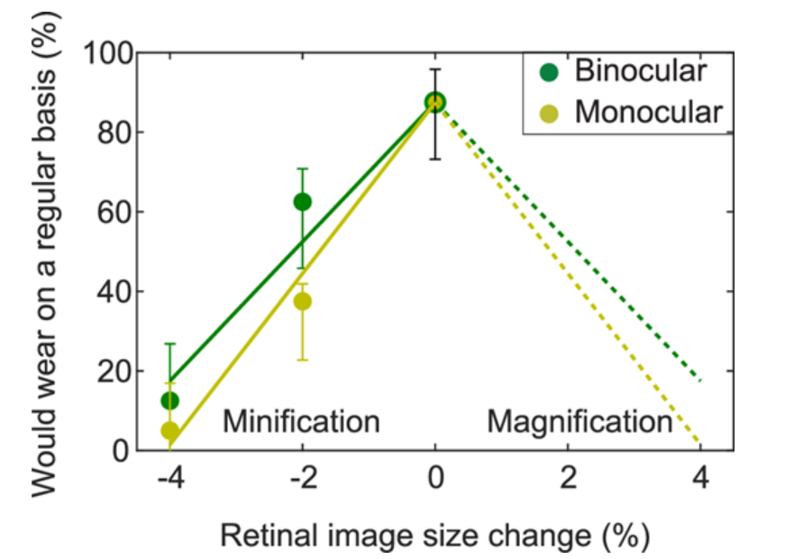
Image Distortion Can Be Nauseogenic
Persistent optical distortion
“Effect of spatial distortions in head-mounted displays on visually induced motion sickness” (Xia, et. Al, 2023)
“The contribution of image minification to discomfort experienced in wearable optics” (McLean et. Al, 2023)
  Retinal image—VOR mismatch
Other factors
HWD fitment
Provocative content
Stereoscopic mathematics
Perception studies of stereoscopic distortion are emerging
Xia, Zhang, Ma, Cheng, and Hu, "Effect of spatial distortions in head-mounted displays on visually induced motion sickness," Opt. Express 31, 1737-1754 (2023) Optica Open Access Publishing Agreement: Authors and readers may use, reuse, and build upon the article, or use it for text or data mining without asking prior permission from the publisher or the Author(s), as long as the purpose is non-commercial and appropriate attribution is maintained.
McLean IR, Erkelens IM, Sherbak EF, Mikkelsen LT, Sharma R, Cooper EA. The contribution of image minification to discomfort experienced in wearable optics. J Vis. 2023 Aug 1;23(8):10. doi: 10.1167/jov.23.8.10. PMID: 37552022; PMCID: PMC10414133. This work is licensed under a Creative Commons Attribution-NonCommercial-NoDerivatives 4.0 International License.
Perceptual Studies of Static and Dynamic Spatial Distortion Effects are Starting to Emerge

Slide 48
Summary of Phenomena
Five Interacting Clusters of Sensory Mismatch/Limitation of Human in HWD
Limited Field of View – Lack of Peripheral Vision
Differences in Virtual and Physical Head Pose – Increased Head Movement – Head Position Measurement – Latency
Visual-Vestibular Conflicts – VOR/Image Lag – False or Missing Motion and Visual Motion Cues
Vergence Accommodation Conflict – Altered Depth Perception – Unnatural Blur
Natural vs. Synthetic Binocular Stereoscopic Vision – Device Issues – Display and Human Alignment – Effect on Eye Movements – Stereoscopic Pipeline – Image Distortion

Slide 49
Applications of This Knowledge
Fundamental
Applied
Specifications
Framework for use

Slide 50
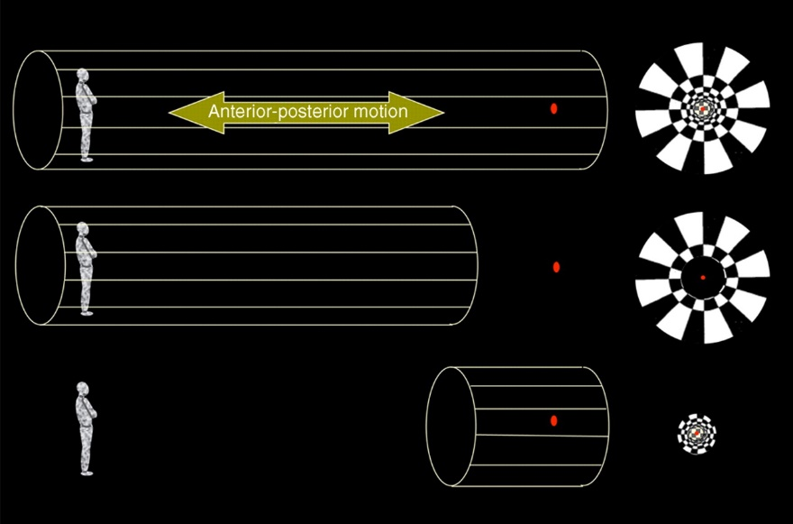
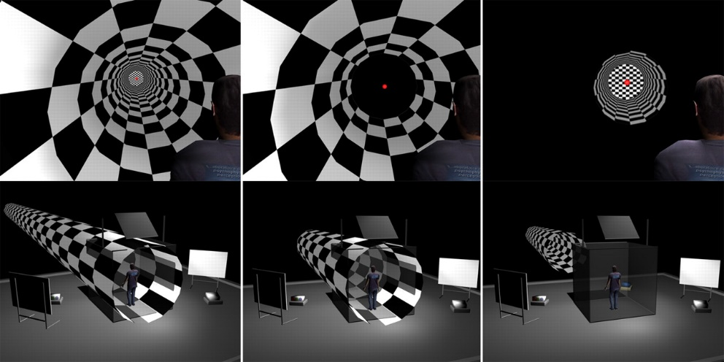
Peripheral Vision Revisited
Flight Simulation and Vision Science Definitions
Flight Simulation: +/- 60°-110° HFOV
2009 limited study of visually induced motion factors
  Dynamic peripheral optic flow stimulates
  Dynamic central vision does not stimulate
  Static images do not stimulate
  Experimental method
    Patterns: Central, peripheral, full field patterns
    Static and dynamic stimuli
    Varying dynamic frequency
  Central/Peripheral boundary between 7° and 15°
  Vision science literature has no consensus
  Did not study variation of effect in different peripheral regions
Does/how does peripheral VIM sensitivity vary with eccentricity?
Piponnier, J.<C., Hanssens, J.<M., & Faubert, J. (2009). Effect of visual field locus and oscillation frequencies on posture control in an ecological environment. Journal of Vision, 9(1):13, 1–10, http://journalofvision.org/9/1/13/, doi:10.1167/9.1.13. PMID: 19271883. License ID: 1629755-3
Old Study Provides Approximate Boundary For
Visually Induced Motion and Basis for Further Research

Slide 51
Why Does Reducing FOV in HWD Reduce Cybersickness?
Widespread observation
Conflicts with Flight Simulation Requirements
Hypothesis:
  Reducing FOV in HWD reduces region of exposure to image distortions providing mostly false visually induced motion cues.
Flight Simulation and Vision Science Communities Could Learn from Each Other

Slide 52
Additional Fundamental Research Questions
Peripheral Vision and Visually Induced Motion
An updated study quantifying peripheral vision and visually induced motion is needed
Do scene distortions induce VIM—stereoscopic and non-stereoscopic stimuli?
Vergence-Accommodation Tolerance Limits
Flight training provides a stress case for existing VAC understanding. Does Shibata (2011) need to be amended or updated for stereoscopic/non-stereoscopic mode switching?
Eye movements and oculomotor stress
Given that VR alters eye movements, what does eye tracking in VR tell us about eye movements in non-VR environments?
How do HWD effect oculomotor movements and stresses? Saccades?

Slide 53
Applied Research Questions
Effects of switching between stereoscopic and non-stereoscopic viewing
Cases
  Natural scenes
  Conventional simulator displays
  Head worn combined optic displays
Study questions
  Fluidity of user interaction (user responses, task switching)
  Ability to interact with/resolve near features (cockpit) and distant small targets
  Frequency, magnitude, and time to sickness effects
Include update of Oberhauser 2018
  What’s Real About Virtual Reality Flight Simulation? Comparing the Fidelity of a Virtual Reality with a Conventional Flight Simulation Environment
Impact of high-fidelity devices (low latency, high timing determinism, well coordinated cues)?
Task by task analyses: Effective, ineffective, or negative training?

Slide 54
Where Should the Screen Be for My Application?
Optical Distance to screen is one of most important specs for VR/MR headset
  Not included in VRcompare - The Internet's Largest VR & AR Headset Database !
Per application selection can make or break its acceptability
This table is based on actual devices and maximum tolerance range from Shibata
Screen Distance Meters | Screen Distance Diopters | +.5 VAC Limit Diopters | -.5 VAC Limit Diopters | +.5 VAC Limit Meters | -.5 VAC Limit Meters
0.65 | 1.54 | 2.04 | 1.04 | 0.49 | 0.96
0.85 | 1.18 | 1.68 | 0.68 | 0.60 | 1.48
1.15 | 0.87 | 1.37 | 0.37 | 0.73 | 2.71
1.30 | 0.77 | 1.27 | 0.27 | 0.79 | 3.71
1.50 | 0.67 | 1.17 | 0.17 | 0.86 | 6.00
1.80 | 0.56 | 1.06 | 0.06 | 0.95 | 18.00
2.00 | 0.50 | 1.00 | 0.00 | 1.00 | Infinite
Underappreciated Device Specification

Slide 55
“VR Is Dead” Success Case Attributes
Varjo documentary “VR Is Dead: Stories from Beyond the Metaverse” success cases all respect limits described in this work
  Automotive and architectural design—slow, user-controlled interaction in personal and action space
  Aeromedical emergency procedures—arms length physical interactions
  Command center—select from many video monitors at fixed distance
  Sand table—numerous users interacting from personal downlook perspectives over common digital 3D terrain
  OpenBCI—prototype biosensing system
  Amphibious vehicles—amphibious combat vehicle prototype and cargo ship—slow
  Flight—general simulation advantages in a small, configurable package
None challenge limits described here
  FOV
  Head position/latency
  Challenging motion and motion conflicts
  Varying depth, VAC, and binocular stereoscopic complex
Varjo Success Cases Corroborate this Analysis

Slide 56
Specifications Needed
Field of view—need consistent and accurate specifications and measurement methods
IPD calibration accuracy
Optical distortion metrics
  Vergence, dipvergence, distortion used in conventional large displays
Head position tracking accuracy and latency
All relevant motions to photon latency

Slide 57
Meaningful Differences Among HWD
Necessary features
IPD calibration
Optical correction compatibility
Differences
Optical distance of display screen
FOV
Engineering quality
  Accuracy/latency of headtracking and eyetracking
  Device ergonomics
  System integration factors
Quality of optics

Slide 58
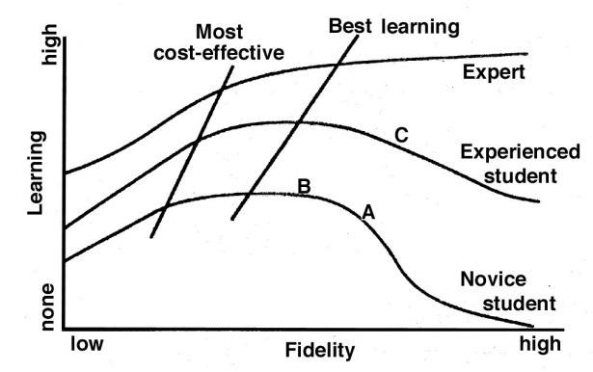
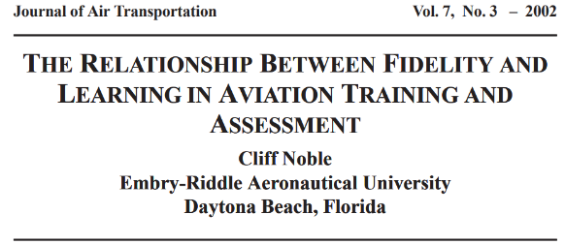
Role of Fidelity in Training
Noble, Cliff. “The Relationship between Fidelity and Learning in Aviation Training and Assessment.” Journal of Air Transportation, 2002. The Relationship Between Fidelity and Learning in Aviation Training and Assessment - NASA Technical Reports Server (NTRS). Copyright: Public Use Permitted.
Conceptual Model for a Total Training System

Slide 59
Framework for Using XR in the
Aviation Training Ecosystem
Commercial aviation Part Task and Task to Tool perspective is appropriate
Different training device levels
  Part task trainers
  Full simulators
Task/learning/assessment levels
  Generic / Representative / Specific
  Self Instruction / Aided Instruction
  Functional Fidelity / Functional and Physical Fidelity
  Training (T) / Testing & Checking (T&C)
Task to Tool Application
  This information should help make informed decisions about uses of HWD technology
  Consider safety and equity implications of sickness—beyond the scope of this work
  Sensory limitations → generally limited support for accurate/crisp/fluid physical interactions
  Fidelity limitations probably largely exclude Specific / Functional and Physical / T&C
Novice training/general orientation appears to be well proven
Task training to correctness, proficiency, and assessment will often be inadequate
HWD based devices have a fidelity ceiling due to sensory
limitations and sickness

Slide 60
Conclusion—Significance of This Work
Unique analysis, distillation, and synthesis of very large body of many-factor research that enables informed application
Virtual/Augmented/Mixed Reality field characterized by
  Massive investments – tens of billion$
  Cost, footprint, deployability are very appealing
  Numerous practical experiments in training, well publicized successes
  Persistent problems and limitations
Cybersickness is a powerful lens
  Indicates something is wrong
  Analysis of causes yields understanding of mechanisms
  Understanding of mechanisms enables smart questions about uses, problems, and limitations
  Smart questions provide short paths to lessons otherwise learned the long, hard way

Slide 61
Goals and Learning Objectives
List 5 clusters of sensory mismatch and limitation inherent to today's Extended Reality Devices
Describe 3 fundamental research questions that should be investigated based on these mechanisms
Describe 3 applied research questions whose efficacy should be evaluated based on the mechanisms of sensory limitation
Describe 5 specifications that should be defined for Extended Reality devices
Describe key technical differentiators among XR devices
Describe a framework facilitating incorporation of XR into the training ecosystem

Slide 62
References
Adriaanse, Nicholas. Cybersickness Considerations for Curricula using Virtual Reality Training Systems. I/ITSEC 2023 Conference.
S. Advani, “Optimization of Motion Cueing Parameters of Hawker 4000 and A320 Simulators by the International Development of Technology (IDT)”, Report Number IDT-R-14-01, Version No. 5, Issue Date 11 June 2014
Avi M. Aizenman, George A. Koulieris, Agostino Gibaldi, Vibhor Sehgal, Dennis M. Levi, and Martin S. Banks. 2023. The Statistics of Eye Movements and Binocular Disparities during VR Gaming: Implications for Headset Design. ACM Trans. Graph. 42, 1, Article 7 (January 2023)
Randall E. Bailey, J.J. (Trey) Arthur III, Steven P. Williams, and Lynda J. Kramer. Latency in Visionic Systems: Test Methods and Requirements. https://ntrs.nasa.gov/api/citations/20050192646/downloads/20050192646.pdf
Britton Z, Arshad Q. Vestibular and Multi-Sensory Influences Upon Self-Motion Perception and the Consequences for Human Behavior. Front Neurol. 2019 Mar 7;10:63. doi: 10.3389/fneur.2019.00063. PMID: 30899238; PMCID: PMC6416181.
Steven A. Cholewiak, Gordon D. Love, Pratul P. Srinivasan, Ren Ng, and Martin S. Banks. 2017. ChromaBlur: Rendering Chromatic Eye Aberration Improves Accommodation and Realism. ACM Trans. Graph. 36, 6, Article 210 (November 2017), 12 pages. DOI: 10.1145/3130800.3130815
Steven A. Cholewiak, Gordon D. Love, Martin S. Banks; Creating correct blur and its effect on accommodation. Journal of Vision 2018;18(9):1. https://doi.org/10.1167/18.9.1

Slide 63
References
Cooper, Emily. (2023). The Perceptual Science of Augmented Reality. Annual Review of Vision Science. 9.10.1146/annurev-vision-111022-123758.
Gao Z, Hwang A, Zhai G, Peli E. Correcting geometric distortions in stereoscopic 3D imaging. PLoS One. 2018 Oct 8;13(10):e0205032. doi: 10.1371/journal.pone.0205032. PMID: 30296289; PMCID: PMC6175294.
Gao Z, Zhai G, Yang X (2020) Stereoscopic 3D geometric distortions analyzed from the viewer’s point of view. PLoS ONE 15(10): e0240661. https://doi.org/10.1371/journal.pone.0240661
Timothy J. Gawne and Martin S. Banks The Role of Chromatic Aberration in Vision. Vol. 10:199-212 (Volume publication date September 2024) https://doi.org/10.1146/annurev-vision-101222-052228
Gibaldi, A. et al. The Active Side of Stereopsis: Fixation Strategy and Adaptation to Natural Environments. Sci. Rep. 7, 44800; doi: 10.1038/srep44800 (2017).
Phillip Guan, Eric Penner, Joel Hegland, Benjamin Letham, and Douglas Lanman. 2023. Perceptual Requirements for World-Locked Rendering in AR and VR. In SIGGRAPH Asia 2023 Conference Papers (SA Conference Papers ’23), December 12–15, 2023, Sydney, NSW, Australia. ACM, New York, NY, USA
Held RT, Banks MS. Misperceptions in Stereoscopic Displays: A Vision Science Perspective. ACM Trans Graph. 2008 Jan 1;2008:23-32. doi: 10.1145/1394281.1394285. PMID: 24683290; PMCID: PMC3966488.
Held RT, Cooper EA, Banks MS. Blur and disparity are complementary cues to depth. Curr Biol. 2012 Mar 6;22(5):426-31. doi: 10.1016/j.cub.2012.01.033. Epub 2012 Feb 9. PMID: 22326024; PMCID: PMC3298574.

Slide 64
References
David M. Hoffman, Ahna R. Girshick, Kurt Akeley, Martin S. Banks; Vergence–accommodation conflicts hinder visual performance and cause visual fatigue. Journal of Vision 2008;8(3):33. https://doi.org/10.1167/8.3.33.
Hussain, R.; Chessa, M.; Solari, F. Mitigating Cybersickness in Virtual Reality Systems through Foveated Depth-of-Field Blur. Sensors 2021, 21, 4006. https://doi.org/10.3390/s21124006
Hwang AD, Peli E. Instability of the perceived world while watching 3D stereoscopic imagery: A likely source of motion sickness symptoms. Iperception. 2014 Oct 7;5(6):515-35. doi: 10.1068/i0647. PMID: 26034562; PMCID: PMC4441027.
Kane D, Held RT, Banks MS. Visual Discomfort with Stereo 3D Displays when the Head is Not Upright. Proc SPIE Int Soc Opt Eng. 2012 Feb 9;8288:828814. doi: 10.1117/12.912204. PMID: 24058723; PMCID: PMC3777229.
Keshavarz, Behrang, Haycock, Bruce. Motion Sickness in Virtual Environments: Theory and Practical Considerations. I/ITSEC 2024 Conference.
Kim J, Kane D, Banks MS. The rate of change of vergence-accommodation conflict affects visual discomfort. Vision Res. 2014 Dec;105:159-65. doi: 10.1016/j.visres.2014.10.021. Epub 2014 Oct 28. PMID: 25448713; PMCID: PMC4294985.
Bernard C. Kress, "Digital optical elements and technologies (EDO19): applications to AR/VR/MR," Proc. SPIE 11062, Digital Optical Technologies 2019, 1106222 (30 July 2019); https://doi.org/10.1117/12.2544404.
McLean IR, Erkelens IM, Sherbak EF, Mikkelsen LT, Sharma R, Cooper EA. The contribution of image minification to discomfort experienced in wearable optics. J Vis. 2023 Aug 1;23(8):10. doi: 10.1167/jov.23.8.10. PMID: 37552022; PMCID: PMC10414133.

Slide 65
References
Noble, Cliff. “The Relationship between Fidelity and Learning in Aviation Training and Assessment.” Journal of Air Transportation, 2002.
Oberhauser, M., Dreyer, D., Braunstingl, R., & Koglbauer, I. (2018). What’s real about virtual reality flight simulation? Comparing the fidelity of a virtual reality with a conventional flight simulation environment. Aviation Psychology and Applied Human Factors, 8(1), 22–34. https://doi.org/10.1027/2192-0923/a000134
Oh H, Son W. Cybersickness and Its Severity Arising from Virtual Reality Content: A Comprehensive Study. Sensors (Basel). 2022 Feb 9;22(4):1314. doi: 10.3390/s22041314. PMID: 35214216; PMCID: PMC8963115.
Palmisano, Allison, Robert, Juno “Cybersickness in Head-Mounted Displays is caused by differences in the User’s Virtual and Physical Head Pose (2020). Frontiers in Virtual Reality, Vol. 1
Pielage H, Zekveld AA, van de Ven S, Kramer SE, Naber M. The pupil near response is short lasting and intact in virtual reality head mounted displays. J Eye Mov Res. 2023 Mar 27;15(3):10.16910/jemr.15.3.6. doi: 10.16910/jemr.15.3.6. PMID: 37162795; PMCID: PMC10164449.
Piponnier, J.C., Hanssens, J.M., & Faubert, J. (2009). Effect of visual field locus and oscillation frequencies on posture control in an ecological environment. Journal of Vision, 9(1):13, 1–10, http://journalofvision.org/9/1/13/, doi:10.1167/9.1.13. PMID: 19271883.
Takashi Shibata, Joohwan Kim, David M. Hoffman, Martin S. Banks; The zone of comfort: Predicting visual discomfort with stereo displays. Journal of Vision 2011;11(8):11. https://doi.org/10.1167/11.8.11.

Slide 66
References
Spiegel DP, Erkelens IM. Vergence-accommodation conflict increases time to focus in augmented reality. J Soc Inf Display. 2024; 32(5): 194–205. https://doi.org/10.1002/jsid.1283
Stanney K, Fidopiastis C, Foster L. Virtual Reality Is Sexist: But It Does Not Have to Be. Front Robot AI. 2020 Jan 31;7:4. doi: 10.3389/frobt.2020.00004. PMID: 33501173; PMCID: PMC7805626.
Stanney, K., Lawson, B. D., Rokers, B., Dennison, M., Fidopiastis, C., Stoffregen, T., … Fulvio, J. M. (2020). Identifying Causes of and Solutions for Cybersickness in Immersive Technology: Reformulation of a Research and Development Agenda. International Journal of Human–Computer Interaction, 36(19), 1783–1803. https://doi.org/10.1080/10447318.2020.1828535
Stanney, Kay; Hughes, Claire; McDowell, Perry; Adriaanse, Nicholas. Mitigation and Management of Minimize Cybersickness in the Design and Implementation of Learning Systems with Virtual Environments. I/ITSEC 2024 Conference.
Depth Perception, Cueing, and Control, Barbara T. Sweet and Mary K. Kaiser, NASA Ames Research Center, Moffit Field CA; AAIA Modeling and Simulation Technologies Conference 08-11 August 2011.
Stauffert J-P, Niebling F and Latoschik ME (2020) Latency and Cybersickness: Impact, Causes, and Measures. A Review. Front. Virtual Real. 1:582204. doi: 10.3389/frvir.2020.582204
VRcompare - The Internet's Largest VR & AR Headset Database
VR IS DEAD - Stories Beyond The Metaverse – Varjo.com

Slide 67
Vater C, Wolfe B, Rosenholtz R. Peripheral vision in real-world tasks: A systematic review. Psychon Bull Rev. 2022 Oct;29(5):1531-1557. doi: 10.3758/s13423-022-02117-w. Epub 2022 May 17. PMID: 35581490; PMCID: PMC9568462.
Andrew J. Woods, Tom Docherty, Rolf Koch, "Image distortions in stereoscopic video systems," Proc. SPIE 1915, Stereoscopic Displays and Applications IV, (23 September 1993); https://doi.org/10.1117/12.157041
Xia, Zhang, Ma, Cheng, and Hu, "Effect of spatial distortions in head-mounted displays on visually induced motion sickness," Opt. Express 31, 1737-1754 (2023)

