Slide 1
Exercises and Experiments
How They Can Play in Campaigns of Learning
S K Numrich, PhD, CMSP
Institute for Defense Analyses (IDA)

Slide 2

Why Experimentation?
“Joint experimentation,
which incorporates wargaming, modeling, and simulation,
is vital to the validation of concepts introduced in the JWC” (Joint Warfighting Concept)
“Experimentation is the crucible where ideas are tested and refined. It provides immediate feedback for concept improvement, rapid acquisition opportunities, and additional venues to collaborate rapidly with industry and allies and partners”
Admiral Christopher W. Grady, “Sharpening Our Competitive Edge,” Joint Force Quarterly 111, 4th Quarter 2023,

Slide 3
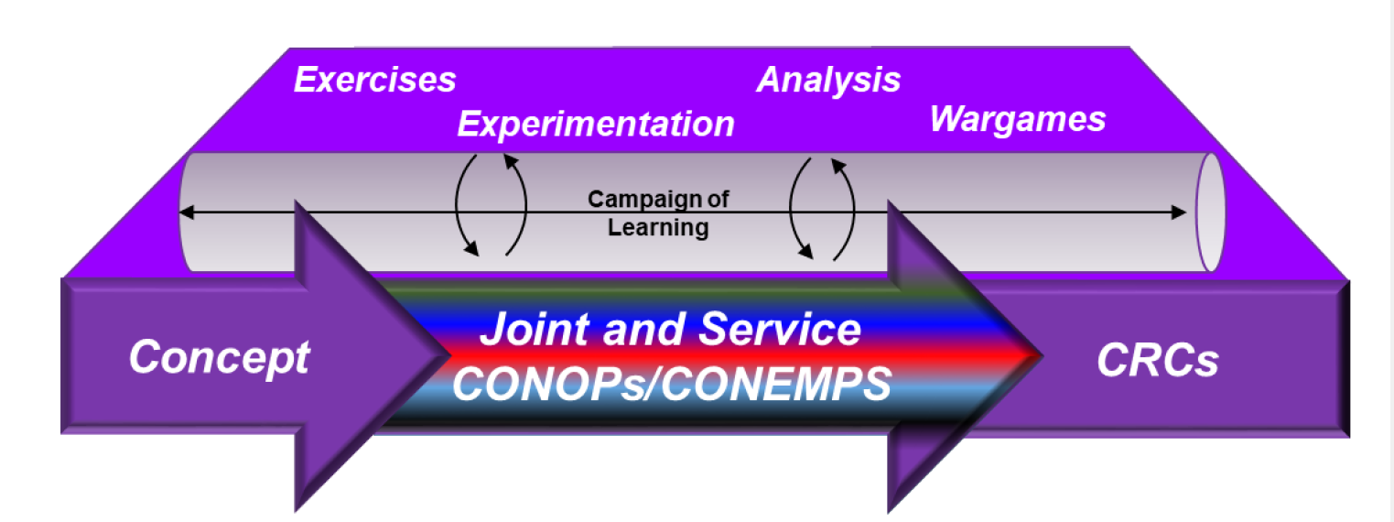
Campaign of Learning
CONOPS: concepts of operation CONEMPS: concepts of employment
CRC: concept-required capabilities
Pathway to Implementing Innovation
This tutorial will put forward a methodology developed in 2021 and used successfully since then to put the collection of the above pieces into an ordered methodology
The methodology uses multiple techniques and borrows heavily from training and exercises
IMPLEMENTING JOINT FORCE DEVELOPMENT AND DESIGN
CJCSI 3030.01A 3 October 2022

Slide 4
Focus
Experimentation as a campaign culminating in Large Scale Exercises (LSE as part of Service and Joint training)
Experimentation campaign as a methodology that can be used in multiple contexts
Concept development and refinement
Exploration of an innovation for its military utility
Prepare an innovation for the “acid” tests in Test and Evaluation (T&E), Doctrine and Tactics, Techniques, and Procedures (TTPs), Development of Leadership and training
Campaign of Learning in implementing the Joint Warfighting Concept
This presentation with focus on the development of ideas and innovations

Slide 5

Learning Objectives
What should you be able to do at the end of
the tutorial?
Define the terms exercise and experiment and discuss the differences between them
Explain how to use feedback in an experimentation campaign and why it is particularly important in campaign of learning
Describe what techniques one can use to mitigate bias in a campaign of learning
Imagine what techniques one could use to make force development and design more agile and responsive

Slide 6
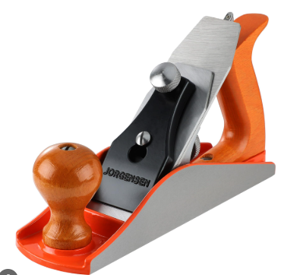
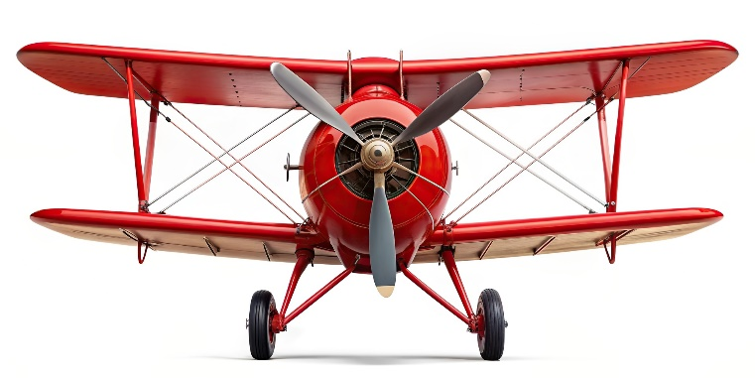
Let’s Consider a Plane
Definitions are IMPORTANT
Especially when we think we all know what we are talking about
So, let’s get on the same wavelength with some basic definitions

Slide 7
Exercises
Dictionary Definition
a process or activity carried out for a specific purpose, especially one concerned with a specified area or skill
Let’s get a bit more specific
A military maneuver or simulated wartime operation involving planning, preparation, and execution that is carried out for the purpose of training and evaluation (JP 3-0), readiness, or rehearsal
Training exercises focus on proficiency in executing current doctrine, using current organizations and equipment.
Please Note!
The purpose of training exercises is NOT whether it is the right doctrine, or the right organization, or the right equipment, but proficiency with it as is
Measurement is on the proficiency of the individual or team
This tutorial will work through what changes need to be made to Large Scale Exercises before they can be profitably used in an experimentation of learning

Slide 8
Experiments
Dictionary Definition
An operation or procedure carried out under controlled conditions in order to discover an unknown effect or law, to test or establish a hypothesis, or to illustrate a known law
How DoD uses Experimentation
Discovery experiments involve introducing novel systems, concepts, organizational structures, technologies, or other elements … to find out whether the innovation appears to have military utility
Hypothesis testing experiments are the classic type used by scholars to advance knowledge by seeking to falsify specific hypotheses (specifically if…then statement) or discover limiting conditions
Technology demonstrations used to show operational organizations that some innovation can, under carefully orchestrated conditions, improve the efficiency, effectiveness, or speed of a military activity.

Slide 9
Campaign
Dictionary Definition
a series of military operations intended to achieve a particular objective, confined to a particular area, or involving a specified type of fighting
A bit more specific
a series of interconnected military operations, or a large-scale military project, designed to achieve specific strategic objectives. It's a distinct phase of a war or conflict, often focused on a particular geographic area or goal.
It encompasses planning, coordination, and execution of military actions
Why are we interested?
The DoD can use the three types of experimentation (hypothesis testing, discovery experimentation, and technology demonstrations} in sequence as a campaign to define and mature potential solutions to military problems
Both solutions and parts of the methodology (red teaming, blue teaming, recursion) can be handed to mission-focused communities, but it is best if those same communities play in the concept refinement that will be the focus of this tutorial

Slide 10
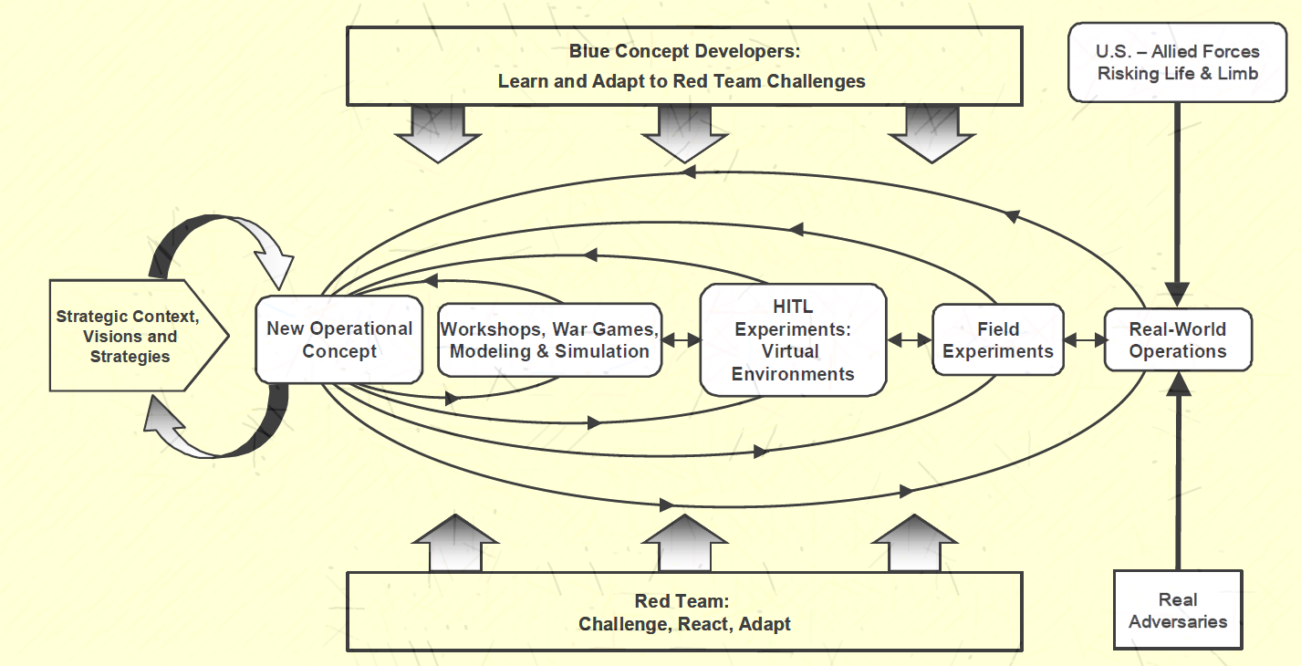
What Does a Campaign of Learning Look Like
This is where the now robust concept or prototype is handed over to the appropriate organizations
HITL: Human in the Loop
Demonstration
Types of Experiments
Hypothesis Testing
Discovery

Slide 11
Three Ingredients for Successful Experimentation
Recursion: the way we learn and improve
It is recursive throughout with each step providing feedback for refining the concept
RED and BLUE Teaming: (help remove bias)
RED: Throughout the process the RED Team is active, providing adversary reactions and adaptations in the face of the new operational concept
BLUE: the BLUE Team modifies the concept in response to the RED Team’s challenges, thus delivering a response to the adaptive adversary
Failure:
Experimentation as a process based on discovery differs from other military activities in its purpose, the means to obtain results, and its tolerance of and even invitation to failure

Slide 12
Evolution of Experimentation
Three Examples
One from wartime necessity: Louisiana Maneuvers
Focused on an operational problem
Repeated approaches learned from Adversary Response
But failure in the end was not an option – robust solutions needed to face German Panzers
One from peacetime exploration of force structure : Future Joint Force 1
Focused on one mission in the process of evolving the Joint Force
Refined and employed the complete process in the complicated diagram in slide 7
Used LVC capabilities with the training community throughout
One exploration of new way of executing a Mission: Close Air Support (CAS)
What kept the leaders up at night: How to execute CAS in the absence of the A10
Focused on one concept
Ended with a much modified concept and a design for new equipment

Slide 13
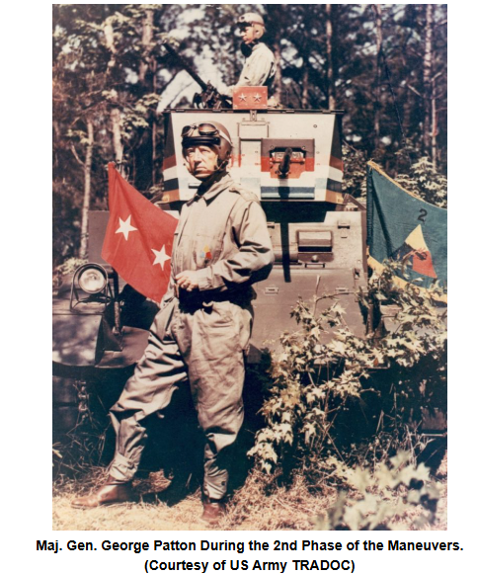
Louisiana Maneuvers
An early use of exercises in experimentation
Back in 1941, the Army did something extreme:
it tested its Doctrine*
Louisiana Maneuvers highlight the importance of new ways of thinking and far-reaching structural reform when facing formidable peer competitors and rapid alterations in the combat landscape**
*By Angry Staff Officer, “It’s Time forAnother Louisiana Maneuvers,” 2016 https://angrystaffofficer.com/2016/04/01/its-time-for-another-louisiana-maneuvers/
**Mcardle, Jennifer, . “Simulating War: Three Enduring Lessons from the Louisiana Maneuvers.” War On the Rocks, Washington, D.C., March 17, 2021. https://warontherocks.com/2021/03/simulating-war-three-enduring-lessons-from-the-louisiana-maneuvers/
*** Illustration: Brown, Kevin, “The Louisiana Maneuvers of 1941”, National Guard Educational Foundation, https://www.ngef.org/the-louisiana-maneuvers-of-1941/#:~:text=The%20Louisiana%20Maneuvers%20were%20so,a%20master%20of%20maneuver%20warfare.

Slide 14
Louisiana Maneuvers (1)
General Headquarters (GHQ) Maneuvers (Louisiana Maneuvers for short)
Four Army field Exercises (Recursion – One Focus)
1940 Louisiana Maneuvers 1941 Tennessee Maneuvers,
1941 Louisiana Maneuvers 1941 Carolina Maneuvers
What keeps the Generals up at night?
Likely to enter war with two peer adversaries – resulted in the need to:
Transform from positional warfare to mechanized and aerial warfare (WWI-WWII)
Test and refine emerging concepts
Identify leadership capable of new warfighting with new concepts
Train and assess newly formed units
When Senator Henry Cabot Lodge complained to General Marshall that soldiers and leaders were making numerous, grievous mistakes during the exercises, General Marshall replied that was the point. He wanted them to make those mistakes in training rather than combat.* (Failure)
*McCradel, Jennifer. “Simulating War: Three Enduring Lessons from the Louisiana Maneuvers.” War On the Rocks, Washington, D.C., March 17, 2021. https://warontherocks.com/2021/03/simulating-war-three-enduring-lessons-from-the-louisiana-maneuvers/.

Slide 15
Louisiana Maneuvers (2)
GHQ Maneuvers were characterized by:
A train up period would focus on deficiencies identified in previous exercises as well as new concepts and capabilities (Recursion)
A large group of trained umpires moderated the battle from large units to individual crews and vehicles*
Questions requiring resolution:
Armor doctrine, anti-tank capabilities, division organization, air-ground integration
Experimentation Methodology
Extended train up period for participating “armies”
placed those field armies into full-scale, intensive exercises that stressed the concepts they were considering (limited RED Teaming)
Afterwards, they evaluated the outcomes, scraped or changed things that did not work, and re-ran the exercises, creating a rapid, full-scale cycle of experimentation and improvement.(feedback and feed forward – Recursion)
*See General Headquarters, U.S. Army. Umpire Manual. Washington, D.C.: General Headquarters, U.S. Army, 1941, for a specific discussion of umpire duties and allocations

Slide 16
Louisiana Maneuvers (3)
Louisiana Maneuvers ended 3 days before Pearl Harbor
They did not get everything right but they are deemed a success for what they learned and accomplished through their experimentation
Outcomes from the Experimentation** (What did they learn?)
In the 16 months, Army leaders had grown the Army an order of magnitude while simultaneously working the transformation for the demands of mechanized warfare
Army re-designed the armor divisions around two “combat commands” that were armor-heavy, all arms formations, This structure and the combined arms approach proved successful and enduring: many Army heavy brigades trace their lineage back to these units*
Recognized the importance of and developed air – land coordination
Helped Army leadership to spot talent and encourage the departure of those unable to function with the evolving concepts
*Gabel, C. R., U.S Army Ghq Maneuvers of 1941, United States Army, Center of Military History, January 1991, Washington, D.C. ISBN-13
**Hunter, L, et al., “Military Exercise Case Studies from Periods of Great Power Competition: Insights Related How Exercises Can Contribute to Concept Development and Strategic Messaging, IDA Report in progress

Slide 17
Louisiana Maneuvers Take-aways
Their methodology embraced recursion, experiencing and learning from failure, and a modicum of RED Teaming
Although training was involved, experimentation was the driver (something we don’t often do today – training is nearly always the driver)
Training exercises are not the ideal venue for experimentation – we will look at this more closely later but,
The first two experiments were less productive than Louisiana 1941 and Carolina 1941 because they followed the approach of training with the static scenarios essential in training for testing performance, but not adequate for experimentation which needs free play and agile RED and BLUE teaming
Concept evolution was possible because of the feedback – feed forward that was built into the train up process, made possible by a series of LSEs, a campaign
Presence of umpires to collect and assess data provided much of the feedback and enabled concept refinement
Anyone heard of combined arms and close air support?

Slide 18
Remember
An innovation or new concept can be
Restructuring the force
Developing new Tactics, Techniques, and Procedures (TTPs)
Challenge leaders in a variety of ways
Conceive of, Design,Test and Integrate a prototype of a new piece of equipment
While we tend to think of innovation in terms of equipment, the Louisiana Maneuvers
Restructured the force
Developed new TTPs (combined arms, close air support)
Challenged new leaders to work with the TTPs and restructured force to find the leaders of tomorrow

Slide 19

Enter the Time Warp
That’s all fine, but where’s the simulation?
Joint Future Force Experiment
Louisiana Maneuvers were Large Scale Exercises (LSE) and in the simulation world would be called Live Simulation.
Warp forward 60 years and we now have simulations and tools not imagined in 1941.
Before we meet the Future Joint Force 1** experiment, let’s look at some of those tools and where they are used in an experimentation campaign
2001
1941
*<a href="https://www.vecteezy.com/free-vector/time-warp">Time Warp Vectors by Vecteezy</a>
.
**Budge, L, et al., “Future Joint Force 1 Experiment: Final Report,” IDA Paper P-3738, October 2022 (CUI)

Slide 20
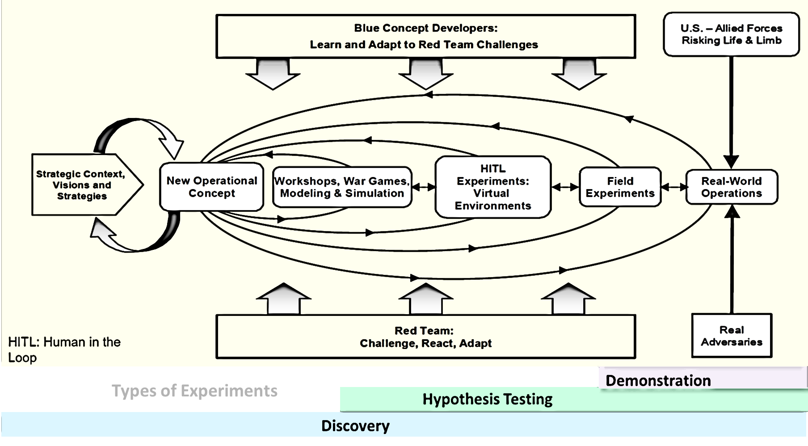
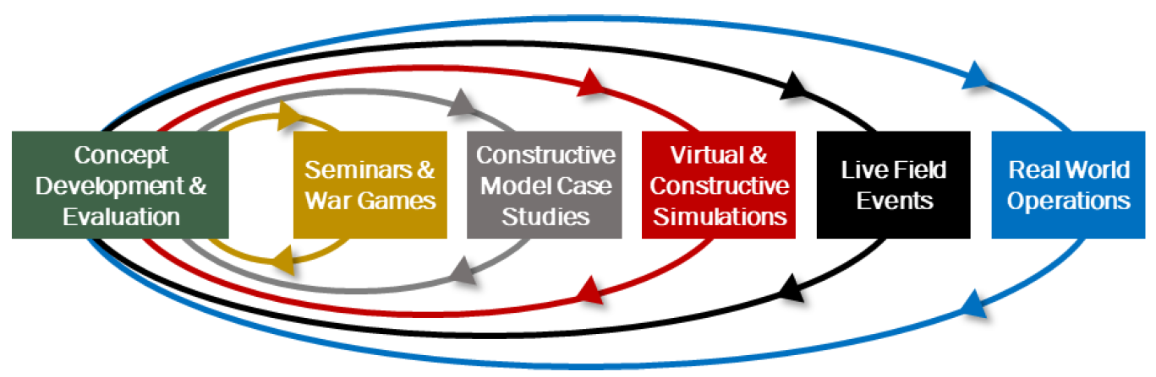
Tools and Their Fit
Recall the flow of an experimentation campaign – you will see it again as we move forward in our explorations
Below the campaign is an illustration of some of the tools we now have in crafting a campaign – they are aligned with the steps in the campaign and are, like the campaign, recursive.
Let’s take a closer look at the tools

Slide 21

Enter Human Ingenuity
Gedanken Experiments (Thought) – Strategy Level
Oft referred to as a BOGSAT – Bunch of Guys Sitting Around a Table
A good starting point if you have the “right” guys
Intensely committed to solving the problem
Representing most critical factors including social and legal
Product: one or more ideas or early concepts
Seminars are really organized, structured BOGSATs
Knowledgeable presenters willing to be challenged
Planned and well-structured data collection for analysis
Product: more refined, structured concepts
Wargames – Operational Level
Many ways to do wargames
All begin with raw concepts and “fight” them into potential solutions
Ingredients
Human ingenuity
Experience
Observations
History
Nuance
Argument
Not detailed physics
In comparison to large scale exercises, these are low-cost options that can produce more robust operational concepts – but we are not finished

Slide 22

Now Add the Functional Environment
I recall being on a technical board for an organization trying to field rapidly all kinds of devices for the wars in Iraq and Afghanistan. They had a proposal they thought would solve many issues. All board members looked at each other in consternation. We responded in unison, “but it defies the laws of physics.”
Constructive Models provide insight (data for analysis)
Data is entered into a computer computation and the computer outputs the result.
The computation generally runs faster than real time and can accommodate own and threat models
The user can run the model through a number of scenarios and over a long period (days, weeks, even longer) repeatedly to create a statistical ensemble of results
Engineering level models address the question of will it work
Engagement and Mission level models explore how it functions against the enemy in operational environments
Theater models look at its value in overall combat
Results go back to the wargamers and concept developers to refine the concept before it goes forward
The operational environment is complicated and even the best of us can hold only so much in our minds at once.
Simulations can provide a way of looking at the complexity of the problem from
The engineering level (does it defy the laws of physics)
To the operational environment with the stress of enemy counter operations all in the presence of the natural environment
Remember: All models are wrong, some are useful.

Slide 23
Review
Thought Experiments, BOGSATs, Seminars, and Wargames apply human ingenuity to a problem to develop concepts for addressing the problem
Concepts may involve force structure of TTPs
Concepts may also involve changes to existing equipment or new equipment
Constructive Simulations
Take the concept and place is in an environment to explore the concepts further
Results of the constructive simulations feed back to the wargamers and concept developers, giving them additional input for refining the concepts
But what about the end user – how will s/he interact with the innovation?
The quick answer is -- never the way we expect
Ingenuity resides with the end user as with the concept developer and you don’t know how the user will react until you see it
Enter live, virtual, constructive (LVC) simulations ( we see LVC in training exercises, but different data collection from that needed for experiments)

Slide 24
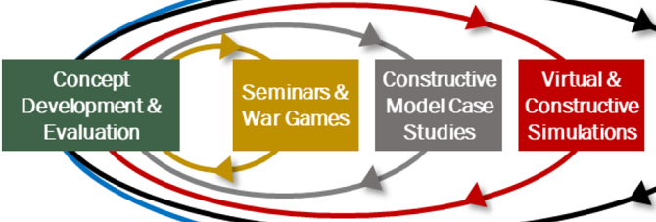
And the Interacting Human
Interaction can be provided in two ways:
Human-in-the-Loop (HITL) or
Live, Virtual, Constructive (LVC)
Both types of interaction are enabled by distributed simulation architectures
HITL Human-in-the-Loop simulations:
A virtual environment is provided by simulated entities and humans are permitted to interact in lieu of a simulated entity.
HITL simulations are real-time simulations with a great degree of human-machine interaction in which military participants receive real-time inputs from the simulation, make real-time decisions, and direct simulated forces or platforms against simulated threat forces.
LVC Simulations are like HITL simulations except that they also accommodate interaction with equipment or live forces (hardware and/or human respectively)
HITL and LVC simulations
Reflect warfighting decision-making better than constructive simulations and analytic wargames
Allow the warfighter to work with new TTPs, force structure, or equipment, but
Due to human involvement, they also introduce variability, making significant changes in results more difficult to detect and cause and effect relationships more difficult to determine.

Slide 25
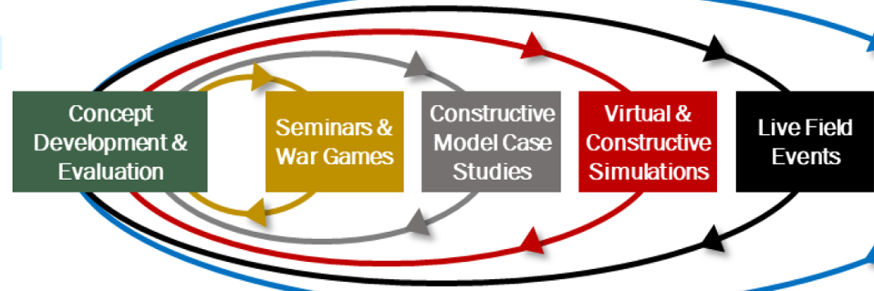
Large Scale Exercises (LSE)
Large Scale Exercise are the final step before operational employment
LSEs bring together a substantial Joint force
LVC capabilities may play, but the primary players are real platforms, systems, and weapons
LSEs are the acid test that pushes the innovation and records it’s inadequacies as well as its benefits
LSEs are expensive
Just the cost of fuel for the aircraft, ships, and land vehicles is prohibitive unless the LSE is combined with or can be used in lieu of a scheduled training exercise
However, the needs of an experiment differ from those of a training exercise
Training events are scheduled well in advance and have their own Title 10 objectives, but one would like experimentation to be agile, responsive and timely
Experimentation vs Training
Training exercises focus on proficiency in executing current doctrine, using current organizations and equipment
Experimentation seeks outcomes such as driving a concept to failure that would be unacceptable in a demonstration or training
Scenarios in experiments feature free play, training scenarios are scripted (note the van Ryper event)
Data collected in training measures warfighter performance and training sites most often DO NOT release their data
Data needed for experiments measures adequacy of an innovation

Slide 26
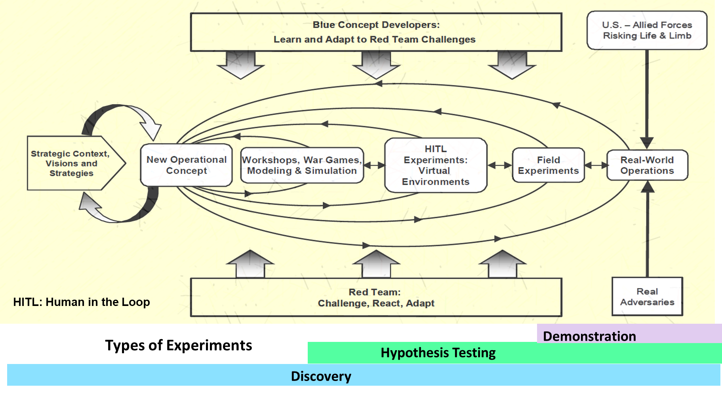
Why Use This Method
We often hear the adage: “Fail early, fail often”
It indicates a process of triage, done repeatedly, to save the best and let the poorer go
The recursion and constant challenge by RED and BLUE teams performs a type of triage
Least expensive methods are used first
Only the best concepts survive to go to field experiments, LSE, most expensive, lease controllable
Learning occurs at every stage
Experiments are disciplined processes with data collection used for analysis and stored in such a way that others can use it – that implies some type of data model
Experiments are not usable unless they are repeatable and that translates into anything the passes muster in a military exercise must behave reliably in actual use – be it concept, force structure, TTPs or equipment

Slide 27
Now – The Method With Tools Applied
Future Joint Force 1
Tools used in the steps of the process are detailed:
Not because we don’t use them, but
Because we fail to use them in a single, focused method
As a consequence, the results from wargames and simulations go unconnected
Future Joint Force 1 uses tools in sequence effectively

Slide 28
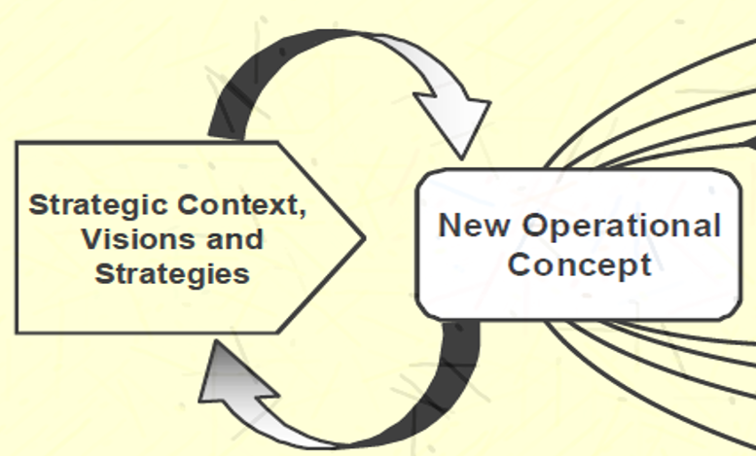
Future Joint Force Experimant 1 (FJF 1)
It’s 2001, and the focus was the whole joint force
Joint Forces Command (JFCOM), Defence Advanced Research Projects Agency (DARPA), and Army Training and Doctrine Command (TRADOC) with the help of the Defense Science Board (DSB) were exploring operational concepts and the organization of the Future Joint Force (FJF)
JFCOM and DARPA tasked the Institute for Defense Analyses (IDA) to conduct and experimentation campaign to explore, test, and refine the concepts for the FJF
IDA engaged a team, the Joint Advanced Warfighting Project (JAWP) as a concept development team responsible for the development of the FJF throughout the experimentation campaign
The JAWP Team began exploring the FJF concept through a series of seminars and wargames
Sensor and weapons experts were brought to the concept development team to help determine current and future technical capabilities
2001
1941
The goal of FJF 1: Explore C2ISR for a future ground force in a joint battle space

Slide 29
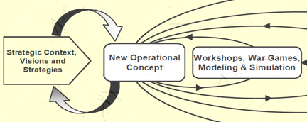
From Seminar to Constructive Simulation
The concept: A light, highly mobile force possessing a significant advantage in situational understanding can be successful over a capable opponent
Why conduct seminars and wargames
Make sure there are no “show stoppers” in the concepts
Determine that the technologies needed are realistic for the time frame under consideration
Results of the seminars and three wargames
Control of ground sensors by headquarters was passed down to cells composed of manned Reconnaissance, Surveillance, and Target Acquisition (RSTA) ground vehicles
Organic Air Vehicles added to the ground RSTA robots
RAND took the results of the seminars and wargames and
Conducted a series of trials using a constructive simulation to “validate” the
New organization
Capabilities of the cells against large RED armored forces
Results
No significant changes to the concept – need for more ground robots and UAVs
Resulting analyses were used to further refine capabilities to be explored in the HITL phase
Kicked off an operational-level seminar wargame to examine potential operational issues

Slide 30
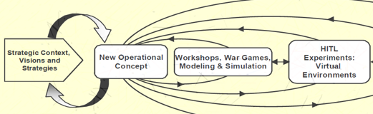

Enter Networked HITL Trials
HITL simulations allow RED and BLUE commands and systems to fight in a free play context within a virtual environment
Four one-week trials explored, each exploring different scenarios
Allowed multiple locations including those with instrumented systems to participate
A Data Collection and Assessment Team assessed Command and Control throughout the BLUE force
Observed performance of individual players
Assess players ability to execute the concept
Added data collection with surveys and questionnaires to complement Assessment Team
HITL simulation recorded entity play and effects
Results
Information displays and standards of information relevancy, accuracy and latency were inadequate
Future warfighters will require a broader skill set, more experience, and specialized training
Experience in the HITL experiment pointed to areas for future exploration

Slide 31
Take-aways from FJF 1
The overall methodology and interplay of seminars, wargames, constructive simulations stressed and tested concepts
Data from all tools were accessible – no training sites were used to collect data
Field Experiments were not needed as there was no prototype or specific TTPs to be further examined
Results: (remember this was 24 years ago) (What did they learn?)
Leader Training: Effective decentralized decision-making will depend on small-unit leaders trained to operate in a highly autonomous yet collaborative environment
Integrate unmanned sensor platforms into manned units
Adaptive joint command and control
Decentralize command and control together with sensor management
Push jointness lower
Fight for information, including taking control of the adversary’s information capabilities
The interplay of all the tools created a more robust opportunity for exploration, learning and assessing than any individual tool
(and, yes, there are more contemporary examples as well)

Slide 32
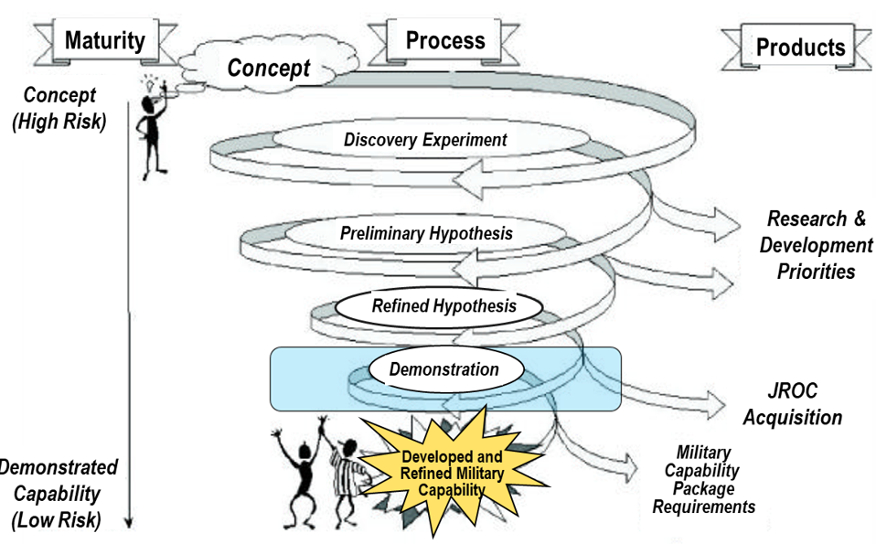
Hand-off to Acquisition
A Current Acquisition Methodology
What Experimentation Can Add
Had the FJF 1 Experimentation Campaign settled on a materiel option, it would have entered the Acquisition process at the Demonstration
However, there are some significant differences between the FJF 1 process and the one on the right
Missing from Acquisition Methodology
First, there is no recursion – outflow to other processes, but not a backward flow
Second, there is no consistent RED teaming – only consideration of R&D priorities and JROC assessment

Slide 33
Fast Forward
What prompted the experimentation: loss of A10
Process started with a variety of different concepts but ended with the idea of a ground controller managing loitering and gliding weapons
No constructive simulation was available, so interactive training simulation venue with exercise scenarios available was chosen
Exercises were completed in 5 months, one week per month and had both BLUE and RED teams with data collection

Slide 34
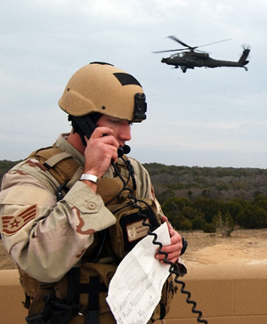
HITL Venue
Close Air Support (CAS)
CAS is defined as “air action by fixed- and rotary-wing aircraft against hostile targets that are in close proximity to friendly forces and that require detailed integration of each air mission with the fire and movement of those forces.” (JP3-09.3, p xi”)
BOGSAT complete, no Constructive Simulation Available
Venue for HITL exercises
AFRL 711th Human Performance Wing, Wright-Patterson AFB
Integrated Combat Operations Training-Research Testbed
a core simulation capability,
a semi-immersive visual environment for the individual being trained,
specialized interface devices (e.g., a laser designator) for the trainee to use,
a flexible C2 structure including radio and simulation interfaces, operator stations equipped with computer and radio interfaces, and
a wealth of scenarios used for training JTACs and controllers of remotely piloted aircraft.
Image courtesy of Battelspace Simulations, Inc., http://www.bssim.com/

Slide 35
A Campaign Altered the Concept
Campaign need not be large and expensive, service campaigns the sweet spot
The following campaign was done in a little over a year from BOGSAT to conclusion
Collaboration between IDA and AFRL
Concept: Weapon-Centric Close Air Support (CAS)
The question that kept multiple services up at night – demise of the A10
Concept after several BOGSATs
Shift the mission burden of CAS from the platform delivering the munition to the control of the munition from the forward ground element, the Joint Tactical Air Controller (JTAC)
Concept for exploration
Allow the ground controller to direct smart weapons (not currently in the AF inventory)
Smart weapons: Standoff Network Enabled Weapon (SNEW) and Loitering Network Enabled Weapon (LNEW)
Focus on the JTACs hand-held device for communications

Slide 36
Concept Changed Throughout
Time for simulation exercises
5 weeks; one week per month for 5 months
First two weeks to understand the processes and data acquisition
Last three for experimenting with and refining the concept
Concept started with JTAC in the field needing a modified Comms Device
Each trial moved the JTAC and the task in different locations
Concept ended with Army Spotters in the field and JTACs at Battalion HQ
Starting point: new weapons assumed, JTAC needed updated comms
Ending Point: JTAC performed targeting, located in HQ,
Need change in Doctrine and Tactics
Need training in targeting for JTACs – only pilots were trained in targeting
Need modification of a comms device, but not the mods originally imagined

Slide 37
We Have the Right Idea, But…

Slide 38
There Are Gaps
All three ingredients for successful experimentation are not always present
Recursion: allows feedback to feed forward for refinement
RED and BLUE Teaming: stresses the concept and fosters adaptation
Failure, or embracing failure: pushes against the envelop of capability hard enough to reach breakthroughs and expose risks
Experimentation done in advance can provide exercises (limited and LSE) with more robust concepts
Exercises are vital in experimentation, but require modification
Training priorities differ and must cede to priorities of experimentation
Scenarios must permit free play
Data based on the performance of the innovation and not on the individual performer must be taken, findable, and useable by others
Analysis must be planned in advance, tools developed or modified, and founded on something other than AARs (After Action Reviews) which have not consistent requirements for format or content
Exercises scheduling should be agile and not totally subject to the Service or CCMD training planning or scheduling – too long to field innovation

Slide 39
DMAG Understand But…
23 Mar 2019 DMAG (from Joint War Gaming & Experimentation, Director Joint Force Development and Design Center, J-7)
A gap exists in our ability to align and prioritize experiments, wargames, exercises and analysis towards joint campaign outcomes
Specified Task: Develop guidance for experiments, wargames, exercises and analysis.
Requires a Joint, global, all domain approach that includes Services and CCMDs
Deputy's Management Action Group (DMAG)
The Deputy's Management Action Group (DMAG) is the primary civilian-military management forum that supports the Secretary of Defense (now War), and addresses top Departmental issues that have resource, management, and broad strategic and/or policy implications.

Slide 40
What’s Driving Us To Skip the Beginning?
The Tyranny of Time

Slide 41
The Tyranny of Time and Its Effects
Time colors our perspectives on the operational environment.
If the clouds of war are looming over us, our focus becomes winning tomorrow’s battle.
There is little time to conceive of or develop new capabilities
We approach the impending confrontation with current capabilities or minimal improvement to them
The directives and instructions issued over the past two decades have focused on rapid transition of capability to support our military fighting in irregular warfare conflicts
While our focus today shifts to highly capable enemies with whom we are now engaged in a competition phase of war rather than live-fire warfare
Our focus is still in rapidly fielding new tools to counter our capable adversaries
The context in which we plan and execute remains tactical rather than strategic at a time when strategic vision is vital
The notion of open-ended experimentation or campaigns of learning is anathema to a generation raised on rapid fielding, fail fast, and adaptation of commercial off-the-shelf solutions

Slide 42

A Second Issue with Time
Time gets away from us and we are continually running to catch up and deal with information overflow
We live in an age of immediate communication
We know of events anywhere in the world within hours, if not moments, of their occurrence
We seem to have a number of live experimentation campaigns going on in the world today yield lessons learned or are they?
For example, observations from the conflict in Ukraine are turning into lessons learned, rightly or wrongly, without time for complete analysis
We need more wargames to understand the demands of both current and future warfare and the applicability of results of individual conflicts like those in Ukraine in a rapidly changing world with conflict in economy, information and shifting alliances
To succeed against a peer threat, the United States has to make better, timelier, more accurate decisions at scale than has ever been contemplated in the history of war
This is an unprecedented challenge
Meeting this challenge demands the use of our best computational and human-driven simulations and wargames in the highly disciplined methodology imposed by the type of experimentation campaign we have been exploring
<a href="https://www.vecteezy.com/free-photos/information-overload">Information Overload Stock photos by Vecteezy</a>

Slide 43
Collaring TIME
To succeed against a peer threat, the United States has to make better, timelier, more accurate decisions at scale than has ever been contemplated in the history of war
This is an unprecedented challenge
Meeting this challenge demands the use of our best computational and human-driven simulations and wargames in the highly disciplined methodology imposed by the type of experimentation campaign we have been exploring
Driven by TIME
We are focusing our energy on LSEs – Large Scale Exercises, the traditional training and readiness venues AND the most expensive way to attempt to conduct experiments
Why? Because they are scheduled on a regular basis to accomplish specific ends
But, they are constrained by their purposes and planning processes which limit the agility and responsiveness of experimentation, and provide little data suitable for analysis
We need to use them, but with a different mindset than training and readiness

Slide 44
Please Note
The following comments are NOT indicating that current doctrine and policy are wrong
To the contrary, they are
Informed by strategy
Grounded in operational understanding
What we are saying is that the implementation is hard and
Has bent to the tyranny of time
Starts past the middle of the ideal process
Requires full coordination: both painful and time-consuming
Lacks whole of government and joint participation at the concept stage
Typical contracting processes and coordination militate against developing a full experimentation campaign

Slide 45
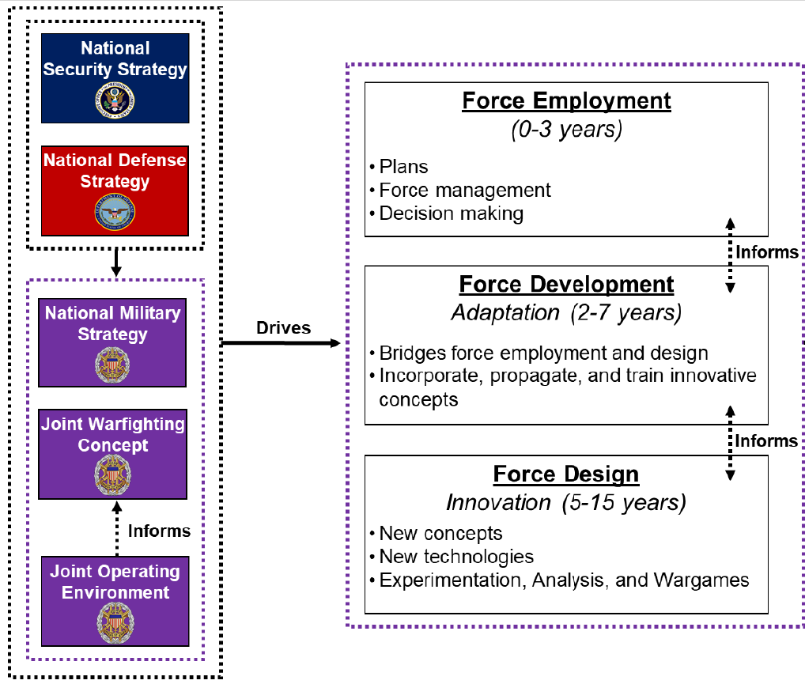
Joint Warfighting Concept (JWC) or Concepts?
The JWC is the direct driver of the current campaign of learning
But we really have multiple JWCs – interpreted by each service (Title 10 authorities)
For many things, the services are the sweet spot for experimentation
Some things need to be born Joint: C4I systems that have to work together flawlessly
Our complicated processes (coordination, acquisition) inhibit true jointness, move too slowly, and drive us to start at the end rather than the middle
Strategizing at the service level and then trying to be Joint is often counterproductive
Cylinders of Excellence do not converge readily
IMPLEMENTING JOINT FORCE DEVELOPMENT AND DESIGN
CJCSI 3030.01A 3 October 2022

Slide 46
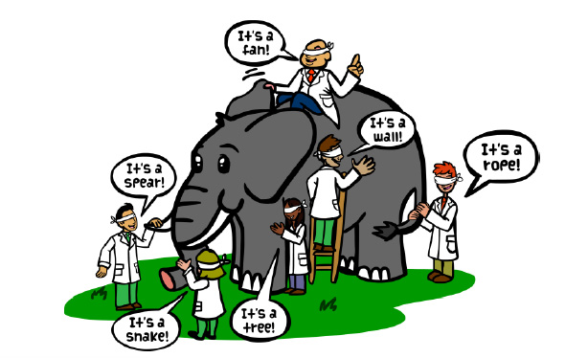
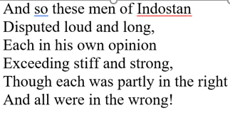
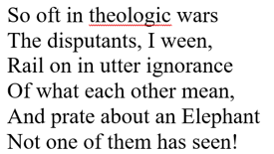
Joint Concept?
https://matthewdicks.com/2018-11-23-m434zpbye4yeodfzhn3qrfh04att2b/
The nuance of the Service concepts most often gets lost in Coordination
≠
?

Slide 47
What Makes Joint Experiment Hard? 1
Roadblocks to Joint Experimentation (Jones, 2000)^{a.}
Assumptions leading to high costs
The first was the cost, assuming that militarily realistic experimentation had to involve expensive copies of new and risky devices that embody unproven technologies
Clearly if there were a way to experiment before the technologies were embodied in the devices, that roadblock could be removed (We have that potential in 2025)
The second roadblock involved providing devices and military personnel over a protracted period of time to both test the devices and develop TTP for their use
Conceiving of alternative forms of experimentation might serve to alleviate this problem.
Budget: The final problem persists today. Because we fight jointly, experiments should be conducted jointly and there are currently few if any budgets for joint experimentation
However, the greatest barrier to engaging in experimentation is a lack of understanding and appreciation of what discovery experimentation means and how it can be carried out (confusing experimentation with training and readiness exercises)
ªJones, Anita. (2000) Science, Technology, and Military Experimentation. The Bridge, Volume 30, Number ¾. editorial Retrieved May 25, 2017 from https://www.nae.edu/File.aspx?id=7327

Slide 48
What Makes Joint Experiment Hard? 2
Cultural Barriers (Defense Science Board^{b}
Experimentation can be an unnatural act for established organizations. Outcomes are uncertain and may be threatening to many in the enterprise.
Experimentation on military operations poses additional intellectual challenges — how to account for exceedingly complex situations, adaptive adversaries, and human behavior under extreme stress.
Lastly, experimentation on joint operations adds yet another layer of difficultly because of the organizational interfaces involved and the relative immaturity of processes for prioritization and resource allocation of joint capabilities.
Legal: Title 10 Authorities and attendant responsibilities
Priorities, funding, acquisition timelines all inhibit JOINT experimentation
Joint Experimentation Forum
Created to address some of the gaps and barriers to successful Joint Experimentation
^{b}Office of the Under Secretary of Defense for Acquisition, Technology, and Logistics, Phase I Report of the joint experimentation: Defense Science Task Force on Joint Experimentation, September 2003

Slide 49
Campaign of Learning
At Its Core an Experimentation Campaign
Most of the parts of an experimentation campaign are present, but the flow is unclear, and the concept is input and not outcome
If the concept is not robust – is not tested and refined, the CRCs may be suboptimal or even wrong
CONOPS: concepts of operation CONEMPS: concepts of employment
CRC: concept-required capabilities
As currently implemented
Exercise planning and coordination seems to dominate the process – borrowed from training
With the focus on near-term hostilities, many CRCs become modifications to current technologies
Significant focus on future is needed to put the force structure on the best footing
IMPLEMENTING JOINT FORCE DEVELOPMENT AND DESIGN
CJCSI 3030.01A 3 October 2022

Slide 50
Experimentation Campaigns Can Combat the Tyranny of Time
Embracing the notion of an Experimentation Campaign is a step in defeating the Tyranny of Time
The Campaign of Learning embraces the concept of an Experimentation Campaign
But starting with Large Scale Exercises amounts to putting what may be a weak concept into an expensive crucible
There will nearly always be a looming crisis, but experimentation starting at concepts need not interfere with today’s crisis and will pay royally in tomorrow conflict
Think experimentation and not training
The implementation is delegated to the Joint training staff, already overworked, but rising to the challenge using many of the methods successful in training doesn’t work for experimentation
Training measures performance of individuals and groups based on current doctrine and systems
Training does not embrace failure
Experimentation seeks to innovate, formulate new doctrine, imagine and design new systems
Experimentation must have free play, recursion, RED and BLUE teaming to test agility and responsiveness and reduce bias
Experimentation requires careful data collection about the concepts and performance of systems, but not about the performance of players

Slide 51
Additional Issues
Contracting makes it hard to create an ecosystem of wargaming and simulations that are not always in competition with each other for funding
Tool developers retain ownership of their tools and access is often impeded contractual relationship – often leading to “creating my own” duplicaction
Maybe OSD needs to create a Federally Funded Tools Ecosystem Center – analogous to Federally Funded Research and Development Centers (FFRDCs)
Path Games once used actively need to be reactivated to develop strategy in a testable manner
Whole of Government participation in the development of Joint strategy is important for understanding the competition phase of military operations and difficult to achieve (conflicting priorities)
In addition to military partners and allies
Add in some futurists and technologists

Slide 52
Last Learning Objective
Imagine what techniques one could use to make force development and design more agile and responsive
Let’s start with some ideas

Slide 53
Remember the Culture
Technology is easy; management, particularly managing future development is hard
Changing technology is easy – people and organizations, not so
Every time the Department tries to make something quick and agile it morphs into slow and bureaucratic (groan or laugh now)

Slide 54
Some Considerations
Who needs to be on your team if you need access to
Stakeholders, tools, data analysts, small and large scale exercise venues
How would structure your RED and BLUE teams?
Would you involve T&E, Acquisition, Training, State?
Who would be at your BOGSAT?
How would you retain the interest of potential stakeholders?
How could you make the process more agile?
How quickly could you design, acquire and analyze data?
How could you assemble the necessary venue? From Services?
How would you decided between Service and Joint innovations?
Which have to be born Joint?
*Tetlock, P.E. & Gardner, D. (2015). Superforecasting: The Art and Science of Prediction. New York City: Crown Publishing Group.

Slide 55
Your goal is a successful Campaign of Learning
There are many answers
Not all Campaigns of Learning require the same elements
All Campaigns require data suitable for analysis and thoroughly tested concepts
Start with the concepts to avoid sending poorly conceived capabilities into an expensive crucible (LSE)

Slide 56
What We Know of Experimentation Campaigns and Exercises
Successful experimentation starts with concepts
Recursion to provide both feedback and feed-forward in the learning process
RED and BLUE teaming to avoid bias
An attitude of embracing failure – we learn best from our mistakes – triage lets the poorer concepts die and brings forward the best of breed
Parts of experimentation methodology can be used by other communities – discovery and recursion benefit T&E and Acquisition
We need a variety of tools
Training tools are critical, but some of the execution and output needs to be adjusted for the demands of experimentation: BOGSATS, wargames, simulation exercises, and field exercises -- use the less expensive to triage the innovation
Experimentation requires data (different from training data) for careful analysis
Large scale exercises are critical for examining Joint capabilities
But is if used for experimentation they require changes not totally consistent with training goals including new data collection methods and the ability to repeat and change in-stride

Slide 57


Learning Objectives
What should you be able to do at the end of
the tutorial?
Define the terms exercise and experiment and discuss the difference between them
Explain how to use feedback in an experimentation campaign and why it is particularly important in campaign of learning
Describe what techniques one can use to mitigate bias in a campaign of learning
Imagine what techniques one could use to make force development and design more agile and responsive

Slide 58
Contacts and References
Alberts, D. S., & Hayes, R. E. (2002). Code of Best Practices for Experimentation. CCRP Publication, http://internationalc2institute.org/codes-of-best-practice/
Angevine, R. G.. (2020, January 23). “Time to Revive Joint Concept Development and Experimentation,” War on the Rocks.
https://warontherocks.com/2020/01/time-to-revive-joint-concept-development-and-experimentation/
Budge, L. D.. (2002). Future Joint Force I Experiment: Final Report (FOUO), IDA Paper P-3738. Institute for Defense Analyses.
Freedberg, S. J. Jr. (2020, July 29). Army Future Ops Depend on Cloud—But Not on JEDI. Breaking Defense. https://breakingdefense.com/2020/07/army-future-ops-depend-on-cloud-but-not-on-jedi/
Joint Staff. Implementing Joint Force Development and Design, CJCSI 3030.01A. (2022). Implementing Joint Force Development and Design. https://www.jcs.mil/Portals/36/Documents/Library/Instructions/CJCSI%203030.01A.pdf
Numrich, S. K., & Woods, K. M. (2017, November 27). Discovery Experimentation: What, Why, How [Tutorial]. Interservice/Industry Training, Simulation and Education Conference (I/ITSEC), Orlando, FL
Office of the Secretary of Defense. (2021). Final Report of the Defense Science Board (DSB) Task Force on Gaming, Exercising, Modeling, and Simulation, (GEMS)—Executive Summary. https://dsb.cto.mil/wp-content/uploads/dsb/site/wwwroot/reports/2020s/GEMS%20Executive%20Summary%20FINAL.pdf
Office of the Under Secretary of Defense for Acquisition, Technology, and Logistics. (2003). Phase I Report of the Defense Science Task Force on Joint Experimentation, September 2003. https://dsb.cto.mil/wp-content/uploads/dsb/site/wwwroot/reports/2000s/ADA429018.pdf.

Slide 59
BACKUPS

Slide 60
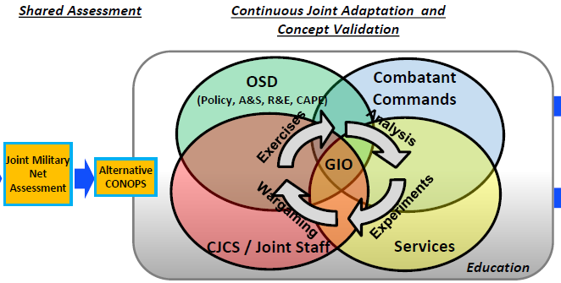
J7 Response
Please Note:
Entry point to the campaign of learning with wargaming, experiments, exercises, and analysis starts at Alternative CONOPS
CONOPS are the result from Commander’s intent and/or CONCEPTS
All the pieces are present, but while the arrows imply recursion, there is not progressive methodology for building learning
(from Joint War Gaming & Experimentation, Director Joint Force Development and Design Center, J-7)

Slide 61
Review: Definitions, Methodology and Process
Context-Specific Definitions
Experiments: Future-oriented testing of proposed capabilities to evaluate their ability to enable preferred ways of operating in the anticipated future operating environment
Exercises: Current-oriented events primarily supporting commanders’ training and readiness objectives for a training audience, can be leveraged as venues for experiments
MG Lew Irwin, Director, Joint Force Development and Design Center, J7 Commandant, Joint Forces Staff College, NDU
Given what we know about Experimentation
Why would we put experimentation AFTER concepts are formed and CONOPS are developed?
In the circle of arrows, shouldn’t wargaming go before experiments and exercises follow. Analysis should be in the center and be conducted continuously throughout?
Yes, it’s only a picture, but pictures leave an imprint on our minds and in this case, an imprint of how things should be done
Experimentation is the crucible where ideas are tested and refined ADM Grady

Slide 62
Concept Change with Each Experiment
Trial 1
Trial 2
JTAC positioned at observation point
Sees target
Received intel update from Battalion
Requests air support from higher HQ
JTAC develops attack plan
JTAC controls weapon
JTAC too busy with two sets of comms – with command and with weapons JTAC controls
JTAC positioned at observation point but now uses JTAC in Battalion HQ for comms
JTAC1 Sees target
JTAC2
Received intel update from Battalion
Requests air support from higher HQ
JTAC1 collaborates with JTAC2 on attack plan
JTAC1 controls weapon
Better but needed closer coordination between comms and plan development
Adjustment based on feedback
JTAC already in the Battalion HQ works in collaboration with the JTAC in the fielc
JTAC in the field no longer needs to handle communications

Slide 63
Final Configuration
Adjustment based on feedback from Trial 2
Moved JTAC from the field into the Battalion HQ
Both JTACS together
Coordinated comms
Received intel
Developed targeting plan
Requested air support
Army Joint Fires Observer (JFO)
Moved into field
Spotted targets
Controlled weapons once fired
Reported damage
Performance improved dramatically
Performance recorded through computer events and observations
Based on HITL experience
Revised focus changed from JTAC device to how and where JTAC was employed
Feed Forward
JTACs need training in targeting
New requirements set for updating the JTAC’s control device

