Slide 1
I/ITSEC 2025 Tutorial Practical use of (emerging) learning technologies
Mr. Gigi Roman ADL Program Manager NATO School Oberammergau roman.gheorghe@natoschool.nato.int | Dr. Biljana Presnall, Vice-President Jefferson Institute bpresnall@jeffersoninst.org | Mr. Ryan Williams Innovation Specialist NATO ACT ryan.williams@nato.int
Notes:
Co-authors/Speakers Background:
Mr. Gigi Roman Course Director, NATO School Oberammergau, NATO Certified Instructor and the Advanced Distributed Learning (eLearning) Program Manager responsible for NATO School’s online education, training and online content management, including new product design and strategic relationships for the organization learning management system, authoring tools and collaboration solutions. In previous roles with NATO School and the PfP community, he has overseen the development of web-based knowledge management systems and the repurposing of instructional materials for online delivery. Member of the Advanced Distributed Learning Working Group and the Educators Working Group of the PfP Consortium of Defense Academies and Security Studies Institutes. Prior to NATO School, he worked with a variety of groups at the Military Academy, International Security Network, George C. Marshall Center, PfP Consortium on project management, online content management, online and classroom training.
Mr. Ryan Williams NATO ACT in Norfolk, Virginia, USA boasting more than 15 years of expertise in eLearning across diverse roles, he embarked on his journey as a programmer, proficiently hardcoding Flash and JavaScript many years ago. His proficiency extends to multimedia design, video production, and adept delivery through Learning Management Systems (LMS) and SCORM. Presently, he actively contributes to a spectrum of projects focused on emerging technologies, including virtual reality, augmented reality, 5G delivery, haptics, and Artificial Intelligence.
Presentation Title: Generative Artificial Intelligence in Training and Education: Hands-On Workshop for Learning Technology Innovations
Dr. Biljana Presnall is Vice President, Jefferson Institute, of the Jefferson Institute with extensive experience in eLearning and military training. She led a digital team on a Department of Defense R&D project to mature the operational integration of Advanced Distributed Learning (ADL) in multinational exercises (MADLx) and contributed to the Annex to NATO ADL Handbook on ADL in Exercises. Her research is primarily focused on leveraging advanced data science methodologies within big data environments to develop innovative data strategies and solutions. This includes the application of artificial intelligence and natural language processing techniques to optimize and drive actionable insights.

Slide 2

Learning Objectives
Explain Generative AI Platforms and Tools
Apply Prompt Engineering Techniques
Analyze Real-World Applications of Generative AI
Identify AI Agent Integrations in Educational Settings
Notes:
Session Outline
The tutorial focuses on Generative AI in training and education. It will cover understanding AI platforms, prompt engineering, real-world applications, and integrating AI agents as outlined.
This workshop is designed for learning technology innovations.
We aim to explore how AI impacts structures, systems, and future communities. We will examine Generative AI's impact on existing structures and systems through understanding platforms, prompt engineering, real-world applications, and integrating AI agents.
We’ve made the tutorial approachable, grounded in science and technology as well as the authors’ unique backgrounds in NATO Training and Education organizations (Gigi, Ryan), organizational learning and commercial entrepreneurship (Biljana.
Our tutorial includes several parts:
Explain Generative AI Platforms and Tools Apply Prompt Engineering Techniques Analyze Real-World Applications of Generative AI Identify AI Agent Integrations in Educational Settings
5. Finally, we end with a practical discussion designed to guide attendees through thinking about different types of change (e.g., efficiencies gained within existing structures versus disruptive paradigmatic change that changes those structures all together). This section includes a focus on how AI is likely to create change within their own organizations and communities and what they should be doing to influence and navigate these changes.

Slide 3

Understanding Generative AI Platforms and Tools
Objective:
Understand how AI-driven tools enhance e-learning
Explore real-world applications in training and education
Open Question:
Which AI tool are you most interested in exploring?
Notes:
We will explore how AI-driven tools are transforming e-learning. We'll look at practical, real-world applications in training and education, and I'm curious, which AI tool are you most interested in exploring?

Slide 4
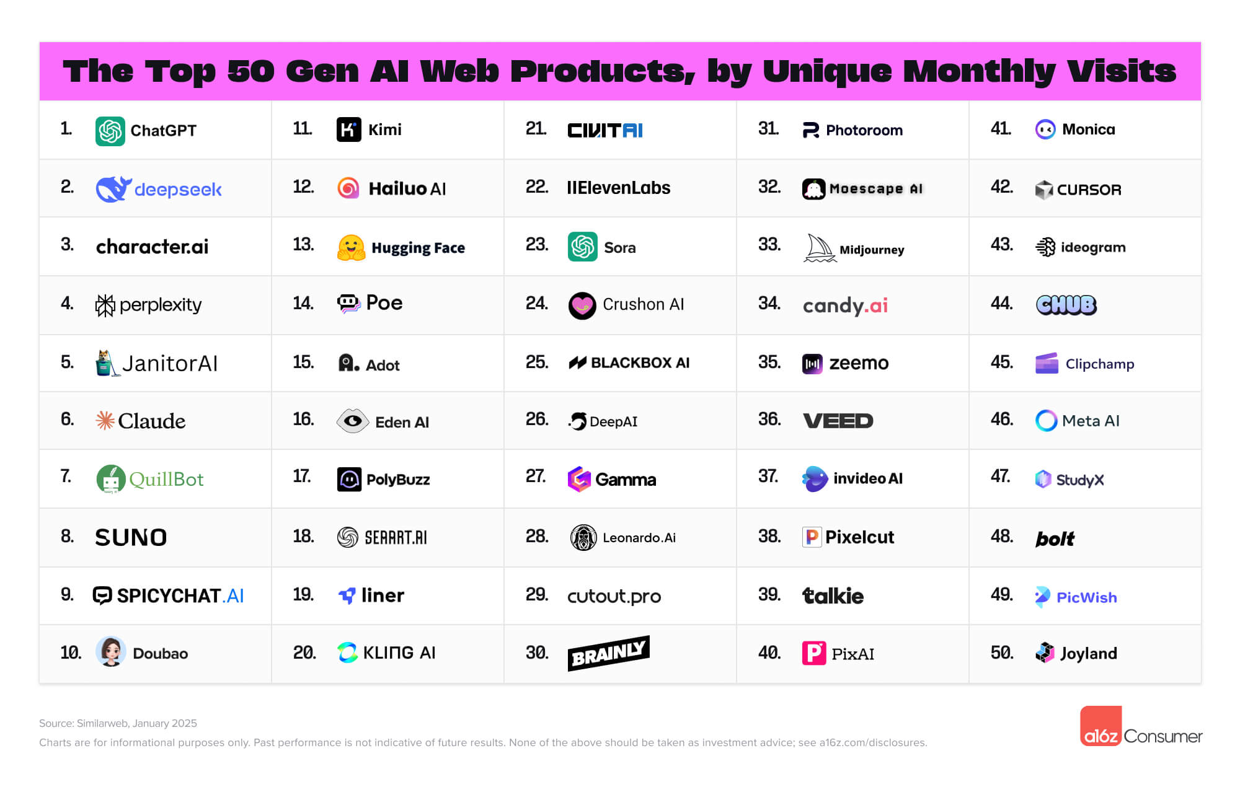
AI Platforms Explored
Notes:
Top 50 Gen AI Web Products from a couple of months ago
17 New companies from the previous list
16 have been on each of the rankings since it started 2 years ago
Deepseek was a huge new comer with its focus on efficiency and lower costs
Several new video platforms with greatly improved quality over the last few months
Also Vibe Coding - term coined by openai found Andrej Karpathy in Feb
“I just see stuff, say stuff, run stuff, and copy paste stuff, and it mostly works.”
Great for prototyping or creating disposable code

Slide 5
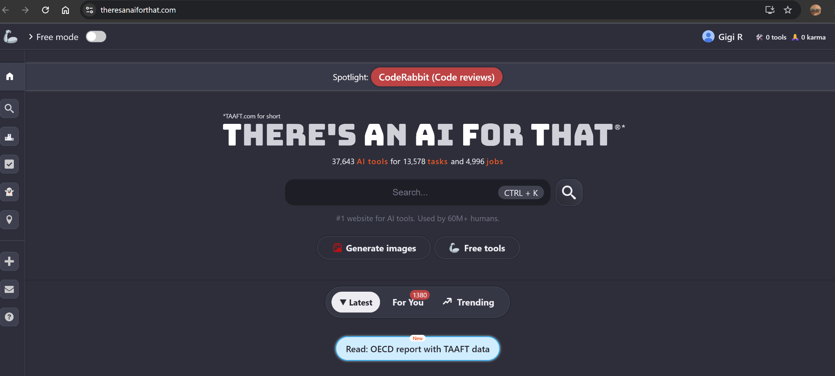
AI Platforms Explored
Notes:
https://theresanaiforthat.com/

Slide 6

AI Platforms Explored
Notes:
https://theresanaiforthat.com/

Slide 7

AI Platforms Explored
Understanding core functions of Generative AI platforms
Exploring different types of platforms is essential for selection.
Identifying key features helps in platform comparisons easily.
Evaluating use cases guides effective application of platforms.
Notes:
Generative AI platforms and tools are revolutionizing how we create content, automate tasks, and solve complex problems. These systems leverage advanced machine learning models to generate text, images, and even code, transforming industries from marketing to software development. This presentation will explore the key platforms, their applications, and the impact they have on various sectors, providing a comprehensive understanding of this cutting-edge technology.

Slide 8
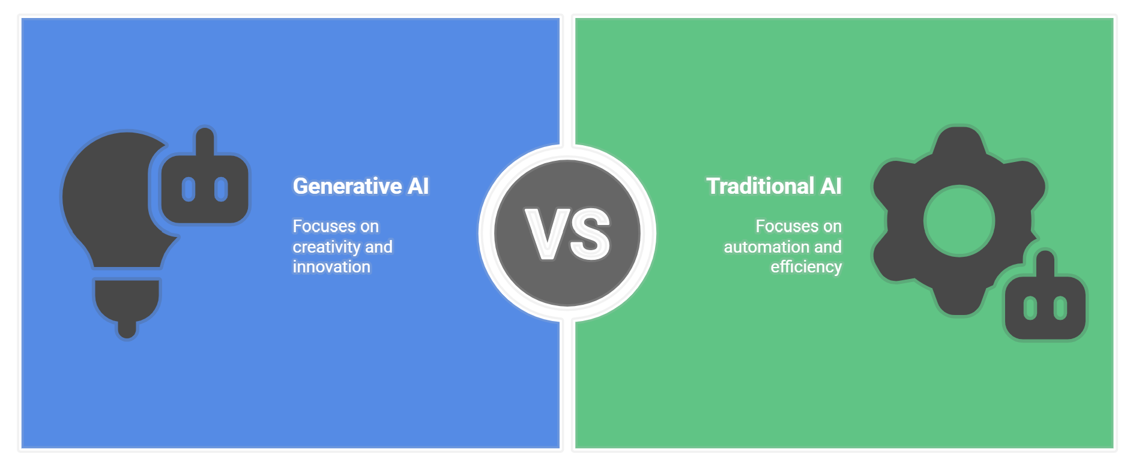
What is Generative AI?
Notes:
Note: these presentation was built with help of AI tools such as: MS Copilot incl. Designer, Napkin AI, Gemini, Notebook LM
Generative AI refers to systems that create new content based on learned patterns
These models use deep learning techniques to produce human-like outputs
Applications range from text generation to image creation and beyond
Unlike traditional AI, generative models focus on creativity and innovation
Examples include chatbots, design tools, and automated content generators

Slide 9

AI in E-Learning – The Landscape
Brief Overview of AI in Education
Current Challenges in Online Training
Content generation
Learner engagement
Feedback and assessment
Discussion Prompt: “What’s the biggest challenge you face in online training?”
Notes:
Brief Overview of AI in Education:
AI in defense education enhances training effectiveness and efficiency.
It supports personalized learning paths and adaptive content delivery.
AI aids in simulation training, providing realistic scenarios and feedback.
It can automate assessments and provide data-driven insights.
AI helps create immersive and engaging learning experiences for military personnel.
Addressing current online training challenges is important in today's rapidly evolving educational landscape. We face significant hurdles in areas like efficient content generation, maintaining consistent learner engagement, and providing timely, effective feedback and assessment. These are key focus areas as we explore Generative AI's potential.
Discussion Prompt: “What’s the biggest challenge you face in online training?” (Ask audience for quick responses)

Slide 10

Key Generative AI Platforms
OpenAI: GPT, DALL-E
Google: Gemini
MidJourney
Hugging Face
IBM Watson Studio
Microsoft Copilot
Perplexity
Notes:
OpenAI offers tools like GPT for text generation and DALL-E for images
Google’s Gemini provides scalable generative models for businesses
MidJourney specializes in creating high-quality images from text prompts
Hugging Face hosts a variety of open-source generative models
IBM Watson Studio integrates generative AI into enterprise workflows

Slide 11
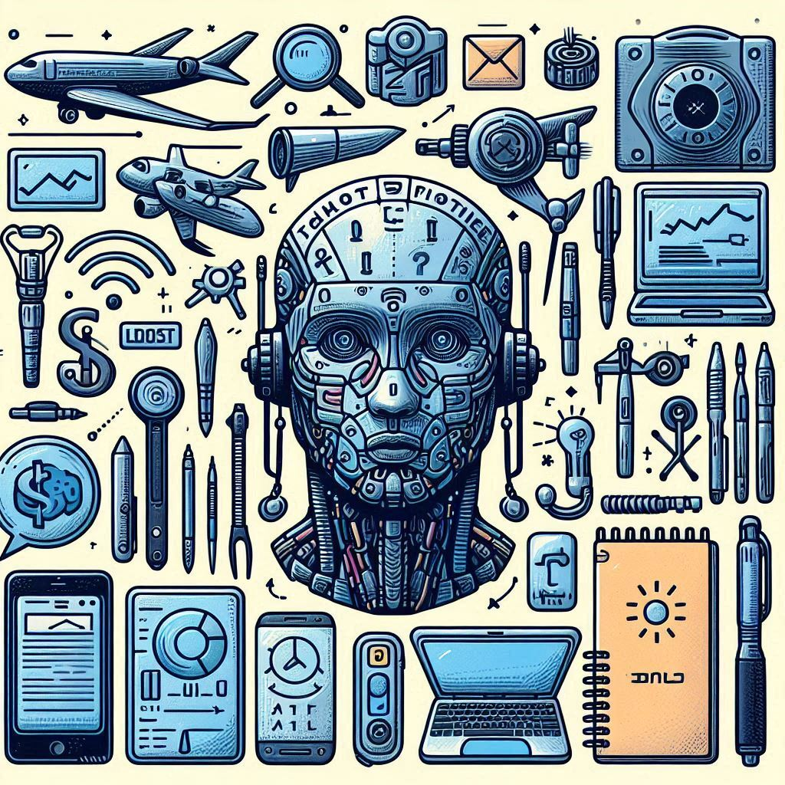
Popular Generative AI Tools
ChatGPT
Stable Diffusion
Google Notebook LM
GitHub Copilot
Runway ML
Microsoft Copilot
Napkin AI
Notes:
ChatGPT generates human-like text responses for various applications
Stable Diffusion creates detailed images from simple text descriptions
Google Notebook LM take notes, summarize documents, and generate insights
GitHub Copilot helps developers by suggesting and completing code snippets
Runway ML enables video editing and generation with AI assistance Napkin AI turns your text into visuals so sharing your ideas is quick and effective.

Slide 12
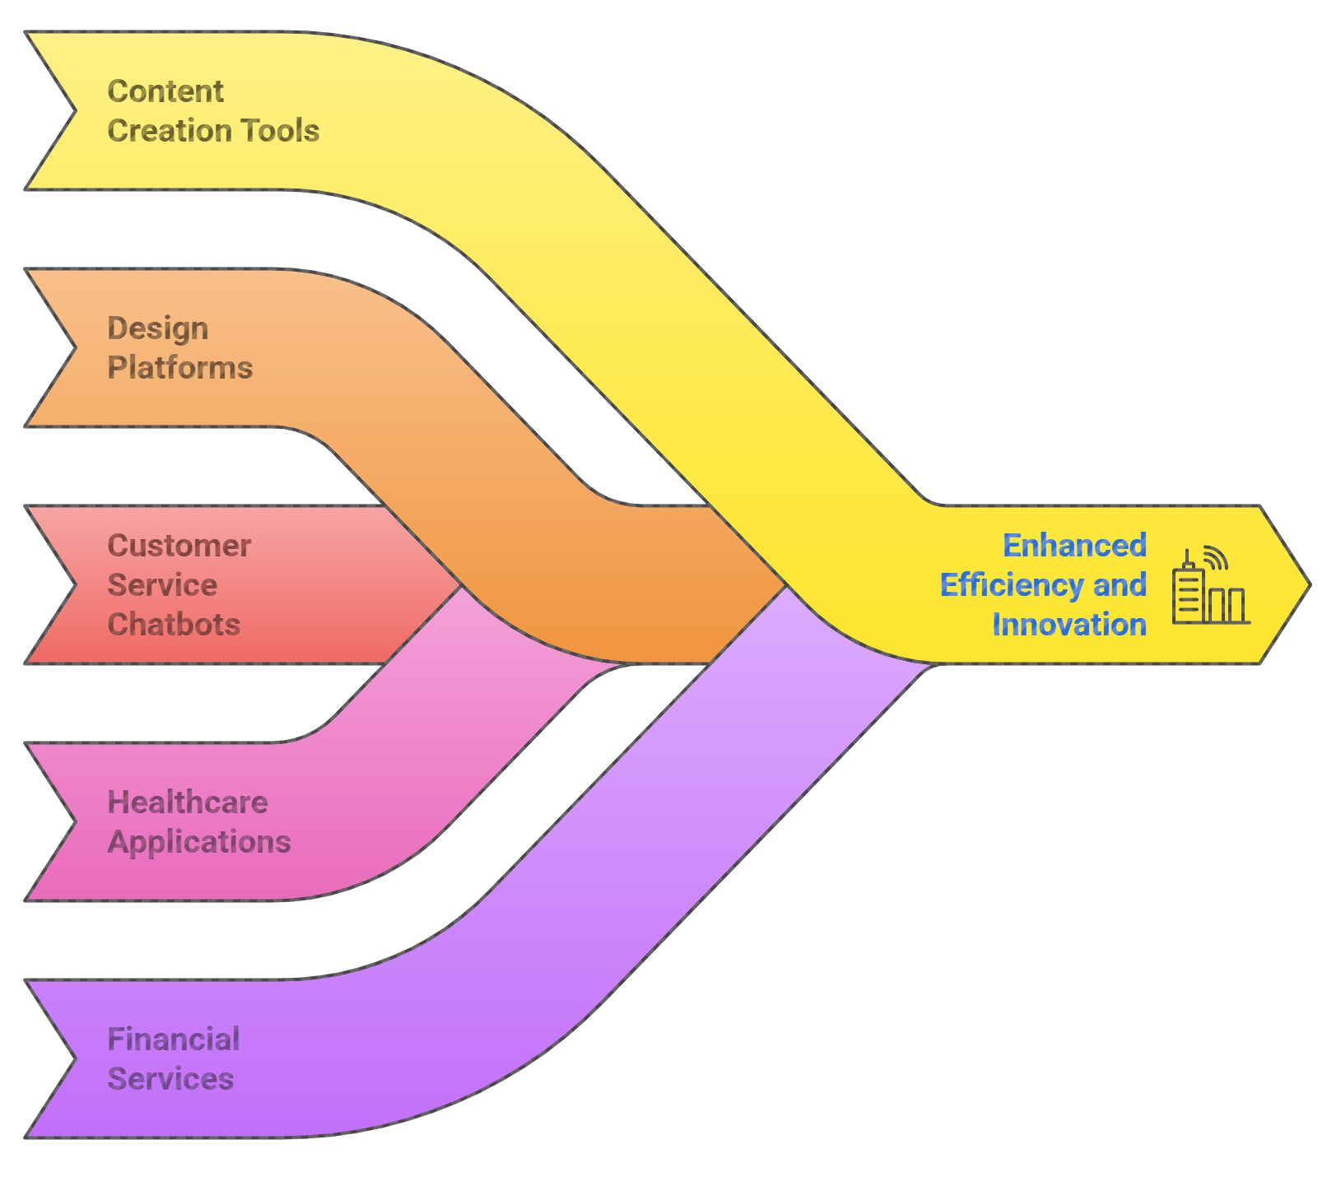
Applications of Generative AI
Notes:
Content creation tools automate blog posts, articles, and social media content
Design platforms generate logos, graphics, and marketing materials
Customer service chatbots provide instant, personalized responses to queries
Healthcare applications assist in drug discovery and medical imaging analysis
Financial services use generative models for fraud detection and risk assessment

Slide 13
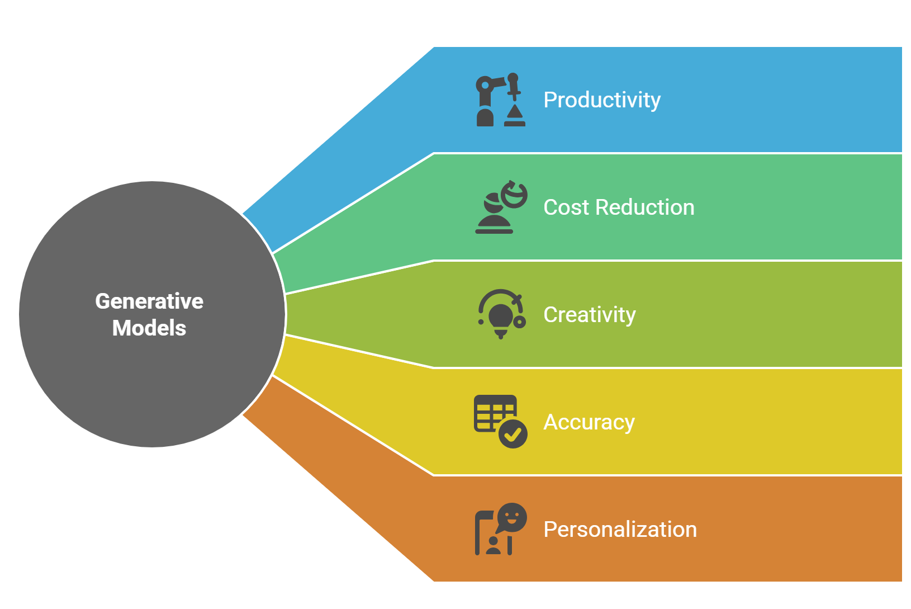
Benefits of Generative AI
Notes:
Increases productivity by automating repetitive and creative tasks
Reduces costs by minimizing the need for human intervention
Enhances creativity by providing new ideas and innovative solutions
Improves accuracy in data analysis and content generation
Enables personalization at scale for marketing and customer interactions

Slide 14
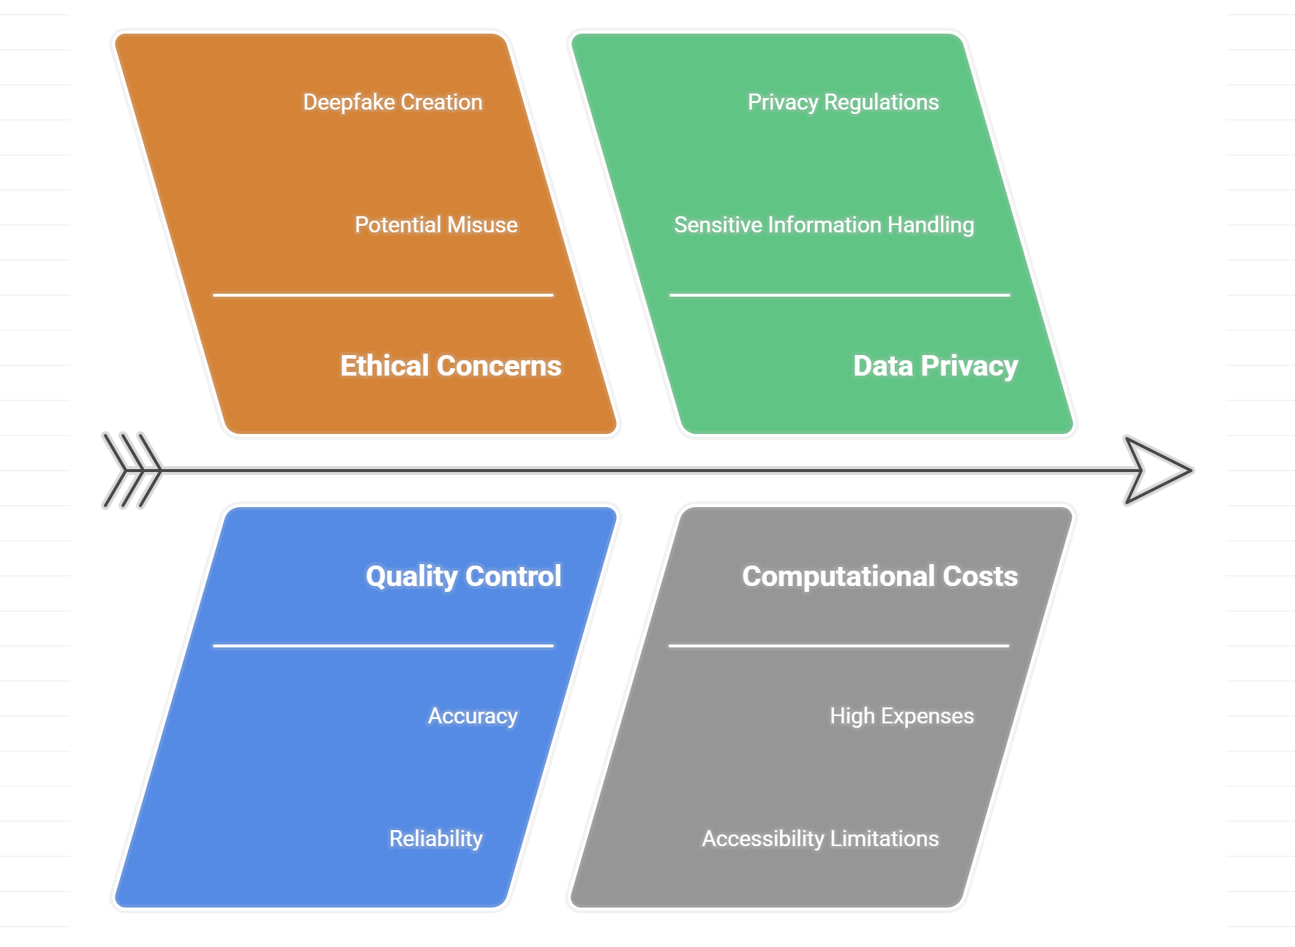
Challenges of Generative AI
Notes:
Ethical concerns arise from potential misuse and deepfake creation
Quality control is necessary to ensure accurate and reliable outputs
Data privacy issues require careful handling of sensitive information
High computational costs can limit accessibility for smaller businesses
Bias in training data can lead to unfair or discriminatory outcomes

Slide 15

Future Trends in Generative AI
Integration with augmented reality
Advancements in multimodal models
Personalized learning
Reduce computational costs
Expansion into new industries
Notes:
Integration with augmented reality will enhance immersive experiences
Advancements in multimodal models will combine text, image, and audio
Increased adoption in education for personalized learning tools
Development of more efficient models to reduce computational costs
Expansion into new industries like agriculture and environmental science

Slide 16
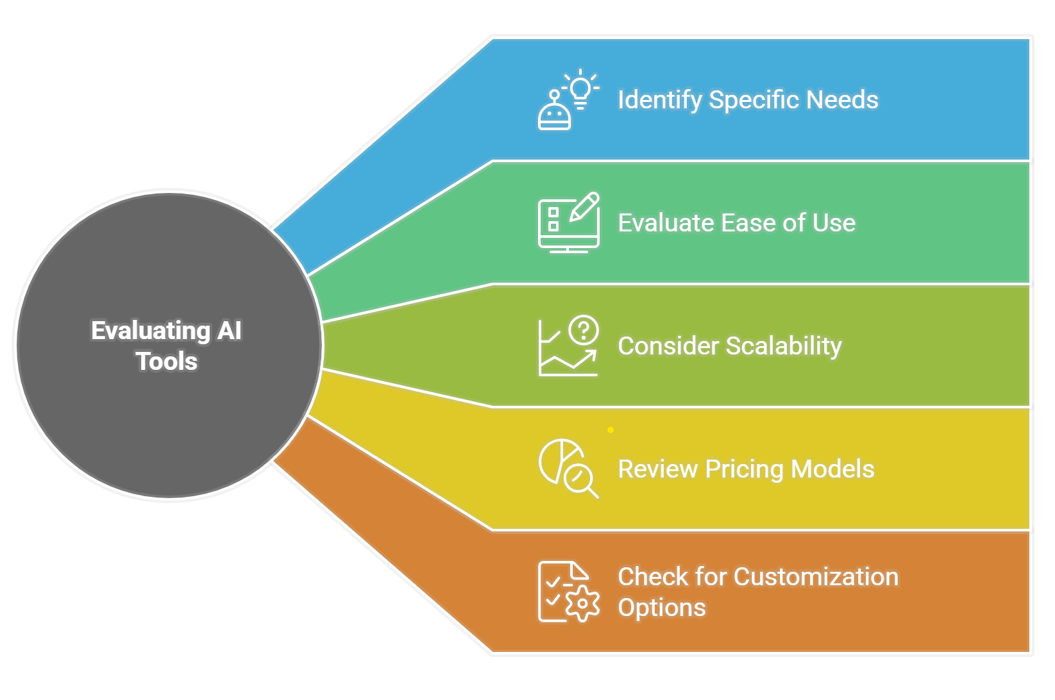
How to Choose the Right Generative AI Tool
Notes:
Identify specific needs such as text generation, image, video creation, or coding
Evaluate ease of use and integration with existing workflows
Consider scalability to ensure the tool can grow with business demands
Review pricing models to find cost-effective solutions
Check for customization options to tailor outputs to unique requirements
Generative AI platforms and tools are transforming industries by enabling automation and creativity. These technologies offer significant benefits, from increased productivity to enhanced personalization, but also present challenges like ethical concerns and data privacy. As the field continues to evolve, businesses and individuals must carefully select tools that align with their needs and stay informed about emerging trends to leverage generative AI effectively.

Slide 17
Apply AI Prompt Engineering Techniques
Prompt engineering involves designing inputs to guide AI model responses
Effective prompts reduce ambiguity and improve output quality
Techniques vary based on the AI model and desired task
Clear and structured prompts lead to more precise results
Contextual information enhances the relevance of AI responses
Notes:
Prompt engineering involves designing inputs to guide AI model responses
Effective prompts reduce ambiguity and improve output quality
Techniques vary based on the AI model and desired task
Clear and structured prompts lead to more precise results
Contextual information enhances the relevance of AI responses

Slide 18
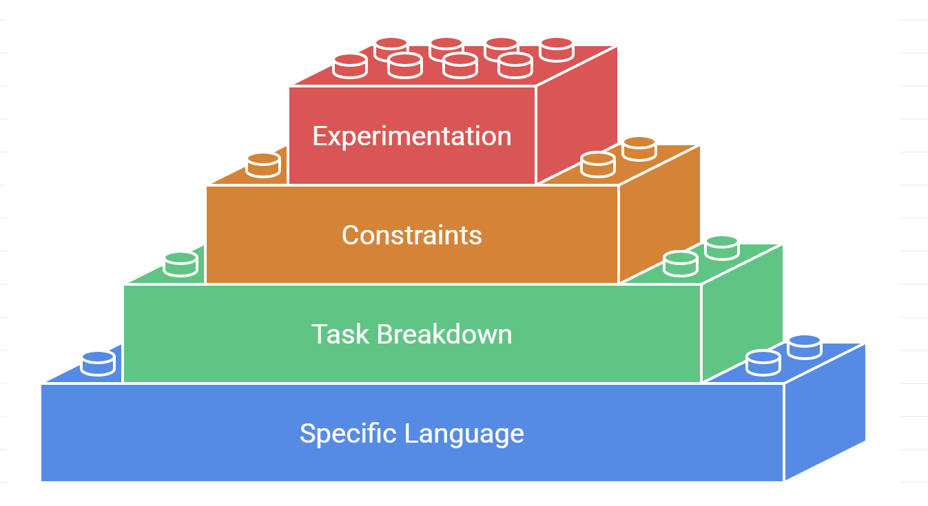
Key Techniques for Effective Prompts
Notes:
Use specific and detailed language to minimize vague outputs Incorporate examples to guide the AI toward desired responses
Break complex tasks into smaller, manageable parts
Include constraints to limit the scope of AI-generated content
Experiment with different phrasing to refine results

Slide 19
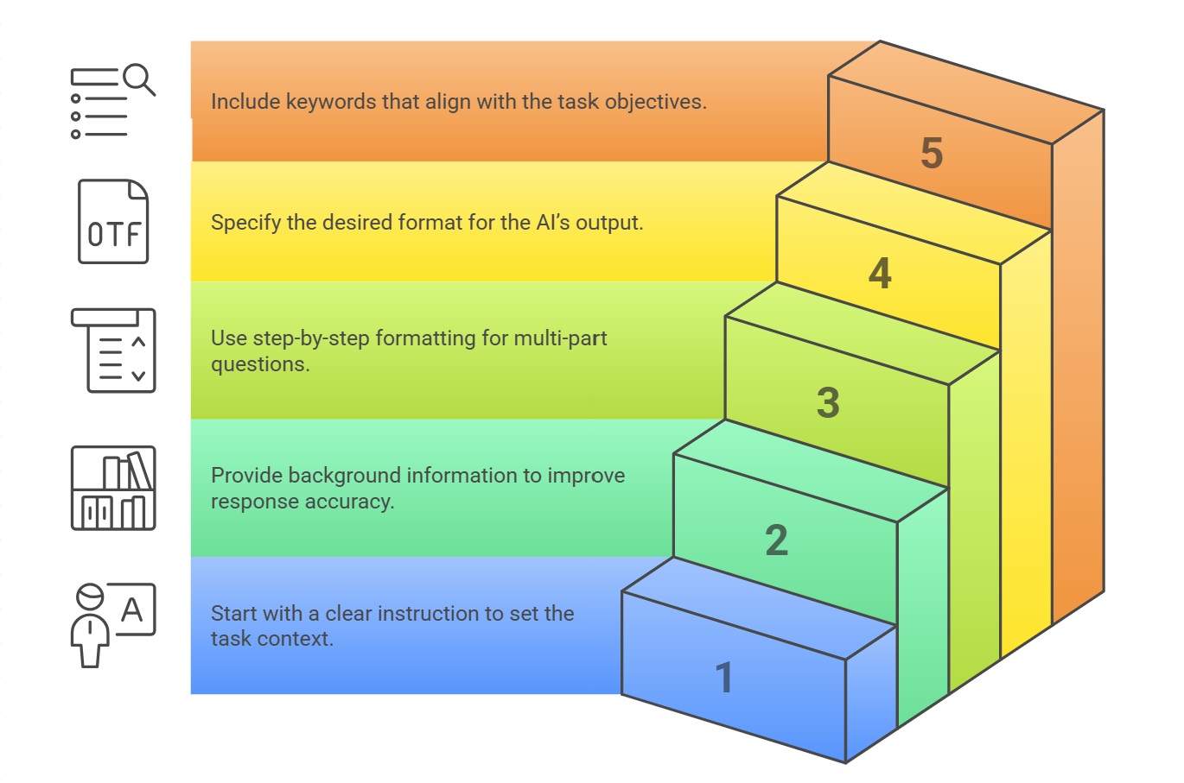
Structuring Prompts for Clarity
Notes:
Begin with a clear instruction to set the task context
Provide background information to improve response accuracy
Use step-by-step formatting for multi-part questions
Specify the desired format for the AI’s output
Include keywords that align with the task objectives

Slide 20
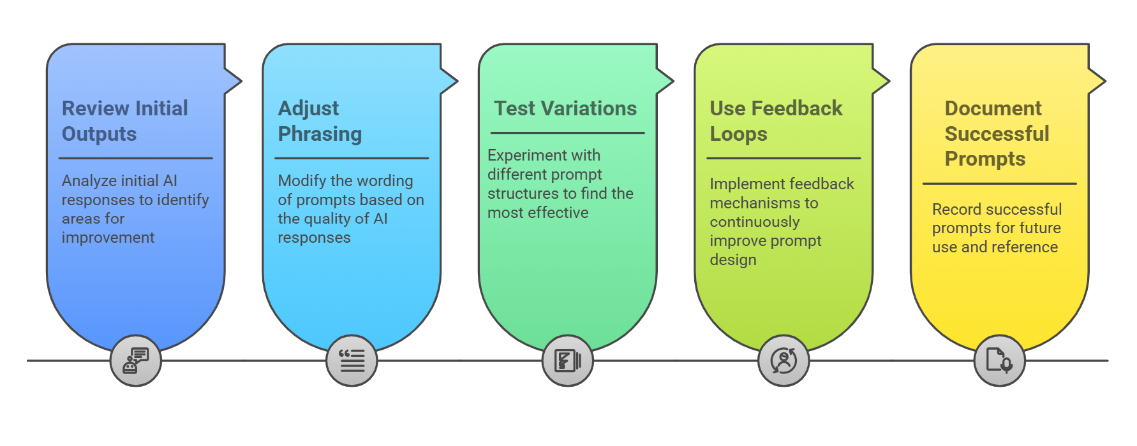
Refining Prompts Through Iteration
Notes:
Prompt engineering is a critical skill for effectively leveraging AI models to generate accurate and relevant outputs. This presentation explores key techniques and best practices for crafting prompts that enhance AI performance. By understanding these methods, users can optimize interactions with AI systems to achieve better results in various applications.
Review initial outputs to identify areas for improvement
Adjust phrasing based on the quality of AI responses
Test variations to determine the most effective prompt structure
Use feedback loops to continuously enhance prompt design
Document successful prompts for future reference

Slide 21
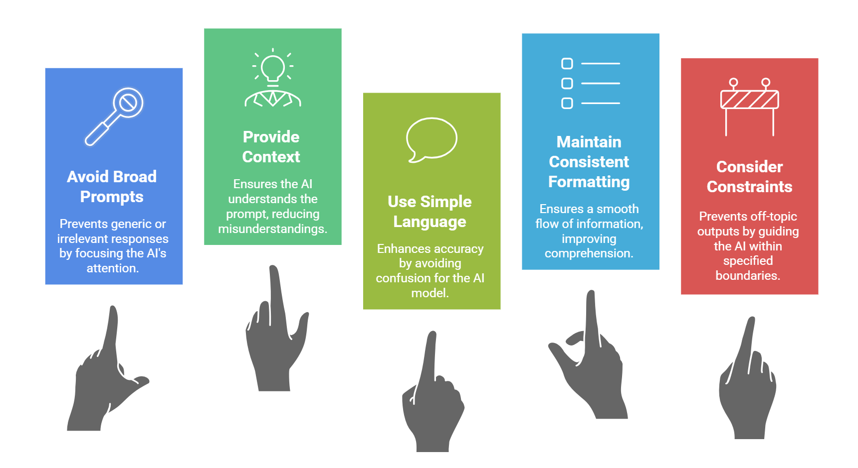
Common Pitfalls in Prompt Engineering
Notes:
Overly broad prompts lead to generic or irrelevant responses
Lack of context results in misunderstandings by the AI
Complex language may confuse the model and reduce accuracy
Inconsistent formatting can disrupt the flow of information
Ignoring constraints may produce outputs that are off-topic

Slide 22
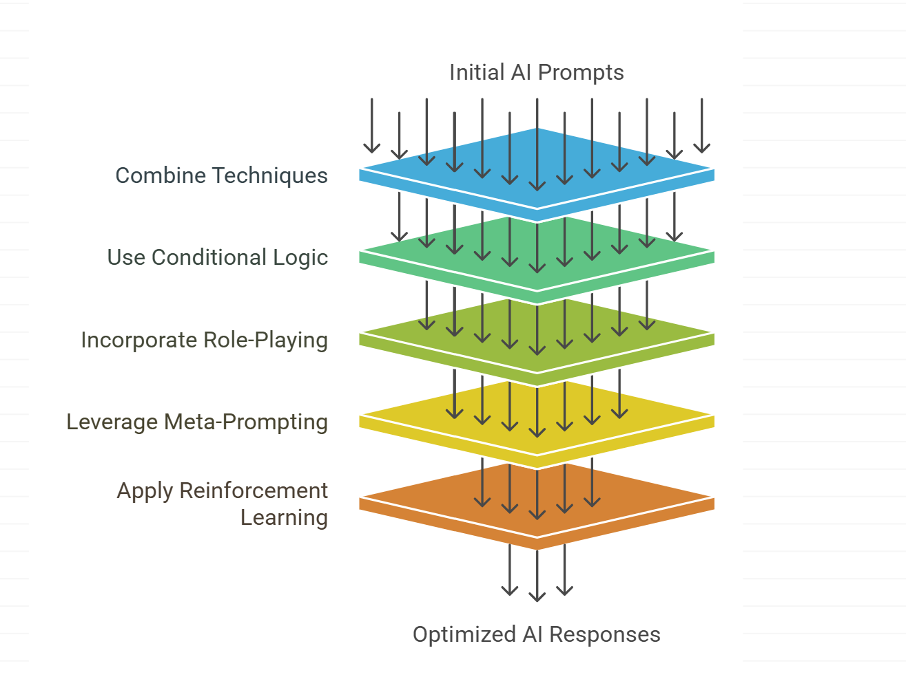
Advanced Prompt Engineering Strategies
Notes:
Combine multiple techniques to create robust prompts
Use conditional logic to guide the AI through decision-making
Incorporate role-playing scenarios for specialized tasks
Leverage meta-prompting to refine responses dynamically
Apply reinforcement learning to iteratively improve prompts

Slide 23
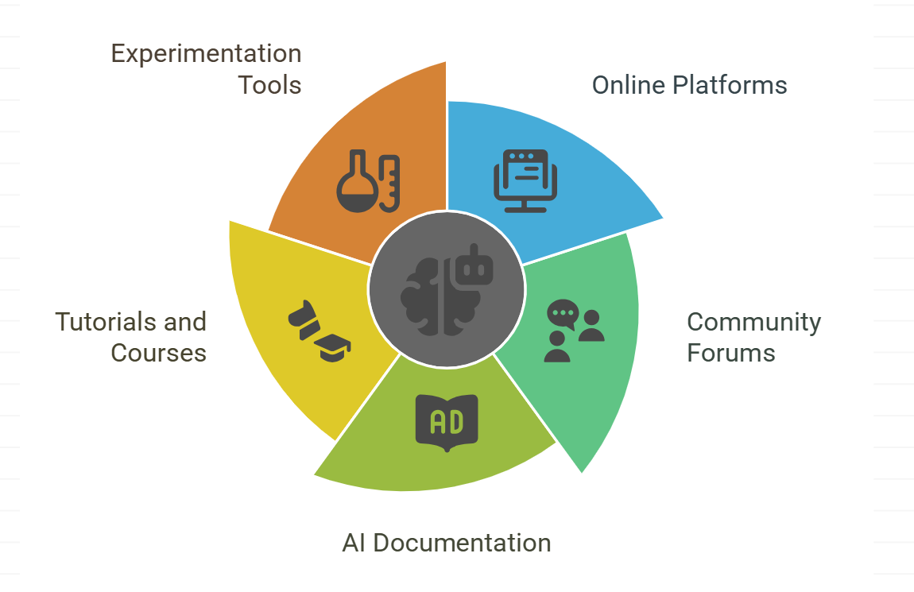
Tools and Resources for Prompt Engineering
Notes:
Online platforms offer templates and examples for prompt design
Community forums provide insights from experienced users
AI documentation includes guidelines for effective prompting
Tutorials and courses help develop prompt engineering skills
Experimentation tools allow testing and refining prompts

Slide 24
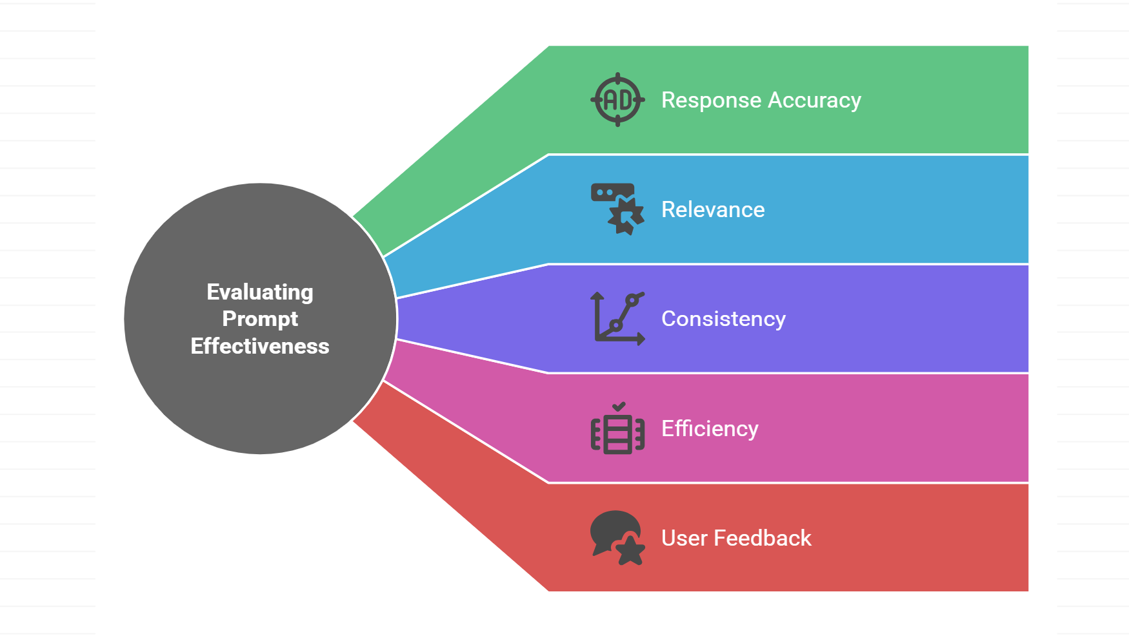
Measuring Prompt Effectiveness
Notes:
Evaluate response accuracy against the intended task
Assess the relevance of outputs to the given context
Measure the consistency of results across multiple attempts
Analyze the efficiency of prompts in generating desired outcomes
Gather user feedback to identify areas for improvement
Prompt engineering is an essential skill for maximizing the potential of AI models. By applying structured techniques and refining prompts through iteration, users can achieve more accurate and relevant outputs. Understanding common pitfalls and leveraging advanced strategies further enhances the effectiveness of AI interactions. Continuous learning and experimentation are key to mastering prompt engineering and unlocking the full capabilities of AI systems.

Slide 25
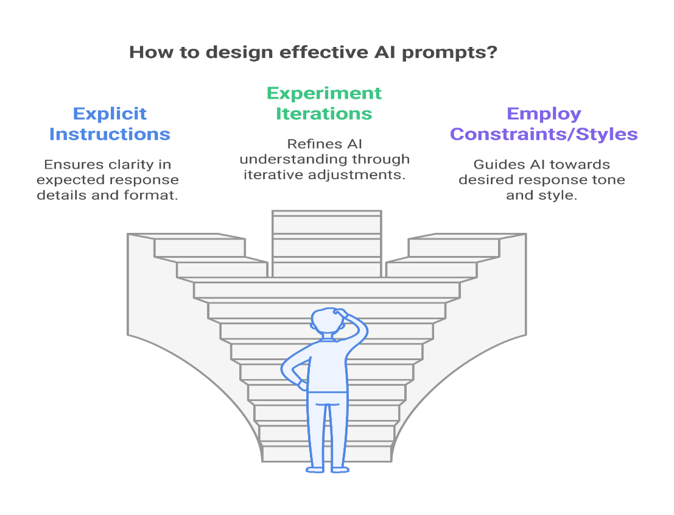

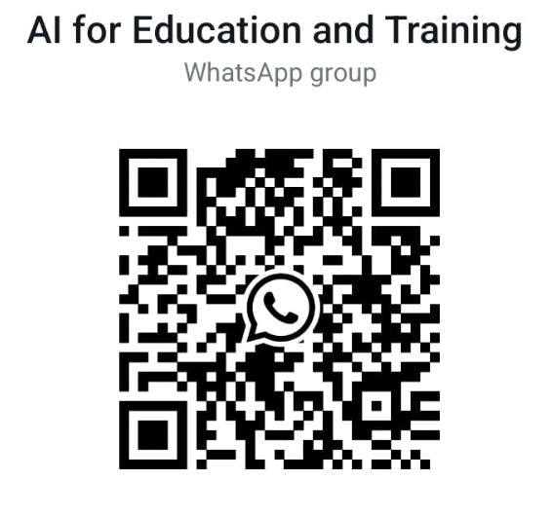
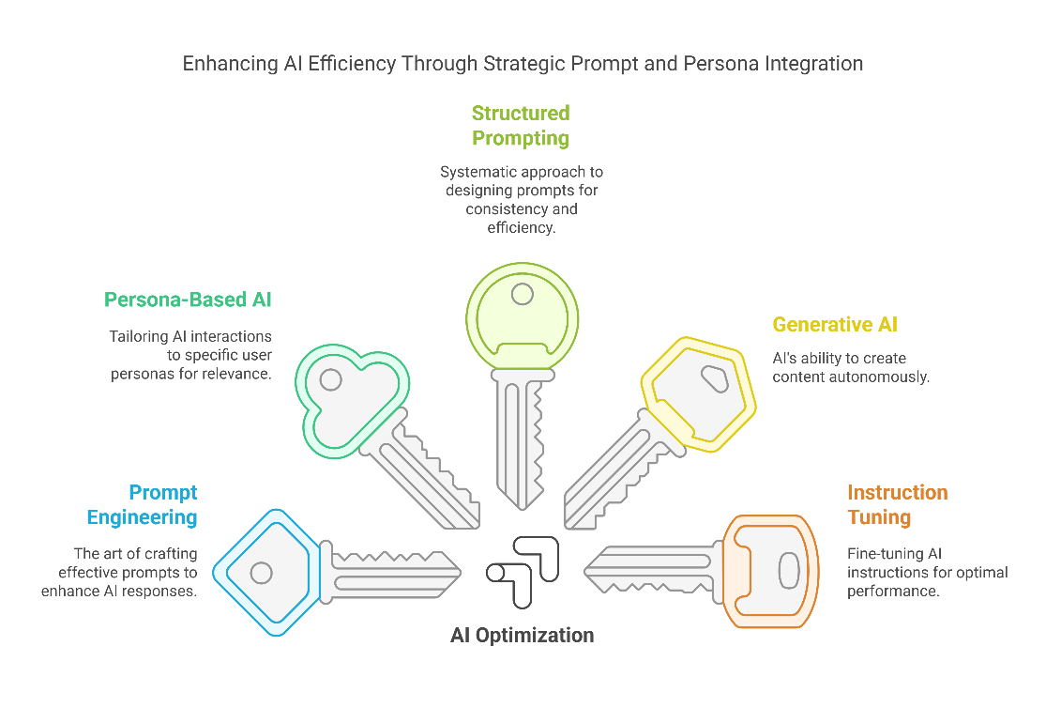
Anatomy of an effective prompt engineering
Abstract
Key Considerations for Prompt Design
Prompt engineering is the art and science of designing inputs that yield optimal outputs from AI models like ChatGPT, Gemini, LLaMA, Claude, Grok and other. Effective prompt engineering enables AI to generate accurate, context-aware, and useful responses. This process involves structuring inputs thoughtfully, leveraging persona-based interactions, and refining prompts through iteration. This poster examines key prompt engineering principles, such as contextualization, specificity, and adaptability. By following best practices, individuals and organizations can unlock AI’s full potential, ensuring it remains a reliable tool for research, automation, and problem-solving. This poster serves as a practical guide for refining AI interactions, illustrating the importance of precision, adaptability, and ongoing improvements in prompt design.
Use explicit instructions: Specify the depth of detail, format, and response length.
Experiment with iterations: Adjust wording to refine AI’s understanding.
Employ constraints and styles: Direct AI towards formal, creative, or analytical responses.
Utilize few-shot learning: Include examples to guide AI behavior.
Conclusion
Methodology
Effective prompt engineering is a skill that enhances AI usability, ensuring outputs align with user expectations. By applying structured methodologies, leveraging persona-based interactions, and iterating for improvement, AI interactions become more reliable and contextually relevant.
The effectiveness of a prompt depends on several factors:
Clarity and Specificity
Contextualization
Structural Composition
Sample prompt
Goal: Summarize the impact of artificial intelligence in training and education. Prompt: “You are an education technology researcher specializing in AI applications. Summarize how AI is reshaping training and education, focusing on three areas: personalized learning, automated assessment, and adaptive curriculum design. Use professional tone and structured language. For each area, include at least one real-world example, preferably from government, defense, or enterprise settings. Cite named technologies or programs where applicable. Keep the response concise but information-dense.”
Keywords
Prompt Engineering; AI Optimization; Large Language Models; Persona-Based AI; Structured Prompting; Generative AI; Instruction Tuning; AI-Driven Interaction. NATO School Oberammergau; NATO; Modernization; Training and Education; Global Programming
Introduction
As AI continues to evolve, the ability to communicate effectively with these systems has become a crucial skill. Unlike traditional programming, where rigid syntax dictates behavior, AI interactions depend on nuanced language cues. Well-crafted prompts can significantly impact AI-generated responses, making them more relevant, precise, and aligned with user expectations. This poster outlines a strategic framework for designing prompts that maximize AI’s potential.
Further information
OpenAI Documentation: https://openai.com/research
Google DeepMind Blog: https://deepmind.com/blog
Meta AI Research: https://ai.facebook.com/research
AI Alignment Literature: https://alignmentforum.org
Email: adl.info@natoschool.nato.int

Slide 26
Apply AI Prompt Engineering Techniques
Prompt example: “Act as an education technology researcher specializing in AI applications. Summarize how AI is reshaping training and education, focusing on three areas: personalized learning, automated assessment, and adaptive curriculum design. Use clear, structured language. For each area, include at least one real-world example, preferably from government, defense, or enterprise settings. Cite named technologies or programs where applicable. Keep the response concise but information-dense.
Notes:
Contextual information enhances the relevance of AI responses

Slide 27

AI technology in military or defense training
Artificial Intelligence Front End Learning Information Execution - AI Felix
NATO Quality Assurance - QA Bot
NATO Defence Educators eAcademy - JEAN AI
Notes:
https://www.act.nato.int/wp-content/uploads/2023/05/2019_ai-felix.pdf
https://www.act.nato.int/article/harnessing-artificial-intelligence/
https://qa.sidecloud.net/
https://deepportal.hq.nato.int/eacademy/e-academy/nato-deep-eacademy-towards-indigenous-ai-model/

Slide 28

NATO Felix AI
Notes:
https://www.act.nato.int/wp-content/uploads/2023/05/2019_ai-felix.pdf
https://www.act.nato.int/article/harnessing-artificial-intelligence/

Slide 29
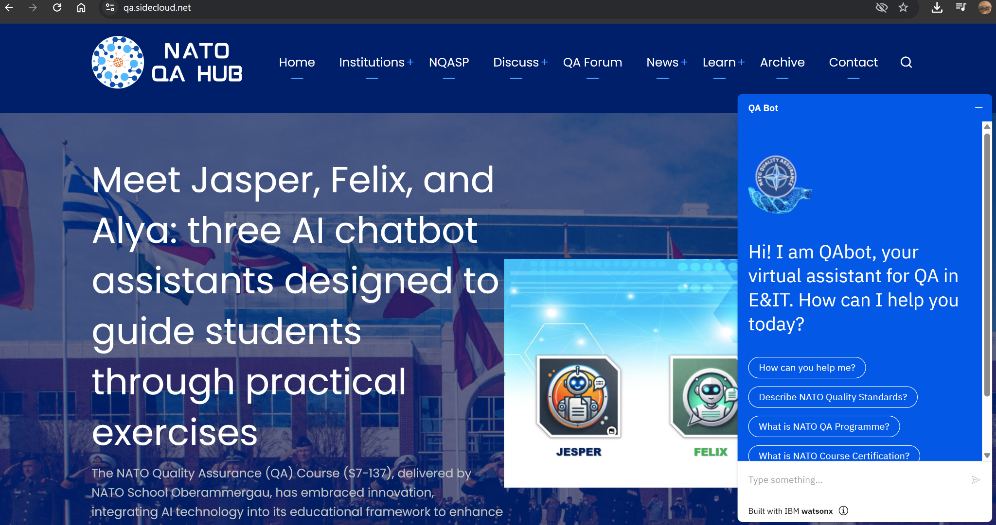
NATO Quality Assurance - QA Bot
- Screen capture from NATO QA HUB with QAbot-
Notes:
https://qa.sidecloud.net/

Slide 30
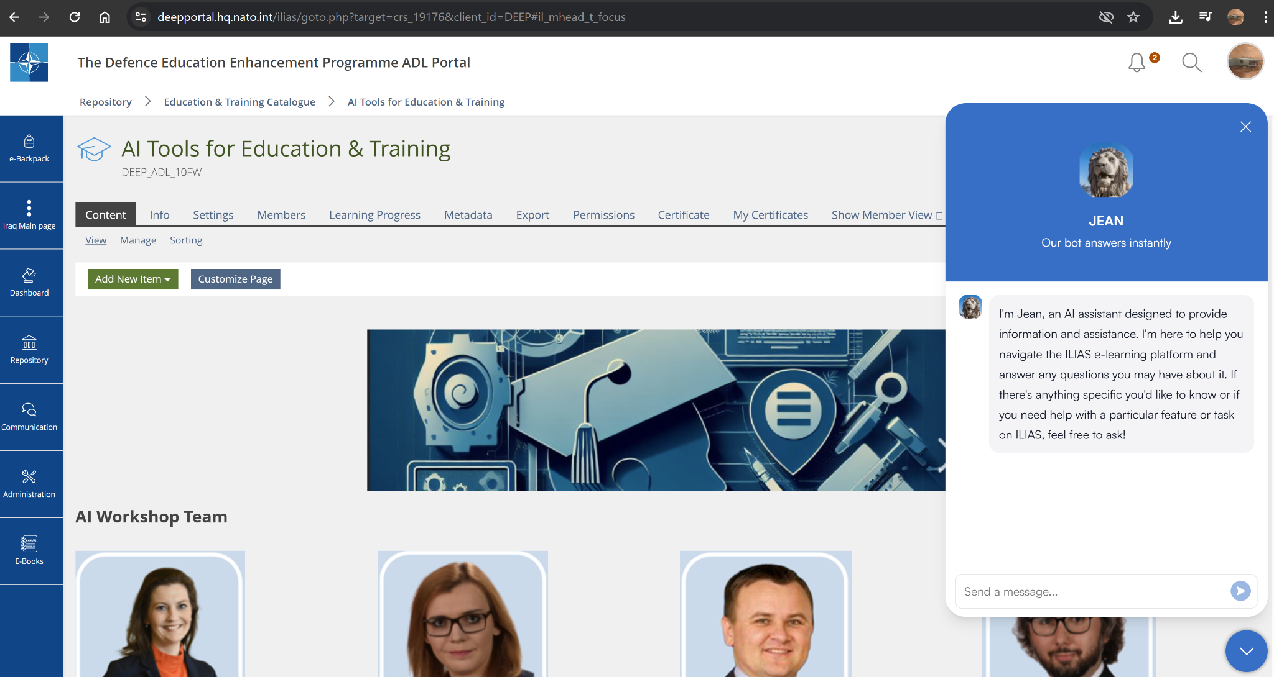
JEAN AI in NATO DEEP eAcademy LMS
- Screen capture from NATO Defense Education Enhancement Programme, eAcademy with JEAN AI -
Notes:
AI models and chatbots have transformative potential in the realm of education. They can
provide personalized learning experiences, adapt to individual learners’; needs, and offer
round-the-clock assistance. For educators, AI can help identify gaps in teaching and suggest
improvements, making education more effective and engaging. AI chatbots can also serve as
a veritable guide to new technologies and the possibilities of their use.
https://deepportal.hq.nato.int/eacademy/e-academy/nato-deep-eacademy-towards-indigenous-ai-model/

Slide 31

AI for Feedback Analysis & Dashboards
AI-driven Feedback Analysis
Survey Results Summary Dashboard

Slide 32


Slide 33
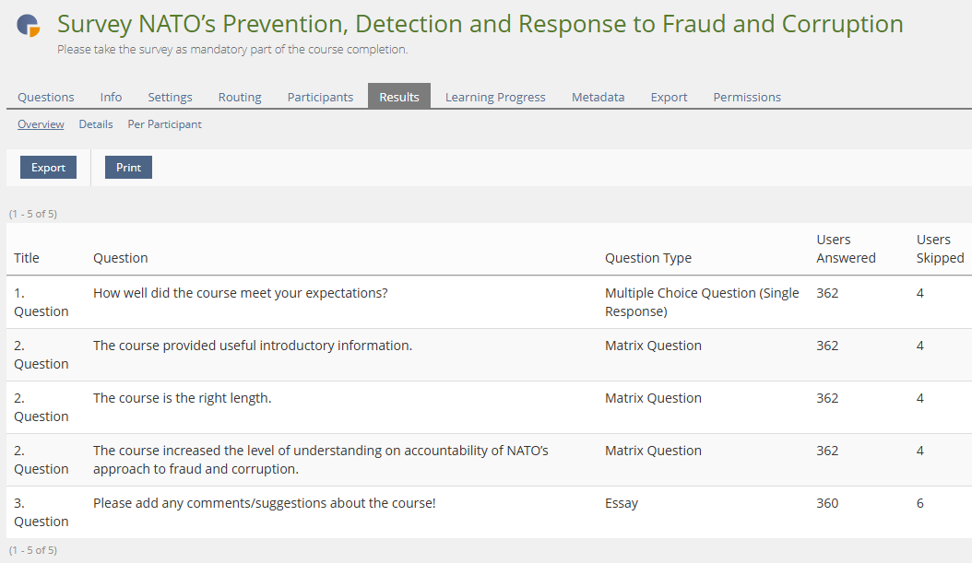

Slide 34
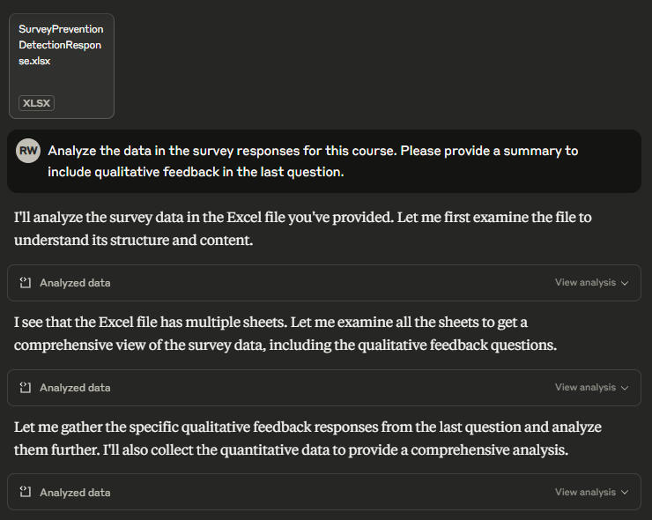

Slide 35
Overall Satisfaction
The survey responses indicate a high level of satisfaction with the course:
Meeting Expectations: 61% of respondents (220 out of 362) rated the course as "Very satisfied [5]", which was also the median rating.
Course Content: 209 respondents rated the course content as "Completely satisfied [5]", indicating that the course provided useful introductory information.
Course Length: 247 respondents rated the course length as "Completely satisfied [5]", suggesting the 45-minute duration was appropriate.
Understanding Level: 206 respondents indicated they were "Completely satisfied [5]" with how the course increased their understanding of NATO's approach to fraud and corruption accountability.

Slide 36
Qualitative Feedback Analysis
The open-ended question "Please add any comments/suggestions about the course!" received 359 text responses. Here's a breakdown of these responses:
Sentiment Analysis
Positive Feedback: 24% of responses contained positive sentiment
Negative Feedback: 9% of responses contained negative sentiment
Neutral Feedback: 67% of responses were neutral

Slide 37
Key Themes
Content Quality (7% of responses)
Course Length (6% of responses)
Technical Aspects (1% of responses)
Structure and Organization (1% of responses)
Engagement (2% of responses)

Slide 38
Overall, the course appears to be meeting its objectives effectively, with only minor adjustments needed to address the feedback provided by participants.
Based on the qualitative feedback, the following recommendations could further enhance the course:
Enrich with Examples: Add more practical examples and case studies to illustrate key concepts.
Increase Visual Content: Consider adding more visual elements and videos to enhance engagement.
Include Practical Applications: Provide more practical guidance on how to apply the concepts in real-world situations.
Improve Course Conclusion: Create a clearer ending to the course rather than leading directly to the next training.
Add Specific Guidance: Consider addressing requested topics like acceptable gifts and specific reporting procedures.

Slide 39
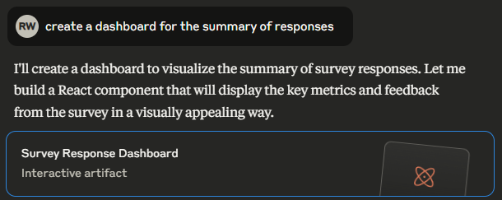

Slide 40
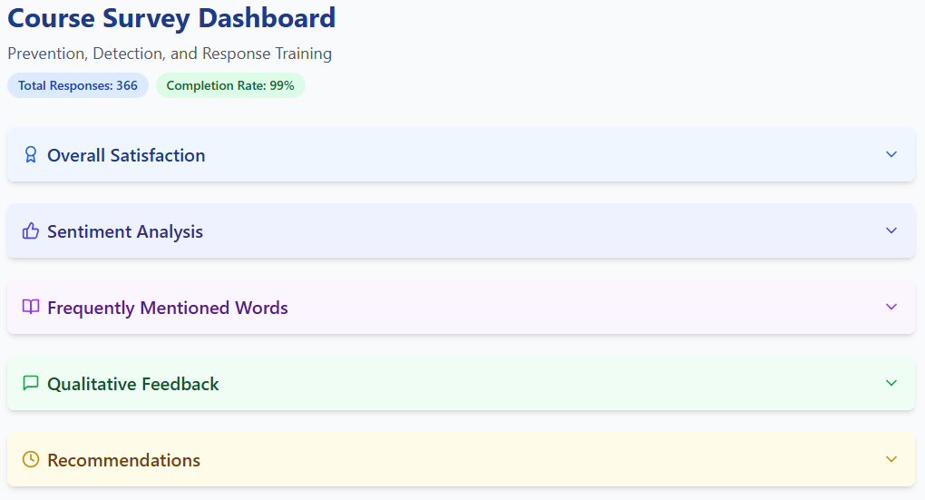

Slide 41
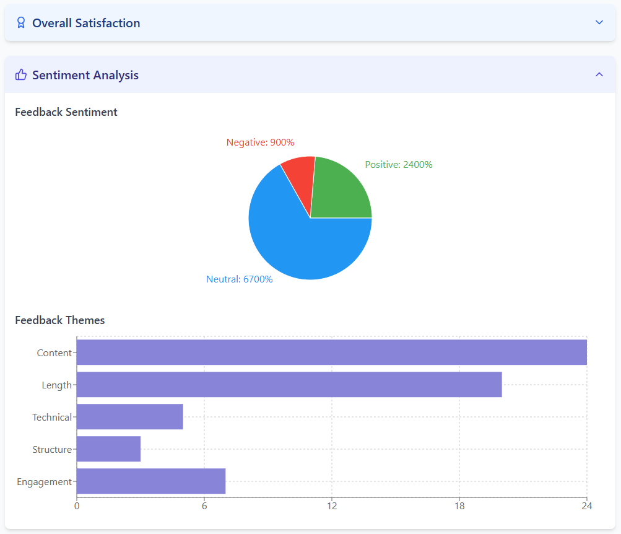

Slide 42
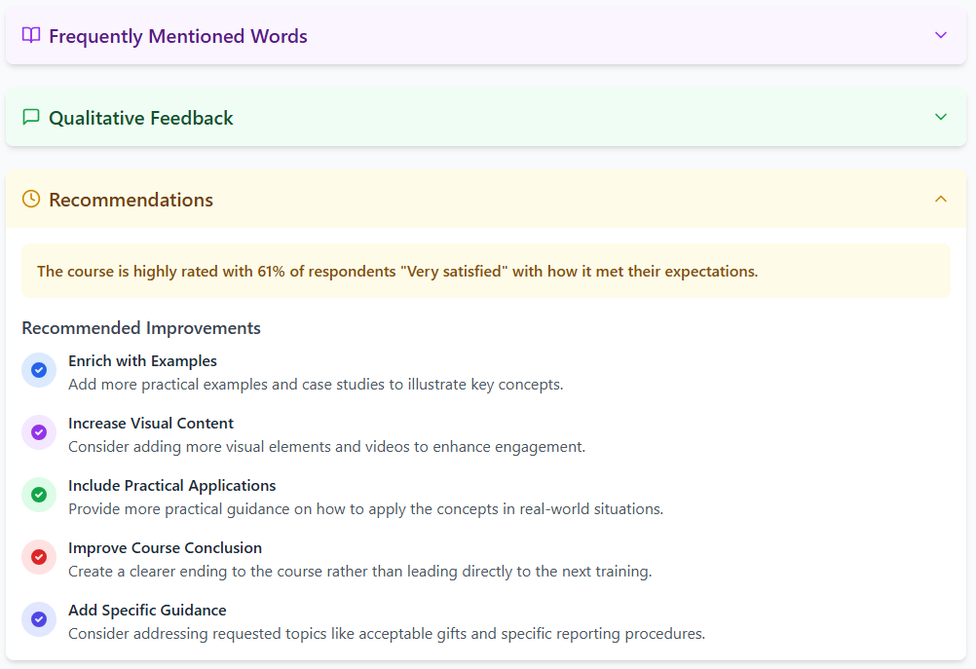

Slide 43
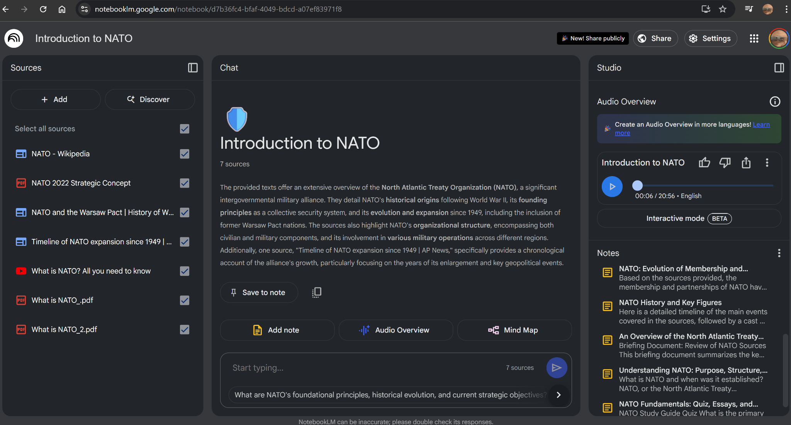
Using AI in Training and Education - NotebookLM
Notes:
https://notebooklm.google.com/notebook/d7b36fc4-bfaf-4049-bdcd-a07ef83971f8

Slide 44
Using AI in Training and Education - Notebook LM
Notes
Understanding
Podcast
FAQ
Interactive Audio
Mindmap
Study
Organize your thinking
Spark new ideas
Notes:
https://notebooklm.google.com/notebook/d7b36fc4-bfaf-4049-bdcd-a07ef83971f8
https://audio.com/gigi-roman/audio/introduction-to-nato
Upload PDFs, websites, YouTube videos, audio files, Google Docs, or Google Slides, and NotebookLM will summarize them and make interesting connections between topics, all powered by Gemini 2.0’s multimodal understanding capabilities.

Slide 45

How AI is used in Design
Can you spot the mistake in the AI generated graphics?
Notes:
The integration of AI in graphic design transforms the creative process by automating repetitive tasks, allowing designers to focus on creativity. Machine learning analyzes large datasets, offering insights into design trends and user preferences, aiding informed decision-making. AI-powered tools expedite ideation and iteration, speeding up the design workflow.

Slide 46
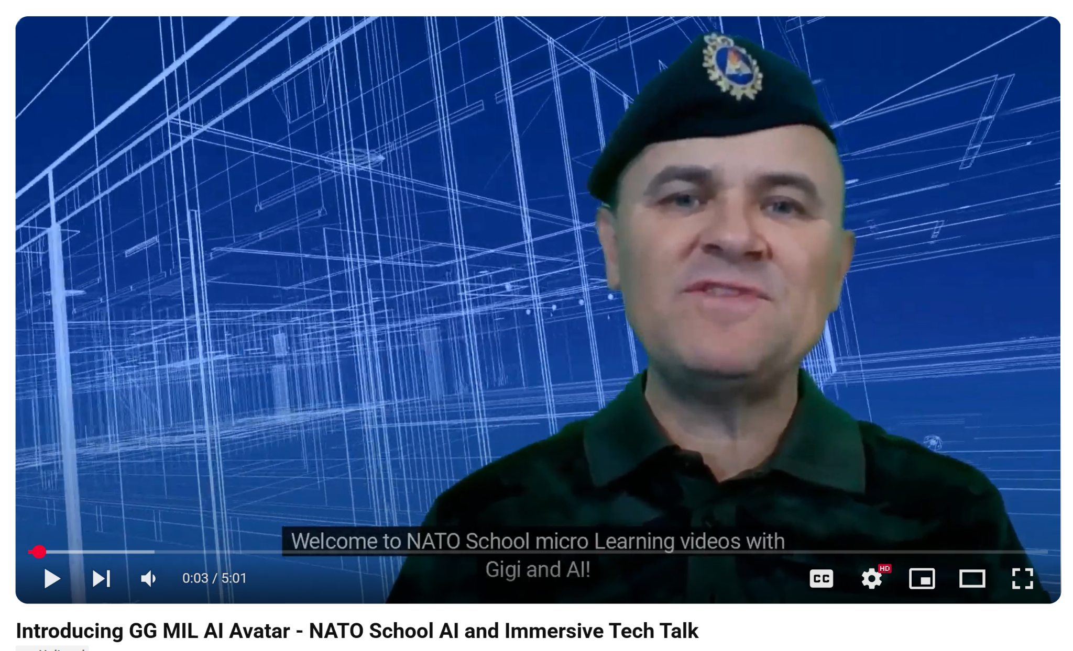
Using AI in Training and Education
Avatar support for MicroLearning Videos
Notes:
The integration of AI in graphic design transforms the creative process by automating repetitive tasks, allowing designers to focus on creativity. Machine learning analyzes large datasets, offering insights into design trends and user preferences, aiding informed decision-making. AI-powered tools expedite ideation and iteration, speeding up the design workflow.
https://www.youtube.com/watch?v=ufjAfTuyrag

Slide 47
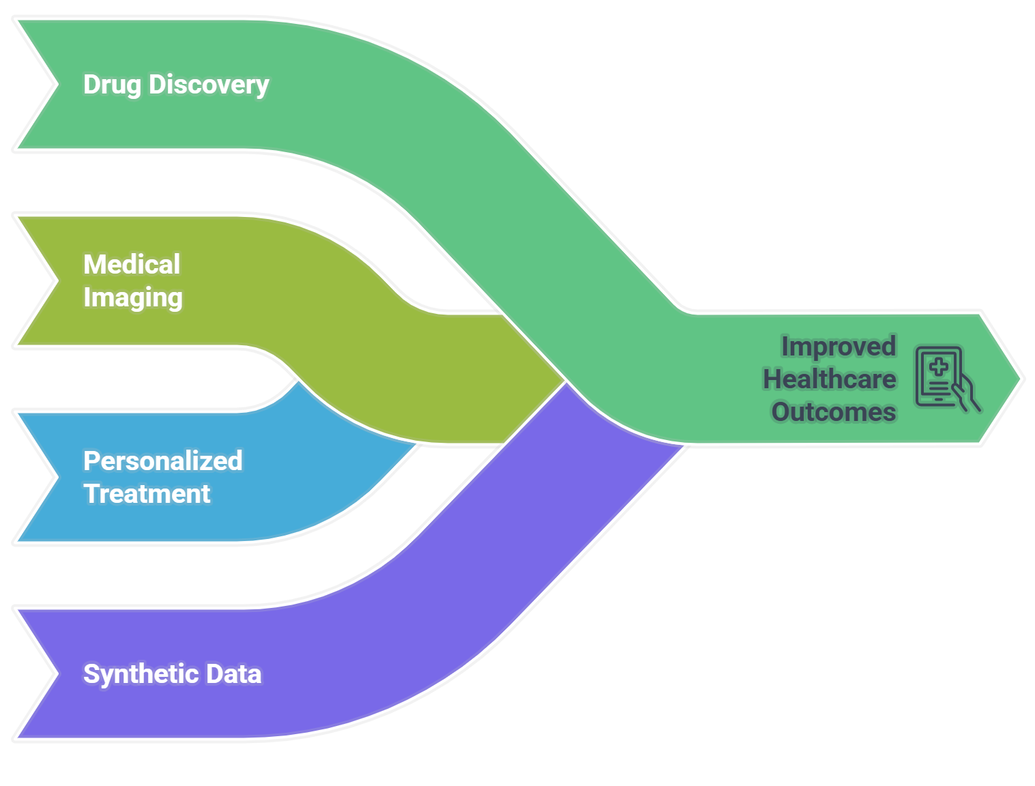
Healthcare Innovations
Notes:
Generative AI assists in drug discovery by simulating molecular structures
Medical imaging is enhanced through AI-generated diagnostic models
Personalized treatment plans are created using patient data analysis
AI-generated synthetic medical data improves research without privacy concerns

Slide 48
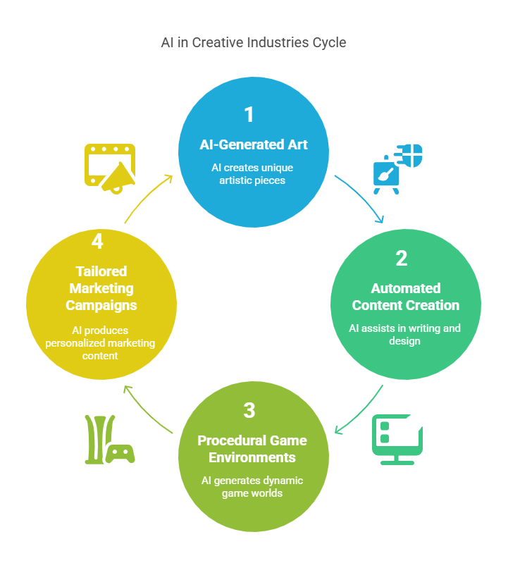
Creative Industries Transformation
Notes:
AI-generated art and music are revolutionizing creative expression
Automated content creation tools assist writers and designers
Video game development benefits from procedurally generated environments
Marketing campaigns utilize AI to produce tailored visuals and copy

Slide 49
Business and Automation
AI-driven chatbots improve customer service with human-like interactions
Automated report generation saves time and reduces human error
Supply chain optimization is achieved through predictive AI models
Customized product designs are generated based on consumer preferences
Notes:
AI-driven chatbots improve customer service with human-like interactions
Automated report generation saves time and reduces human error
Supply chain optimization is achieved through predictive AI models
Customized product designs are generated based on consumer preferences

Slide 50
Education and Training
Personalized learning experiences are created using generative AI tools
AI tutors provide real-time feedback and adaptive lessons
Educational content is generated to meet diverse learning needs
Virtual simulations offer immersive training environments
Notes:
Personalized learning experiences are created using generative AI tools
AI tutors provide real-time feedback and adaptive lessons
Educational content is generated to meet diverse learning needs
Virtual simulations offer immersive training environments

Slide 51
Financial Services Advancements
Fraud detection systems are enhanced with AI-generated anomaly patterns
Automated financial reports are produced with high accuracy
AI-driven investment strategies optimize portfolio management
Customer service in banking is improved with intelligent virtual assistants
Notes:
Fraud detection systems are enhanced with AI-generated anomaly patterns
Automated financial reports are produced with high accuracy
AI-driven investment strategies optimize portfolio management
Customer service in banking is improved with intelligent virtual assistants

Slide 52
Entertainment and Media
AI-generated scripts and storylines assist filmmakers and writers
Deepfake technology creates realistic visual effects for movies
Music composition tools help artists develop new melodies and beats
Personalized content recommendations enhance user engagement
Notes:
AI-generated scripts and storylines assist filmmakers and writers
Deepfake technology creates realistic visual effects for movies
Music composition tools help artists develop new melodies and beats
Personalized content recommendations enhance user engagement

Slide 53
Ethical Considerations
Bias in AI-generated content must be carefully monitored and addressed
Intellectual property rights for AI-created works require clear guidelines
Transparency in AI decision-making processes is essential for trust
Ethical frameworks must be established to govern generative AI use
Notes:
Bias in AI-generated content must be carefully monitored and addressed
Intellectual property rights for AI-created works require clear guidelines
Transparency in AI decision-making processes is essential for trust
Ethical frameworks must be established to govern generative AI use

Slide 54
Future Trends and Predictions
Generative AI will become more integrated into everyday applications
Advancements in AI will lead to more sophisticated and creative outputs
Collaboration between humans and AI will redefine workflows
Regulatory standards will evolve to address new challenges
Notes:
Generative AI will become more integrated into everyday applications
Advancements in AI will lead to more sophisticated and creative outputs
Collaboration between humans and AI will redefine workflows
Regulatory standards will evolve to address new challenges
Generative AI is revolutionizing industries by enabling innovation, automation, and creativity. From healthcare to entertainment, its applications are vast and transformative. As technology advances, ethical considerations and regulatory frameworks will play a crucial role in shaping its future. Embracing generative AI responsibly will unlock new opportunities and drive progress across various sectors.

Slide 55
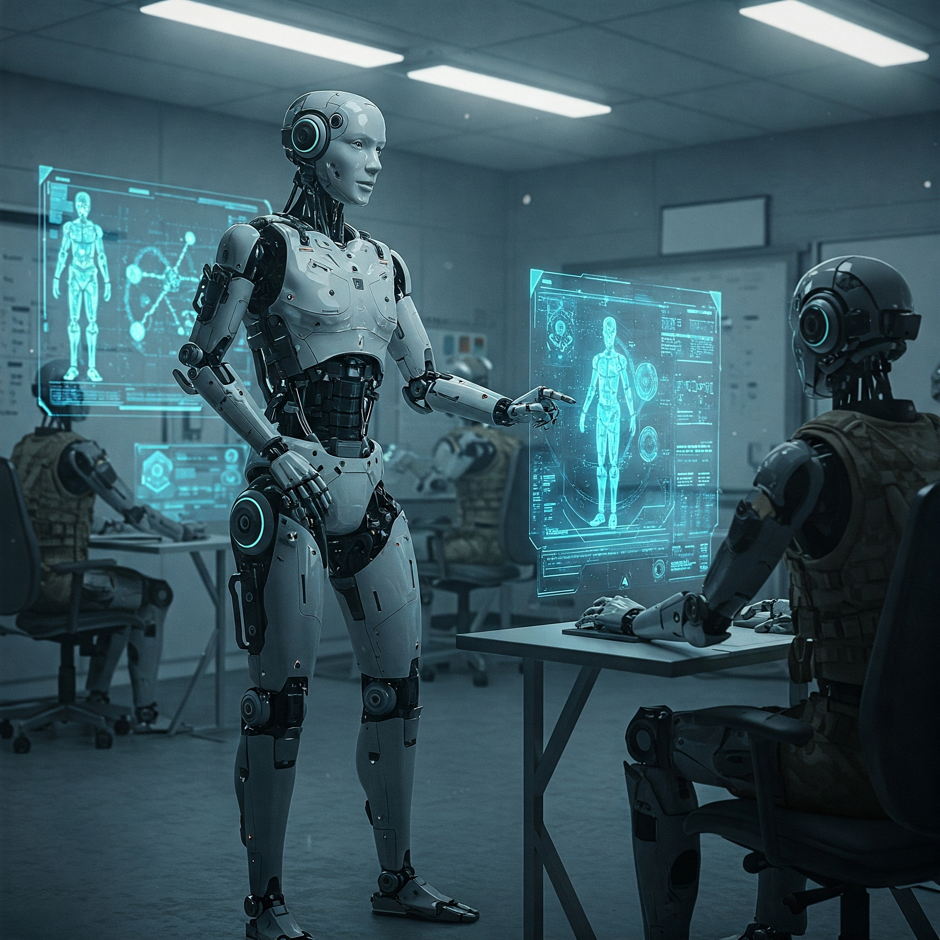
Integrating AI Agents in Educational Settings
What are AI Agents
Features
How they work?
Types of AI Agents
Applications in Educations
Challenges
Notes:
AI agents are increasingly being integrated into educational settings, transforming the way students learn and educators teach. These intelligent systems leverage advanced algorithms to provide personalized learning experiences, automate administrative tasks, and offer real-time support. we are going to explore here together the various ways AI agents are being utilized in education, their benefits, and the challenges they present.

Slide 56
What are AI Agents ?
Generative agents are computational software agents that simulate believable human behavior (Park et al., 2023).
•Store and recall their past experiences in natural language
•Reflect on those experiences to form higher-level summaries and insights.
•Plan future actions dynamically based on both current context and past reflections.
•Act and react in an environment, exhibiting human-like behaviors -all enabled by large language models
Notes:
AI agents are increasingly being integrated into educational settings, transforming the way students learn and educators teach. These intelligent systems leverage advanced algorithms to provide personalized learning experiences, automate administrative tasks, and offer real-time support. we are going to explore here together the various ways AI agents are being utilized in education, their benefits, and the challenges they present.

Slide 57
Key Features
Autonomy (minimal human intervention)
Reasoning and planning
Learning and adaptation
Memory
Interaction (text, voice, video…)
Notes:
AI agents are increasingly being integrated into educational settings, transforming the way students learn and educators teach. These intelligent systems leverage advanced algorithms to provide personalized learning experiences, automate administrative tasks, and offer real-time support. we are going to explore here together the various ways AI agents are being utilized in education, their benefits, and the challenges they present.

Slide 58
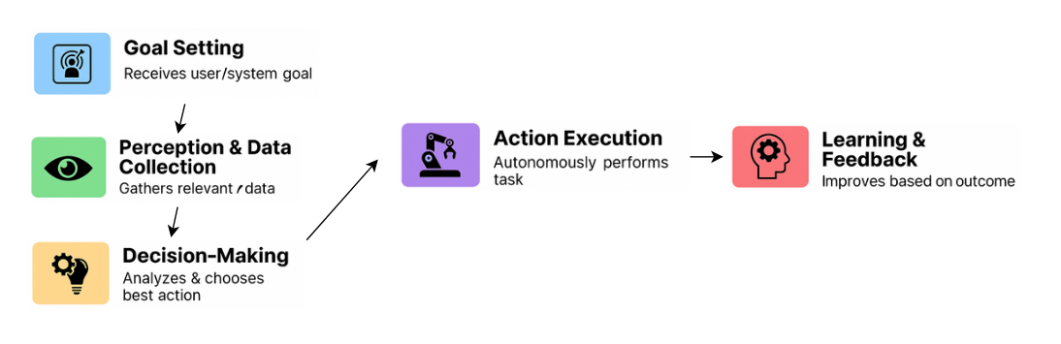
How they work?
Notes:
AI agents are increasingly being integrated into educational settings, transforming the way students learn and educators teach. These intelligent systems leverage advanced algorithms to provide personalized learning experiences, automate administrative tasks, and offer real-time support. we are going to explore here together the various ways AI agents are being utilized in education, their benefits, and the challenges they present.

Slide 59

Types of AI Agents
•Intelligent Tutoring Systems
•Pedagogical Agents
•Conversational Agents
•Recommender Agents
•Assessment & Feedback Agents
•Simulation & Scenario Agents
Notes:
AI agents are increasingly being integrated into educational settings, transforming the way students learn and educators teach. These intelligent systems leverage advanced algorithms to provide personalized learning experiences, automate administrative tasks, and offer real-time support. we are going to explore here together the various ways AI agents are being utilized in education, their benefits, and the challenges they present.

Slide 60
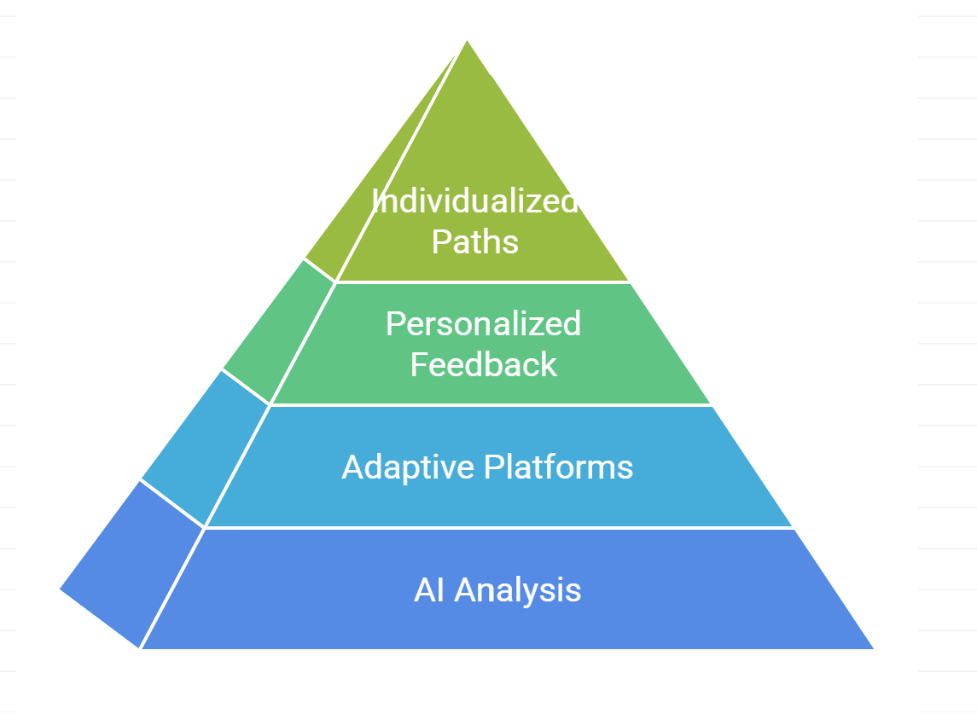
Application in Education
•Personalized Learning
•Intelligent Tutoring and Real-Time Support
•Administrative Automation
•Enhanced Engagement and Accessibility
•Data-Driven Insights for Educators
Notes:
AI agents are increasingly being integrated into educational settings, transforming the way students learn and educators teach. These intelligent systems leverage advanced algorithms to provide personalized learning experiences, automate administrative tasks, and offer real-time support. we are going to explore here together the various ways AI agents are being utilized in education, their benefits, and the challenges they present.

Slide 61
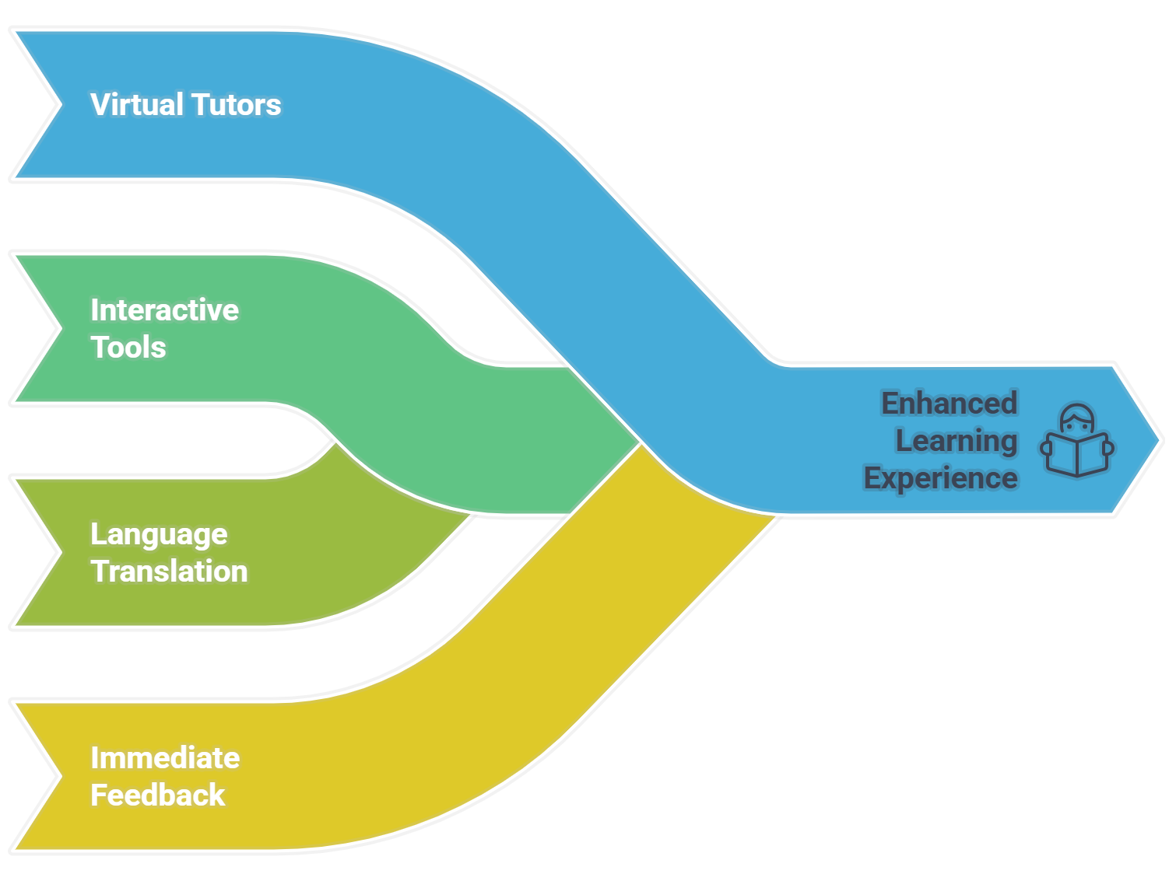
Real-Time Support and Tutoring
Notes:
Virtual tutors offer 24/7 assistance and guidance to students
Interactive learning tools engage students through gamification and simulations
Real-time language translation aids in multilingual classrooms
Immediate feedback mechanisms enhance learning retention and understanding

Slide 62
Enhancing Accessibility
AI-Driven Tools
Voice Recognition
Inclusive Education
Adaptive Interfaces
Inclusive Content
Notes:
AI-driven tools support students with disabilities through assistive technologies
Voice recognition and text-to-speech features aid visually impaired students
Adaptive interfaces accommodate different learning styles and abilities
Inclusive educational content ensures all students can participate fully

Slide 63
Administrative Efficiency
AI-powered chatbots handle student inquiries and administrative tasks
Automated grading systems reduce teacher workload and provide instant feedback
Predictive analytics help in identifying at-risk students and interventions
Streamlined scheduling and resource allocation improve operational efficiency
Notes:
AI agents are increasingly being integrated into educational settings, transforming the way students learn and educators teach. These intelligent systems leverage advanced algorithms to provide personalized learning experiences, automate administrative tasks, and offer real-time support. This presentation explores the various ways AI agents are being utilized in education, their benefits, and the challenges they present.
AI-powered chatbots handle student inquiries and administrative tasks
Automated grading systems reduce teacher workload and provide instant feedback
Predictive analytics help in identifying at-risk students and interventions
Streamlined scheduling and resource allocation improve operational efficiency

Slide 64
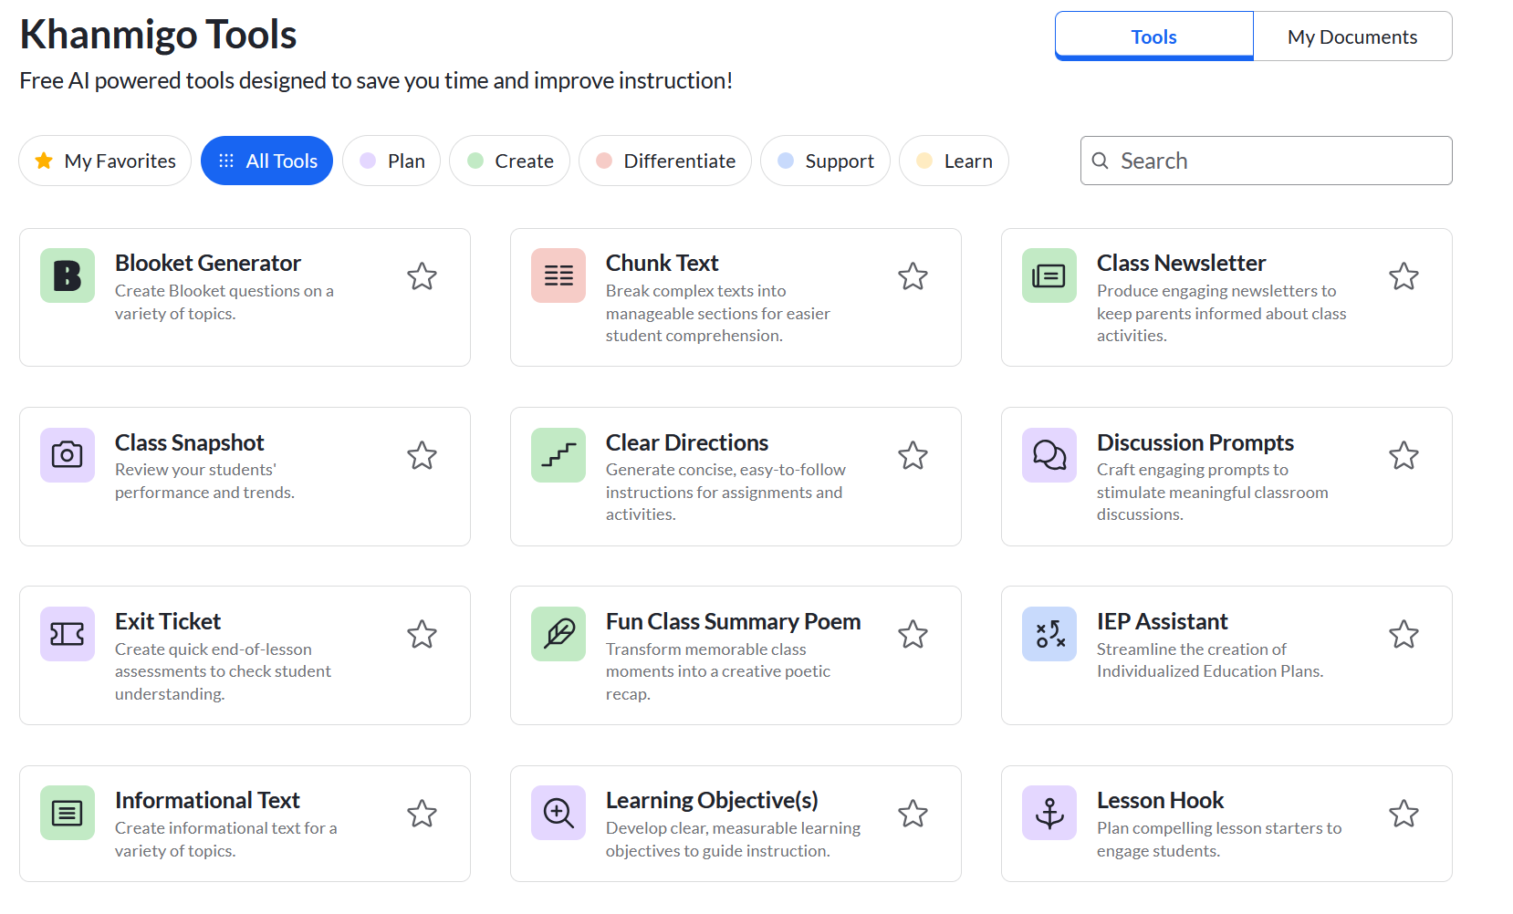
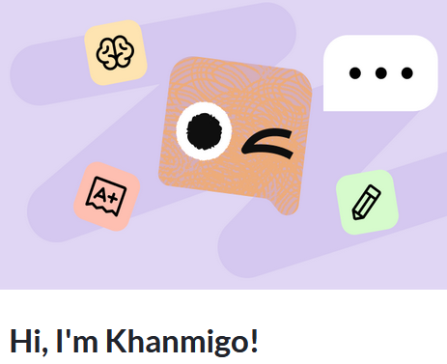
Applications in Education
AI-powered tutor and teaching assistant built with OpenAI’s GPT models.
Notes:
AI agents are increasingly being integrated into educational settings, transforming the way students learn and educators teach. These intelligent systems leverage advanced algorithms to provide personalized learning experiences, automate administrative tasks, and offer real-time support. This presentation explores the various ways AI agents are being utilized in education, their benefits, and the challenges they present.

Slide 65
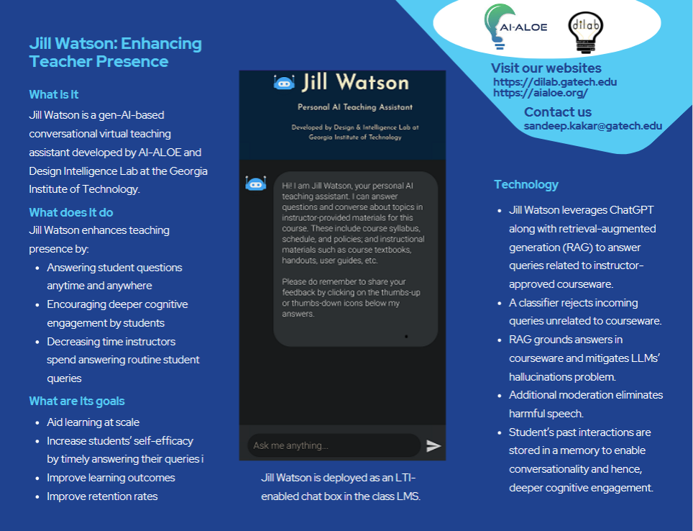

Applications in Education
AI agent built on IBM Watson used as a teaching assistant in an online course.
Notes:
AI agents are increasingly being integrated into educational settings, transforming the way students learn and educators teach. These intelligent systems leverage advanced algorithms to provide personalized learning experiences, automate administrative tasks, and offer real-time support. This presentation explores the various ways AI agents are being utilized in education, their benefits, and the challenges they present.

Slide 66


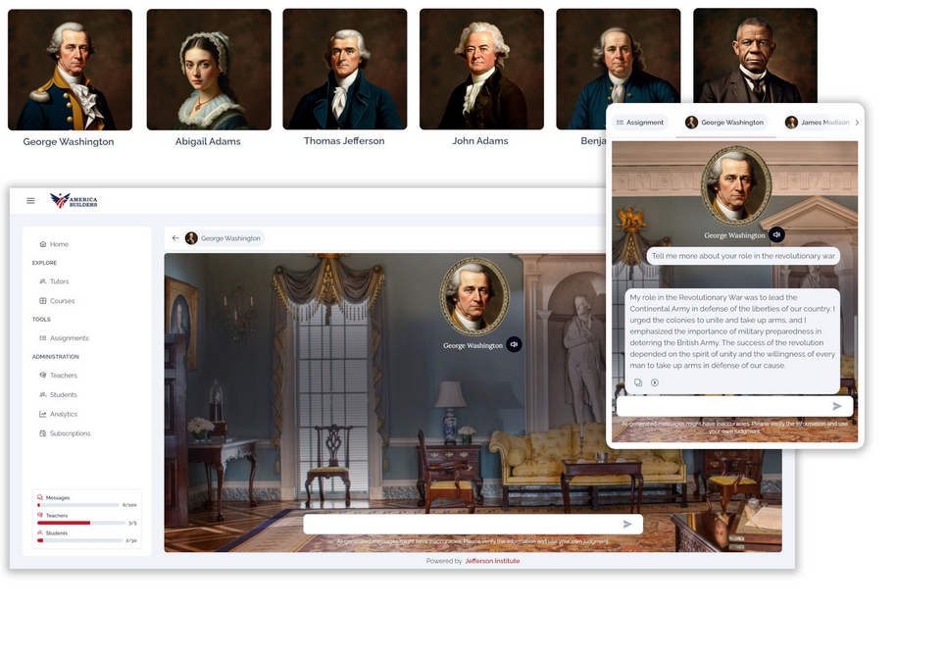
Applications in Education
AI-powered history teaching assistants built with OpenAI’s GPT models.
Notes:
AI agents are increasingly being integrated into educational settings, transforming the way students learn and educators teach. These intelligent systems leverage advanced algorithms to provide personalized learning experiences, automate administrative tasks, and offer real-time support. This presentation explores the various ways AI agents are being utilized in education, their benefits, and the challenges they present.

Slide 67
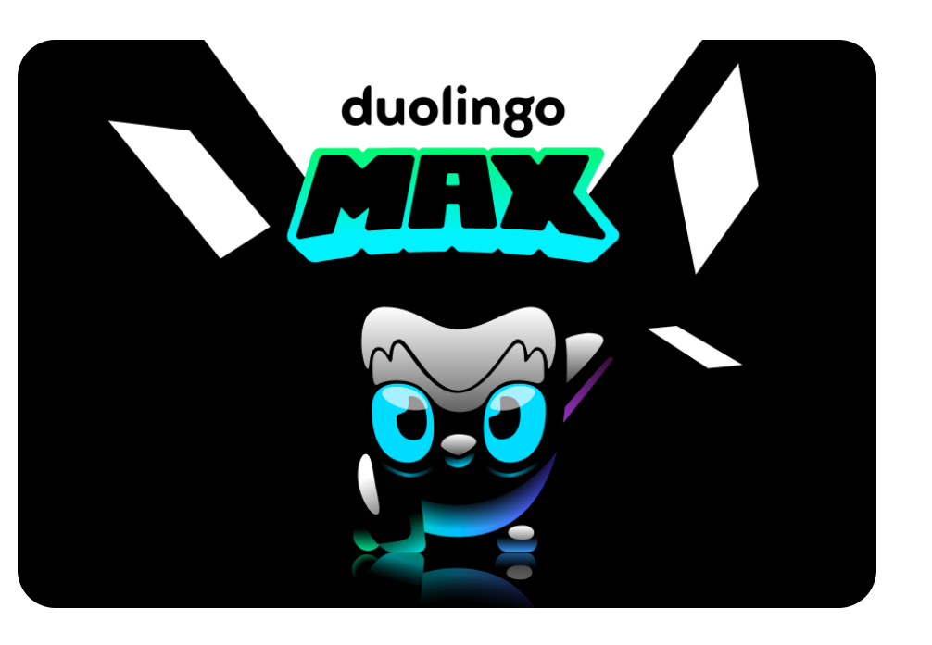
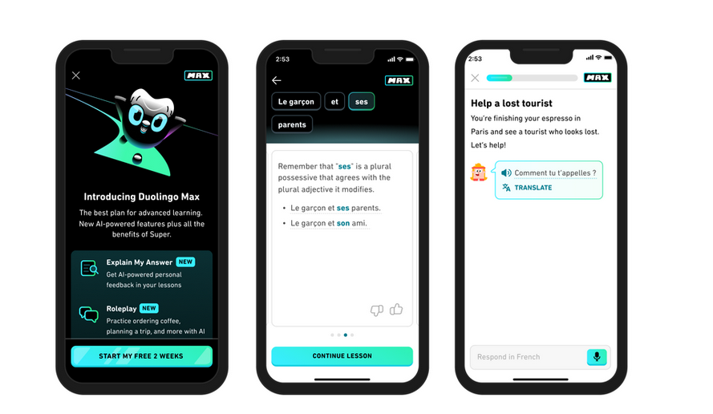
Applications in Education
Language learning helper as an interactive chatbot that explains answers and engages in role-play conversations.
Notes:
AI agents are increasingly being integrated into educational settings, transforming the way students learn and educators teach. These intelligent systems leverage advanced algorithms to provide personalized learning experiences, automate administrative tasks, and offer real-time support. This presentation explores the various ways AI agents are being utilized in education, their benefits, and the challenges they present.

Slide 68


Applications in Education
AI writing assistant, feedback tool and originality detector.
Notes:
AI agents are increasingly being integrated into educational settings, transforming the way students learn and educators teach. These intelligent systems leverage advanced algorithms to provide personalized learning experiences, automate administrative tasks, and offer real-time support. This presentation explores the various ways AI agents are being utilized in education, their benefits, and the challenges they present.

Slide 69
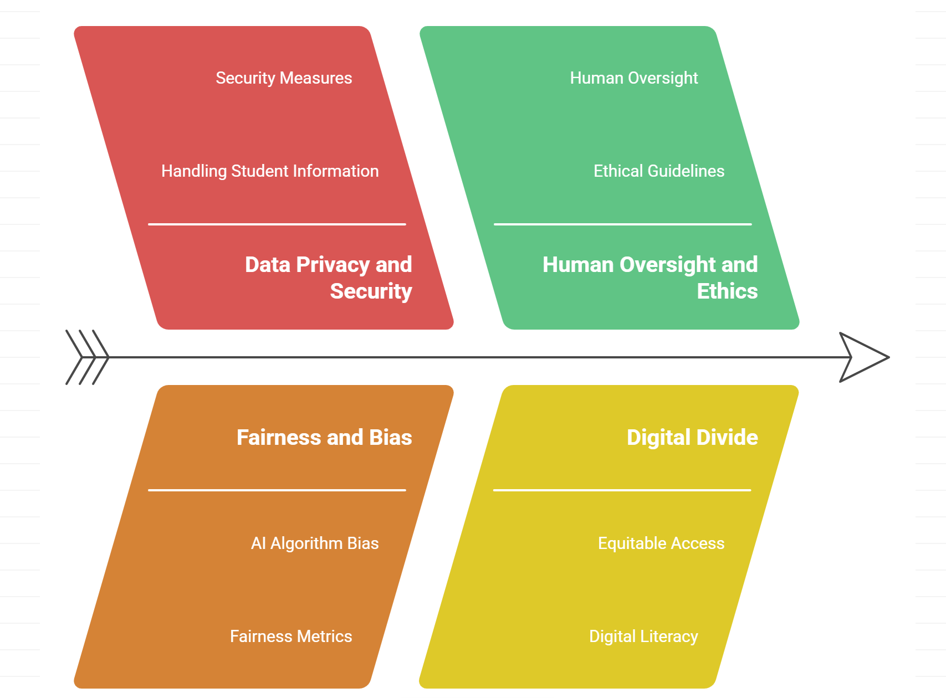
Challenges
Data Privacy Risks
Digital Divide
Balancing Human Interaction Algorithmic Fairness and Inclusion
Ethical Responsibility
High Cost
Notes:
Data privacy and security concerns in handling student information
Ensuring fairness and avoiding bias in AI algorithms
Maintaining human oversight and ethical guidelines in AI deployment
Addressing the digital divide and ensuring equitable access to AI tools
The integration of AI agents in educational settings holds immense potential to revolutionize learning and teaching processes. By providing personalized learning experiences, enhancing administrative efficiency, and offering real-time support, AI agents can significantly improve educational outcomes. However, it is crucial to address ethical considerations and challenges to ensure the responsible and equitable use of these technologies in education.

Slide 70
Practical discussion
How AI is likely to create change within your own organizations and communities and what we should be doing to influence and navigate these changes?
Notes:
Finally, we end with a practical discussion designed to guide attendees through thinking about different types of change (e.g., efficiencies gained within existing structures versus disruptive paradigmatic change that changes those structures all together). This section includes a focus on how AI is likely to create change within their own organizations and communities and what they should be doing to influence and navigate these changes.

Slide 71

Q/A
Q&A and Open Discussion
Addressing participant questions
Encouraging open dialogue
Next Steps & Resources
Outlining future actions
Providing additional resources
Continuous AI updates on WhatsApp Community for Education and Training
Notes:
Finally, we end with a practical discussion designed to guide attendees through thinking about different types of change (e.g., efficiencies gained within existing structures versus disruptive paradigmatic change that changes those structures all together). This section includes a focus on how AI is likely to create change within their own organizations and communities and what they should be doing to influence and navigate these changes.

Slide 72
I/ITSEC 2025 Tutorial Practical use of (emerging) learning technologies
Thank you!
Mr. Gigi Roman ADL Program Manager NATO School Oberammergau roman.gheorghe@natoschool.nato.int | Dr. Biljana Presnall, Vice-President Jefferson Institute bpresnall@jeffersoninst.org | Mr. Ryan Williams Innovation Specialist NATO ACT ryan.williams@nato.int
Notes:
Co-authors/Speakers Background:
Mr. Gigi Roman Course Director, NATO School Oberammergau, NATO Certified Instructor and the Advanced Distributed Learning (eLearning) Program Manager responsible for NATO School’s online education, training and online content management, including new product design and strategic relationships for the organization learning management system, authoring tools and collaboration solutions. In previous roles with NATO School and the PfP community, he has overseen the development of web-based knowledge management systems and the repurposing of instructional materials for online delivery. Member of the Advanced Distributed Learning Working Group and the Educators Working Group of the PfP Consortium of Defense Academies and Security Studies Institutes. Prior to NATO School, he worked with a variety of groups at the Military Academy, International Security Network, George C. Marshall Center, PfP Consortium on project management, online content management, online and classroom training.
Mr. Ryan Williams NATO ACT in Norfolk, Virginia, USA boasting more than 15 years of expertise in eLearning across diverse roles, he embarked on his journey as a programmer, proficiently hardcoding Flash and JavaScript many years ago. His proficiency extends to multimedia design, video production, and adept delivery through Learning Management Systems (LMS) and SCORM. Presently, he actively contributes to a spectrum of projects focused on emerging technologies, including virtual reality, augmented reality, 5G delivery, haptics, and Artificial Intelligence.
Presentation Title: Generative Artificial Intelligence in Training and Education: Hands-On Workshop for Learning Technology Innovations
Dr. Biljana Presnall is Vice President, Jefferson Institute, of the Jefferson Institute with extensive experience in eLearning and military training. She led a digital team on a Department of Defense R&D project to mature the operational integration of Advanced Distributed Learning (ADL) in multinational exercises (MADLx) and contributed to the Annex to NATO ADL Handbook on ADL in Exercises. Her research is primarily focused on leveraging advanced data science methodologies within big data environments to develop innovative data strategies and solutions. This includes the application of artificial intelligence and natural language processing techniques to optimize and drive actionable insights.

